Slide 1
General information about leukopoesis.
Violation of leukopoesis.
Leukocyte formula
Typical changes in the leukocyte formula in the most common diseases of the internal organs.

Slide 2
Blood facts
Approximately 8% of an adult’s body weight is made up of blood.
Females have around 4-5 litres, while males have around 5-6 litres. This difference is mainly due to the differences in body size between men and women.
Blood mean temperature is 38 degrees Celcius.
It has a pH of 7.35-7.45, making it slightly basic (less than 7 is considered as acidic).
Whole blood is about 4.5-5.5 times as viscous as water, indicating that it is more resistant to flow than water. This viscosity is vital to the function of blood because if blood flows too easily or with too much resistance, it can strain the heart and lead to severe cardiovascular problems.
Blood in the arteries is a brighter red than blood in the veins because of the higher levels of oxygen found in the arteries.
An artificial substitute for human blood has not been found.

Slide 3
Functions of blood
Blood has three main functions: transport, protection and regulation.
Transport
Blood transports the following substances:
Gases, namely oxygen (O₂) and carbon dioxide (CO₂), between the lungs and rest of the body
Nutrients from the digestive tract and storage sites to the rest of the body
Waste products to be detoxified or removed by the liver and kidneys
Hormones from the glands in which they are produced to their target cells
Heat to the skin so as to help regulate body temperature

Slide 4
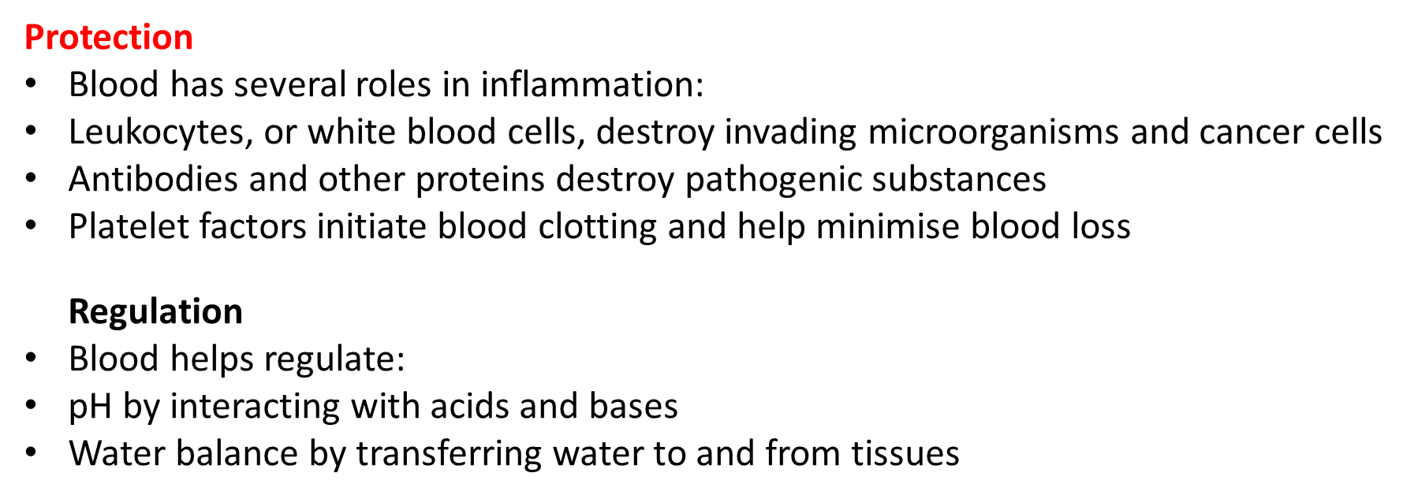

Slide 5
Composition of blood
Blood is classified as a connective tissue and consists of two main components:
Plasma, which is a clear extracellular fluid
Formed elements, which are made up of the blood cells and platelets
The formed elements are so named because they are enclosed in a plasma membrane and have a definite structure and shape. All formed elements are cells except for the platelets, which are tiny fragments of bone marrow cells.
Formed elements are:
Erythrocytes, also known as red blood cells (RBCs)
Leukocytes, also known as white blood cells (WBCs)
Platelets

Slide 6
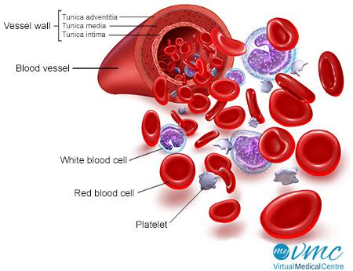
Composition of blood

Slide 7
Leukocytes are further classified into two subcategories called granulocytes which consist of neutrophils, eosinophils and basophils; and agranulocytes which consist of lymphocytes and monocytes.
The formed elements can be separated from plasma by centrifuge, where a blood sample is spun for a few minutes in a tube to separate its components according to their densities. RBCs are denser than plasma, and so become packed into the bottom of the tube to make up 45% of total volume. This volume is known as the haematocrit. WBCs and platelets form a narrow cream-coloured coat known as the buffy coat immediately above the RBCs. Finally, the plasma makes up the top of the tube, which is a pale yellow colour and contains just under 55% of the total volume.

Slide 8
White blood cells
White blood cells (WBCs) are also known as leukocytes. They can be divided into granulocytes and agranulocytes. The former have cytoplasms that contain organelles that appear as coloured granules through light microscopy, hence their name.
Granulocytes consist of neutrophils, eosinophils and basophils. In contrast, agranulocytes do not contain granules. They consist of lymphocytes and monocytes.

Slide 9
GRANULOCYTES
Neutrophils: These contain very fine cytoplasmic granules that can be seen under a light microscope. Neutrophils are also called polymorphonuclear (PMN) because they have a variety of nuclear shapes. They play roles in the destruction of bacteria and the release of chemicals that kill or inhibit the growth of bacteria.
Eosinophils: These have large granules and a prominent nucleus that is divided into two lobes. They function in the destruction of allergens and inflammatory chemicals, and release enzymes that disable parasites.
Basophils: They have a pale nucleus that is usually hidden by granules. They secrete histamine which increases tissue blood flow via dilating the blood vessels, and also secrete heparin which is an anticoagulant that promotes mobility of other WBCs by preventing clotting.

Slide 10
Agranulocytes
Lymphocytes: These are usually classified as small, medium or large. Medium and large lymphocytes are generally seen mainly in fibrous connective tissue and only occasionally in the circulation bloodstream. Lymphocytes function in destroying cancer cells, cells infected by viruses, and foreign invading cells. In addition, they present antigens to activate other cells of the immune system. They also coordinate the actions of other immune cells, secrete antibodies and serve in immune memory.
Monocytes: They are the largest of the formed elements. Their cytoplasm tends to be abundant and relatively clear. They function in differentiating into macrophages, which are large phagocytic cells, and digest pathogens, dead neutrophils, and the debris of dead cells. Like lymphocytes, they also present antigens to activate other immune cells.

Slide 11
Leukopoiesis
Leukopoiesis refers to the production of leukocytes (WBCs). It begins when some types of haemocytoblasts differentiate into three types of committed cells:
B progenitors, which are destined to become B lymphocytes
T progenitors, which become T lymphocytes
Granulocyte-macrophage colony-forming units, which become granulocytes and monocytes

Slide 12
These cells have receptors for colony-stimulating factors (CSFs). Each CSF stimulates a different WBC type to develop in response to specific needs. Mature lymphocytes and macrophages secrete several types of CSFs in response to infections and other immune challenges. The red bone marrow stores granulocytes and monocytes until they are needed in the bloodstream. However, circulating leukocytes do not stay in the blood for very long. Granulocytes circulate for 4-8 hours and then migrate into the tissues where they live for another 4-5 days. Monocytes travel in the blood for 10-20 hours, then migrate into the tissues and transform into a variety of macrophages which can live as long as a few years. Lymphocytes are responsible for long-tern immunity and can survive from a few weeks to decades. They are continually recycled from blood to tissue fluid to lymph and finally back to the blood.

Slide 13
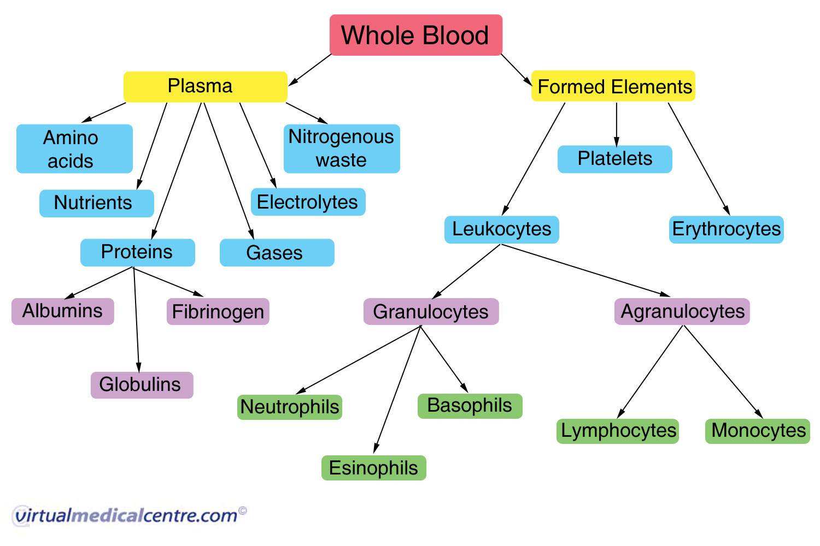
Overall, the rise in fibrinogen is the most common and significant change in blood during ageing because it contributes to a rise in plasma viscosity, red blood cell aggregation and a rise in blood viscosity at low shear rates. Increased age is associated with a state of hypercoagulation of blood, making older people more susceptible to clot formation and atherosclerosis.

Slide 14
What do your blood test results mean?
A full blood count (FBC) is a very common clinical procedure and often the “starting point” for most medical investigations. An FBC not only tests for disorders and abnormalities of the blood but, as blood travels throughout the whole body, it can give an indication of disease present in other organs.

Slide 15
Leucocytes (from others - Greek Λευκός - white and κύτος - receptacle, body) - white blood cells; heterogeneous group of different appearance and functions of human blood cells or animals, isolated on the basis of the presence of the nucleus and the absence of a separate color. In the blood of an adult, leukocytes are 1000 times less than red blood cells, and on average they are is 4-9 • 10⁹ / liter. In newborns, especially in the first days of life, the number of leukocytes can vary greatly from 9 to 30.10⁹ / liter. In children aged 1-3 years, the number of leukocytes in the blood ranges from 6.0 to 17.0 • 10⁹ / l, and in 6-10 years in the range of 6.0-11.0 • 10⁹ / l .
The amount of leukocytes in the blood is not constant, but dynamically changes depending on the time of day and the functional state of the organism.

Slide 16
The amount of leukocytes usually increases somewhat until the evening, after eating, as well as after physical and emotional stress.
An increase in the total absolute amount of leukocytes per unit volume above the upper limit of the norm is called absolute leukocytosis, and its decrease below the lower limit is absolute leukopenia.
True leukocytosis occurs when the formation of leukocytes increases and their output from the bone marrow. If the increase in the content of leukocytes in the blood is due to the circulation of those cells, which under normal conditions are attached to the inner surface of blood vessels, such leukocytosis is called redistributive.
It is the redistribution of leukocytes due to fluctuations throughout the day. So, the amount of white blood cells usually increases somewhat until the evening, as well as after eating.
Physiological leukocytosis is observed in the premenstrual period, in the second half of pregnancy, 1-2 weeks after delivery.

Slide 17
Physiological redistribution leukocytosis can occur after eating, after physical or emotional stress, exposure to cold or heat.
Leukocytosis as a pathological reaction most often indicates an infectious or aseptic inflammatory process in the body. In addition, leukocytosis is often manifested in poisoning with nitrobenzene, aniline, in the initial phase of the radiation sickness, as a side effect of some medications, as well as malignant neoplasms, acute blood loss and many other pathological processes. In the most severe form, leukocytosis is manifested in future leukosis.

Slide 18
Leukopenia can also be physiological (constitutional leukopenia) and pathological, redistributive and true.
Some Causes Of Leukopenia:
• chronic infections: tuberculosis, HIV;
• hypersplastic syndrome;
• lymphogranulomatosis;
• aplastic state of the bone marrow;
• stress.
There are several types of leukocyte division, the easiest of which is based on the presence / absence of specific granules in their cytoplasm.

Slide 19
According to the morphological features of white blood cells, painted according to Romanovsky-Gimza, since Ehrlich traditionally divided into two groups:
• granular leukocytes, or granulocytes - cells that have large segmented nuclei and exhibit specific graininess of the cytoplasm; Depending on the ability to perceive dyestuffs, they are divided into neutrophilic, eosinophilic and basophilic;
• Non-grainy leukocytes, or agranulocytes, are cells that do not have a specific granularity and contain a simple, unsegmented nucleus, which include lymphocytes and monocytes.

Slide 20
Leukocyte formula (leukogram) - the percentage of different types of leukocytes, which is determined by counting them in a colored blood smear under a microscope.
There is such a notion as the shift of the leukocyte formula to the left and to the right.
• The shift of the leukocyte formula to the left - an increase in the number of immature (pulmonucleus) neutrophils in the peripheral blood, the appearance of methemyelocytes (young), myelocytes;
• The shift of the leukocyte formula to the right is a decrease in the normal number of rodenuclear neutrophils and an increase in the number of segmental neutrophils from hyper-segmented nuclei (megaloblastic anemia, kidney and liver disease, state after blood transfusion).

Slide 21
Neutrophils are normally represented by three or two groups: may be present in small numbers or lack young (s) 1-5%; rod-core (p / a) 1-5% and segmental (s / y) 40-68%. They have mainly bactericidal and detoxification functions, bearing the conditional name of microphages (reflecting the leading mechanism of their immune function - phagocytosis).
Depending on the degree of maturity and the shape of the nucleus in the peripheral blood, the rod-nucleus (younger) and segment-specific (mature) neutrophils are isolated. Younger cells of the neutrophilic series - young (metamyelocytes), myelocytes, and promyelocytes - appear in the peripheral blood in the event of pathology and are evidence of stimulation of the formation of cells of this species.

Slide 22
The duration of circulation of neutrophils in the blood is on average about 6.5 hours, then they migrate to the tissue.
Normally, blood levels: 48-78%
Limits of the norm of neutrophil content in the leukocyte formula:
Adults 47 - 72%
Children normally have 2 cross-sectional leukocyte formulas at the age of 5 days and 4-5 years, with up to 5 days prevailing neutrophils over lymphocytes, almost as an adult, and then there is the first intersection: the ratio of lymph. / Nutrition from ≈20% / 60% turns into 60% / 20%, it is preserved until the second crossing of the leukocyte formula, usually it occurs in 4 year, but it is admissible for 5 years, after which the content and proportion of neutrophils / lymphocytes meet the standards of an adult.

Slide 23
Increase (neutrophilia) cause:
• inflammatory processes;
• myocardial infarction, lung;
• malignant neoplasms;
• many infectious processes.
To decrease (neutropenia) lead:
• viral infections (hepatitis, measles, rubella, influenza, chicken pox, poliomyelitis);
• infections caused by the simplest (toxoplasma, malaria);
• postinfectious condition;
• aplastic anemia;
• fungal infections;
• chronic bacterial infections (strepto - or staphylococci, tuberculosis, brucellosis)
• Radiation therapy.

Slide 24
Increase in the number of immature neutrophils (shift to the left):
• Acute inflammation (circular pneumonia);
• Certain infectious diseases (scarlet fever, Bushiv inflammation, diphtheria);
• Malignant tumors (cancer of the kidney, breast and prostate parenchyma) and metastasis to the bone marrow;
• Myeloproliferative diseases, especially chronic myelogenous leukemia;
• Tuberculosis;
• Myocardial infarction;
• bleeding
• Hemolytic crisis;
• Sepsis;
• Toxication;
• shock;
• Physical strain;
• Acidosis and coma.

Slide 25
Eosinophils (E) also have phagocytic properties, but this property is primarily used to participate in the allergic process. They phagocyrite antigen complex anti-antibodies, formed predominantly IgE.
eosinophils:
Adults 0.5 - 5.0%
Children under 12 years of age 0.5 - 7.0%
12 - 16 years 0.5 - 6.0%
Increase (eosinophilia) is observed at:
• allergic conditions (bronchial asthma, allergic skin lesions, hay fever);
• helminth infestation (ascariasis, echinococcosis, giardiasis, trichinosis, stronhyloidosis);
• infectious diseases (in the stage of recovery);
• after administration of antibiotics;
• collagenose;

Slide 26
Reduction (eosinopenia) occurs when:
• some acute infectious diseases (typhoid fever, dysentery);
• acute appendicitis;
• sepsis;
• injuries;
• burns;
• surgical interventions;
• in the first day of myocardial infarction.

Slide 27
Basophils (B) - participate in inflammatory and allergic processes in the body.
Normally 0 to 1%
An increase in basophils occurs when:
• allergic conditions;
• diseases of the blood system;
• acute inflammatory processes in the liver;
• endocrine disorders;
• chronic inflammations in the gastrointestinal tract;
• ulcerative inflammation of the intestine;
• lymphogranulomatosis.

Slide 28
Reducing basophils (basophilopenia) occurs when:
• long-term radiation therapy;
• acute infections;
• acute lung inflammation;
• Hyperfunction of the thyroid gland;
• stress states.

Slide 29
Monocytes (M) - refer to agranulocytes.
Relative to the system of phagocytic mononuclear cells. They remove from the body die cells, the remains of destroyed cells, denatured protein, bacteria and complexes antigen - an antibody.
Normally the content of monocytes in the blood: 3-11%
Increase (monocytosis) occurs when:
• infectious diseases (tuberculosis, syphilis, protozoal infections);
• some diseases of the blood system;
• malignant neoplasms;
• collagenose;
• surgical interventions;
• during recovery from acute conditions.

Slide 30
Reduction (monocytopenia, or monopenia) occurs:
• after treatment with glucocorticoids;
• with severe septic processes;
• aplastic anemia (lesions of the bone marrow);
• Hairy-cell leukemia;
• childbirth;
• Typhoid fever

Slide 31
Lymphocytes (L / F) are of three types: T-, B- and NK-lymphocytes. They are involved in the recognition of antigens. T-lymphocytes are involved in the processes of cellular immunity, and B-lymphocytes - in the processes of humoral immunity. NK-lymphocytes (natural killer cells or natural killer cells, NK cells) are large granular lymphocytes that have a natural cytotoxicity against cancer cells and cells infected with viruses.
Norms of the content of lymphocytes in the leukocyte formula:
Adults 19 - 37%
Norm of lymphocytes in children - see. description of neutrophils - cross-section of leukocyte formula

Slide 32
Increase (lymphocytosis) occurs:
• after heavy physical labor;
• during menstruation;
• acute infectious diseases (chicken pox, rubella, and pertussis);
• viral infections (influenza, adenovirus and cytomegalovirus infections).
Reduction (lymphopenia) occurs when:
• secondary immune deficiencies;
• lymphogranulomatosis;
• severe viral diseases;
• ingestion of corticosteroids;
• malignant neoplasms;
• Renal insufficiency;
• circulatory failure.

Slide 33
Leucopoiesis (Latin leucopoesis, leucopoiesis); leuco + grech poiesis development, education; son. : leukogenesis, leukocytopoiesis) - formation of leukocytes; usually occurs in the hematopoietic tissue of the bone marrow.
Leukocytopoiesis (leukopoiesis) includes granulocytopoiesis (granulopoiesis), lymphocytopoiesis (lymphopoiesis) and monocytopoiesis (monopoiesis).
In the granulocyte series, myeloblasts are the first morphologically distinguishable cell. It has a gently structured nucleus, a single nucleolus.
The shape of the nucleus is round, the size is slightly smaller than in the erythroblast. Myeloblasts differs from undifferentiated blast from the class of cells - predecessors of the presence of granularity in the cytoplasm; the shape of the cell is more often round, even.

Slide 34
The next stage of maturation of granulocytes is promyelocyte - neutrophilic, eosinophilic and basophilic.
The round or bean nucleus of the promyelocytes is larger than the nucleus of the myeloblasts almost twice, although this cell is not polyploid; it is often eccentric, and in it you can see the remnants of the nucleolus. The structure of chromatin already loses the delicate filamentous structure of blast cells, although it does not have a crustal structure. The area of ​​the cytoplasm is approximately equal to the area of ​​the nucleus; the cytoplasm is abundantly saturated with grainy, which has characteristics specific to each row. For the neutrophilic series, the promyelocyte is the granular cell itself. Its granularity is polymorphic - large and small, colored and acidic and basic dyes.

Slide 35
Myelocytes are a cage with round or oval, often eccentrically located nucleus, which have lost any of the signs of Blast. The cytoplasm is painted grayish-blue, and its granularity in neutrophilic myelocytes is smaller than that of promyelocytes. The relative area of ​​the cytoplasm increases. Eosinophilic myelocytes have a characteristic orange-red granularity of the same type, basophilic myelocytes - polymorphic large basophilic granularity.
Metamelocyte is characterized by a bean-shaped, coarse-deep core, usually eccentric. The area of ​​its cytoplasm more than the area of ​​the nucleus and the cytoplasm contains the same grainy as myelocytes, but in neutrophilic Methamelocytes it is more poor than in the myelocytes.

Slide 36
In the lymphocyte series of lymphoblasts (large lymphocytes) has all the features undifferentiated Blast, but is sometimes characterized by single large nucleosides. Detection in a smear from a lymph node or spleen Blast without granularity allows it to be attributed to lymphoblasts.
An attempt to differentiate lymphoblasts, monoblasts and undifferentiated blast by size and form of the nucleus, on the width of the rim of the cytoplasm, is not successful, as lymphoblasts can undergo a variety of changes under the influence of antigenic stimulation.

Slide 37
Leukemia (leukemia, aleukemia, blubbery, incorrect "blood cancer") - a clonal malignant (neoplastic) disease of the hematopoietic system. To leukemias is a large group of diseases, different in their etiology. With leukemias, a malignant clone can occur from both immature hematopoietic bone marrow cells and from mature and mature blood cells.
In leukemia, tumor tissue originally grows at the site of bone marrow localization and gradually replaces the normal sprouts of hematopoiesis. As a result of this process in patients with leukemia, various variants of cytopenia - anemia, thrombocytopenia, lymphocytopenia, granulocytopenia, which leads to increased bleeding, hemorrhage, suppression of immunity with the addition of infectious complications, are naturally developing.

Slide 38
Symptoms of leukemia (leukemia)
There are 5 basic principles of classification:
1 By the nature of the course
- acute, from immature cells (blast), and
- chronic, ripen and mature cells.
It should be noted that acute leukemia never turns into chronic, and chronic never gets worse. Thus, the terms "acute" and "chronic" are used only for convenience, the meaning of these terms in hematology differs from the value in other medical disciplines.
2 On the degree of differentiation of tumor cells
- undifferentiated
- Blastny
- Cystic leukemia;

Slide 39
3 In accordance with cytogenesis
This classification is based on representations of hematopoiesis.
A. Acute leukemia in cytogenesis is divided into:
- Limfoblastny
- Myeloblastic
- monoblast,
- Myelomonoblastny
- Erythromeloblastny
- Megacaroblastny
- Non-differentiated.

Slide 40
B. Chronic leukemia is represented by leukemia:
myelocytic origin:
- Chronic myeloblastic leukemia,
- Chronic neutrophilic leukemia,
- Chronic eosinophilic leukemia,
- Chronic basophilic leukemia
- Myelosclerosis
- Erythraemia / true polycythemia
- Essential thrombocythemia

Slide 41
The main clinical signs of acute leukemia:
• large number of blast cells and their superiority (more than 30%, more often 60-90%);
• "leukemic failure" - the disappearance of intermediate forms of cells against a background of a large number of blast;
• simultaneous presence of abazofilii and aneozinophilia;
• fast-acting anemia.
The main clinical signs of chronic leukemia (signs are the same, but the exact opposite):
• small number of blast cells or their absence (less than 30%, more often 1-2%);
• absence of leukemic failure, ie, the presence of intermediate forms of cells (promielocytes and myelocytes);
• basophilic - eosinophilic association, that is, the simultaneous presence of basophilia and eosinophilia;
• slowly progressing anemia with an increase in the rate of its development during its exacerbation.

Slide 42
In the diagnosis of leukemias, morphological examination is of great importance.
The basic methods of lifetime morphological diagnosis are the study of peripheral blood smears and bone marrow biopsy, which are obtained when treating a combs of the iliac bone or puncture of the sternum as well as other organs.

