Slide 1

Odessa National Medical University
Faculty of international
Department of occupational pathology, functional diagnostics and phthisiopulmonogy
Screening methods for assessing structural and functional changes in bone tissue and the risk of developing osteoporotic fractures.
PhD, assistant professor Tetiana Prutiian

Slide 2
Introduction
Osteoporosis is a serious risk factor for bone fracture, which has a large medical cost and social burden.
Osteoporosis is a major public health concern in our aging population. Often asymptomatic until a bone fracture has occurred, osteoporosis is characterized by low bone mass, decreased bone strength, and increased risk of fractures.
Osteoporosis is especially prevalent in older adults, and fractures in this population are associated with psychological disorders, permanent disability, and an increased risk of mortality.
The sequelae of osteoporosis lead to a significant economic burden, with an estimated annual healthcare cost of $17 to $20 billion since 2005, a number that is expected to exceed $25 billion by the year 2025.
Despite the growing burden of osteoporosis, it remains largely underdiagnosed and undertreated.

Slide 3
Osteoporosis is a silent disease: it is difficult to notice at an early clinical stage, and only after the occurrence of spinal or hip fracture can a severe loss in bone density be detected.
Factors leading to bone fracture are classified into direct (congenital) and indirect (acquired) factors. Direct factors include age, body type, heredity, hormones, sex, and ethnicity.
People with slimmer bodies or who are older are more vulnerable to osteoporosis.
Hereditary factors, such as family medical history, are also critical determinants of osteoporosis risk.
Generally, women are 6–8 times vulnerable to osteoporosis as men are; for women, bone density declines rapidly after menopause or decreased gonad function.

Slide 4
Indirect factors primarily comprise environmental factors and health habits, such as smoking, excessive alcohol consumption, excessive caffeine consumption, lack of exercise, insufficient exposure to sunlight, insufficient calcium intake, insufficient or excessive protein intake, and long-term medication use.
Osteoporosis screening and risk factor evaluation allow clinicians to determine which groups require follow-up interventions that reduce their risks of disease and death.

Slide 5
Screening methods for assessing the structural and functional state of bone tissue and the risk of osteoporotic fractures
X-ray morphometry of the spine
Computerized X-ray osteodensitometry
Ultrasound densitometry
The role of questionnaires in fracture risk assessment:
a) One-minute fracture risk assessment test (test-1 and test-2)
b) FRAX - 10-year risk assessment model for femur fractures and other large osteoporotic fractures (FRAX-1 and FRAX-2)

Slide 6
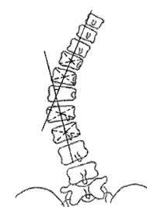
X-ray morphometry of the spine
is a quantitative method of assessing the severity, nature and prevalence of deformational changes of vertebrae in osteoporosis.
It is of great importance in the diagnosis and differential diagnosis of vertebral body deformities characteristic of osteoporosis.
Based on the numerical evaluation of vertebral body height reduction at the level from the fourth thoracic (Th4) to the fourth lumbar (L4) vertebral bodies

Slide 7

X-ray morphometry of the spine
There are 6 points used to determine vertebral height
Determine the linear dimensions of the vertebra:
- anterior - A
- middle - M
- posterior - P
And vertebral body indexes:
- anteroposterior (A/P)
- mid-posterior (M/P)
- posterior-posterior (P/Rp) - the ratio of the real size of the posterior edge to its normal size.
Vertebral deformities usually mean the presence of severe osteoporosis, but there is an opinion that early diagnosis of this disease is possible with minimal deformational changes.

Slide 8
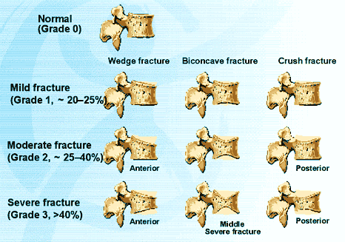
Types and severity of vertebral body deformities

Slide 9
X-ray morphometry of the spine
A fracture is diagnosed when the height ratio is below a certain level (<0.80-0.85).
The anterior vertebral height is less than the posterior vertebral height in the mid-thoracic spine, equal to the posterior vertebral height in the lower thoracic and lumbar spine, and greater than the posterior vertebral height in the lower lumbar spine.
The bodies of the lumbar vertebrae are larger than those of the thoracic vertebrae.

Slide 10
Types of vertebral body deformity
- anterior wedge deformity - reduction of predominantly anterior height with relative preservation of middle and posterior heights (decrease in the index (A/P))
- double concave deformity ("fish vertebrae" type deformity) - decrease in predominantly medial height of the vertebral body with relative preservation of anterior and medial heights (M/P index).
- posterior wedge deformity - decrease in the predominantly posterior height of the vertebral body with relative preservation of the anterior and middle heights (decrease in the (P/Rp) index).
- compression deformity - a relatively uniform decrease in all vertebral body heights

Slide 11
Algorithm for verification of vertebral pain syndrome using Х-morphometric analysis
Pain
Spinal radiography
Visual detection of vertebral
deformities and fractures
X-ray morphometric analysis
Radiomorphometric parameters are normal
Decrease in radiomorphometric parameters
Magnetic resonance tomography
Prevention and treatment of osteoporotic conditions
Control radiography with X-ray morphometric analysis after 1.5-2 years

Slide 12
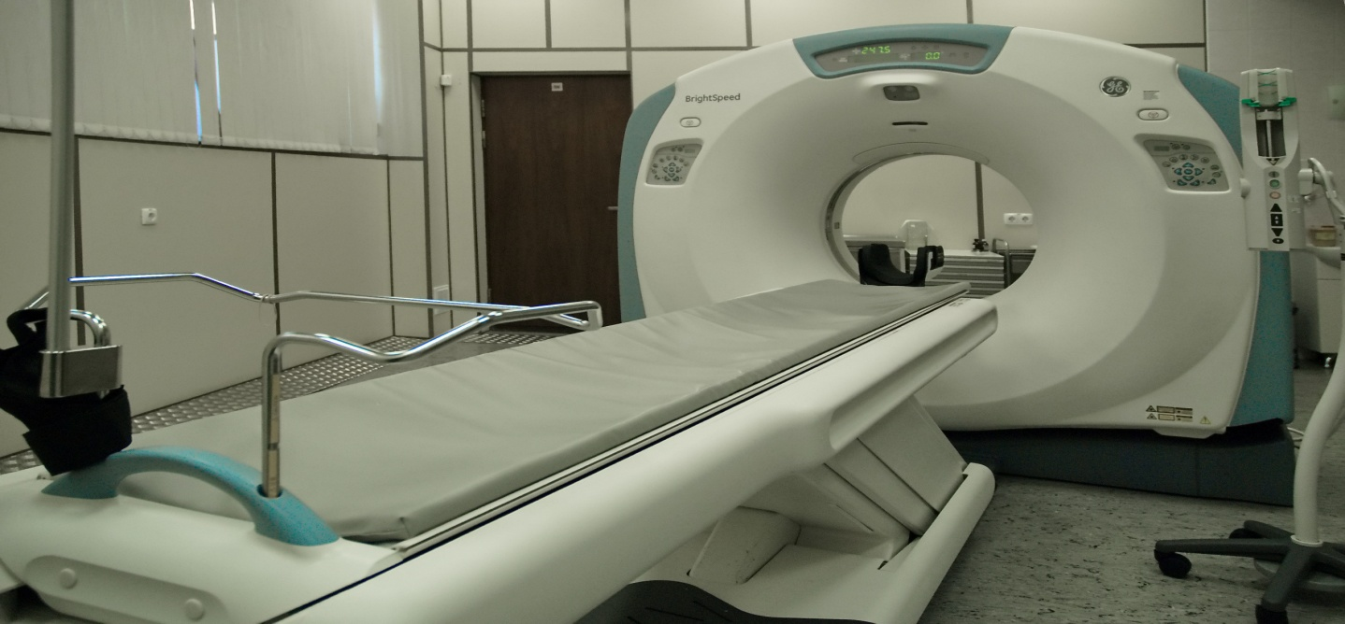
Computerized X-ray osteodensitometry
It is an affordable and reliable method of determining bone changes in clinics where computed X-ray osteodensitometry equipment is available.
Computed X-ray osteodensitometry is used worldwide because of its low cost and minimal equipment requirements.
Computed X-ray osteodensitometry can be used by first contact physicians as primary screening for osteoporosis.

Slide 13
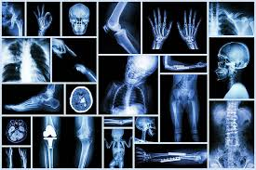
Computed X-ray osteodensitometry
At present, computerized X-ray osteodensitometry can be a choice in predicting osteoporotic fractures, and the values of X-ray osteodensitometric indices should be taken into account when forming a risk group for the development of osteoporotic fractures

Slide 14
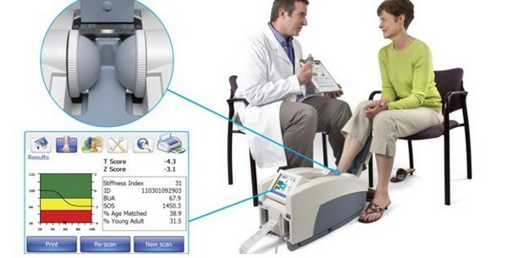
Ultrasound densitometry
Ultrasound densitometry (USD) is an informative and safe screening method for identifying at-risk patients.
USD is a simple and reliable method for assessing the risk of osteoporotic fractures.

Slide 15
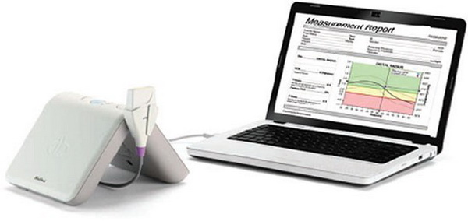
Ultrasound densitometry
Ultrasound densitometryUSD measure the average velocity of ultrasound propagation through bone and soft tissues, its broadband attenuation and calculate the bone mineral density index.
The study is performed in the area of the heel bone or lower leg.
Ultrasound provides additional information about bone structure.
The speed of ultrasound propagation is an important indicator of vertebral body deformation.

Slide 16
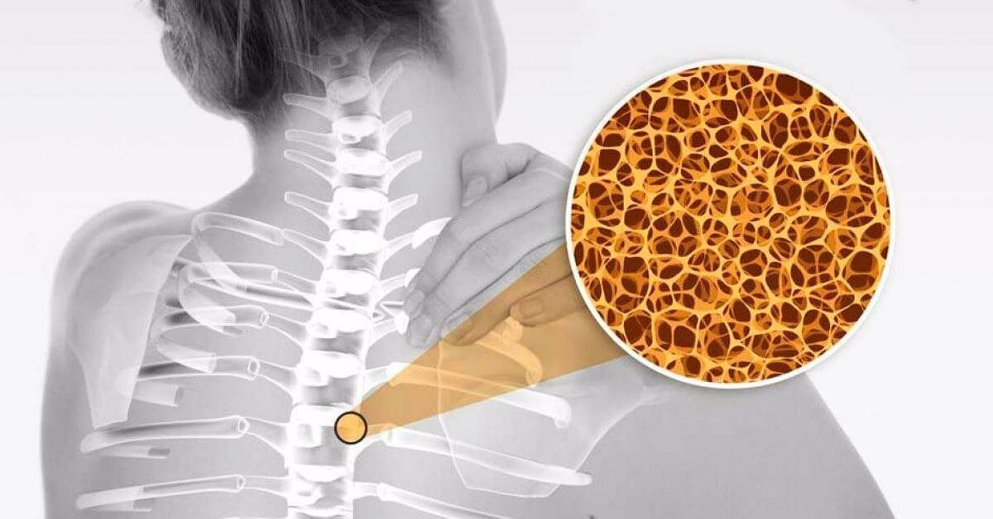
The main advantages of ultrasound densitometry in comparison with other methods for assessing the state of bone tissue
the assessment is carried out in a non-invasive way, without ionizing radiation on the patient
equipment is affordable and portable compared to X-ray densitometry devices
diagnostics can be used in epidemiological studies
in patients with risk factors for osteoporosis confirmed by ultrasound, densitometry is an effective alternative to X-ray densitometry in those regions and countries where X-ray densitometry is not available
currently, ultrasonic densitometry should be used in conjunction with the assessment of risk factors for osteoporosis.

Slide 17
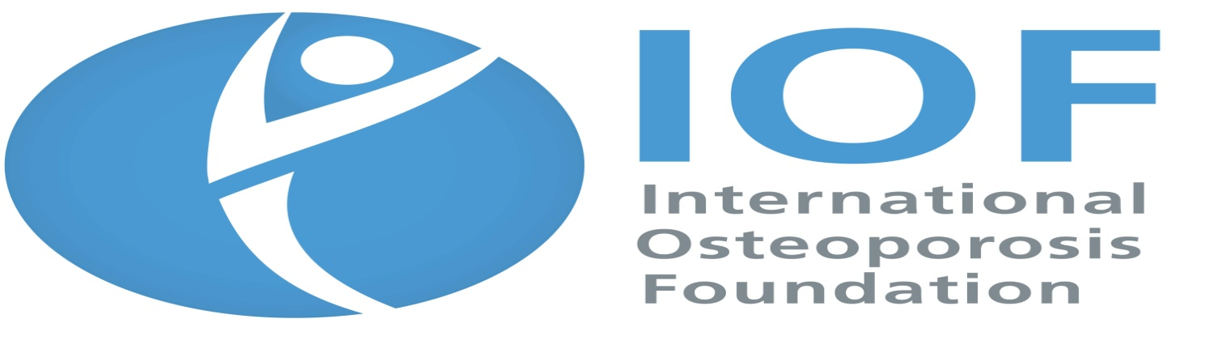
The role of questionnaires in assessing the risk of fractures
The influence of various factors in the etiology of osteoporotic fractures determines the search and development of tools for assessing and predicting their risk.
The One-minute osteoporosis risk test by the International Osteoporosis Association (IOF) has received wide application in practice.
In the subsequent IOF it is proposed to use two versions of the questionnaire.
The first version of the test includes 10 questions (test-1). The second version - 19 questions (test-2).

Slide 18
Take the IOF One-minute Osteoporosis Risk Test https://riskcheck.osteoporosis.foundation/
- Are you one in three women or one in five men in the world with osteoporosis? Osteoporosis weakens bones and causes fractures that can lead to severe disability.
- Take the Minute Test to determine if you are at risk. If you answer "yes" to any of these questions, it does not mean that you have osteoporosis, but you may be at risk.
We recommend that you show this test to your doctor, who will decide if you need further testing. Today, osteoporosis is easy to diagnose and treat.
--Consider how you can change your lifestyle to reduce your risk of developing osteoporosis.

Slide 19
Even if you answered "no" to all questions, make sure that your lifestyle is consistent with one that is aimed at maintaining a healthy skeleton, including adequate calcium intake and physical activity.
If you are over 50 years of age, we recommend discussing the condition of your bones with your doctor.

Slide 20
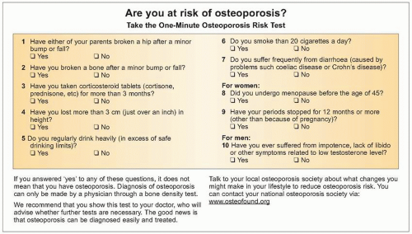
Take the IOF One-minute Osteoporosis Risk Test https://riskcheck.osteoporosis.foundation/

Slide 21
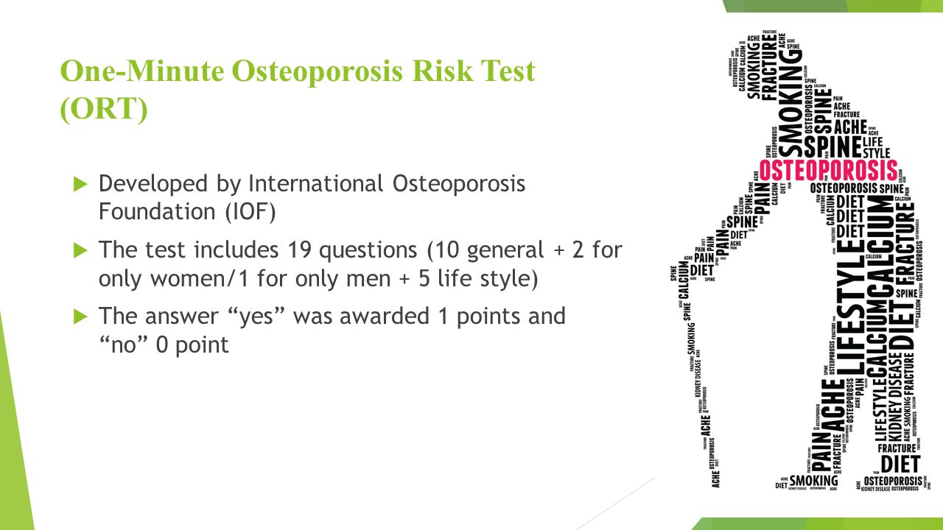

Slide 22
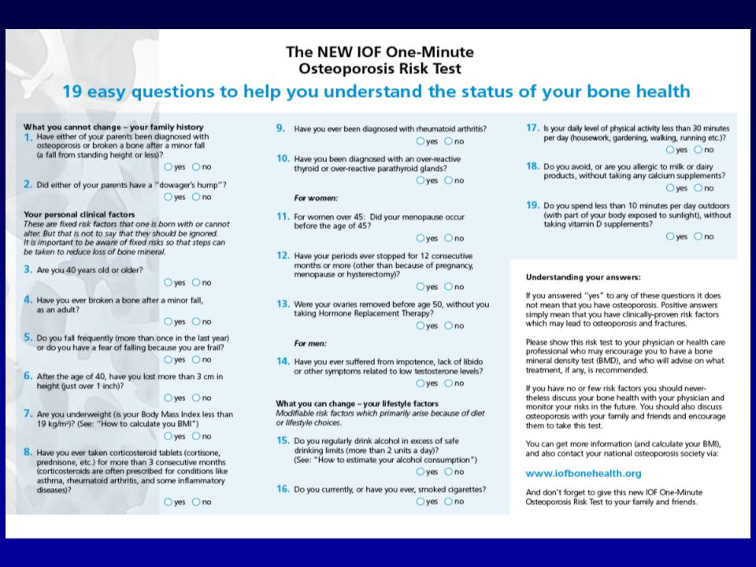
The NEW IOF One-minute Osteoporosis Risk Test https://riskcheck.osteoporosis.foundation/
https://www.bbcbonehealth.org/sites/bbc/files/documents/risktestenglish2.pdf

Slide 23
The NEW IOF One-Minute Osteoporosis Risk Test www.iofbonehealth.org
Understanding answers :
If you answered “yes” to any of these questions it does not mean that you have osteoporosis.
Positive answers simply mean that you have clinically-proven risk factors which may lead to osteoporosis and fractures.
Please show this risk test to your physician or health care professional who may encourage you to have a bone mineral density test (BMD), and who will advise on what treatment, if any, is recommended.
If you have “no” or few risk factors you should nevertheless discuss your bone health with your physician and monitor your risks in the future.
You should also discuss osteoporosis with your family and friends and encourage them to take this test. You can get more information (and calculate your BMI), and also contact your national osteoporosis society via: www.iofbonehealth.org
And don’t forget to give this new IOF One-Minute Osteoporosis Risk Test to your family and friends

Slide 24
How to calculate your Body Mass Index (BMI)
Body mass index (BMI) is a measure based on height and weight that applies to both adult men and women.
BMI Categories:
  Underweight = below 18.5
  Normal weight = 18.5 – 24.9
  Overweight = 25 – 29.9
  Obesity = 30 or greater
Imperial BMI Formula:
The imperial BMI formula accepts weight measurements in pounds & height measurements in either inches or feet. 1 foot = 12 inches.

Slide 25
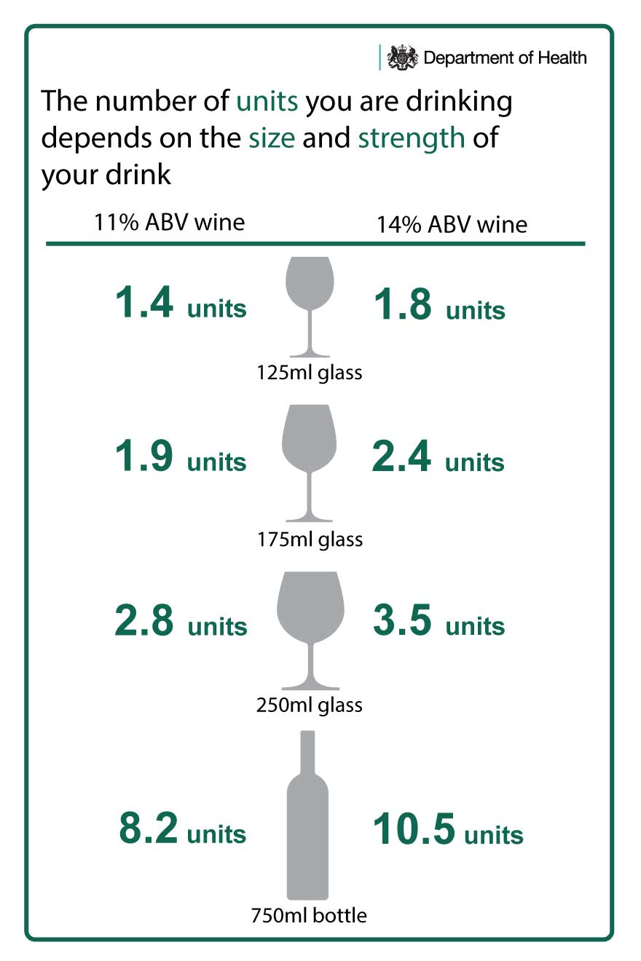
How to estimate your alcohol consumption
A unit of alcohol is equivalent to 10 ml (or approximately 8 grams) of pure ethanol, the active chemical ingredient in alcoholic beverages.
Excessive alcohol consumption increases the risk of osteoporosis and fractures.

Slide 26
Fracture Risk Assessment Tool (FRAX) https://frax.shef.ac.uk/FRAX/tool.aspx?lang=uk
In 2008, a group of experts from the World Health Organization developed another tool for assessing the risk of osteoporosis and its complications in men and women with and without assessment of bone mineral density.
Method (tool) for assessing the 10-year risk of femoral fractures and other large osteoporotic fractures (radius, humerus, clinically significant fractures of the vertebral bodies and femur), developed based on the use of age, body mass index and clinical risk factors for fractures using index of bone mineral density of the femoral neck or without it in men and women over 40 years of age.
The FRAX method provides a quantitative assessment of the total risk of fractures based on a mathematical analysis of existing risk factors for osteoporosis/
The combination of a risk factor in a model is not a simple summation of their influence as each factor has its own clinical significance and its inclusion in the scheme May significantly influence the results.

Slide 27
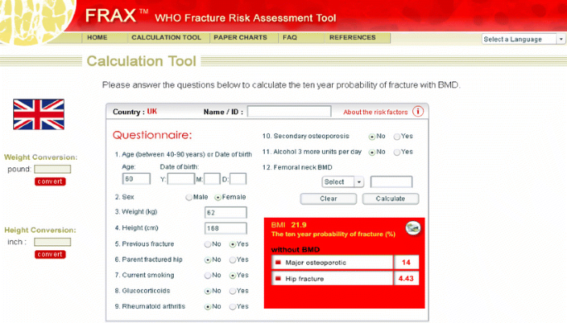
Fracture Risk Assessment Tool (FRAX) https://frax.shef.ac.uk/FRAX/tool.aspx?lang=uk
Currently, this questionnaire is freely available on the Internet (https://frax.shef.ac.uk/FRAX/tool.aspx?lang=uk) in up to 27 languages.

Slide 28
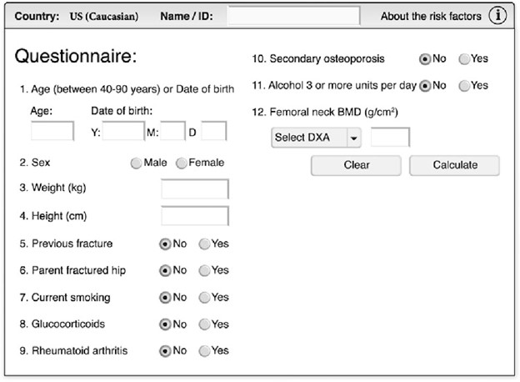
Fracture Risk Assessment Tool (FRAX) https://frax.shef.ac.uk/FRAX/tool.aspx?lang=uk

Slide 29
Fracture risk assessment using FRAX
With unlimited access to the use of X-ray densitometry, a fracture risk assessment using a fraction should be carried out in the following cases:
Postmenopausal women with one or more risk factors for fractures where this assessment could significantly affect the management and treatment of patients
A woman with a low energy fractures to clarify the need for treatment with normal bone mineral density
Women without a history of low energy fractures and femoral fractures should have a FRAX without bone mineral density
Patients with FRAX values ​​above threshold values ​​should have bone mineral density measured using x-ray densitometry to reassess the likelihood of fractures

Slide 30
Fracture risk assessment using FRAX
Assessment of fracture risk using a fraction without bone mineral density:
A post-menopausal woman with one or more risk factors for fracture, where this assessment would have a significant impact on the management and treatment of patients
A woman with a history of low analytical fractures to clarify the need for treatment with normal bone mineral density
A man and woman without a history of stunted fractures and femoral fractures should have a FRAX without bone mineral density
A question at the beginning of treatment It can be considered in patients whose indicators exceed the permissible value

Slide 31
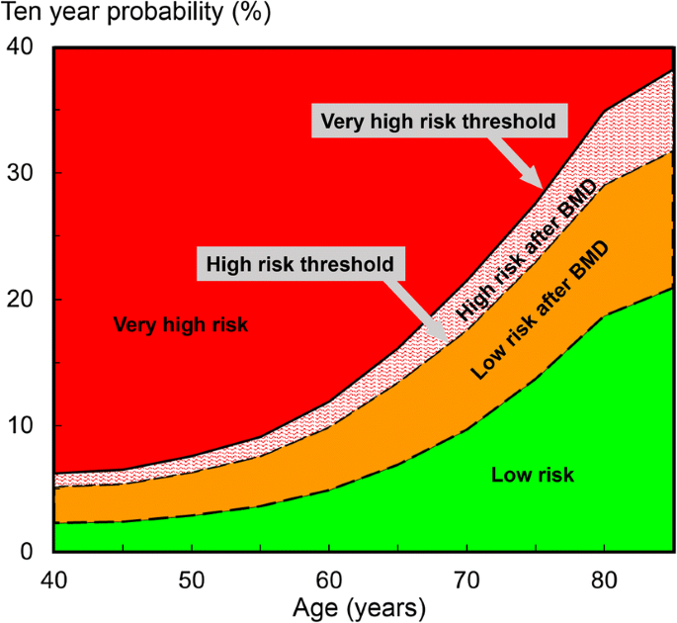
Threshold levels of 10-year fracture probability for measuring bone mineral density and the appointment of treatment for osteoporosis, depending from age

Slide 32
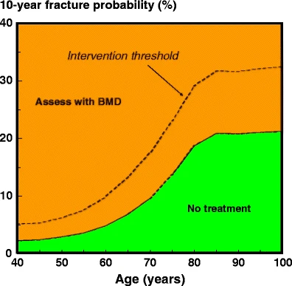
Unrestricted access to densitometry
Assessment of fracture risk in countries with high access to DXA. DXA is undertaken in women with a clinical risk factor.
Assessment with DXA and/or treatment is not recommended where the FRAX probability is lower than the lower assessment threshold (green area).
BMD is recommended in other women and treatment recommended where the fracture probability exceeds the intervention threshold (dotted line).

Slide 33
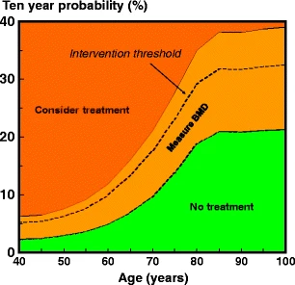
Limited access to densitometry
Assessment guidelines based on the 10-year probability of a major fracture (in percent).
The dotted line denotes the intervention threshold.
Where assessment is made in the absence of BMD, a BMD test is recommended for individuals where the probability assessment lies in the orange region.

Slide 34
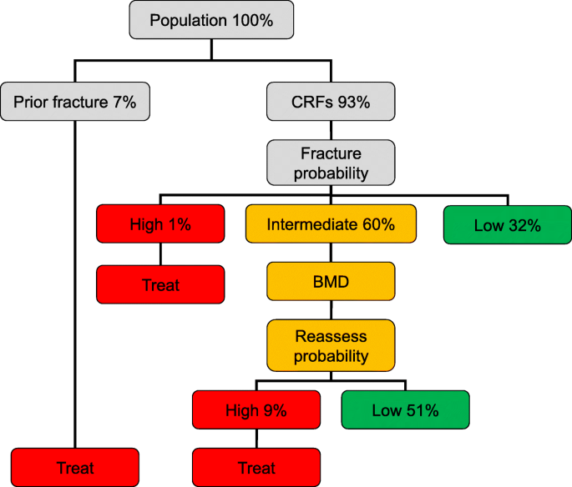
Management algorithm for the assessment of individuals at risk of fracture. The numbers in each category of risk denote the percentage of women in each category

Slide 35
Intervention thresholds as set by FRAX-based 10-year probability (in percent) of a major osteoporotic fracture equivalent to women with a previous fracture (no other clinical risk factors, a body mass index of 24 kg/m² and without BMD)
Age range (years) | Intervention threshold (%) | Lower –upper assessment threshold (%)
40-44 | 5,2 | 2,3-6,2
45-49 | 5,4 | 2,4-6,5
50-54 | 6,3 | 2,9-7,6
55-59 | 7,6 | 3,6-9,1
60-64 | 9,9 | 4,9-11,9
65-69 | 13,4 | 6,9-16,1
70-74 | 17,6 | 9,7-21,5
75-79 | 23,0 | 13,7-27,6
80-84 | 29,1 | 18,7-34,9
85-89 | 31,8 | 20,9-38,2
90-94 | 31,7 | 20,8-38,0
95-99 | 32,2 | 21,1-38,6
100+ | 32,5 | 21,3-39,0

Slide 36
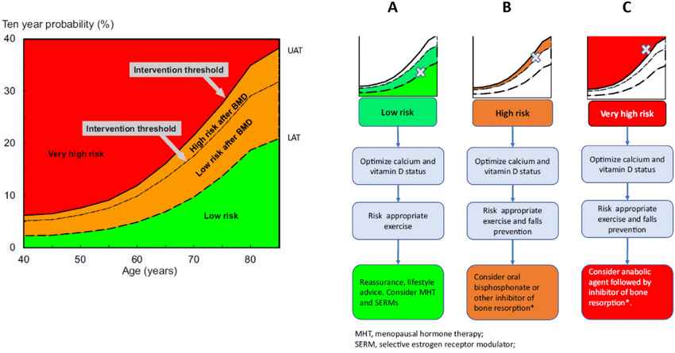
Algorithm for entering patients entering the clinic
Initially conducts an initial assessment to assess the likelihood of a fracture based on age, sex, body mass index, and clinical risk factors
Patients is classified as having a high average and low risk of future fractures
Categorization of patients using frax tools is based on a ten-year probability of developing a low-analytic fracture for women aged 50 to 80 years

Slide 37
Сonclusions
The use of a questionnaire is the first step in identifying patients with osteoporosis at the outpatient stage and can be an effective screening method, especially when combined with ultrasound densitometry or X-ray hand dosimetry techniques, which are low-cost and can be used at various stages of medical care for patients with osteoporosis.

