Slide 1
Lecture 1
"Drugs that affect the afferent nervous system. Characteristics, classification, relationship between structure and pharmacological action, mechanism of action, methods of production, methods of analysis, application in medicine "

Slide 2
MEDICINES AFFECTING THE AFFERENT NERVOUS SYSTEM
Means acting in the area of the ends of the afferent (sensitive) nerves are divided into two groups:
Means that reduce the sensitivity of the afferent nerve endings or protect them from the irritating effects of various agents:
means for local anesthesia;
adsorbents;
enveloping;
emollients;
binders.
Means that stimulate the termination of afferent nerves:
irritants;
bitterness;
vomiting;
laxatives;
expectorants.

Slide 3
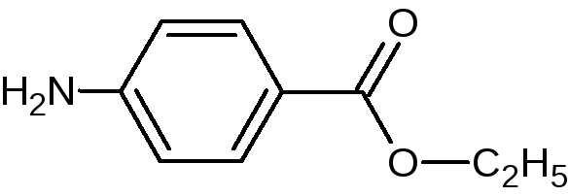
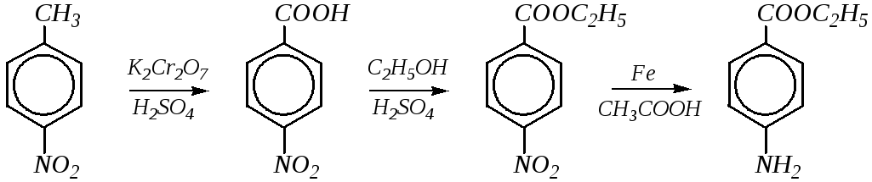
Drugs for local anesthesia
Mechanism of action. It is believed that they act on the membrane of nerve fibers, blocking sodium channels and, thus, block the conduction of impulses.
The strength and duration of action of local anesthetics generally depend on the degree of their lipophilicity, because lipophilic compounds easily penetrate into cells.
Esters of p-aminobenzoic acid
Benzocaine (Anesthesia)
Synthesis.

Slide 4
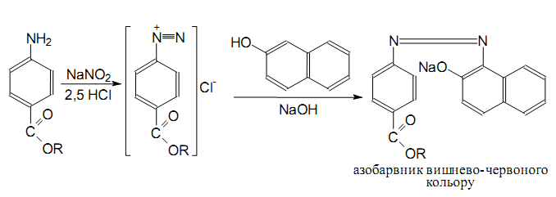
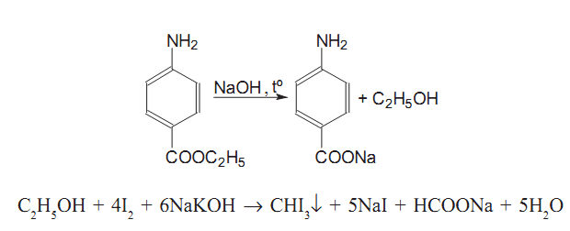
Identification.
1. Reaction to the primary aromatic amino group (formation of azo dye):
Reaction to ethanol residue - iodoform test (after hydrolysis):

Slide 5
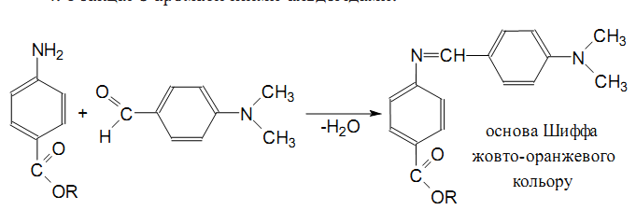
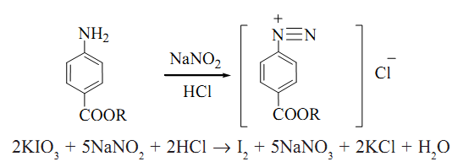
The reaction of formation of the Schiff base of yellow-orange color:
Quantitative definition.
Nitritometry, direct titration, indicator - iodine starch paper, f = 1:

Slide 6
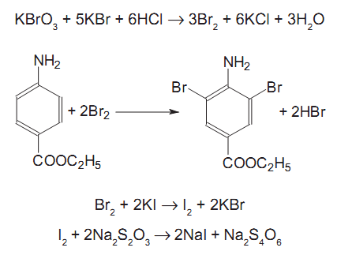
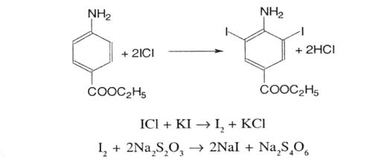
In parallel, conduct a control experiment.
2. Bromatometry, back titration:
3. Iodlochrometry, back titration:

Slide 7
Storage. In a well-sealed container that protects from light.
Application. In the form of 5-10% ointment or powder for urticaria or skin diseases accompanied by itching, as well as for analgesia of wounded and ulcerated surfaces. In diseases of the rectum - candles. For anesthesia of mucous membranes - 5-20% oil solutions. Orally in powders, tablets for analgesia of mucous membranes with spasms and pain in the stomach, hypersensitivity of the esophagus, etc.

Slide 8
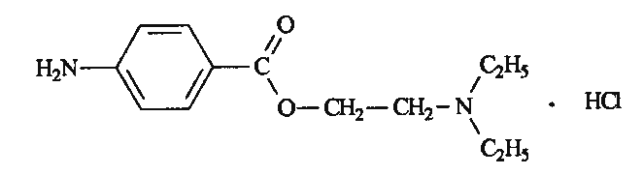
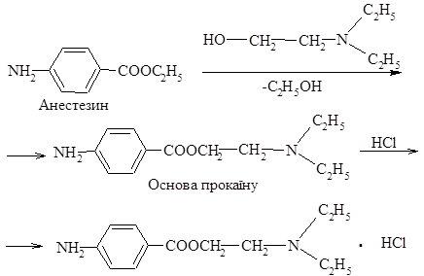
Procaine hydrochloride (Novocaine)
Synthesis.

Slide 9
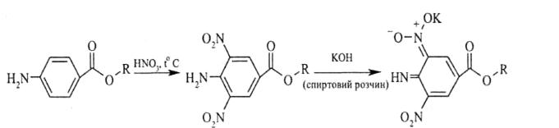
Properties. White crystalline powder on the tongue causes numbness. Very easily soluble in water, soluble in 96% alcohol, practically insoluble in ether.
Identification.
T. pl., IR, UV spectroscopy.
Reactions to chlorides: Ag + + Cl– = AgCl¯.
Reactions on the primary aromatic amino group.
LZ + HNO3 (smoky) ®evaporated to dryness in a water bath, cooled and the residue dissolved in acetone. To the resulting solution is added a solution of potassium hydroxide alcohol; should appear brownish-red color:

Slide 10
Quantitative definition.
Nitritometry, s = 1.
Alkalimetry by bound HCl, indicator - phenolphthalein, f= 1.
Argentometry for bound HCl,f= 1.
Storage. In well-sealed dark glass jars.
Application. Local anesthetic. At absorption and at direct introduction into blood influences all organism as a whole. Reduces the formation of acetylcholine and reduces the excitability of peripheral cholinergic systems. Blocks the autonomic ganglia. Reduces smooth muscle spasms, reduces the excitability of the heart muscle.

Slide 11
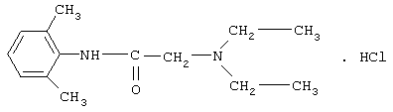
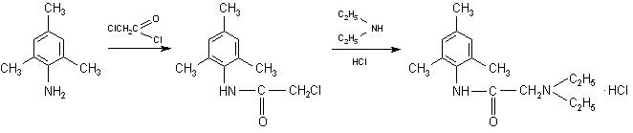
Acetanilide derivatives
Lidocaine hydrochloride
Synthesis.

Slide 12
Properties.White or almost white crystalline powder, practically insoluble in water, soluble in ethanol and methylene chloride, soluble in ether; mp 66-69 ° C. Store in a tightly closed container, in a dark place.
Identification.
IR spectrum, so pl. substances.
T. pl. the reaction product with picric acid (230 ° C with decomposition).
Color reaction with a solution of cobalt (II) nitrate (blue-green precipitate).
Quantitative definition.
Acidimetry (titrant 0.1 M hydrochloric acid solution).
Application. Local anesthetic, which is used to perform various types of anesthesia (terminal, infiltration, conduction). Lidocaine hydrochloride also has a pronounced antiarrhythmic activity.

Slide 13
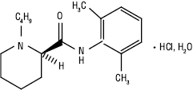
Arylamides of piperidinecarboxylic acids
Bupivacaine hydrochloride
Properties. White crystalline powder or colorless crystals, soluble in water, easily soluble in alcohol. T. pl ≈ 254 ° C with decomposition.
Identification.
T. pl. basics of bupivacaine (105-108 ° C), IR spectroscopy, TLC.
Reactions to chlorides: Ag + + Cl– = AgCl
Quantitative definition. By alkalimetry in a mixture of ethyl alcohol and 0.01 M HCl acid solution potentiometrically.
Application. The local anesthetic also has an antiarrhythmic effect. The analgesic effect continues after cessation of anesthesia, which reduces the need for postoperative analgesia.

Slide 14
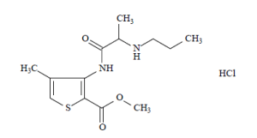
Articaine hydrochloride (Ultracaine)
Application. Local anesthetic, has a rapid and relatively long-lasting effect.

Slide 15
Antacids, enveloping and astringents
Magnesium preparations
Magnesium oxide is light, magnesium oxide is heavy
Extraction. By calcination of basic magnesium carbonate at 900-1000 ° C:
3MgCO3 · Mg (OH) 2 · 3H2O=4MgO + 3CO2­ + 4H2O.
Properties.Small amorphous white powders. Practically insoluble in water, in which an alkaline reaction is detected. Soluble in dilute acids, in most cases with a weak release of gas bubbles. In the air, absorbing carbon dioxide, turn into magnesium carbonate.
Bulk volume: 15.0 g MgO lung ® volume of about 150 ml.
15.0 g of heavy MgO ® volume of about 30 ml.
Identification.
Confirmed after dissolution in HNO3 diluted:
MgO + 2HNO3 ® Mg (NO3) 2 + H2O.

Slide 16
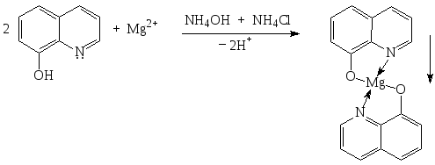
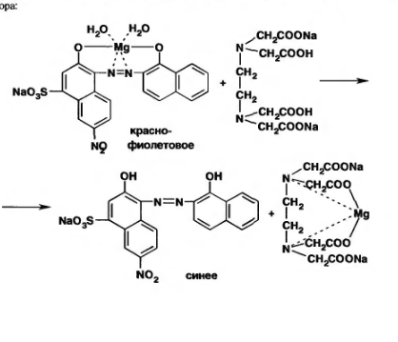
Reaction with 8-oxyquinoline - a yellow-green crystalline precipitate is formed:
Quantitative definition.
Complexometry, direct titration, indicator - pickling black, f = 1, purple color turns blue:

Slide 17
Acidimetry, back titration, methyl orange indicator:
MgO + 2HCl = MgCl2 + H2O,
HCl + NaOH = NaCl + H2O.
Storage. In a well-sealed container.
Application. Antacid with high acidity of gastric juice, is one of the components of the drug "Almagel".

Slide 18
Magnesium carbonate is the main light
Magnesium carbonate is the main heavy
Extraction.
4MgSO4 + 4Na2CO3 + 4H2O = 3MgCO3 · Mg (OH) 2 · 3H2O + 4Na2SO4 + CO2
Properties.White powders. Practically insoluble in water, soluble in dilute acids with rapid evolution of gas bubbles.
Identification.
Bulk volume: 15.0 g lung ® volume ~ 180 ml
15.0 g heavy ® volume ~ 30 ml.
The substances react with magnesium and carbonates.
Quantitative definition. Complexometry, direct titration after dissolution in HCl acid, s = 1.
The calculation is based on magnesium oxide (40–45%).
Storage. In a well-sealed container.
Application. Astringent and antacid.

Slide 19

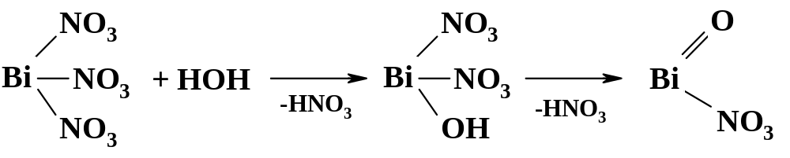
Bismuth preparations
Bismuth nitrate is the main
Extraction.
Bi₂O3 + 3C = 2Bi + 3CO­,,
Bi + 4HNO3 =Bi (NO3) 3 + NO­ + 2H2O.
Aqueous solutions of bismuth nitrate are hydrolyzed in boiling water to form insoluble bismuth nitrate basic:

Slide 20
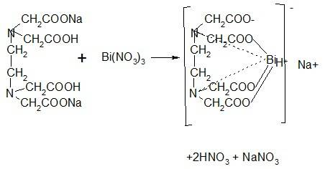
Properties.White amorphous or fine crystalline powder, practically insoluble in water, alcohol, soluble in HCl, HNO3. Soaked in water, stains blue litmus paper red (pH< 7).
Identification.
The substance gives characteristic reactions to bismuth.
With KI solution ® black precipitate, soluble in excess reagent:
Bi (NO3) 3 + 3KI = BiI3¯ + 3KNO3,
BiI₃¯ + KI = K [BiI4].
When calcined ® yellow-brown vapors and a bright yellow residue:
Quantitative definition. Complexometry, direct titration, indicator - xylenol orange, f = 1:

Slide 21
Adsorbents
Activated charcoal
Extraction. Obtained by pyrolysis of hardwood without air access. To increase the adsorption capacity of coal is treated with superheated steam at 800 ° C, while removing the resinous substance. Then the coal is treated with solutions of zinc chloride, magnesium chloride, sodium hydroxide or phosphoric acid, followed by heating to 300 - 400 ° C. The added substances decompose and are distilled off, loosening the coals and increasing the pore surface. Next, the coal is thoroughly washed with water to clean the impurities and dried.
Cleanliness test. Since the drug is used in large doses, AND pays great attention to the purity of activated carbon: regulates the content of impurities of chlorides, sulfates, heavy metals, iron, arsenic. There should be no sulfides, cyanides.
Determine the adsorption capacity of activated carbon with methylene blue and the degree of grinding.
Storage. In a well-sealed container, in a dry place.
Application. With dyspepsia, food poisoning, poisoning by alkaloids, salts of heavy metals.

Slide 22
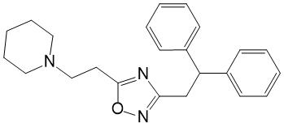
Antitussives of peripheral action
Mechanism of actionantitussive central action is to suppress the cough center. Drugs of peripheral action suppress sensitive receptors and receptors of tension of a mucous membrane of respiratory tracts (trachea, bronchial tubes, pulmonary fabric).
Prenoxdiazine (Libexin)
Properties. White or almost white crystalline powder.
Application. Antitussive agent of peripheral action, antitussive effect lasts more than 3-4 hours. At catarrhs ​​of the upper respiratory tract, acute and chronic bronchitis, bronchopneumonia, bronchial asthma, emphysema, and others.

Slide 23
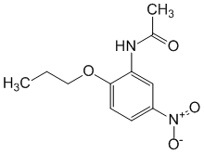
Acetylaminonitropropoxybenzene
Application. Antitussive, analgesic, deodorizing effect; facilitates breathing and stops the development of reflex cough of any nature; leads to thinning of mucus, pain relief and anti-inflammatory effect.

Slide 24
Expectorants
Expectorants by mechanism of action will be divided into the following groups:
Bronchosecretory or secretomotor agents (rehydrators) that help remove liquid sputum (thermopsis grass, marshmallow roots, potassium iodide, sodium bicarbonate, etc.):
  means of reflex action;
  means of resorptive action.
Expectorants of direct action (mucolytics) that promote the dilution of sputum (trypsin crystalline, acetylcysteine, bromhexine, ambroxol, etc.):
  preparations of proteolytic enzymes, as well as nucleases;
  synthetic mucolytics;
  stimulants of surfactant synthesis (bromhexine, ambroxol - lasolvan);
  surfactant substitutes (alveofact, exosurf) - prescribed to infants with disseminated intravascular coagulation syndrome.

Slide 25
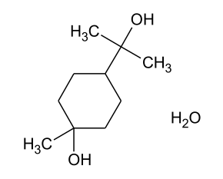
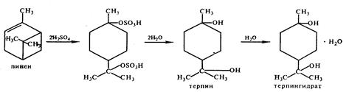
Drugs that stimulate expectoration
Terpene hydrate
Extraction. Hydration of pinene contained in the foamy fraction of turpentine:

Slide 26
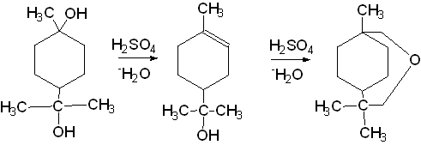
Properties. Colorless transparent crystals or white odorless crystalline powder, slightly bitter in taste. Slightly soluble in water, chloroform, ether, soluble in alcohol. Sublimes when heated to 100 ° C, in dry warm air slowly evaporates.
Identification.
When adding to the hot solution of terpene hydrate (TG) H2SO4 (conc.) The liquid becomes cloudy and acquires a fragrant smell of terpineol:

Slide 27
When TG evaporates dry with an alcoholic solution of FeCl3 in a porcelain cup, carmine-red, violet, and green color appear simultaneously in different places, and when blue is added to the cooled residue of benzene.
T. pl. 115-117 ° C.
Quantitative definition. For the substance AND does not provide a quantitative determination. The TG content can be determined by colorimetric method, which is based on the reduction of phosphoric tungstic acid.
Storage. In a well-sealed container.
Application. In chronic bronchitis as an expectorant.

Slide 28
Questions:
Drugs for local anesthesia.
Analysis of antacids, envelopes and astringents.
Adsorbents.
Antitussives of peripheral action.
Expectorants.
Irritants.

Slide 29
Literature:
Pharmaceutical chemistry/ Lectures for English-speaking students/ V.A. Georgiyants, P.O. Bezugly, G.O. Burian. – Kharkiv: NUPh ; Original, 2013. – 576 p.

