Slide 1
Lecture № 4
«Calcium ion antagonists. Antioxidants. Drugs that affect the renin-angiotensin system. Hypo- and hypertensive drugs.
Characteristics, classification, relationship between structure and pharmacological action, mechanism of action, methods of production, methods of analysis, application in medicine "

Slide 2
Calcium antagonists
Calcium antagonists Is a group of drugs that block calcium channels.
Classification by generations
I generation: verapamil, nifedipine, diltiazem.
Characteristics: relatively short duration of action - up to 6.5 hours
II generation: amlodipine, lercanidipine.
Characteristics: duration of action - up to 36 hours
Classification by chemical structure
Diphenylalkylamine derivatives (verapamil).
Benzothiazepine derivatives (diltiazem).
These first two groups have antianginal, antiarrhythmic, antihypertensive effect.
Dihydropyridine derivatives (nifedipine).
This group has only antianginal and antihypertensive effects.

Slide 3
Classification
Verapamil.
Nifedipine.
Diltiazem.
Flunarizine and its derivatives (affect cerebral circulation).
Prenylamine and its derivatives (antianginal drugs).
Calcium preparations of other chemical structure (indomethacin, β-blockers).

Slide 4
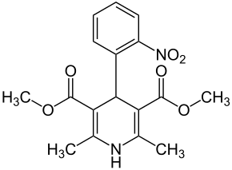
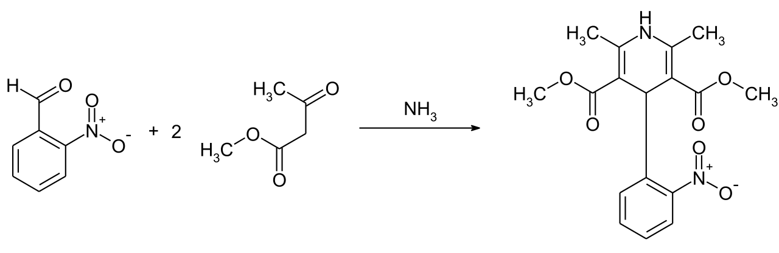
Nifedipine
Mechanism of action. Blocking the so-called "slow" calcium channels, slowing down the entry of calcium ions into cells and reducing its concentration in cells.
Synthesis.

Slide 5
Properties. Yellow crystalline powder, practically insoluble in water, soluble in acetone, moderately in ethanol.
Identification.
T. pl. 171-175 ° C, IR spectrum, TLC.
With a solution of naphthylethylenediamine hydrochloride - red color.
Quantitative definition.
Cerimetry, indicator - ferroin.
Storage. Store in a dark place.
Application. Antianginal, antiarrhythmic, antihypertensive drug. Dilates coronary and peripheral (arterial) vessels, has a negative inotropic effect, reduces myocardial oxygen demand; has antiarrhythmic activity, does not suppress the conduction system of the heart; reduces peripheral vascular resistance and significantly lowers blood pressure.

Slide 6
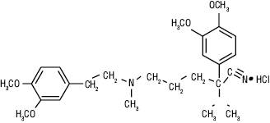
Verapamil hydrochloride
Mechanism of action. It blocks the potential of dependent calcium channels and disrupts the entry of calcium ions into cells, in particular cardiomyocytes and vascular smooth muscle cells, while the concentration of calcium in the blood does not change.
Properties. White crystalline powder, soluble in water, moderately soluble in ethanol, practically insoluble in ether.
Identification.
IR spectrum.
Reaction to chlorides.
Quantitative definition. By non-aqueous titration in anhydrous acetic acid in the presence of mercury (II) acetate, the equivalence point is determined potentiometrically.
Storage. In a well-sealed container.
Application. Antianginal, antiarrhythmic, antihypertensive drug.

Slide 7
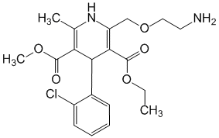
Amlodipine
Mechanism of action. Calcium channel blocker, which inhibits the transmembrane transfer of calcium ions to smooth muscle cells of the myocardium and blood vessels. The mechanism of antihypertensive action of the drug is due to the relaxing effect on vascular smooth muscle.
Properties. White crystalline powder, slightly soluble in water, moderately soluble in ethanol.
Application. Antianginal, antihypertensive drug.

Slide 8
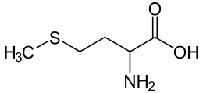
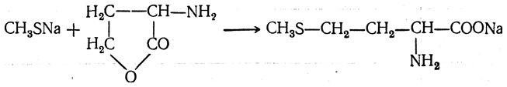
Antioxidants
Antioxidants (Latin antioxydanta <Greek anti - against + oxy [genium] - oxygen) - multifunctional compounds of various natures, capable of eliminating or inhibiting the free radical oxidation (BPO) of organic substances with monomolecular oxygen.
Methionine
Mechanism of action. Has a lipotropic effect, promotes the synthesis of choline, phospholipids; participates in the synthesis of adrenaline, creatine; activates the action of hormones, vitamins, enzymes.
Synthesis.

Slide 9
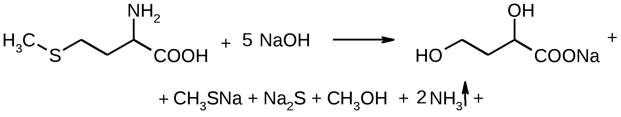
Properties. Crystalline powder of white or almost white color, or colorless crystals. Soluble in water, very slightly soluble in 96% alcohol, practically insoluble in ether.
Identification.
Specific rotation, IR spectrum, TLC.
Reaction with NaOH and sodium nitroprusside in the presence of glycine - dark red color:
Na2S + Na2 [Fe (CN) 5NO] = Na4 [Fe (CN) 5NOS].
Non-pharmacopoeial reactions.
  After alkaline hydrolysis, the mixture is acidified by the smell of hydrogen sulfide and mercaptan:
Na2S + CH3SNa + 2H2SO4 = H2S­ + CH3SH­ + Na2SO4 + NaHSO4.
When heating drugs with a solution of ninhydrin - blue-violet color.

Slide 10
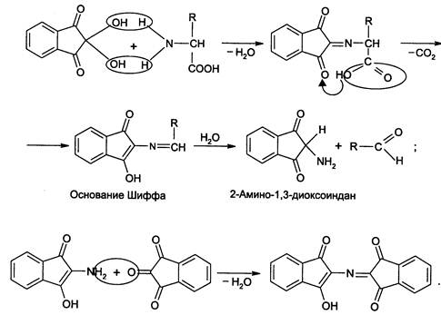
Quantitative definition.
1. Acidimetry in non-aqueous medium, direct titration, s = 1.
2. Determination of nitrogen after H2SO4 mineralization.
3. Alkalimetry by the method of Serensen (formal titration).
4. Iodometry in phosphate buffer medium, s = 2.
Storage. In well-sealed dark glass, in a dark place.
Application. For the treatment and prevention of diseases and toxic lesions of the liver.

Slide 11
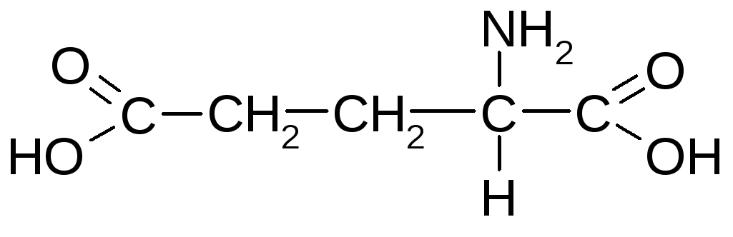
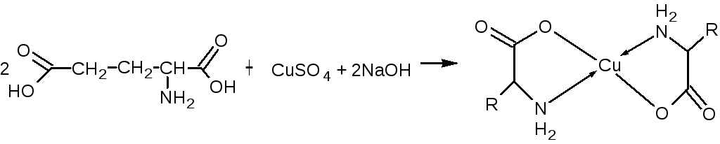
Glutamic acid
Mechanism of action. It belongs to the neurotransmitter amino acids that stimulate the transmission of excitation at the synapses of the central nervous system.
Properties. White crystalline powder or colorless crystals. Easily soluble in boiling water, slightly soluble in cold water, practically insoluble in acetic acid, acetone,
96% alcohol and ether.
Identification.
T. pl., Specific rotation, IR spectrum, TLC.
Reaction with NaOH in the presence of formalin and phenolphthalein.
Non-pharmacopoeial reaction with CuSO4 - in an alkaline environment, a complex salt is formed, colored in dark blue:

Slide 12
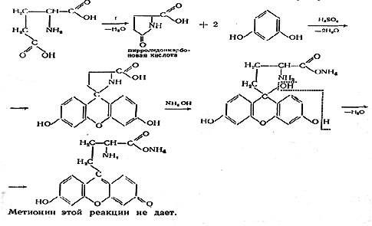
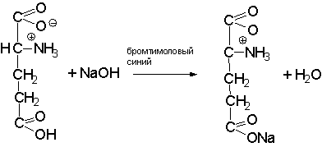
Non-pharmacopoeial reaction: during fusion with resorcinol in the presence of concentrated H2SO4, a red melt is formed; when adding water and ammonia solution, a red-violet color with green fluorescence appears:
Quantitative definition.
Alkalimetry, direct titration, indicator - thymol bromine blue, s = 1:

Slide 13
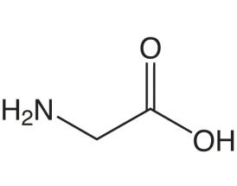
Determination of nitrogen after H2SO4 mineralization.
3. Alkalimetry by the method of Serensen (formal titration), s = 1/2.
Storage. In a well-sealed container that protects from light.
Application. For the treatment of CNS diseases, epilepsy, psychosis, reactive states. In pediatrics - with mental retardation of various etiologies, cerebral palsy, Down's disease.
Glycine
Mechanism of action. It is a neurotransmitter of the inhibitory type of action and a regulator of metabolic processes in the central nervous system.

Slide 14
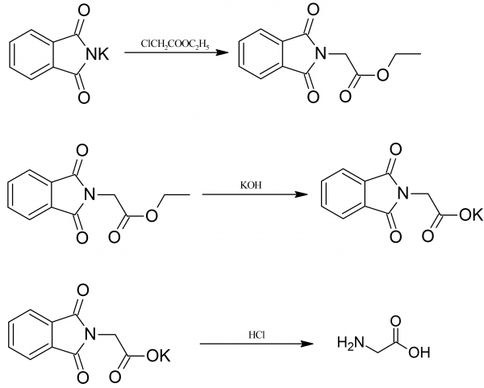
Synthesis.
Properties. White crystalline powder, slightly soluble in water, sparingly soluble in 96% alcohol, practically insoluble in ether.
Identification.
IR spectrum, TLC.
Reaction with NaClO + HCl + resorcinol ® purple color with greenish-yellow fluorescence ® oranges ® yellow.
Quantitative definition.
Acidimetry in a non-aqueous medium with potentiometric indication of equivalence point, s = 1:
H2NCH2COOH + HClO4 = [H3 + NCH2COOH] ClO4–
Application. Functional and organic diseases of the nervous system, ischemic stroke and cerebrovascular disorders, as an adjunct in the treatment of alcoholism.

Slide 15
Antihypertensive drugs
Angiotensin-converting enzyme inhibitors (ACE)
Antihypertensive (antihypertensive) drugs are more often classified by mechanism of action than by chemical structure.
Antihypertensive drugs lower blood pressure by various mechanisms.
Classification of antihypertensive drugs
According to the effectiveness and importance in the treatment of hypertension, a large number of antihypertensive drugs can be divided into basic and auxiliary drugs. The group of basic antihypertensive drugs include:
β-blockers.
Calcium channel blockers.
Angiotensin-converting enzyme (ACE) inhibitors and angiotensin II receptor blockers.
Diuretics.

Slide 16
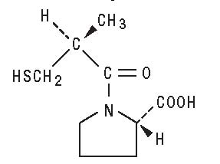
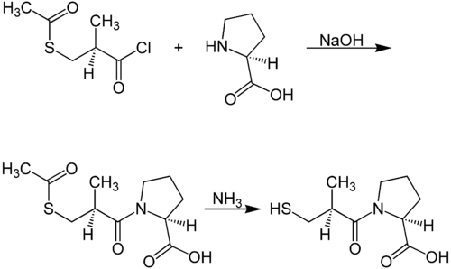
Captopril
Mechanism of action. An ACE inhibitor that prevents the conversion of angiotensin I to angiotensin II, which is a potent vasoconstrictor.
Synthesis.

Slide 17
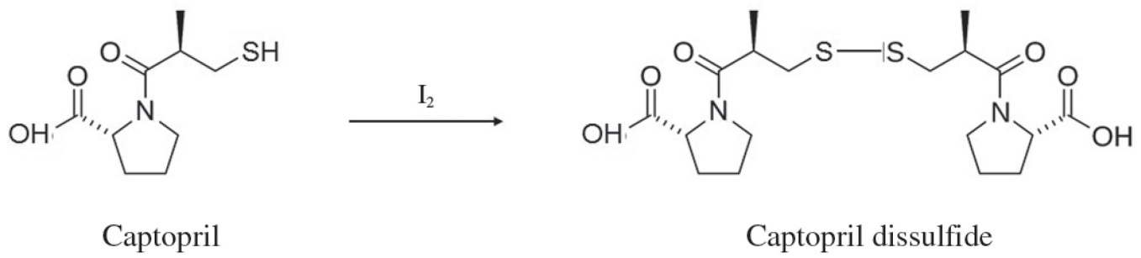
Properties. White or almost white crystalline powder, easily soluble in water, methylene chloride and methanol. Soluble in dilute alkali solutions.
Identification.
T. pl., IR spectrum.
TLC, by decolorization of iodine solution.
Quantitative definition.
Method of iodometric titration with potentiometric fixation of the equivalence point:
Storage. Store in a tightly closed container.
Application. Treatment of all forms of hypertension, congestive heart failure, myocardial infarction and to prevent renal failure in patients with diabetic nephropathy or other chronic kidney disease (in the presence or absence of hypertension).

Slide 18
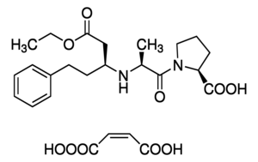
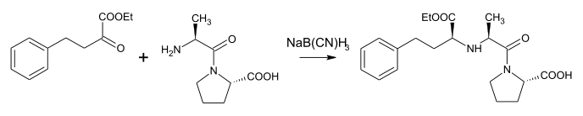
Enalapril maleate
Mechanism of action. After oral administration, the drug is rapidly absorbed and transformed (by hydrolysis) into the active metabolite - enalaprilat, which has the properties of a highly specific ACE inhibitor. Enalaprilat inhibits the conversion of angiotensin I to angiotensin II and the breakdown of bradykinin.
Synthesis.
Properties. White or almost white crystalline powder, slightly soluble in water, soluble in methanol and ethanol.
Application. Treatment of arterial hypertension, heart failure, prevention of clinically severe heart failure in patients with asymptomatic left ventricular dysfunction.

Slide 19
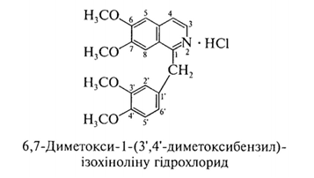
Antispasmodics
Antispasmodics (Latin spasmolytica <Latin spasmus - spasm, convulsions + Greek lysis - decomposition, dissolution) - drugs that eliminate spasms of smooth muscles of internal organs, reduce the frequency of spastic contractions.
Classification
By mechanism of action:
myotropic;
neurotropic.
Myotropic antispasmodics reduce the tone of smooth muscle organs by directly affecting biochemical processes in smooth muscle cells.
Neurotropic antispasmodics have an antispasmodic effect by disrupting the transmission of nerve impulses in the autonomic ganglia or at the end of the autonomic nerves that stimulate smooth muscle.
Papaverine hydrochloride

Slide 20
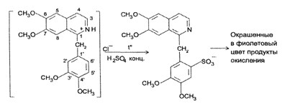
Mechanism of action. Inhibition of the enzyme phosphodiesterase, which promotes the intracellular accumulation of cyclic 3 ', 5'-adenosine monophosphate, and, as a consequence, leads to a violation of smooth muscle contractility and their relaxation in spastic conditions.
Properties. White crystalline powder, odorless, hygroscopic, slightly bitter taste, moderately soluble in water, soluble in chloroform, slightly soluble in ethanol, insoluble in ether.
Identification.
UV spectrum, so pl. bases after NH4OH precipitation.
Reaction to chlorides:
+ HNO3 (conc.) → yellow color, when heated → orange (in a porcelain cup).
Reaction with H2SO4 (conc.) On heating → purple color:

Slide 21
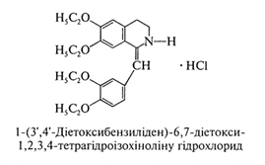
Quantitative definition.
Alkalimetry in a mixture of alcohol and 0.01 M HCl solution with potentiometric fixation of the titration endpoint, s = 1.
Acidimetry in non-aqueous medium, direct titration in the presence of mercury (II) acetate, s = 1.
Alkalimetry in aqueous-alcoholic medium without the use of chloroform, s = 1.
Spectrophotometry (in dosage forms).
Storage. In a well-sealed container that protects from light.
Application.Antispasmodic. Spasms of peripheral vessels, vessels of a brain; endarteritis, spasms of smooth muscles of the abdominal cavity, bronchi; premedication (as an excipient).
Drotaverine hydrochloride (NO-SPA)

Slide 22

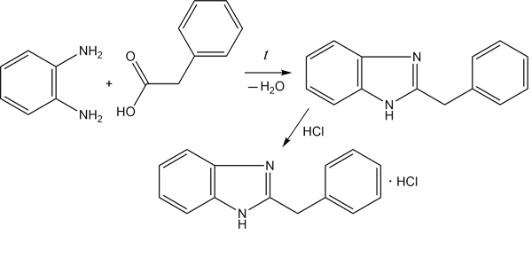
Mechanism of action. Drotaverine hydrochloride is chemically and pharmacologically similar to papaverine, but has a stronger and longer antispasmodic activity.
Application. Antispasmodic. The effect of drotaverine is stronger than the effect of papaverine, absorption is faster and more complete, it is less bound to plasma proteins. The advantage of drotaverine is also that, unlike papaverine, after its parenteral administration there is no such side effect as respiratory stimulation.
Bendazole
Mechanism of action. Reduces the content of free calcium in smooth muscles, causing them to relax; increases the synthesis of nucleic acids and proteins, stimulates the immune system (promotes the formation of antibodies, phagocytosis, interferon synthesis). Activates interneuronal contacts in the spinal cord.
Synthesis.

Slide 23
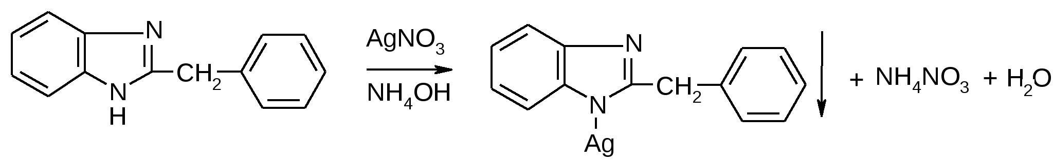
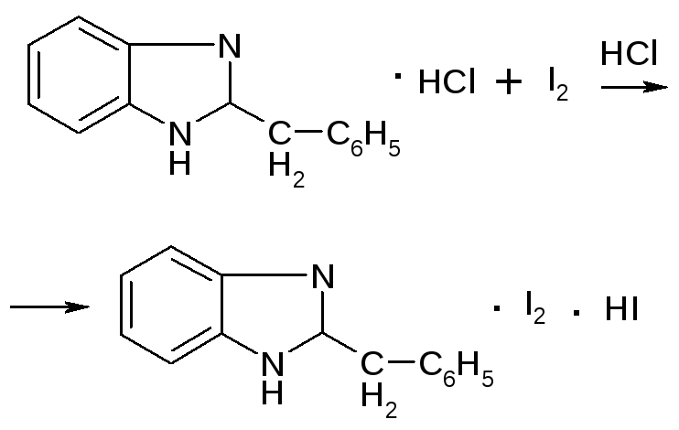
Properties. White, sometimes with a slightly grayish or yellowish tinge crystalline powder, bitter-salty to taste. Hygroscopic. Unlike other hydrochlorides, it is sparingly soluble in water, easily soluble in alcohol and sparingly soluble in chloroform, slightly soluble in acetone, practically insoluble in ether.
Identification.
UV spectrum.
After precipitation of the base with ammonia in the filtrates determine the chlorides:
The presence of heterocyclic nitrogen atoms - reaction with a solution of iodine in an acidic environment - a precipitate of reddish-silvery color (≤ 25 ° C):

Slide 24

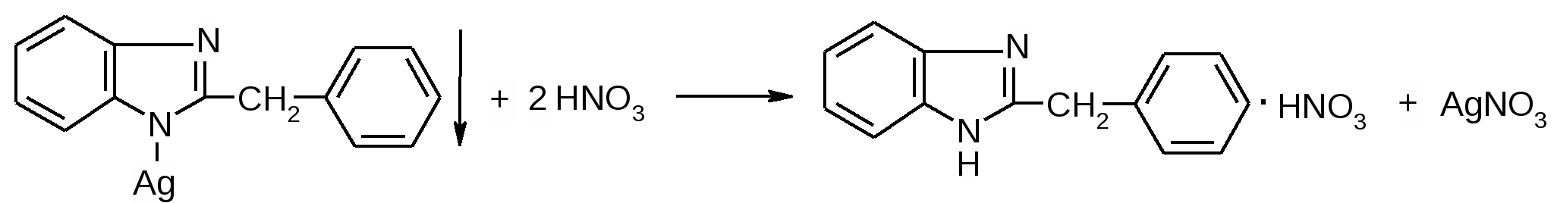
Reaction with an alcoholic solution of Co (NO3) 2 with the formation of a blue color:
In the presence of chloroform, bendazole reacts with a solution of ammonium vanadate in concentrated H2SO4. The chloroform layer gradually turns cherry color.
Cleanliness test. A specific impurity - o-phenylenediamine is determined by reaction with FeCl3 in an acidic environment - should not appear pink.
Quantitative definition.
Acidimetry in non-aqueous medium, direct titration in the presence of mercury (II) acetate, s = 1.
Thiocyanatometry by substituent, s = 1:

Slide 25
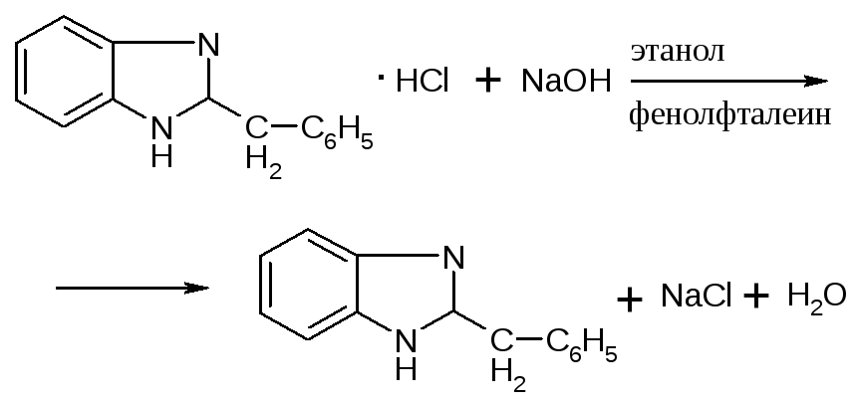
AgNO3 + NH4SCN = AgSCN+ NH4NO3
FeNH4 (SO4) 2 + 3NH4SCN = Fe (SCN) 3 + 2 (NH4) 2SO4.
Argentometry, direct titration in the presence of acetone and CH3COONa solution, indicator - potassium chromate, s = ½.
Alkalimetry of bound acid HCl, s = 1:
Storage. In a container that protects from light and moisture.
Application. Bendazole is a synthetic analogue of papaverine. Antispasmodic, for spasms of blood vessels (exacerbation of hypertension, hypertensive crises) and smooth muscles of internal organs (spasms of the pylorus of the stomach, intestines); in the treatment of nervous diseases (mainly residual effects of polio, peripheral paralysis of the facial nerve, polyneuritis).

Slide 30
Questions:
Calcium antagonists.
Antioxidants.
Antihypertensive (antihypertensive) drugs.
Antispasmodics.

