Slide 1
Lecture № 5
"Drugs that affect the excretory system (diuretics).
Characteristics, classification, relationship between structure and pharmacological action, mechanism of action, methods of production, methods of analysis,
application in medicine "

Slide 2
MEANS AFFECTING THE SELECTIVE SYSTEM
Diuretics
Diuretics- drugs that increase the formation of urine (diuresis). Diuretics are divided into hyduretics (cause mainly water diuresis) and saluretics.
Saluretics - increase the excretion of sodium and potassium salts and thereby increase diuresis. Diuretics, which excrete mainly sodium and store potassium in the body, are often allocated to a separate group and are called potassium-sparing diuretics.
Classification by force of action
According to the ability to inhibit the reabsorption of Na + in the renal tubules (hence the strength of action) diuretics are divided into the following groups:
strong (inhibit reabsorption by 10-20%) - furosemide, ethacrynic acid, mannitol;
medium potency (inhibit reabsorption by 5-8%) - dichlothiazide;
weak diuretics (inhibit reabsorption by no more than 3-5%) - spironolactone, triamterene.

Slide 3
Classification by mechanism of action
Loop. Inhibit the transport of Na +, K +, Mg2 + and Cl- ions across the apical membrane of epithelial cells in the thick segment of the ascending part of the Henle loop.
Thiazides. Inhibit the transport of Na +, Cl– ions across the apical membrane in the distal convoluted tubule.
Potassium-sparing. Affects the distal renal tubules, which either reduces potassium secretion or is an aldosterone antagonist.
Osmotic. Increases the osmotic pressure of the blood, which promotes the transfer of fluid from the tissue sector (interstitial) into the lumen of blood vessels increases the osmotic pressure of the blood, changes the hormonal regulation of urination (до aldosterone and vasopressin) increases glomerular filtration and suppresses reabsorption.
Combined. Combined diuretics simultaneously have a diuretic effect and lower blood pressure. The main advantage of these drugs is that the effect occurs 1-3 hours after ingestion and lasts from 6 to 9 hours.

Slide 4
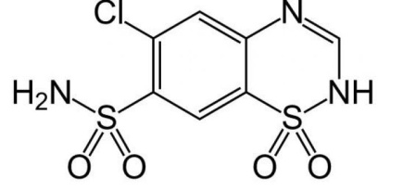
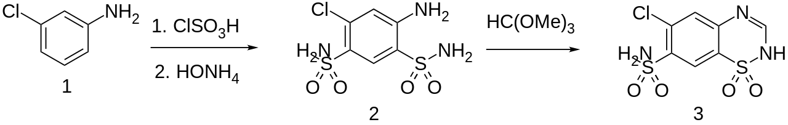
Chlorothiazide
Mechanism of action. Increased diuresis by blocking the reabsorption of sodium and chlorine ions at the beginning of the renal tubules. Thus, they increase the excretion of sodium and chloride and, consequently, water. The excretion of other electrolytes, namely potassium and magnesium, also increases.
Synthesis.
Properties. White or almost white crystalline powder, very insoluble in water, moderately soluble in acetone, slightly soluble in alcohol, soluble in dilute solutions of alkalis.
Identification.
IR, UV spectrum, TLC.
By the release of ammonia when heated with crystalline NaOH (blueing of red litmus paper) and the release of hydrogen sulfide during acidification (blackening of lead-acetate paper).
Quantitative definition. Alkalimetry method in alcohol neutralized with phenolphthalein; indicator - phenolphthalein.
Storage. In a dark place.
Application. Diuretic with antihypertensive effect.

Slide 5
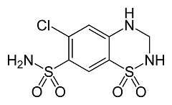
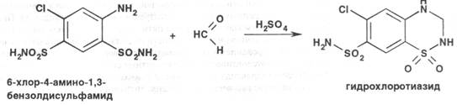
Hydrochlorothiazide
Mechanism of action. Increased diuresis by blocking the reabsorption of sodium and chlorine ions at the beginning of the renal tubules. Increases the excretion of potassium, magnesium, bicarbonate ions; reduces the excretion of calcium in the urine as a result of direct action on the distal tubules, which can prevent the formation of calcium kidney stones.
Synthesis.
Properties. White or almost white odorless crystalline powder. Very sparingly soluble in water, soluble in acetone, moderately soluble in alcohol. Soluble in dilute solutions of alkalis.

Slide 6
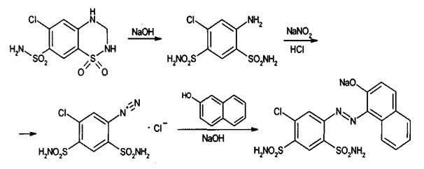
Properties. White or almost white odorless crystalline powder. Very sparingly soluble in water, soluble in acetone, moderately soluble in alcohol. Soluble in dilute solutions of alkalis.
Identification.
T. pl., IR, UV spectrum.
When alloying with KOH, ammonia is released, which is determined by the smell or blueing of wet red litmus paper.
After acid hydrolysis, the formaldehyde substance to which it is released is determined by reaction with chromotropic acid to form a purple color.
The curd atom is determined after mineralization to sulfates by the action of HNO3 (conc.):
SO42– + Ba2 + = BaSO4¯.
The substance under the action of H2SO4 (conc.) Acquires a purple color.
After alkaline hydrolysis → reaction with primary aromatic amines:

Slide 7
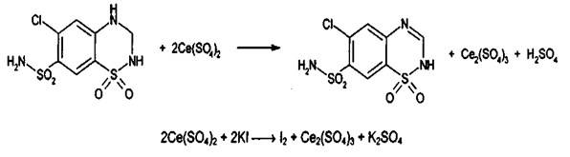
Quantitative definition.
Alkalimetry in a non-aqueous medium, titrant - [(C4H9) 4N] OH, medium - DMSO, potentiometrically, or titrant CH3ONa, medium - Ru or 1-butylamine, indicator - a solution of azo violet in benzene.
Cerimetry, back titration, indicator - starch, s = 1/2:
Storage. In well-sealed glasses, in a dry, dark place.
Application. Diuretic with antihypertensive effect.

Slide 8
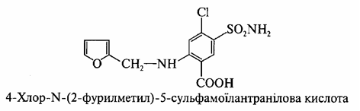
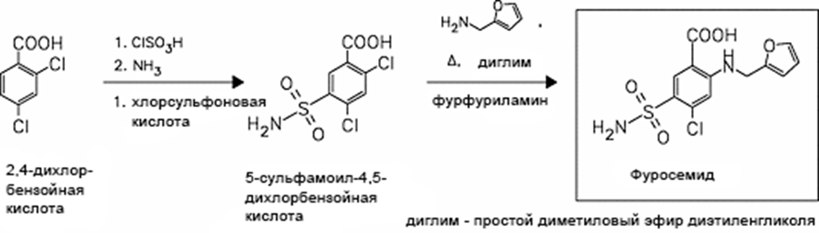
Furosemide
Mechanism of action. Associated with blockade of reabsorption of sodium and chlorine ions in the ascending part of the Henle loop; affects the tortuous tubules. The drug causes severe diuretic, natriuretic, chloruretic effects. Also increases the excretion of potassium, calcium, magnesium.
Synthesis.

Slide 9
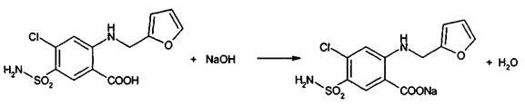
Properties. White or almost white crystalline powder. Practically
insoluble in water, soluble in acetone, moderately soluble in ethanol, sparingly soluble in ether.
Identification.
IR, UV spectrum.
The diazotization reaction followed by azo combination with naphthylenediamine hydrochloride is violet-red color.
Quantitative definition.
Alkalimetry in non-aqueous medium (DMF), indicator - bromothymol blue:
Storage. In a well-sealed container that protects from light and moisture.
Application. Loop diuretic, in chronic heart failure, pulmonary edema, brain, hypertension, chronic renal failure, forced diuresis

Slide 10
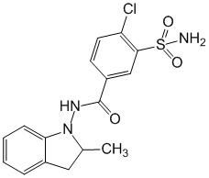
Indapamide
Mechanism of action. Associated with blockade of reabsorption of sodium, chlorine and water ions in the proximal and distal tubules, as well as in the ascending part of the Henle loop. The antihypertensive effect does not change and is well preserved in renal dysfunction.
Properties. White crystalline powder. Practically insoluble in water, soluble in ethanol, slightly soluble in ether.
Identification.
IR, UV spectrum, TLC.
Quantitative definition. By the specific absorption coefficient at λmax = 241 nm in ethanol.
Application. Diuretic and antihypertensive agent.

Slide 11
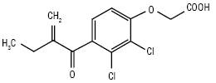
Ethacrynic acid
Mechanism of action. Has a pronounced diuretic effect, blocking the active reabsorption of ions in the proximal convoluted tubules and at the level of the ascending knee of the Henle loop. Causes increased urinary excretion of sodium, chlorine, potassium and calcium ions.
Properties. White or almost white crystalline powder, very slightly soluble in water, slightly soluble in alcohol and ether, soluble in a solution of ammonia, alkalis and carbonates.
Identification.
IR, UV spectrum.
By fluorescence reaction at λ = 254 nm after heating in the presence of hydroxylamine hydrochloride, alcohol solution of potassium hydroxide and water.
By reaction with a solution of the sodium salt of chromotropic acid after heating the substance with a solution of sodium hydroxide (purple aurine dye).
Beilstein test for halogen (blue-green color of the flame).
Quantitative definition. Alkalimetry method in a mixture of methanol and water with potentiometric fixation of the equivalence point.
Application.A strong diuretic. Edema syndrome of various genesis, in particular, in chronic heart failure stage IIB-III, nephrotic syndrome, portal hypertension syndrome. At inefficiency of other diuretic drugs.

Slide 12
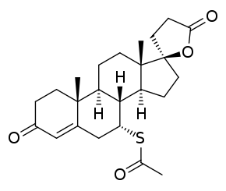
Aldosterone antagonists (potassium-sparing)
Spironolactone
Mechanism of action. Competitive inhibition of the effect of aldosterone.
Properties. Yellowish-white or light yellowish-brown powder, odorless or with a slight characteristic odor. Practically insoluble in water, slightly soluble in ether, soluble in alcohol, easily soluble in chloroform.
Identification.
T. pl., IR, UV spectrum, TLC.
When shaking with H2SO4 (conc.) - the appearance of an orange color of the solution with yellow-green fluorescence.
Characteristic reaction to sulfide ions.
Quantitative definition.
Spectrophotometrically 0.1 M solution of the substance in methanol, λ ~ 238 nm.
Storage. In a tightly closed container, in a dark place.
Application. Potassium-sparing diuretic.

Slide 13
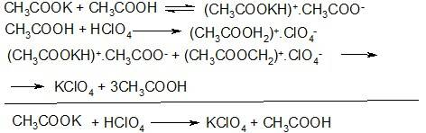
Osmotic diuretics
Potassium acetate
CH3COOK
Mechanism of action. Reduces the reabsorption of sodium ion, and the amount of water reaching the distal tubules increases.
Synthesis.
2CH3COOH + K2CO3 = 2CH3COOK + CO2­ + H2O.
Properties. White crystalline powder or colorless crystals. Blurs in the air. Very easily soluble in water, easily soluble in 96% alcohol.
Identification.
Reactions to potassium ions.
Reactions to acetates - with sulfuric acid:
CH3COO– + H + = CH3COOH­.
Quantitative definition.
Acidimetry in non-aqueous medium, indicator - naphtholbenzein, s = 1:
Acidimetry, direct titration, indicator - tropeolin-00, s = 1: CH3COOK + HCl = CH3COOH + KCl.
Storage. In a well-sealed container that protects against moisture.
Application. Diuretic for edema associated with circulatory disorders.

Slide 14
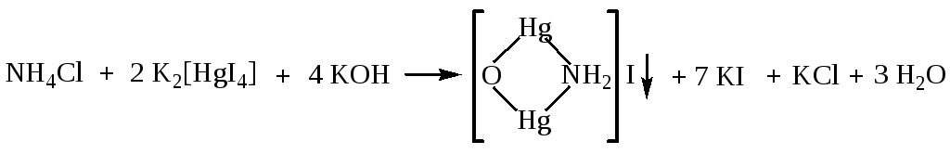
Diuretics - xanthine derivatives
Ammonium chloride NH4Cl
Mechanism of action.It forms ammonium ions, hydrogen and chlorine ions in the blood, as a result of which there is a shift of the acid-base state towards acidosis. Stimulates the glands of the mucous membranes of the respiratory tract, which facilitates expectoration of bronchial secretions. Potassium ions are excreted in small amounts, but it has no independent value as a diuretic.
Synthesis. NH3 + HCl = NH4Cl.
Properties.White crystalline powder or colorless crystals. Easily soluble in water.
Identification.
Reactions on ammonium cation:
NH4 + + OH– = NH3­ + H2O.
Reaction with Nessler's reagent - yellow precipitate:
Reaction to chlorides:
Quantitative definition.
Substitute alkalimetry method. A formaldehyde solution is added to the substance, and the formed hydrochloric acid is titrated with a solution of sodium hydroxide (indicator - phenolphthalein).
Storage. In a well-sealed container.
Application. Together with diuretics that cause alkalosis,
as well as expectorant for pneumonia, bronchitis, etc.

Slide 15
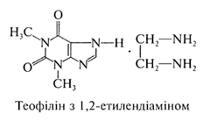
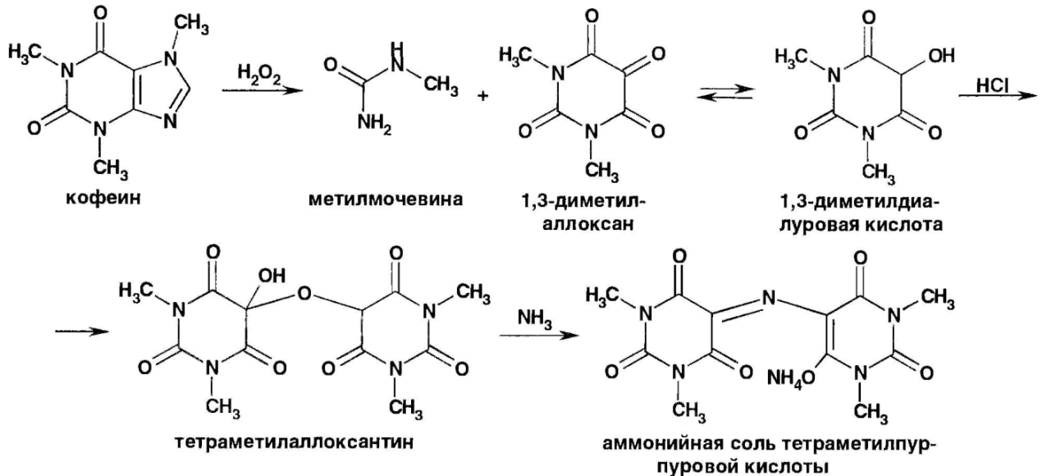
Aminophylline
Mechanism of action. Due to the ability of aminophylline to block adenosine receptors, nonselectively inhibit the enzyme phosphodiesterase and thus increase the concentration of cyclic 3 ', 5'-adenosine monophosphate (cAMP) in tissues, inhibit the transport of calcium ions through "slow" channels of its intracellular cell membranes.
Properties.White, sometimes with a yellowish tinge crystalline powder with a faint ammonia odor. Absorbs carbon dioxide in the air, while reducing its solubility. Soluble in water, aqueous solutions have an alkaline reaction.
Identification.
Murexide test - purple-red color:

Slide 16
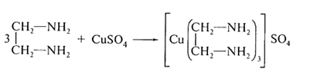

Ethylenediamine with a solution of CuSO4 forms a bright purple color:
Quantitative definition.
Ethylenediamine is determined acidometrically, the indicator is methyl orange, s = 1/2:
Aminophylline is determined by alkalimetry by substitution after drying the sample in an oven at 125-130 ° C until the smell of amines disappears, s = 1.
The content of anhydrous theophylline in aminophylline should be 80-85%, in aminophylline for injection - 75-82%.
Storage. In a well-sealed container filled to the top, protecting from light and moisture.
Application. Antispasmodic, bronchodilator, diuretic.

Slide 17
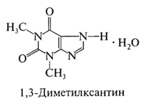
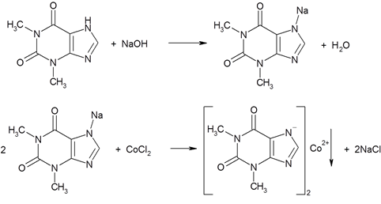
Theophylline
Mechanism of action. It is caused by blocking of adenosine receptors, suppression of phosphodiesterases, increase in the content of intracellular cAMP, decrease in intracellular concentration of calcium ions.
Properties. White crystalline powder, odorless, slightly soluble in cold water, ethanol, ether, chloroform, soluble in hot water and hot ethanol, in solutions of acids and alkalis.
Identification.
Group reaction - murexide test.
Specific reactions.
The reaction of the Na-salt of theophylline with a solution of CoCl2 - white with a pink tinge precipitate:

Slide 18
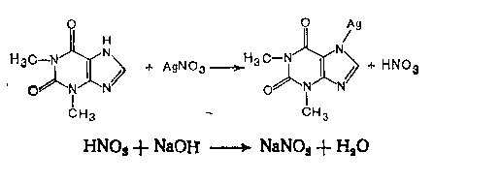
With an alkaline solution of sodium nitroprusside Na2 [Fe (CN (5NO)) - green color, disappears with the addition of excess acid:
Quantitative definition.
Alkalimetry by substituent, s = 1:
Storage. In a well-sealed container, protect from light.
Application. Antispasmodic, bronchodilator, diuretic.

Slide 19
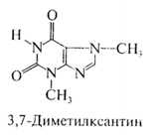
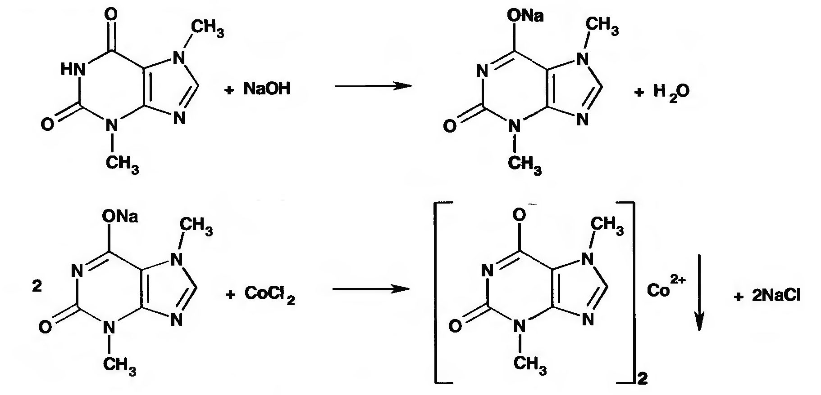
Theobromine
Mechanism of action. It is caused by blocking of adenosine receptors, suppression of phosphodiesterases, increase in the content of intracellular cAMP, decrease in intracellular concentration of calcium ions.
Properties.White crystalline powder, bitter in taste. Very slightly soluble in water, ethanol, ether, chloroform, slightly soluble in hot water, easily soluble in solutions of acids and alkalis.
Identification.
Group reaction - murexide test.
Specific reactions.
The reaction of Na-salt of theobromine with a solution of CoCl2 is an intense purple color, which quickly disappears and a precipitate of grayish-blue color is formed:

Slide 20
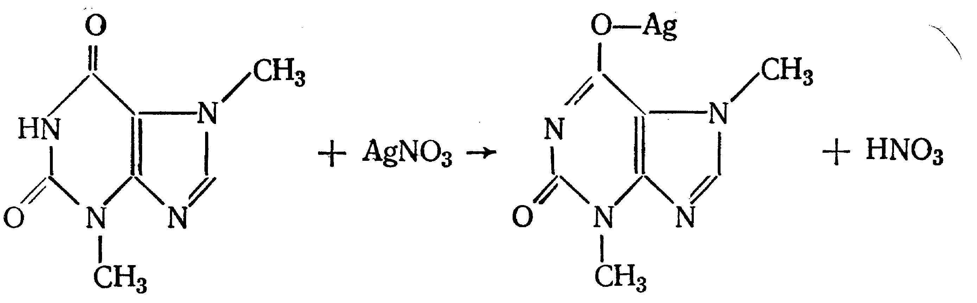
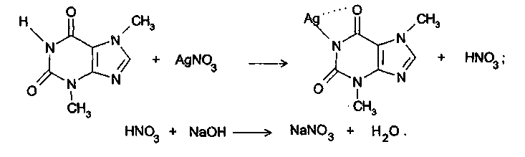
The reaction of the Na-salt of theobromine with a solution of AgNO3 - a thick gelatinous mass (Ag-salt), which is diluted when heated to 80 ° C and solidifies again when cooled:
Quantitative definition.
Alkalimetry by substituent, s = 1:
Storage. In a well-sealed container.
Application. Antispasmodic, bronchodilator, diuretic.

