Slide 1
Antimicrobial drugs. Sulfanilamides. Derivatives of naphthyridine and quinolonecarboxylic acids. Derivatives of 8-oxyquinoline, quinoxaline and nitrofural. Characteristics, classification, connection between structure and action, mechanism of action, methods of production, methods of analysis, application in medicine.
Lecture 7

Slide 2
ANTIMICROBIAL MEDICINES
Antimicrobial drugs (Greek anti - against + micros - small + bios - life) - drugs that have a depressant effect on bacteria.
A.p. divided into two groups:
non-selective antimicrobial drugs that have a detrimental effect on most microorganisms (antiseptics and disinfectantscompounds);
drugs with a more selective effect on certain types of bacteria and a significant breadth of therapeutic action (chemotherapeutic drugs - antibiotics and synthetic antibacterial drugs: sulfonamides, derivatives quinolone, naphthyridine, quinoline, nitrofuran,imidazole).
Specific chemotherapeutic (with selective cytotoxicity) anti-TB drugs are divided into two groups:
I series drugs (main): isonicotinic acid hydrazide (isoniazid) and its derivatives (hydrazones), antibiotics (streptomycin, rifampicin), PAS
and its derivatives;
drugs of the II series: ethionamide, prothionamide, ethambutol, cycloserine, pyrazinamide, thioacetazone, aminoglycosides (kanamycin).

Slide 3
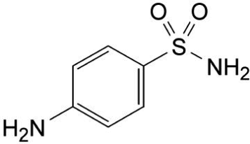
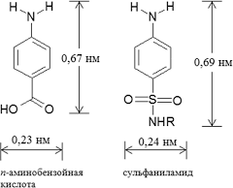
Derivatives of sulfanilic acid amide
Mechanism of action. Based on the competitive antagonism of sulfonamides and para-aminobenzoic acid (PABX): PABX is the starting product for the synthesis of folic acid in the microbial cell, without which the growth and reproduction of the microbial cell is impossible. The microbial cell absorbs sulfanilamide instead of PABX and thus blocks the first stage of nucleic acid synthesis.
Analogies in the structure of PAS and sulfonamide

Slide 4
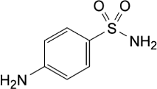
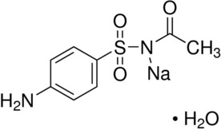
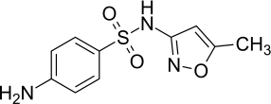

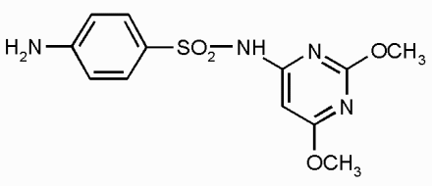
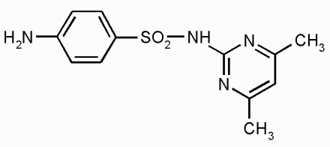
Some sulfonamides
Sulfanilamide Sulphacetamidesodium Cotrimoxazole
Sulfathiazole
Sulfadimethoxine Sulfadimidine Sulfamethoxazole

Slide 5
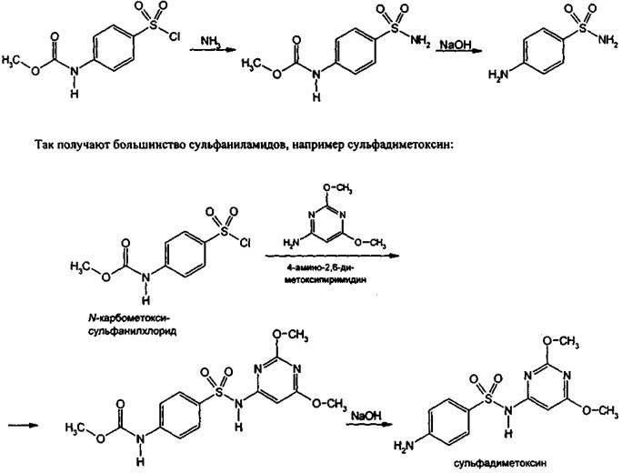
Synthesis.

Slide 6

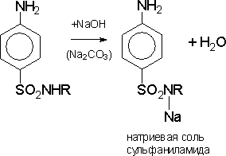
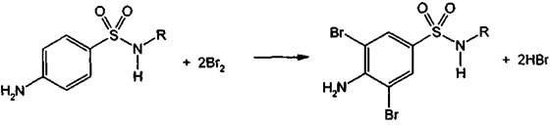
As bases are soluble in acids, forming salts, which are highly hydrolyzed in water and practically do not exist:
Easily soluble in alkalis and alkali metal carbonates:
All sulfonamides can be halogenated, nitrated, sulfonated:

Slide 7
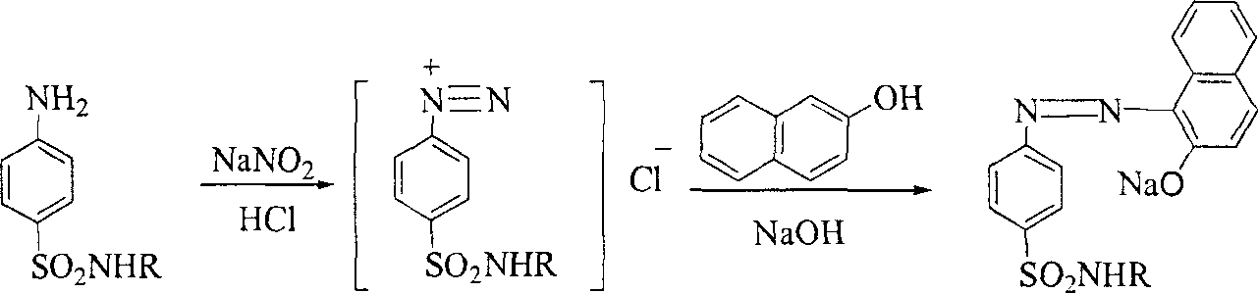
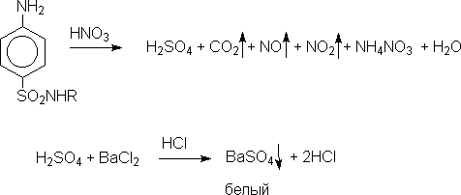
Sulfanilamides enter into a diazotization reaction followed by azo combination - cherry red color appears:
To detect the sulfur atom in the sulfamide group - oxidation reaction; received sulfates are determined by reaction with barium chloride:

Slide 8
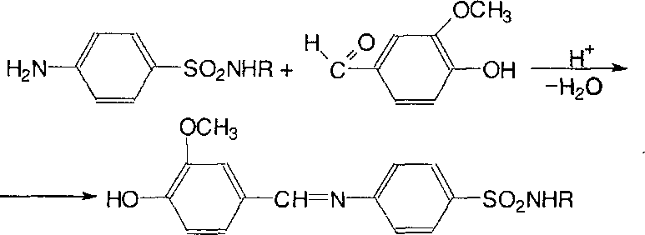
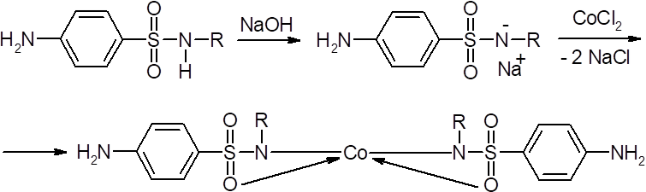
Lignin test - used for rapid analysis. Conducted on wood or unbleached paper: LZ + 1 drop of HCl - orange-red color:
Reactions with salts of heavy metals, Cu (II), Fe (III) - colored complexes are formed, soluble or insoluble in water

Slide 9
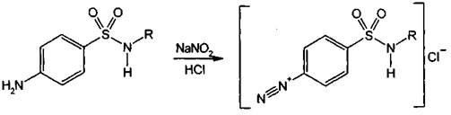
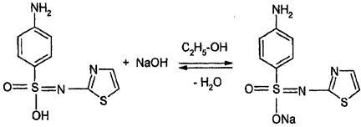
Quantitative definition.
The method of nitritometry, at a temperature not exceeding 20 ºC, s = 1:
Alkalimetry. Based on the acidic properties of the sulfamide group, the indicator is thymolphthalein, s = 1:

Slide 10

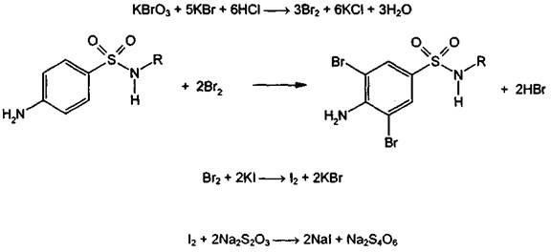
Acidimetry. Sodium salts of sulfonamides can be titrated with acid in alcohol-acetone medium, the indicator is methyl orange, s = 1:
Bromatometry, back titration. The method is based on the halogenation reaction of sulfonamide drugs, titrated solution - potassium bromate. Excess bromine is determined iodometrically, the indicator is starch; s = 1.5:

Slide 11
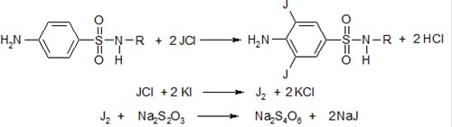
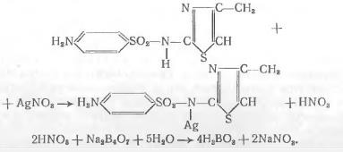
Iodochlorometry, back titration, s = 1/2:
Argentometry, titration is performed in the presence of sodium tetraborate, indicator - potassium chromate (Mora method), s = 1:
Photocolorimetry - based on the ability of sulfonamides to form azo dyes.
Spectrophotometric methods of quantitative determination.
Application. Chemotherapeutic medicinal means for treatment diseases, caused by streptococci, gonococci, meningococci, staphylococci, Escherichia coli.

Slide 12
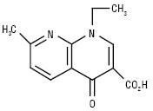
Derivatives of naphthyridine and quinolonecarboxylic acids Nalidixic acid
Mechanism of action. Inhibition of DNA synthesis.
Properties. Virtually white or pale yellow crystalline powder, practically insoluble in water, soluble in ethanol, chloroform, methylene chloride and in dilute solutions of alkalis and carbonates.
Identification.
  IR, UV spectrum, TLC.
  The reaction of the substance in hydrochloric acid with β-naphthol is orange-red.
Quantitative definition. Alkalimetry in ethanol.
Storage. Store in a tightly closed container, protected from light
place.
Application. Infectious and inflammatory diseases, mainly of the gastrointestinal tract and urogenital
systems caused by sensitive microorganisms.

Slide 13
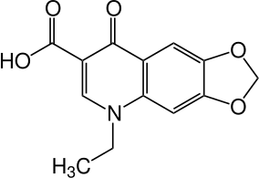
Oxolinic acid
Mechanism of action. Inhibition of DNA synthesis in bacterial cells.
Properties. Almost white or yellowish crystalline powder, practically insoluble in water, alcohol, sparingly soluble in methylene chloride, soluble in dilute alkali solutions.
Identification.
IR, UV spectrum, TLC.
Quantitative definition. Titration of tetrabutylammonium hydroxide in DMF with potentiometric fixation of the equivalence point.
Storage. In a tightly closed container, protected from light
place.
Application. Cystitis, pyelitis, nephritis, prostatitis. Bacteriuria caused
sensitive to the drug microorganisms.

Slide 14
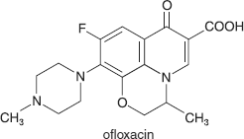
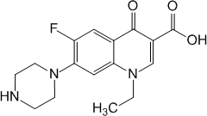
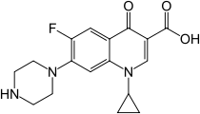
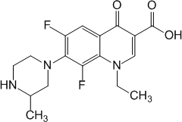
Fluoroquinolones
Ofloxacin
Norfloxacin
Ciprofloxacin hydrochloride
Lomeofloxacin hydrochloride
Pefloxacin

Slide 15
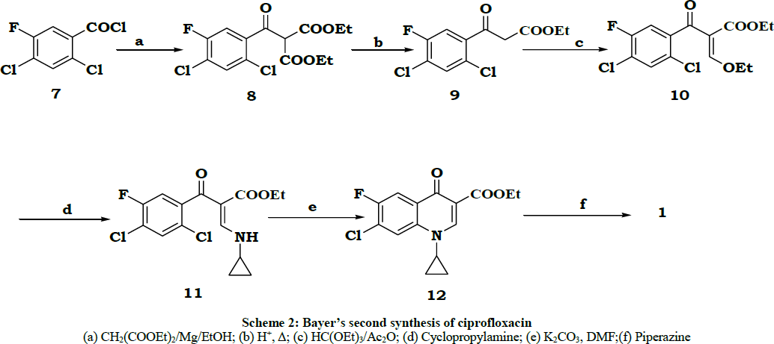
Mechanism of action. They act bactericidal, disrupting DNA synthesis in bacterial cells, blocking two vital bacterial enzymes - DNA gyrase and topoisomerase.
Synthesis.

Slide 16
Properties. Pale yellow crystalline powders, norfloxacin and ciprofloxacin are hygroscopic. Very little or practically insoluble in water, slightly soluble in alcohol and acetone. Norfloxacin is photosensitive. The hydrochloride salts of ofloxacin and ciprofloxacin are soluble in water and practically insoluble in alcohol, acetone and methylene chloride.
Identification.
IR spectrum.
Hydrochloride salts - a reaction to chlorides.
Reactions to heterocyclic N-nitrogen atom with total alkaloids reagents -K2[HgI4], picric acid, etc.
Fluoride is determined after mineralization.
Quantitative definition.
Acidimetry in non-aqueous medium, direct titration, s = 1.
Hydrochloride salts are determined by liquid chromatography.
Storage. In a well-sealed container, in a dark place.
Application. All fluoroquinolones are active against most gram-negative microorganisms, many strains of staphylococci, legionella, mycoplasmas, chlamydia. In infections of the respiratory tract, skin and soft tissues, bones and joints, gastrointestinal tract, postoperative infections. Activity increases in a number:ofloxacin - norfloxacin - ciprofloxacin - lomeofloxacin

Slide 17
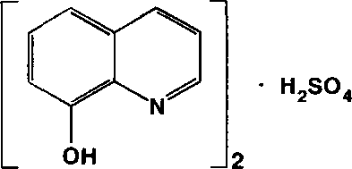
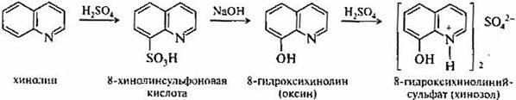
Derivatives of 8-hydroxyquinoline Quinozol
Mechanism of action. Disrupts protein synthesis, forms chelates, the latter enhance oxidative processes in the protoplasm.
Synthesis.

Slide 18
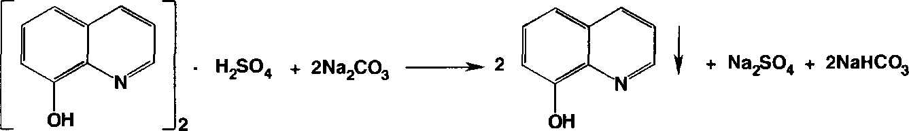
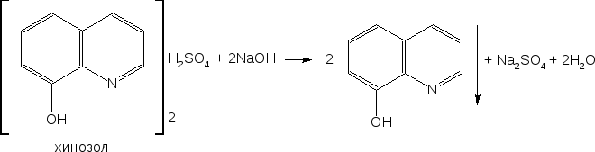
Properties. Fine-crystalline powder of lemon-yellow color, peculiar smell. Easily soluble in water, little - in alcohol.
Identification.
Reaction with aqueous Na solution2CO3 - precipitate of 8-oxyquinoline, which dissolves in excess reagent:
Complexation reactions with metal ions (Mg2+, Fe3+, Cu2+).
Quantitative definition.
Alkalimetry of bound acid H2SO4.
Application. Antiseptic and spermicidal drug.

Slide 19
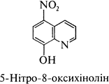
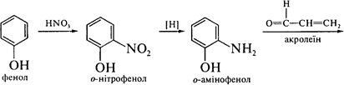
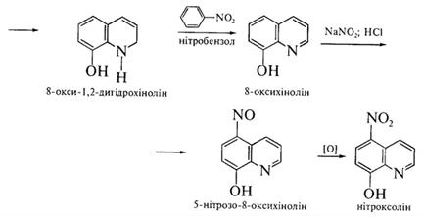
Nitroxoline
Mechanism of action. Blocks the function of the enzyme by binding metal ions in the enzymes of microorganisms, thus preventing the binding of these enzymes to a specific substrate.
Synthesis.

Slide 20
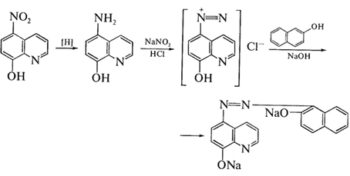
Properties. Fine-crystalline powder of yellow or grayish-yellow color.
Practically insoluble in water.
Identification.
UV spectrum.
With FeCl solution3 - black and green color.
Restore -NO2 to -NH2, reaction of diazotization and azo combination - orange-red color:

Slide 21
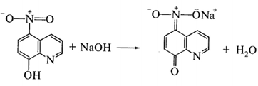
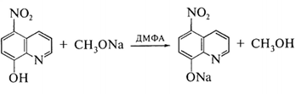
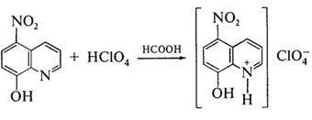
Reaction with NaOH solution - red-orange color:
Quantitative definition.
Alkalimetry in a non-aqueous medium, direct titration, indicator - thymol blue in DMF, s = 1:
Acidimetry in non-aqueous medium, direct titration, indicator - malachite green, s =1:

Slide 22
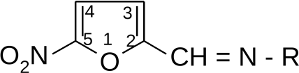
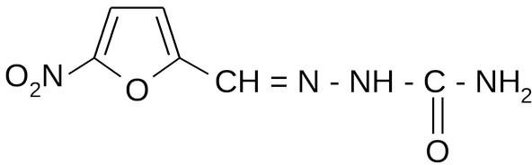
Nitritometry after reduction of the nitro group to the amino group, s = 1.
Storage. In a dry, dark place.
Application. Antibacterial means at infections urogenital tract (pyelonephritis, cystitis, etc.).
Nitrofuran derivatives
Nitrofural
Mechanism actions. Connected with ability restore nitro group in amino group, disrupt DNA function, inhibit cellular respiration of microorganisms.

Slide 23
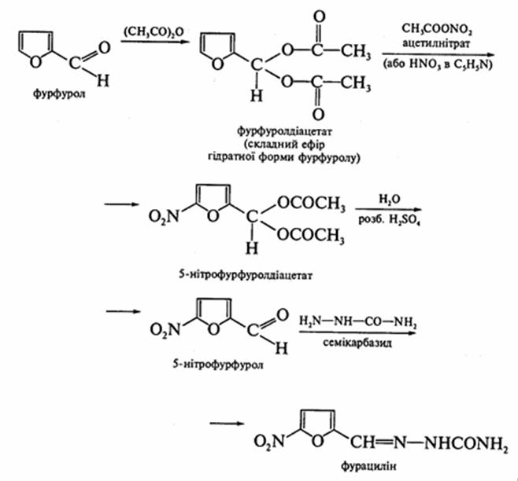
Properties. Crystalline powder of yellow or brownish-yellow color. Very slightly soluble in water (1: 4200, in the presence of NaCl solubility increases), slightly soluble in 96% alcohol, practically insoluble in ether, soluble in alkali solutions.

Slide 24
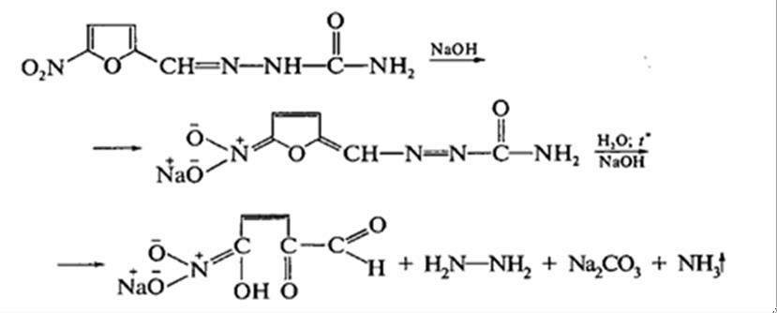
Identification.
1. ANDH-, UV-spectrum, TLC.
2. + NaOH - orange-red color, heating - selectionammonia:
3. Heating in an acidic medium with Zn-dust - the solution discolors due to the reduction of -NO2 to -NH2.

Slide 25
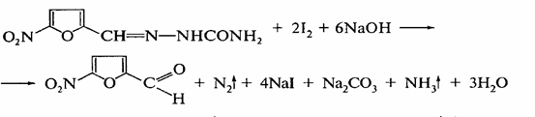
Quantitative definition.
Iodometry in alkaline medium, back titration, indicator - starch, s = 1/2:
I2 + NaOH =NaI + NaOI + H2O,
NaI + NaOI + H2SO4 =I2 + Na2SO4 + H2O, I2 + Na2S2Oh3 =2NaI + Na2S4O6.
Spectrophotometry (standard method at λ = 375 nm).
Photocolorimetry (determination of the optical density of an alkaline solution of F.).
Storage. In well-sealed dark glass, in a cool place protected from light.
Application. Antibacterial agent, acts on a variety of gram-positive and gram-negative microorganisms. Externally for the treatment and prevention of purulent-inflammatory processes and internally for treatment
bacterial dysentery.

Slide 26
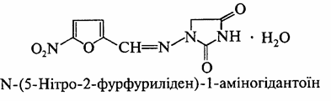
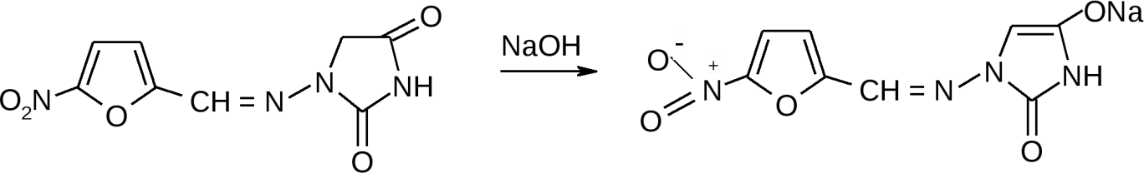
Nitrofurantoin
Mechanism actions. Connected with ability restore nitro group in amino group, disrupt DNA function, inhibit cellular respiration of microorganisms.
Properties. Yellow, odorless, crystalline powder, bitter in taste. Very slightly soluble in water and 96% alcohol, slightly soluble in acetone, soluble in DMF.
Identification.
  Med + NaOH - dark red color:

Slide 27
  A solution of the drug in DMF - yellow, + alcohol KOH - brown-yellow.
Quantitative definition.
UV spectrophotometry.
Photocolorimetry by reaction with aqueous alkali solution.
Alkalimetry in a non-aqueous medium, titrant - CH3ONa in a mixture of DMF and dioxane, indicator - thymol blue, s = 1.
Storage. In a well-sealed container that protects from light and moisture.
Application. Antibacterial agent. Bacterial infections of the urinary tract (pyelitis, pyelonephritis, cystitis, urethritis), including for the treatment of recurrences, as well as for the prevention of infection during urological operations, catheterization, cystoscopy.

Slide 28

Furazolidone
Mechanism of action.Disrupts the process of bacterial cellular respiration, inhibits the biosynthesis of nucleic acids.
Properties. Yellow or greenish-yellow odorless powder, bitter in taste.
Practically insoluble in water and ether, very slightly soluble in 96% alcohol.
Identification.
Aqueous solution of drugs + NaOH solution, heating - brown.
A solution of the drug in DMF - yellow, + a solution of KOH in alcohol - purple
IR spectroscopy.
Quantitative definition.
Photocolorimetry by reaction with an alcoholic solution of KOH.
UV spectrophotometry (λ = 367 nm).
Storage. In a well-sealed container that protects from light.
Application. Antibacterial and antiprotozoal agent. Bacillary dysentery, paratyphoid, food poisoning,
enterocolitis, giardiasis, Trichomonas colpitis.

