Slide 1
Anti-TB drugs. Means for the treatment of cancer. Antiviral and antimalarial drugs. Characteristics, classification, the relationship between structure and action, mechanism of action, methods of production, methods of analysis, application in medicine “
LECTURE 8

Slide 2
ANTI-TUBERCULOSIS DRUGS
Classification of UTD on the strength of the inhibitory effect on mycobacteria, efficacy and tolerability with long-term use
Drugs of the I series (main): isoniazid, rifamlycin, pyrazinamide, ethambutol, streptomycin sulfate (drugs are more active, less toxic).
Series II drugs (reserve): ethionamide, prothionamide, kanamycin sulfate, cycloserine, sodium paraaminosalicylate (PAS) (less effective, less well tolerated, but can inhibit the growth of mycobacteria, developing resistance to drugs of the first series).
Classification of UTD by chemical structure and mechanism of action
Synthetic means: isoniazid, ethambutol, sodium paraaminosalicylate (PAS), ethionamide, pyrazinamide, thioacetazone.
Antibiotics: rifampicin, cycloserine, streptomycin sulfate, kanamycin sulfate, florimycin sulfate.

Slide 3
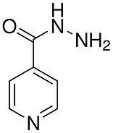
Classification of UTD on clinical effectiveness Group A. The most effective drugs: isoniazid, rifampicin.
Group B. Less effective drugs: ethambutol, streptomycin, kanamycin, florimycin, ethionamide, prothionamide, pyrazinamide, cycloserine.
Group C. The least effective drugs: PASK, thioacetazone.
Derivatives of isonicotinic acid hydrazide Isoniazid
Mechanism of action. Associated with inhibition of the synthesis of long-chain mycolic acids, which are components of the cell membrane of mycobacteria.

Slide 4
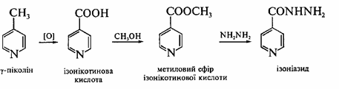
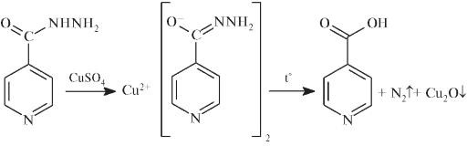
Synthesis.
Properties. White crystalline powder, bitter in taste. Easily soluble in water, sparingly soluble in alcohol, practically insoluble in ether.
Identification.
T. pl., IR spectrum.
With CuSO4 - blue color and precipitate, gas bubbles:

Slide 5
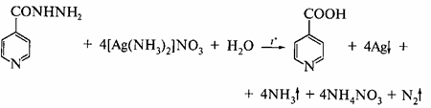
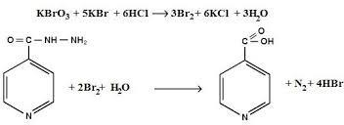
medicine + solution [Ag (NH3)2] NO3 - yellowish precipitate, then plaque Ag on the walls:
Reactions to the pyridine cycle.
Quantitative definition.
Bromatometry, direct titration, indicator - methyl red, s = 1,5:

Slide 6
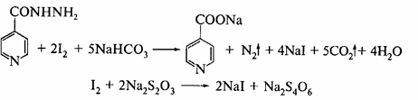
Iodometry, back titration, indicator - starch, s = 1/2:
Storage. In a well-sealed container that protects from light.
Application. Anti-tuberculosis drug.

Slide 7
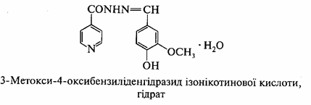
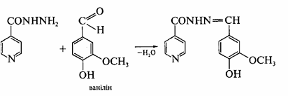
Ftivazide
Mechanism of action. Associated with inhibition of the synthesis of long-chain mycolic acids, which are components of the cell membrane of mycobacteria.
Synthesis.
Properties. Light yellow or yellow fine crystalline powder with a faint odor of vanillin, tasteless. Very slightly soluble in water, slightly soluble in 96% alcohol, easily soluble in acids and alkali solutions.

Slide 8
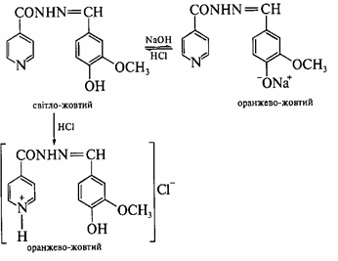
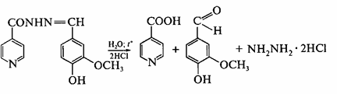
Identification.
medicine + 2,4-dinitrochlorobenzene, heating + NaOH - yellowish-brown color.
medicine + NaOH - light yellow → orange-yellow; + HCl → yellow → orangeevo yellow:
medicine + HCl, heating - the smell of vanillin:

Slide 9
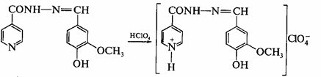
Quantitative definition.
Acidimetry in non-aqueous medium, direct titration, indicator - crystal violet, s = 1:
Storage. In a well-sealed container.
Application. Anti-tuberculosis drug.

Slide 10
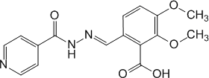
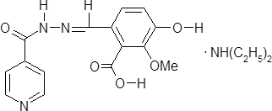
Opiniazide
Opiniazide is soluble
Mechanism of action. Associated with inhibition of the synthesis of long-chain mycolic acids, which are components of the cell membrane of mycobacteria.
Properties. Opiniazide - white or with a weak yellowish tint crystalline powder, slightly soluble in water, practically insoluble in ether, easily soluble in mineral acids and alkali solutions.
Opiniazide is soluble - white or with a weak yellowish tinge crystalline powder, easily soluble in water, slightly soluble in alcohol, practically insoluble in ether.
Identification.
  Medicine + 2,4-dinitrochlorobenzene, heating + NaOH - brown-red color.
  Medicine + CuSO4 - green precipitate of copper salt.
  Medicine + NaOH, heating - the characteristic smell of diethylamine.
Storage. In a well-sealed container that protects from light.
Application. UT drugs.

Slide 11
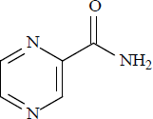
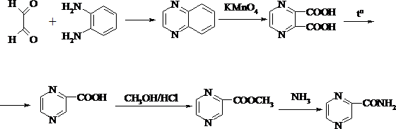
Pyrazine derivatives Pyrazinamide
Mechanism of action. Not precisely established, it is believed that the mechanism is similar to that of isoniazid and is associated with impaired metabolism of mycolic and nucleic acids in mycobacteria.
Synthesis.

Slide 12
Properties. White crystalline powder, odorless, moderately soluble in water and chloroform, slightly soluble in alcohol, very slightly soluble in ether.
Identification.
T. pl. IR, UV spectrum.
Medicine + FeSO4 - orange-red color, + NaOH - blue.
Medicine + NaOH, heating - the smell of ammonia.
Quantitative definition.
Non-aqueous titration in a mixture of chloroform and acetic anhydride, indicator - Sudan red.
Storage. In a well-sealed container.
Application. Anti-tuberculosis drug.

Slide 13
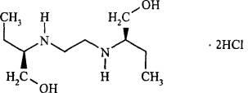
Derivatives of aliphatic amines Ethanbutol hydrochloride
Mechanism of action. Associated with inhibition of RNA and protein synthesis, the ability to interact with ions of divalent biometals (copper, magnesium), disruption of the structure of ribosomes and inhibition of the intensity of lipid metabolism.
Properties. White crystalline powder, easily soluble in water, soluble in alcohol, very insoluble in ether.
Identification.
IR spectrum.
Reaction with CuSO4 in the presence of NaOH - blue color.
Reaction to chlorides.
Quantitative definition.
Spectrophotometry.
Storage. In a well-sealed container.
Application. Anti-tuberculosis drug.

Slide 14
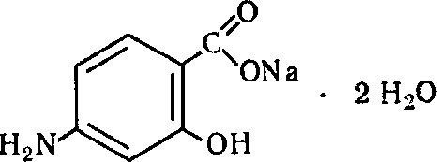
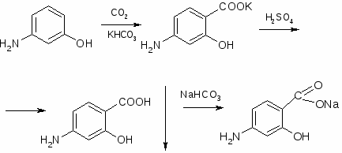
Derivatives of p-aminosalicylic acid Sodium paraaminosalicylate
Mechanism of action. Associated with inhibition of folic acid synthesis and inhibition of the formation of mycobacterin, a component of the mycobacterial wall.
Synthesis.
Properties. White, sometimes with a slightly yellowish or pink tinge fine-grained powder, easily soluble in water, sparingly soluble in alcohol. Aqueous solutions darken when standing. Na-PASK decomposes at 80 ° C, so the solution cannot be sterilized by heating.

Slide 15
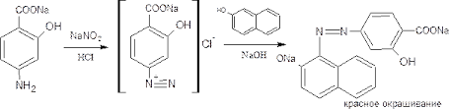
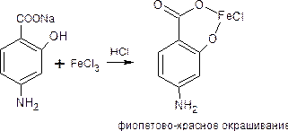
Identification.
  Reaction to the primary aromatic amino group:
  Reaction with FeCl3 - purple-red color:
  Reactions on sodium cation.
  UV spectrum.

Slide 16
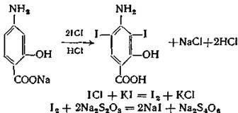
Quantitative definition.
Nitritometry with external indicator (iodine starch paper), s = 1.
Acidimetry, direct titration, s = 1.
Bromatometry, s = 1.5.
Iodochlorometry, s = ½:
Storage. In a well-sealed container that protects from light.
Application. Anti-tuberculosis drug.

Slide 17
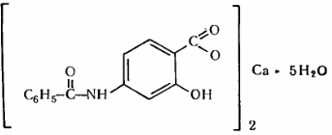
Calcium benzamidosalicylate
Mechanism of action. Close to the sodium salt of PASK.
Properties. White, sometimes with a yellowish tinge powder. Practically insoluble in water, sparingly and slowly soluble in 95% ethyl alcohol, soluble in methyl alcohol with the formation of slightly turbid solutions.
Identification.
Reaction to Ca2+ after preheating with HCl.
Medicine + FeCl3 - purple color.
Quantitative definition. Complexometry, s = 1.
Storage. In a well-sealed container that protects from light.
Application. Anti-tuberculosis drug.

Slide 18
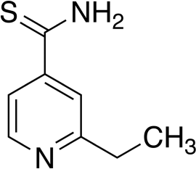
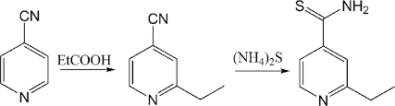
Isonicotinic acid thioamides Ethionamide
Mechanism of action. Today it is not completely known. It is generally known that ethionamide inhibits mycobacterial protein synthesis.
Synthesis.
Properties. Yellow crystalline powder with a faint or moderate odor of sulfur. Not hygroscopic, practically insoluble in water and ether, sparingly soluble in ethanol and methanol.
Identification.
IR, UV spectrum.
Medicine + NaOH, heating - the smell of ammonia, blue litmus paper.
Medicine + HCl, heating - emission of H vapors2S, determined by the blackening of the filter paper soaked in the solution (CH3COO)2Pb: H2S + (CH3COO) 2Pb=PbS + 2CH3COOH.
Quantitative definition.
Acidimetry in non-aqueous medium (glacial acetic acid), direct titration, indicator - crystalline violet, s = 1.
Application. Anti-tuberculosis drug.

Slide 19
MEDICINES FOR THE TREATMENT OF ONCOLOGICAL DISEASES CLASSIFICATION OF ANTUCOTHINAL MEDICINES
Synthetic means.
  Alkylating agents.
  Chlorethylamine derivatives.
  Ethyleneimine derivatives.
  Methanesulfonic acid derivatives.
  Derivatives of nitrosourea.
  Platinum compounds.
  Antimetabolites.
  Folic acid antagonists.
  Purine antagonists.
  Pyrimidine antagonists.
Natural remedies.
  Antitumor antibiotics.
  Antitumor agents of plant origin.
  Enzyme preparations with antitumor activity.
Hormonal drugs and their antagonists.
Immunological agents.
  Interferons.
  Interleukins.

Slide 20
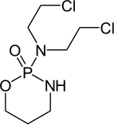
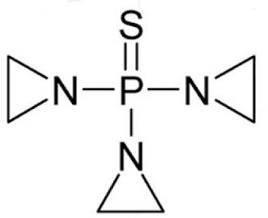
Cyclophosphamide
Thiotepa
Mechanism of action. It is based on the interaction between the alkylating metabolites C., T., and DNA. This alkylation leads to the rupture and cross-linking of DNA strands and DNA proteins.
Properties. Cyclophosphamide - white or almost white crystalline powder, easily soluble in alcohol, chloroform, sparingly soluble in ether, acetone, water.
Identification.
T. pl., IR spectrum.
Medicine + AgNO3, heating - white precipitate, soluble in NH4OH.
Medicine + H2SO4, + HNO3, heating, + (NH4)2MoO4 - yellow color.
Quantitative definition.
Argentometry (Folgard's method).
Storage. In a well-sealed container, protected from light, at a temperature not exceeding 10 C °.

Slide 21
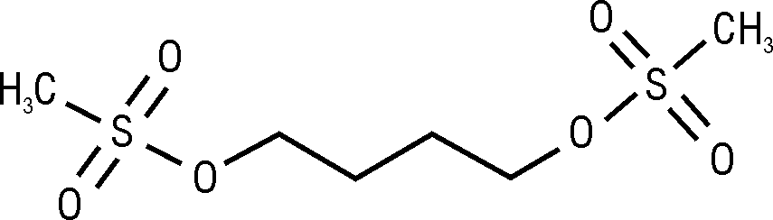
Busulfan
Mechanism of action. It consists in the action of active metabolites of B. on tumor cells, as a result of which the DNA of tumor cells is crosslinked.
Identification.
T. pl., IR spectrum, TLC.
Medicine + NaOH, heating - white gelatinous precipitate:
CH3SO2 – O– (CH2) 4 – O – SO2CH3 + 2NaOH =2CH3SO3Na + HO (CH2) 4OH.
Reaction to sulfates after mineralization:
SO42–+ Ba2+ = BaSO4
Quantitative definition.
Alkalimetry after hydrolysis, direct titration, indicator - phenolphthalein, s = ½:
CH3SO2 – O– (CH2) 4 – O – SO2CH3 + H2O=2CH3SO3H + HO (CH2) 4OH,
CH3SO3H + NaOH = CH3SO3Na + H2O.
Storage. In a well-sealed container that protects from light.
Application. Antitumor drug.

Slide 22
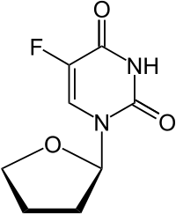
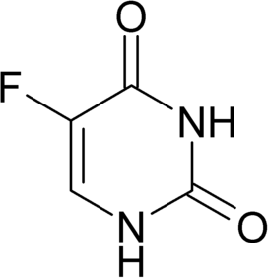
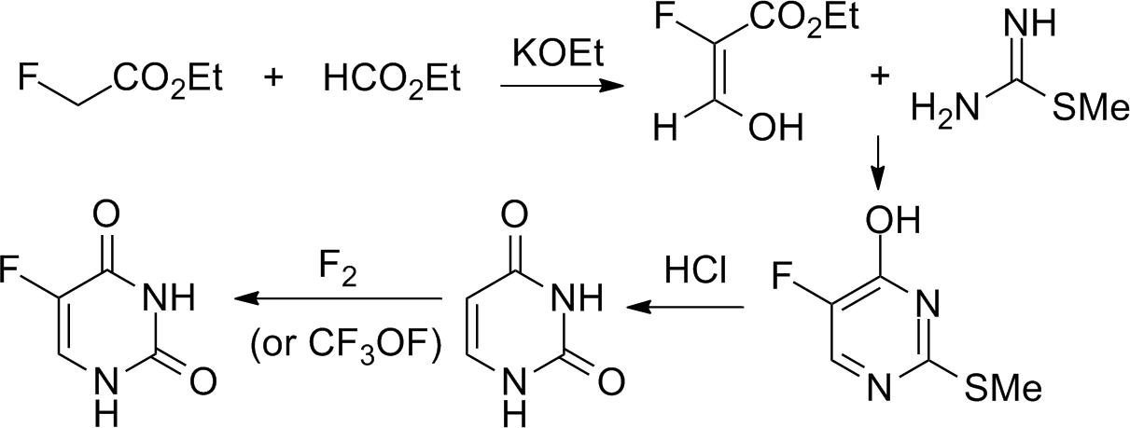
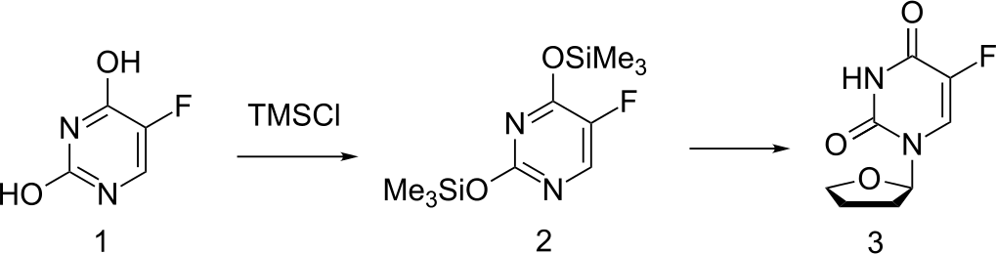
Fluorouracil
Tegafur
Mechanism of action. It consists in inhibiting the synthesis of purine nucleotides in DNA by competitive metabolism after uptake by M., F., and T. cells.
Synthesis.

Slide 23
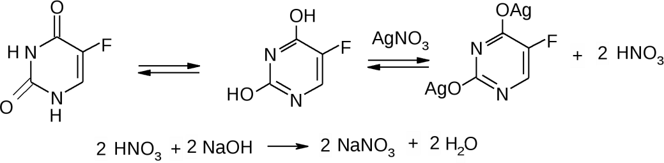
Properties. Odorless white crystalline substances. Fluorouracil is moderately soluble
in water, slightly soluble in 96% ethanol, practically insoluble in ether. Tegafur is sparingly soluble in water and ethanol.
Identification.
UV, IR spectrum, TLC.
Reactions with salts of heavy metals: medicine + AgNO3, HgCl2 - white precipitates, drugs + salts of Co (II) - purple color.
Fluoride is detected by:
after preliminary mineralization: 2F– + CaCl2 → CaF2 ↓ + 2Cl– - white opalescence.
after combustion with oxygen in the presence of hydrogen peroxide:
Fe (SCN) 3 + 6F– → [FeF6] 3– + 3SCN– - discoloration of Fe (SCN) solution3.
Quantitative definition. Fluorouracil.
Alkalimetry by substitute, indicator - phenolic red, s = ½:

Slide 24
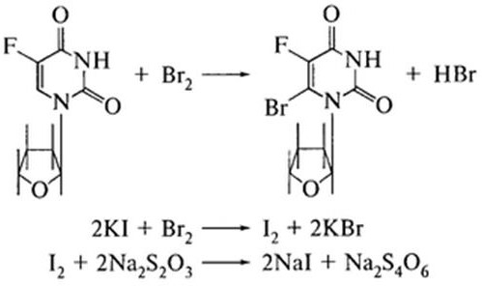
Quantitative definition. Tegafur.
Bromometry, back titration, indicator - starch, s = 3:
KBrO3 + 5KBr + 6HCl → 3Br2 + 6KCl + 3H2O.
Storage. In a well-sealed container that protects from light.
Application.Antitumor drugs.

Slide 25
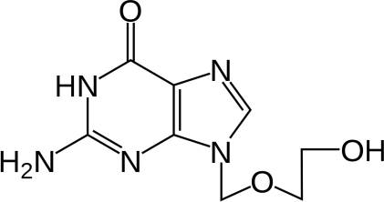
ANTI-VIRUS DRUGS
Nucleoside analogues Acyclovir
Mechanism of action. Under the action of an enzyme that is produced only in infected cells, A. is converted to the active form, acyclovir triphosphate (TFA). TFA penetrates into the infected cell and is incorporated into the DNA synthesis of the virus, thereby blocking its reproduction.
Properties.White or almost white crystalline powder, slightly soluble in water, easily soluble in DMSO, very slightly soluble in alcohol. Soluble in dilute mineral acids and alkali solutions.
Identification.
IR spectrum.
Quantitative definition.
Acidimetry method in non-aqueous medium (acetic acid anhydrous).
Storage. In a well-sealed container.
Application. Infections, caused virus Herpes simplex, herpes babies in immunodeficiency conditions, chickenpox.

Slide 26
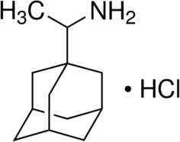
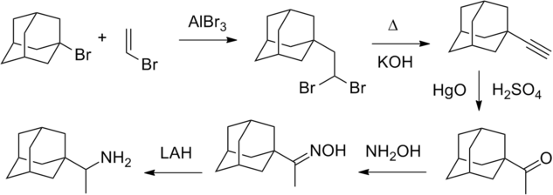
Derivatives of adamantane Remantadin
Mechanism of action. Rimantadine inhibits virus replication in the early stages of the cycle by disrupting the formation of the viral envelope.
Synthesis.
Properties. White crystalline powder, bitter in taste, very slightly soluble in water, easily soluble in chloroform, slightly soluble in alcohol.
Application. Effective against various influenza A viruses, and also has an antitoxic effect in influenza caused by type B virus.

Slide 27
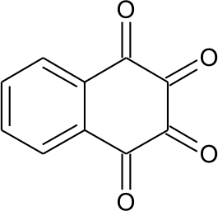
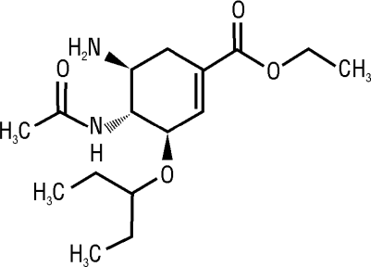
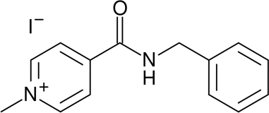
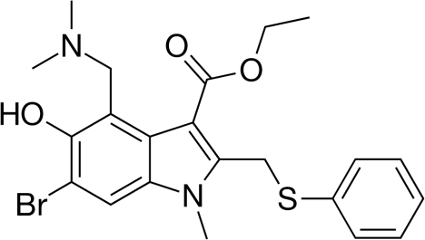
Antiviral drugs of other chemical groups
Oxolin Oseltamivir Amizon
Arbidol Oxolin

Slide 28
Mechanism of action. Has virocidal activity, blocking the binding sites of influenza virus (mostly type A2) with the surface of the cell membrane, protects cells from the penetration of the virus.
Properties. White or white with a creamy tint crystalline powder. Easily soluble in water, aqueous solutions are unstable, darken quickly in an alkaline environment.
Identification.
Drugs + 30% NaOH solution - blue color.
Application. For viral diseases of the eyes, skin, viral rhinitis and for the prevention of influenza.

Slide 29
Antimalarial drugs
The modern classification of antimalarial drugs is based on their chemical structure:
  Derivatives of 4-methanolquinoline (quinine dihydrochloride, sulfate, hydrochloride; mefloquine).
  Derivatives of 4-aminoquinoline (hingamine, hydroxychloroquine).
  Derivatives of 8-aminoquinoline (primaquine, quinocide).
  Diaminopyrimidine (chloridine).
  Derivatives of biguanide (bigumal, chlorproguanil).
  Derivatives of 9-aminoacridine (acrychine)
Antimalarial drugs differ from each other in tropism in relation to certain forms of development of Plasmodium in the human body. In this regard, there are:
gametoschizotropic drugs (affect erythrocyte schizonts) - quinine, hingamine, acridine, bigumal,chloridine;
histoschizotropic drugs (affect tissue schizonts) -
  on preerythrocyte forms - bigumal, chloridine;
  on paraerythrocytic forms - quinocide.
hamontotropic drugs (affect sexual forms) - quinocide, bigumal, chloridine, hingamine.

Slide 30
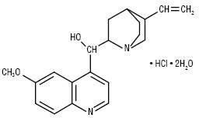
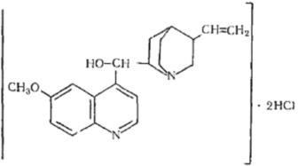
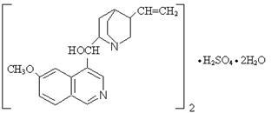
Quinine hydrochloride Quinine dihydrochloride
Quinine sulfate
Mechanism of action. May be associated with dysfunction of lysosomes and blocking the synthesis of nucleic acids in Plasmodium cells.
Properties. Quinine salts are colorless, odorless crystalline substances that are very bitter in taste. Under the influence of light gradually turn yellow. They are all left-handed isomers.
Quinine dihydrochloride is very soluble, hydrochloride is soluble, and sulfate is slightly soluble in water.

Slide 31
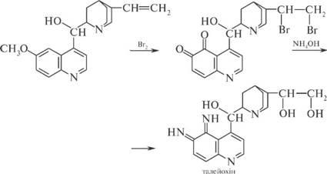



Identification.
The general reaction - thaleoquine test: to the drug solution add a few drops of bromine water and ammonia solution - there is an emerald green color:
Solutions of all salts of quinine + H2SO4 (conc.) in UV light - blue fluorescence.
Reactions on the anion: chlorides or sulfates:
Saline solution + H2SO4 + alcohol solution I2 - green crystals of hepatitis:

Slide 32
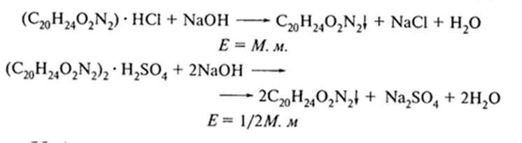
Quantitative definition.
  Gravimetric method:
Alkalimetry, in a mixture of chloroform and alcohol:
Storage. In a well-sealed container that protects from light.
Application. Antimalarial drugs that stimulate the muscles of the uterus (quinine sulfate, quinine hydrochloride).

Slide 33
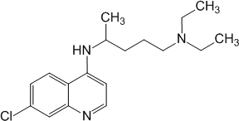
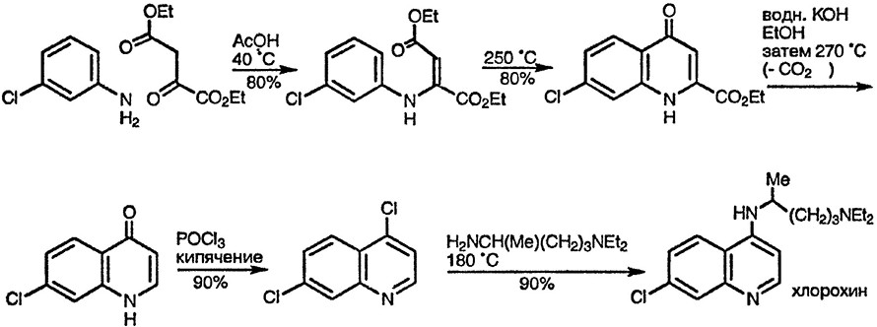
Chloroquine phosphate
Mechanism of action. The mechanism of the schizontocidal action of H. in the blood is not fully understood, but ultimately leads to a violation of the DNA synthesis of the parasite.
Synthesis

Slide 34
Properties. White or almost white crystalline powder, hygroscopic, easily soluble in water, very slightly soluble in ethanol, ether and methanol.
Identification.
IR, UV spectrum.
T. pl. picrat.
Reaction to phosphates after removal of chloroquine base by chloroform:
PO43– + AgNO3 → Ag3PO4 ↓.
Quantitative definition.
Non-aqueous acidimetry method with potentiometric fixation of equivalence point.
Storage. In a well-sealed container that protects from light.
Application. Malaria caused by drug-sensitive plasmodia. Prevention of malaria in people who visited endemic areas. Amoebiasis. Diseases of the joints, connective tissue and skin.

Slide 35
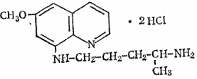
Quinocide
Mechanism of action. Disorders of parasite DNA synthesis.
Properties. Orange-yellow crystalline powder with a bitter taste. Very soluble in water, sparingly soluble in 95% alcohol, practically insoluble in ether, acetone.
Identification.
IR, UV spectrum.
Reaction to chlorides
Discoloration of bromine water and formation of dibromide derivative.
Reactions with general alkaloid reagents: Wagner, Mayer and others.
Medicine + NaOH - the formation of a precipitate of the base of the quinocide.
Quantitative definition.
Argentometry, s = 1/2.
Acidimetry in non-aqueous medium (glacial acetic acid) in the presence of mercury (II) acetateatu, direct titration, indicator - crystal violet, s = 1/2.
Acid-base titration in a two-phase medium (alcohol-chloroform mixture), indicator - phenolphthalein, s = ½:
C15H21N3O⋅2HCl + 2NaOH = C15H21N3O + 2NaCl + 2H2O, C15H21N3O + 2HCl = C15H21N3O⋅2HCl.
UV spectrophotometry.
Storage. In a well-sealed dark glass container. Antimalarial means. For warning remote relapses three-day and four-day malaria.

