Slide 1
"Antifungal drugs. Drugs for the treatment of protozoal infections. Anthelmintics. Characteristics, classification, connection between structure and action, mechanism of action, methods of production, methods of analysis, application in medicine "
LECTURE 9

Slide 2
ANTIFUNGAL MEDICINES
Antifungal drugs (Latin fungicida <fungus + cido kill) - these are drugs used to treat fungal diseases and have fungicidal and fungistatic action
Classification
By origin and chemical structure of drugs are divided into:
Antibiotics.
  Polyene series: amphotericin, nystatin, pimafucin.
  Benzofurancyclohexane derivatives: griseofulvin.
Synthetic drugs.
  Azoles.
    Imidazoles: ketoconazole (nizoral, dermatol), clotrimazole (canesten, candida) and others.
    Riazoles: fluconazole (diflucan), itraconazole (orungal).
  Allylamines: terbinafine (lamisil).
  Others: undecyl acid and its combinations (mycoseptin, thiolac, zincundan), naftifine (exoderyl), iodine preparations, boric acid, sodium bicarbonate, sodium tetraborate, dyes.
Herbal remedies: galenic preparations of walnut, elderberry, burdock.

Slide 3
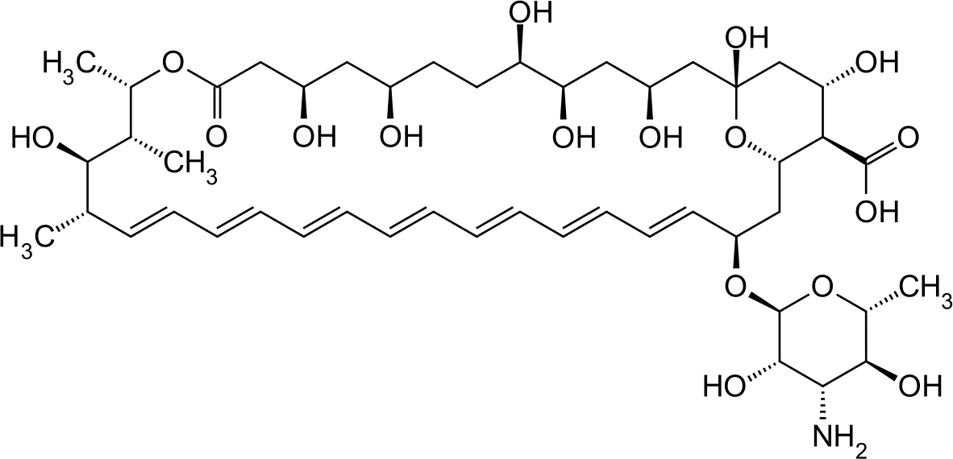
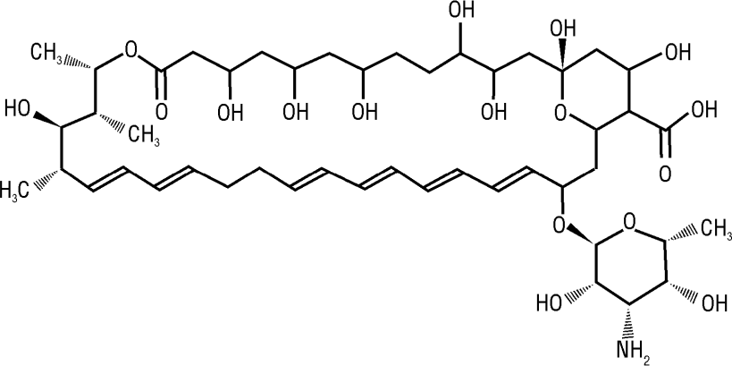
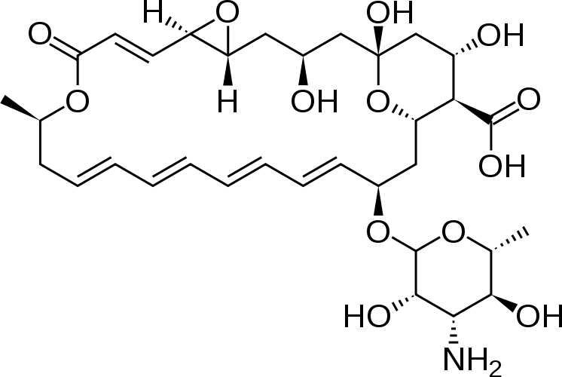
Polyene antibiotics
Amphotericin B
Nystatin
Natamycin

Slide 4
Molecules of polyene antibiotics consist of a macrocyclic aglycone (the structure of an aglycone has 6-7 double bonds and 35-40 carbon atoms) and amino sugars connected by a glycosidic bond.
Mechanism of action. Am., No., On. binds to the sterol cell membrane of fungi, as a result of which the membrane becomes unable to function as a selective barrier, which leads to the loss of major components of the cell.
Properties.
Amphotericin B - yellow or orange powder, practically insoluble in water, soluble in DMSO and propylene glycol, sparingly soluble in DMF, practically insoluble in alcohol.
Identification.
IR spectrum of the substance, UV spectrum of the solution in a mixture of DMSO / methanol.
A solution of A. in DMSO + H3PO4 - a blue ring on the border of two layers.
Quantitative definition.
Microbiological method.
Storage. In a well-sealed container in a dark place at a temperature of 2-8° C.
Application. In the treatment of potentially life-threatening fungal infections;
with systemic mycoses.

Slide 5
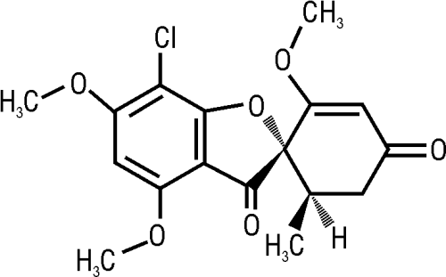
Griseofulvin
Mechanism of action. The drug binds to keratin (which is contained in nail beds, hair follicles, skin, etc.) and disrupts the synthesis of the cell wall of fungi, DNA and protein replication, and forms a complex with soluble DNA.
Properties. White or yellowish-white very fine powder, the particles of which are generally 5 μm in size, sometimes reaching a size of about 30 μm, practically insoluble in water, very soluble in DMF, sparingly soluble in ethanol and methanol.
Identification.
IR spectrum, so pl. ~ 220 ° C.
Reaction with K2Cr2Oh7 + H2SO4 (conc.) - dark red color.
Quantitative definition.
Spectrophotometry method.
Storage. In a well-sealed container that protects from light.
Application. Antifungal agent. Dermatomycoses, skin epidermophytia, nail lesions caused by pathogenic fungi.

Slide 6
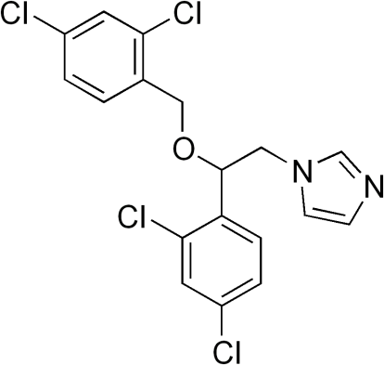
Synthetic azole preparations
Miconazole
Mechanism of action. It consists in damage to the cell membranes of fungi, disruption of lipid metabolism and permeability of the cell wall of fungi.
Properties. White powder, very soluble in water and ether, soluble in ethanol, chloroform, methanol, has a polymorphism.
Identification.
IR spectrum, so pl., TLC.
Quantitative definition. Acidimetry in non-aqueous medium (acetic non-aqueous acid, methyl ethyl ketone), indicator - naphtholbenzeine, s = 1.
Storage. In a dark place.
Application. In fungal and fungal bacterial lesions of the skin and nails, candidiasis of the vagina and gastrointestinal tract, oropharyngeal candidiasis.

Slide 7
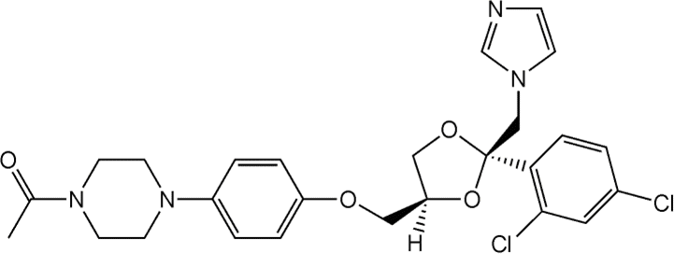
Ketoconazole
Mechanism of action. Associated with impaired biosynthesis of ergosterol, triglycerides and phospholipids required for the formation of the cell membrane of fungi.
Properties. White or almost white crystalline powder, practically insoluble in water, soluble in methylene chloride, methanol, moderately soluble in ethanol.
Identification.
IR spectrum.
Reaction with solution n-dimethylaminobenzaldene in 1 M HCl solution - purple color.
Quantitative definition. Acidimetry.
Storage. In a well-sealed container, in a dark place.
Application. With superficial and systemic mycoses.

Slide 8
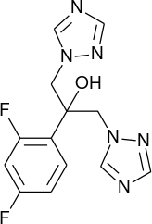
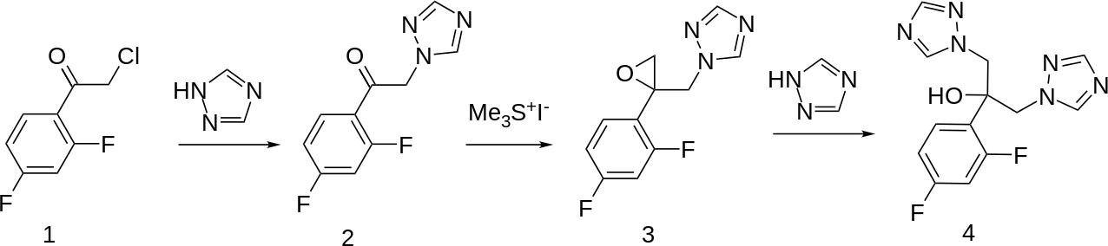
Fluconazole
Mechanism of action. Is to inhibit the synthesis of sterols in fungal cells, which leads to damage to the cell membranes of fungi.
Synthesis.
Application. Antifungal means. Cryptococcal meningitis, candidiasis, dermatomycoses.

Slide 9
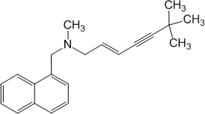

Allylamines
Terbinafine
Naftifine
Mechanism of action. It is the inhibition of sterol synthesis in fungal cells by inhibiting the enzyme squalene epoxidase, which leads to damage to fungal cell membranes.
Application. Antifungal drugs. Fungal infections of the skin and nails.

Slide 10

Undecylenic acid
Mechanism of action. Exactly not installed.
Properties. White crystalline substance or light yellow liquid with a characteristic odor, practically insoluble in water, easily soluble in alcohol, ether, essential oils, benzene.
Identification.
By refractive index at 25 ± 0.5 ° C.
Determine the temperature at which the compound crystallizes.
When heated KU with aniline an amide is formed from so pl. 66–68 ° C.
In a mixture of acids H2SO4 diluted and ice vinegar discolors KMnO solution.
Quantitative definition. Alkalimetry, indicator - phenolphthalein.
Storage. In a tightly closed non-metallic container, in a cool place protected from light.
Application. Treatment and prevention of fungal skin diseases.

Slide 11
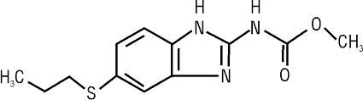
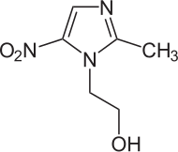
Means for the treatment of protozoal infections
Protozoan infections, or protozooses (Latin protosooses) - infections caused by parasitic protozoa.
This group includes dangerous diseases: amebiasis, malaria, trypanosomiasis, leishmaniasis.
Albendazole
Mechanism of action. The anthelmintic action of albendazole is due to inhibition of tubulin polymerization, which leads to metabolic disorders and helminth death.
Application. Antiprotozoal and anthelmintic drug with a broad spectrum of action.
Metronidazole
Mechanism of action. Is the biochemical reduction of the 5-nitro group of metronidazole. The reduced 5-nitro group of metronidazole interacts with the DNA of microorganisms, inhibiting its synthesis, which leads to the death of microorganisms.

Slide 12
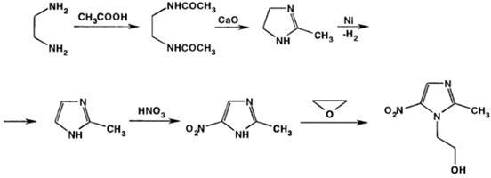
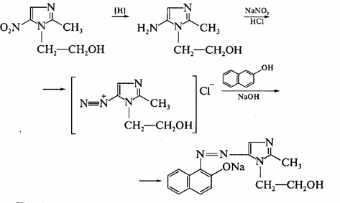
Properties. White or yellowish crystalline powder, slightly soluble in water, acetone, ethanol and methylene chloride, very insoluble in ether.
Identification.
1. IR, UV spectrum, t.pl.
2. T. pl. picrate: 148-153 ° C.
Pink color of the solution with β-naphthol.
Azo dye formation reaction after -NO reduction2 to -NH2:

Slide 13
Quantitative definition.
  Acidimetry in a non-aqueous medium, the indicator is crystalline purple, s =1.
  UV spectrophotometry.
  Photocolorimetry.
Storage. In a well-sealed container, in a dark place.
Application. Antiprotozoal drug with a broad spectrum of action.
Trichomoniasis, giardiasis, amoebic dysentery, treatment and prevention of anaerobic infections, severe mixed anaerobic and aerobic infections (in combination with an adequately selected antibiotic).

Slide 14
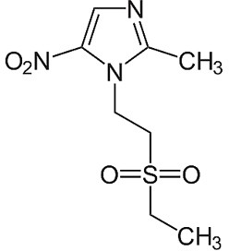
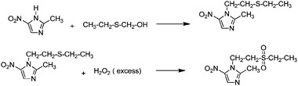
Tinidazole
Mechanism of action. Due to its significant lipophilicity, it easily penetrates into microorganisms, where it is reduced by nitroreductase and destroys bacterial DNA.
Synthesis.

Slide 15
Properties. White or bright yellow crystalline powder, insoluble in water, soluble in acetone, dichloromethane, moderately soluble in methanol.
Identification.
IR spectrum, so pl., TLC.
UV spectrum in methanol in the range λ = 220–350 nm.
The reaction of azo dye formation after reduction of -NO2 to -NH2.
Quantitative definition.
Acidimetry in Wednesday icy acetic acids (the end titration determine potentiometrically).
Storage. In a well-sealed container, in a dark place.
Application. Antiprotozoal drug. Acute and chronic trichomoniasis, giardiasis, amoebic dysentery, cutaneous leishmaniasis; treatment and prevention of anaerobic and mixed infections of any localization.

Slide 16
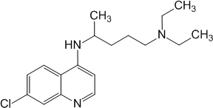
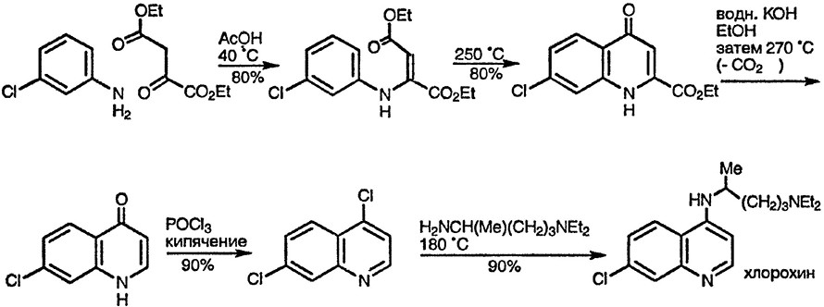
Chloroquine phosphate
2H3PO4
Mechanism of action. Associated with disruption of DNA replication in Plasmodium falciparum cells, the mechanism of action on pathogenic amoebae has not been established.
Synthesis.
Properties. White or almost white crystalline powder, hygroscopic, easily soluble in water, very insoluble in ethanol, ether and methanol.
Identification.
IR, UV spectrum. T. pl. picrat.
Reaction to phosphates after removal of chloroquine base CHCl3:
PO43–+ 3Ag + → Ag3PO4↓.
Quantitative definition. Non-aqueous acidimetry method with potentiometric fixation of equivalence point.
Storage. In a well-sealed container that protects from light. Application. Malaria caused by drug-sensitive plasmodia.
Prevention of malaria in people who visited endemic areas. Amoebiasis. Diseases of the joints, connective tissue and skin.

Slide 17

Anthelmintics
Anthelmintics (Greek anti - against + helmis, helminthos - worm, worm) - anthelmintic drugs used to treat worm infestations.
A.p. classified by the type of helminths on which the drugs act. According to this classification, there are three main groups of AP:
  drugs used in intestinal nematodes - piperazine adipinate, thiabendazole, mebendazole, levamisole,pyrantel;
  preparations, which are applied at intestinal cestodes - niclosamide, aminoacrychin, seedspumpkin;
  drugs used in extraintestinal helminthiasis - dithrazine citrate, praziquantel, chloxyl.
Mebendazole
Mechanism of action. Due to selective disruption of the activity of the microtubular system of cells of the intestinal tract of helminths, which leads to irreversible death of helminths.

Slide 18
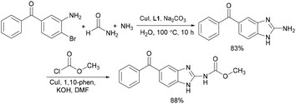
Synthesis.
Properties. White or yellowish powder, practically insoluble in water, ethanol, diethyl ether, soluble in mineral acids, easily soluble in formic acid.
Identification.
IR, UV spectrum.
Quantitative definition.
Acidimetry, titration with 0.1 M hydrochloric acid solution with potentiometric indication.
Storage. In a well-sealed container that protects from light.
Application. Anthelmintic drug with a broad spectrum of action.
Enterobiasis, ascariasis, hookworm, pagesgiloidosis, trichocephaly, trichinosis, teniosis, echinococcosis, multiple nematodes, alveococcosis, capillariosis, gnathostomosis, mixed helminthiasis

Slide 19
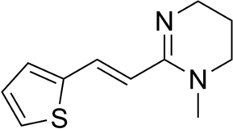
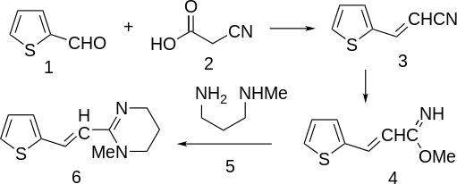
Pyrantel
Mechanism of action. Leads to neuromuscular blockade, paralyzing helminths, as a result of which they are excreted by intestinal peristalsis together with fecal masses.
Synthesis.
Application. Anthelmintic drug with a broad spectrum of action.

Slide 20
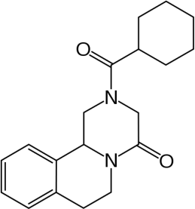
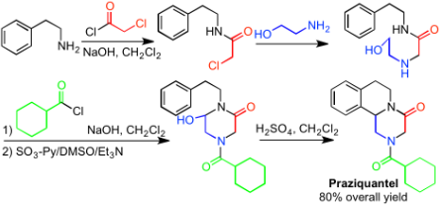
Praziquantel
Mechanism of action. It is based on the suppression of neuromuscular activity and disruption of energy metabolism of parasites, which causes paralysis and death of helminths with their subsequent removal from the gastrointestinal tract.
Synthesis.

Slide 21
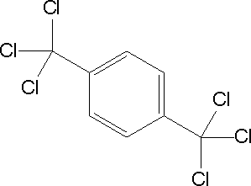
Properties. White crystalline powder, bitter on taste. Hygroscopic, easily soluble in chloroform and DMSO, soluble in ethanol, very insoluble inwater.
Application. Anthelmintic drug with a broad spectrum of action.
Treatment of infections caused by schistosomes, hepatic and pulmonary trematodes.
Hloxyl
Mechanism of action. Contributes to the destruction of the integumentary tissues of helminths.
Properties. White crystalline powder, tasteless and odorless. Practically insoluble in water, sparingly soluble in ethanol.
Application. Anthelmintic drug. Liver helminthiasis - liver disease caused by parasitic worms: opisthorchiasis, fasciolosis, clonorchosis.

