Slide 1
Lecture № 10
“Antiseptics and disinfectants. Antipediculosis and acaricides. Characteristics, classification, mechanism of action, methods of production, methods of analysis, application in medicine. "

Slide 2
ANTISEPTICS AND DISINFECTANTS
Antiseptics (Greek anti - against, septicas - rot) can lead to death or stop the growth and development of microorganisms on the surface of the human body.
Disinfectants (dės - denial, infecere - infect) neutralize pathogenic microorganisms in the environment. They are used for finishing rooms, linen, utensils, medical instruments, equipment, patient care items.
Classification
The classification of antiseptic and disinfectants is based on their chemical structure:
a group of halogens and halogen-containing compounds;
aromatic antiseptics;
aliphatic antiseptics;
group of dyes;
oxidants;
nitrofuran derivatives;
detergents;
salts of heavy metals.

Slide 3

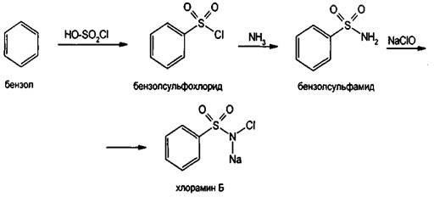
Halogens and halogen-containing agents Chloramine
Mechanism of action. Due to high oxidative properties and the ability to cause denaturation of protein.
Synthesis.
Properties. Crystalline powder white or white with a yellowish tinge.
Easily soluble in water, soluble in 96% alcohol, practically insoluble in ether.

Slide 4
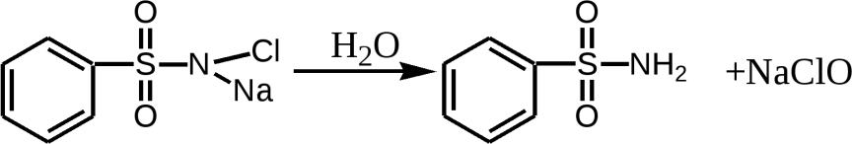
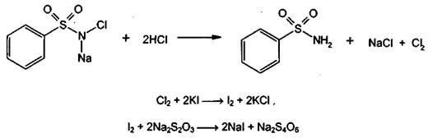
Identification.
When dissolved in water - hydrolysis:
NaClO + H2O = NaOH + HClO, 2HClO=2HCl + O2.
Chlorine decomposition reaction:
After calcination - reactions to chlorides, sulfates and sodium

Slide 5
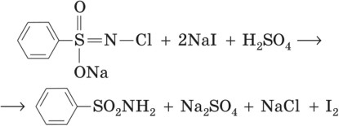
Quantitative definition.
Iodometry, direct titration by substituent, indicator - starch, s = 1/2:
HOCl + 4KI + H2SO4 = K2SO4 + 2I2 + 2KCl + 2H2O,
I2 + 2Na2S2O3 = 2NaI + Na2S4O6.
Storage. In a well-sealed container, in a dark, dry, cool place.
Application. Antiseptic. For the treatment of infected wounds, for hand disinfection (0.25-0.5% solutions), tools, care items for infectious patients (1-3% solutions).

Slide 6
Iodine I2
Mechanism of action. Reacts with oxidative - sulfide (SH) and hydroxyl (OH) - groups of amino acids that are part of the enzymes and structural proteins of microorganisms, inactivating or destroying these proteins.
Receiving. Sources - drilling water and seaweed (0.5%).
Identification.
Sublimation.
Aqueous solution of J. + starch - blue color.
Quantitative definition.
The iodine solution in KI is titrated with sodium thiosulfate, the indicator is starch, s = 1/2:
I2 + 2Na2S2O3=2NaI + Na2S4O6.
Storage. In glass jars with ground corks, in a cool, dark place.
Application. Antiseptic.

Slide 7
Iodine alcohol solution, 5%
Storage: iodine - 5.0 g; KI - 2.0 g; 96% alcohol - 41.0 g; water purifier. up to 100 ml. Properties. Transparent red-brown liquid with a characteristic odor. Identification.
LZ + starch solution - blue-blue color.
Extraction of iodine with chloroform to decolorize the aqueous layer, which is divided into two parts:
  in one determine the ion K+ by reaction with tartaric acid;
  in the second - iodide ion by the reaction:
2NaI + 2NaNO2 + H2SO4=I2 + 2NO2+ 2Na2SO4 + 2H2O.
The reaction of formation of iodoform:
C2H5OH + 4I2 + 6NaOH=CHI3+ 5NaI + HCOONa + 5H2O
Quantitative definition. Iodine content - titration of sodium thiosulfate to decolorize the solution, s = 1/2:
I2 + 2Na2S2Oh3 =2NaI + Na2S4Oh6.
Potassium iodide content - by the method of Faience:
2NaI + KI + 3AgNO3 = 3AgI + KNO3 + 2NaNO3
Storage. In dark glass cups, in a dark place.
Application. Antiseptic.

Slide 8
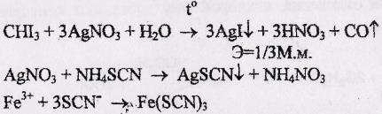
Triiodomethane, CHI3
Synthesis. Electrolysis of potassium iodide solution in the presence of sodium carbonate and ethanol:
C2H5OH + 4I2 + 3Na2CO3 = CHI3 + 5NaI + HCOONa + 2H2O + 3CO2
Properties. Lemon-yellow powder with a sharp specific odor. First melts, then decomposes with the release of violet vapors of iodine. J. solutions decompose rapidly under the action of light and air with the release of iodine.
Identification. When heated, violet vapors of iodine are released
CHI3 + 2О2 = 3I2 + CO + СО2 + H2O.
Quantitative definition. Folgard's Argentometry:
Storage. In a well-sealed container, which protects from light, in a cool place.
Application. Antiseptic.

Slide 9

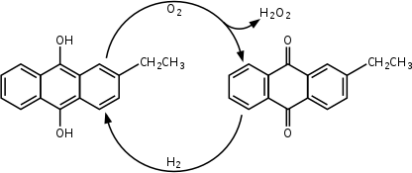
Oxidizers
Hydrogen peroxide solution 3, 30%
Mechanism of action. In cells under the influence of enzymes (peroxidase, catalase) hydrogen peroxide decomposes with the release of atomic oxygen, which exhibits antimicrobial, deodorizing, depigmenting properties.
Synthesis. The main industrial method - oxidation of anthrahydroquinone:
Properties. Colorless, clear liquid of weakly acid reaction. Decomposes in light, in interaction with oxidants, reducing agents, alkalis, iron, copper, manganese with the formation of oxygen. Miscible in all proportions with water.
Identification.
In an acidic environment decolorizes a solution of KMnO4.
Reaction of formation of superchromic acids at interaction with K2CrO4 in an acidic environmentin the presence of diethyl ether. Ether is added to remove chromium peroxides, because in an acidic environment they decompose to form chromium (III) green:

Slide 10
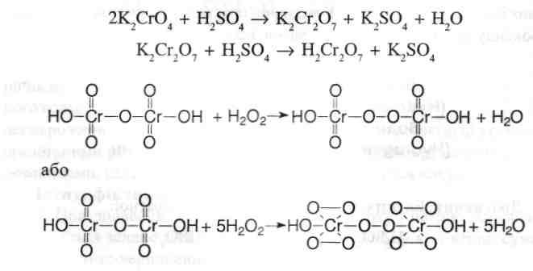
Quantitative definition. Permanganatometry without indicator, s = 2,5:
5H2O2 + 2KMnO4 + 3H2SO4 = 2MnSO4 + K2SO4 + 8H2O + 5O2.
Storage. In a place protected from light, if the substance does not contain a stabilizer, it is stored at t 15 ° C.
Application. Antiseptic, also has a hemostatic effect.

Slide 11
Potassium permanganate KMnO4
Mechanism of action. In the presence of light oxidizing organic substances (tissue components, manure), it easily breaks down oxygen and turns into manganese dioxide, which, depending on the concentration of the solution, has an astringent, irritating or cauterizing effect. The oxygen released has antimicrobial and deodorizing properties.
Synthesis.2MnO2 + 4KOH + O2 = 2K2MnO4 + 2H2O, 2K2MnO4 + Cl2=2KMnO4 + 2KCl.
Properties. Dark purple or almost black crystals, usually with a metallic luster, soluble in cold water, easily soluble in boiling water. Decomposes on interaction with certain organic substances. An explosion may occur when interacting with certain organic compounds or substances that are easily oxidized.
Identification.
Drugs + alcohol, NaOH solution - green color:
4MnO4–+ 4OH-=MnO42–+ O2­ + 2H2O.
The formation of a dark brown precipitate after boiling the solution (1):
3MnO42–+ 2H2Oh =MnO2 + 2MnO4–+ 4OH-.
LZ + hydrogen peroxide, H2SO4 (divorce) - discoloration of the solution:
2КМnО4 + 5H2AT2 + 3H2SO4=2MnSO4 + K2SO4 + 5О2­ + 8H2AT.
Quantitative definition. Iodometry, titration by substitute, indicator - starch, s = 1/5:
КМnО4 + 10KI + 8H2SO4 =2MnSO4 + 6K2SO4 + 5I2 + 8H2O. I2 + 2Na2S2O3 = 2NaI + Na2S4O6.
Storage. In a well-sealed container. Application. Antiseptic.

Slide 12
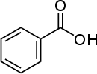
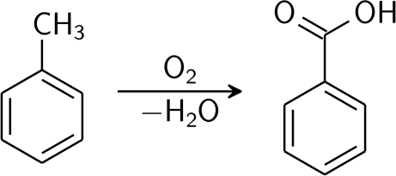
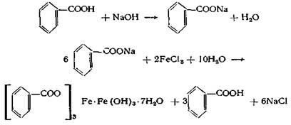
Acids and alkalis Benzoic acid
Mechanism of action. It consists in the denaturation of proteins of body cells and microbial cells.
Synthesis.
Properties. White crystalline powder. When heated, it sublimes. Slightly soluble in water, soluble in boiling water, easily soluble in 96% alcohol, ether and fatty oils.
Identification.
T. pl.
Characteristic reaction with FeCl3 - pink-yellow precipitate:

Slide 13
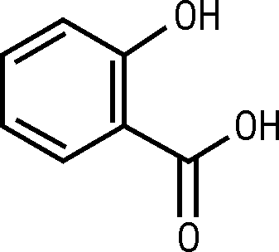
Quantitative definition.Alkalimetry in an alcohol medium, direct titration, indicator - phenolic red, s = 1:
C6H5COOH + NaOH = C6H5COONa + H2O.
Storage. In a well-sealed container.
Application. Antiseptic.
Salicylic acid

Slide 14
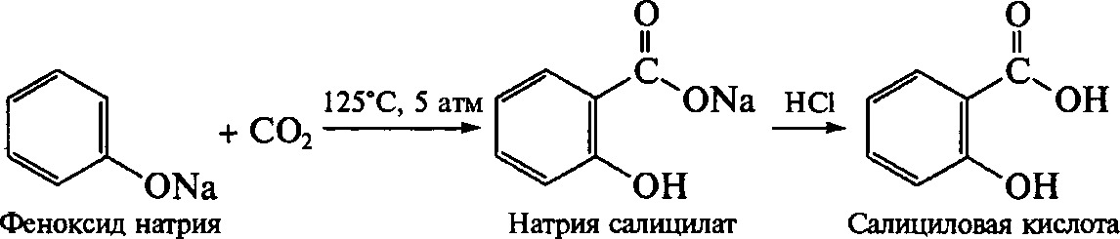
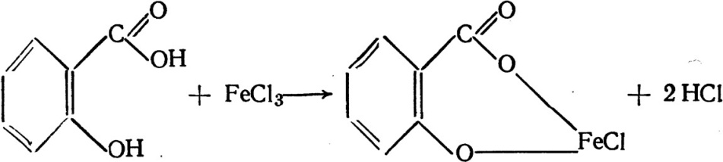
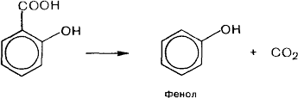
Mechanism of action. It consists in the denaturation of proteins of body cells and microbial cells.
Synthesis.
Properties. White small needle crystals or light crystalline powder, sweet and sour to taste. Poorly soluble in water, easily - in alcohol and ether.
Identification.
Reaction with FeCl3 - blue-violet color:
When heated - decarboxylation with the formation of phenol:
The reaction of formation of aurine dye with a solution of NS (O) H and H2SO4(k.).
Quantitative definition. Alkalimetry in an alcoholic medium, direct titration, indicator - phenolphthalein, s = 1.
Storage. In a well-sealed container.
Application. Antiseptic.

Slide 15
Silver nitrate AgNO3
Mechanism of action. Provides denaturation of protein, blockade of sulfhydryl groups of enzyme systems of protoplasm of microbial cells.
Synthesis.
Ag · Cu + 4HNO3 → AgNO3 + Cu (NO3)2 + NO + 2H2O.
Properties. White crystalline powder or clear colorless crystals.
Very soluble in water, soluble in 96% alcohol.
Identification.
Reactions to silver and nitrates.
Quantitative definition.
Thiocyanatometry, direct titration, indicator - iron (III) ammonium sulfate, s = 1:
AgNO3 + NH4SCN → AgSCN ↓ + NH4NO3,
3NH4SCN + FeNH4(SO4)2 → Fe (SCN)3 + 2 (NH4)2SO4.
Storage. In a well-sealed container, in a dark place.
Application. Antiseptic, cauterizing agent.

Slide 16
Zinc oxide ZnO
Mechanism of action. Causes denaturation of proteins and the formation of albuminates.
Synthesis.
Calcination of zinc feldspar:
ZnCO3 → ZnO + CO2
Annealing at 250ºС freshly precipitated basic carbonate zinc, obtained from zinc sulfate by the reaction:
5ZnSO4 + 5Na2CO3 + 3H2O → 2ZnCO3 ·3Zn (OH)2 + 5Na2SO4 + 3CO2
Properties. White or white with a yellowish tinge amorphous odorless powder, practically insoluble in water and alcohol, soluble in solutions of alkalis, diluted with mineral acids.
Identification.
When zinc is calcined, the oxide turns yellow, and when cooled, it turns white again.
The substance is dissolved in dilute hydrochloric acid:
ZnO + 2HCl → ZnCl2 + H2O
The resulting solution was diluted with water and reacted with zinc.
Non-pharmacopoeial reaction - when annealing zinc oxide from cobalt (II) nitrate, a characteristic green color is formed (Rinman's greens):
ZnO + Co (NO3)2 → CoZnO2 + 2NO2 + 1 / 2O2
Quantitative definition.
Complexometry, direct titration after dissolution of the substance in dilute acetic acid in the presence of GMT, indicator - xylenol orange, s = 1. Storage. In a sealed container. Application. Externally in the form of powders, ointments, pastes, as an astringent, desiccant and disinfectant for skin diseases.

Slide 17


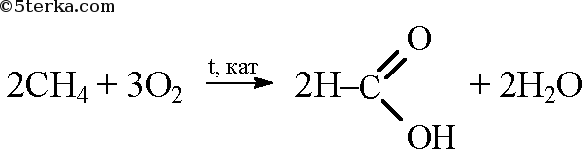
Formaldehyde aldehydes 35% solution
Mechanism actions. At penetration in cell or dispute formaldehyde easily combined with amino groups of the protein, blocks the reactive groups of the protein molecule.
Synthesis.
  Oxidation of methanol:
  Oxidation of methane by the method of Mendeleev:
Properties. Transparent colorless liquid. Miscible with water and 96% alcohol. May become cloudy during storage.
During storage, it polymerizes to form a paraform (white precipitate). To prevent polymerization, a stabilizer is added - methyl alcohol (up to 15%).

Slide 18
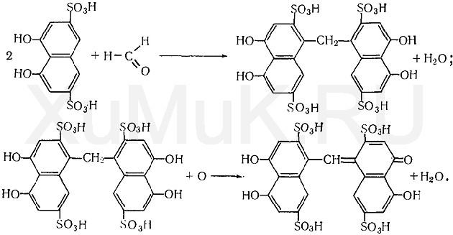
Identification.
Upon interaction with the sodium salt of chromotropic acid in the presence of concentrated sulfuric acid, a violet-blue or violet-red color is formed (aurine dye):
Intense red color is formed from phenylhydrazine hydrochloride and potassium ferricyanide solution.

Slide 19

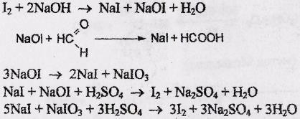
The reaction of the "silver mirror":
Non-pharmacopoeial reaction - with salicylic acid in the presence of concentrated sulfuric acid - red color
Quantitative definition.
Iodometry in alkaline medium, back titration, indicator - starch, s = 1/2:

Slide 20
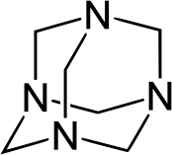
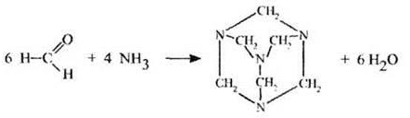


Methenamin
Mechanism of action. The mechanism of action is cleavage in an acidic environment with the release of formaldehyde, which denatures the protein structures of microbes.
Synthesis.
Properties. Colorless crystals or white crystalline powder without odor, burning and sweet, and then bitter taste. When heated, it evaporates without melting. Aqueous solutions have an alkaline reaction. Forms salts with acids. Easily soluble in water and alcohol, soluble in chloroform.
Identification.
The smell of formaldehyde after acid hydrolysis:
Upon subsequent addition of sodium hydroxide, ammonia is released:
Quantitative definition.
Acid-base back titration, indicator - methyl red, s = 1/2:
Storage. In a well-sealed container.
Application. Antiseptic, used orally and intravenously for urinary tract infections. Antidote for poisoning by salts of heavy metals.

