Slide 1
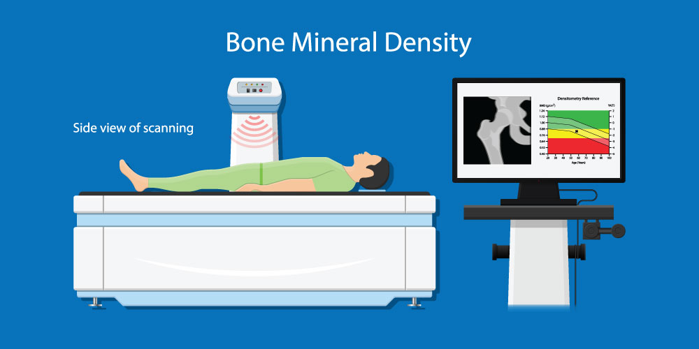
Odessa National Medical University
Faculty of international
Department of occupational pathology, functional diagnostics and phthisiopulmonogy
Instrumental diagnostic methods for assessing structural and functional changes in bone tissue and the risk of developing osteoporotic fractures.
PhD, assistant professor Tetiana Prutiian

Slide 2
Introduction
The diagnosis of osteoporosis is most difficult in the early stages of the disease.
Therefore, in recent years, more and more new diagnostic methods have appeared that help determine the risk group and early loss of tissue in various groups of the population.
One of the main determinants of the strength of bone tissue and the risk of fractures is the mineral density of bone tissue.
Today, various methods are used to measure the mineral density of bone tissue, among them: central (X-ray densitometry and quantitative computer tomography) and peripheral (X-ray absorptiometry, ultrasonic densitometry).

Slide 3
Mineral density of bone tissue
the «gold standard» for determining the mineral density of the femoral neck of the spine and the entire skeleton is X-ray densitometry.
X-ray densitometers provide the usual speed and high accuracy of measurement compared to alternative methods of research.
The mineral density of bone tissue has a number of significant advantages in predicting sharp fractures, as well as in monitoring the effectiveness of treatment aimed at preventing fractures

Slide 4
Osteoporosis criteria based on bone densitometry data (WHO, 1994)
Recommendation of the World Health Organization delicious mass divided by the degree of loss into three categories.
These categories are placed on the T-scale which belongs to the net mean squared deviated.
The value of this deviation the density of the bone tissue of a particular patient may differ from that of young healthy people.
Use these criteria here this fracture is defined in the case when the mineral density or mineral saturation of the bone tissue is painful 2.5 mean square deviations below or in a young healthy person .
If the patient can have one or more -1 and -2.5 - mineral density or saturation by 1 - 2.5 standard deviation below the average of young healthy people will diagnose low bone mass or «osteopenia».

Slide 5
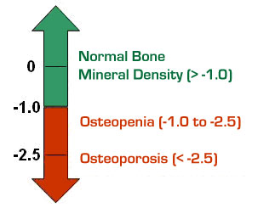
DEXA
DXA test results are scored compared
with the BMD of young, healthy people.
This results in a measure called a T-score.
The risk of fracture most often is lower in people with osteopenia than those with osteoporosis.
But, if bone loss continues, the risk of fracture increases.
DXA T-score | Bone mineral density (BMD)
Not lower than –1.0 | Normal
Between –1.0 and –2.5 | Osteopenia (mild BMD loss)
–2.5 or lower | Osteoporosis

Slide 6
Indications for measuring the mineral density bone tissue
women aged 65 years and older men aged 70 years and older
women of postmenopause periods and men aged 50-69 years recommend measurements of bone mineral density along with risk factor assessment
patients with a history of fractures are recommended to determine bone mineral density and assessment the state of the vertebral bodies to assess the degree of osteoporosis
the determination of the mineral density of bone tissue must be carried out by the X-ray densitometry with the assurance of the nearest measurement quality

Slide 7
Bone Densitometry
What is Bone Density Testing?
This is a way of measuring the amount of calcium in a certain amount of bone.
This is important because the amount
of calcium in your bone determines how strong it is.
If the bone density is very low, then you have osteoporosis and a very high risk of fracturing your bones.
A standard X-ray is not a good way to measure bone density, because you must lose about 30% of your bone mass before it can be detected this way.
The most advanced is called“Dual-energy X-ray Absorptiometry” or DXA.

Slide 8
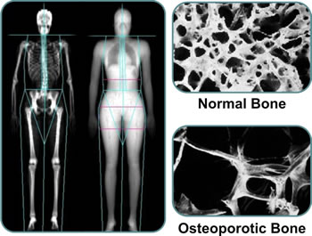
DEXA
Simple test that measures bone mineral density.
Often the measurements are at your spine and your hip, including a part of the hip called the femoral neck, at the top of the thighbone (femur).
The test is quick and painless.
It is similar to an X-ray, but uses much less radiation.
Even so, pregnant women should not have this test, to avoid any risk of harming the fetus.

Slide 9

Who needs bone densitometry?
Anyone who wants an accurate measurement
of bone density.
However, because of cost concerns, the test
is most often done for those with high risk of developing osteoporosis, or to monitor the effectiveness of treatment for osteoporosis.
Consult with your physician if you think you might benefit from knowing your bone density.

Slide 10
The categories for which bone densitometry is most often done are:
Estrogen deficient women undecided about taking hormones.
Those with spinal abnormalities or X-ray evidence of bone loss.
Anyone taking long-term corticosteroid treatment (such as Prednisone).
Primary hyperparathyroidism with no symptoms.
Monitoring of therapy for osteoporosis.

Slide 11
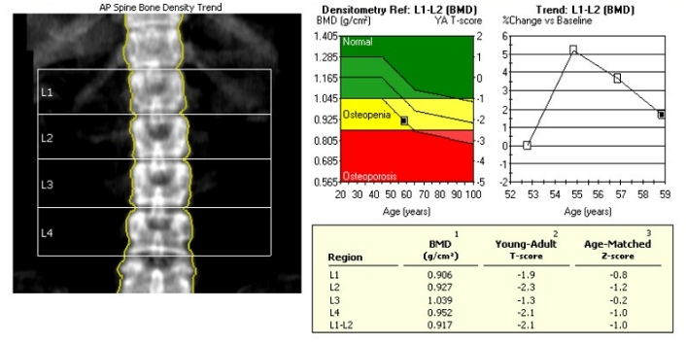

Slide 12
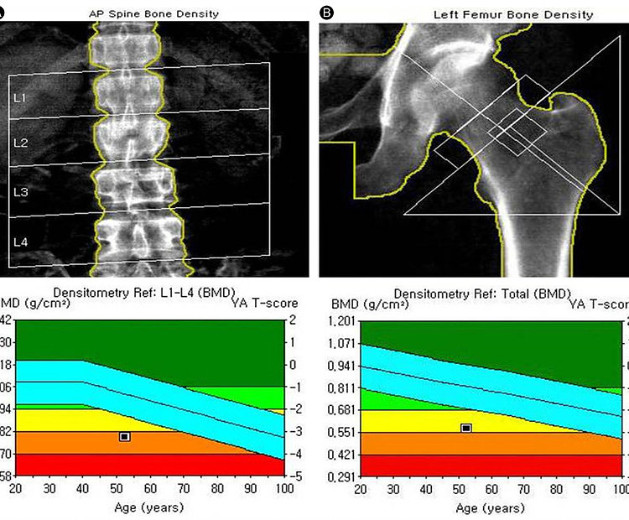

Slide 13
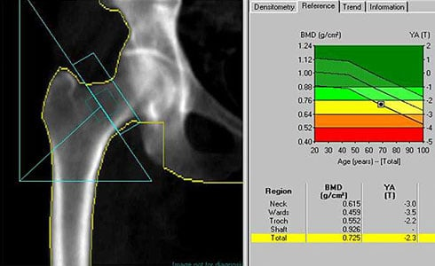

Slide 14
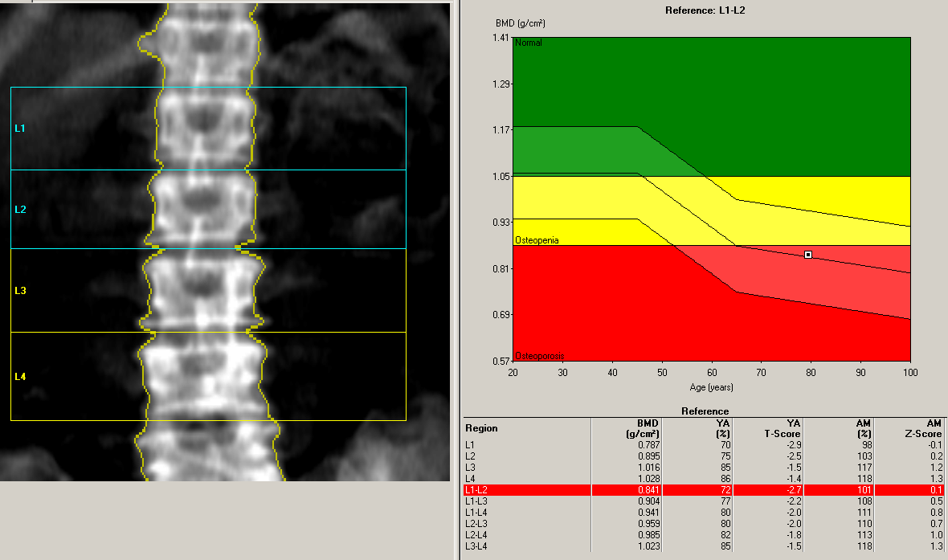

Slide 15
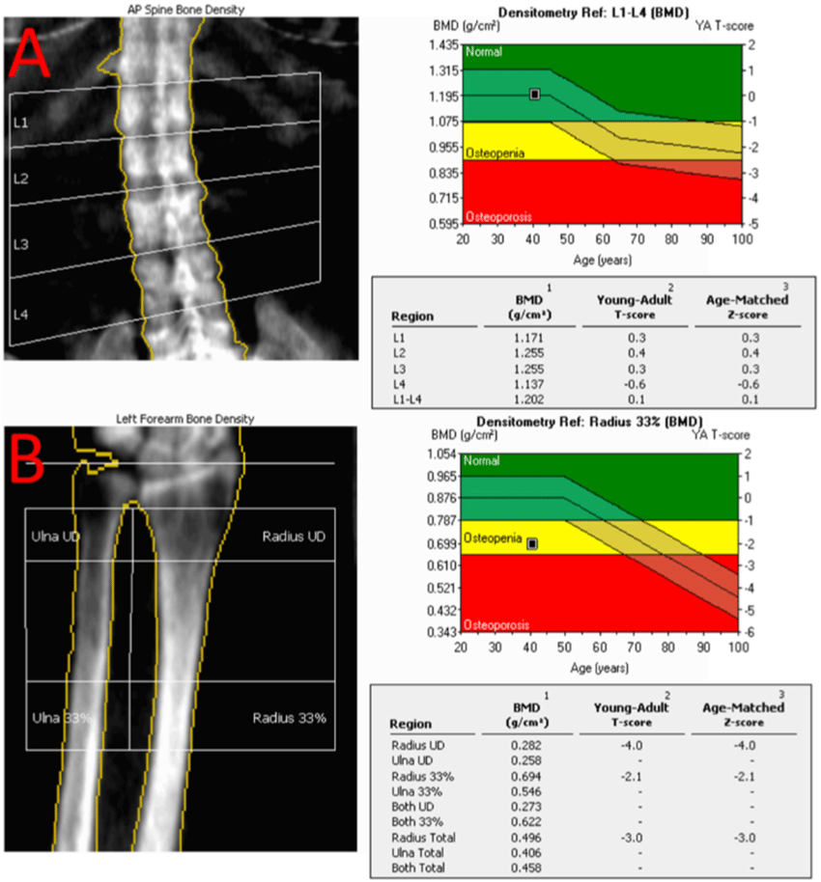

Slide 16
