Slide 1
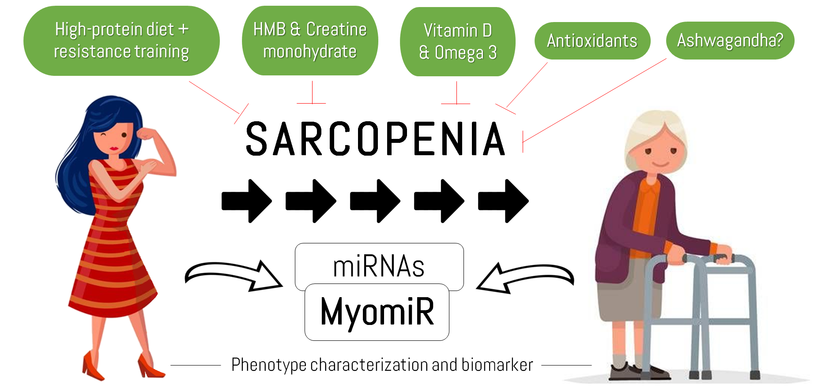
Odesa Netional Medical University
Department of occupational pathology, functional diagnostics and phthisiopulmonogy
Sarcopenia: epidemiology, mechanisms of development.
Features of the clinical course, treatment and rehabilitation of patients with sarcopenia.
PhD, Associate Professor Zahorodnaya L.I.

Slide 2
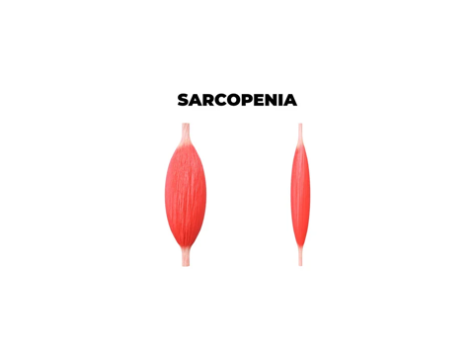
Sarcopenia is a syndrome characterized by progressive and generalized loss of skeletal muscle mass and strength and it is strictly correlated with physical disability, poor quality of life and death.
• In 1989, Rosenberg proposed the term ‘sarcopenia’ (Greek ‘sarx’ or flesh + ‘penia’ or loss)
• Although it is primarily a disease of the elderly, its development may be associated with conditions that are not exclusively seen in older persons.
• Beyond the age of 50 years, loss of leg muscle mass (1–2% per year) and loss of strength (1.5–5% per year) have been reported.
• The condition can be best understood as skeletal muscle failure or insufficiency

Slide 3
In 2016, the Centers for Disease Control and Prevention (CDC) declared sarcopenia a specific disease by creating an International Classification of Disease (ICD) 10 code for the condition.
This designation made sarcopenia a reportable disease by healthcare providers. Therefore, it increased the diagnosis and treatment of the disease.
This label helps distinguish sarcopenia from similar diseases and allows researchers to begin collecting valuable data about the condition

Slide 4
The medical definition of sarcopenia is the gradual loss of muscle mass, strength and function. The condition commonly affects the elderly population and is thought to occur due to aging. Sarcopenia can greatly impact your quality of life by reducing your ability to perform daily tasks. It can lead to the loss of your independence and the need for long-term care.
Sarcopenia affects your musculoskeletal system and is a major factor in increased frailty, falls and fractures. These conditions can lead to hospitalizations and surgeries, which increase the risk of complications including death.
Sarcopenia can also affect people with a high body mass index (BMI), in a condition called sarcopenic obesity. People with obesity and sarcopenia have a greater risk for complications than with obesity or sarcopenia alone.

Slide 5
Group on Sarcopenia in Older People (EWGSOP)
• The presence of low skeletal muscle mass and either low muscle strength (e.g., handgrip) or low muscle performance (e.g., walking speed or muscle power); when all three conditions are present, severe sarcopenia may be diagnosed. (2010).
• The ‘presarcopenia’ stage is characterized by low muscle mass without impact on muscle strength or physical performance (2010).
• In the revised guidelines, muscle strength comes to the forefront, as it is recognized that strength is better than mass in predicting adverse outcomes: 2018 operational definition of sarcopenia
• Low muscle strength (Criterion 1)
• Low muscle quantity or quality (Criterion 2)
• Low physical performance (Criterion 3)
Probable sarcopenia is identified by Criterion 1. 2.
Diagnosis is confirmed by additional documentation of Criterion 2. 3.
If Criteria 1, 2 and 3 are all met, sarcopenia is considered severe

Slide 6
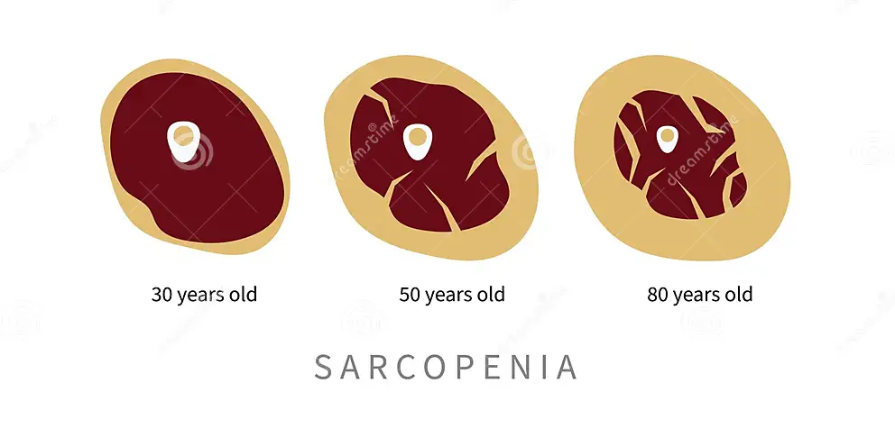
The European Society Clinical Nutrition and Metabolism Special Interest Groups (ESPEN-SIG)
• The presence of low skeletal muscle mass and low muscle strength (which they advised could be assessed by walking speed)
Replacement of muscle tissue with fat during aging.

Slide 7
The International WorkingGroup on Sarcopenia (IWGS)
• The presence of low skeletal muscle mass and low muscle function (which they advised could be assessed by walking speed) and “that [sarcopenia] is associated with muscle mass loss alone or in conjunction with increased fat mass”

Slide 8
Epidemiology
Sarcopenia most commonly affects people ages 60 and older. The rates increase with age. The disease affects both sexes equally. Studies on affected ethnicities are inconsistent. The rates of the condition increase in people with chronic disease.
Studies are inconsistent, and many people don’t receive a diagnosis or treatment for sarcopenia. But rates of the condition range from 5% to 13% in people ages 60 and older. The estimates increase to 11% to 50% in people ages 80 and older.

Slide 9
Case finding
Clinical practice Research studies
SARC-F questionnaire Ishii screening tool SARC-F questionnaire
The patient must complete a questionnaire SARC-F.

Slide 10
SARC F questionnaire
• Five-domain symptom-based questionnaire:
S — Strength.
A — Assistance with walking.
R — Rising from a chair.
C — Climbing stairs.
F — Falls.
• The total score is 10 points (with each component scoring 2)
• A score of ≥4 points is predictive of sarcopenia

Slide 11
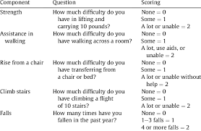

Slide 12
Ishii et al score chart
• Probability of sarcopenia estimated using a score chart composed of three variables: age, grip strength and calf circumference.
• Score in men: 0.62×(age−64)−3.09×(grip strength−50)−4.64×(calf circumference−42). – Probability in men: 1/1[1+e−(sum score/10−11.9)].
• Score in women: 0.80×(age−64)−5.09×(grip strength−34)−3.28×(calf circumference−42). – Probability in women: 1/1[1+e−(sum score/10−12.5)
• Sum score above 105 in men and 120 in women determines people having a high probability of sarcopenia

Slide 13
Skeletal muscle strength
Clinical practice
Research setting
Grip strength Chair stand test (chair rise test) 5 times sit to stand
Grip strength Chair stand test (chair rise test) 5 times sit to stand

Slide 14
Grip strength
• The Jamar dynamometer is validated and widely used for measuring grip strength, although use of other brands is being explored
• EWGSOP2 sarcopenia cut-off points for Grip strength
– <27 kg for men <16kg for women

Slide 15
Chair stand test
• The chair stand test (also called chair rise test) can be used as a proxy for strength of leg muscles (quadriceps muscle group).
• The chair stand test measures the amount of time needed for a patient to rise five times from a seated position without using his or her arms; the timed chair stand test is a variation that counts how many times a patient can rise and sit in the chair over a 30-second interval
• Since the chair stand test requires both strength and endurance, this test is a qualified but convenient measure of strength.
• EWGSOP2 sarcopenia cut-off points for Chair stand –
>15 s for five rises

Slide 16
Skeletal muscle mass or Skeletal muscle quality
Clinical practice
Research studies
Appendicular skeletal muscle mass (ASMM) by Dual-energy X-ray absorptiometry (DXA)*
Whole-body skeletal muscle mass (SMM) or ASMM predicted by Bioelectrical impedance analysis (BIA)
Lumbar muscle cross-sectional area by CT or MRI Lumbar muscle cross-sectional area by CT or MRI Muscle quality by mid-thigh or total body muscle quality by muscle biopsy, CT, MRI or Magnetic resonance Spectroscopy (MRS
Appendicular skeletal muscle mass (ASMM) by Dual-energy X-ray absorptiometry (DXA)
Whole-body SMM or ASMM by Magnetic Resonance Imaging (MRI, total body protocoI)
Mid-thigh muscle cross-sectional area by Computed Tomography (CT) or MRI
Lumbar muscle cross-sectional area by CT or MRI
Muscle quality by mid-thigh or total body muscle quality by muscle biopsy, CT, MRI or Magnetic resonance Spectroscopy (MRS

Slide 17
Muscle quantity or mass
• Muscle quantity can be reported as:
– total body Skeletal Muscle Mass (SMM)
– Appendicular Skeletal Muscle Mass (ASM)
– muscle cross-sectional area of specific muscle groups or body locations.
• There are multiple methods of adjusting the result for height or for BMI e.g. namely using height squared (ASM/height2), weight (ASM/weight) or body mass index (ASM/BMI).
• Magnetic resonance imaging (MRI) and computed tomography (CT) are considered to be gold standards for non-invasive assessment of muscle quantity/mass. cut-off points for low muscle mass are not yet well defined for these measurements.
• Dual-energy X-ray absorptiometry (DXA) is a more widely available instrument to determine muscle quantity (total body lean tissue mass or appendicular skeletal muscle mass) non-invasively, but different DXA instrument brands do not give consistent results.
• Bioelectrical impedance analysis (BIA), more study is necessary to validate prediction equations for specific populations

Slide 18
EWGSOP2 sarcopenia cut-off points for low muscle quantity
• ASM – <20 kg for men <15 kg for women
• ASM/height2 – <7.0 kg/m2 for men <5.5 kg/m2 for women

Slide 19
Calf circumference
• Although anthropometry is sometimes used to reflect nutritional status in older adults, it is not a good measure of muscle mass.
• Calf circumference has been shown to predict performance and survival in older people (cut-off point <31 cm).
• As such, calf circumference measures may be used as a diagnostic proxy for older adults in settings where no other muscle mass diagnostic methods are available

Slide 20
Physical performance
Clinical practice
Research studies
Gait speed
Short physical performance battery (SPPB)
Timed-up-and-go test (TUG)
400-meter walk or long-distance corridor walk (400-m walk)
Gait speed
Short physical performance battery (SPPB)
Timed-up-and-go test (TUG)
400-meter walk or long-distance corridor walk (400-m walk)

Slide 21
• Physical performance defined as an objectively measured whole-body function related to locomotion.
• This is a multidimensional concept that not only involves muscles but also central and peripheral nervous function, including balance.
• Gait speed: a single cut-off speed ≤0.8 m/s is advised by EWGSOP2 as an indicator of severe sarcopenia. • The SPPB is a composite test that includes assessment of gait speed, a balance test, and a chair stand test. The maximum score is 12 points, and a score of ≤ 8 points indicates poor physical performance.
• TUG ≥20 s
• The 400-m walk test assesses walking ability and endurance. For this test, participants are asked to complete 20 laps of 20 m, each lap as fast as possible, and are allowed up to two rest stops during the test. Non-completion or ≥6 min for completion is considered sarcopenia

Slide 22
The current EWGSOP recommendations focus on European populations and use of normative references (healthy young adults) whenever possible, with cut-off points usually set at −2 standard deviations compared to the mean reference value.
• In specific circumstances, use of −2.5 standard deviations for more conservative diagnosis

Slide 23
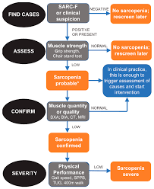
ALGORITHM
FOR SARCOPENIA DETECTION

Slide 24
Classification
Primary and secondary sarcopenia
• Sarcopenia is considered ‘primary’ (or age-related) when no other specific cause is evident
• sarcopenia is considered ‘secondary’ when causal factors other than (or in addition to) ageing are evident.
• Sarcopenia can occur secondary to a systemic disease, especially one that may invoke inflammatory processes, e.g. malignancy or organ failure.
• Physical inactivity also contributes to development of sarcopenia, whether due to a sedentary lifestyle or to disease-related immobility or disability.
• sarcopenia can develop as a result of inadequate intake of energy or protein, which may be due to anorexia, malabsorption, limited access to healthy foods or limited ability to eat

Slide 25
Acute and chronic sarcopenia
• Sarcopenia that has lasted less than 6 months is considered an acute condition,
• Sarcopenia lasting ≥6 months is considered a chronic condition.
• Acute sarcopenia is usually related to an acute illness or injury, while chronic sarcopenia is likely to be associated with chronic and progressive conditions and increases the risk of mortality.
• This distinction is intended to underscore the need to conduct periodic sarcopenia assessments in individuals who may be at risk for sarcopenia in order to determine how quickly the condition is developing or worsening.

Slide 26
Sarcopenic obesity
• Reduced lean body mass in the context of excess adiposity.
• Obesity exacerbates sarcopenia, increases the infiltration of fat into muscle, lowers physical function and increases risk of mortality

Slide 27
Malnutrition-associated sarcopenia
• Low muscle mass has recently been proposed as part of the definition of malnutrition.
• Also in malnutrition, low fat mass is usually present, which is not necessarily the case in sarcopenia.
• low dietary intake (starvation, inability to eat), reduced nutrient bioavailability (e.g. with diarrhea, vomiting) or high nutrient requirements (e.g. with inflammatory diseases such as cancer or organ failure with cachexia

Slide 28
Frailty
• The physical phenotype of frailty, described by Fried and co-workers shows significant overlap with sarcopenia; low grip strength and slow gait speed are characteristic of both.
• Weight loss, another diagnostic criterion for frailty, is also a major etiologic factor for sarcopenia.
• Treatment options for physical frailty and for sarcopenia likewise overlap—provision of optimal protein intake, supplementation of vitamin D, and physical exercise.
• Taken together, frailty and sarcopenia are still distinct—one a geriatric syndrome and the other a disease. While sarcopenia is a contributor to the development of physical frailty, the syndrome of frailty represents a much broader concept.

Slide 29
Causes of sarcopenia
Mitochondria dysfunction and sarcopenia
Muscle, being the largest organ in the body, is mainly made up of highly contractile and energy-dependent myocytes. To carry out its contractile function, muscle cells receive neurotransmitters such as acetylcholine and dopamine from motor neurons at the motor plates. It is well established that both the muscle and neurons are high energy consuming cells which are greatly addicted to adenosine triphosphate (ATP) supply for them to function and are hence highly dependent on the proper functioning of mitochondria, the powerhouse and ATP supply organelle of the cell.

Slide 30
As age takes toll, mitochondria dysfunction in the muscle started to occur resulting in an increase in levels of apoptosis and reduced capabilities for muscle regeneration that were commonly observed in sarcopenic patients . In addition to the muscular changes, age-related mitochondria deregulation also results in motor neuronal cell death , that ultimately resulted in innervation impairment and an ~27% reduction in the motor unit pool that possibly accounts for the muscular atrophy and loss in muscular contractile force in sarcopenic aged humans and rodents.
The mitochondria are double membrane bound organelles that contain their own genetic material, the mitochondria DNA (mtDNA) and produces ATP through the electron transport chain process which consists of a series of oxphos reactions . The oxphos reactions in mitochondria produces high levels of ROS which are damaging for mtDNA, creating mutations, and deletion in them . Hence, mitochondria fission and fusion are in place to maintain mitochondria homeostasis in the cell. Mitochondria fusion and fission are two different processes with fusion being to process that mitigates stress by mixing contents of partially damaged mitochondria as a form of complementation while the latter being the process necessary to create new mitochondria and contribute to quality control of mitochondria via removal of damaged mitochondria.

Slide 31
However, as age progresses, mitochondria homeostasis is no longer maintained due to numerous processes, namely the building up of ROS which can be attributed to the reduction in antioxidant enzyme levels in both muscle and neuron cells . This accumulation of ROS results in mtDNA deletion or mutation causing mitochondrial dysfunction. To further add on to the already dire situation, mitophagy–proteosome–induced mitochondria clearance function also deteriorates with age . As the number of damaged mitochondria accumulates, not only does the mitochondria not able to produce sufficient ATP to sustain cellular function in muscle and neurons, there will also not be enough normal functional mitochondria to act as complementary partners for mitochondria fusion to take place to restore mitochondria homeostasis. These events ultimately lead to damaged mitochondria membrane potential and leakage of mitochondria content to the cell cytosol that initiates apoptosis in both muscle and neurons, leading to muscular atrophy and muscle dennervation in sarcopenia .

Slide 32
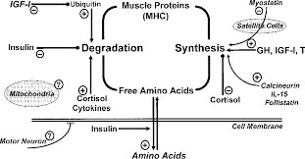
Skeletal muscle protein turnover is a complex regulated process

Slide 33
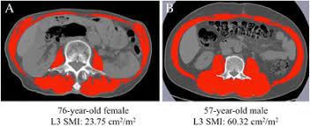
ALTERNATIVE OR NEW TESTS AND TOOLS
Lumbar 3rd vertebra imaging by computed tomography
• CT images of a specific lumbar vertebral landmark (L3) correlated significantly with whole-body muscle.
• Quantification of lumbar L3 cross-sectional area has also been done by MRI.

Slide 34
Mid-thigh imaging (by MRI or CT)
• Mid-thigh muscle area is more strongly correlated with total body muscle volume than are lumbar muscle areas L1–L5.
• it is a good predictor of whole-body skeletal muscle mass and very sensitive to change.
Psoas muscle measurement with computed tomography
• CT-based measurement of the psoas muscle has also been reported as simple and predictive of morbidities in certain conditions (cirrhosis, colorectal surgery)
• However, because psoas is a minor muscle, other experts argue that it is not representative of overall sarcopenia

Slide 35
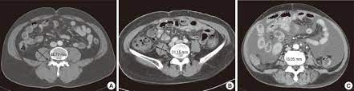

Slide 36
Muscle quality measurement
• Micro- and macroscopic changes in muscle architecture and composition, and to muscle function delivered per unit of muscle mass.
• the term muscle quality has been applied to ratios of muscle strength to appendicular skeletal muscle mass or muscle volume.
• there is no universal consensus on assessment methods for routine clinical practice.
• CT and MRI can determine infiltration of fat into muscle and using the attenuation of the muscle.
• muscle quality has been assessed by BIA-derived phase angle measurement

Slide 37
Ultrasound assessment of muscle
• It is reliable and valid
• Assessment of pennate muscles such as the quadriceps femoris can detect a decrease in muscle thickness and cross-sectional area within a relatively short period of time, thus suggesting potential for use of this tool in clinical practice.
• ultrasound has the advantage of being able to assess both muscle quantity and quality.
• The EuGMS sarcopenia group recently proposed a consensus protocol for using ultrasound in muscle assessment, including measurement of:
– muscle thickness
– cross-sectional area
– fascicle length
– pennation angle
– Echogenicity: it reflects muscle quality, since non-contractile tissue associated with myosteatosis shows hyper-echogenicity.

Slide 38
Creatine dilution test
• The excretion rate of creatinine is a promising proxy measure for estimating whole-body muscle mass.
• an oral tracer dose of deuterium-labelled creatine (D3-creatine) is ingested by a fasting patient; labelled and unlabelled creatine and creatinine in urine are later measured using liquid chromatography and tandem mass spectrometry.
• Total body creatine pool size and muscle mass are calculated from D3-creatinine enrichment in urine.
• Creatine dilution test results correlate well with MRI-based measures of muscle mass and modestly with measures from BIA and DXA

Slide 39
Risk Factors
• Genetic and lifestyle factors operating across the life course.
• age, gender and level of physical activity are major risk factors.

Slide 40
Frequent underlying causes of sarcopenia
Nutritional
• Low protein intake
• Low energy intake
• Micronutrient deficiency
• Malabsorption and other gastrointestinal conditions
• Anorexia (ageing, oral problems)
Associated with inactivity
• Bed rest, immobility, deconditioning
• Low activity, sedentary lifestyle
Disease
• Bone and joint diseases
• Cardiorespiratory disorders including chronic heart failure and chronic obstructive pulmonary disease
• Metabolic disorders (particularly diabetes)
• Endocrine diseases (particularly androgen deprivation)
• Neurological disorders
• Cancer
• Liver and kidney disorders
Iatrogenic
• Hospital admission
• Drug-related

Slide 41
Pathophysiology of sarcopenia
The factors leading to sarcopenia are multifactorial:
Disuse coupled with aging is the major underlying cause
Poor blood flow to muscle, especially the muscle capillaries due to a decline in nitric oxide production.
damage to the mitochondrial membrane permeability pore and apoptosis
The age-related loss of motor neuron end plates is a major component of sarcopenia
physiological anorexia of aging that leads to weight loss. Weight loss results in a 75% loss of fat and a 25 % loss of muscle and bone. Only a very small amount of muscle is regained when a person gains weight. The increase of fat during weight regain is one of the major causes of sarcopenic obesity.
Loss of anabolic hormones, such as testosterone, DHEA, growth hormone, and insulin-growth factor 1
Insulin resistance, which occurs with aging and obesity, plays an important role in decreasing available glucose and protein for muscle anabolism
increase in proinflammatory cytokines (e.g., interleukin-6, interleukin-1, and tumor necrosis factor alpha). These lead to protein catabolism through the activation of NFkB

Slide 42
Differential diagnosis
• The three main conditions in the differential diagnosis of sarcopenia are malnutrition, cachexia, and frailty
Sarcopenia is a type of muscle atrophy that specifically affects people as they grow older. Muscle atrophy is the loss of muscle tissue. The two conditions share common features of muscle loss, but the processes behind them are different. A decrease in the size and number of your muscle fibers causes sarcopenia. With muscle atrophy, there’s a reduction in the size of the fibers, but the amount of fibers stays the same.
Everyone experiences some amount of muscle loss as they age. But with sarcopenia, this muscle loss happens faster. The good news is, there are ways to treat and even reverse the effects of the condition. If you’ve experienced muscle weakness, loss of endurance or any other symptoms of sarcopenia, call your healthcare provider. They can diagnose the condition and develop a treatment plan for you to revert the muscle loss and improve your condition.

Slide 43
BIOMARKERS
• Both tissues and blood biomarkers
• Blood biomarkers includes markers of:
– the neuromuscular junction
– muscle protein turnover
– behaviour-mediated pathways
– inflammation-mediated pathways
– Growth factors
– redox-related factors
– hormones
– anabolic factors

Slide 44
• Histology still represents the gold standard for the recognition of the pathophysiological mechanisms of different sarcopenic syndromes; however, biopsy samples are often unavailable for ethical reasons and not agreeable to elderly patients.
Cellular changes in sarcopenic muscle include:
reduction in the size and number of myofibres, which particularly affects type II fibres.
intramuscular and intermuscular fat infiltration (myosteatosis)
a decreased number of type II fibre satellite cells.
Altered mitochondrial integrity in myocytes

Slide 45
BLOOD BIOMARKERS
Neuromuscular junctions
• One of the most investigated mechanisms involved in the pathogenesis of sarcopenia is the impairment of the neurophysiological functions, which seem to be associated to a dysfunction of neuromuscular junctions due to increased proteolytic cleavage of agrin (protein synthesized by motor neurons that seems to activate the receptor tyrosine kinase muscle-specific (MuSK), that stabilizes the acetylcholine receptor (AChR)).
• Neurotrypsin, a protease of synaptic origin, would cleave agrin, producing a C-terminal agrin fragment.(CAF)
• some studies have shown, that CAF circulating levels are much higher in sarcopenic than in non-sarcopenic subjects

Slide 46
Endocrine system
Sarcopenia is characterized by a variable decline of several hormones:
sex hormones (e.g. testosterone and dehydroepiandrosterone (DHEA)
growth hormones (e.g. growth hormone (GH) and Insulin-like growth factor 1 (IGF-1).
NB: the development of sarcopenia may be provoked by thyroid pathologies. However, although women with subclinical hypothyroidism had a higher prevalence of sarcopenia, it was shown that TSH levels were not associated with muscle mass, strength or quality

Slide 47
Growth factor
One of the theories about the onset of sarcopenia refers to an imbalance between muscle cells growth enhancer and suppressor factors, in favor of the latter.
Myostatin overexpression leads to severe atrophy (but controversial results)
2. Activin A and B: 100 fold more effective in causing muscular wasting, compared to myostatin.
3. Growth Differentiation Factor-15:a suppressor of muscle growth potentially involved in sarcopenia
Tumor Growth Factor β (TGFβ)
Brain-Derived Neurotrophic Factor (BDNF)
Follistatin (FST) is considered the main inhibitor of myostatin in the process of muscle wasting.
Iristin
Bone morphogenic protein

Slide 48
Muscle protein turnover
• An early sign of sarcopenic damage would be detected by early structural alterations of the muscle:
Decreased serum creatinine level
Decreased N-terminal type III procollagenase
Increased 3-methylhistidine
Increased Skeletal muscle-specific isoform of troponin T

Slide 49
Inflammation-mediated pathways
• It is well known that the adipose tissue, whose relative percentage often increases in association with sarcopenia, secretes a huge number of pro- inflammatory cytokines, such as interleukins (IL-6, IL-1) and tumor necrosis factor alpha (TNF-alpha), all found to be related to aging processes and, accordingly, to sarcopenia.
• Butyryl-cholinesterase: marker of chronic inflammation and malnutrition, is linearly related with grip strength and muscular mass in elderly subjects.

Slide 50
Redox-related factors
• Oxidized low-density lipoprotein (oxLDL), markers of lipoprotein peroxidation and protein carbonyls, and therefore, markers of oxidative damage, are associated with mobility limitation and grip strength decrease in older persons.
• antioxidant substances, like carotenoids and vitamin C, and circulating levels of alpha- and gamma-tocopherol seem to be inversely correlated with sarcopenia determinants
Behavior-mediated pathways
• Behavioral factors, such as the degree of physical activity, nutritional status and obesity are very important in the onset of sarcopenia

Slide 51
Consequences of sarcopenia
• Physical disability
• Poor endurance
• Falls
• Frailty
• Hospitalization
• Institutionalization
• Morbidity
• Poor QoL
• Mortality
Changes in body composition • lean body mass is lost while fat mass may be preserved or even increased. • The loss in muscle mass may be associated with increased body fat so that despite normal weight there is marked weakness (sarcopenic obesity)

Slide 52
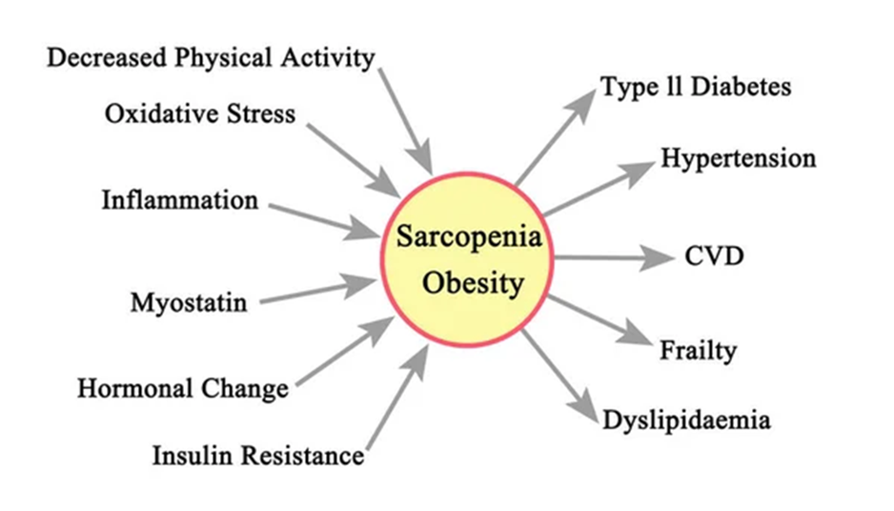
Changes in body composition
• lean body mass is lost while fat mass may be preserved or even increased.
• The loss in muscle mass may be associated with increased body fat so that despite normal weight there is marked weakness (sarcopenic obesity)

Slide 53
THERAPY
physical activity is the primary treatment of sarcopenia (also prevention). – Resistance exercise improves skeletal muscle strength and mass – Aerobic exercise may also show some benefit
Nutritional interventions combined with exercise:
• adequate intake of protein
• vitamin D,
• antioxidant nutrients
• long-chain polyunsaturated fatty acids
3. No specific drugs have been approved for the treatment of sarcopenia however many drugs were considered for potential benefits: vitamin D (only if <50 nmole) , combined oestrogen-progesterone, dehydroepiandrosterone, growth hormone, growth hormone-releasing hormone, combined testosterone-growth hormone, insulin- like growth factor-1, pioglitazone, testosterone (in hypogonadism), and angiotensin-converting enzyme inhibitors

Slide 54
Clinical trials
• Antibodies that modulate myostatin and the activin II receptor are in clinical trials
• Ghrelin agonists, which increase food intake and release growth hormone, are also under evaluation

Slide 55
Resistance Training (RT)
With an adequate training stimulus, older men and women show similar or greater strength gains compared with young individuals as a result of resistance training.
2-3 fold increases in muscle strength can be accomplished in a relatively short period of time (3-4 months) in fibres recruited during training in this age population, resulting from marked increases in fibre diameter. RT is, therefore, an effective way to increase tissue energy requirements and decrease body fat mass and, crucially, to maintain metabolically active muscle mass in healthy older people.
KEY QUESTION: How should older adults strength train?

Slide 56
RECOMMENDATIONS
large muscle rhythmic aerobic forms of exercise that can be easily integrated into most older adults' lives:
- Walking, running, swimming, and cycling
- Low-intensity sports/activities, e.g. boules, golf, t’ai chi chuan, gardening
- RT using small dumbbells, or stationary machines
Maximizing both the quality and quantity of life in older adults is best accomplished by incorporating these activities into an individual's habitual lifestyle. O ACSM guidelines recommend light- to-moderate-intensity lifestyle physical activities to optimize health. O In addition to increased muscle mass, moderate or high-intensity exercise can elicit adaptations in the CV system and in CV disease risk factors.
Initiation and maintenance of long-term light-to-moderate-intensity physical activity programs in older adults may reduce the rate of age-associated deterioration in numerous physiological functions

Slide 57
Prevention
You may not be able to completely prevent sarcopenia since the condition happens as part of the natural aging process. But you can take steps to slow the progression of the disease. These include:
Make healthy food choices: Maintain a healthy diet that includes high-quality proteins. Aim for 20 to 35 grams of protein in each meal.
Exercise: Maintain a physically active lifestyle that includes exercises such as resistance training.
Routine physicals: See your healthcare provider regularly, and let them know about any changes in your health.

