Slide 1
Herpes virus type 3
Varicella-Zoster
Мd Gerasimenko o.a.
ONMedU
Department of Infectious Diseases

Slide 2
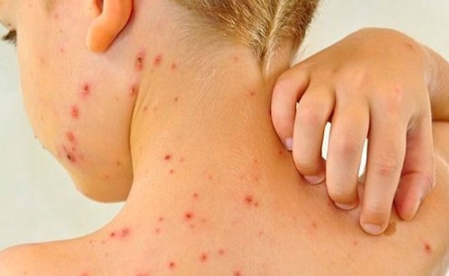
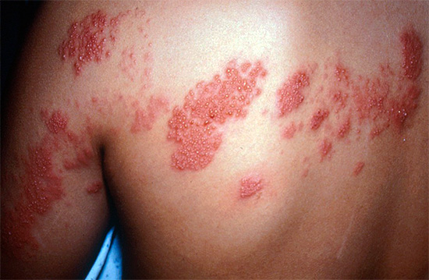
Herpes virus type 3 causes two types of lesions - chicken pox ( varicella ) and shingles ( zoster ). The primary infection proceeds like chicken pox, and its recurrences — like ringworm.

Slide 3
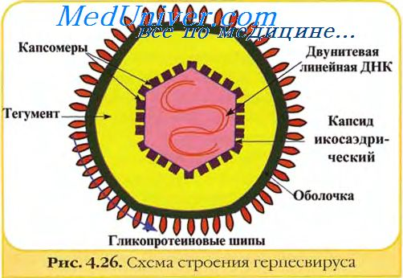
The herpes virus type 3 was discovered by the Brazilian doctor E. Aragao (1911).

Slide 4
Epidemiology of chicken pox and shingles
80-90% of the adult population of the Earth have a history of chickenpox. The incidence of shingles does not exceed 10% in persons who have contracted chickenpox.
Reservoir of the Varicella-Zoster virus - a sick person, the virus is transmitted by airborne and contact (through a vesicle that separates) way.

Slide 5
Pathogenesis of lesions in chicken pox and shingles
The Varicella-Zoster virus initially multiplies in the mucosal epithelium of the upper respiratory tract, and then disseminates through the lymph and blood flow to the skin. Reproduction of the virus in the cells of the spinous layer leads to their ballooning degeneration ( Tsanka cells ). In the nuclei of the affected cells, eosinophilic bodies of inclusions ( Lipschütz bodies ) are formed.
Infection with the virus usually occurs in childhood - at this age, the disease takes the form of chickenpox. After recovery, the virus remains in the body forever, localizing in the processes of the trigeminal nerve.
Shingles develops as a result of reactivation of the virus in sensitive nodes of persons who have contracted chickenpox. Triggering mechanisms of reactivation are associated with immune disorders.

Slide 6
SYMPTOMS OF HERPES ZOSTER
Shingles and chickenpox have an acute onset. Severe pain occurs in the area of the nerve affected by the disease, which lasts for 3-12 days (the term depends on how badly the nerve is affected). Overheating, bending the limbs and even touching the skin can increase painful sensations. Primary symptoms include a significant or slight increase in temperature.

Slide 7
HERPES ZOSTER: EXTERNAL MANIFESTATIONS
Making a diagnosis is much easier after the appearance of external manifestations of the disease, usually they appear a few days after the onset of pain.
The skin and mucous membranes in the affected areas become swollen and reddened.
After that, groups of bubbles (vesicles) filled with liquid appear on the surface of the skin. It is not recommended to open the blisters in any case - this can lead to infection.
The transparent liquid inside the bubbles gradually becomes cloudy, the bubbles themselves burst, and crusts form in their place.
The disease lasts for 1-3 weeks. As a rule, after the appearance of skin rashes, the pain decreases or disappears completely, but in some cases it is possible to preserve them for several years - especially when ganglionitis or ganglioneuritis occurs .

Slide 8
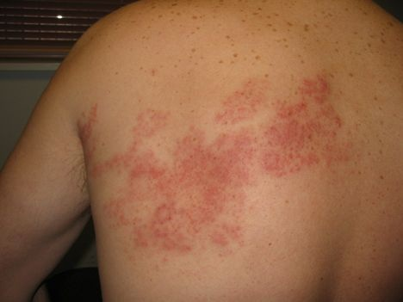

Slide 9
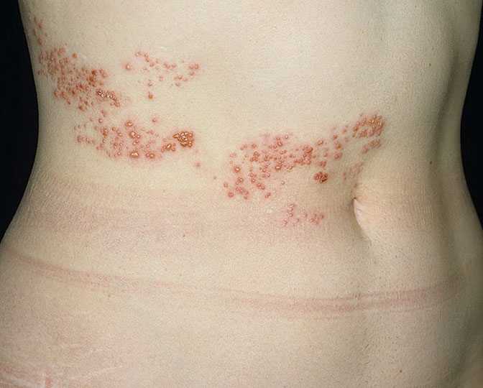

Slide 10
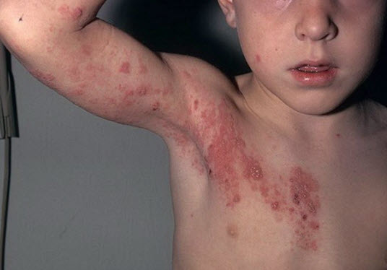

Slide 11
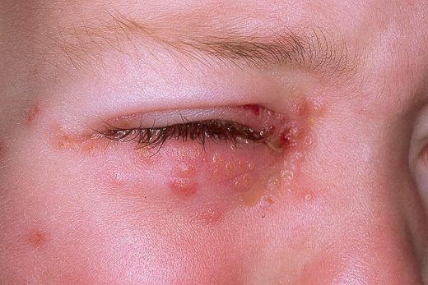

Slide 12
Treatment
Treatment of herpes type 3 pursues several main goals:
stimulate the healing process of the skin;
prevent the development of complications (visceral, from the side of the central nervous system, etc.);
prevent the spread of herpes infection inside the body (especially in patients with reduced immune status); reduce manifestations of pain syndrome in the acute phase;

Slide 13
Antiviral therapy for herpes zoster
The main method of treatment with herpes zoster, as with other herpesvirus infections, there is the use of antiviral drugs. With this disease, it is recommended to start taking antiviral drugs no later than 72 hours after the appearance of the rash - this allows you to reduce the duration of the pain syndrome and often helps prevent the development of postherpetic neuralgia.
Patients with normal immunity are usually prescribed 1000 mg of acyclovir or 500 mg of famciclovir per day during the week. In patients with immunodeficiency states, the dosage and duration of treatment may be increased.
In addition to the mentioned drugs, the following are also used in the treatment of herpes zoster on the body: Brivudine 125 mg 4 times/day for children at the rate of 5 mg. per kg three times a day for 5 days. Valaciclovir 1 gr. 3 somewhere a day for 10 days.

Slide 14
Additional therapy
To eliminate the pain syndrome, reduce intoxication and eliminate other unpleasant symptoms and phenomena accompanying herpes zoster, other methods are used:
Immunotherapy
Taking interferon and its inducers allows you to stimulate the body's defenses, thereby accelerating the recovery process and preventing the generalization of the infection.
Pain relievers
Herpes zoster is often accompanied by severe pain, so the use of paracetamol, ibuprofen, diclofenac and other pain relievers is of great importance.

Slide 15
Anticonvulsants
Gabapentin , pregabalin , carbamazepine and others. They help relieve muscle spasms.
Antidepressants
Tricyclic antidepressants and selective serotonin reuptake inhibitors have an analgesic effect and help correct the psychological state of the patient.
Physiotherapy methods
Magnetolaserotherapy, transcutaneous electronic neurostimulation, hyperbaric oxygenation, reflexology - various methods of physiotherapy are used to eliminate pain syndrome, accelerate regeneration processes and strengthen the body.

Slide 16
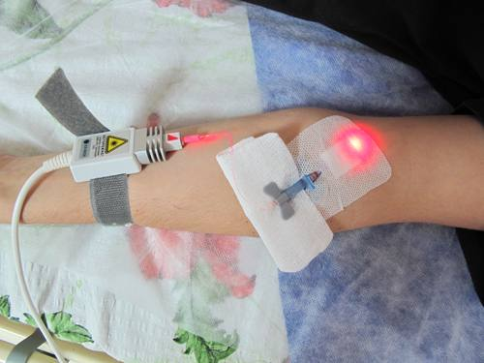
Laser irradiation of blood in the treatment of herpes virus infection
Laser irradiation of blood (photohemotherapy, intravascular laser irradiation of blood, VLOK) is a method of efferent therapy (extracorporeal detoxification), which is dosed irradiation of blood with low-intensity therapeutic lasers.

Slide 17
The main factors of the therapeutic effect are considered to be:
antiseptic (bactericidal) action
correction of cellular and humoral immunity
increase in non-specific resistance of the body
stimulation of regenerative (healing) processes
anti-inflammatory action
in addition to the factors listed above, some additional ones appear:
improving the rheological properties of blood ("flowability")
vasodilator effect
increasing the oxygen transport function of the blood
normalization of the acid-base state (KOS) of the blood
normalization of blood proteolytic activity
increasing the antioxidant activity of the blood
stimulation of erythroposis
detoxification action
anti-allergic action

Slide 18
Indications for laser irradiation of blood are very large. The main ones are listed below :
acute and chronic inflammatory processes of various localization
sepsis
endo- and exotoxicosis (poisoning)
bypassing diseases of the arteries
acute and chronic thrombophlebitis
chronic ischemic heart disease
inflammatory (infectious) complications after operations and injuries
immunodeficiency states
autoimmune diseases
allergic diseases (especially bronchial asthma)
acute and chronic pancreatitis
some skin diseases (dermatoses, psoriasis, neurodermatitis, acne , furunculosis)
diabetes
polycystic ovaries
burn disease
trophic ulcers
some infectious diseases (viral hepatitis, herpes , candidiasis )

