Slide 1

Herpesvirus infections

Slide 2
Herpesviruses
Herpesviridae family refers to DNA-things that persist in the host's body for life.
Widespread in the human population - from 30 to 90% and cause various diseases.

Slide 3
Dissemination
All life on planet Earth is sick, except for mushrooms and some types of algae.
More than 80 types of herpes viruses are known.
Out of 80 types of herpes, only 9 can cause disease in humans.
The two most common are types I and II ( orofacial and urogenital). However, herpes viruses of type I can cause lesions of the genitals and vice versa.
95% of the inhabitants of the planet Earth are infected with herpes virus type I.

Slide 4
Herpesviruses do not always destroy the affected cells.
Herpes viruses of types I and II persist in the cells of the paravertebral sensory ganglia of the SR. For CMV, the "reservoir" of persistence in the body is the salivary glands.
Under the influence of the "trigger factor", HSV is activated and moves from the ganglion along the axon of the peripheral nerve to the epithelial cells, where it replicates ( viremia ).

Slide 5
Forms of herpes simplex, taking into account the prevalence of the process:
localized;
common;
generalized .

Slide 6
Clinical classification
I. Mucocutaneous herpes:
herpetic gingivostomatitis ;
herpes labialis et nasalis ;
herpetic lesions of the skin;
herpetic panaritium;
herpetic eczema;
herpetic eye disease;
genital herpes;
herpetic infection of the pelvic organs (proctitis, ureteritis , cystitis, etc.).

Slide 7
Clinical classification
II. Herpetic lesion of the nervous system:
encephalitis;
aseptic meningitis;
autonomous radiculopathy .
III. Visceral herpes infection:
esophagitis;
pneumonia;
hepatitis;
other defeats.
IV. Generalized herpes: Herpes of newborns .
Herpes in HIV-infected patients and patients with immunodeficiency of other genesis.

Slide 8
Primary herpes:
Herpetic gingivostomatitis .
Primary labial herpes.
Primary genital herpes.
Primary anal herpes.
Herpes of wrestlers (skin).
Primary herpes of the brushes.
Primary herpes of newborns.
Kaposi's primary herpetic eczema .
MA. Samgin and A.A. Haldin (2000)

Slide 9
Recurrent herpes:
Typical form (herpes of the face, genitals, buttocks, hands, etc.).
Atypical forms: pruritic (neurotic), erythematous , papular.
Kaposi's recurrent herpetic eczema .
Herpes simplex against the background of severe accompanying pathologies: erosive-ulcerative , generalized .

Slide 10
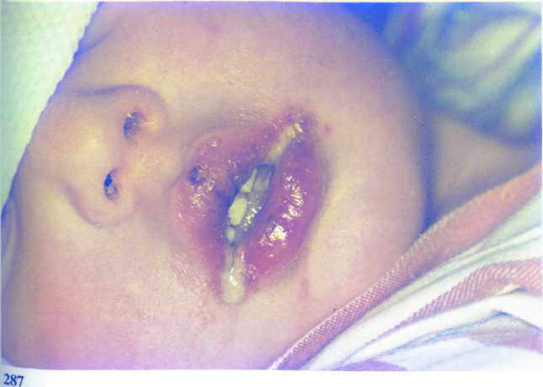
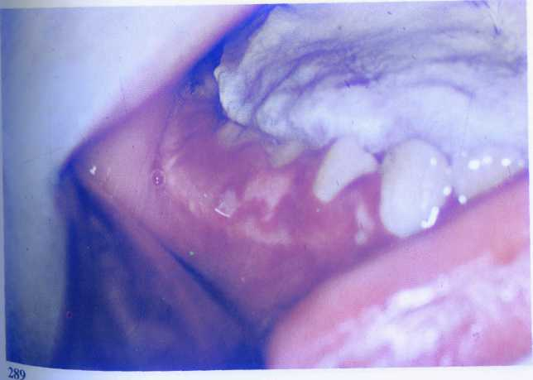
Gingivostomatitis

Slide 11
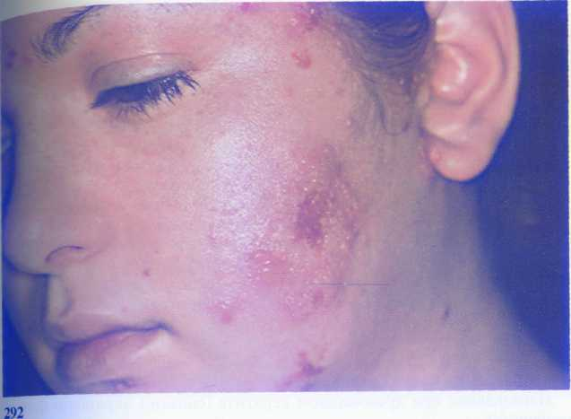
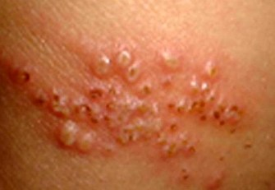
Primary herpes of the skin

Slide 12
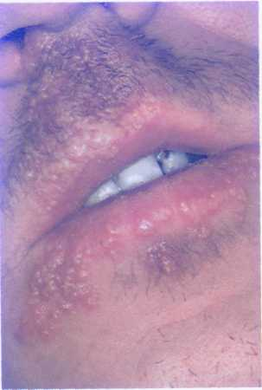
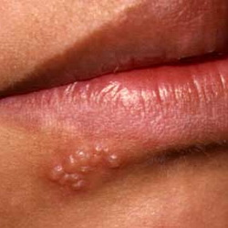
Labial herpes.

Slide 13
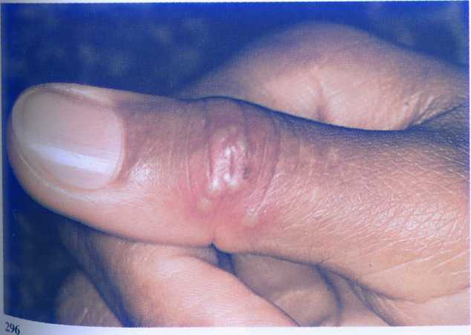
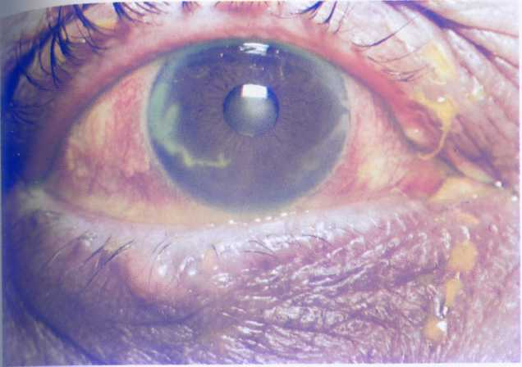
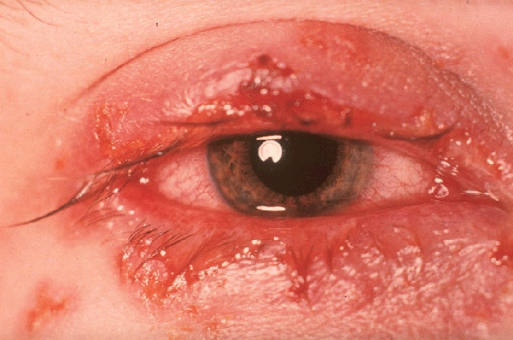
Herpetic panaritium
Ophthalmoherpes

Slide 14
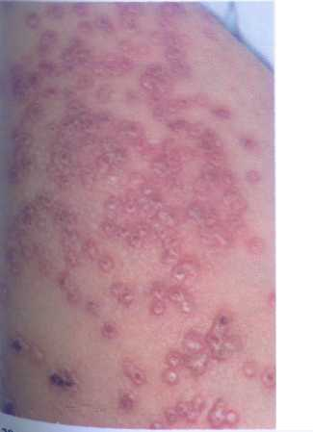
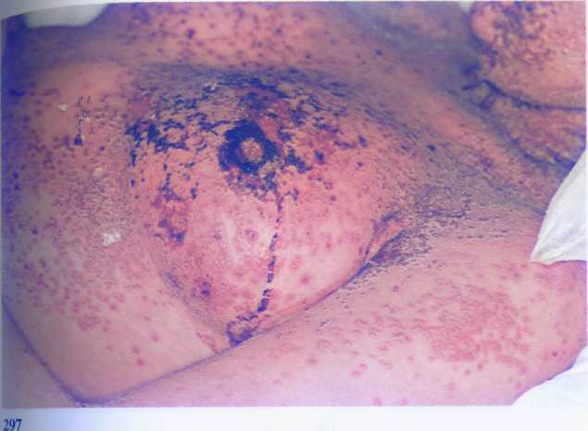
Herpetic eczema

Slide 15
Laboratory diagnosis of infections caused by HSV-1, HSV-2 types
Blood serum antibodies - IgM , IgG by ELISA method, a primary test for chronic carriage or activation of the infection is required.
DNA in blood serum by PCR reveals viremia .
DNA of the virus in the urine by the PCR method reveals viruria .
Cytomorphological method in smears-prints from erosions - intracellular inclusions.
Histological examination in HSV reveals giant, rounded multinucleated cells with specific intranuclear inclusions.

Slide 16
CMVI

Slide 17
Etiology
The causative agent is a DNA-genomic virus of the genus Cytomegalovirus subfamily Vetaherpesvirinae family Herpesviridae . 3 strains of the virus are known: Davis , AD-169 and Kerr .
Slow reproduction of the virus in the cell is possible without its damage.
The virus is inactivated by heating and freezing, and is well stored at room temperature. It is stored for a long time at -90 °C, it is relatively stable at pH 5.0-9.0 and quickly breaks down at pH 3.0.

Slide 18
Epidemiology
The reservoir and source of infection is a person with an acute or latent form of the disease. The virus can be in various biological secretions: saliva secreted by the nasopharynx, tears, urine, feces, seminal fluid, cervical secretions.

Slide 19
Mechanisms and ways of transmission
Airborne, contact (direct and indirect - through household items) and transplacental .
It is possible to become sexually infected with a transplant of internal organs (kidneys or heart) and transfusion of blood from an infected donor.
Intranatal infection of the child is observed much more often transplacentally . The most dangerous for the fetus is infection of the mother in the first trimester of pregnancy.
In such situations, the frequency of intrauterine development disorders is the highest.

Slide 20
Pathogenesis
The gates of infection can be mucous membranes of the upper respiratory tract, gastrointestinal tract, or genital organs.
The virus enters the blood; short-term viremia ends with localization of the pathogen in leukocytes and mononuclear phagocytes.
Infected cells increase in size ( cytomegaly ), acquire a typical morphology with nuclear inclusions, which represent an accumulation of the virus. The formation of cytomegalic cells is accompanied by interstitial lymphohistiocytic infiltration, the development of nodular infiltrates, calcifications and fibrosis in various organs, iron-like structures in the brain.

Slide 21
Pathogenesis
to persist for a long time and latently in organs rich in lymphoid tissue.
Can suppress cell immunity by direct action on T-lymphocytes.
In various immunodeficiency conditions, primarily in cases of cellular immunity, reactivation of the pathogen and its hematogenous generalization with damage to almost all organs and systems are possible.
the epitheliotropic nature of the virus is of great importance . It is especially pronounced in relation to the epithelium of the salivary glands, which under the influence of the virus turns into cytomegalic cells.

Slide 22
clinical picture
Among the various variants of the course of CMVI, subclinical forms and latent virus-carrying prevail .
Clinically expressed infection occurs in conditions of reduced immune response of the body.
According to one of the classifications, congenital CMV infection in acute and chronic forms and acquired CMV infection in latent, acute mononucleosis or generalized forms are distinguished.

Slide 23
Acquired CMV infection .
  In adults and older children, it mostly proceeds latently in the form of asymptomatic carriage or subclinical form with a chronic course.
  Acute form of acquired CMVI. Often it may not have exact clinical symptoms, sometimes the main clinical manifestations are similar to flu, infectious mononucleosis or viral hepatitis.

Slide 24
Laboratory diagnosis of CMV
Cytoscopy of saliva and urine.
Blood serum antibodies - IgM , IgG by ELISA method, a primary test for chronic carriage or activation of the infection is required.
Avidity - terms of infection
DNA in blood serum by PCR reveals viremia .
DNA of the virus in the urine by the PCR method reveals viruria .
Histological examination of CMV shows giant, rounded cells with a nucleus occupying almost the entire cytoplasm, enlarged due to homogeneous inclusion.

Slide 25
In case of primary CMV infection, IgM is detected , in case of reactivation of the process, both IgM and IgG are detected .
With congenital CMV infection, IgM titers decrease rapidly, they may be absent already in the second year of a child's life.
Virological methods (isolation of the virus on the culture of human fibroblasts, determination of the antigen of the virus in the research material using monoclonal antibodies) have not become widespread in clinical practice due to complexity.

Slide 26
Diseases are caused by HVL of type VI

Slide 27
herpesvirus type VI was isolated in 1986 from leukocytes of six patients suffering from various lymphoproliferative diseases.
The virus shows a tropism for T-lymphocytes.
HHV type 6 is widespread. Two subtypes of the virus have been described - 6A and 6B, which differ genetically.
Infants are often infected with human herpesvirus when maternal antibodies disappear from the blood.

Slide 28
The transmission mechanisms of HHF 6 have not been sufficiently studied
The virus persists in blood, urine, respiratory secretions, and saliva.
Post-transplantation seroconversion in 45% of organ and tissue recipients

Slide 29
Clinic
Diseases associated with primary acute HCV 6 infection include: chronic fatigue syndrome ( myalgic encephalomyelitis ); sudden exanthema in newborns and older children, infectious mononucleosis in adolescents and adults, not related to EBV infection ; histiocytic necrotic lymphadenitis
Diseases associated with persistent HCV 6 infection include: lymphoproliferative (immunodeficiency, lymphadenopathy , polyclonal lymphoproliferation ); malignant lymphomas ( non-Hodgkin lymphoma , peripheral T-cell leukemia, B-cell lymphoma , Hodgkin's disease .

Slide 30
Sudden rash ( pseudorubella )
The main manifestation of primary infection in children aged 3 months to 3 years.
The incubation period of the disease is 5-15 days.
Fever (38.5-40 °C) for 3-5 days, intoxication, lymphadenopathy with an increase in cervical and occipital lymph nodes, sometimes with enanthema in the form of a small maculo-papular rash on the soft palate and uvula (Nagayama spots ) of the conjunctiva eyelid, rash
The development of the rash is mainly associated with HHF 6V
Sometimes during the febrile period, phenomena of serous meningitis or meningoencephalitis (HCV 6A?) with a benign course are observed.

Slide 31
Exanthema occurs when the temperature drops.
Rashes usually immediately appear on the trunk, with further spread to the neck, face, upper and lower limbs.
Eruptions of a roseolous , macular or maculo-papular nature, pink in color, up to 2 mm in diameter, pale when pressed, rarely coalesce, are not accompanied by itching.
Elements of the rash persist for several hours or for 1-3 days, disappear, sometimes an exanthema in the form of erythema is noted .

Slide 32
Diagnostics
IFA
PCR
Antibodies are absent in the acute phase of the disease and begin to be determined mainly on the 6-8th day after the onset of the disease.
Ig M-antibodies are released on the 5th day of fever and are detected within 2-3 weeks. IgG - antibodies appear on the 7th day, reaching a maximum after 2-3 weeks, and persist for a long time.

Slide 33
Diseases caused by HVL VII

Slide 34
Chronic fatigue syndrome (CFS)
Herpesvirus infection, characterized by unexplained general weakness, fatigue, increased anxiety, depression, sleep disturbance, increased irritability in the morning, low-grade fever for 6 months, lymphadenopathy .
Affects people of working age 25-50 years

Slide 35
Viruses are present in: saliva, blood, breast milk, SMR, genital secretions.
Pathogenetic theories:
Suppression of the immune system (decrease in the number of immunoglobulins, activity of CD4, NK, increase in activity of CD8c).
Neuroendocrine regulation (reduction in the activity of the hypothalamic-pituitary-adrenal system).
Autonomic dysfunction

Slide 36
For 6 or more months, 4 or more of the following symptoms are simultaneously noted:
impaired memory or concentration;
pharyngitis;
soreness of cervical or axillary lymph nodes;
muscle pain;
pain in several joints;
occurrence of headache;
sleep that does not bring rest;
general malaise after physical exertion.

Slide 37
Laboratory diagnosis of herpes virus type VII is quite difficult.
Enzyme immunoassay (ELISA) for antibodies ( IgG ) and polymerase chain reaction (PCR) for detection of viral DNA are most often used to determine this infectious agent.

Slide 38
Treatment of herpes infection
Only patients with manifest forms of herpes infection are subject to treatment.
In those cases when hospitalization is necessary ( generalized herpes, severe herpes gingivostomatitis or vaginal herpes) patients should be placed in a separate ward, taking into account the ease of spreading the infection.

Slide 39
Etiotropic therapy
Acyclovir ( zovirax , geviran , herpevir , medaxon ) orally 200 mg 5 times a day for 5-10 days. In case of damage to the central nervous system (meningitis, encephalitis) 20-30 mg/kg per day intravenously .
Valacyclovir ( Valtrex , Valavir ) orally 500 mg 2 times a day for 5-10 days.
Famciclovir ( penciclovir ) for primary herpes (labial, genital) - 250 mg 3 times a day for 5 days; with relapse - 250 mg 2 times a day for 5 days.

Slide 40
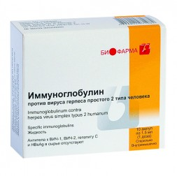
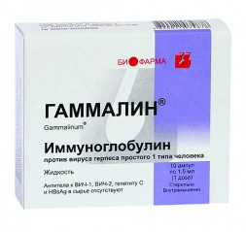
Immunotherapy
Inducers of interferons ( amixin , cycloferon, tiloron )
α-interferons ( Roferon , Alfarekin , Intrabion , Eberon ) 1-3 million each Eat intramuscularly every other day, the course of treatment is 1-3 months.
Thymic factors ( thymalin , T-activin )
Immunomodulators with polyvalent action ( halavit , polyoxidonium , lycopid , imidazoles)
Vaccine
Adaptogens , vitamins
Immunoglobulins in 2 to 3 doses (3.0 to 4.5 ml) intramuscularly per day No. 5 to 7.

Slide 41
Principles of phasing of therapy
I stage : treatment in acute period of illness (Relapse) | Antiherpetic drugs (intravenously, orally , locally). • Increasing the dose and duration of chemotherapy course of treatment and prevention in persons with immunodeficiency • Natural antioxidants (vitamins E and C), the course is 10-14 days. • In the case of pronounced exudative prostaglandin inhibitors are shown as a component ( Indomethacin , etc.), a course of 10-14 days. • Immunobiological agents: drugs IFN or its inducers, immunomodulators
II stage : therapy in remission, early convalescence | The main goal is to prepare the patient for vaccine therapy. • Immunomodulators . • Adaptogens of plant origin. • With pronounced immunosuppression - thymus hormones ( thymalin , etc.) for a short course

Slide 43
Treatment of CMVI
Ganciclovir ( Cimeven ) intravenously drip 5 - 10 mg/kg per day after 12 hours, course - 1 - 3 weeks .
Foscarnet ( foscavir ) intravenously drip 60 - 90 mg/kg per day after 8 hours, course - 2 - 3 weeks .
Anticytomegalovirus immunoglobulin (cytotect, megalotect) intravenously in 2 doses (3.0 ml) h/d No. 5
With generalized forms of corticosteroids 2-5 mg/kg per day - 10-15 days
α-interferons 1 – 3 million Part time - 3 - 6 months.

Slide 44
For the treatment of diseases caused by HGL 6 - immunoglobulin ( herpimun 6) intravenously in 2 doses (3.0 ml) h/ d No. 5
For the treatment of CFS - groprinosin 50 mg/kg per day - 3 - 9 days.

Slide 45


Thank you !

