Slide 1
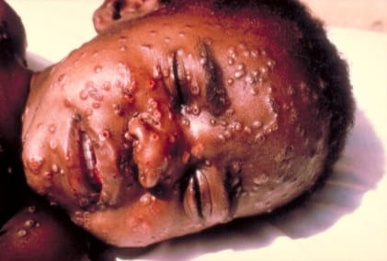
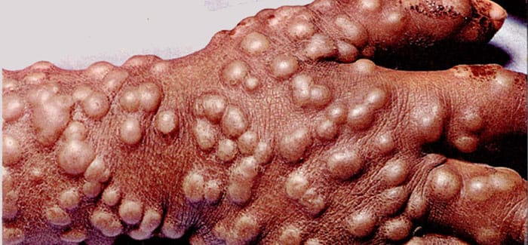
    SMALLPOX

Slide 2
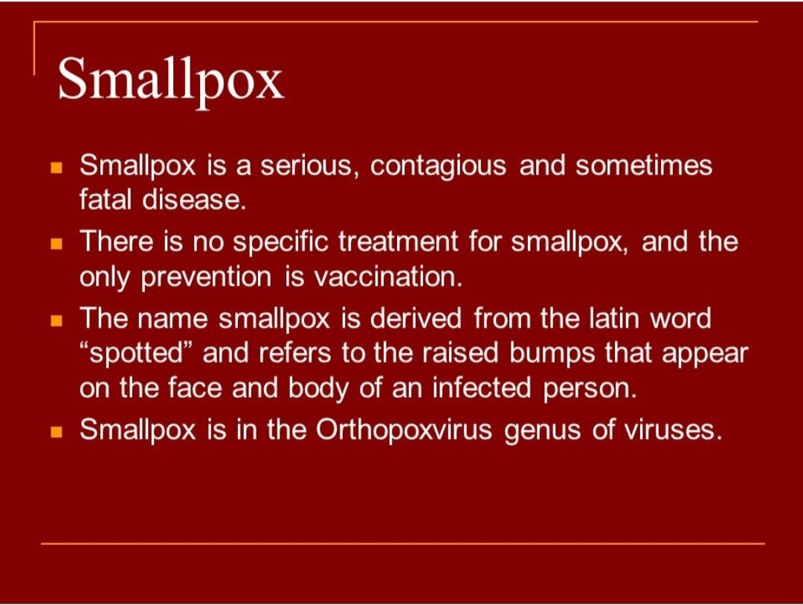

Slide 3
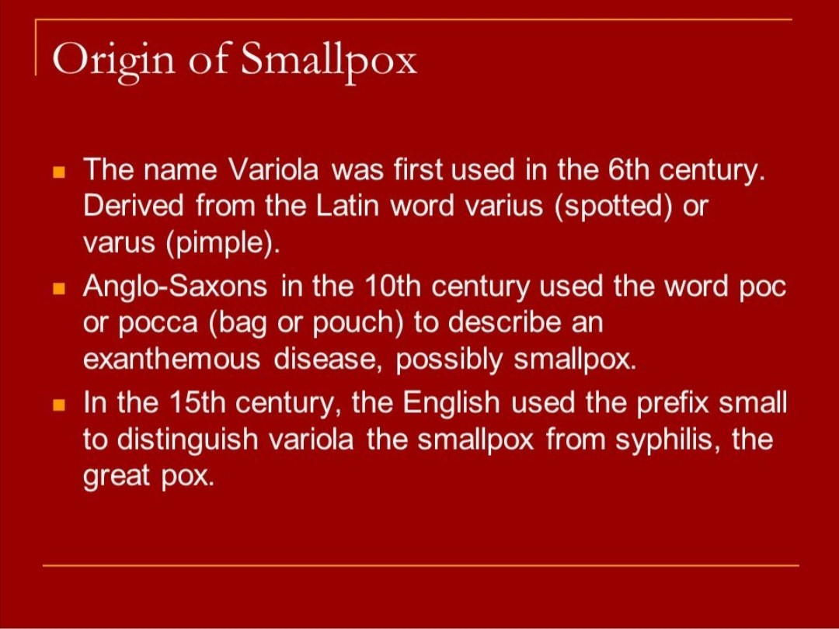

Slide 4
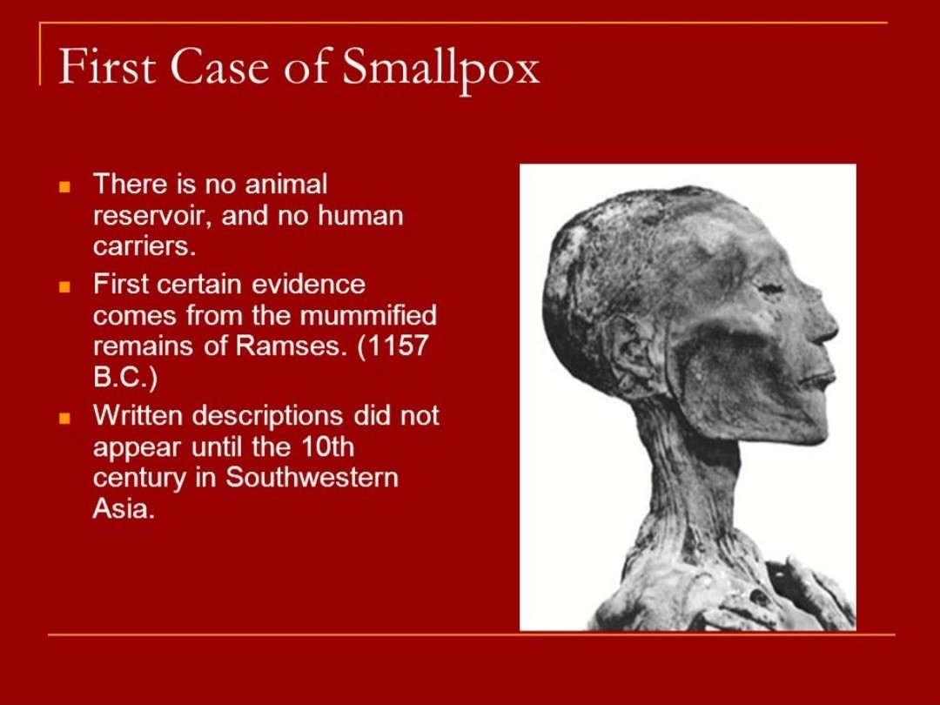

Slide 5
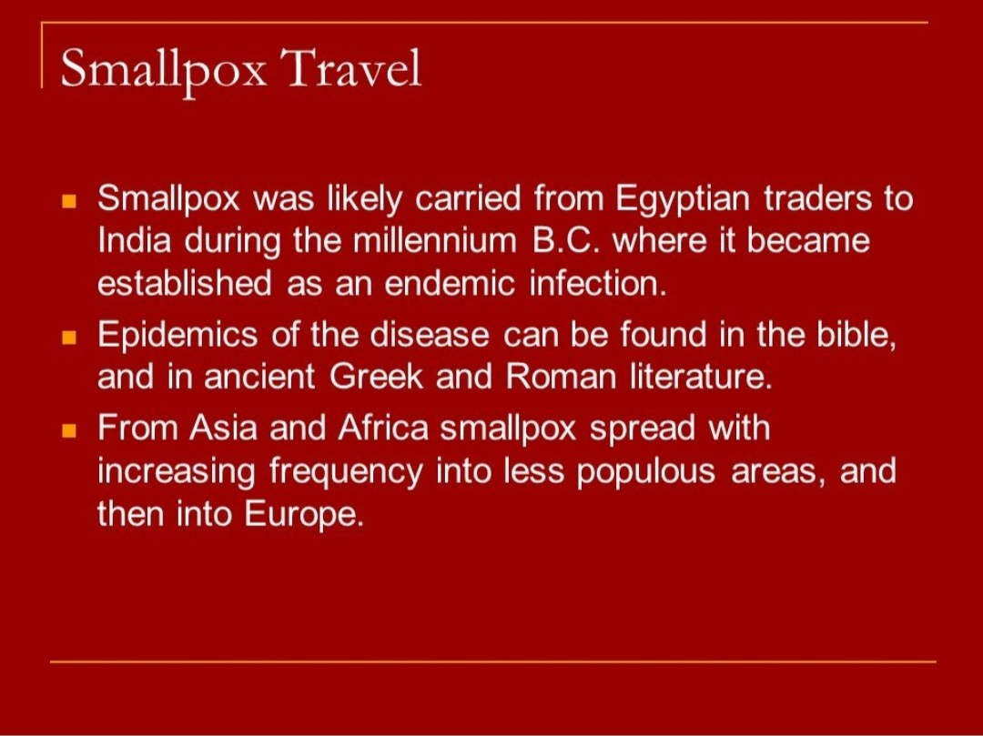

Slide 6
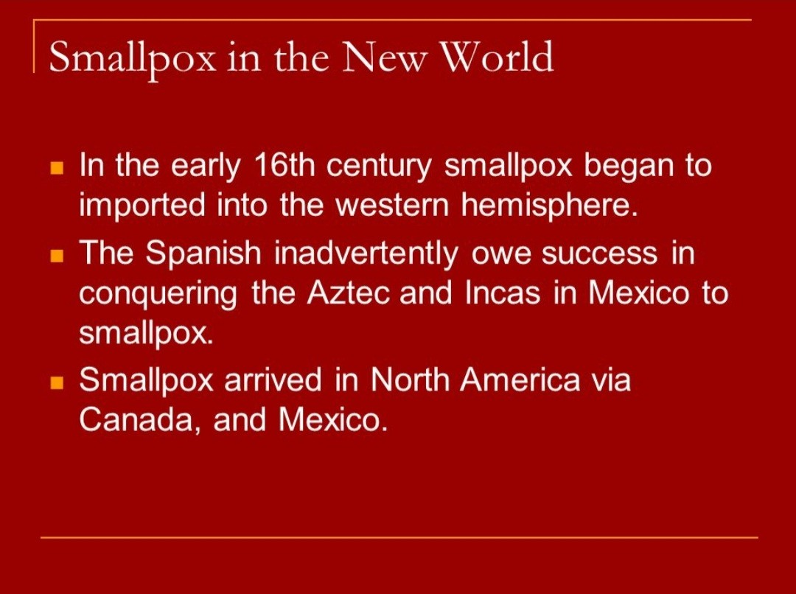

Slide 7
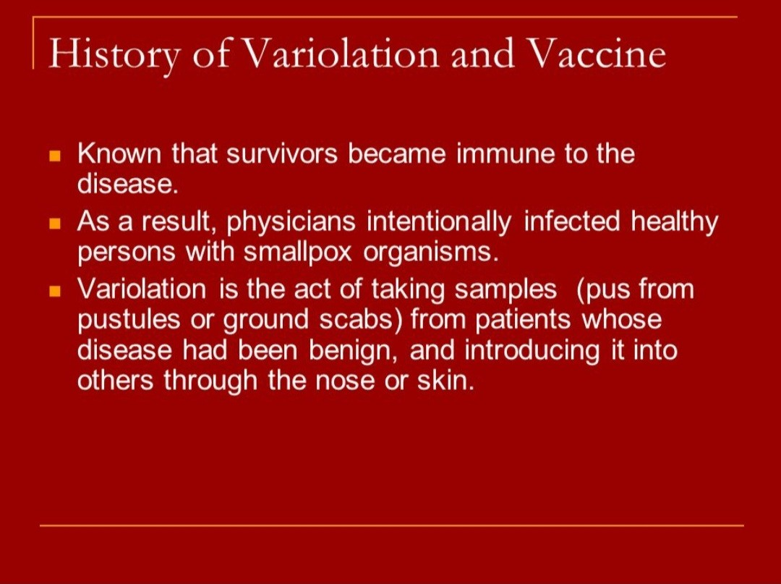

Slide 8
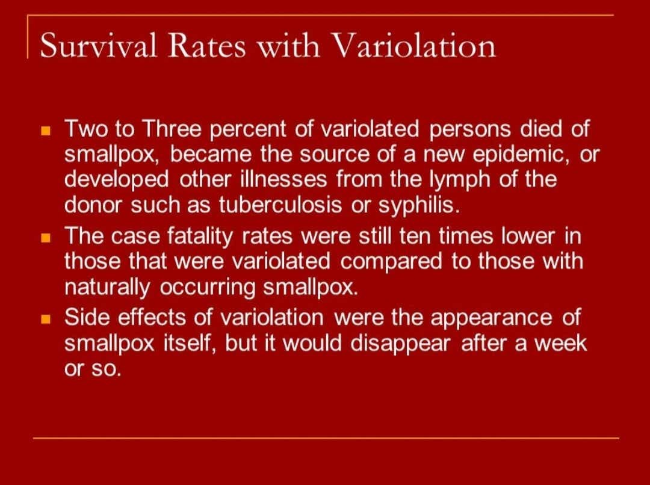

Slide 9
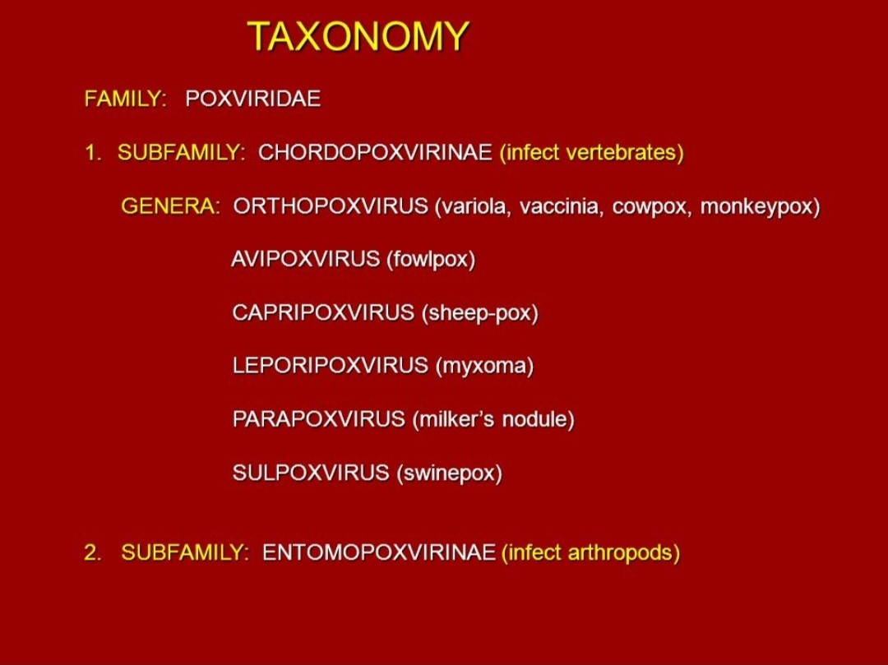
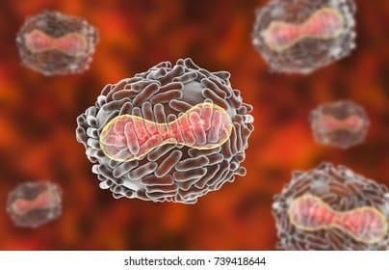

Slide 10
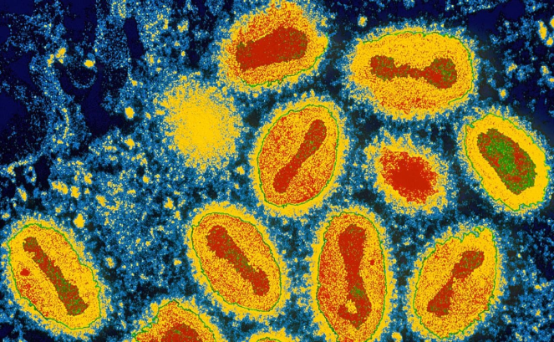
  MICROBIOLOGY
Caused by variola virus
Belongs to genus orthopoxvirus , the family poxviridae and subfamily chordopoxvirinae
Single,linear,double-stranded DNA molecules and replicate in cytoplasm
Shaped like bricks and measure about 300X – 200mm in size
Incubation 12-14 days ( range 7-17 days )
2 clinical forms :
Variola major
Variola minor

Slide 11
    MICROBIOLOGY
Variola major
  Classic small pox
  Predominant form in Asian epidemics
  Highest mortality (nearly 30%)
Variola minor
  Causes milder disease
  Discovered in 20th century
  Started in S.Africa
  Was most predominant form in N.America

Slide 12
    Types
Classic small pox considered the most communicable disease , about 30% of unvaccinated people who came in contact with the virus were infected
Hemorrhagic variety of variola had a much higher death rate (95%) than classic small pox and lead to death more quickly
Malignant or flat forms of smallpox affected 6% of the population and evolved slower than the classic type of small pox but with the death rate of almost 100%
Modified variety of variola essentially affected people who were vaccinated

Slide 13
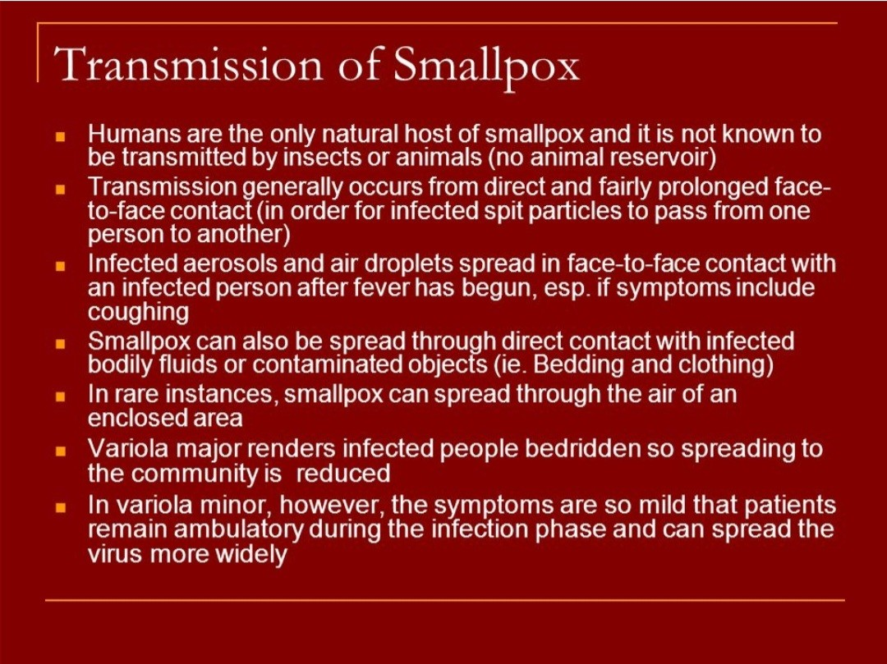

Slide 14
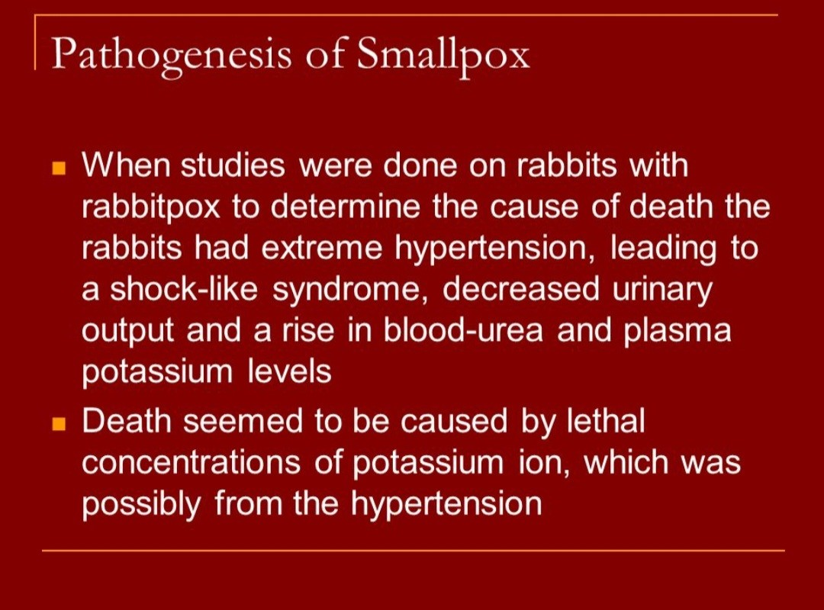

Slide 15
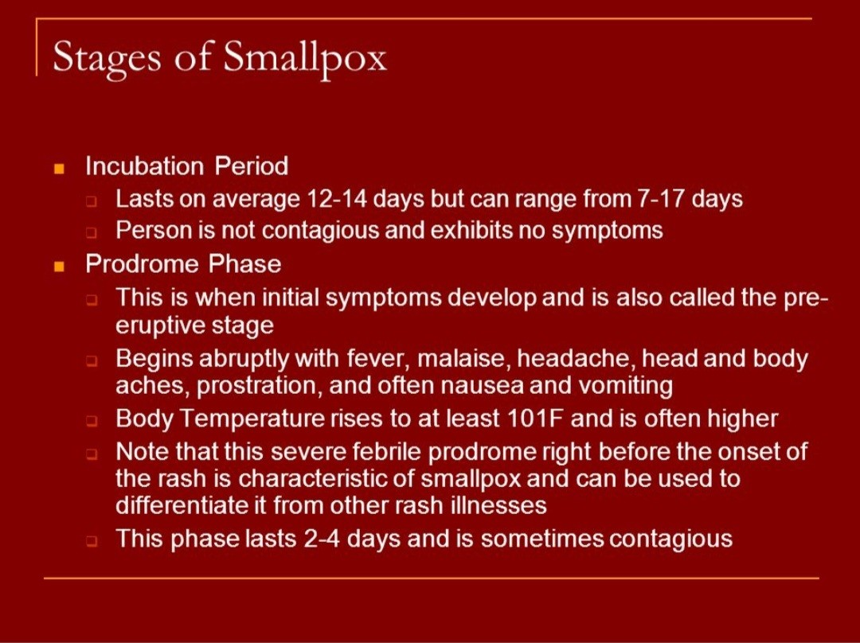

Slide 16
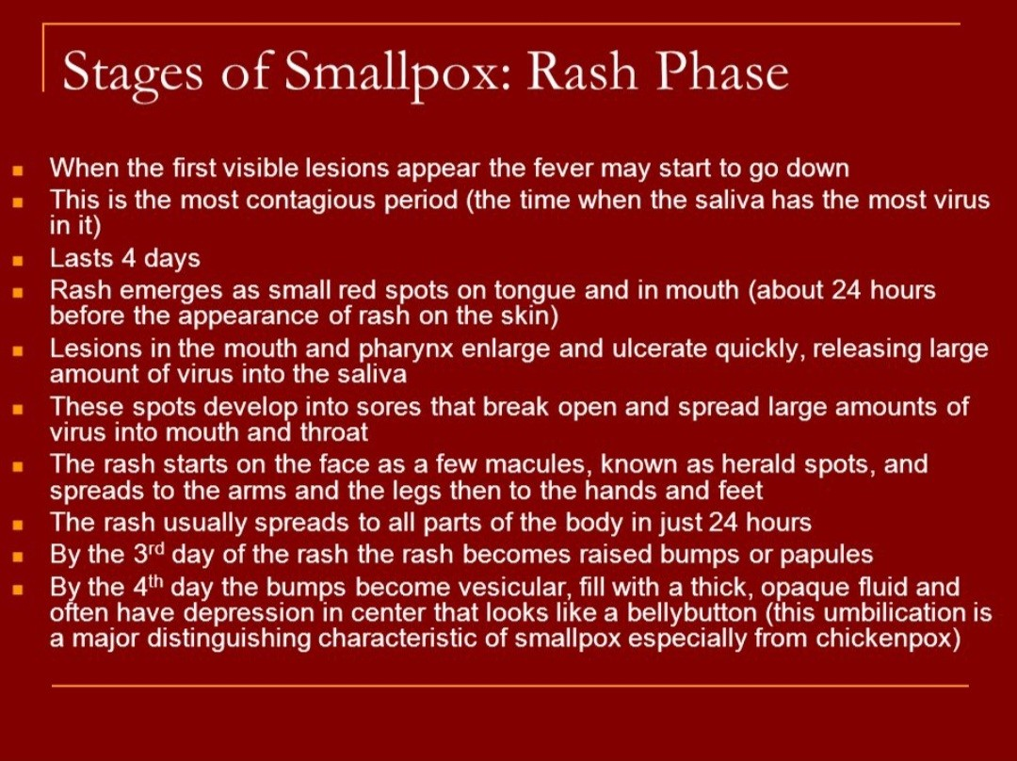

Slide 17
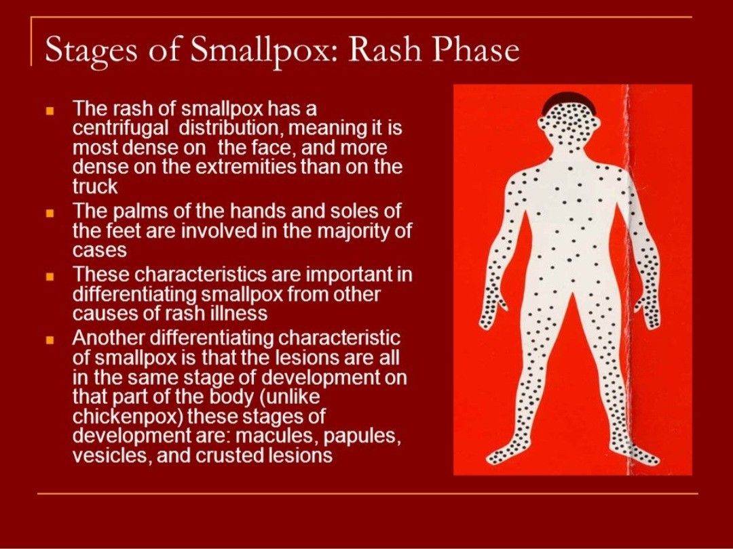

Slide 18
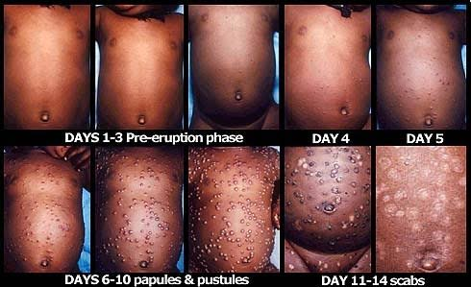

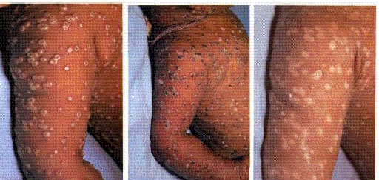

Slide 19
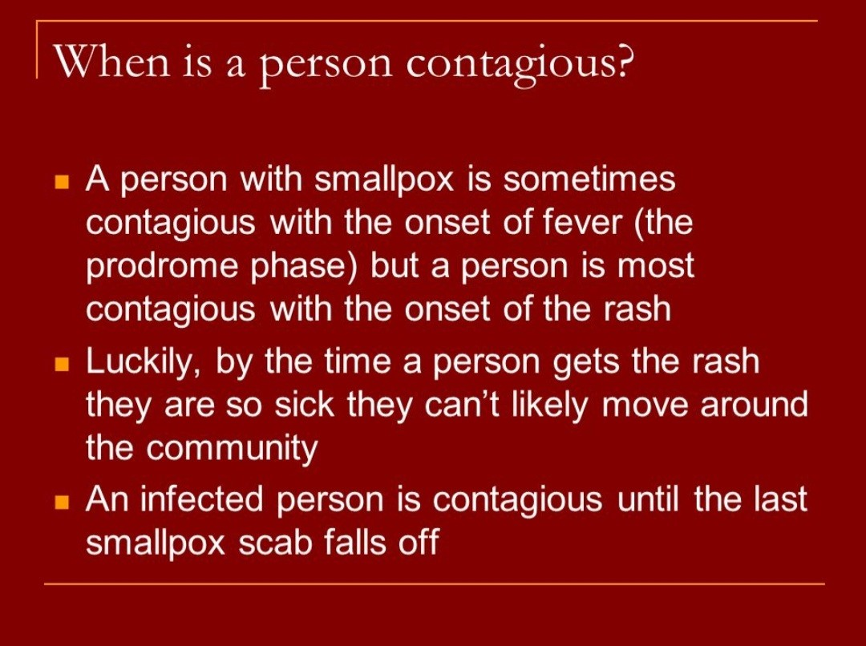

Slide 20
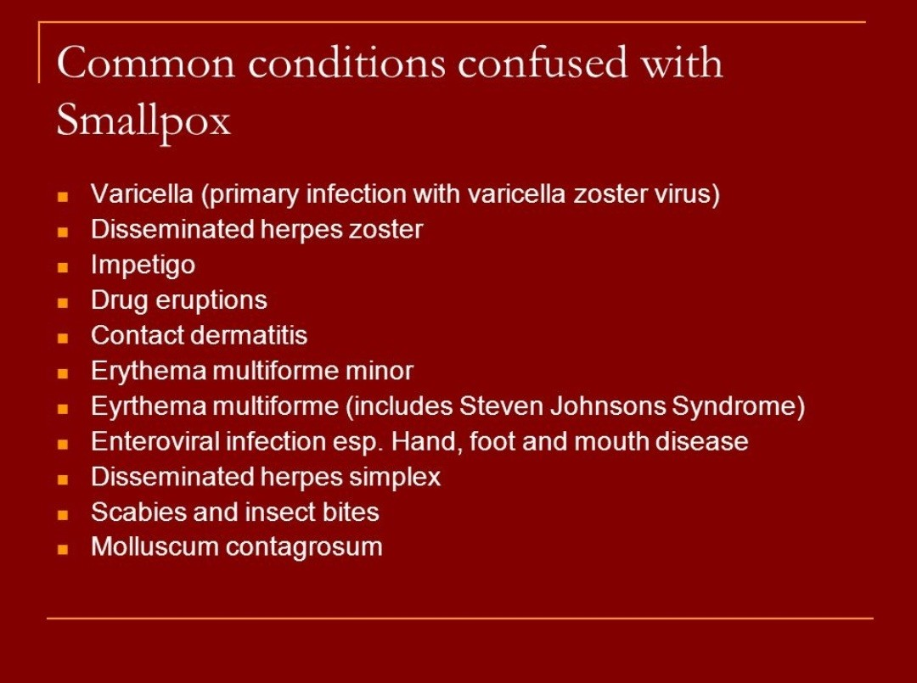

Slide 21
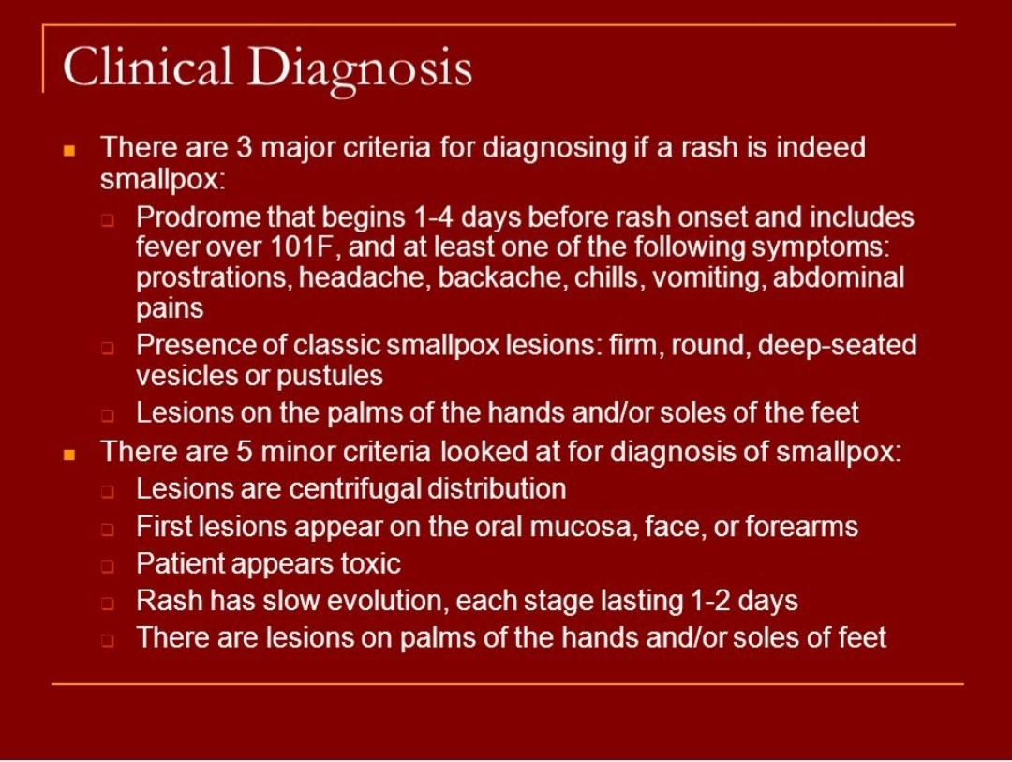

Slide 22
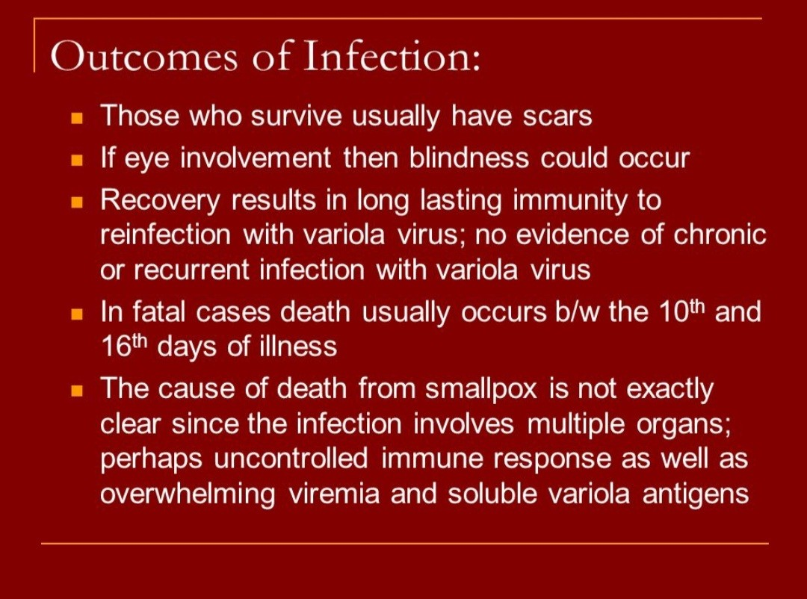

Slide 23
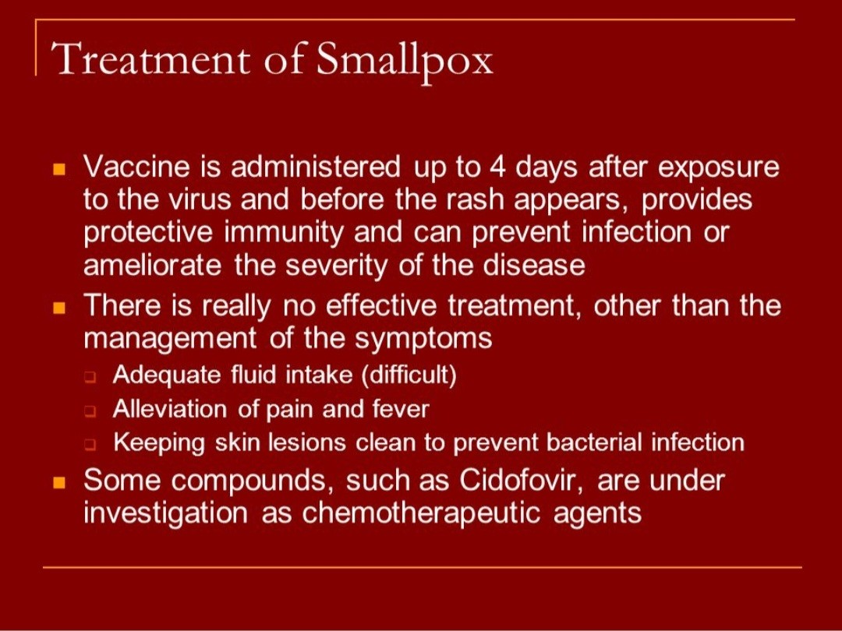

Slide 24
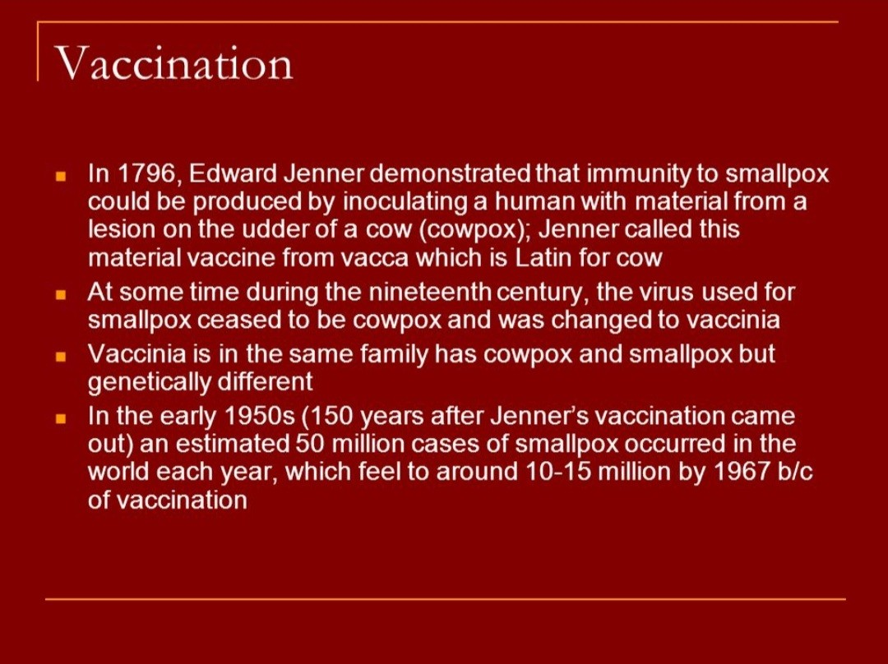

Slide 25
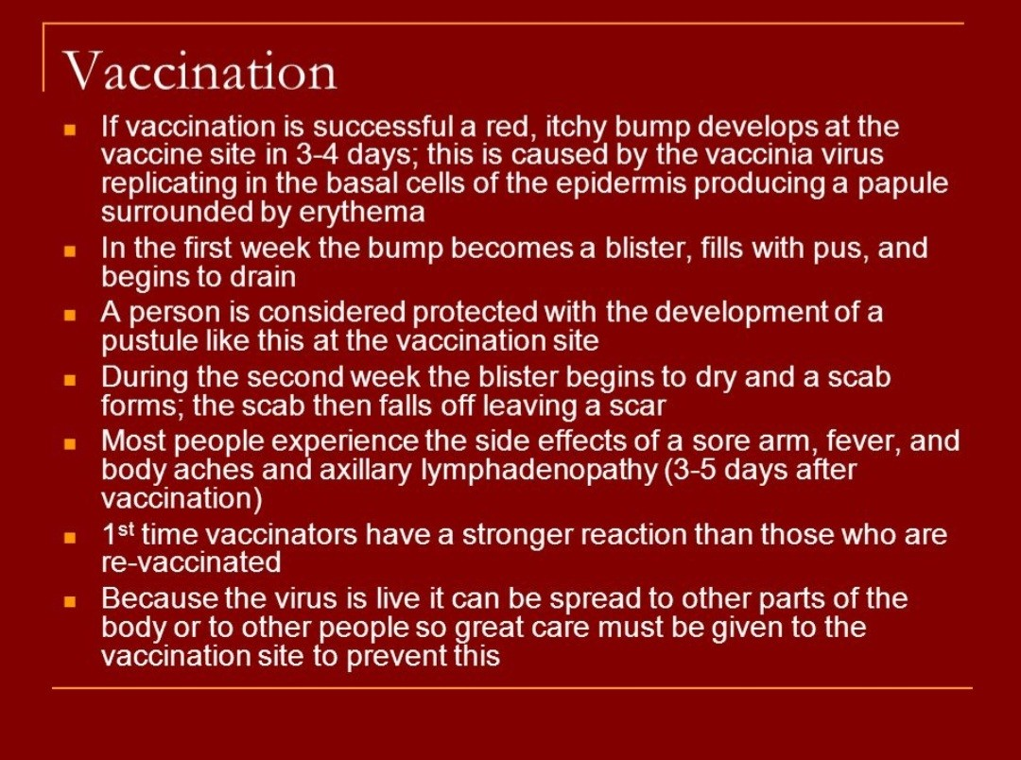

Slide 26
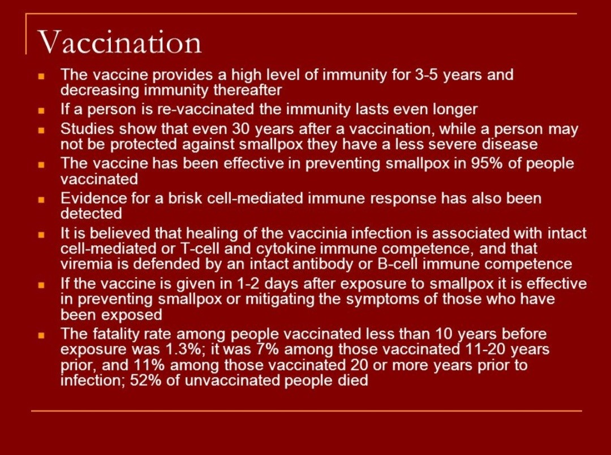

Slide 27
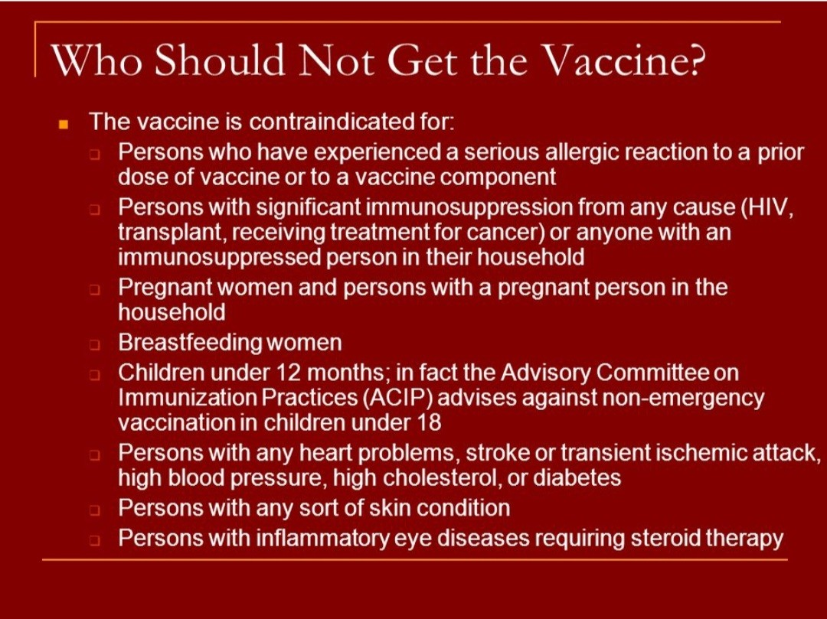

Slide 28
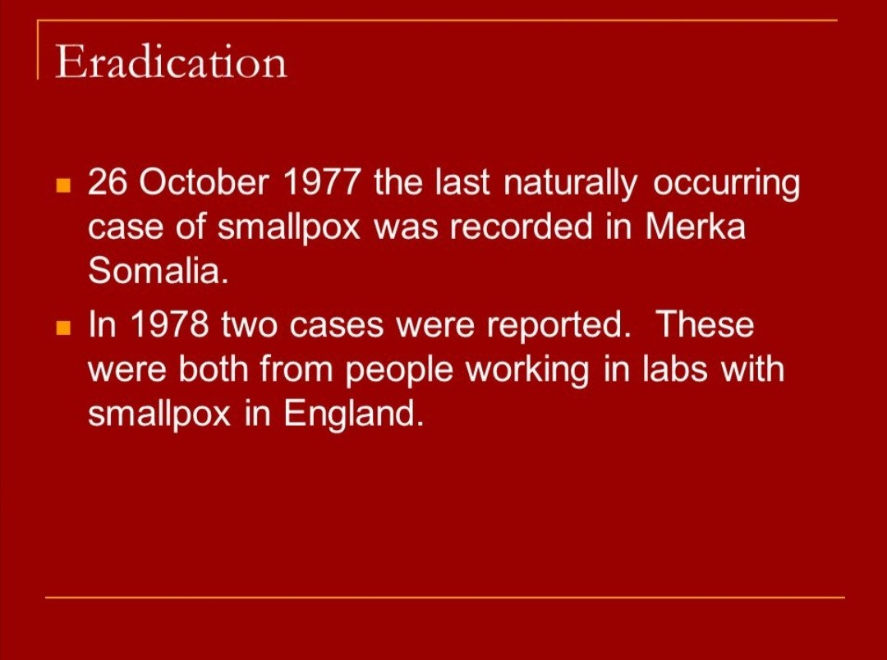

Slide 29
