Slide 1
RUBELLA

Slide 2
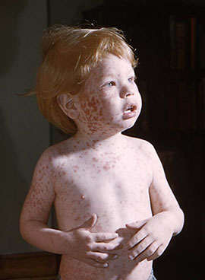
WHAT IS RUBELLA ?
German measles, also known as rubella, is a viral infection that causes a red rash on the body.
Aside from the rash, people with German measles usually have a fever and swollen lymph nodes.
German measles is typically a mild infection that goes away within one week, even without treatment. However, it can be a serious condition in pregnant women, as it may cause congenital rubella syndrome in the fetus.
Congenital rubella syndrome can disrupt the development of the baby and cause serious birth defects, such as heart abnormalities, deafness, and brain damage.

Slide 3
ETIOLOGY
The disease is caused by the rubella virus, in the genus Rubivirus from the family Matonaviridae, that is enveloped and has a single-stranded RNA genome.
The virus is transmitted by the respiratory route and replicates in the nasopharynx and lymph nodes.
The virus is found in the blood 5 to 7 days after infection and spreads throughout the body.
The virus has teratogenic properties and is capable of crossing the placenta and infecting the fetus where it stops cells from developing or destroys them.
During this incubation period, the patient is contagious typically for about one week before he/she develops a rash and for about one week thereafter.

Slide 4
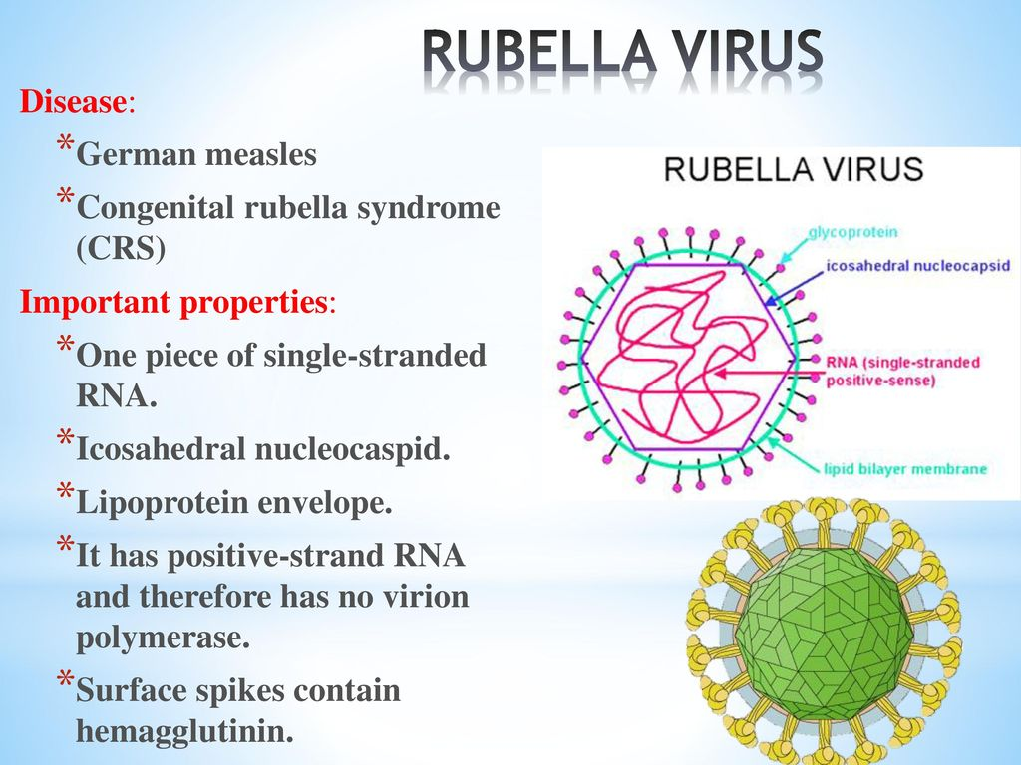

Slide 5
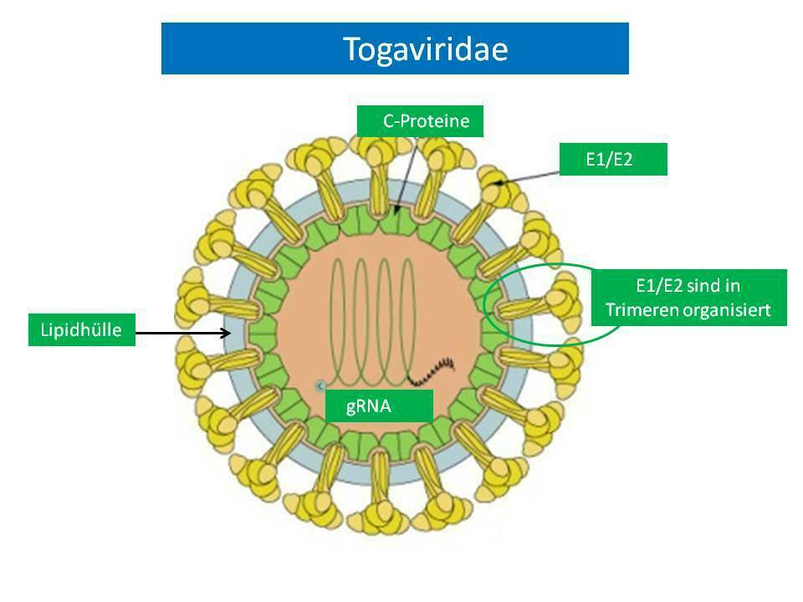
STRUCTURE OF THE VIRUS
Rubella virus is the only member of the Rubivirus genus of the Togavirus family. Unlike most Togaviruses it is NOT arthropod-borne, but is acquired via the respiratory route.
It is an enveloped (toga=cloak), non-segmented, positive sense, RNA virus and replicates in the cytoplasm.
Its nucleocapsid has icosahedral symmetry .
There is only one major antigenic type

Slide 6
EPIDEMIOLOGY
The source of infection is a sick person, who probably becomes infective a few days before the disease becomes manifest.
Contagiousness does not probably disappear with the rash because the virus is sometimes found in the secretion of the nasal mucosa two weeks (and over) after the rash resolves.
The infection is probably transmitted mainly by the aerial-droplet route. Pregnant women with manifest or symptomless rubella may become the source of intrauterine infection of the fetus.
Susceptibility of children to rubella is high. Most develop the disease at the age between 1 and 7.
Life-long stable immunity develops as a rule, and a repeated infection is rare.

Slide 7
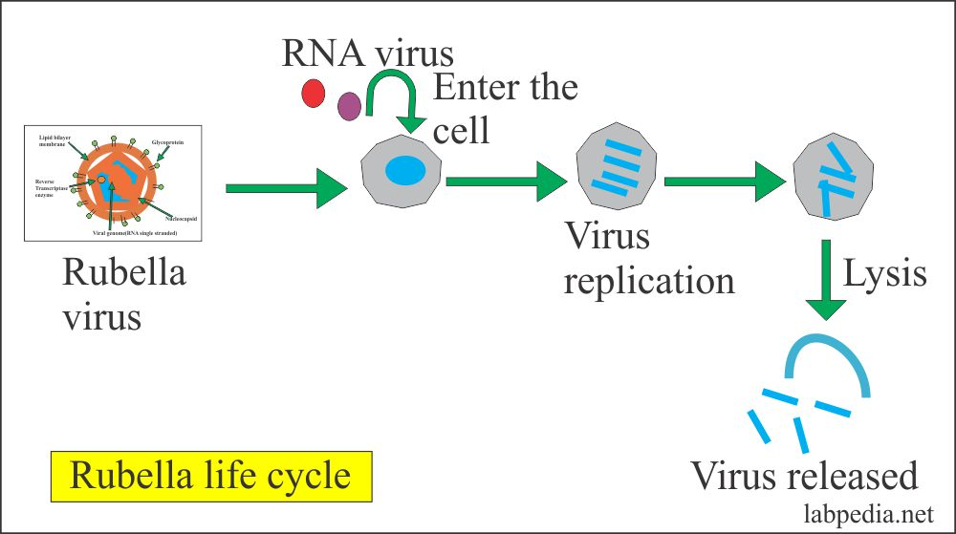

Slide 8
PATHOGENESIS
The average incubation period of rubella is 14 days, with a range of 12 to 23 days. Symptoms are often mild, and up to 50% of infections may be subclinical or inapparent.
In young children, rash is usually the first symptom.
In older children and adults, there may be a 1- to 5-day prodrome with low-grade fever, malaise, lymphadenopathy, and upper respiratory symptoms preceding the rash.
Lymphadenopathy may begin a week before the rash and last several weeks. The rubella rash is maculopapular and occurs 14 to 17 days after exposure. The rash usually occurs initially on the face and then progresses from head to foot. It lasts about 3 days and is occasionally pruritic.
The rash is fainter than a measles rash, does not coalesce, and is often more prominent after a hot shower or bath. Postauricular, posterior cervical, and suboccipital nodes may be involved.

Slide 9
CLASSIFICATION
Acquired Rubella
Congenital Rubella Syndrome (CRS)

Slide 10
CLINICAL MANIFESTATION
The incubation period lasts 15–21 days, sometimes up to 24 days.
The prodromal period lasts from several hours to 1–2 days, and often passes unnoticed.
A slight rise in temperature is noted, and occasionally slight malaise, cough, and reddening of the conjunctiva (cojunctivitis).
The typical symptom is swelling of the post-auricular cervical, suboccipital, and other lymph nodes which develops 1–3 days before the eruption and disappears several days after it subsides.
The swollen glands are usually about the size of a large pea, hard, and slightly tender on palpation.

Slide 11
RASH
The rash invades the face and neck, and covers the whole body within a few hours.
It is localized mainly on the extensor surface of the limbs, back and buttocks, and is sparse on the abdomen and chest, and particularly on the face.
Its elements are pale red, round or oval spots, sometimes slightly elevated above the surface of the skin, with no tendency to coalesce.
They vary in size from a pin-head to a lentil. Small elements predominate in some cases, and large ones in others.
The rash lasts 2 or 3 days and disappears rapidly without leaving any pigmentation.
Subsequent desquamation is not observed.

Slide 12
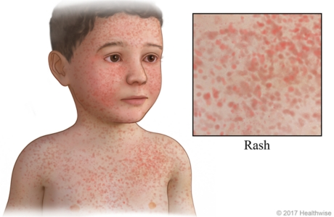
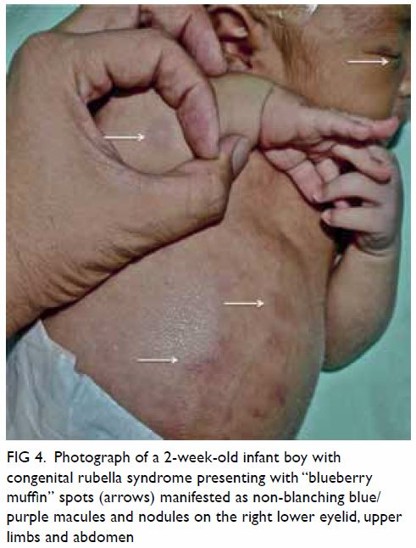
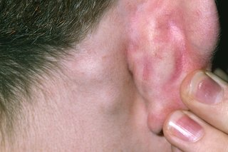

Slide 13
CLINICAL MANIFESTATIONS
Eruption is accompanied with a slight rise in temperature, usually to 38°C, but temperature often remains normal trough out the whole disease course.
The catarrhal phenomena of prodromal o not become more intense.
The patient’s condition is not severe, as a rule.
Simultaneously with the skin eruption, an enanthem in the small red spots appears on the facial mucosa; but Belsky — Filatov — Koplik’s spots never occur.
Some individuals (especially adults and especially women) get arthralgia and sometimes arthritis which usually clears up in a few weeks.

Slide 14
SYMPTOMS
Mild fever of 102 F (38.9 C) or lower
Headache
Stuffy or runny nose
Inflamed, red eyes
Enlarged, tender lymph nodes at the base of the skull, the back of the neck and behind the ears
A fine, pink rash that begins on the face and quickly spreads to the trunk and then the arms and legs, before disappearing in the same sequence
Aching joints, especially in young women

Slide 15
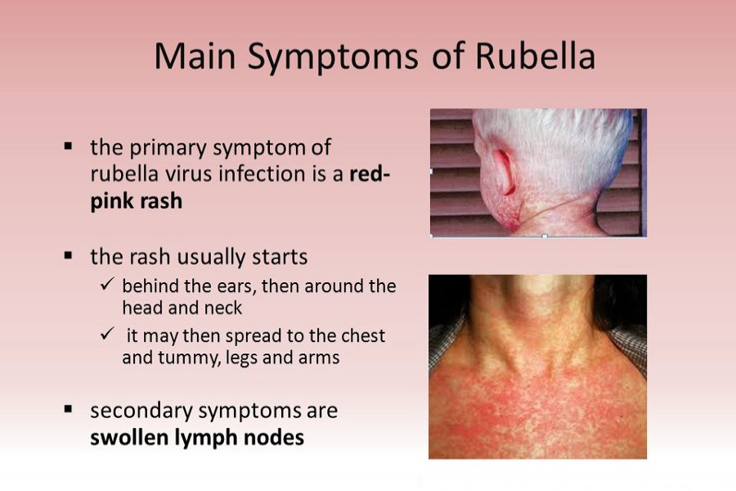

Slide 16
CONGENITAL RUBELLA SYNDROME
Congenital rubella syndrome (CRS) is an illness in infants that results from maternal infection with rubella virus during pregnancy.
When rubella infection occurs during early pregnancy, serious consequences–such as miscarriages, stillbirths, and a constellation of severe birth defects in infants–can result.
The risk of congenital infection and defects is highest during the first 12 weeks of gestation and decreases thereafter; defects are rare after infection in the 20th week (or later) of gestation.
Common congenital defects of CRS include cataracts, congenital heart disease, hearing impairment, and developmental delay.
Infants with CRS often present with more than one of these signs but may also present with a single defect, most commonly hearing impairment

Slide 17
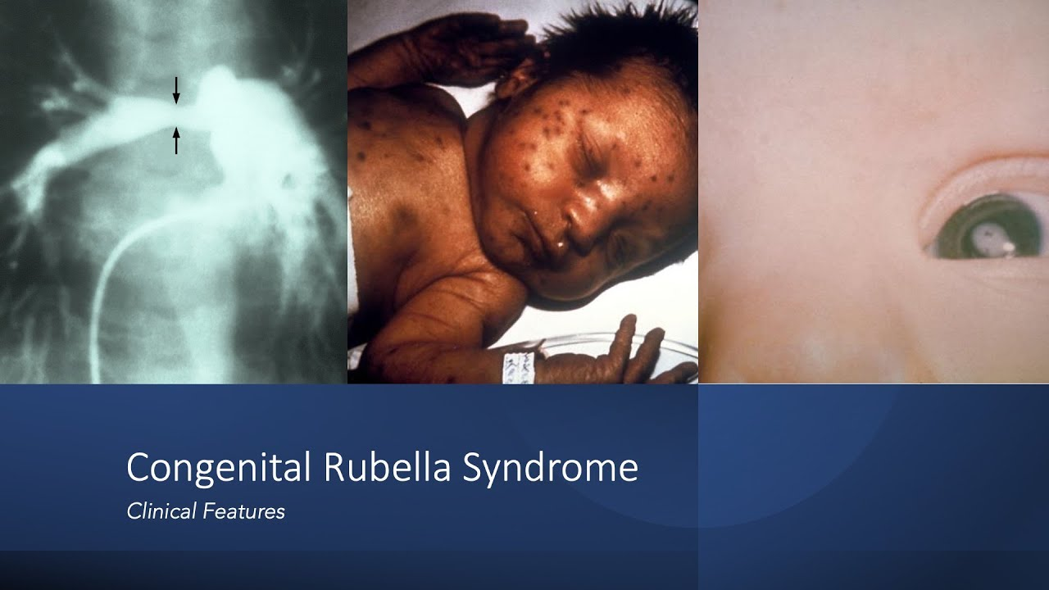

Slide 18
CONGENITAL RUBELLA SYNDROME
Hearing loss. This is the most common sequela of congenital rubella infection (58% of patients) especially when the latter occurs after four months of pregnancy.
Ophthalmic problems (congenital cataract, glaucoma, retinopathy, microphthalmia .These occur in about 43% of patients.
Congenital heart defects including, among others, pulmonary artery stenosis and patent ductus arteriosis. The Ductus arteriosis is a short blood vessel through which blood going to the fetal heart (through the pulmonary artery) is shunted away from the lungs to the aorta. It usually closes at or shortly after birth and blood passes freely to the lungs. If however, it remains open (patent ductus arteriosis), blood flow is reversed and blood from the aorta goes to the pulmonary artery and recirculates to the lungs. It then requires surgical ligation. These occur in about half of patients.
Neurologic problems (psychomotor retardation, mental retardation, microcephaly)
Intrauterine growth retardation
Thrombocytopenia purpura
Hepatomegaly
Splenomegaly

Slide 19
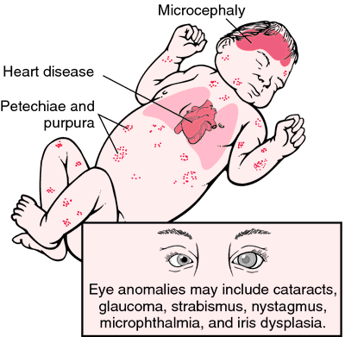
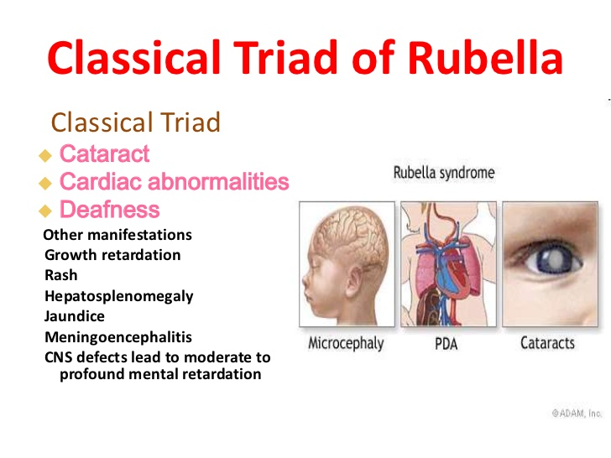

Slide 20
DIAGNOSIS
CLINICAL CRITERIA INCLUDE :
Acute onset of disease
Moderate increase in body temperature
Moderate cattharal symptoms
Posterior cervical and, particularly, bilateral occipital lymphadenopathy
Macular or small-spotted rash on the unchanged background of skin, predominantly without fusion of elements.
Simultaneous character of rash (absence of succession)
Disappear rash in 3 days without pigmentation.

Slide 21
DIAGNOSIS
SPECIFIC DIAGNOSIS :
Serological tests can be applied for rubella diagnosis or virus isolation, or PCR.
Serological confirmation of a diagnosis is based on the detection of antibodies of IgM class in one sample of serum or significant (more than 4 times) increase in the titre of IgG class antibodies in paired sera obtained with an interval of 2-3 weeks.
It should r noted that in some cases false positive results of examination – detection of IgM antibodies against rubella in person with other viral infections for example, infectious mononucleosis, cytomegalovirus, parvovirus infection, etc., can be registered
An accurate retrospective diagnosis of rubella is ensured by revealing the increasing antibody titre by the hemagglutination-inhibition reaction, the neutralization and the complement-fixation tests which are carried out two times at a ten-day interval.

Slide 22
TREATMENT
Treatment of rubella is usually symptomatic.
Antihistamine drugs can be useful for adult patients with uncomplicated rubella, when rash is accompanied by itching.
For treatment of arthritis, NSAIDSs are used.
Patients with encephalitis are provided supporting therapy with adequate provision of needs in fluid and electrolytes.
Cases of severe thrombocytopenia require administration of immunoglobulin.

Slide 23
PROPHYLAXIS
Patients with rubella are isolated for 5 days after the rash appears.
A child with congenital rubella syndrome is considered contagious for 1 year (if repeated analyses for virus detection are negative, this term is shortened).
A pregnant woman should avoid any contact with a sick person with the exanthematous infection.
Detection of infection in pregnancy at the early stage (before 14-16 weeks) in the absolute indication for the abortion.
Persistent detection of antibodies of IgG class against rubella provided negative results for antibodies of IgM class always points to the infection passed earlier by a mother is not indication for abortion.

Slide 24
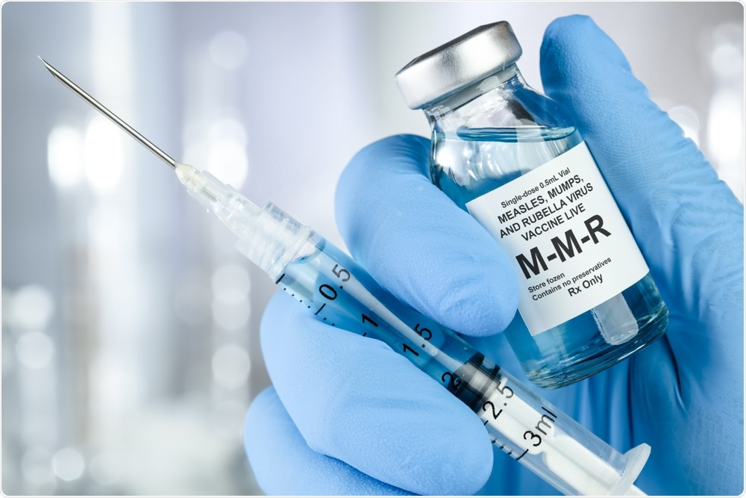
SPECIFIC PROPHYLAXIS
Vaccine prevention serves as the only effective method for rubella control.
A live rubella vaccine is used for specific prophylaxis.
The first dose is administered at age of 12 months.
Revaccination is carried out at the age 6 and 15.
The current vaccine strategy is to immunize all infants at 12 to 15 months of age with measles-mumps-rubella (MMR) vaccine and to administer a second dose of MMR during childhood.

Slide 25
COMPLICATIONS
Frequent complications include arthritis, rare – thrombocytopenic purpura, myocarditis, Gullian-Barre syndrome, encephalitis, neuritis of ophthalmic nerve and aplasia of the bone marrow.
Acute encephalitis occurs in one case for 5000-6000 of patients with rubella and clinically very similar to measles encephalitis, but in contrast to it, CNS lesion in rubella does not lead to demyelination.
In pregnant women, still born and spontaneous abortions are possible.
Complications in case of congenital rubella syndrome :
Heart defects.
Cataracts.
Deafness.
Delayed learning.
Liver and spleen damage.
Diabetes.
Thyroid problems

Slide 26
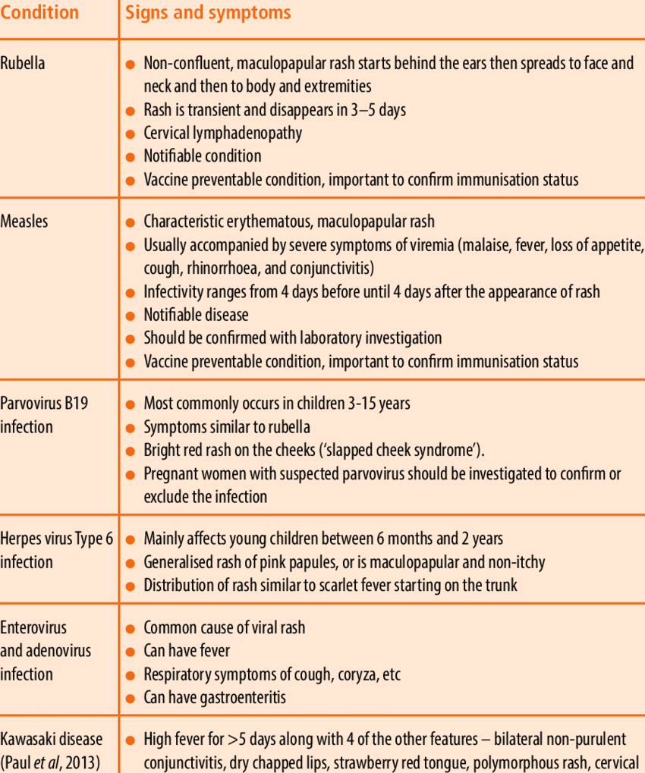

Slide 27
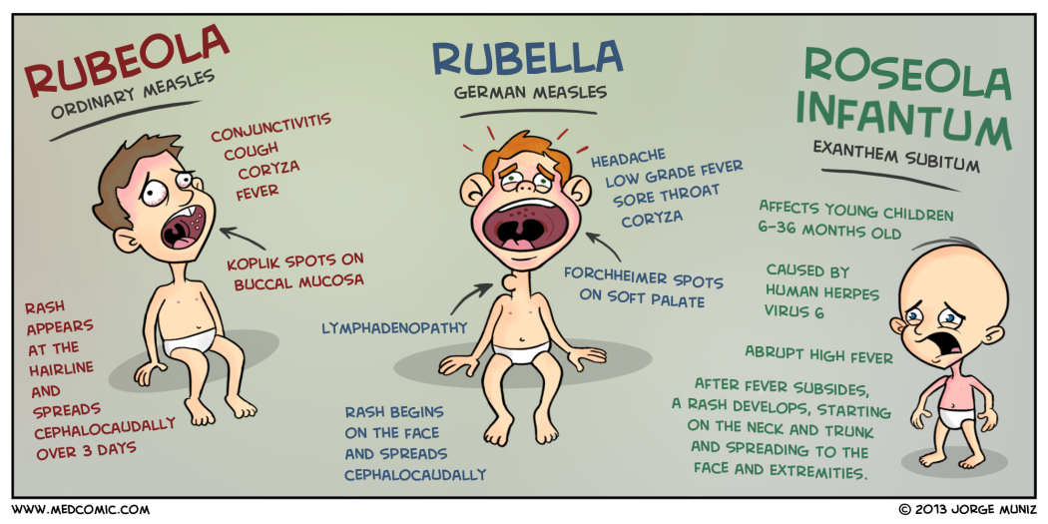

Slide 28
