Slide 1
Aminogycoside Antibiotics

Slide 2
Aminoglycoside antibiotics are are widely used for the treatment of severe gram-negative infections such as pneumonia or bacteremia, often in combination with a β-lactam antibiotic
Aminoglycoside is a bactericidal antibiotitic
A disadvantage of the aminoglycosides is their association with nephrotoxicity and ototoxicity

Slide 3
Aminoglycoside
not absorbed orally
IV route primary route of
administration-occasionally given IM
quite hydrophilic-distributes primarily in extracellular fluid~25% of body weight; relatively poor tissue penetration
protein binding (20-30%)-not clinically significant
well distributed except for the eye, CNS, CSF.
Must be given intrathecally for CNS infections.
Increased Vd seen in CHF, peritonitis, ascites, acute burn injury, s/p surgery, immediately post partum patients.

Slide 4
Aminoglycosides have a concentration-dependent postantibiotic effect
The mechanisms of action for aminoglycosides are binding tothe 30S ribosomal subunit inhibiting protein synthesis and misreading of mRNA causingdysfunctional protein production.

Slide 5
Example
Streptomycin
Kanamycin
Amikacin
Gentamycin
Tobramycin
Neomycin
Netilmycin

Slide 6
Preparations
Streptomycin sulphate injection
Kanamycin sulphate injection
Neomycin sulphate cap
Gentamicin sulphate injection
Tobramycin injection
Amikacin injection
Netilmicin injection
Paromomycin cap
Framycetin ointment, cream or solution

Slide 7
Routes of administrarions
Since they are not absorbed from the gut, they are administered intravenously and intramuscularly
Topical preparations for wounds
Oral administration can be used for gut decontamination (e.g., in hepatic encephalopathy).
nebulized form (tobramicyn)

Slide 8
Therapeutic Aminoglycoside
Two method of dosage administration
The conventional method of dosing aminoglycoside antibiotics is to administer multiple daily doses (usually every 8 hours).
extended-interval(usually the total daily dose given once per day) aminoglycoside administration

Slide 9
Conventional Dosing
Therapeutic steady state peak concentrations for gentamicin, tobramycin, and netilmicin are generally 5–10 μg/mL for gram-negative infections

Slide 10
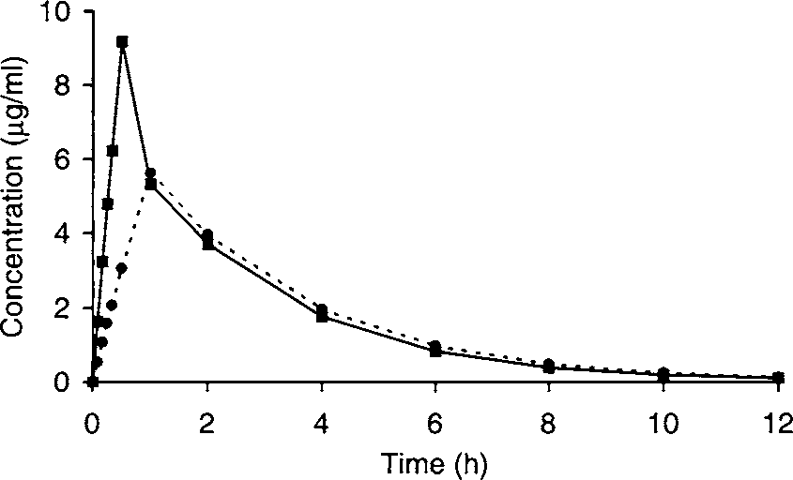
Aminoglycoside antibiotics are given as short-term (1/2–1 hour) infusions

Slide 11
Extended Interval Dosing
Aminoglycosides have bactericidal activity against most gram-negative bacteria including Acinetobacter, Citrobacter, Enterobacter, E. Coli, Klebsiella, Proteus, Providencia, Pseudomanas, Salmonella, Serratia and Shigella. The MIC's of gram negative bacteria are usually less than 2 mcg/ml for gentamicin and tobramycin and 8 mcg/ml for amikacin.

Slide 12
Nephrotoxicity and ototoxicity are due to accumulation of aminoglycoside in the relevant tissue
Studies are available that attempt to determine nephrotoxicity differences among antibiotics. Gentamicin accumulates to a greater extent in kidney tissue when compared to tobramycin

Slide 13
Aminoglycosides can cause permanent vestibular and/or auditory ototoxicity. Factors associated with otoxicity include increasing age, duration of therapy, elevated peak and trough levels, concurrent loop diuretics or vancomycin, underlying disease states and previous exposure to aminoglycosides.
Gentamicin accumulates to a greater extent in kidney tissue when compared to tobramycin

Slide 14
Toxicitas Aminoglycoside
Major: Vestibular toxicity; auditory toxicity;
renal toxicity (reversible); neuromuscular toxicity (post-synaptic
curare-like action).
Minor: skin rash; drug induced fever.

Slide 15
Nephrotoxicity → nonoliguric renal failure, with a slow rise in serum creatinine and a hypoosmolar urinary output developing after several days of therapy.
Factors associated with nephrotoxicity include:
duration of treatment
increasing age
compromised renal function
volume depletion
elevated peak
trough levels
concurrent nephrotoxic drugs (i.e., vancomycin)
previous exposure to aminoglycosides

Slide 16
Permanent vestibular and/or auditory ototoxicity.
Factors associated with otoxicity include:
increasing age
duration of therapy
elevated peak and trough levels
concurrent loop diuretics or vancomycin
underlying disease states
previous exposure to aminoglycosides

Slide 17
Differential Toxicity Among Aminoglycosides
Gentamicin accumulates to a greater extent in kidney tissue when compared to tobramycin
Because doses of amikacin are larger than for gentamicin and tobramycin, amikacin in renal accumulation must be adjusted for dosage differences
gentamicin is the most widely used aminoglycoside, followed by tobramycin and netilmicin

Slide 18
Pharmacokinetic parameters
Volume Distribution (Vd)
  The average Vd of aminoglycoside in otherwise healthy adults is 0.26 L/kg (range: 0.2-0.3)
  obese patients require a correction in the weight used for Vd calculation: LBW + 40% of weight above LBW
  Patients with cystic fibrosis have a markedly increased Vd of 0.35 L/kg
  ICU patients may have a Vd 25-50% above normal

Slide 19
2. Elemination Rate
  Aminoglycoside elimination is closely correlated with creatinine clearance, the average value for the slope is between 0.0024 and 0.0029
  Cystic fibrosis patients show a 50% increase in elimination rate

Slide 20
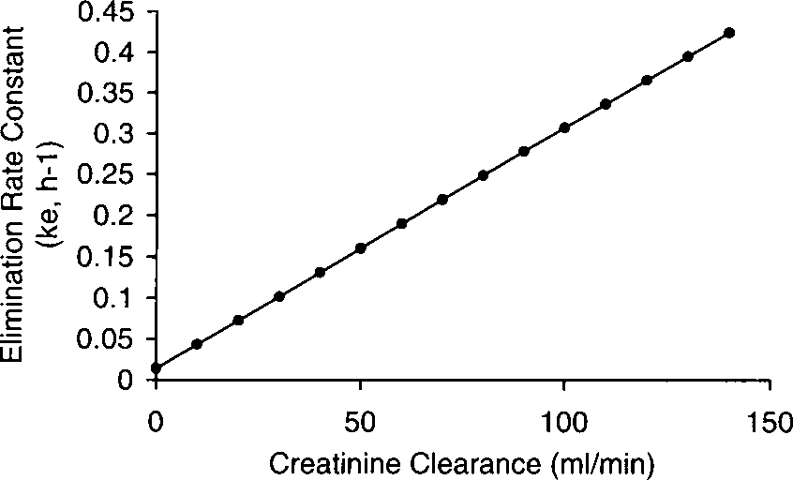
Relationship between renal and aminoglycoside elimination

Slide 21
Clinical Monitoring Parameters
Aminoglycoside peak and trough levels
Serum creatinin
Weight
Urine output
Baseline and weekly audiograms, and check for tinnitus or vertigo daily.

Slide 22
Therapeutic serum concentrations (mcg/ml)
 | Gentamycin (mcg/ml) | Amikacin (mcg/ml)
Peak Serious infection Life-Threatening infection | 6-8 8-10 | 20-25 25-30
Through Serious infection Life-Threatening infection | 0,5-1,5 1-2 | 1-4 4-8

Slide 23
Precautions
Proper timing of serum sampling is critical.
The trough sample should be obtained 30 minutes prior to the dose. Measure the peak level 15 to 30 minutes after completion of the IV infusion to avoid the distributive phase. Measure the peak level 90 minutes after an IM injection. Drawing the peak too soon will result in inaccurate analysis.

Slide 24
Drug Interaction
Aminoglycosides + Vancomycin,14,17,87 amphotericin B, cyclosporin, and furosemide enhance the nephrotoxicity potential
Aminoglycosides + penicillins (penicillin G, ampicillin, nafcillin, carbenicillin, ticarcillin) can inactivate aminoglycosides in vivo and in blood specimen tubes intended for the measurement of aminoglycoside serum concentrations

Slide 25
All adult patients requiring aminoglycoside therapy except:
  Pregnant patients;
  Patients with extensive burn (>20% of body surface area)
  Patients with severe liver disease (e.g., ascites);
  Patients with severe renal disease (CLcr < 30 mL/min);
  Neutropenic patients;
  Patients with enterococcal endocarditis;
  Patients with Gram positive infections (when the aminoglycoside is used for synergy);
  Patients with a history of allergy to aminoglycosides;
  Patients with a history or signs of a hearing loss or vestibular dysfunction.
Also, pulse dosing of aminoglycosides has not been well studied in children and cannot yet be recommended for this population.

Slide 26
Dosage Aminoglycoside
The single dose for gentamicin and tobramycin is 5 mg per kg of actual body weight (ABW) unless the patient is >20% heavier than the ideal body weight (IBW).
For obese patients, a dosing weight should be calculated (see equations below). The calculated dose is diluted in 100 mL of normal saline and infused over one hour.
Doses as high as 7 mg/kg have been used, but there no evidence that doses >5 mg/kg offer any advantage.
For amikacin, the dose is 20 mg/kg.

Slide 27
Dosage Computation
Estimate creatinin clearance
Cockcroft and Gault equation
CrCl: (140 - age) x IBW / (Scr x 72)
(x 0.85 for females)
Note: if the ABW (actual body weight) is less than the IBW use the actual body weight for calculating the CRCL. If the patient is >65yo and creatinine<1, use 1 to calculate the creatinine clearance.

Slide 28
2. Estimate elimination rate constant (ke) and half-life (t1/2).
ke = 0.00293(CrCl) + 0.014
T1/2 = 0.693 / Kel
3. Estimate Volume Distribution (V)
The patient has no disease states or conditions that would alter the volume of distribution from the normal value of 0.26 L/kg

Slide 29
4. Choose desired steady-state serum concentrations
Gram-negative pneumonia patients treated with aminoglycoside antibiotics require steady-state peak concentrations (Cssmax) equal to 8–10 μg/mL; steady-state trough (Cssmin) concentrations should be <2 μg/mL to avoid toxicity. Set Cssmax = 9 μg/mL and Cssmin = 1 μg/mL.

Slide 30
5. Use intermittent intravenous infusion equations to compute dose
τ = [(ln Cssmax − ln Cssmin) / ke] + t
6. Calculate Loading Dose:______(mg)
Gentamicin/Tobra: 1.5-2.5 mg/kg x ABW (usually 2 mg/kg)
Amikacin: 6-7.5 mg/kg x ABW
Vancomycin: Loading doses are not usually administered since concentrations following the first maintenance dose are normally well above the usual MIC's

Slide 31
TERIMAKASIH

