Slide 1
Antibiotic Use in Pregnancy

Slide 2


Slide 3
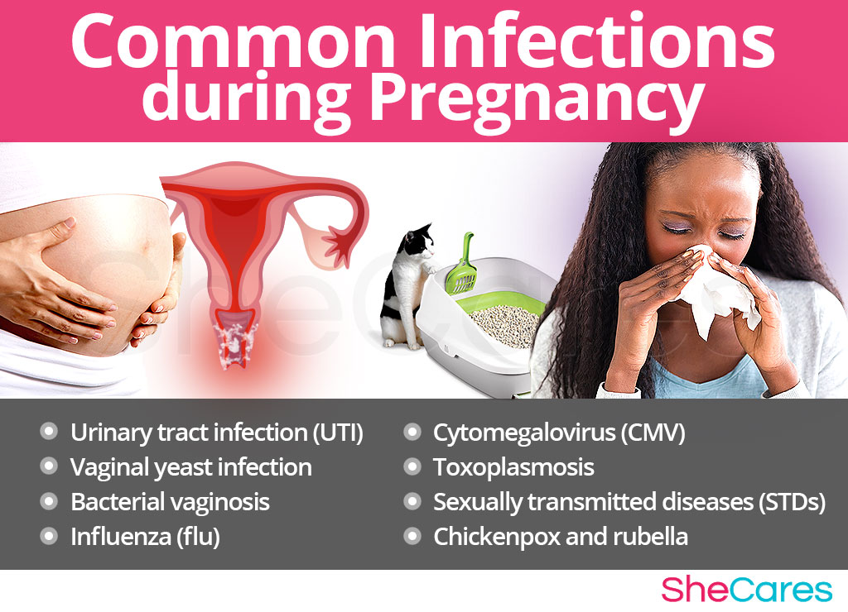

Slide 4
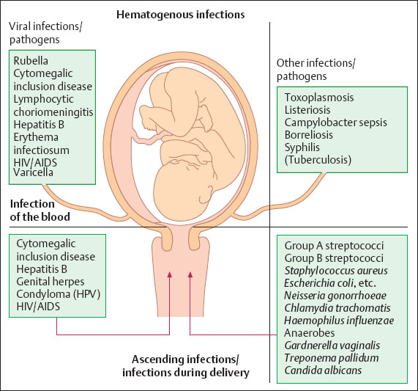

Slide 5
The Food and Drug Administration (FDA)'s list of Pharmaceutical Pregnancy Categories helps medical providers (and their patients) know the prenatal safety of medications. The categories are A, B, C, D, and X. To break it down, here is what the different categories mean.
Category A: Shown to be safe for pregnant people
Category B: Animal studies did not show risk to the fetus; no adequate human studies
Category C: Animal studies showed adverse effects on the fetus or no animal or human studies
Category D: Animal studies showed increased risk to the fetus, but the benefits may outweigh the risks
Category X: Animal studies show clear risk and no benefits.

Slide 6
Penicillins
Penicillin | Penicillin G Aqueous penicillin G Procaine penicillin G Benzathine penicillin G Penicillin V | Strep. pyogenes (Grp.A)** Step. agalactiae (Grp.B)** C. perfringens(Bacilli)** | Hypersensitivity reaction Hemolytic anemia
Aminopenicillins | Ampicillin Amoxicillin | Above + ↑ Gram-negative: E. faecalis** E. Coli** | Above
Penicillinase-resistant-penicillins | Methicillin Nafcillin Oxacillin Cloxacillin Dicloxacillin | Above + PCNase-producingStaph. aureus | Above + Interstitial nephritis
Antipseudomonal penicillins | Carbenicillin Ticarcillin Piperacillin | Above + Pseudomonas aeruginosa** | Abo

Slide 7
Cephalosporins
1st generation | Cefazolin Cephalexin | Staph. aureus** Staph. epidermidis** Some Gram-negatives: E. Coli Klebsiella | Allergic reaction Coombs-positive anemia (3%)
2nd generation | Cefoxitin Cefaclor Cefuroxime | Above + ↑ Gram-negative | Allergic Reaction ETOH Disulfiram reaction
3rd generation | Ceftriaxone Cefotaxime Ceftazidime Cefepime (4th generation) | Above + ↑ Gram-negative Pseudomonas | Allergic Reaction ETOH Disulfiram reaction

Slide 8
Carbapenems
Imipenem (+ cilastatin)
Meropenem
Doripenem
Ertapenem

Slide 9
Other Cell Wall Inhibitors
Vancomycin (bactericidal: disrupts peptioglycan cross-linkage) | Vancomycin | MRSA** PCN/Ceph allegies** S. aureus S. epidermidis | Red man syndrome Nephrotoxicity Ototoxicity
Beta-lactamase Inhibitors (bactericidal: blocking cross linking) | Clavulanic Acid Sulbactam Tazobactam | S aureus** S epidermis** E.Coli** Klebsiella** | Hypersensitivity Reaction Hemolytic anemia
Carbapenems | Imipenem (+ cilastatin) Meropenem Doripenem Ertapenem | Broadest activity of any antibiotic (except MRSA, Mycoplasma)
Aztreonam | Aztreonam | Gram-negative rods Aerobes Hospital-acquired infections
Polymyxins | Polymyxin B Polymyxin E | Topical Gram-negative infections
Bacitracin | Bacitracin | Topical Gram-positive infections

Slide 10
Fluoroquinolones
Fluoroquinolones (bactericidal: inhibit DNA gyrase enzyme, inhibiting DNA synthesis)
1st generation | Nalidixic acid | Steptococcus Mycoplasma Aerobic Gram + | Phototoxicity Achilles tendon rupture Impaired fracture healing
2nd generation | Ciprofloxacin Norfloxacin Enoxacin Ofloxacin Levofloxacin | As Above +Pseudomonas | as above
3rd generation | Gatifloxacin | As above + Gram-positives | as above
4th generation | Moxifloxacin Gemifloxacin | As above + Gram-positives + anaerobes | as above

Slide 11
Glycopeptides and Lipoglycopeptides
Vancomycin
Telavancin
Oritavancin
Dalbavancin

Slide 12
Macrolides and Ketolides

Slide 13
Classification (depending on the methods of obtaining and the number of carbon atoms in the macrocyclic lactone ring, which is their structural basis):
14-членне | 15-членне (азаліди) | 16-членне
Natural
erythromycin, oleandomycin) |  | Spiramycin (Rovamycin) Josamycin (Vilprofen) Midekamycin (Macropen)
Synthetic
Roxithromycin (Rulid) Clarithromycin (Clacid) Dirithromycin Telithromycin Flurithromycin | Azithromycin (Sumamed) | Myocamycin Rokitamycin
Similar in mechanism of action to macrolide antibiotics are ketolides (telithromycin), which, unlike macrolides, are able to overcome some resistance mechanisms of Gr(+) bacteria.

Slide 14
Anti-50S ribosomal subunit
Macrolides (bacteriostatic: reversibly binds 50S) | Erythromycin Azithromycin Clarithromycin | Streptococcus H. influenzae Mycoplamsa pneumonia | Coumadin Interaction (cytochrome P450)
Chloramphenicol (bacteriostatic) | Chloramphenicol | H influenzae Bacterial Meningitis Brain absces | Aplastic Anemia Gray Baby Syndrome
Lincosamide (bacteriostatic: inhibits peptidyl transferase by interfering with amino acyl-tRNA complex) | Clindamycin | Bacteroides fragilis S aureus Coagulase-negative Staph & Strep Excellent Bone Penetration | Pseudomembranous colitis Hypersensitivity Reaction
Linezolid (variable) | Linezolid | Resistant Gram-positives
Streptogramins | Quinupristin Dalfopristin | VRE GAS and S. aureus skin infections

Slide 15
Tetracyclines
Classification:
Biosynthetic - tetracycline, oxytetracycline.
Semi-synthetic - methacycline, doxycycline (vibramycin)
Combined - oletetrin, ericycline

Slide 16
Aminoglycosides
(bactericidal: irreversible binding to 30S) | Gentamicin Neomycin Amikacin Tobramycin Streptomycin | Aerobic Gram-negatives Enterobacteriaceae Pseudomonas | Nephrotoxicity Ototoxicit

Slide 17
Other DNA Inhibitors
Metronidazole(bacteridical: metabolic biproducts disrupt DNA) | Metronidazole (Flagyl) | Metronidazole (Flagyl) | Anaerobics | Seizures Crebelar dysfunction ETOH disulfram reaction
RNA Synthesis Inhibitors
Rifampin(bactericidal: inhibits RNA transcription by inhibiting RNA polymerase) | Rifampin | Rifampin | Staphylococcus Mycobacterium (TB) | Body fluid discoloration Hepatoxicity (with INH)
Mycolic Acids Synthesis Inhibitors
Isoniazid | Isoniazidz |  | TB Latent TB
Folic acid Synthesis Inhibitors
Trimethoprim/ Sulfonamides (bacteriostatic: inhibition with PABA) | Trimethoprim/Sulfamethoxazole (SMX) Sulfisoxazole Sulfadiazine | Trimethoprim/Sulfamethoxazole (SMX) Sulfisoxazole Sulfadiazine | UTI organisms Proteus Enterobacter | Thrombocytopenia Avoid in third trimester of pregnancy
Pyrimethamine | Pyrimethamine | Pyrimethamine | Malaria T. gondii

Slide 18

ДЯКУЮ ЗА УВАГУ!

