Slide 1
Antibiotics

Slide 2
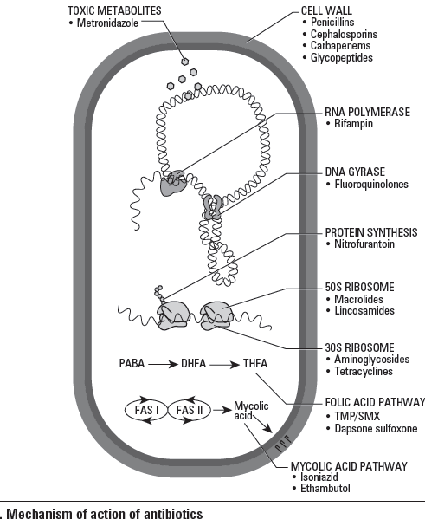

Slide 3
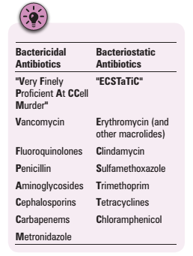

Slide 4
Empiric Antimicrobial Therapy
Choose antibiotic(s) to cover for most likely and lethal organisms for the type of infection
Prior to obtaining laboratory results (usually reserved for serious infections)
Adjust antibiotic(s) based on C&S
  if causative organism identified, use antibiotic to which organism is sensitive
  if causative organism not identified, re-evaluate need for ongoing antimicrobial therapy (and continue with empiric antibiotic(s) if indicated)

Slide 5
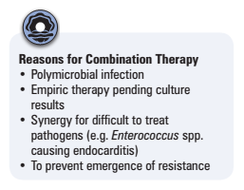

Slide 6
Classification
Cell Wall Inhibitors
Glycopeptides
Protein Synthesis Inhibitors
Topoisomarase Inhibitors
Anti-metabolites
Anti-mycobacterials
Sulfones

Slide 7
Cell Wall Inhibitors
Include :
-penicillins
-cephalosporins
-carbapenems
-glycopeptides

Slide 8
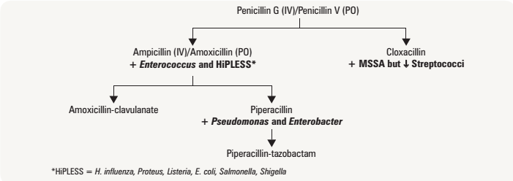
Penicillins

Slide 9
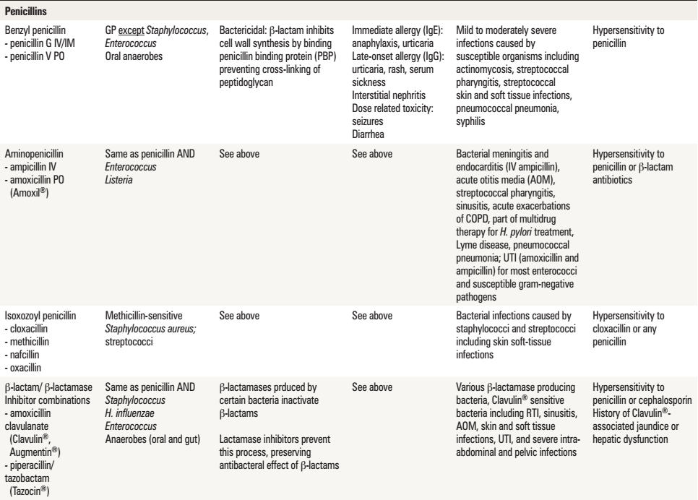

Slide 10
Cephalosporins (IV/PO)
1st generation: cephalexin/cefazolin (mostly GP, some GN)
2nd generation: cefuroxime/cefuroxime (some GP and some GN, *anaerobes)
3rd generation: cefixime/cefotaxime, ceftriaxone (good Streptococcalcoverage, mostly GN) and ceftazidime (no GP, mostly GN, Pseudomonas)
4th generation: --/cefepime (most GP, most GN, Pseudomonas)

Slide 11
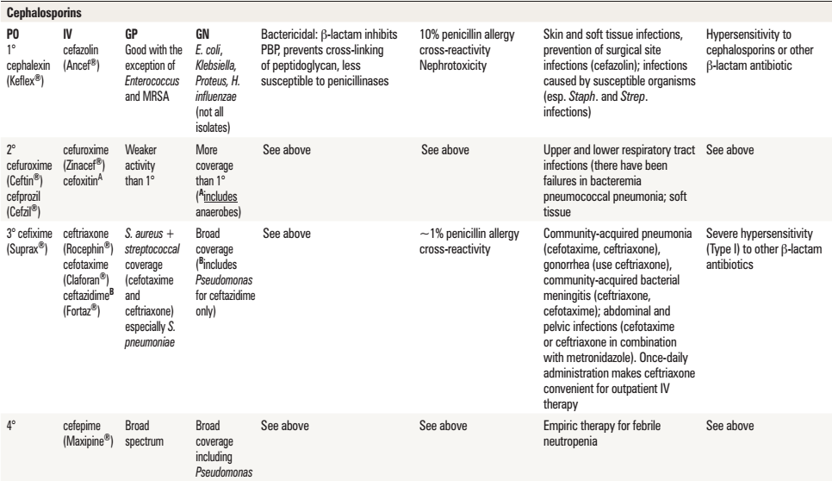

Slide 12
Carbapenems
(broad coverage: GP, GN and anaerobes)
imipenem (+ Pseudomonas)
meropenem (+ Pseudomonas)
ertapenem

Slide 13
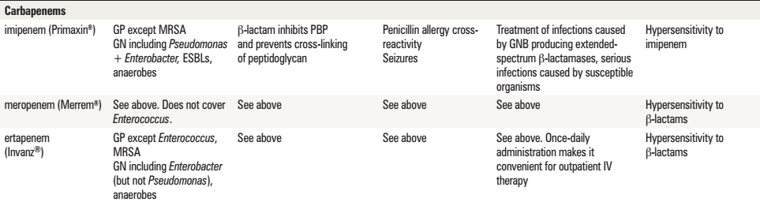

Slide 14
Glycopeptides
(all GP and C. difficile– the oral form)
vancomycin

Slide 15
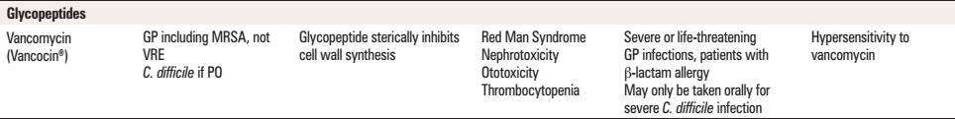

Slide 16
Protein Synthesis Inhibitors
50S ribosome inhibitors
-Macrolides
-Lincosamides
30S ribosome inhibitors
-Aminoglycosides
-Tetracyclines

Slide 17
Macrolides
[GP, Hemophilus, and atypical bacteria (Legionella, Chlamydophila, Mycoplasma)]
erythromycin
clarithromycin
azithromycin

Slide 18
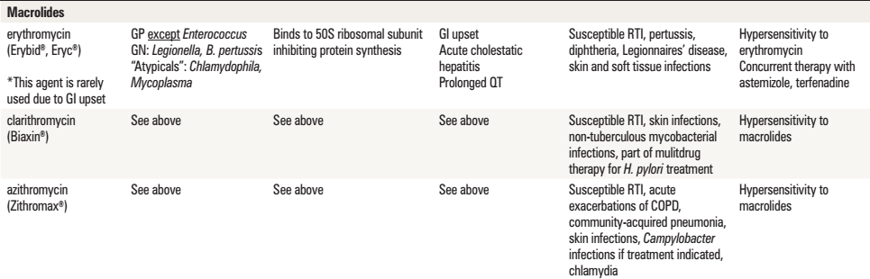

Slide 19
Lincosamides
clindamycin (most GP, GN anaerobes)
chloramphenicol (broad-spectrum)
linezolid (for resistant GP infections)

Slide 20
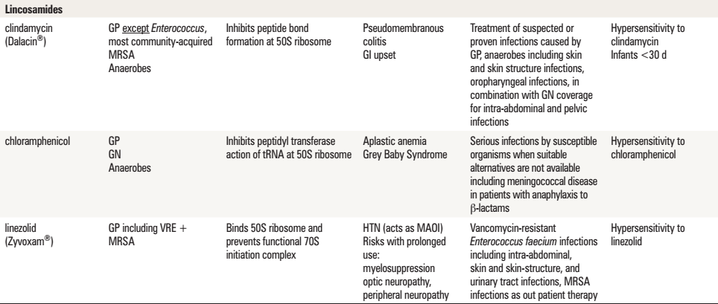

Slide 21
Aminoglycosides
(GN aerobic bacilli)
gentamicin
tobramycin
amikacin

Slide 22
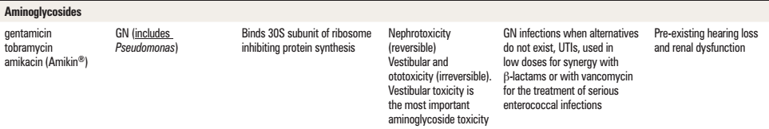

Slide 23
Tetracyclines
(GP, syphilis, Chlamydophila, Rickettsia, Mycoplasma)
doxycycline/tetracycline

Slide 24
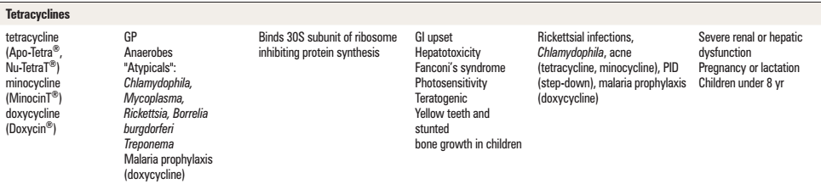

Slide 25
Topoisomarase Inhibitors
Flouroquinolones
Rifampin
Metronidazole

Slide 26
Fluoroquinolones
(GN – although resistance becoming a huge problem)
ciprofloxacin (+ Pseudomonas)
norfloxacin (for UTI only)
respiratory fluoroquinolones (some GP, GN, "atypicals", Legionella, Mycoplasma, Chlamydophila)
levofloxacin
moxifloxacin (+ anaerobes)

Slide 27
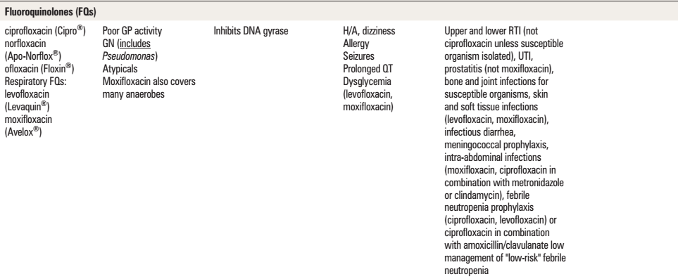

Slide 28
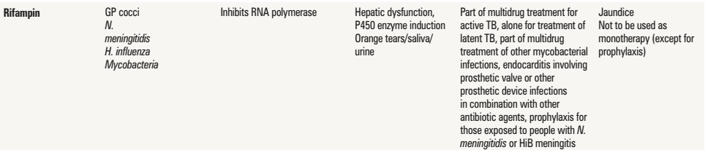
Rifampin
(GP mostly, H. Inf., N. meningitidis and mycobacteria)

Slide 29
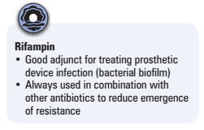

Slide 30
Metronidazole
(anaerobes incl. C. difficile; Trichomonas, Entamoeba)

Slide 31
Anti-metabolites
Trimethoprim-sulfamethoxazole
Nitrofurantoin

Slide 32
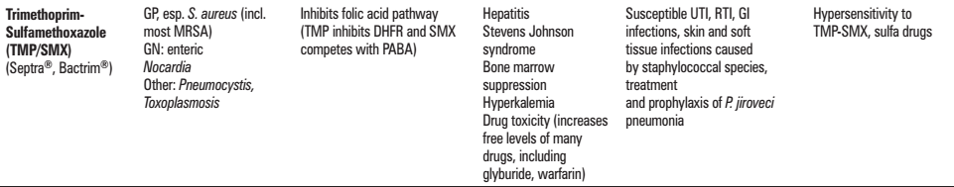
TMP/SMX
(GN bacilli, S. saprophyticus, Enterococcus)

Slide 33
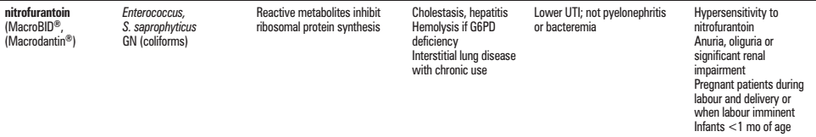
Nitrofurantoin
(GN bacilli, S. saprophyticus, Enterococcus)

Slide 34
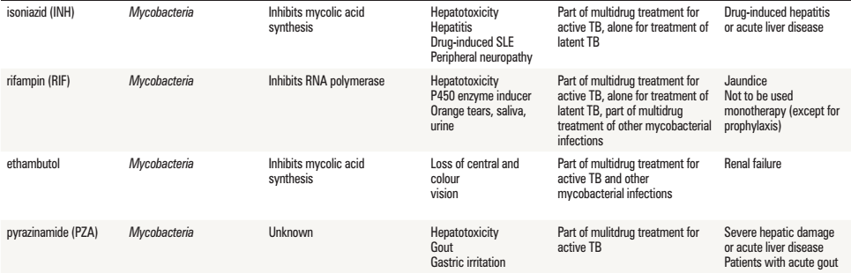
Anti-mycobacterials

Slide 35
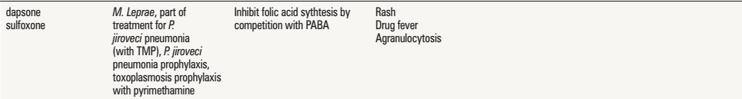
Sulfones

Slide 36
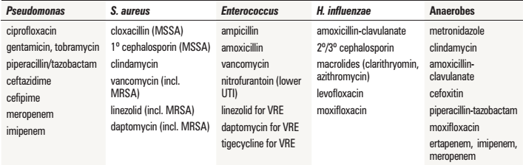
Antibiotics for Selected Bacteria

Slide 37
Others
treatment for C. Difficile: metronidazole OR oral vancomycin; consider both in serious infection

Slide 38
Resources
Toronto Notes 2014

Slide 39
Thank You
The End

