Slide 1
Carbapenems

Slide 2
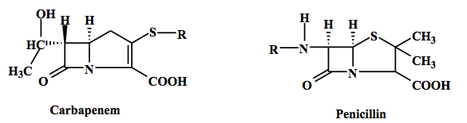
Carbapenems
Carbapenem antibiotics were originally developed from thienamycin,
a naturally derived product of Streptomyces cattleya.
Carbapenems are very similar to the penicillins (penams), but the sulfur atom in position 1 of the structure has been replaced with a carbon atom, hence the name of the group, is carbapenems.

Slide 3
Spectrum
Carbapenems are active against
Gram Positive strains
(Streptococcus and Staphylococcus, Corynebacterium and Listeria)
Gram Negative strains
(Escherichia coli, Proteus mirabilis, Enterobacter cloacae, Serratia marcescens, Helicobacter pylori, Salmonella enteritidis, Salmonella typhi)
P. aeruginosa & Acinetobacter Baumannii

Slide 4
Mechanism of action
Carbapenems are bactericidal.
Kills bacteria by binding to penicillin-binding proteins thus inhibiting cell wall synthesis.

Slide 5
Carbapenems
Carbapenems | Microbiology
Ertapenem | Bactericidal for both Gram-positive and Gram-negative organisms and therefore useful for empiric broad-spectrum antibacterial coverage. (Note: MRSA resistance to this class.)
Doripenem
Imipenem/Cilastatin
Meropenem
Notes:
Empiric:a person who, in medicine or other sciences, relies solely on observation and experiment.

Slide 6
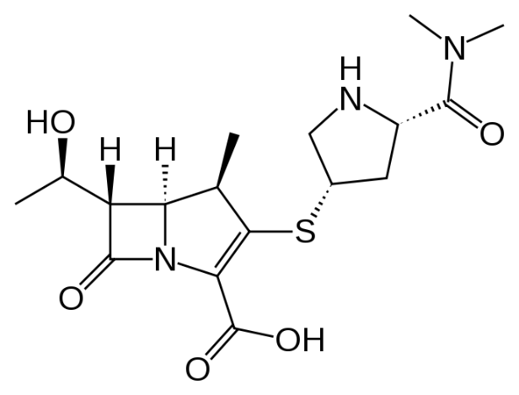
Meropenem

Slide 7
Meropenem
It is a β-lactam and belongs to the subgroup of carbapenem
Meropenem is an ultra-broad-spectrum antibiotic
Active against gram positive, gram negative, aerobic, anaerobic and atypical bacteria.
It penetrates well into many tissues and body fluids, including cerebrospinal fluid, bile, heart valve, lung, and peritoneal fluid
Meropenem is the only drug recommended in 3 months children

Slide 8
Spectrum
Meropenem Active against
Gram-positive aerobes | Enterococcus faecalis, Staphylococcus aureus, Streptococcus agalactiae, Streptococcus milleri Streptococcus pneumoniae, Streptococcus pyogenes
Gram-negative aerobes | Citrobacter freundii, Citrobacter koseri, Enterobacter aerogenes, Enterobacter cloacae, Escherichia coli, Haemophilus influenzae, Klebsiella oxytoca,
Gram-positive anaerobes | Clostridium perfringens, Peptoniphilus asaccharolyticus, Peptostreptococcus species
Gram-negative anaerobes | Bacteroides caccae, Bacteroides fragilis group, Prevotella bivia, Prevotella disiens.
Atypical bacteria | Chlamydiaceae and Mycoplasmataceae
Notes:
Unlike imipenem, it is stable to dehydropeptidase-1, so can be given without cilastatin.
Atypical bacteria are bacteria that do not color with gram-staining but rather remain colorless: they are neither Gram-positive nor Gram-negative. These include the Chlamydiaceae and the Mycoplasmataceae (including mycoplasma and ureaplasma); the Rickettsiaceae are also often considered atypical.

Slide 9
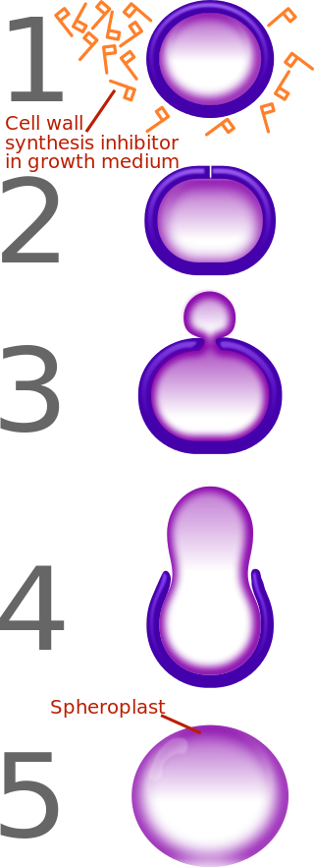
Mechanism of action
Meropenem exerts its bactericidal activity by inhibiting bacterial cell wall synthesis in Gram-positive and Gram-negative bacteria through binding to penicillin-binding proteins (PBPs).
Notes:
Unlike imipenem, it is stable to dehydropeptidase-1, so can be given without cilastatin.

Slide 10
Pharmacokinetic Parameters
Pk Parameters | Meropenem
Peak Concentration | 1h(range: 0.5 -1.5 hours)
T1/2 | 1 h
Excretion | Urine 70%,Faecal 2%

Slide 11
Adult Dose
Indication | Administered every 8 hours | Duration
Severe pneumonia including hospital and ventilator-associated pneumonia. | 500 mg or 1 g | 10-14 days
Broncho-pulmonary infections in cystic fibrosis | 2 g | 10-14 days
Complicated urinary tract infections | 500 mg or 1 g | 10-14 days
Complicated intra-abdominal infections | 500 mg or 1 g | 10-14 days
Complicated skin and soft tissue infections | 500 mg or 1 g | 10-14 days
Bacterial Meningitis | 2 g IV | 7 to 21 days
Notes:
Meropenem is usually given by intravenous infusion over approximately 15 to 30 minutes (see section 6.2, 6.3 and 6.6).
Alternatively, doses up to 1 g can be given as an intravenous bolus injection over approximately 5 minutes. There are limited safety data available to support the administration of a 2 g dose in adults as an intravenous bolus injection.

Slide 12
Paediatric Dose
The recommended dose regimens are shown in the table below
Infection | Dose to be administered every 8 hours
Severe pneumonia including hospital and ventilator-associated pneumonia | 10 or 20 mg/kg
Broncho-pulmonary infections in cystic fibrosis | 40 mg/kg
Complicated urinary tract infections | 10 or 20 mg/kg
Complicated intra-abdominal infections | 10 or 20 mg/kg
Complicated skin and soft tissue infections | 10 or 20 mg/kg
Acute bacterial meningitis | 40 mg/kg
Management of febrile neutropenic patients | 20 mg/kg

Slide 13
Paediatric Dose
Children under 3 months of age
The safety and efficacy of meropenem in children under 3 months of age have not been established, limited pharmacokinetic data suggest that 20 mg/kg every 8 hours may be an appropriate regimen
Children over 50 kg body weight
The adult dose should be administered. There is no experience in children with renal impairment.

Slide 14
Special population
Pregnancy : Category B
This drug should not be used during pregnancy unless the benefit outweighs the risk to the foetus
Not recommended in lactating mothers
Dose in elderly patients
No dose adjustment is required for the elderly with normal renal function or creatinine clearance values above 50 ml/min.
Notes:
Pregnancy Categories
S FDA pregnancy category B:
A:Generally acceptable. Controlled studies in pregnant women show no evidence of fetal risk.
B:May be acceptable. Either animal studies show no risk but human studies not available or animal studies showed minor risks and human studies done and showed no risk.
C:Use with caution if benefits outweigh risks. Animal studies show risk and human studies not available or neither animal nor human studies done.
D:Use in LIFE-THREATENING emergencies when no safer drug available. Positive evidence of human fetal risk.
X:Do not use in pregnancy. Risks involved outweigh potential benefits. Safer alternatives exist.
NA:Information not available.

Slide 15
Renal Insufficiency
Renal impairment Creatinine clearance | Dosage
CrCl >50 mL/min | 0.5-1 g IV q 8hr
CrCl 26-50 mL/min | 0.5-1 g IV q 12hr
CrCl 10-25 mL/min | 0.25-0.5 g IV q 12hr
CrCl <10 mL/min | 0.25-0.5 g IV q 24hr
Hepatic insufficiency
No dose adjustment required in Hepatic impairment

Slide 16
Preparation Of Solution
For Intravenous Bolus Administration
Constitute injection vials (500 mg and 1 g) with Water for Injection.
Shake to dissolve and let stand until clear.
VIAL strength | AMOUNT OF DILUENT ADDED (ML) | APPROXIMATE AVERAGE CONCENTRATION (MG/ML)
500 mg | 10 | 50
1 gram | 20 | 50
Notes:
intravenous bolus
a relatively large dose of medication administered into a vein in a short period, usually within 1 to 30 minutes. The IVbolus is commonly used when rapid administration of a medication is needed, such as in an emergency;

Slide 17
Preparation Of Solution
For Infusion
Infusion vials (500 mg and 1 gram) may be directly constituted with a compatible infusion fluid. Alternatively, an injection vial may be constituted, then the resulting solution added to an intravenous container and further diluted with an appropriate infusion fluid
Compatible fluids are 0.9% Nacl, 5% Dextrose and water for injection
Notes:
Infusion therapy involves the administration of medication through a needle or catheter. It is prescribed when a patient’s condition cannot be treated effectively by oral medications.

Slide 18
After Reconstitution
The reconstitution solutions for intravenous injection or infusion should be used immediately.
Diluent | Number of Hours Stable at Controlled Room Temperature 15-25°C (59-77°F) | Number of Hours Stable at 4°C (39°F)
Sodium Chloride Injection 0.9% | 4 | 24
Dextrose Injection 5.0% | 1 | 4

Slide 19
Adverse Reactions
Inflammation at the injection site
Injection site reaction
Pain at the injection site
Edema at the injection site
Notes:
Thrombophlebitis :inflammation of the wall of a vein with associated thrombosis, often occurring in the legs during pregnancy.
Edema:a condition characterized by an excess of watery fluid collecting in the cavities or tissues of the body.

Slide 20
Warnings and Precautions
The concomitant use of valproic acid/sodium valproate and meropenem is not recommended
Meropenem may reduce serum valproic acid levels.
Contraindicated in hypersensitivity

Slide 21
Interaction
Interacting drugs | Interactions
Valproic acid | Meropenem reduced the serum concentrations of valproic acid to below the therapeutic concentration range , therefore increasing the risk of breakthrough seizures.
Probenecid | Probenecid competes with meropenem for active tubular secretion, resulting in increased plasma concentrations of meropenem. Co-administration of probenecid with meropenem is not recommended.
Store below below 25°C.

Slide 22
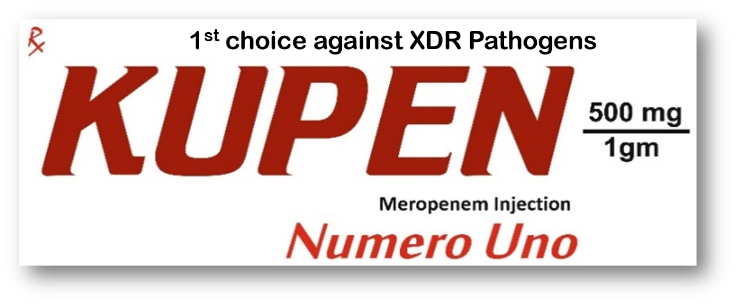
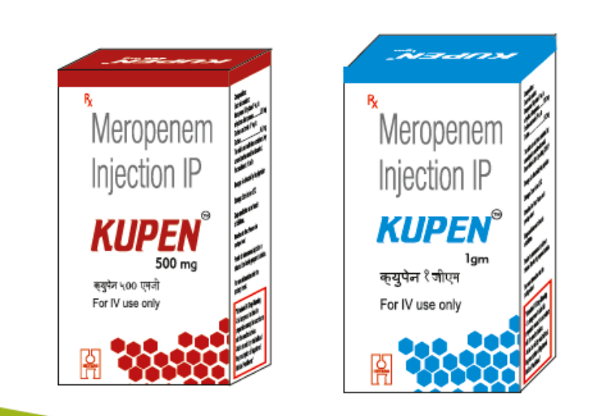
Introducing…..

Slide 23
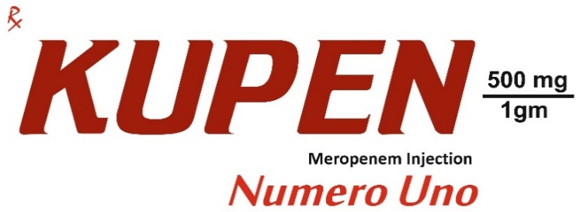
Indication
Complicated Skin and soft tissue infection
Septicaemia
Bacterial Meningitis

Slide 24
Target Customer
Neuro
Surgeon
Physician
Intensivist
Gastro

Slide 25
Market Opportunity

Slide 26
s.n | BRAND | COMPANY | MAT UNIT DEC 15 | MAT UNIT DEC 16 | MAT UNIT GR DEC 16 | MAT VAL DEC 15 | MAT VAL DEC 16 | MAT VAL GR DEC 16
 | Total |  | 8014.18 | 10346.90 | 29.11 | 496.17 | 652.47 | 31.50
1 | MERO | ARISTO | 1936.22 | 2506.71 | 29.46 | 66.00 | 84.44 | 27.94
2 | MEROMAC | MACLEODS | 1296.68 | 1575.75 | 43.98 | 42.68 | 52.70 | 45.97
3 | MEROTEC | ZUVENTUS | 913.66 | 1066.40 | 16.72 | 33.32 | 41.98 | 25.99
4 | MEROTROL | LUPIN | 797.76 | 959.50 | 20.27 | 37.34 | 39.48 | 5.74
5 | MERONEM | ASTRAZENECA | 627.91 | 944.42 | 50.41 | 112.70 | 170.64 | 51.41

Slide 27
BRAND NAME | COMPANY | MEROPENEM 500MG PRICE | MEROPENEM 1G PRICE
MERONEM | ASTRAZENECA | 1347 | 2496
MERO | ARISTO | 499 | 648
MEROTROL | LUPIN | 599 | 889
MEROMAC | MACLEODS | 349 | 592
MEROCRIT | CIPLA | 1290 | 2425
KUPEN | HETERO | 378 | 599

Slide 28
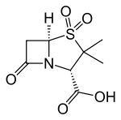
Sulbactam

Slide 29
Sulbactam
Sulbactam is a β-lactamase inhibitor.
This drug is given in combination with β-lactam antibiotics to inhibit β-lactamase, an enzyme produced by bacteria that destroys the antibiotics.

Slide 30
Mechanism of action
Sulbactam is an irreversible inhibitor of β-lactamase it binds to the enzyme and does not allow it to degrade the antibiotic.

Slide 31
Sulbactam
Pk Parameters | Sulbactam
Peak Concentration | 30 min
Volume of distribution | 13.9L
Excretion | Urine

Slide 32
Meropenem Resistance
Resistance arises due to mutations in penicillin-binding proteins, production of metallo-β-lactamases
Percentage of resistance for Meropenem is 84% in MDR bacteria like Acinetobacter baumannii & Pseudomonas aeruginosa

Slide 33
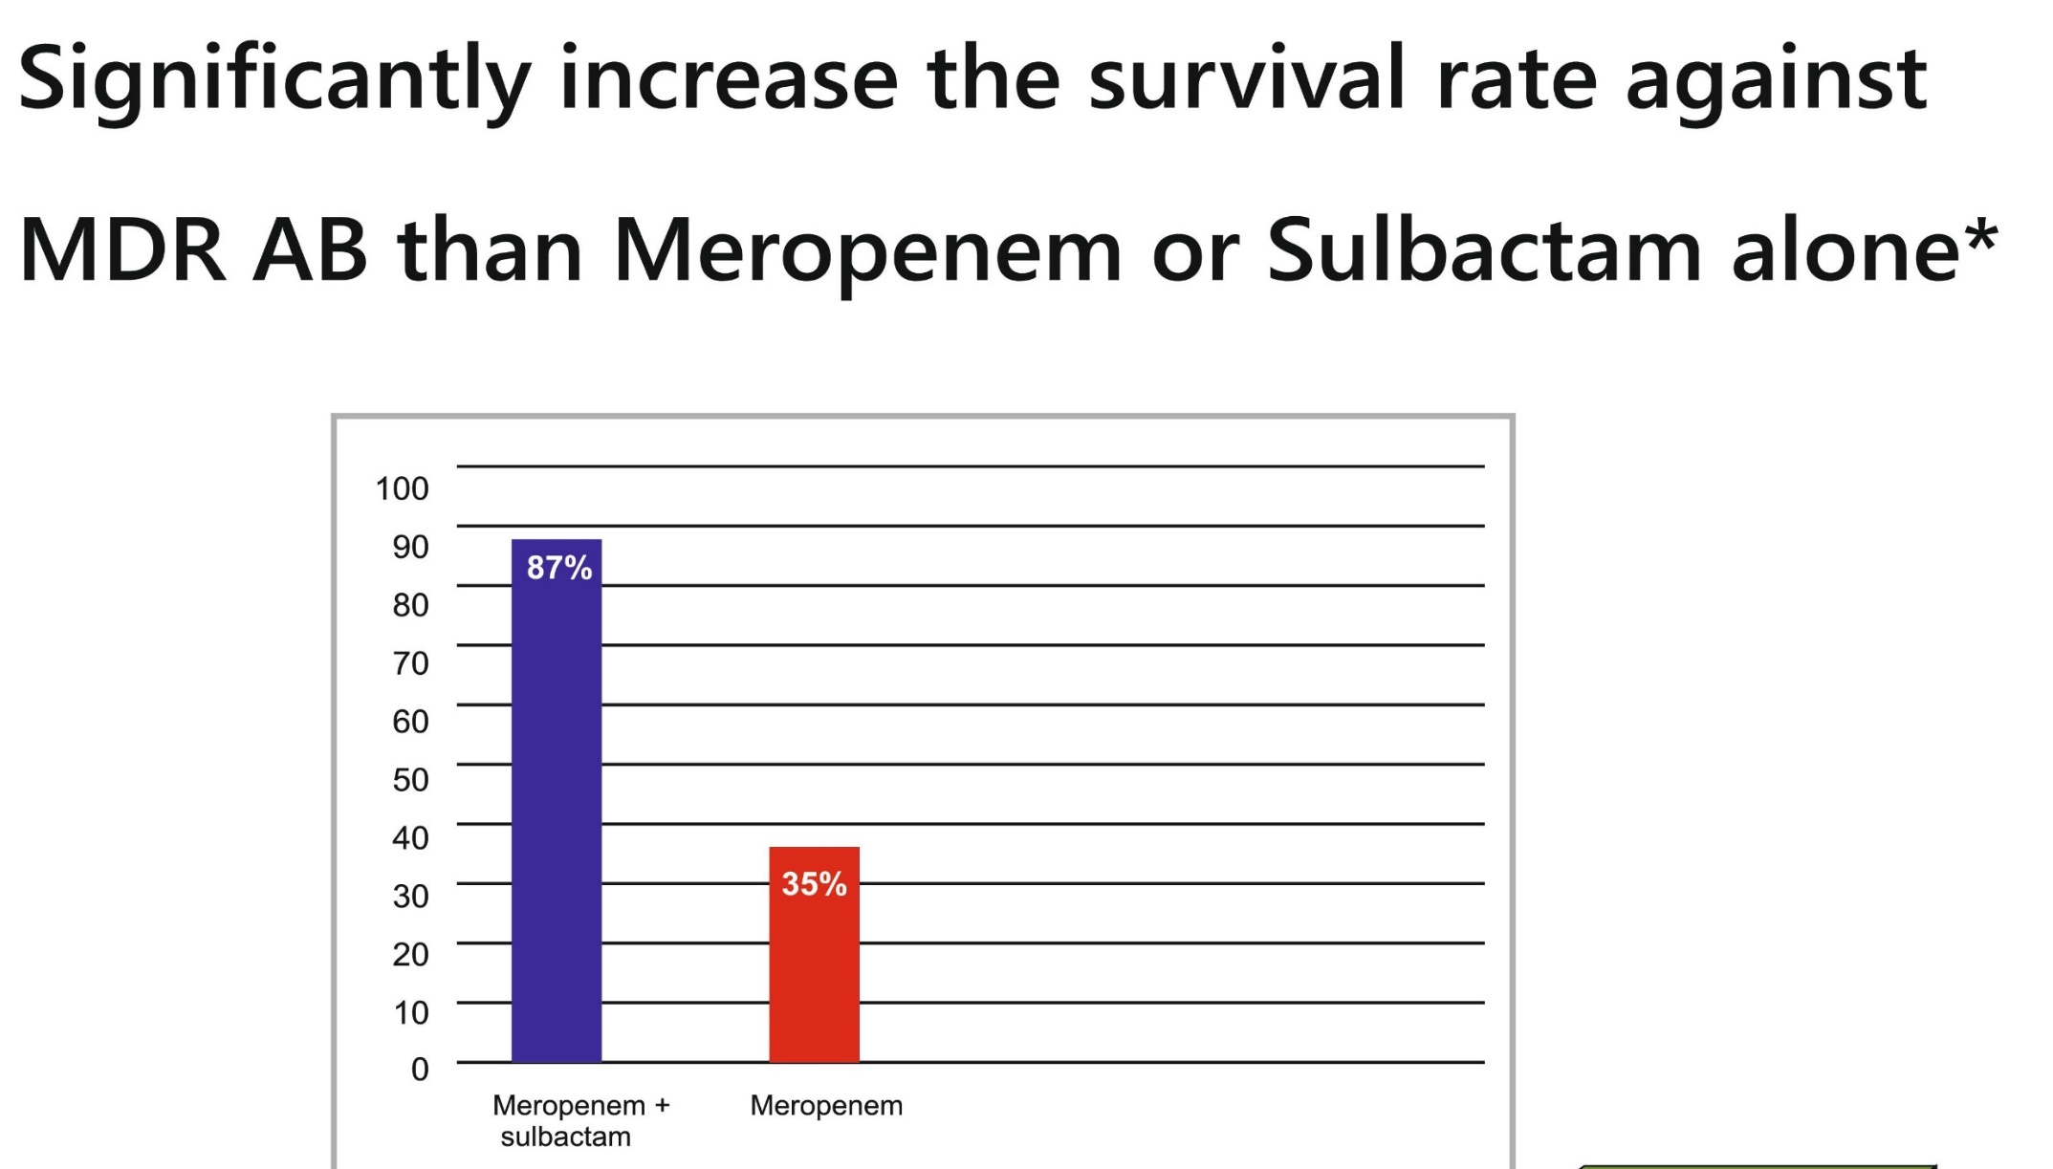
Meropenem + Sulbactam

Slide 34
Meropenem + Sulbactam
Meropenem combined with sulbactam, was active against carpabenem-resistant strains and, in one instance, even against MBL-producing strains
Meropenem with sulbactam for the treatment of infections with MDR A. baumannii, especially VAP, have been published, achieving defined “favorable outcomes”
Ref: Global Challenge of Multidrug-Resistant Acinetobacter baumannii

Slide 35
Indication
Indication | Dose and Administration | Duration
Severe Pneumonia | 1.5g q8h | 7-10 days
Septicaemia | 1.5g q8h | 7-10 days
cSSTIs | 1.5g q8h | 7-10 days

Slide 36
Renal imapairment
Creatinine clearance | Dose | Doing interval
CrCl >50 mL/min | Recommended dose 0.5-1g | q 8 h
CrCl 26-50 mL/min | Recommended dose 0.25-1g | q 12 h
CrCl 10-25 mL/min | One-half recommended dose | q 12 h
CrCl <10 mL/min | One-half recommended dose | q 24 h

Slide 37
Special Populations
Pregnancy category B
Benefit justifies the potential risk of foetus
Not recommended in lactating mothers
Paediatric use
Not recommended in Paediatric patients
Geriatric use
No dose adjustment is required for the elderly with normal renal function or creatinine clearance values above 50 ml/min.

Slide 38
Preparaion of solution
Intravenous bolus administration: Constitute injection vial (1.5g) with water for injection. Shake to dissolve. Constituted solutions are clear , and colorless or pale yellow
Injection vial constituted with water for injection for bolus administration upto 50mg/ml of meropenem may be stored for upto
2 hr controlled room temperature 15-25⁰ C or 12 hr at 4⁰ C
Vial Size(mg) | Amount Diluent Added (mL) | Approx avg concentration (mg/mL)
1.5g | 20 | 75

Slide 39
For Infusion
Infusion vial (1.5g) may be directly constituted infusion fluid. Alternately an injection vial may be constituted then the resulting solution added to an I.V. container and further diluted with an appropriate infusion fluid.
After reconstitute 0.9% Nacl solution and water for injection, Merpenem stable at room temp for 8h and under refrigerator for 18hr Solution of I.V. Meropenem should not be frozen
Store at 25⁰ C

Slide 40

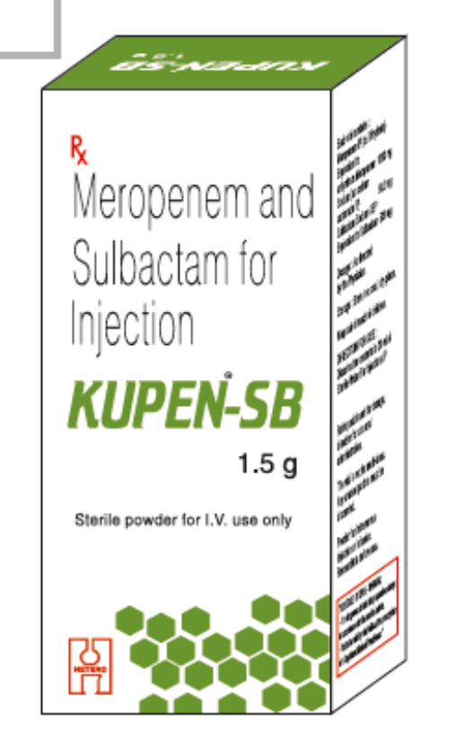
Introducing…..

Slide 41
Indications
Severe Pneumonia
Bacteraemia/Septicaemia
Severe UTIs

Slide 42
Target Customer
Nephro
Physician
Intensivist
Gastro

Slide 43
Market opportunity

Slide 44
s.n | BRAND | COMPANY | MAT UNIT DEC 15 | MAT UNIT DEC 16 | MAT UNIT GR DEC 16 | MAT VAL DEC 15 | MAT VAL DEC 16 | MAT VAL GR DEC 16
 | Total |  | 576.74 | 651.84 | 13.02 | 44.28 | 48.54 | 9.63
1 | MERO SB | ARISTO | 311.77 | 350.21 | 12.33 | 19.23 | 22.66 | 17.85
2 | MEROMAC PLUS | MACLEODS | 80.94 | 77.36 | -4.42 | 4.76 | 4.55 | -4.42
3 | MEROBAX SB | ARISTO | 62.93 | 56.86 | -9.64 | 5.28 | 5.16 | -2.22
4 | MEROTROL-S | LUPIN LTD | 39.03 | 48.65 | 24.65 | 4.07 | 4.43 | 8.68
5 | MEROTEC XP | ZUVENTUS HEALTHCARE LTD | 25.71 | 42.71 | 66.12 | 1.86 | 3.09 | 66.12

Slide 45
BRAND NAME | COMPANY | PRICE
MERO SB | ARISTO | 848
MEROBAX SB | ARISTO | 1149
MEROMAC PLUS | MACLEODS | 1390
MERIMIX | WOCKHARDT | 2950
MEROTROL S 1.5G | LUPIN | 1265
MEROPLAN 1.5G | ABBOTT | 2690
ZAXTER XP | ALKEM | 899
KUPEN SB | HHCL | 899

Slide 46
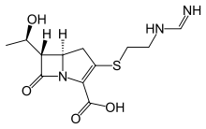

Imipenem + Cilastatin

Slide 47
Imipenem
Imipenem is an intravenous β-lactam antibiotic
It was the first member of the carbapenem class of antibiotics.
It is particularly important for its activity against Pseudomonas Aeruginosa and the Enterococcus species.
Imipenem is rapidly degraded by the renal enzyme dehydropeptidase 1 when administered alone, and is always co-administered with cilastatin to prevent this inactivation

Slide 48
Cilastatin
Cilastatin is a chemical compound which inhibits the human enzyme dehydropeptidase.
Dehydropeptidase is an enzyme found in the kidney and is responsible for degrading the antibiotic imipenem.
Cilastatin with imipenem in order to protect it from dehydropeptidase and prolong
its antibacterial effect.
Notes:
This property is due to the phisico-chemical similarities between membrane dipeptidase (MDP), the compound it is usually set to target, and the bacterial metallo-beta-lactamase Therefore Cilastatin is considered a beta-lactamase inhibitor

Slide 49
Mechanism of action
Imipenem acts as an antimicrobial through inhibiting cell wall synthesis of various Gram-positive and Gram-negative bacteria.
Bactericidal effects result through inhibition of cellular growth and division and the loss of cell wall integrity, eventually causing cell wall lysis.
Cilastatin prevents renal metabolism of Imipenem
Notes:
It remains very stable in the presence of β-lactamase produced by some bacteria, and is a strong inhibitor of β-lactamases from some Gram-negative bacteria that are resistant to most β-lactam antibiotics.

Slide 50
Spectrum
Imipenem Spectrum of activity against
Aerobic gram-positive | S. aureus including penicillinase-producing strains, Group D streptococcus including E., Streptococcus pneumoniae, S. pyogenes (Group A streptococci), S. viridans group
Aerobic gram-negative | Acinetobacter spp., including A. calcoaceticus, Citrobacter spp., Enterobacter cloacae, E. coli, H. influenzae, K. pneumoniae, Pseudomonas aeruginosa Anaerobic gram-positive microorganisms: Peptostreptococcus spp.
Anaerobic gram-negative | Bacteroides spp., Fusobacterium spp.

Slide 51
Pharmacokinetics
PK Parameters | Imipenem | Cilastatin
Half-life | 1.11h | 1.2 h
C max | 21 to 58 μg/ml | 21 to 55 μg/ml
Excretion | Urine 70% | Urine 70%

Slide 52
Imipenem + Cilastatin Dosing
Mild infections | Fully susceptible organisms: 250 mg IV q6hr | Moderately susceptible organisms: 500 mg IV q6hr
Moderate infections | Fully susceptible organisms: 500 mg IV q6-8hr | Moderately susceptible organisms: 500 mg IV q6hr or 1 g IV q8hr
Severe infections | Fully susceptible organisms: 500 mg IV q6hr | Moderately susceptible organisms: 1 g IV q6-8hr; not to exceed 50 mg/kg/day or 4 g/day, whichever is lower

Slide 53
Adult Dose
Indication | Dose | Duration
Lower Respiratory Tract, Skin/Skin Structure, & Gynecologic Infections | 500 mg IV q12hr | depending on organism sensitivity
Intra-abdominal Infections | Mild to moderate: 500 mg IV q6hr Severe: 500 mg IV q6hr or 1 g q8hr | 4-7 days
Pseudomonas Infections (Pneumonia, folliculitis, bacteraemia) | 500 mg IV q6hr | depending on organism sensitivity
Urinary Tract Infections | Uncomplicated: 250 mg IV q6hr Complicated: 500 mg IV q6hr | depending on organism sensitivity
*IMIPENEM AND CILASTATIN
Is not indicated in patients with meningitis because safety and efficacy have not been established

Slide 54
Paediatric Dose
For children and infants the following dosage schedule is recommended:
(a) CHILDREN ≥ 40 kg body weight should receive adult doses.
(b) CHILDREN AND INFANTS < 40 kg body weight should receive 15 mg/kg at six hour intervals. The total daily dose should not exceed 2 gm.
Clinical data are insufficient to recommend dosing for children less than 3 months of age and paediatric patients with impaired renal function
Pregnancy Category C
Use with caution if benefits outweigh risks
Notes:
Cystic fibrosis :An inherited life-threatening disorder that damages the lungs and digestive system.

Slide 55
Renal Imapairment
Creatinine Clearance | Dose
CrCl ≥71 mL/min/1.73 m² | 250 mg IV q 6hr
CrCl 41-70 mL/min/1.73m² | 250 mg IV q 8hr
CrCl 21-40 mL/min/1.73 m² | 125-250 mg IV q12hr
CrCl ≤20 mL/min/1.73 m² | 125-250 mg IV q12hr
CrCl <5 mL/min/1.73 m² | Use IV only if hemodialysis is instituted within 48 hours
Hemodialysis: Give supplemental dose after each dialysis, then q12hr
Hepatic impairment
No dose adjustment is recommended in patients with impaired hepatic function
Notes:
Hepatotoxicity
More serious hepatic injury from imipenem/cilastatin is rare, but jaundice and liver test abnormalities have been reported in 0.1% of patients in prospective trials of the agent. Several instances of cholestatic jaundice arising during or shortly after therapy have been reported with imipenem-cilastatin
Obstructive Jaundice (Cholestatic Liver Disease) This develops when the flow of bile normally excreted by the liver is either reduced or blocked and retained in the bloodstream.

Slide 56
Reconstitution solutions
Reconstitution of infusion bottles
Reconstitute infusion bottles with 100 mL of compatible diluent It should be shaken until a clear solution is obtained.
Dose ( mg) | Volume of solvent to be added (ml) | Mean approximate concentration of product (mg/ml of imipenem)
500 | 10 | 5
Diluents: 0.9% Nacl & 5% or 10% Dextrose
Store at 25⁰ C

Slide 57
I.V. Preparation of solution
For I.V. administration Constitute injection vial with compatible diluent
Reconstitute vials with a portion usually 10 mL of IV fluid
Normal colour ranges from clear to yellow, but solution should be discarded if brown
Diluent | Room Temperature (25°C) | Refrigeration (4°C)
0.9%Sodium Chloride | 4h | 24h
5% or 10% Dextrose | 4h | 24h

Slide 58
Adverse Reaction
Phlebitis
Eosinophilia
Miscellaneous dermatologic effects
Potentially false-positive Coombs test
Miscellaneous hematologic effects
Transient increase in blood urea nitrogen
Seizures
Nausea, diarrhoea, vomiting
Notes:
inflammation of the walls of a vein. phlebitis

Slide 59
Drug interactions
Generalized seizures have been reported in patients who received ganciclovir and IMIPENEM AND CILASTATIN
IMIPENEM AND CILASTATIN and probenecid results in only minimal increases in plasma levels of imipenem and plasma half-life, it is not recommended that probenecid be given with IMIPENEM AND CILASTATIN.
IMIPENEM AND CILASTATIN should not be mixed with or physically added to other antibiotics.
Notes:
Ganciclovir (INN) /ɡænˈsaɪkləvɪər/ or DHPG (9-(1,3-dihydroxy-2-propoxymethyl)guanine, alternative spelling: "Gancyclovir") is an antiviral medication used to treat cytomegalovirus (CMV) infections.

Slide 60
Warnings
Contraindications
Hypersensitivity to imipenem or cilastatin
Cautions
History of hypersensitivity to penicillins
Use with caution in CNS disorders (eg., history of seizures); adjust dosage in renal impairment to avoid risk of seizures; carbapenem use has been associated with seizures
Prolonged use increases risk of superinfections
Notes:
A superinfection is generally defined as a second infection superimposed on an earlier one, especially by a different microbial agent of exogenous or endogenous origin, that is resistant to the treatment being used against the first infection.

Slide 61

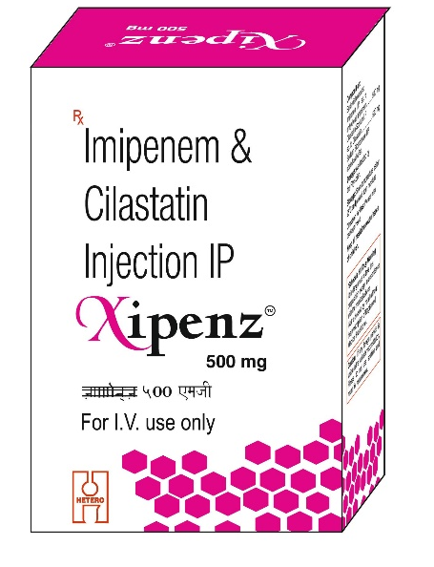
Introducing…..

Slide 62
Indication
Complicated Skin and soft tissue infection
IAI
RTIs

Slide 63
Target Customer
Gastro
Chest Physician
Physician
Intensivist

Slide 64
Market Opportunity

Slide 65
s.n | BRAND | COMPANY | MAT UNIT DEC 15 | MAT UNIT DEC 16 | MAT UNIT GR DEC 16 | MAT VAL DEC 15 | MAT VAL DEC 16 | MAT VAL GR DEC 16
 | Total |  | 2533.36 | 2044.49 | -19.30 | 236.76 | 187.44 | -20.83
1 | ZIENAM | MSD | 708.99 | 365.70 | -48.42 | 93.40 | 51.97 | -44.36
2 | LUPINEM | LUPIN | 603.28 | 649.64 | 7.68 | 25.23 | 27.17 | 7.68
3 | IMICRIT | CIPLA | 354.46 | 445.29 | 25.62 | 40.14 | 56.11 | 39.78
4 | CILANEM | RANBAXY | 242.73 | 132.79 | -45.29 | 24.56 | 14.34 | -41.60
5 | ZILAMAC | MACLEODS | 105.83 | 156.77 | 48.14 | 7.00 | 10.37 | 48.09

Slide 66
BRAND NAME | COMAPANY | MRP
CILANEM | RANBAXY | 1089
I-NEM | GLENMARK | 1200
CILAXTAR | ALKEM | 1203
IMICRIT | CIPLA | 1268
PRIMAPEN | BIOCON | 1287
ZIENAM | MSD | 1325
XIPENZ 500 MG | HHCL | 1089

Slide 67
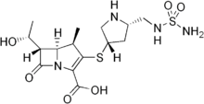
Doripenem

Slide 68
Doripenem
Doripenem is a beta-lactam and belongs to the subgroup of carbapenems.
An ultra-broad-spectrum antibiotic.
More active against Pseudomonas aeruginosa then other carbapenems

Slide 69
Mechanism of action
Doripenem exerts its bactericidal activity by inhibiting bacterial cell wall biosynthesis.
Doripenem inactivates multiple essential penicillin-binding proteins (PBPs).
In E. coli and P. aeruginosa, doripenem binds to PBP 2, which is involved in the maintenance of cell shape, as well as to PBPs 3 and 4.

Slide 70
Spectrum
Doripenem active against
Facultative Gram-negative microorganisms | Acinetobacter baumannii, Escherichia coli, Klebsiella pneumonia, Proteus mirabilis, Pseudomonas aeruginosa
Facultative Gram-positive microorganism | Streptococcus constellatus , Streptococcus intermedius
Anaerobic microorganisms | Bacteroides caccae ,Bacteroides fragilis Bacteroides thetaiotaomicron, Bacteroides uniformis Bacteroides vulgatus, Peptostreptococcus micros

Slide 71
Pharmacokinetics
PK parameters | Doripenem
Elimination half-life | 1 hour
Elimination | Urine 71%
C_{max} | 23 mcg/mL

Slide 72
Indication
Indication | Dose | Duration
cIAIs | 500mg IV q8h | 5-14 days
cUTIs | 500mg IV q8h | 10 days
Pyelonephritis | 500mg IV q8h | 10 days

Slide 73
Renal Impairment
Estimated CrCl (mL/min) | Recommended Dosage
> 50 | No dosage adjustment necessary
≥ 30 to ≤ 50 | 250 mg* administered intravenously (over 1 hour) every 8 hours
> 10 to < 30 | 250 mg* administered intravenously (over 1 hour) every 12 hours
Hepatic Impairment
No dose adjustment required in hepatic impairment

Slide 74
Preparation of solution
Constitute the 500 mg vial with 10 mL of water for injection or 0.9% Nacl injection and gently shake to injection a suspension. The resultant concentration is approximately 50 mg/mL.
Infusion solution concentration is approx. 4.5 mg/mL
Store at 25⁰ C

Slide 75
Storage of Constituted Solutions
Upon constitution with 0.9% sodium chloride (normal saline) injection, doripenem suspension in the vial may be held for 1-hour prior to transfer and dilution in the infusion bag.
Following dilution of the suspension with normal saline or 5% dextrose
Infusion prepared in | Stability Time at Room Temp | Stability time at 2–8°C
Normal saline | 12h | 72h
5% Dextrose | 4 hours | 24h

Slide 76
Adverse Reactions
Pain
Redness
Swelling
Nausea
Headache
Diarrhoea
Rash
seizures

Slide 77
Special Population
Pregnancy category B
Use with caution if benefits outweigh risks
Paediatric Use
Safety and effectiveness in paediatric patients have not been established.
Geriatric use
This drug is known to be excreted substantially by the kidney, and the risk of
adverse reactions to this drug may be greater in patients with impaired renal function .
Notes:
Because elderly patients are more likely to have decreased renal function

Slide 78
Interaction
Interacting drugs | Interactions
Valproic acid | Doripenem reduced the serum concentrations of valproic acid to below the therapeutic concentration range in healthy subjects
Probenecid | Reduces renal clearance of doripenem, resulting in increased doripenem concentrations

Slide 79
Warnings and Precautions
Increased mortality in ventilator-associated bacterial pneumonia patients. Doripenem is not indicated for ventilator-associated bacterial
Seizures have been reported with the use of Doripenem. It has been shown that co-administration of with valproic acid reduces the serum concentration of valproic acid.
Patients with seizure disorders controlled with valproic acid or sodium valproate will therefore be at an increased risk for breakthrough seizures.
Contraindications in hypersensitivity

Slide 80
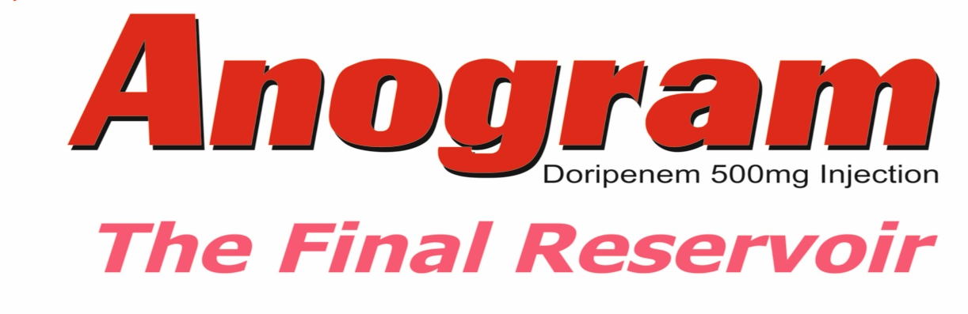

Introducing…..

Slide 81
Indication
cIAIs
cUTIs
Pyelonephritis

Slide 82
Target Customer
Gastro
Intensivist
Nephro
Physician

Slide 83
Market Opportunity

Slide 84
S.N | BRAND | COMPANY | MAT UNIT DEC 15 | MAT UNIT DEC 16 | MAT UNIT GR DEC 16 | MAT VAL DEC 15 | MAT VAL DEC 16 | MAT VAL GR DEC 16
 | Total |  | 134.43 | 95.16 | -29.21 | 30.44 | 21.23 | -30.24
1 | SUDOPEN | RANBAXY | 72.83 | 29.37 | -59.67 | 16.31 | 6.81 | -58.25
2 | DORIKEM | ALKEM | 18.81 | 12.55 | -33.30 | 4.12 | 2.51 | -39.10
3 | DORIGLEN | GLENMARK | 10.08 | 16.19 | 60.60 | 2.60 | 4.37 | 68.49
4 | MIDONEM | MICRO | 8.82 | 19.92 | 125.90 | 1.44 | 3.26 | 125.90
5 | ICUPEN | ABBOTT | 5.90 | 4.08 | -30.81 | 1.67 | 1.15 | -31.15

Slide 85
BRAND | COMAPANY | MRP
DORIGLEN | GLENMARK | 3250
DORINOSA | NATCO | 3106
ICUPEN | ABBOTT | 2850
SUDOPEN | RANBAXY | 2850
DORIPIC | WOCKHARDT | 1399
DORIKEM | ALKEM | 1459
EXELDOR | ZYDUS | 2950
ANOGRAM 500 MG | HHCL | 1499

Slide 86
Brand Name | COMPOSITION | PACK | MRP'S | INDICATIONS | TARGET CUSTOMER
KUPEN 500MG | MEROPENEM 500 MG | VIAL | 378.00 | SEPTICAEMIA,BACTERIAL MENINGITIS,SSTI | Neuro Surg,Phy,Gastro & Intensivist
KUPEN 1G | MEROPENEM 1GM | VIAL | 599.00
KUPEN SB | MEROPENEM 1G + SULBACTAM 500 MG | VIAL | 899.00 | SEVERE PNEUMONIA,BACTERAEMIA,UTI | Nephro,Phy,Gastro & Intensivist
XIPENZ | IMEPENEM 500 MG + CILASTATIN 500 MG | VIAL | 1089.00 | IAI,PNEUMONIA,SSTI | Chest Phy,Phy,Gastro & Intensivist
ANOGRAM | DORIPENEM 500 MG | VIAL | 1499.00 | IAI,UTI & PYELONEPHRITIS | Nephro,Phy,Gastro & Intensivist

Slide 87
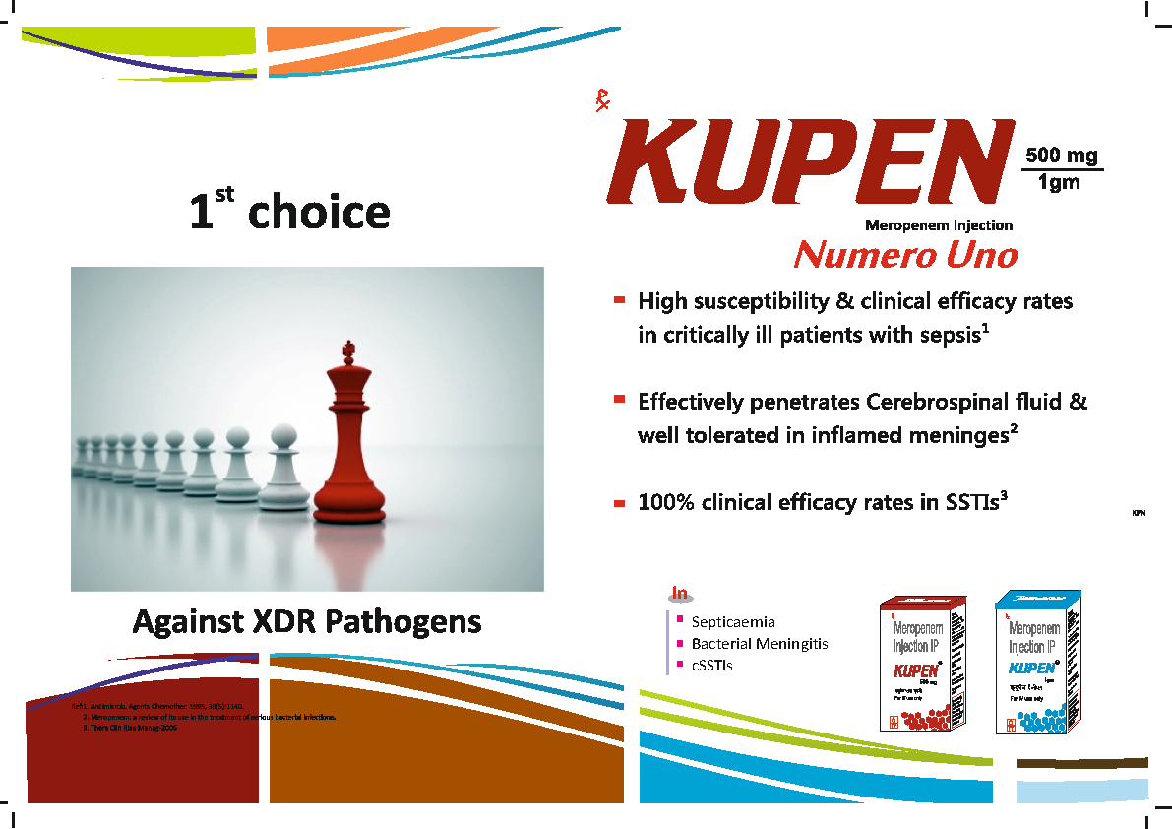



Carbapenems

