Slide 1

FLUOROQUINOLONES

Slide 2



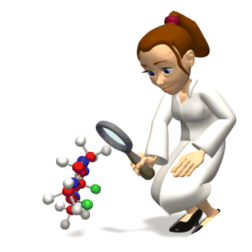

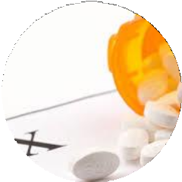
LEARNING OUTLINES JSMU
Classify the Fluoroquinolones
Explain their harmacokinetics, dynamics
and clinical uses
p
5/24/2021

Slide 3

QUINOLONES
Nalidixic acid is the predecessor to all fluoroquinolones
It was the first quinolone, isolated as a by-product of the synthesis of chloroquine and made available for the treatment of urinary tract infections*.
Synthetic antimicrobials having a QUINOLONE STRUCTURE
A broader spectrum of antimicrobial activity,
Active against gram-negative bacteria
Newer fluorinated compounds also inhibit gram- positive
* Ref: goodmans gillman 13th ed

Slide 4


CLASSIFICATION
1st GENERATION
2nd GEN
3rd GEN
4th GEN
Nalidixic acid
Norfloxacin Ciprofloxacin Ofloxacin
Levofloxacin
Moxifloxacin

Slide 5

Fluroquinolone
These are quinolone antimicrobials having one or more fluorine substitutions.
Fluoroquinolone use has been closely tied to Clostridium difficile infection and the spread of antimicrobial resistance in many organisms (methicillin resistance in staphylococci →  MRSA).

Slide 6
QUINOLONES
Fluoroquinolone
Fluorination of the quinolone structure at position 6 and introduction of a piperazine substitution at position 7
High potency
Expanded spectrum
Better tissue penetration
and good tolerability.
Slow development of
resistance
Nalidixic acid
Low potency
Modest blood, tissue levels
Limited spectrum
High frequency of bacterial
resistance

Slide 7
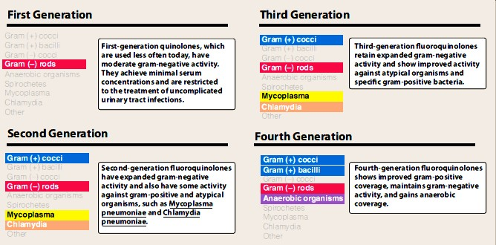

Slide 8

Mechanism of action
Fluoroquinolones enter the bacterium by passive diffusion through water-filled protein channels (porins) in the outer membrane.
Inside the cell, they inhibit the replication of bacterial DNA
Interfering the action of DNA gyrase (topoisomerase II) and topoisomerase IV during bacterial growth and reproduction.

Slide 9
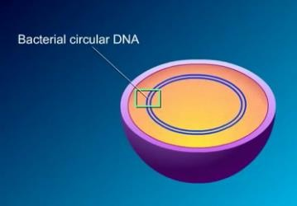
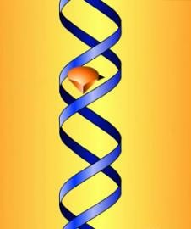
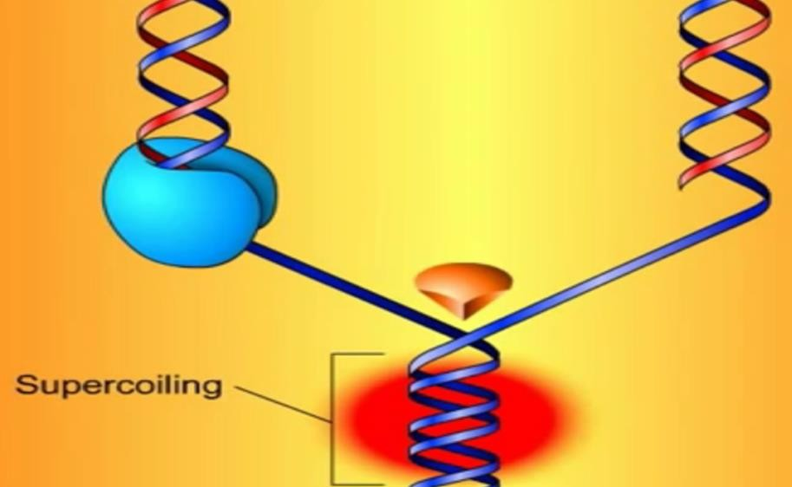

Slide 10
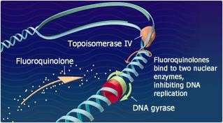
Binding of quinolone to both the enzyme and the DNA forms a ternary complex that inhibits the
resealing step, and can cause inducing cleavage of DNA.
DNA gyrase is a bacteriospecific
cell death by

Slide 11
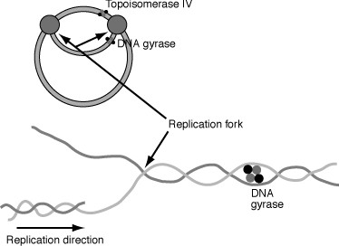
The second topoisomerase division.
site
blocked by fluoroquinolones—
IV—is required by bacteria for cell
It has been implicated in process of segregating newly replicated DNA.

Slide 12
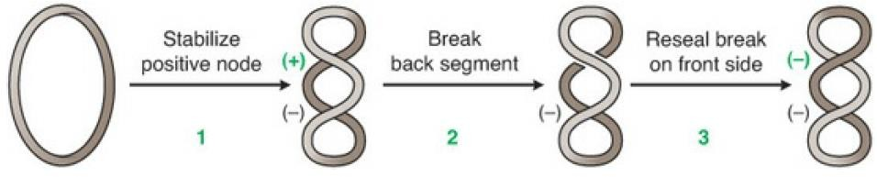
Model of the formation of negative DNA supercoils by DNA gyrase

Slide 13
The enzyme binds to two segments of DNA (1), creating a node of positive (+) superhelix.
The enzyme then introduces a double-strand break in the DNA and passes the front segment through the break (2).
The break is then resealed (3), creating a negative (–) supercoil.
Quinolones inhibit the nicking and closing activity of the gyrase and, at higher concentrations, block the decatenating activity of topoisomerase IV

Slide 14
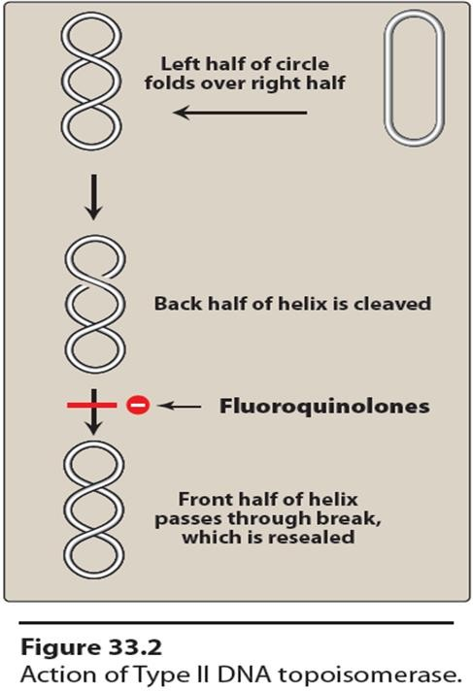
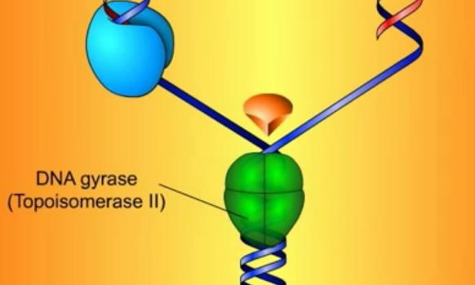

Slide 15
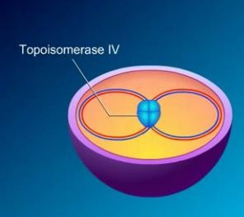
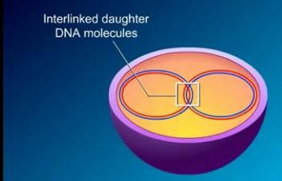
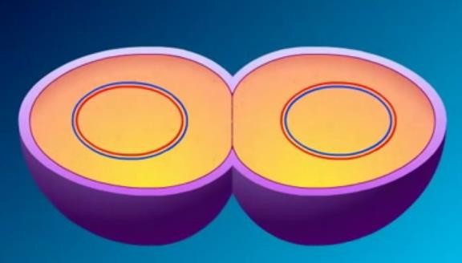
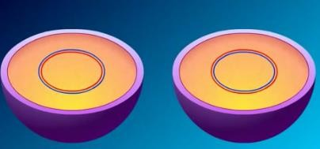

Slide 16
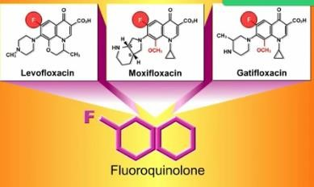
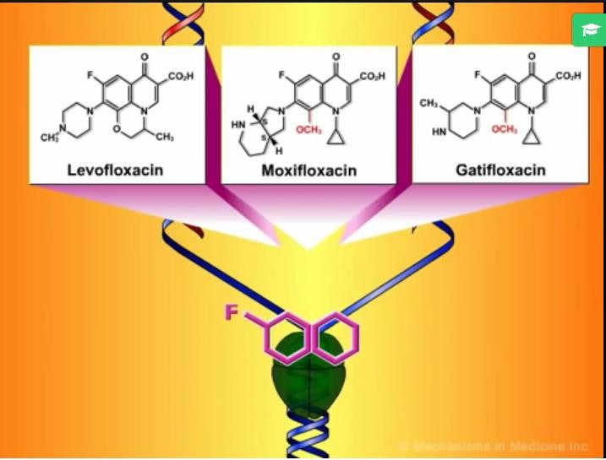

Slide 17
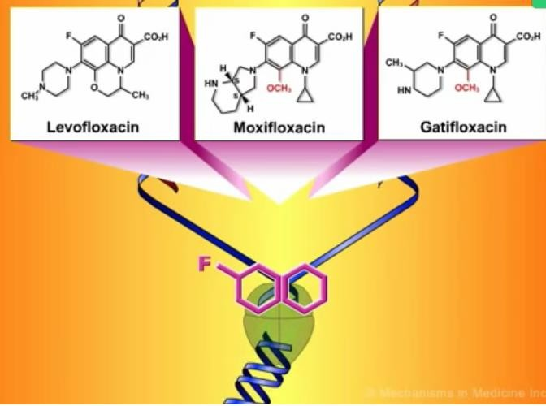
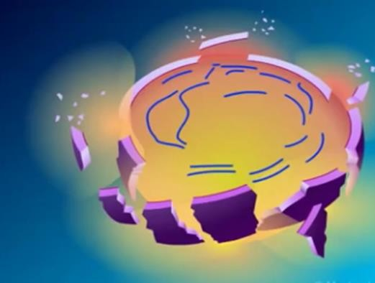

Slide 18
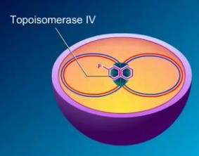
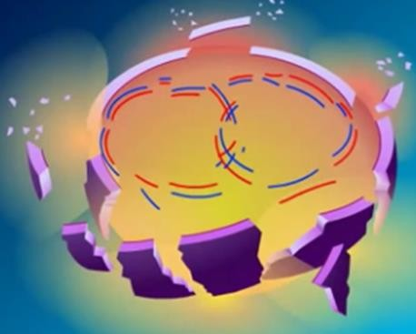

Slide 19
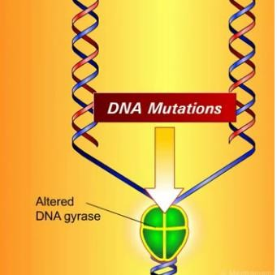
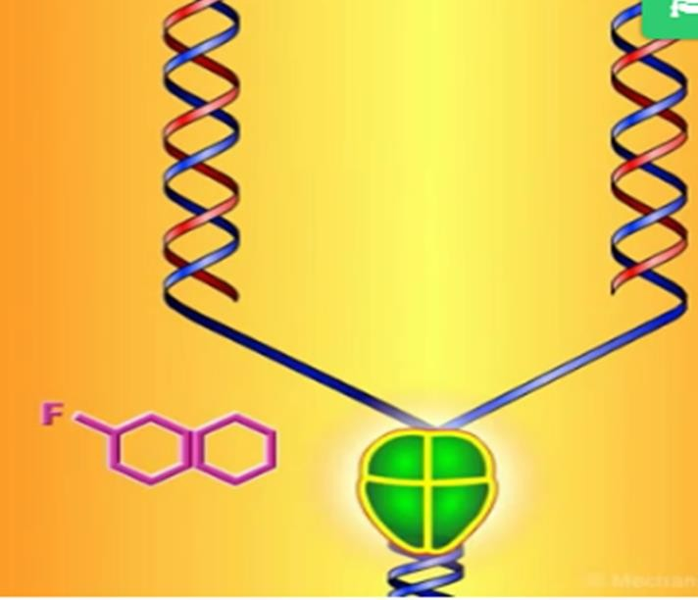
RESISTANCE

Slide 20
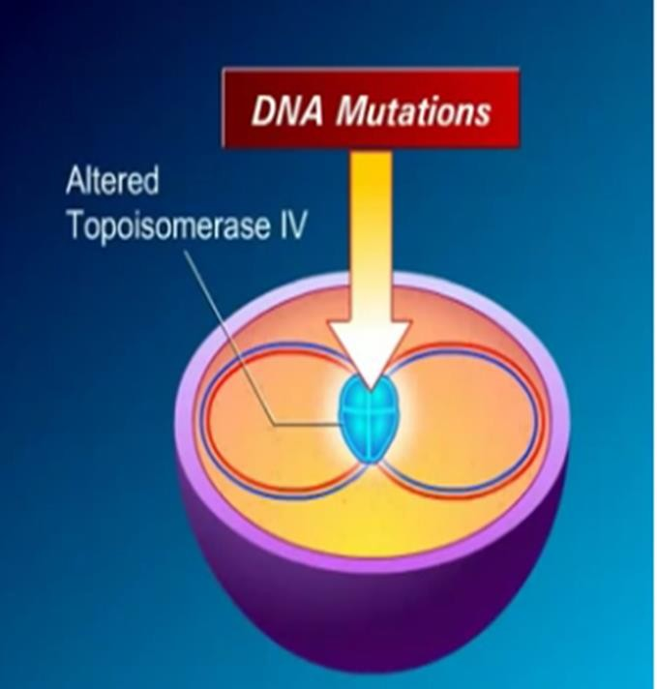
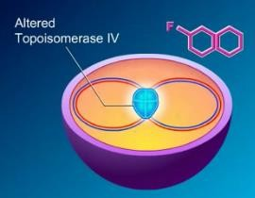
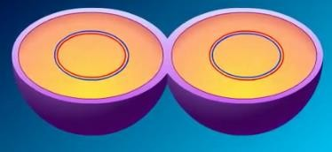

Slide 21

Resistance
No plasmid-mediated resistance.
Resistant MRSA, pseudomonas, coagulase negative staphylococci, and enterococci have unfortunately emerged due to chromosomal mutations.
Cross-resistance exists among quinolones.

Slide 22
1. Altered target:
Chromosomal mutation in in bacterial genes gyrA or parC have been associated with decrease affinity fir flouroquinolones at their site of action.
Mutations in the bacterial DNA gyrase have been associated with a decreased affinity for fluoroquinolones.
Resistance is
frequently associated with
and
mutations in
both DNA gyrase
Topoisomerase IV.

Slide 23
2. Decreased accumulation:
Reduced intracellular concentration of the drugs in the bacterial cell is linked to two mechanisms.
One involves a decreased number of porin proteins in the outer membrane of the resistant cell, thereby impairing access of the drugs to the intracellular topoisomerases.
Energy-dependent efflux system in the cell membrane---pumps drug out of cell.

Slide 24

Antimicrobial spectrum
Bactericidal
Effective against gram negative
  Enterobacteriaceae
  Pseudomonas species
  Haemophilus influenzae
  Moraxella catarrhalis
  Legionellaceae
  Chlamydia
  Mycoplasma
  Brucella
Some mycobacteria (including Mycobacterium tuberculosis) .
Effective treatment of gonorrhea but not syphilis.

Slide 25
INDICATIONS
Levofloxacin and moxifloxacin have good activity against gram-positive organisms, Streptococcus pneumoniae.
Moxifloxacin has activity against many anaerobes.
If used
prophylactically fluoroquinolones
before transurethral lower incidence of
surgery,
postsurgical urinary tract infections (UTIs).

Slide 26

Nalidixic acid
First generation
Non-fluorinated quinolone
Bactericidal
Narrow spectrum of susceptible organisms
Confined to the urinary tract.
Active against gram-negative bacteria,
Coliforms: E. coli, Proteus, Klebsiella, Enterobncter, Shigella
But not Pseudomonas.
It acts by inhibiting bacterial DNA gyrase
Resistance to nalidixic acid develops rather rapidly.
Urinary antiseptic, as a second line drug
Diarrhoea caused by Proteus, E. coli, Shigella or Salmonela

Slide 27


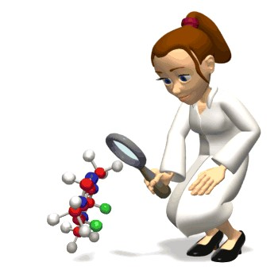
PHARMACOKINETICS
5/24/2021

Slide 28

Pharmacokinetics
Absorbed orally
Binding to plasma proteins ranges from 10 to 40%.
Levels are high in bone, urine (except moxifloxacin), kidney, and prostatic tissue (but not prostatic fluid), and concentrations in the lung exceed those in serum.
Penetration into cerebrospinal fluid is relatively low except for ofloxacin, for which concentrations can be as high as 90
% of those in serum.
Partly metabolized in liver: one of the metabolites is active.

Slide 29
Excreted in urine with a plasma t½ -8 hrs.
High concentration attained in urine (20-50 times that in plasma) is lethal to the common urinary pathogens.
Accumulate leukocytes,
in macrophages and polymorphonuclear thus being effective against intracellular
organisms such as Legionella pneumophila.
Most fluoroquinolones are excreted renally
Moxifloxacin, is excreted by liver

Slide 30
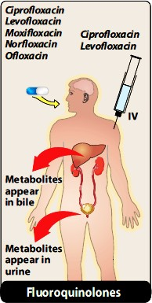
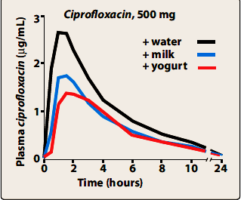

Slide 31


Ciprofloxacin
₂nd
generation prototype
Treatment :-
Urinary tract infections,
Gonorrhoea, Chancroid,
Gastroenteritis due to bacilli.
Enterobacteriaceae and gram-negative
Typhoid fever drug of first choice → 95% S.typhi….Rx typhoid carrier
Traveler’s diarrhea caused by E. coli.
Inhalational anthrax
Pseudomonas aeruginosa infections associated with cystic fibrosis.

Slide 32
INDICATIONS
Alternative to more toxic drugs, aminoglycosides.
May act synergistically with β-lactams
Resistant tuberculosis.
Bone, soft tissue, gynaecological and wound infections
Used along with clindamycin/metronidazole cover anaerobes) it is a
good drug for diabetic foot.
Gram-negative septicaemia along with 3rd generation
cephalosporin or aminoglycosides
Meningitis, Respiratory infection

Slide 33

Norfloxacin
Effective against both gram-negative (P.aeruginosa) and gram-positive organisms
Treatment
Complicated and uncomplicated UTIs
Prostatitis
Traveler's diarrhea
It is not effective in systemic infections.

Slide 34

Levofloxacin
Isomer of ofloxacin and has largely replaced it clinically.
3rd generation
It has broad spectrum activity, utilized in a wide range of infection
Indications:
Skin infections
Acute sinusitis
Acute exacerbation of chronic bronchitis
Community-acquired pneumonia
Nosocomial pneumonia
Excellent activity against S. pneumoniae respiratory infections

Slide 35

Moxifloxacin
Long-acting 4th generation
Enhanced activity against gram-positive organisms (S.pneumoniae)
Excellent activity against many anaerobes.
Very poor activity against P. aeruginosa.
Indications:
Pneumonias, bronchitis, sinusitis, otitis media
Moxifloxacin does not concentrate in urine and is not indicated for the treatment of UTIs.

Slide 36

Lomefloxacin
It is a second generation difluorinated quinolone
Equal in activity to ciprofloxacin
More active against some gram-negative bacteria and chlamydia.
Due to rare and fatal side effects these drugs are withdrawal from
the U.S. market
Lomefloxacin Sparfloxacin (phototoxicity, QTc prolongation)
Gatifloxacin (hypoglycemia)
Temafloxacin (immune hemolytic anemia)
Trovafloxacin (hepatotoxicity)
Grepafloxacin (cardiotoxicity)
Clinafloxacin (phototoxicity)

Slide 37

Sparfloxacin
Second generation difluorinated quinolone
Enhanced activity against gram-positive bacteria (Strep. pneumoniae, Staphylococcus, Enterococcus), Bacteroides, fragilis, anaerobes and mycobacteria.
Indications
Pneumonia, exacerbations of chronic bronchitis, sinusitis and ENT infections.
Good efficacy in tuberculosis, MAC (mycobacterium avium complex) infection in AIDS and leprosy.
Chlamydial infections.

Slide 38

Gatifloxacin
Cause tachycardia and prolong QTc interval;
Contraindicated
Hypokalaemia and with other drugs that can Prolong QT.
Phototoxicity, CNS effects
Swelling over face
Changes in blood glucose level
Risk of Torsades de pointes.
It has been discontinued in USA, and is not available in the UK.

Slide 39
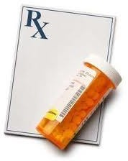
CLINICAL PHARMACOLOGY
5/24/2021

Slide 40

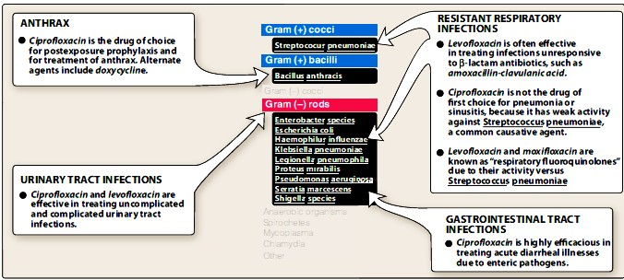

Slide 41

Uses
Levofloxacin :-
Prostatitis due to E. Coli
Sexually transmitted diseases, except syphilis.
Alternative therapy in gonorrhea.
Nalidixic acid :-
Urinary antiseptic, generally as a second line drug
Diarrhea caused by Proteus, E. coli, Shigella or Salmonella
Ampicillin resistant Shigella enteritis.

Slide 42

Adverse reactions
Very well tolerated.
Gastrointestinal: most common
nausea, vomiting, and diarrhea
Rashes → nalidixic acid
Central nervous system problems:
headache and dizziness or light-headedness.
Epileptic patient, should be treated cautiously
Cipro, nalidixic acid → interferes in the metabolism of theophylline and may evoke seizures in children .
Phototoxicity: fluoroquinolones , rare nalidixic acid

Slide 43
Connective tissue problems:
Articular cartilage erosion (arthropathy) immature experimental animals.
Children with cystic fibrosis, who receive fluoroquinolones for
acute pulmonary exacerbations.
Increased risk of tendinitis or tendon rupture with systemic
fluoroquinolone → Achilles tendon
Higher risk at 60 years of age, those receiving concomitant corticosteroid therapy, and in patients with kidney, heart, or lung transplants.

Slide 44

Contraindications
Pregnancy
Nursing mothers
Children under 18 years of age
Moxifloxacin, may prolong the QTc interval
  Should not be used in patients who are predisposed to arrhythmias
  Who are taking antiarrhythmic medications

Slide 45


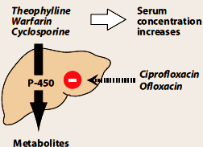
Drug interactions
Antacids and cations delays
absorption
Increase serum | levels | of
theophylline by | inhibiting | its
metabolism.
Raise the serum levels of
warfarin, caffeine, cyclosporine.

Slide 46



Thank You

