Slide 1
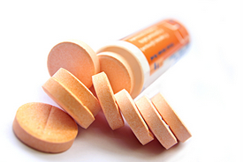
Fluroquinolones basics
Dr.T.V.Rao MD

Slide 2
quinolones
The quinolones are a family of synthetic broad-spectrum antibiotics. The term quinolone(s) refers to potent synthetic chemotherapeutic antibacterial agent.
The first generation of the quinolones begins with the introduction of nalidixic acid in 1962 for treatment of urinary tract infections in humans. Nalidixic acid was discovered by George Lesher and co-workers in a distillate during an attempt at chloroquine synthesis.[]
They prevent bacterial DNA from unwinding and duplicating

Slide 3
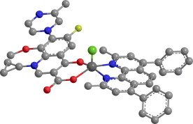
What are Fluroquinolones
The Fluroquinolones are a relatively new group of antibiotics. Fluroquinolones were first introduced in 1986, but they are really modified quinolones, a class of antibiotics, whose accidental discovery occurred in the early 1960.

Slide 4
The fluoroquinolones are…
The fluoroquinolones are a family of synthetic, broad-spectrum antibacterial agents with bactericidal activity.The first fluoroquinolones were widely used because they were the only orally administered agents available for the treatment of serious infections caused by gram-negative organisms, including Pseudomonas species.

Slide 5
Quinolones and fluoroquinolones act
Quinolones and fluoroquinolones are chemotherapeutic bactericidal drugs, eradicating bacteria by interfering with DNA replication.
Quinolones inhibit the bacterial DNA gyrase or the topoisomerase enzyme, thereby inhibiting DNA replication and transcription. Recent evidence has shown eukaryotic topoisomerase is also a target for a variety of quinolone-based drugs. Thus far, most of the compounds that show high activity against the eukaryotic type II enzyme contain aromatic substituents at their C-7 positions.

Slide 6
Mechanism of action
Quinolones can enter cells easily via porins and, therefore, are often used to treat intracellular pathogens such as Legionella pneumophila and Mycoplasma pneumoniae. For many Gram-negative bacteria, DNA gyrase is the target, whereas topoisomerase IV is the target for many Gram-positive bacteria. However, there is debate concerning whether the quinolones still have such an adverse effect on the DNA of healthy cells, in the manner described above, hence contributing to their adverse safety profile. This class has been shown to damage mitochondrial DNA

Slide 7
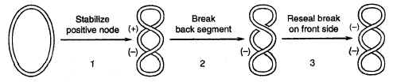
Mechanism of Action
Dual MOA:
  Inhibition of bacterial DNA Gyrase (Topoisomerase II)
    Formation of quinolone-DNA-Gyrase complex
    Induced cleavage of DNA
  Inhibition of bacterial Topoisomerase IV
    Mechanism poorly understood
Mechanism of DNA Gyrase
Notes:
Topo IV mechanism not well understood; mostly Topo II inhibition in G-; Topo IV inhibition more in G+; Quinolones bind to the DNA-gyrase complex resulting in a new quinolone-DNA-gyrase complex. This conformational change results in the prevention of DNA supercoiling which ultimately results in DNA cleavage

Slide 8
Fluoroquinolones have broad spectrum activity
As a group, the fluoroquinolones have excellent in vitro activity against a wide range of both gram-positive and gram-negative bacteria. The newest fluoroquinolones have enhanced activity against gram-positive bacteria with only a minimal decrease in activity against gram-negative bacteria. Their expanded gram-positive activity is especially important because it includes significant activity against Streptococcus pneumoniae.

Slide 9
Classification
Quinolones (1st generation)
  Highly protein bound
  Mostly used in UTIs
Fluoroquinolones (2nd, 3rd and 4th generation)
  Modified 1st generation quinolones
  Not highly protein bound
  Wide distribution to urine and other tissues; limited CSF penetration.
Notes:
Quinolones highly protein bound so best activity is in protein-free compartment (i.e. urinary tract); fluoro group attached to central ring

Slide 10
Generation | Drug Names | Spectrum
1st | nalidixic acid cinoxacin | Gram- but not Pseudomonas species
2nd | norfloxacin ciprofloxacin enoxacin ofloxacin | Gram- (including Pseudomonas species), some Gram+ (S. aureus) and some atypicals
3rd | levofloxacin sparfloxacin moxifloxacin gemifloxacin | Same as 2nd generation with extended Gram+ and atypical coverage
4th | *trovafloxacin | Same as 3rd generation with broad anaerobic coverage
Notes:
Trovafloxacin first designed as a novel therapeutic approach to MRSA infections but was withdrawn in 1999 due to liver toxicity and death

Slide 11
first-generation
The first-generation agents include cinoxacin and nalidixic acid, which are the oldest and least often used quinolones. These drugs had poor systemic distribution and limited activity and were used primarily for gram-negative urinary tract infections. Cinoxacin and nalidixic acid require more frequent dosing than the newer quinolones, and they are more susceptible to the development of bacterial resistance.

Slide 12
Second Generation
The second-generation fluoroquinolones have increased gram-negative activity, as well as some gram-positive and atypical pathogen coverage. Compared with first-generation quinolones, these drugs have broader clinical applications in the treatment of complicated urinary tract infections and pyelonephritis, sexually transmitted diseases, selected pneumonias and skin infections

Slide 13
Second Generation
Second-generation agents include ciprofloxacin, enoxacin, lomefloxacin, norfloxacin and ofloxacin. Ciprofloxacin is the most potent fluoroquinolone against P. aeruginosa. Ciprofloxacin and ofloxacin are the most widely used second-generation quinolones because of their availability in oral and intravenous formulations and their broad set of FDA-labeled indications.

Slide 14
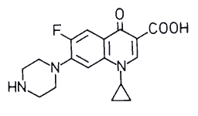
Ciprofloxacin
Administration [Usual Dosage]: IV, PO [500 – 750 mg q 8-12h]
Spectrum: Gram- aerobic rods, and Legionella pneumophila, and other atypical. Poor activity against Strep. pneumoniae.
Indications:
  -- Nosocomial pneumonia
  -- Intra-abdominal infections
  Uncomplicated/complicated UTI
  Anthrax exposure and prophylaxis
Unique Qualities:
  Binds divalent cations (i.e. Ca & Mg) which decreases absorption
  -- Increased effects of warfarin
ADRs
  QTC prolongation, torsades de pointes, arrhythmias
  Nausea, GI upset
  Interstitial nephritis
Notes:
Not inclusive list of indications; patients at risk for tendon effects (>60 yo, renal failure, dialysis, concomitant corticosteroid therapy, dyslipidemia); weakest quinolone against MSSA

Slide 15
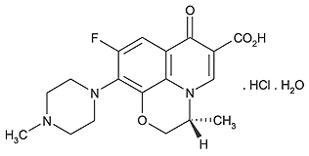
Levofloxacin
Administration [Usual Dosage]: IV, PO and ophthalmic [500-750 mg q24h]
Spectrum: Gram-, Gram+ (S. aureus including MRSA & S. pneumoniae) and Legionella pneumophila, atypical resp. pathogens,
Mycobacterium tuberculosis
Indications:
  Chronic bronchitis and CAP
  -- Nosocomial pneumonia
  SSTIs
  Intra-abdominal infections
Unique Qualities:
  Binds divalent cations (i.e. Ca & Mg) which decreases absorption
  ADRs
  Blood glucose disturbances in DM patients
  QTC prolongation, torsades de pointes, arrhythmias
  Nausea, GI upset
  Interstitial nephritis
Notes:
Not inclusive list of indications; patients at risk for tendon effects (>60 yo, renal failure, dialysis, concomitant corticosteroid therapy, dyslipidemia)

Slide 16
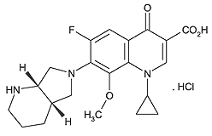
Moxifloxacin
Administration [Usual Dosage]: IV, PO and ophthalmic [400mg q24h]
Spectrum: Gram-, Gram+ (S. aureus including MRSA & S. pneumoniae) & atypicals (L. pneumophila, C pneumonia & M. pneumoniae), Mycobacterium tuberculosis, gram-negative anaerobes
Indications:
  Chronic bronchitis
  CAP
  Bacterial conjuctivitis
  Sinusitis
Unique Qualities:
  Binds divalent cations (i.e. Ca & Mg) which decreases absorption
  Safety and efficacy not established in patients <18 y.o.
ADRs
  Blood glucose disturbances in DM patients
  QTC prolongation, torsades de pointes, arrhythmias
  Nausea, GI upset
  Interstitial nephritis
Notes:
Not inclusive list of indications; Chlamydia pneumonia and Mycoplasma pneumonia

Slide 17
Third Generation
The third-generation fluoroquinolones are separated into a third class because of their expanded activity against gram-positive organisms, particularly penicillin-sensitive and penicillin-resistant S. pneumoniae, and atypical pathogens such as Mycoplasma pneumoniae and Chlamydia pneumoniae. Although the third-generation agents retain broad gram-negative coverage, they are less active than ciprofloxacin against Pseudomonas species.

Slide 18
Third Generation
Because of their expanded antimicrobial spectrum, third-generation fluoroquinolones are useful in the treatment of community-acquired pneumonia, acute sinusitis and acute exacerbations of chronic bronchitis, which are their primary FDA-labeled indications. The third-generation fluoroquinolones include levofloxacin, gatifloxacin, moxifloxacin and sparfloxacin

Slide 19
Fourth Generation
The fourth-generation fluoroquinolones add significant antimicrobial activity against anaerobes while maintaining the gram-positive and gram-negative activity of the third-generation drugs. They also retain activity against Pseudomonas species comparable to that of ciprofloxacin. The fourth-generation fluoroquinolones include trovafloxacin .
Because of concern about hepatotoxicity, trovafloxacin therapy should be reserved for life- or limb-threatening infections requiring inpatient treatment (hospital or long-term care facility), and the drug should be taken for no longer than 14 days

Slide 20
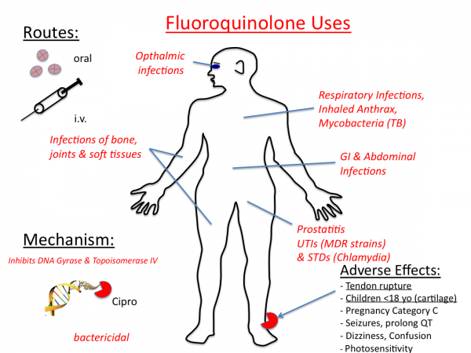

Slide 21
RESPIRATORY FLUOROQUINOLONES
They have enhanced Gram + activity & against atypical pneumonia agents (chlamydia, mycoplasma & legionella)
Levofloxacin: with improved activity against pneumococcus
Moxifloxacin: improved activity against anaerobes & Mycobacterium tuberculosis; hepatic clearance results in low urinary levels (not recommended for UTIs)
Gemifloxacin: similar spectrum as Moxifloxacin, little hepatic metabolism, eliminated/excreted in the urine & feces

Slide 22
Restriction Fluoroquinolone
Fluoroquinolones are approved for use only in people older than 18. They can affect the growth of bones, teeth, and cartilage in a child or fetus. The FDA has assigned fluoroquinolones to pregnancy risk category C, indicating that these drugs have the potential to cause teratogenic or embryocidal effects. Giving fluoroquinolones during pregnancy is not recommended unless the benefits justify the potential risks to the fetus. These agents are also excreted in breast milk and should be avoided during breast-feeding if at all possible.

Slide 23
Withdrawal of Fluroquinolones from markets
Grepafloxacin has been withdrawn from the market by the manufacturer because of adverse cardiac events.
Sparfloxacin was withdrawn in February, 2001, primarily due to lack of sales [
Trovafloxacin was withdrawn because of the risk of hepatic toxicity.
Gatifloxacin was withdrawn because of an increased frequency of hypoglycemia and hyperglycemia compared to other marketed fluoroquinolones.

Slide 24

Gemifloxacin
Gemifloxacin has been approved for the treatment of mild to moderate community-acquired pneumonia and acute exacerbation of chronic bronchitis, but almost 14 percent of women under age 40 develop rash when taking the drug for longer than seven days. This adverse effect is largely avoided by use of a five day course of treatment.

Slide 25
Concerns with use of Fluoroquinolone
Fluoroquinolones, including Gemifloxacin mesylate, are associated with an increased risk of tendinitis and tendon rupture in all ages. This risk is further increased in older patients usually over 60 years of age, in patients taking corticosteroid drugs, and in patients with kidney, heart or lung transplants .Fluoroquinolones, including Gemifloxacin mesylate , may exacerbate muscle weakness in persons with myasthenia gravis. Avoid Gemifloxacin mesylate in patients with known history of myasthenia gravis

Slide 26
Fluoroquinolones: indications and uses
The newer fluoroquinolones have a wider clinical use and a broader spectrum of antibacterial activity including gram-positive and gram-negative aerobic and anaerobic organisms. Some of the newer fluoroquinolones have an important role in the treatment of community-acquired pneumonia and intra-abdominal infections. The serum elimination half-life of the fluoroquinolones range from 3 -20 hours, allowing for once or twice daily dosing.

Slide 27
Fluoroquinolones disadvantages:
Tendonitis or tendon rupture
Multiple drug interactions
Not used in children
Newer quinolones produce additional toxicities to the heart that were not found with the older agents

Slide 28
Cautions on use of Fluoroquinolones
Fluoroquinolones have neuromuscular blocking activity and may exacerbate muscle weakness in patients with myasthenia gravis.
Exacerbation of myasthenia gravis symptoms in patients with myasthenia gravis can lead to a requirement for respiratory support in some patients.
Fluoroquinolone antibiotics should be avoided in patients with a known history of myasthenia gravis.

Slide 29
Programme created by Dr.T.V.Rao MD for Medical and Paramedical Students in the Developing World
Email
doctortvrao@gmail.com

