Slide 1
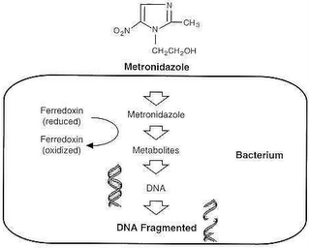
METRONIDAZOLE
Belongs to Nitroimidazole class of antibiotics.
MECHANISM OF ACTION:
Nitro group reduced by certain redox potential operative only in anaerobic microbes
To highly reactive nitro radical which exerts cytotoxicity by damaging DNA

Slide 2
Highly effective against anaerobic bacteria like Closridium perfringens, Helicobacter pylori, spirochetes,etc.
Almost completely absorbed from small intestine. Plasma t ½ 8hrs.
ADVERSE EFFECTS
Anorexia, nausea, headache, dryness of mouth.
Prolonged administration may cause peripheral neuropathy and CNS effects.

Slide 3
CONTRAINDICATIONS:
NEUROLOGICAL DISEASE, BLOOD DYSCRASIAS, 1ST TRIMESTER OF PREGNANCY AND CHRONIC ALCOHOLISM.
INTERACTIONS:
Alcohol intolerance
Enzyme inducers(phenobarbitone,rifampin) may reduce its therapeutic effect.

Slide 4
PREPARATIONS: FLAGYL, METROGYL, METRON 400mg tab
USE:
Extensively used to treat orodental infections, because anaerobic bacteria are frequently involved.
Drug of choice for acute necrotizing ulcerative gingivitis in which it is often combined with either penicillinV, amoxicillin, erythromycin or tetracycline.

Slide 5
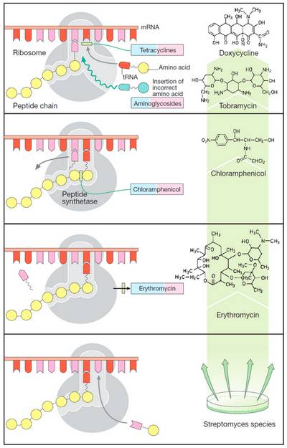
DOXYCYCLINE belongs to Group III Tetracycline
MECHANISM OF ACTION:
Primarily bacteriostatic
Inhibit protein synthesis by binding to 30S ribosome
Attachment of aminoacyl-t-RNA to the mRNA-ribosome complex is interferred with.

Slide 6
Cocci like N. gonorrhoeae, N. meningitidis,
most gram positive bacilli, spirochetes, etc. are sensitive.
Resistance to tetracyclines develops in a graded manner.
Doxycycline are completely absorbed irrespective of food.
Primarily excreted in urine by glomerular filtration.
Enzyme inducers like phenobarbitone and phenytoin enhance metabolism and reduce t1/2 of doxycycline.

Slide 7
ADVERSE EFFECTS:
Epigastric pain, nausea, vomiting and diarrhoea.
Liver and kidney damage
Phototoxicity
Brown discouration,ill formed teeth, more susceptible to caries.
PRECAUTIONS:
Tetracyclins should not be used during pregnancy, lactation and in children
Donot mix injectable tetracyclines with penicillin- inactivation occurs.

Slide 8
USES:
0.1-0.2G/DAY THERAPY CONTROLS GINGIVAL INFLAMMATION AND HELPS TO NORMALISE THE PERIODONTAL MICROFLORA.
PREPARATIONS:
TETRADOX, NOVADOX 100mg cap

Slide 9
CIPROFLOXACIN belongs to fluoroquinolones
Most potent first generation FQ active against E. coli, K. pneumoniae, Salmonella typhi, Staph. Aureus, etc.
High potency.
Rapidly absorbed orally, foods delays absorption, first pass metabolism occurs.
Has high tissue penetrability.

Slide 10
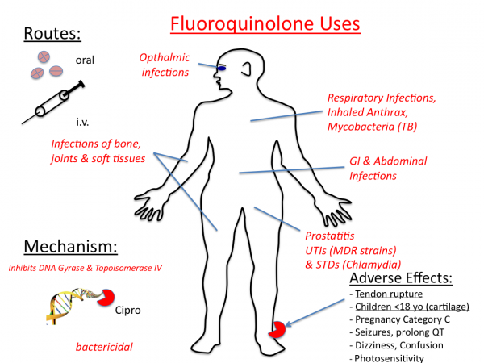

Slide 11
ADVERSE EFFECTS
Nausea, vomiting, bad taste, hypersensitivity reactions, headache, anxiety, etc.
INTERACTIONS:
NSAIDs may enhance the CNS toxicity of FQs
USES:
Effective in a broad range of infections including some difficult to treat ones.
PREPARATIONS: CIPLOX, CIFRAN 250,500,750 mg daily

Slide 12
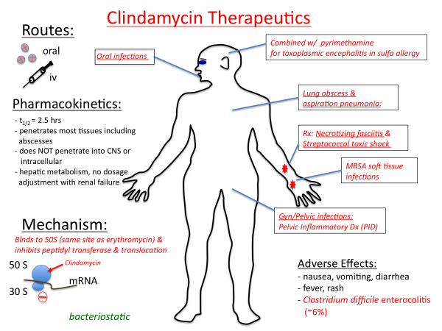
CLINDAMYCIN

Slide 13
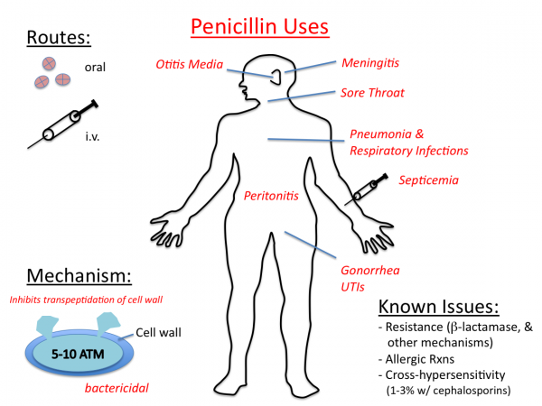
penicillin

Slide 14
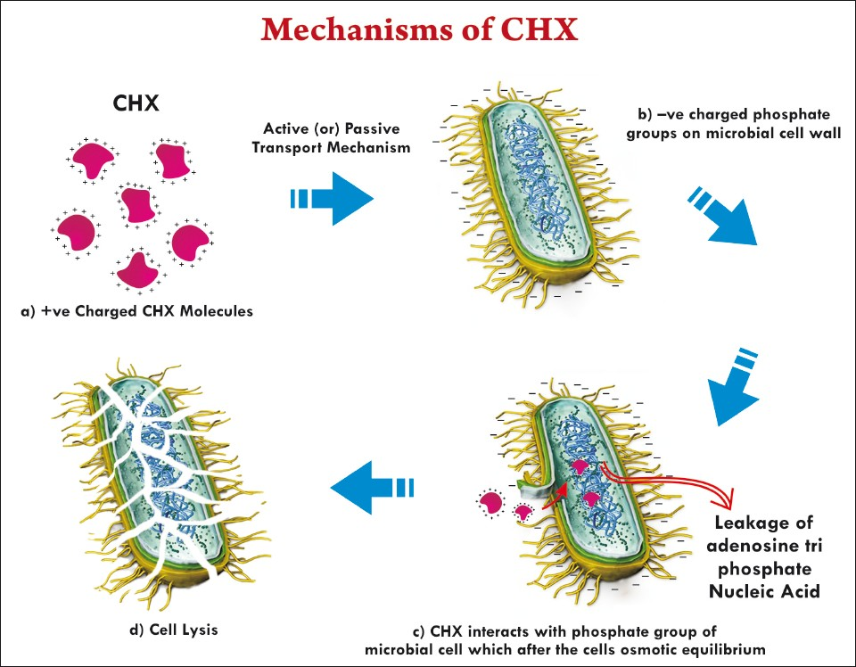
CHLORHEXIDINE
Powerful, nonirritating, cationic antiseptic
Disrupts bacterial cell membrane.
Secondary action is denaturation of intracellular proteins.

Slide 15
-More active against gram positive bacteria.
-Used extensively for surgical scrub, neonatal bath, obstetrics, general skin antiseptic.
-Most widely employed antiseptic in dentister, mainly in form of oral rinse(0.12-0.2%) or toothpaste(0.5-1%).
-Most effective antiplaque and antigingivitis agent.
-Good results have been obtained in acute necrotizing gingivitis.
-Twice daily chlorhexidine rinse markedly reduces oral infections in immunocompromised patients.

Slide 16
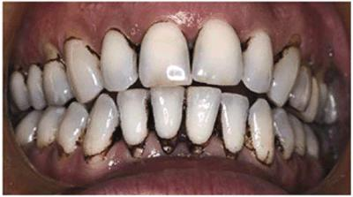
Major disadvantage of intraoral use of chlorhexidine is brownish discolouration of teeth and tongue, an unpleasant after taste, alteration of taste perception
CHLODIN, HEXIL 0.2% mouthwash

