Slide 1

PENICILINE
Dr. Md. Rageeb Md. Usman
Associate Professor
Department of Pharmacognosy
Smt. Sharadchandrika Suresh Patil
College of Pharmacy,
Chopda, Maharashtra, India

Slide 2
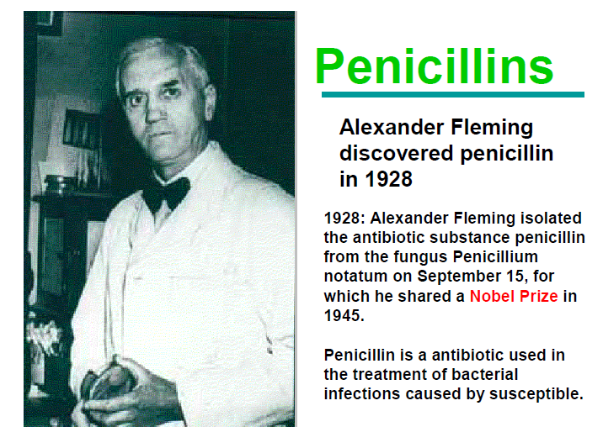

Slide 3
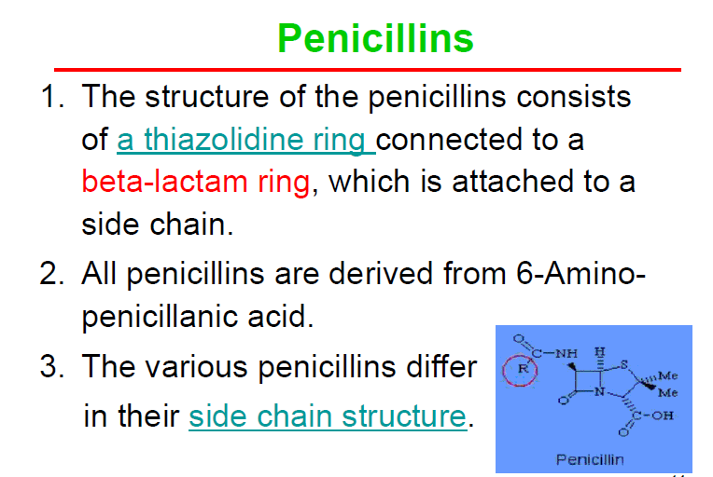

Slide 4
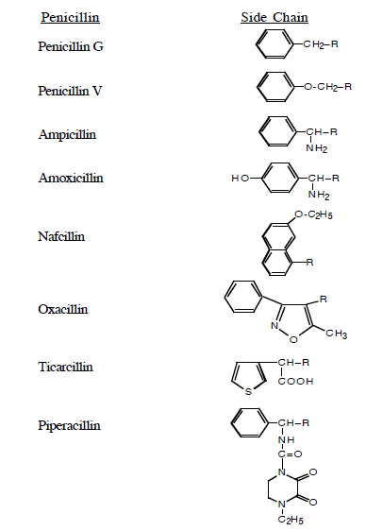
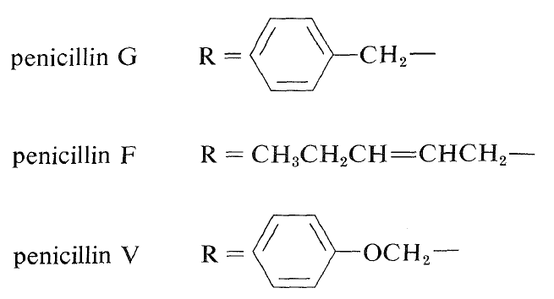

Slide 5
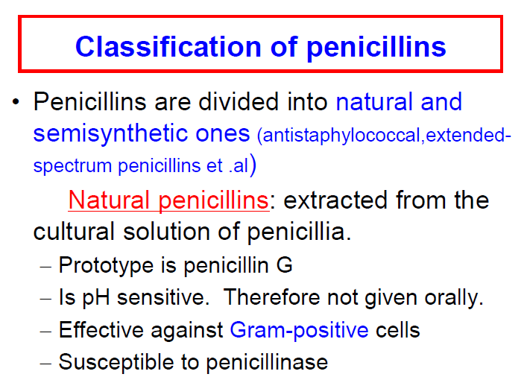

Slide 6
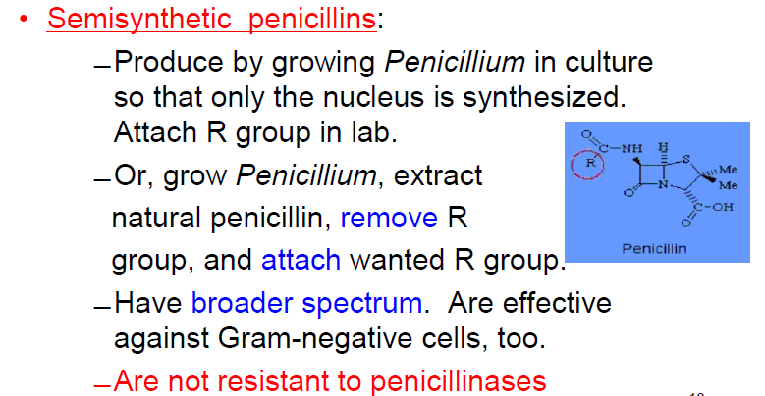

Slide 7
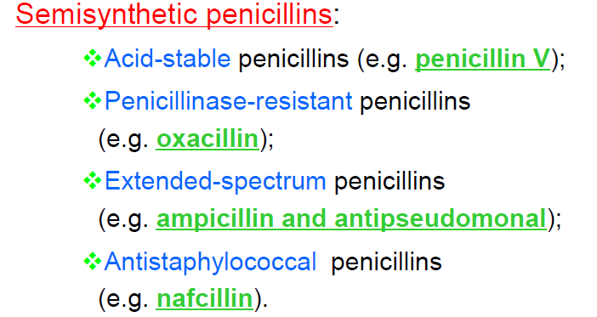

Slide 8
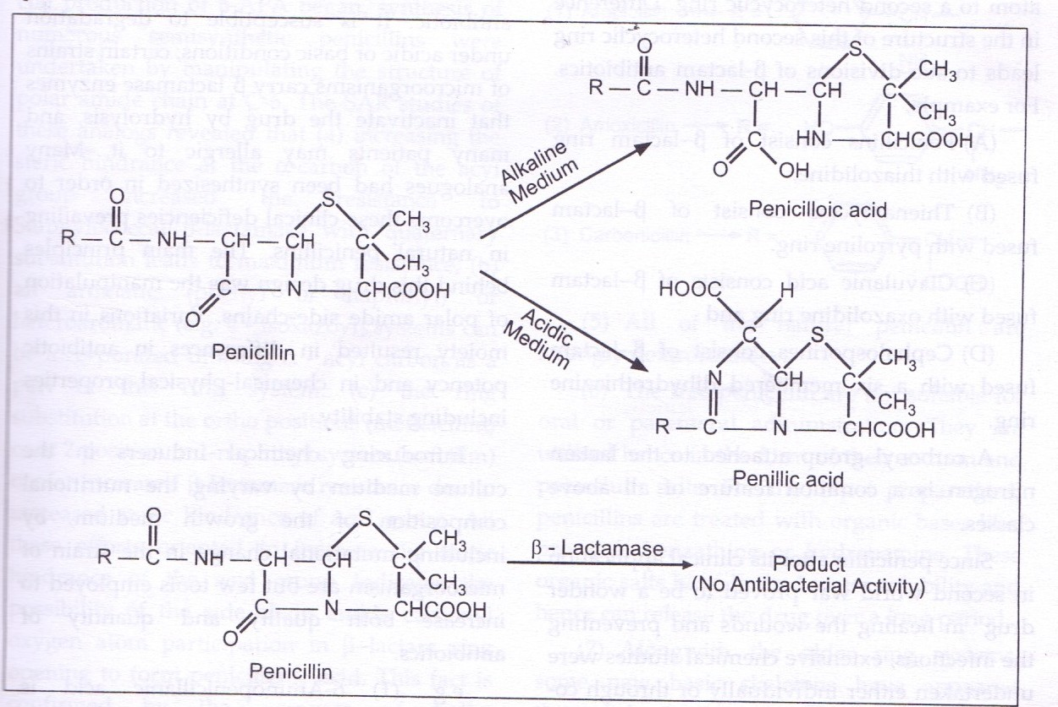

Slide 9
