Slide 1
VANCOMYCIN
Group 5
R.M 2

Slide 2
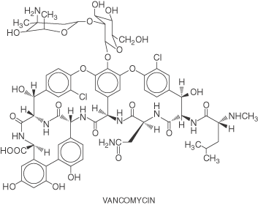
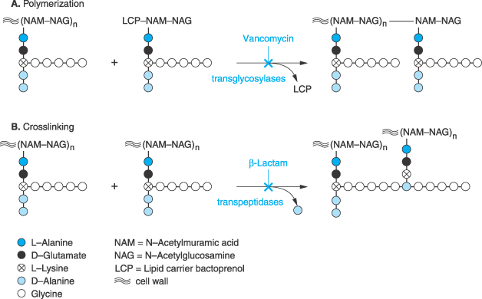
Class: Glycopeptide antibiotic
MOA: Inhibition of bacterial cell wall synthesis by binding D-ala-D-ala
Goodman & Gilman’s The Pharmacological Basis of Therapeutics – 11th Ed. (2006)

Slide 3
IV, PO
Spectrum: Gram (+)
Drug of Choice
  MRSA
Indications
  IV: Serious methicillin-resistant Staphylococcal infections: pneumonia, endocarditis, osteomyelitis, SSSI
  PO: pseudomembranous colitis (metronidazole preferred)
  Staphylococcal infections in Penicillin allergic patients
  NOTE: Do not use in non-Penicillin allergic patients. Vancomycin does not kill as rapidly as antistaphylococcal β-lactams, and may negatively impact clinical outcome
Unique Qualities
  Monitor trough serum concentrations
  Poor oral absorption
  Adjust dose for renal impairment
ADRs
  “Red Man” Syndrome
  Ototoxicity
  Nephrotoxicity w/ other nephrotoxic agents

Slide 4
introduction
Vancomycin is a glycopeptide antibiotic used to treat severe gram-positive infections due to organisms that are resistant to other antibiotics such as methicillin-resistant staphylococci and ampicillin-resistant enterococci.
It is also used to treat infections caused by other sensitive gram-positive organisms in patients that are allergic to penicillins.

Slide 5
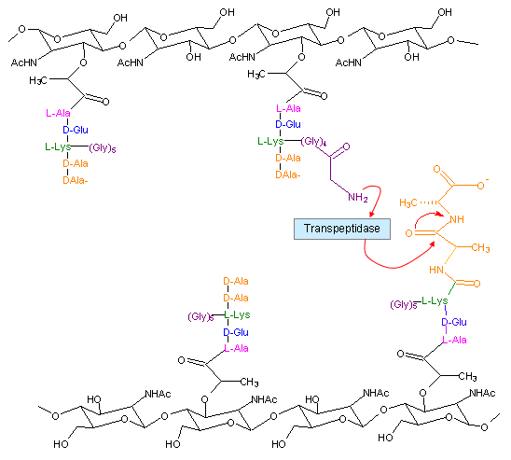
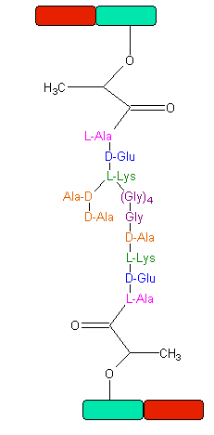
Peptidoglycan Synthesis
“Penicillin binding protein”
Notes:
Note the D-ala-D-ala vancomycin binding site
This crosslinking gives stability and strength to the cell wall

Slide 6
Vancomycin is bactericidal and exhibits time-dependent or concentration-independent bacterial killing.
Antibiotics with time-dependent killing characteristically kill bacteria most effectively when drug concentrations are a multiple (usually three to five times) of the minimum inhibitory concentration (MIC) for the bacteria

Slide 7
The mechanism of action
The mechanism of action for vancomycin is inhibition of cell wall synthesis in susceptible bacteria by binding to the D-alanyl-D-alanine terminal end of cell wall precursor units
Inhibition of cell wall synthesis: target is murein monomers → peptidoglycan precursors. Glycopeptides bind to the terminus region of the pentapeptide → forms a stable complex → can’t be incorporated into the growing cell wall

Slide 8
Mechanism of resistance:
  Enterococcus: Van A – E
    Peptidoglycan precursor has decreased affinity for vancomycin – D-ala-D-ala replaced by D-ala-D-lac
  Staphylococcus aureus (MIC < 2 mcg/mL; Inhib 4 – 8 mcg/mL, > 16 Resist):
    VISA isolates:
      Increased amount of precursor with decreased affinity
      Thicker cell wall
    hVISA: heterogenous bacterial population
Notes:
Resistance: instead of the terminal end d-alanyl – d-alanine the end is substituted with lactate or serine
VanA: high MICs to vanc
Resistance can be acquired or intrinsic. Most common acquired resistance seen in E. faecium then faecalis
VanA cluster genes: regulated by sensor kinase on membrane surface → it senses the glycopeptide → induces production of VanA
Heteroresistance of Staph aureus: can occur at MICs 1 – 2 mcg/mL
Intrinsic resistance to vancomycin: seen with lactobacillus, pediococcus → precursor is d-alanyl – d-lactate

Slide 9
THERAPEUTIC AND TOXIC CONCENTRATIONS
Vancomycin is administered as a short-term (1-hour) intravenous infusion.
Infusion rate related side effects have been noted when shorter infusion times (~30 minutes or less) have been used.

Slide 10
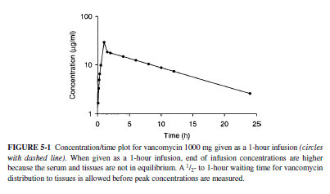

Slide 11
the therapeutic range for steady-state peak concentrations is usually considered to be 20–40 μg/mL
ototoxicity has been reported when vancomycin serum concentrations exceed 80 μg/mL

Slide 12
We should monitor for signs and symptoms that may indicate ototoxicity is occurring in a patient.
auditory: tinnitus, feeling of fullness or pressure in the ears, loss of hearing acuity in the conversational range;
vestibular: loss of equilibrium, headache, nausea, vomiting, vertigo, dizziness, nystagmus, ataxia).

Slide 13
the average vancomycin MICs for Staphylococcus aureus and Staphylococcus epidermidis are 1–2 μg/mL
minimum predose or trough steady-state concentrations equal to 5–10 μg/mL are usually adequate to resolve infections with susceptible organisms.
Methicillin-resistant S. aureus (MRSA) with MICs of 1.5–2 μg/mL may require higher steady-state trough concentrations to achieve a clinical cure

Slide 14
Vancomycin penetrates into lung tissue poorly (average serum:tissue ratio of 6:1) and pulmonary concentrations are highly variable among patients
Based on these findings and reports of therapeutic failures, recent treatment guidelines for hospital-aquired pneumonia recommend vancomycin steady-state trough concentrations equal to 15–20 μg/mL

Slide 15
vancomycin steady-state concentrations above 15 μg/mL are related to an increased incidence of nephrotoxicity.

Slide 16
Nephrotoxicity and ototoxicity cannot be completely avoided when using vancomycin by keeping serum concentrations within the suggested ranges.
However, by adjusting vancomycin dosage regimens so that potentially toxic serum concentrations are avoided, drug concentration-related adverse effects should be held to the absolute minimum.

Slide 17
CLINICAL MONITORING PARAMETERS
to monitor both steady-state peak and trough vancomycin serum concentrations
serum creatinine concentrations
Ideally, a baseline serum creatinine concentration is obtained before vancomycin therapy is initiated and three times weekly during treatment.
clinical signs and symptoms of auditory

Slide 18
BASIC CLINICAL PHARMACOKINETIC PARAMETERS
Vancomycin is almost completely eliminated unchanged in the urine primarily by glomerular filtration (≥90%)
Plasma protein binding is ~ 55%.
This antibiotic is given by short-term (1 hour) intermittent intravenous infusion.
Intramuscular administration is usually avoided because this route has been reported to cause tissue necrosis at the site of injection.

Slide 19
Oral bioavailability is poor (<10%) so systemic infections cannot be treated by this route of administration.
However, patients with renal failure who have been given oral vancomycin for the treatment of antibiotic-associated colitis have accumulated therapeutic concentrations because gut wall inflammation increased vancomycin bioavailability and renal dysfunction decreased drug clearance.

Slide 20
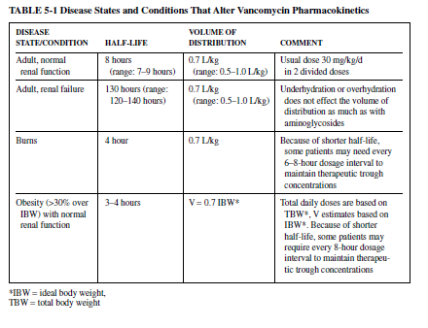

Slide 21
Normal Patients
The recommended dose for vancomycin in patients with normal renal function is 30 mg/kg/d given as 2 or 4 divided daily doses.
In normal weight adults, the dose is usually 2 g/d given as 1000 mg every 12 hours.

Slide 22
EFFECTS OF DISEASE STATES AND CONDITIONS ON
VANCOMYCIN PHARMACOKINETICS AND DOSING
Nonobese adults with normal renal function (creatinine clearance >80 mL/min) have an average vancomycin half-life of 8 hours (range = 7–9 hours)
the average volume of distribution for vancomycin is 0.7 L/kg (range 0.5–1.0 L/kg) in this population.

Slide 23
Burn Patients
Major body burns (>30–40% body surface area) can cause large changes in vancomycin pharmacokinetics.
48 to 72 hours after a major burn, the basal metabolic rate of the patient increases to facilitate tissue repair. The increase in basal metabolic rate causes an increase in glomerular filtration rate which increases vancomycin clearance.
Because of the increase in drug clearance, the average half-life for vancomycin in burn patients is 4 hours.

Slide 24
Obesity
Obese individuals with normal serum creatinine concentrations have increased vancomycin clearance secondary to increased glomerular filtration rate and are best dosed with vancomycin using total body weight.
The reason for the increased drug clearance is kidney hypertrophy which results in larger creatinine clearance rates.
Volume of distribution does not significantly change with obesity and is best estimated using ideal body weight (IBW) in patients more than 30% overweight (>30% over IBW, V =0.7 L/kg IBW)

Slide 25

Because the primary pharmacokinetic change for vancomycin in obesity is increased drug clearance with a negligible change in volume of distribution
average half-life decreases to 3.3 hours
While the average dose in morbidly obese and normal weight patients with normal serum creatinine concentrations was ~30 mg/kg/d using total body weight in both populations,
some morbidly obese patients required every-8-hour dosing to maintain vancomycin steady-state trough concentrations above 5 μg/mL.30

Slide 26
Premature infants
Premature infants (gestational age 32 weeks) have a larger amount of body water compared to adults.
However, vancomycin volume of distribution (V = 0.7 L/kg) is not greatly affected by these greater amounts of body water as is the case with aminoglycoside antibiotics.
Kidneys are not completely developed at this early age so glomerular filtration and vancomycin clearance (15 mL/min) are decreased.
A lower clearance rate with about the same volume of distribution as adults results in a longer average half-life for vancomycin in premature babies (10 hours)

Slide 27
Persamaan Parameter Farmakokinetik Vancomisin
  CL_{vanco} (mL/min/kg) = (0.695 x CL_{cr} [mL/min/kg] + 0.05

Slide 28
Pharmacokinetic Parameters Comparison Among Models
Estimate CL_{vanco} based on the CL_{cr}
Estimate Vd
Estimate Ke based
Estimate the trough level based on
  The dose given to patients
  Above Ke
  Bolus model

Slide 29
Methods Comparison
Methods | Equation
Kinetidex ® | (Ke = 0.00083 x CLcr + 0.0044)
Matzke method | CL_{vanco} (mL/min) = (CL_{cr} x 0.689) + 3.66 | Cockcroft-Gault method, ABW
 | V=0.72L/kg if CL_{cr} is >60mL/min; V=0.89L/kg if CL_{cr} is 10 -60 mL/min; V=0.9L/kg if CL_{cr} is <10mL/min | ABW
Bauer method | CL_{vanco} (mL/min/kg) = (0.695 x CL_{cr} [mL/min/kg] + 0.05 | (**)
 | V = 0.7L/kg | ABW
Practial method | Using Vd=0.7L/kg CL_{vanco} = 0.7 x CL_{cr} | ABW
(**) Cockcroft-Gault with ABW up to ABW/IBW = 1.3, after that IBW is used.

Slide 30
Reference
Birt JK, Chandler MH. Using clinical data to determine vancomycin dosing parameters. Ther Drug Monit. 1990; 12:206–9.
Matzke GR, McGroy RW, Halstenson CE et al. Pharmacokinetics of vancomycin in patients with various degrees of renal function. Antimicrob Agents Chemother. 1984; 25:433–7.
Burton ME, Gentle DL, Vasko MR. Evaluation of a Bayesian method for predicting vancomycin dosing. DICP. 1989; 23:294–300.
Rodvold KA, Blum RA, Fischer JH et al. Vancomycin pharmacokinetics in patients with various degrees of renal function. Antimicrob Agents Chemother. 1988; 32:848–52.
Rodvold KA, Blum RA, Fischer JH et al. Vancomycin pharmacokinetics in patients with various degrees of renal function. Antimicrob Agents Chemother. 1988; 32:848–52.
Ambrose PJ, Winter ME. Vancomycin. In: Winter ME. Basic clinical pharmacokinetics, 4th ed. Philadelphia: Lippincott Williams & Wilkins; 2004:451–76.
Bauer LA. Applied clinical pharmacokinetics. New York: McGraw Hill, Medical Publishing Division; 2001:180–261.
Murphy, J. et. Al. Predictability of Vancomycin Trough Concentrations Using Seven Approaches for Estimating Pharmacokinetic Parameter. American Journal of Health-System Pharmacy. 2006:63(23)2365-2370.

Slide 31
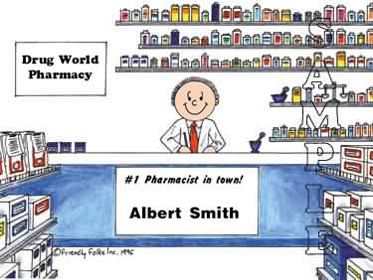
Thanks For Your Attention

