Slide 1

Diagnosis and Initial Management of HIV/AIDS:
What the Primary Care Provider Should Know
Carolyn K. Burr, EdD, RN
Co-Clinical Director NY/NJ AETC LPS
Deputy Director François-Xavier Bagnoud Center
December 17th, 2013
Support for this program is provided in part through an educational training grant from the New Jersey Department of Health (NJDOH), Division of HIV,STD and TB Services.

Slide 2
Objectives
Describe two ways HIV can be transmitted
Identify two laboratory tests used to assess HIV disease
Describe the clinical progression of HIV
Discuss the purpose of antiretroviral treatment

Slide 3
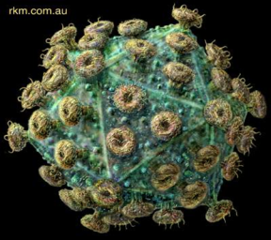
What is HIV
Human
Immunodeficiency
Virus
HIV is a retrovirus that attacks the immune system.
Its genetic material, RNA, must be converted in to DNA during replication.
Over time, the immune system and the body loses its ability to fight the virus.

Slide 4

HIV and the Immune System
The CD4 cells coordinate a body’s immune response to an invader (bacteria, virus, etc.)
BUT, when HIV enters CD4 cells for reproduction, it damages the CD4 cell, eventually killing it.
The body’s immune system works hard making more CD4 cells
Overtime, HIV destroys the CD4 cells faster than the immune system can make new ones
So, HIV damages the very system that usually protects the body from infection.

Slide 5
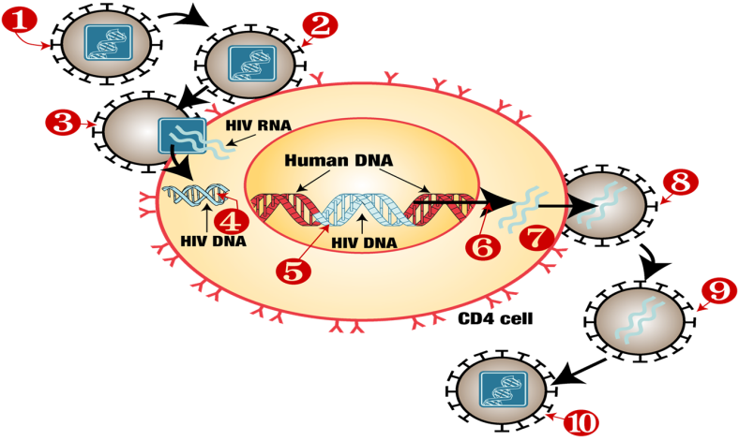
HIV Life Cycle
Notes:
HIV approaches a human CD4 T-lymphocyte.
Binding: HIV binds with glycoproteins to a CD4 receptor and either a CCR5 or CXCR4 co-receptor protein.
Fusion: The virus fuses to the host cell and releases RNA into the cell.
Reverse Transcription: The HIV enzyme reverse transcriptase converts single stranded HIV RNA into double stranded HIV DNA.
Integration: HIV DNA enters the hosts nucleus and is integrated into the host’s DNA using an enzyme called integrase creating a provirus.
6. Transcription: The provirus becomes active and uses RNA polymerase to create copies of HIV genomic material, as well as messenger RNA (mRNA). The mRNA is used as a blueprint to make long chains of HIV proteins
7. Assembly: The enzyme protease cuts the long chains of HIV into individual proteins and assemble an virus particle containing HIV RNA.
8. Budding: The newly assemble virus buds form the host cell taking with it a part of the cell’s outer envelope. This covering is a mixture of protein and sugar forming the HIV glycoproteins.
9. The immature virus breaks free of the infected cell
10. Maturation: Protease completes cutting the HIV protein chains into individual proteins and the newly formed copy of HIV can now infect other cells.
AIDSinfo. (2005, May). The HIV life cycle. Retrieved from http://www.aidsinfo.nih.gov/ContentFiles/HIVLifeCycle_FS_en.pdf
AIDS InfoNet. (2010, April 9). HIV life cycle. Retrieved from http://www.aidsinfonet.org/img/uploaded/image/106-life-cycle.jpg

Slide 6
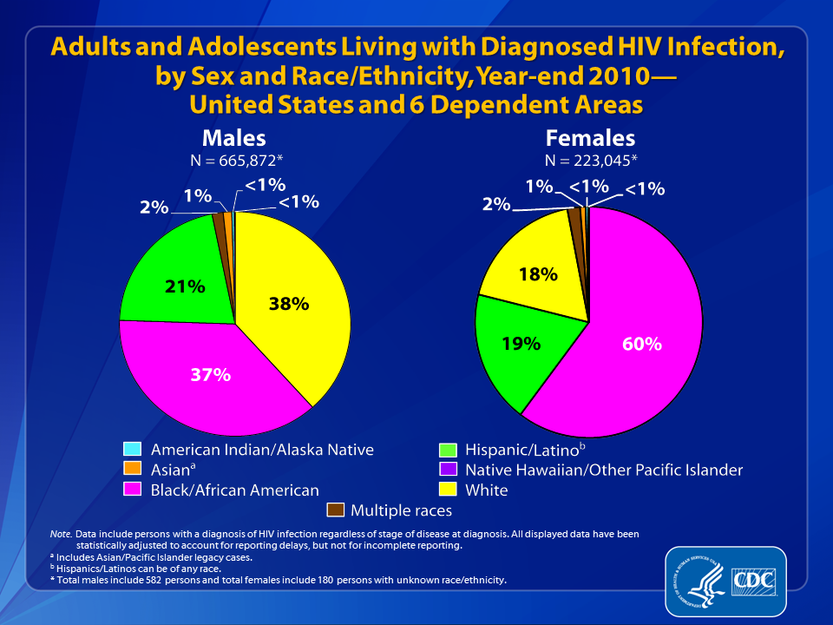
Notes:
At the end of 2010, an estimated 888,921* adults and adolescents were living with diagnosed HIV infection in the United States and 6 dependent areas.
Among the 665,872* males living with diagnosed HIV infection, 38% were white, 37% were black/African American, and 21% were Hispanic/Latino. Approximately 2% were Asian and approximately 1% were males of multiple races. Less than 1% each were American Indian/Alaska Native and Native Hawaiian/other Pacific Islander.
Among the 223,045* females living with diagnosed HIV infection, 60% were black/African American, 19% were white, and 18% were Hispanic/Latino. Approximately 2% were females of multiple races, 1% were Asian, and less than 1% each were American Indian/Alaska Native, and Native Hawaiian/other Pacific Islander.
Data include persons with a diagnosis of HIV infection regardless of stage of disease at diagnosis. All displayed data are estimates. Estimated numbers resulted from statistical adjustment that accounted for reporting delays, but not for incomplete reporting.
The Asian category includes Asian/Pacific Islander legacy cases (cases that were diagnosed and reported under the pre-1997 Office of Management and Budget race/ethnicity classification system).
Hispanics/Latinos can be of any race.
* Persons living with diagnosed HIV infection by race/ethnicity are classified as adult or adolescent based on age at year-end 2010. Total number adults and adolescents living with HIV infection is inclusive of persons of unknown sex. Total males include 582 persons and total females include 180 persons with unknown race/ethnicity.

Slide 7
HIV in New Jersey
36,648 people are living with HIV
34%
Women
(53% between 20-49)
78%
Minorities
159 perinatal exposures
3% infected
79%
40 years or older
Notes:
NJ Department of Health. New Jersey HIV/AIDS Report. (31December, 2012). Retrieved from http://www.state.nj.us/health/aids/documents/qrt1212.pdf

Slide 8
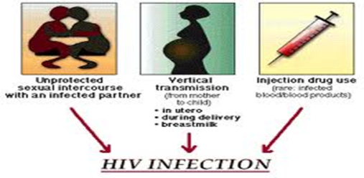
HIV Transmission
Blood
Semen
Vaginal Secretions
Breast milk
Comes into contact with:
  mucous membranes, damaged tissue, or is injected into the body
Through:
  Vaginal, anal, or oral sex
  Contaminated needles
  IV drug use
Notes:
HIV is transmitted when blood, semen, vaginal secretions, or breast milk comes into contact with a mucous membrane, damaged tissue, or is injected into the body.
Methods of transmission include vaginal, anal, or oral sex, or contaminated needles commonly through IV drug use.
Centers for Disease Control and Prevention. (2010, March 25). HIV transmission. Retrieved from http://www.cdc.gov/hiv/resources/qa/transmission.htm

Slide 9
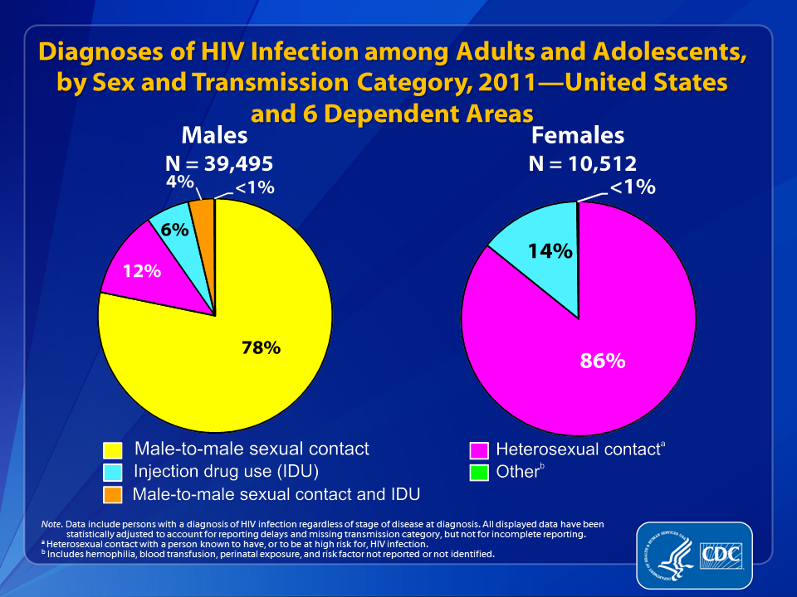
Notes:
In 2011, among adult and adolescent males diagnosed with HIV infection in the United States and 6 dependent areas, an estimated 78% of infections were attributed to male-to-male sexual contact, 12% to heterosexual contact, 6% to injection drug use, 4% to male-to-male sexual contact and injection drug use, and less than 1% to other transmission categories.
Among adult and adolescent females, 86% of diagnosed HIV infections were attributed to heterosexual contact, 14% were attributed to injection drug use, and less than 1% to other transmission categories.
Data include persons with a diagnosis of HIV infection regardless of stage of disease at diagnosis. All displayed data are estimates. Estimated numbers resulted from statistical adjustment that accounted for reporting delays and missing transmission category, but not for incomplete reporting.
Heterosexual contact is with a person known to have, or to be at high risk for, HIV infection.
Other transmission categories include hemophilia, blood transfusion, perinatal exposure, and risk factor not reported or not identified.

Slide 10
HIV Transmission
Perinatal transmission during pregnancy, labor and deliver, or breastfeeding
Occupational exposure via needle stick or exposure to eyes, nose, or open wound
  Since 1981 there have been 57 documented cases of occupational transmission in the US
Blood transfusion or organ donation from an HIV infected donor (rare in US)
Notes:
Infants can be infected with HIV during pregnancy, labor and deliver, or through breastfeeding.
Infection through blood transfusion or organ donation is rare in the US
Centers for Disease Control and Prevention. (2010, March 25). HIV transmission. Retrieved from http://www.cdc.gov/hiv/resources/qa/transmission.htm

Slide 11

HIV Transmission
HIV is NOT transmitted by casual contact
  Working or playing with an HIV positive person
  Closed mouth kissing
  Shaking hands
  Public pools
  Hugging
  Public toilet
HIV is not transmitted by air, food, or mosquito and does not survive long outside the body.
Notes:
As health professionals, it is important to provide HIV education to patients and clients in order to decrease the stigma of the infection. Reinforce with patients that HIV is not transmitted by casual contact like working or playing together, closed mouth kissing, shaking hands, public pools, hugging, or public toilets. It is not transmitted by air, food, or mosquitoes and does not survive long outside the body.
Centers for Disease Control and Prevention. (2010, March 25). HIV transmission. Retrieved from http://www.cdc.gov/hiv/resources/qa/transmission.htm

Slide 12

HIV Testing
CDC recommends routine HIV testing for ALL patients:
  Aged 13-64
  Initiating TB treatment
  Seeking treatment for STI’s
  Who are pregnant
Repeat Screening Recommended
  Annually people at high risk
  Before beginning a new sexual relationship
  When clinically indicated
  After an occupational exposure
Notes:
The Centers for Disease Control recommend routine HIV screening for all people aged 13-64. Testing is also recommended before initiating treatment for tuberculosis, for those seeking treatment for sexually transmitted infections, and for all pregnant women to prevent perinatal transmission. Repeat screening is also recommended annually for people at high risk for HIV acquisition, before beginning a new sexual relationship, after an occupational exposure, and when clinically indicated.
Centers for Disease Control and Prevention. (2006). Revised recommendations for HIV testing of adults, adolescents, and pregnant women in health care settings. MMWR, 55 (No. RR-14), 1-17.
High risk criteria
IV drug users and their sex partners
People who exchange sex for drugs or money
Sex partners of people infected with HIV
People, or their sex partners, who have had more than one sex partner since their last HIV test
The USPSTF recommends that clinicians screen for HIV infection in adolescents and adults ages 15 to 65 years. Younger adolescents and older adults who are at increased risk should also be screened.
Grade: A Recommendation.
The USPSTF recommends that clinicians screen all pregnant women for HIV, including those who present in labor who are untested and whose HIV status is unknown.
Grade: A Recommendation.

Slide 13
HIV Testing
Benefits of routine opt-out HIV testing
  Reduces the stigma of testing
  Reduces transmission
  Majority of people aware of their HIV status reduce behaviors that transmit infection
  Perinatal transmission can be prevented if mother’s HIV status is known
  Improves patient outcomes (with early diagnosis of HIV)
Notes:
Providing routine HIV testing serves first to reduce the stigma of testing. Secondly, it reduces the transmission of HIV. Marks et al. conducted a meta-analysis of studies which looked at high risk behaviors among people who knew they were HIV-positive versus those who were unaware of status. The analysis found a 68% reduction (95% CI: 59%-76%) in unprotected anal or vaginal intercourse for those people who knew they were HIV-positive and had an uninfected partner. It is important that patients are tested and know their status because they are more likely to take steps to prevent transmission to others.
Similarly, perinatal transmission of HIV from mother to infant can be prevented if the mother's HIV status is known.
Perinatal transmission rates can be reduced to less than two percent when a mother is known to be HIV-positive and the dyad receives appropriate care during pregnancy, intrapartum, and postnatally.
Thirdly, early diagnosis of HIV can improve patient outcomes.
Centers for Disease Control and Prevention. (2006). Revised recommendations for HIV testing of adults, adolescents, and pregnant women in health care settings. MMWR, 55 (No. RR-14), 1-17.
Marks, G, Crepas, N., et al. (2005, August 1). Meta-analysis of high-risk behavior in persons aware and unaware they are infected with HIV in the United States. J Acquir Immune Defic Syndr, 39(4), 446-53.

Slide 14
Sequence of HIV Assay Reactivity During Early HIV
Infection relative to Western Blot*
WB POSITIVE
Trinity Uni-gold Recombigen (2)
OraSure Oraquick Advance (1)
Bayer ADVIA Centaur (14)
Clearview Statpak/Complete (5)
Bio-Rad Ag/Ab combo (19)
Ortho Vitros Eci/ECiQ (13)
Abbott Architect
Ag/Ab Combo (20)
Bio-Rad Mulltispot (7)
Gen-Probe Aptima (26)**
Medmira Reveal G3 (6)
BioRad GS + O (12)
DPP HIV1/HIV-2(6)
BioLytical Insti (9)
Avioq(6)
-25
-20
- 15
-10
- 5
0
NAT
4th gen IA
3rd gen Lab IA
2nd gen IA
3rd gen POC IA
1st gen WB
Estimated # of days HIV assay is reactive before a positive Western blot result is obtained
*Assay sensitivity above is based on frozen plasma only. Whole-blood and oral fluid has not been
characterized for early infection.
**Current data suggests that the Gen-Probe Aptima can detect HIV-1 RNA ~9-11 days after infection.
Adapted from Owen et al J Clin Micro 2008 and Masciotra et al J Clin Virol 2011

Slide 15
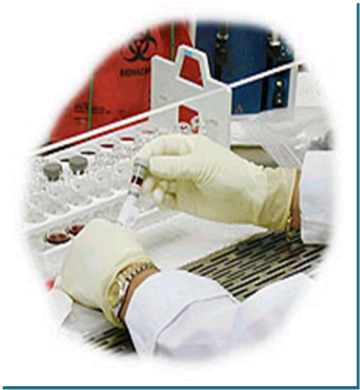
HIV Laboratory Tests – CD4 Count
CD4 count –measures state of a person’s immune function
  Adult values are approximately 500-1300
  Used to determine stage of HIV progression
  Determines risk of opportunistic infection
  Historically guided decisions about antiretroviral therapy (ART)
Notes:
CD4 counts measure the number of CD4 cells per microliter of blood and are monitored in order to gain information about a patient's state of current immune function, as well as predict future disease progression. CD4 counts are the main tool in the decision to initiate antiretroviral therapy, and are used to guide the clinical management for opportunistic infection. CD4 counts can be helpful in monitoring the success of antiretroviral therapy, however viral load is the most important test when assessing ART efficacy. CD4 percentages are also used in the clinical setting and generally do not reflect transient fluctuations in CD4 counts.
Coffey, S (Ed.). (2011). Guide for HIV/AIDS clinical care. Rockville, MD: U.S. Department of Health and Human Services Health Resources and Services Administration HIV/AIDS Bureau.
Panel on Antiretroviral Guidelines for Adults and Adolescents. (2012, March27). Guidelines for the use of antiretroviral agents in HIV-1-infected adults and adolescents. Retrieved from http://www.aidsinfo.nih.gov/ContentFiles/AdultandAdolescentGL.pdf.

Slide 16
HIV Laboratory Tests – Viral Load
Detects the amount of virus present
  High viral loads increase risk for disease progression and HIV transmission
Monitors effectiveness of ART
  Goal of therapy is an undetectable viral load
Used during acute infection to detect virus
Measured by HIV-1 RNA PCR
Notes:
Viral load is measured using HIV-1 RNA PCR and indicates the number of copies per milliliter of plasma. Testing measures the burden of infection, is useful for predicting clinical progression of HIV/AIDS and is the most important indicator of response to ART. It can also be used as a tool to detect viremia in acute infection before antibodies are produced. High viral loads are associated with increased risk of HIV transmission and clinical progression to AIDS. The goal of ART is to have patients achieve viral load suppression.
Coffey, S (Ed.). (2011). Guide for HIV/AIDS clinical care. Rockville, MD: U.S. Department of Health and Human Services Health Resources and Services Administration HIV/AIDS Bureau.

Slide 17
Clinical Progression
Acute Retroviral Syndrome
  Two thirds of all patients experience symptoms
  Occurs 2-6 weeks after initial infection
  Symptoms last 2-4 weeks
  May be mistaken for influenza, mononucleosis, or other viral process
  During this period HIV virus is replicating rapidly and CD4 count decreases until the body’s immune response recovers CD4 cells and decreases viral load

Slide 18

Clinical Progression
Clinical Latency
  Virus is replicating at low levels
  CD4 cells are maintained at a healthy level
  Virus is transmittable
  This period may last for several years

Slide 19
Clinical Progression
Clinical symptoms will begin to develop at the end of this period as CD4 count falls and viral load increases.
May include
  Bacillary angiomatosis (lesion on skin caused by infection with gram negative organism
  Persistent or resistant vulvovaginal candidiasis
  PID
  Cervical Dysplasia
  Hairy leukoplakia
  Herpes Zoster
  Fever or diarrhea lasting longer than one month

Slide 20

AIDS
AIDS is characterized by certain infections that take advantage of the body’s weakened immune system.
A diagnosis of AIDS is made when an HIV positive patient has a CD4 count of less that 200 or 14% or the patient is diagnosed with an AIDS defining condition
Progression from initial infection with HIV to advanced HIV/AIDS varies among people and can take several months to up to 10 years or more.

Slide 21
Opportunistic Infections
Opportunistic infections are infections that take advantage of a weakened immune system to cause more frequent or severe illness
  CDC identifies 29 infections
  Prophylactic drugs may be given to prevent illness for some conditions
  Other clinical options include
    Effective ART
    Vaccination
    Avoiding exposure to certain pathogens
    Disease treatment
    Preventing disease recurrence (secondary prophylaxis or chronic maintenance therapy)
Notes:
Candidiasis of bronchi, trachea, or lungs
Candidiasis of esophagus
Cervical cancer, invasive
Coccidioidomycosis, disseminated or extrapulmonary
Cryptococcosis, extrapulmonary
Cryptosporidiosis, chronic intestinal (>1 month's duration)
Cytomegalovirus disease (other than liver, spleen, or nodes), onset at age >1 month
Cytomegalovirus retinitis (with loss of vision)
Encephalopathy, HIV related
Herpes simplex: chronic ulcers (>1 month's duration) or bronchitis, pneumonitis, or esophagitis (onset at age >1 month)
Histoplasmosis, disseminated or extrapulmonary
Isosporiasis, chronic intestinal (>1 month's duration)
Kaposi sarcoma
Lymphoma, Burkitt, immunoblastic, or primary of brain
Mycobacterium avium complex or Mycobacterium kansasii, disseminated or extrapulmonary
Mycobacterium tuberculosis of any site, pulmonary, disseminated, or extrapulmonary
Mycobacterium, other species or unidentified species, disseminated or extrapulmonary
Pneumocystis jirovecii pneumonia
Pneumonia, recurrent
Progressive multifocal leukoencephalopathy
Salmonella septicemia, recurrent
Toxoplasmosis of brain, onset at age >1 month
Wasting syndrome attributed to HIV

Slide 22
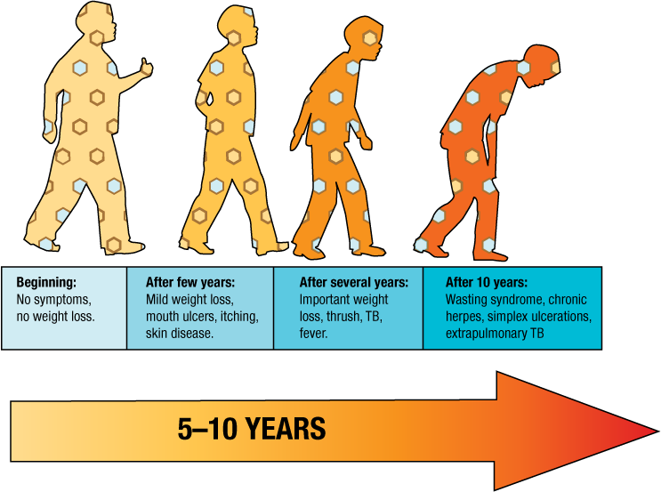
Clinical Progression

Slide 23

What can we do?

Slide 24
Antiretroviral Therapy
Recommended for all HIV-positive people
  To prevent disease progression
  To prevent transmission of infections
Strength of recommendation based on
  CD4 count
  Transmission risk
See Guidelines for the Use of Antiretroviral Agents in HIV-1 Infected Adults and Adolescents available at http://www.aidsinfo.nih.gov/ for more info

Slide 25
Confusing terminology?
ART = Anti Retroviral Therapy
ARV = Anti Retro Virals
HAART = Highly Active Anti Retroviral Therapy
Triple Therapy = Three Antiretrovirals
“The Cocktail”

Slide 26
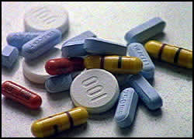
Basic Facts about ARVs
ARVs are divided into classes, each of which attacks HIV in a different way.
New classes becoming available through clinical trials.
Always use 3 or more different ARV medications for therapy.
Regimen should be selected by an experienced HCW.
Other medications interact with ARVs.

Slide 27

HIV as a Chronic Disease
ARVs change HIV from a terminal (fatal) disease to a “chronic disease”
Examples of chronic diseases:
  Diabetes
  High blood pressure
  Asthma
  Schizophrenia

Slide 28
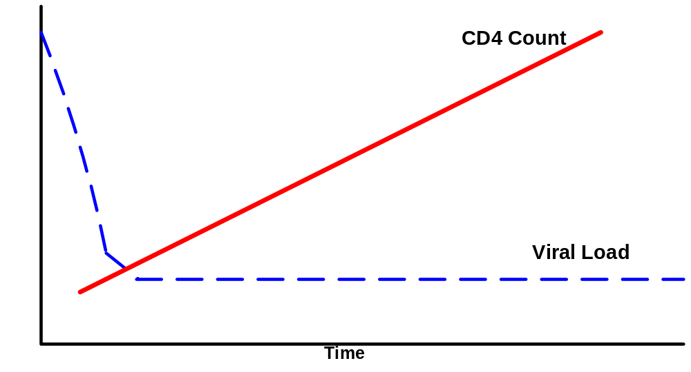
Advantages of ARV Therapy
Improved patient health
Reduced illness
Reduced hospitalisations
Fewer deaths from AIDS
Notes:
Reducing HIV-Related mortality and morbidity.
Restoring and/or preserving immune function
Maximally and durably suppressing viral replication (viral load < 48)
Maintaining normal physical growth and neurocognitive development
Improving quality of life

Slide 29
Goals of Treatment
Improve quality of life
Reduce HIV-related morbidity and mortality
Restore and/or preserve immunologic function
Maximally and durably suppress HIV viral load
Prevent HIV transmission

Slide 30
How do ARVs control HIV?
ARVs reduce the ability of the HIV virus to replicate
In turn, this increases the ability of the body to fight disease
Reduces the risk of HIV transmission
HIV
Replication
Immune
Response

Slide 31
The Ideal ARV
No toxicities
Good tolerability
Complete viral suppression
No resistance

Slide 32
Initial Treatment: Choosing Regimens
3 main categories:
  1 NNRTI + 2 NRTIs
  1 PI + 2 NRTIs
  1 II + 2 NRTIs
Combination of NNRTI, PI, or II + 2 NRTIs preferred for most patients
Fusion inhibitor, CCR5 antagonist not recommended in initial ART
Advantages and disadvantages to each
type of regimen
Individualize regimen choice
Notes:
Summary of Recommended Regimens
The most extensively studied combination antiretroviral regimens for treatment-naïve patients generally consist of two NRTIs plus either one NNRTI or a PI (with or without ritonavir boosting). A list of Panel-recommended components for initial therapy in treatment-naïve patients can be found in Table 6. Potential advantages and disadvantages of the components recommended as initial therapy for treatment-naïve patients are listed in Table 7 to guide prescribers in choosing the regimen best suited for an individual patient. A list of agents or components not recommended for initial treatment can be found in Table 8. Some agents or components that are not recommended for use because of lack of potency or potential serious safety concerns are listed in Table 9

Slide 33
Achievable…..?
YES
ARVs are able to significantly reduce viral load, allowing the immune system to recover followed by an increase in quality of life and reduction in morbidity and mortality
BUT
they are not perfect……….

Slide 34
Managing Side Effects
‘Acceptable’
(transient, manageable)
Versus
‘Unacceptable’
(severe, adverse reactions)
…..but, ALL must be reported so that they can be managed appropriately

Slide 35
Basic Facts about Adherence and ARV Therapy
ARV blood concentrations must remain constant; low concentrations allow HIV to mutate.
HIV mutations cause drug resistance.
ARV medications must be taken every day otherwise they will not work.
Things that can lower drug concentrations:
  Missing 1 or 2 ARV medication doses regularly
  Taking ARV medication late
  Taking ARVs with certain foods or other medications

Slide 36
Treatment Adherence
A patient’s ability to follow a prescribed treatment regimen
Major factor in success of drug regimen
Significant determinant of survival
Willingness to start treatment and take medications exactly as directed
Level of adherence affects how well ART decreases the HIV viral load
Average US ART adherence rate is about 70%
Notes:
36

Slide 37
Treatment Adherence
Factors associated with poor adherence
  Depression
  Active alcohol or drug use
  Low literacy
  Lack of social support (unstable social situation, chaotic lifestyle)
  Lack of support from partner
  Advance HIV infection
  Young age
  Disbelief in treatment efficacy
  Unstable housing
  Cognitive impairment
  Competing priorities
    Childcare, food and work

Slide 38
Treatment Adherence
Complexity of medication regimen
Adverse drug effects
Poor patient provider relationships
Lack of resources
Poor literacy
Substance abuse
Stigma
Travel away from home
Sleeping through doses
Treatment fatigue
  Adherence should be assessed at each visit

Slide 39
Treatment Adherence
Strategies to improve adherence
  Choose once daily dosing if possible
  Avoid complex or poorly tolerated regimes
  Use fixed dose combinations if possible
  Use multidisciplinary approach
  Provide tools and support
    Reminder alarms
    Text message reminders
    Education and counseling
    Pill boxes

Slide 40
Resistance
Skipping doses of medications may cause the virus to mutate leading to strains of HIV that are resistant to medications
Drug resistant strains can be transmitted
Viral fitness: Ability of a virus to enter and destroy CD4 cell (caused by the number resistant mutations developed)
Notes:
GET RID OF THE SHADOW!!!

Slide 41
Resistance Testing
Genotype
  Amplifies and sequences HIV to look for mutations known to correlate with drug resistance. Most successful if viral load is above 1000 copies/ml
  Recommended as initial form of resistance testing
    Use to select effective ART
Phenotype
  HIV reverse transcriptase and protease genes are spliced and created into a laboratory strain
  The strain is grown in the presence of escalating concentrations of ARV drugs
    Process takes 2-3 weeks and is costly
  Recommended for patients with complicated multidrug resistance patterns

Slide 42
Take Home Messages: HIV 101
HIV infection is a treatable, chronic illness
Routine HIV testing is essential not only for treatment of HIV but also for prevention
ART improves quality of life and decreases
  Mortality
  Morbidity
  Risk of transmission to partners
Adherence is key to ARV effectiveness

Slide 43
Resources
AIDS Education and Training Center National Resource Center www.aidsetc.org
NY/NJ AETC http://www.nynjaetc.org/index.html
NY/NJ AETC Trainings On-Demand Online Courses http://www.nynjaetc.org/on-demand/index.html#CME
National Clinicians Consultation Center www.nccc.ucsf.edu
AIDSInfo Clinical Guidelines http://aidsinfo.nih.gov/guidelines
François-Xavier Bagnoud Center http://fxbcenter.org/

Slide 44
THANK YOU!

