Slide 1
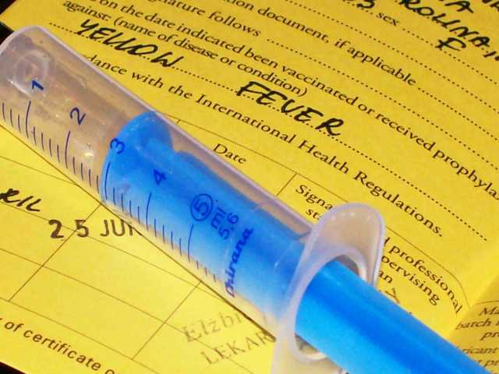

Translated from Russian to English - www.onlinedoctranslator.com
Yellow fever.

Slide 2
YELLOW FEVER
Acute viralarbovirus natural focal transmissve infectious disease, which characterized by general intoxication, high fever, hemorrhagic syndrome, damage to the liver, kidneys and other organs.
Lat.Febris flava.
Synonyms: amaryl fever, amaryllosis typhus, amaryllosis

Slide 3
In 2005, the World Health Assembly adopted a new version of the international health regulations. From now on, the regulations in accordance with these rules are subject to ".cases that may become an emergency in the field of public health, but are of international concern."
These include:
Cholera, pneumonic plague, yellow fever, Marburg hemorrhagic fever, Ebola, Lassa, West Nile fever, smallpox, poliomyelitis, which is caused by the "wild" polio virus, human influenza, which is caused by a new subtype (including the avian influenza virus),SARS;
Other diseases that are of particular national and regional concern (eg dengue fever, meningococcal disease);
Other public health emergencies that may affect the population of another country: floods, chemical releases, nuclear reactor accidents, and the like.

Slide 4
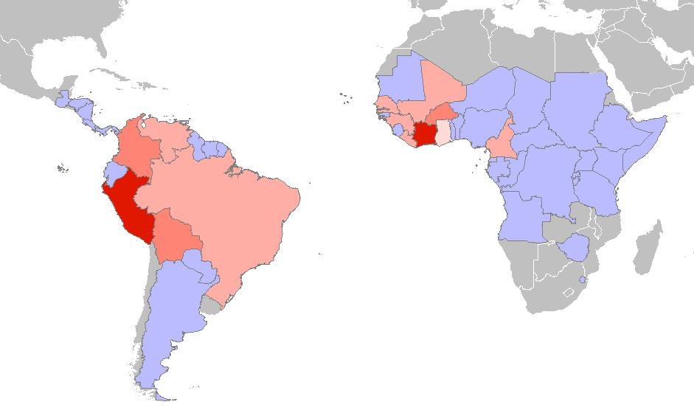
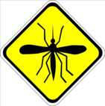

Slide 5
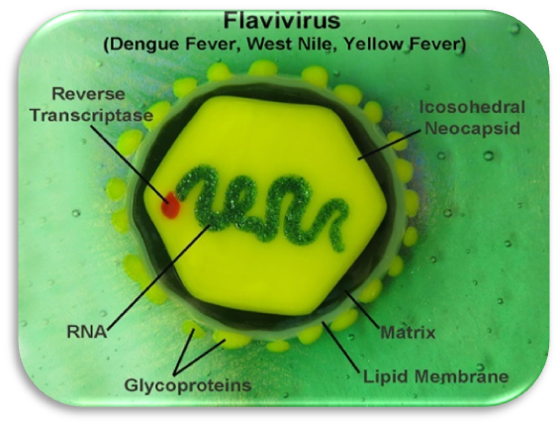
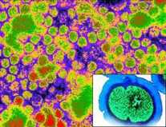
The causative agent of yellow fever is an RNA-containing arbovirus of the genusTogaviridae.
Yellow fever virus has antigenic affinity for many other flaviviruses (Zika virus, dengue);
The yellow fever virus is represented by one serotype, which is important for the development of a vaccine;
The virus is sensitive to high temperatures, at low temperatures it can persist for years;

Slide 6
There are 2 epidemiological types of yellow fever foci: jungle (primary, natural, zoonotic) and urban (secondary, anthropurgic).
In the jungle focus, the main source of infection and reservoir are monkeys - marmosets and others; some rodents, marsupials, opossums, hedgehogs.
In the urban type, the source of infection is a sick person during the period of viremia.
Yellow fever virus vectors are mosquitoes of the genus Aedes (A.aegypty, A.africanus)
The susceptibility of people is universal, does not depend on age and gender

Slide 7
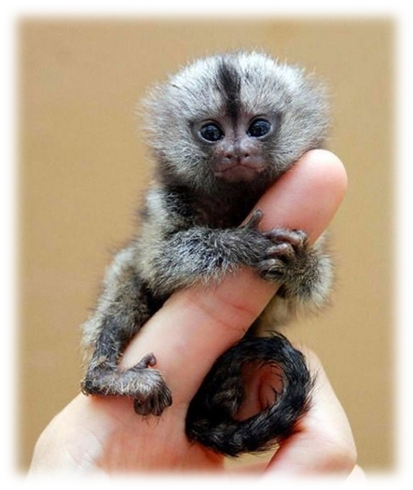
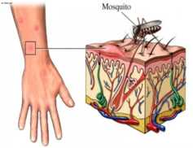
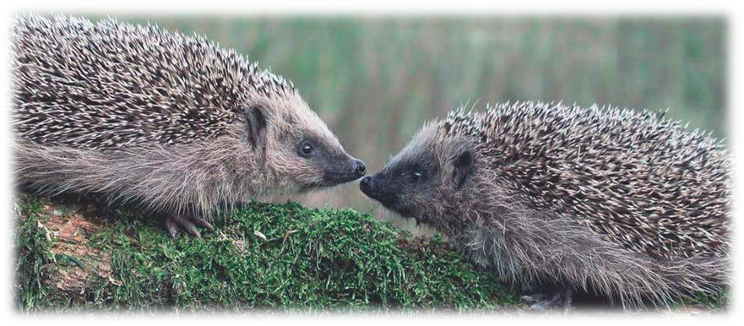
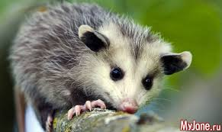

Slide 8
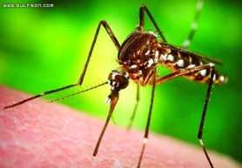
There is no innate immunity to yellow fever.
Those who have been ill acquire stable lifelong immunity.
In vaccinated, neutralizing antibodies appear 7-10 days after immunization and persist for 6 years.

Slide 9
A95 Yellow fever
A95.0 Forest yellow fever
A95.1 Urban yellow fever
A 95.9 Yellow fever, unspecified

Slide 10
Incubation period - 2-6days
Typical form of yellow fever has a cyclic flow with 3 phases:
1)initial period (phase of active hyperemia);
2) short-term period remissions (weakening period, temperature drop, transitional period), this period may sometimes be absent;
3) period of venous stasis.
4) the period of convalescence.

Slide 11
Initial period (3-4 days).
The disease begins acutely.
The temperature reaches 38.5-40°C.
Strong headache.
Pain in the muscles of the back and limbs.
Nausea, vomiting.
Agitation, hallucinations, delusions.
Puffiness and hyperemia of the patient's face.
Amaryl mask: the patient's face is purple, with a bluish tint, the eyes are anxious, filled, the sclera are injected, photophobia, lacrimation is noted.
The mucous membrane of the mouth is bright red, edematous.
Heart sounds are muffled.
Liver and spleen slightly enlarged and sensitive
Petechiae, symptoms of bleeding.
By the end of the phase, scleral icterus appears.
From the 4-5th day of illness, jaundice appears, it is rarely pronounced.
Usually bright jaundice is observed in patients with a favorable and prolonged course of the disease.

Slide 12
The period of short-term remission
On the 4th-5th day of the disease, a short-term remission is observed (from several hours to 1-2 days) with a critical decrease in temperature and an improvement in the condition.
The initial period (the stage of hyperemia) and the stage of remission constitute the early phase of the disease.
Reactive period (venous stasis)
Severe general intoxication;
hemorrhagic syndrome;
Hyperemia of the face is replaced by cyanosis;
Hepatosplenomegaly and jaundice increases;
Arterial pressure decreases, the pulse is rare (Fage's symptom - the pulse lags behind the temperature);
Possible renal and hepatic failure

Slide 13
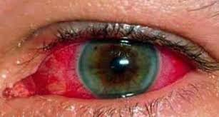
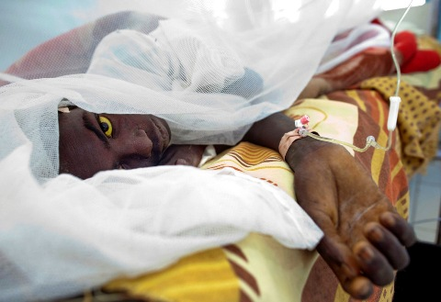

Slide 14
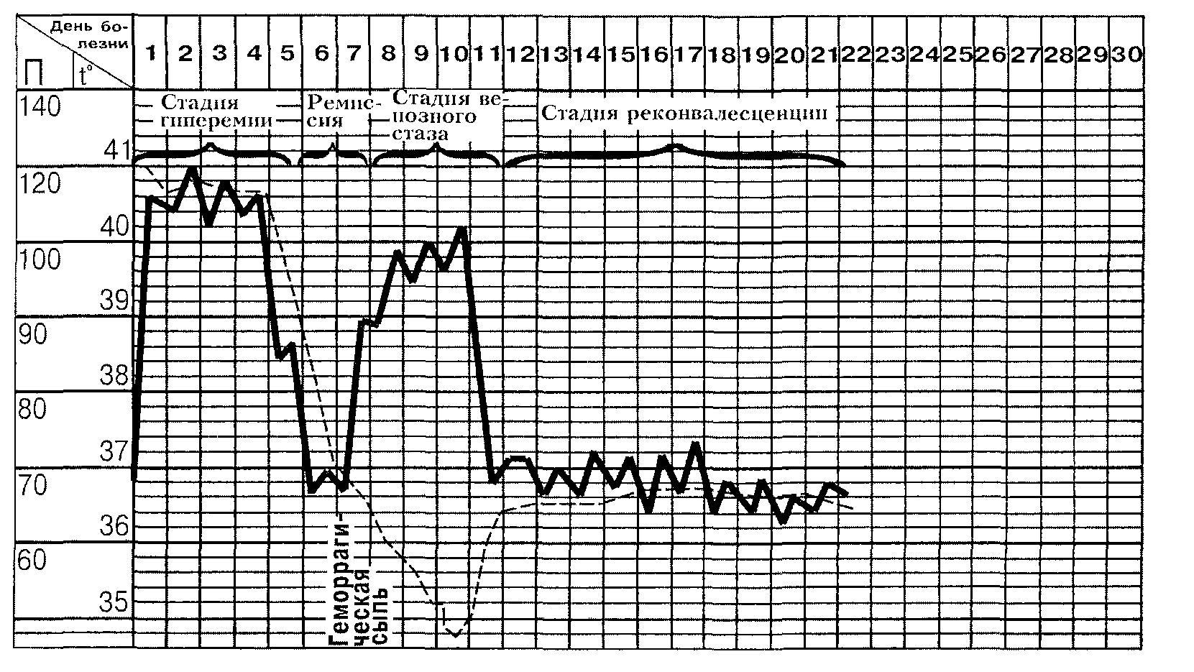

Slide 15
bleeding;
Uremia;
Liver failure;
Pneumonia;
Myocarditis;
Thrombophlebitis;
Gangrene of the limbs;

Slide 16
CBC
Leukopenia due to a decrease in the number of neutrophils.
Leukopenia is most pronounced on the 5-6th day of illness.
ESR is accelerated.
Gerela investigation of urine
gradual increase in protein to a significant amount.
granular and hyaline cylinders are found.
from the 3-4th day of illness - bile pigments.
Biochemical research
Increase in the content of free and bound bilirubin.
The content of albumin and blood coagulation factors (prothrombin, proconvertin, fibrinogen, etc.) decreases.
The activity of transferases - alanine aminotransferase (ALT) and aspartate aminotransferase (AST) increased to significant values.

Slide 17
Serological tests
PCR

Slide 18
Death occurs in the stage of venous stasis on the 6-9th day of illness due acute renal or liver liver failure
Mortality during epidemics 20-30% (according to some sources up to 50-80%)

Slide 19
Specific Therapy yellow fever insufficiently developed.
Pathogenetic and symptomatic therapy is carried out

Slide 20

Vaccination is the single most important measure to prevent yellow fever.
One dose of the vaccine provides protection for 30-35 years or more, and possibly for life. Serious side effects are extremely rare

Slide 21
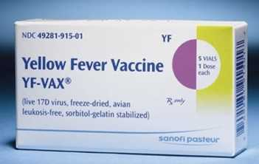
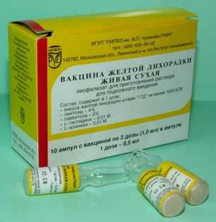
French neurotropic strain Dakar
American vaccine prepared from strain 17-D on chicken embryos.

Slide 22


It is of vital importancemosquito control.Transfer riskyellow fever in urban areasreduceby destroying potential mosquito breeding sites and adding insecticides to water sources where the initial stages of their development take place.
Insecticide spraying to kill adults during urban outbreaks, combined with emergency vaccination campaigns, can reduce or eliminate yellow fever transmission, allowing"buy time" for development of immunity in the vaccinated population.

Slide 23
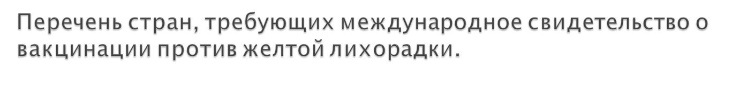
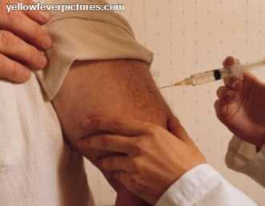
Benin
Burkina Faso
Gabon
Ghana
Zaire
Cameroon
Congo
Ivory Coast
Liberia
Mauritania
Mali
Niger
Rwanda
Sao Tome and Principe
Togo
french guiana
Central African Republic

Slide 24
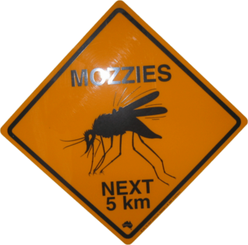
Thanks for your attention!

