Slide 1
Amebiasis

Slide 2
AMEBIASIS
Amoebiasis is a parasitic infection common in under-developed countries and among populations with low socio-economic status living in congested localities with poor sanitation. Causative organism is a protozoon; Entamoeba histolytica, that principally affects colon and liver.

Slide 3
The protozoan Entamoeba histolytica causes amebiasis. There are three species of intestinal amoebas. Entamoeba histolytica causes most symptomatic diseases. Entamoeba dispar is nonpathogenic, and Entamoeba moshkovskii is reported increasingly, but its pathogenicity is unclear.

Slide 4
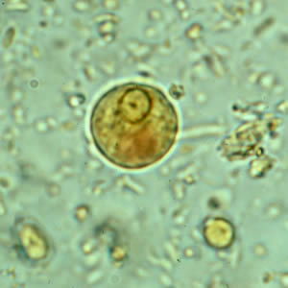
Life cycle
includes 2 stages:
Vegetative stage (unresistant)
Stage of the rest (cysts)

Slide 5
E. histolytica is a pseudopod-forming, protozoal parasite that causes proteolysis and tissue lysis. Humans are the natural hosts.
Amoebic infection occurs by the ingestion of mature cysts in fecally-contaminated food or water or from the hands.
Excystation of the mature cysts occurs in the small intestine, and trophozoites are released; the trophozoites then move to the large intestine. The trophozoites increase by binary fission and produce cysts. Both stages pass in the feces.
The cysts can survive days to weeks in the external environment because of the protection provided by the cyst wall. The cyst is responsible for further transmission of the parasite. Ingestion of only a small number of organisms can cause disease.

Slide 6
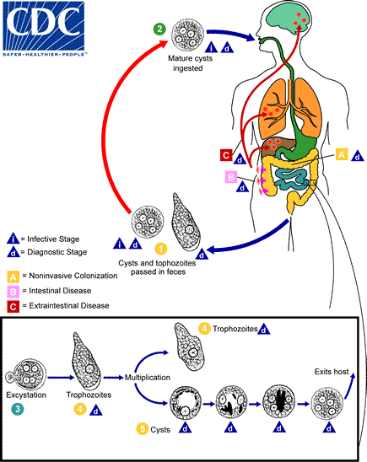

Slide 7
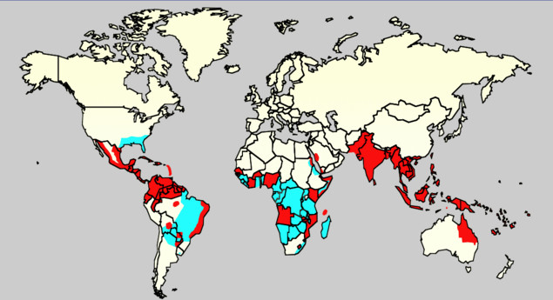

Slide 8
Amebiasis occurs worldwide, but it is more prevalent in tropical and developing countries. Approximately 40–50 million of world's population is estimated to be infected by Entamoeba histolytica (E. histolytica) annually with 40,000 deaths.
Among infected, 90% are asymptomatic and 1% may develop invasive amebiasis or involves other organs

Slide 9
In 10% of infected patients, pathogenic amoebae penetrate the mucous of the colon: this is the intestinal amoebiasis (amoebic dysentery). The clinical picture is similar to that of shigellosis, which is the principal cause of dysentery.
Occasionally, the pathogenic amoebae migrate via the blood stream and form peripheral abscesses. Amoebic liver abscess is the most common form of extra-intestinal amoebiasis.

Slide 10
CLINICAL FORMS
E histolytica is capable of causing a spectrum of illness. Intestinal conditions resulting from E histolytica infection include the following:
Asymptomatic infection
Symptomatic noninvasive infection
Acute proctocolitis (dysentery)
Fulminant colitis with perforation
Toxic megacolon
Chronic nondysenteric colitis
Ameboma
Perianal ulceration

Slide 11
Patients with amebic colitis typically present with a several-week history of cramping abdominal pain, weight loss, and watery or bloody diarrhea.
The gradual onset and variable signs and symptoms make diagnosis difficult.

Slide 12
The differential diagnosis of a diarrheal illness with occult or grossly bloody stools should include
infection with:
shigella
salmonella
campylobacter
enteroinvasive and enterohemorrhagic
E coli.
Noninfectious causes include:
inflammatory bowel disease
ischemic colitis
diverticulitis
arteriovenous malformation.

Slide 13
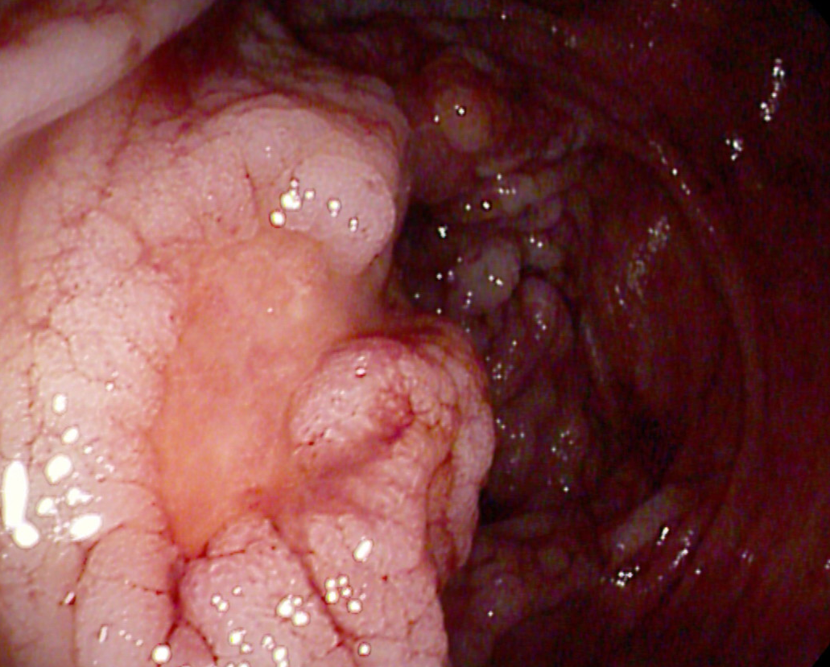
Amoebic dysentery
  diarrhoea containing red blood and mucus
  abdominal pain, tenesmus
  no fever or moderate fever
  possibly signs of dehydration

Slide 14
Unusual manifestations of amebic colitis
acute necrotizing colitis
toxic megacolon
ameboma
perianal ulceration with potential formation of a fistula.

Slide 15
Very uncommonly the disease takes a fulminant super-acute course because of development of Necrotizing Amoebic Colitis, which has very high mortality ranging from 55% to 100% if diagnosis and treatment is delayed.
Diagnosis is difficult and frequently confused with inflammatory bowel disease leading to wrong treatment with steroids with devastating results. Perforation is common in FAC, and peritonitis is the commonest cause of death.

Slide 16
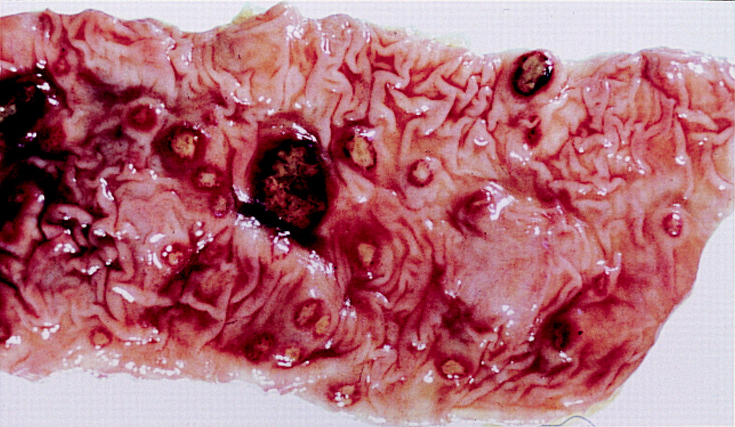

Slide 17
term “ameboma” originally described as amebic granuloma
Ameboma of the large bowel is a rare condition that occurs in 1% of all cases with invasive amebiasis characterized by mass of granulation tissue with peripheral fibrosis and a core of inflammation related to chronic amebic infection.

Slide 18
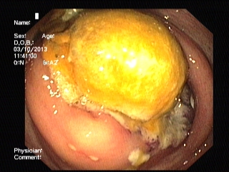
An ameboma usually presents as pain and lump in the right iliac fossa and/or symptoms of bowel obstruction.
It can mimic as appendicular abscess and Crohn's disease in younger individuals and colon cancer and diverticulitis in elderly

Slide 19
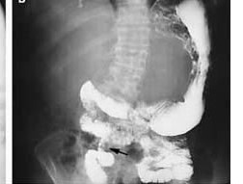
Picture shows luminal narrowing (arrow) on a barium-enema examination in a patient with ameboma.

Slide 20
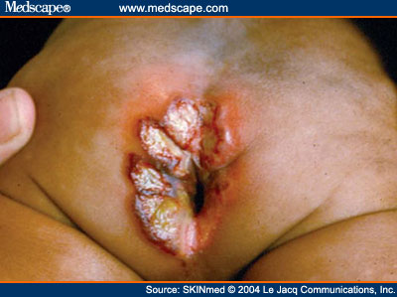

Slide 21
Extraintestinal conditions resulting from E histolytica infection
Liver abscess
Pleuropulmonary disease
Peritonitis
Pericarditis
Brain abscess
Genitourinary disease

Slide 22
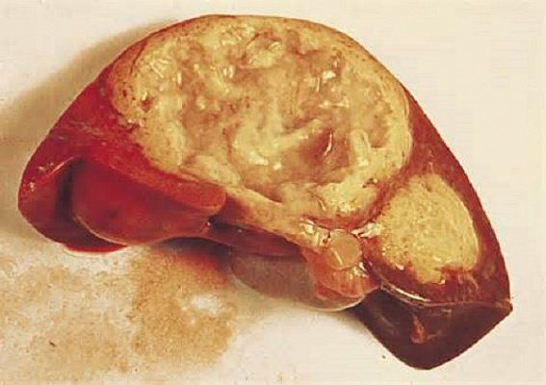

Slide 23
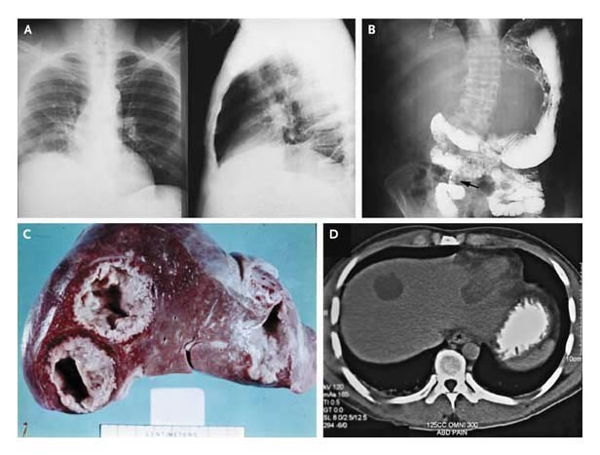

Slide 24
Panel A shows a posteroanterior (left-hand side) and lateral (right-hand side) chest radiograph in a patient with amebic liver abscess. The findings include elevated right hemidiaphragm and evidence of atelectasis. Panel B shows luminal narrowing (arrow) on a barium-enema examination in a patient with ameboma. Panel C shows two abscesses in the right lobe and one abscess in the left lobe in a patient with amebic liver abscess. In Panel D, abdominal computed tomography in a patient with amebic liver abscess shows one abscess in the right lobe and one abscess in the left lobe.

Slide 25
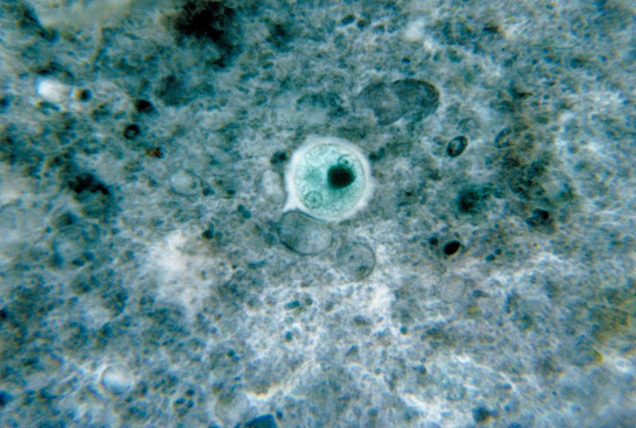
Asymptomatic human infections are usually diagnosed by finding cysts shed in the stool. Various flotation or sedimentation procedures have been developed to recover the cysts from fecal matter and stains help to visualize the isolated cysts for microscopic examination. Since cysts are not shed constantly, a minimum of three stools are examined.

Slide 26
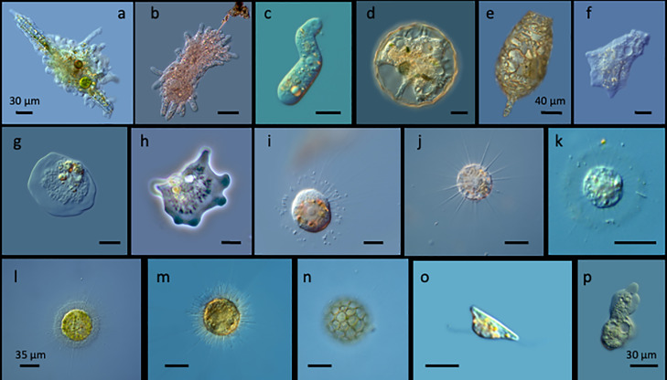
In symptomatic infections, the motile form (the trophozoite) is often seen in fresh feces.

Slide 27
Serological tests exist, and most infected individuals (with symptoms or not) test positive for the presence of antibodies. The levels of antibody are much higher in individuals with liver abscesses. Serology only becomes positive about two weeks after infection. More recent developments include a kit that detects the presence of amoeba proteins in the feces, and another that detects ameba DNA in feces. These tests are not in widespread use due to their expense.

Slide 28
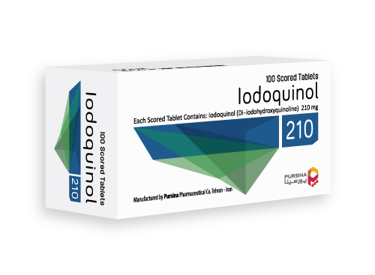
Treatment
Paromomycin
Iodoquinol (Yodoxin)
Diloxanide furoate
To treat invasive amebiasis:
metronidazole
tinidazole
Treatment of hepatic amebiasis has been successful in some patients with
chloroquine
dehydroemetine

Slide 29
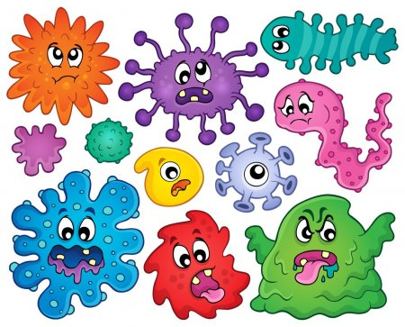
THANKS FOR YOUR ATTENTION!

