Slide 1
LEISHMANIASIS

Slide 2
Leishmaniasis is caused by unicellular protozoa of genus Leishmania and primary affects the host’s reticuloendothelial system. The clinical syndromes ranging from self-healing cutaneous ulcers to fatal visceral disease.

Slide 3
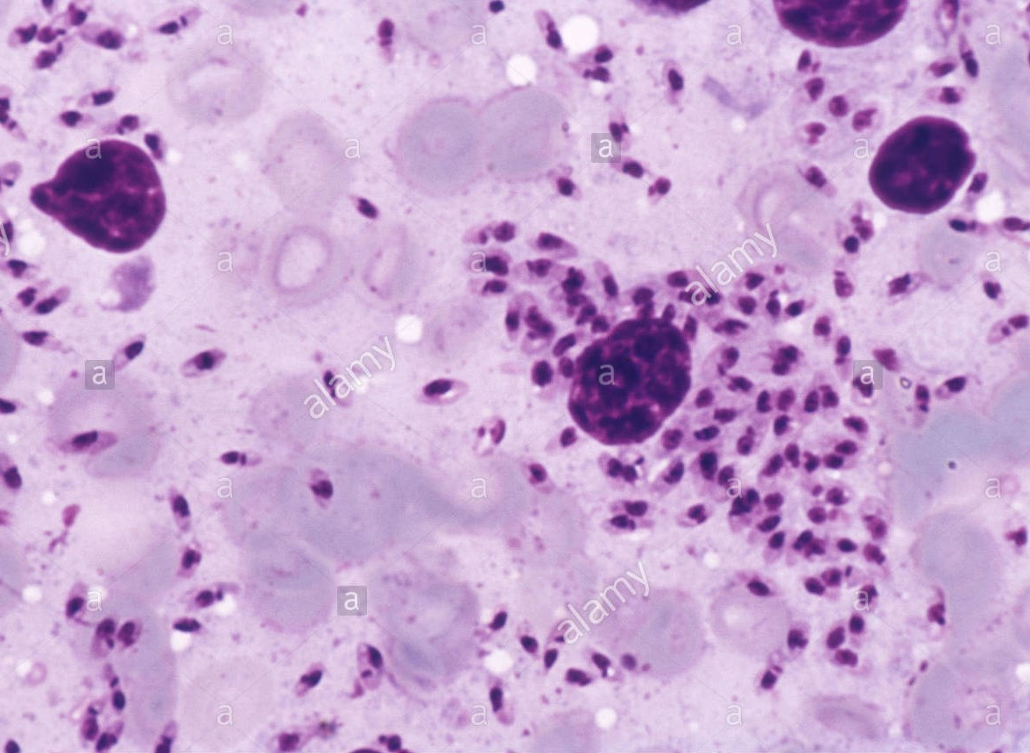
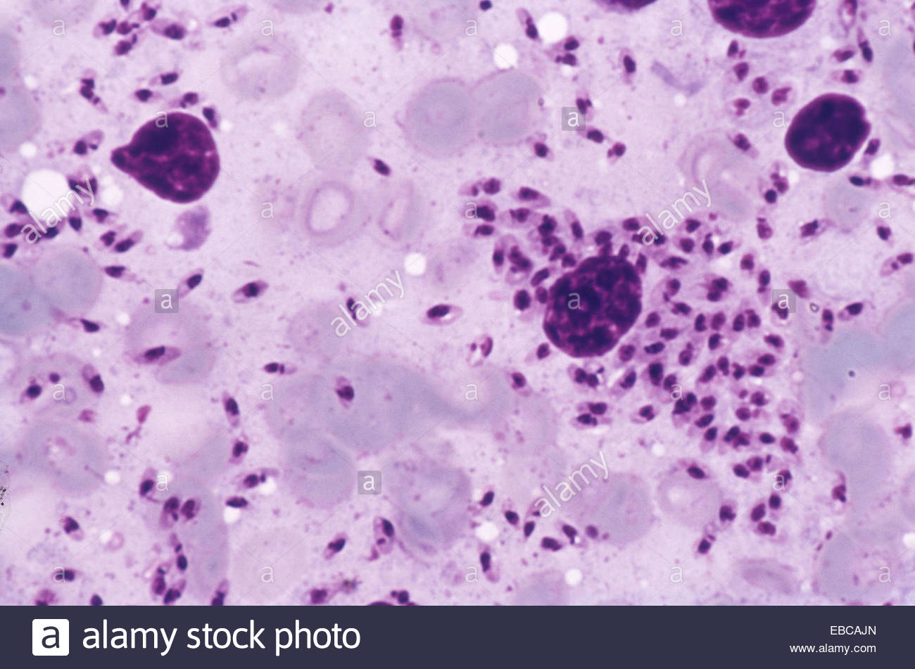

Slide 4
These syndromes fall into three categories:
Visceral leishmaniasis
Cutaneous leishmaniasis
Mucosal leishmaniasis

Slide 5
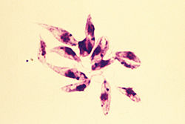
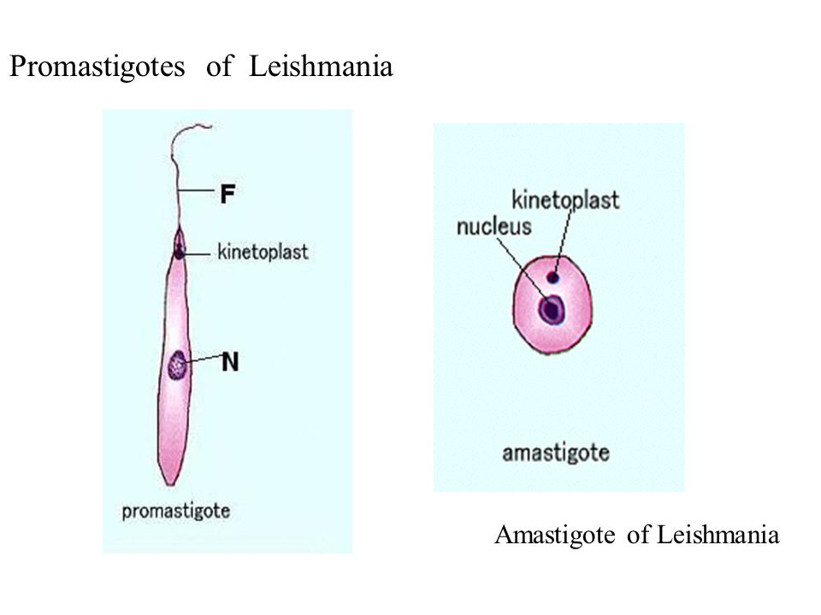
20 species of
genus Leishmania
Order Kinetoplastidae
Family Trypanosomatidae
Occurs in two forms:
Extracellular, flagellate promastigotes in sandfly vector
Intracellular nonflagellate amastigotes in vertebral hosts

Slide 6
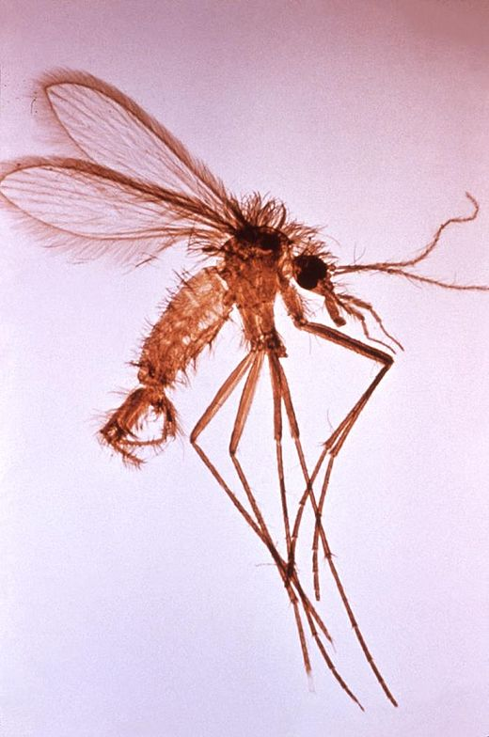
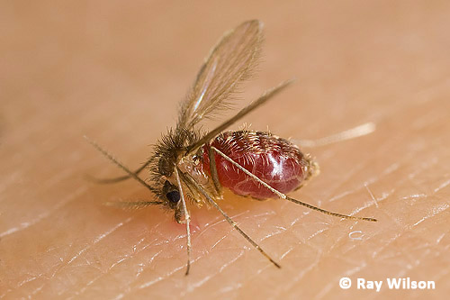
The organisms are transmitted by
phlebotomine sandflies of genus Phlebotomus in the “Old World” (Asia, Africa, Europe)
genus Lutzomia
in the “New word” (America)

Slide 7
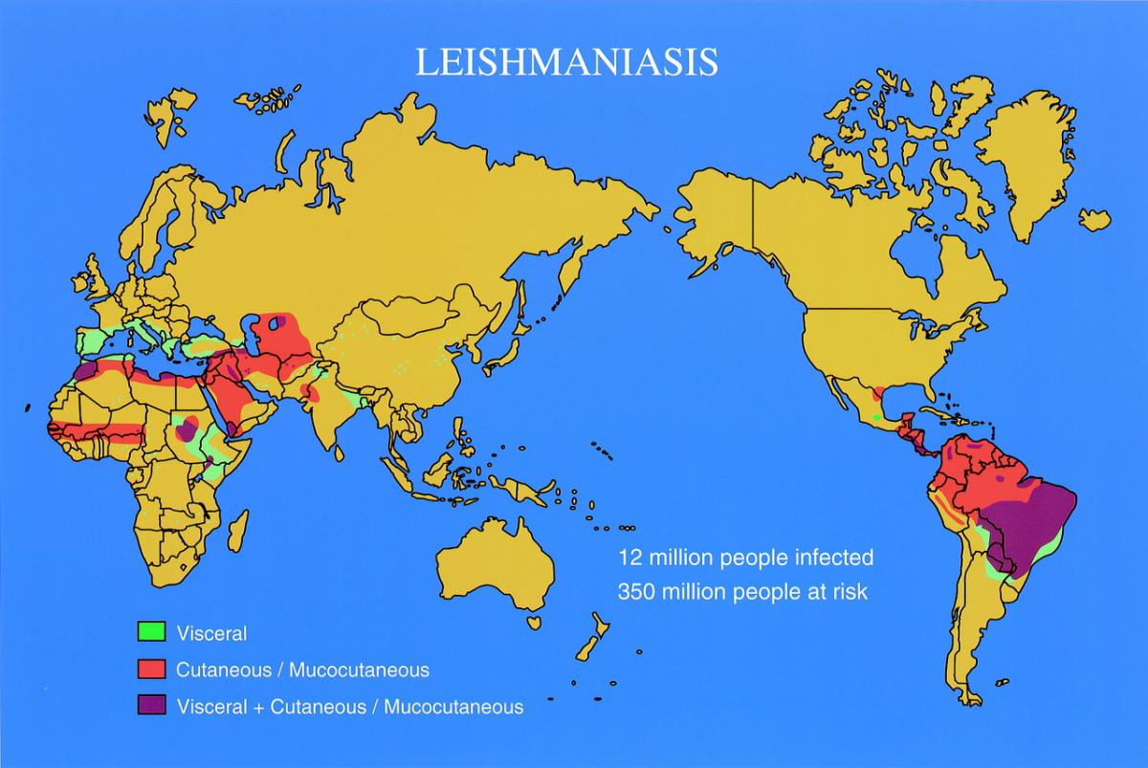
Geographical distribution

Slide 8
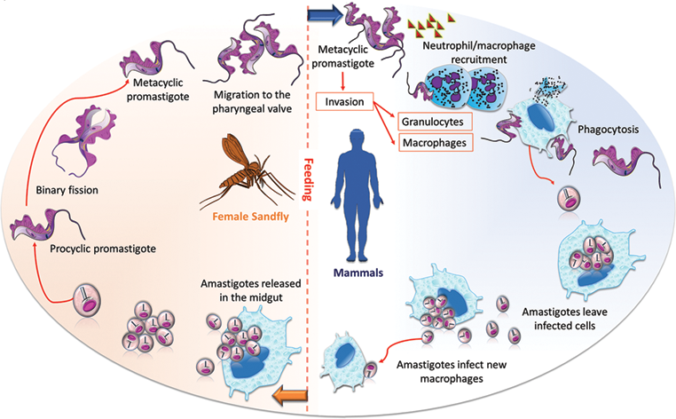

Slide 9
Visceral leishmaniases
VL (kala-azar, black fever)
Causative agent : L.donovani
Sources of infection: humans, rodents, dogs, foxes

Slide 10
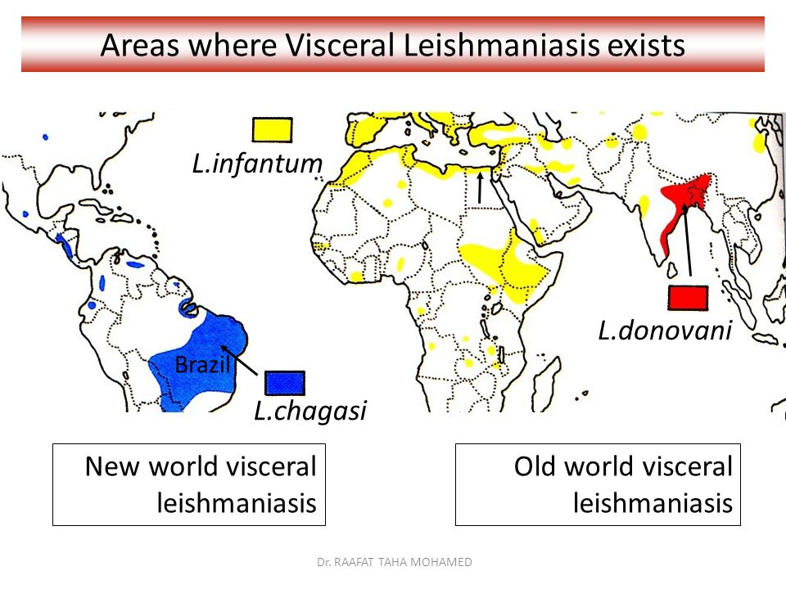
India, Bangladesh, Sudan, Ethiopia and Brasil are the largest foci of VL and account for 90% of world’s VL burden.
Zoonotic VL occurs in the Middle East, Pakistan, Georgia, Azerbaijan.
VL is rare in West and sub-Saharan Africa

Slide 11
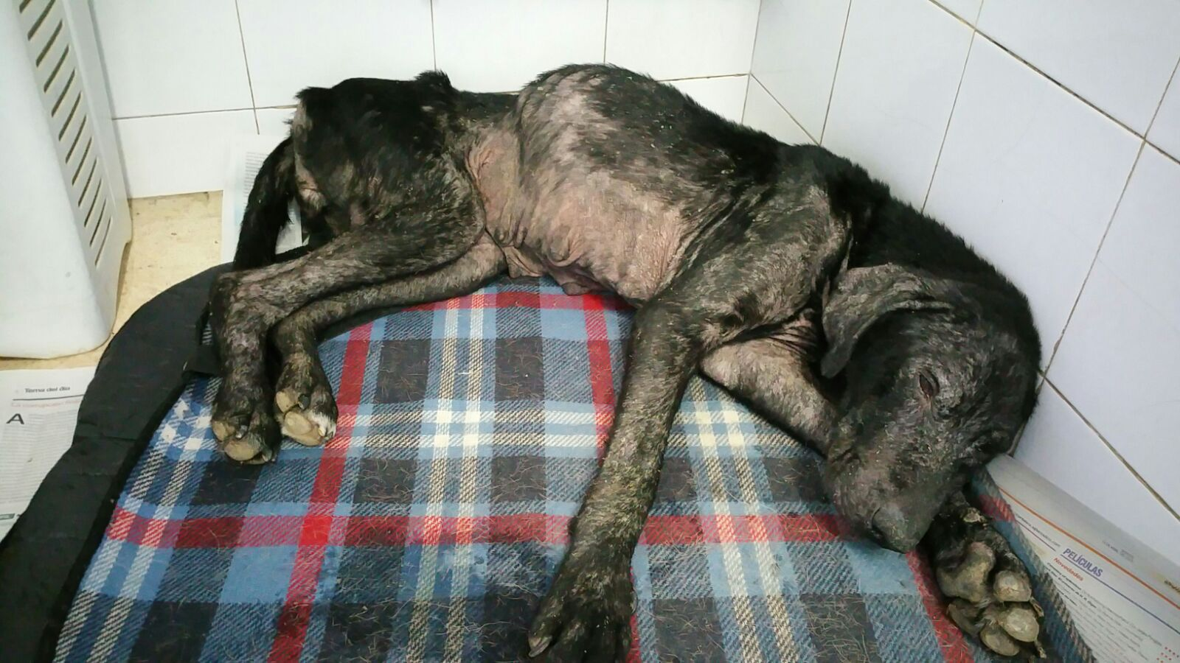
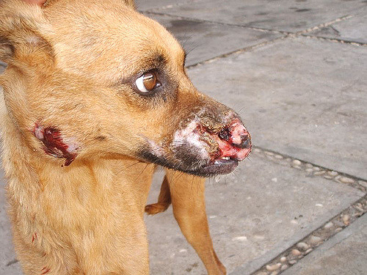
Mediterrenian VL due to L.infantum has a large canine reservoir and was seen primary in infants before advent of HIV-infection. In Mediterrenian Europe 70% of adult VL cases are assosiated with HIV-co-infection.

Slide 12
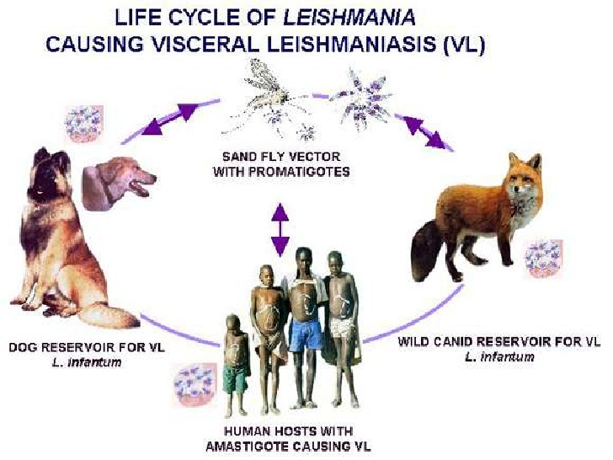

Slide 13
Pathogenesis
For every case of classical visceral leishmaniasis, there are about 30 subclinical infections that cause leishmanin positivity and lifelong immunity to the infecting species.
Established visceral infections are characterized by the failure of specific cell-mediated immunity.

Slide 14
The parasite multiplies freely in macrophages in the spleen, bone marrow, lymphoid tissues, jejunal submucosa, and Kupffer cells of the liver.
Histology shows a variable degree of granuloma formation and interstitial inflammation in the liver that may lead to fibrosis. In the spleen especially, there is massive reticuloendothelial hyperplasia and infiltration with plasma cells.
Small splenic infarcts may develop.

Slide 15
Clinical features
The male/female ratio is between 3:1 and 4:1.
Incubation period varies from 3 weeks to 1 year, on the average 6-8 months
Initial period
general weakness
decrease of appetite
adynamia
enlarged spleen (may be palpable by the second week of ilness
primary affect remains unnoticed by some patients

Slide 16
Patients with advanced disease are wasted, with hair changes and pedal oedema typical of hypoalbuminaemia.
Hyperpigmentation is characteristic of visceral leishmaniasis in India (kala-azar means ‘black disease’).
The liver is moderately enlarged in one-third of cases. In African patients, a generalized lymphadenopathy is common.

Slide 17
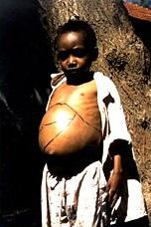
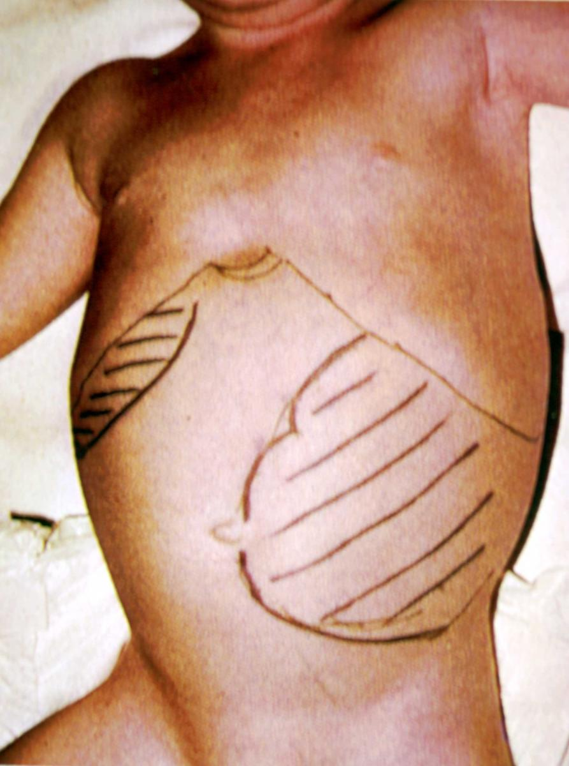
Clinical features
Period of climax
cardinal symptom is fever – mainly wave-like, associated with chills
splenomegaly (spleen may become hugely enlarged)
hepatomegaly
the skin becomes dry, hyperpigmentated.
diffuse papular eruption that on spontaneous resolution can leave hypopigmented macules. (skin leishmanoid)
Weight loss

Slide 18
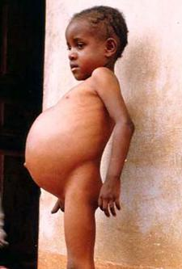
Hypoalbuminemia may manifest as pedal edema and ascitis
Anemia cause heart failure
Epistaxis, retinal hemorrhages, gastrointestinal bleeding are associated with thrombocytopenia
Secondary infections (bacterial pneumonia, tuberculosis, bacillary

Slide 19
Post-kala-azar dermal leishmaniasis (PKDL)
About up to 10% of Indian patients and up to 50% of Sudanese patients develop a rash on the face, extensor surfaces of the arms and legs, and trunk after recovery from visceral leishmaniasis.

Slide 20
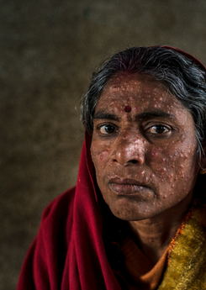
In India, the rash begins after an interval of 1 or 2 years and progresses over many years: pale macules become erythematous plaques, papules, or nodules resembling lepromatous leprosy, and almost the entire body surface may be involved.

Slide 21
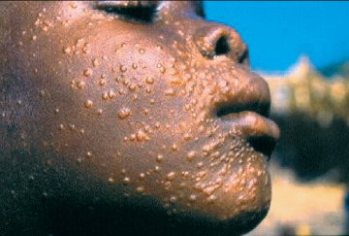
In Kenya, the rash usually appears while the patient is still recovering, as discrete nodules, which show a granulomatous histology with scanty parasites. It heals spontaneously within 6 months. Sudanese patients show a mixture of these two forms.

Slide 22
DIFFERENTIAL DIAGNOSIS
malaria;
influenza
typhoid fever
epidemic typhus
leucosis
sepsis
brucellosis

Slide 23
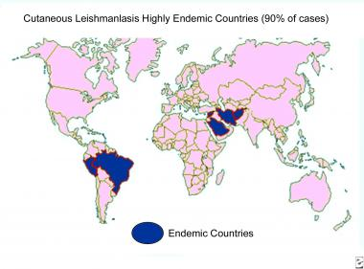
Cutaneous leishmaniases

Slide 24
Old world forms
New world forms
L.tropica - anthroponosis, urban or suburban areas
L.major – zoonosis (desert rodents), natural-foci disease (Middle East, Africa, central Asia)
L.panamensis, L.mexicana, L.amasonensis , L.brasiliensis – anthropozoonosis (human, range of forest animals)

Slide 25
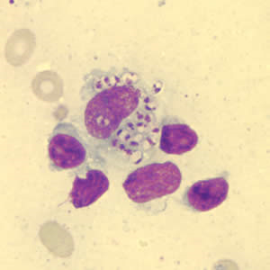
The parasitized macrophage granuloma is infiltrated by lymphocytes and plasma cells. Piecemeal or focal necrosis destroys parasitized cells. The overlying epidermis shows hyperkeratosis and ulcerates. In chronic lesions, epithelioid cells and Langhans giant cells produce a picture similar to that of noncaseous tuberculosis.

Slide 26
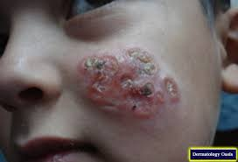
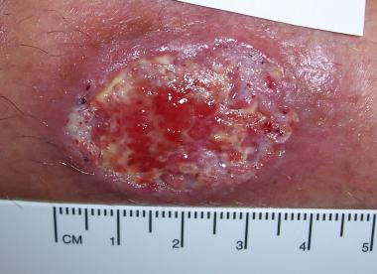
Clinical manifestation
A few days or weeks after a bite of sandfly a papule develops and grows into nodule that ulcerates in some week or month
Usually painless
Consist of necrotic tissue and crusted serum

Slide 27
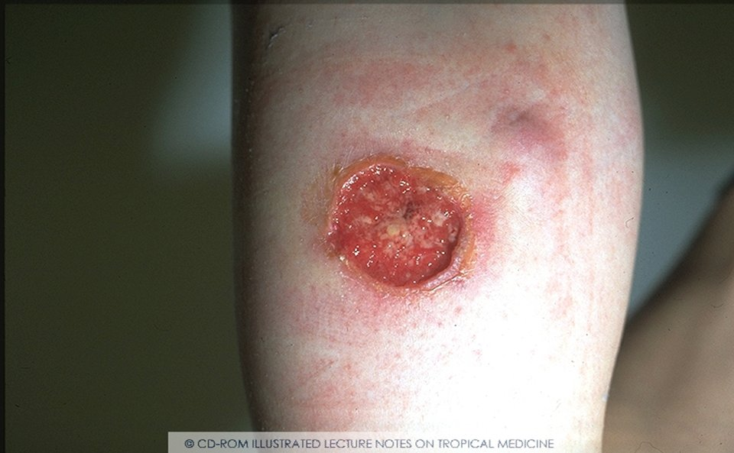
Cutaneous leishmaniasis ulcerated lesion (zoonotic varient of CL)

Slide 28
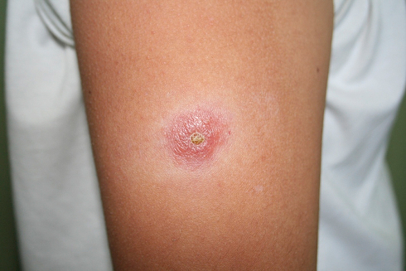
Cutaneous leishmaniasis - Raised erythematous nodule in anthroponotic variant of CL

Slide 29


Slide 30
LEISHMANIASIS OF EASTERN AFRICA
Etiology.
Leishmania archibaldi.
Epidemiology.
Leishmaniasis of Eastern Africa is antropozoonosis.
Clinical manifestations.
development of the primary affect;
skin leishmanoid develops inrarely after clinical recovery;
there is tendency to relapses of the disease.
Treatment.
Pentavalent antimonial copmounols
Pentostam 0.1-0.4 g in a day – 16 days
Glucautime 12.0 ml/day – 12-15 days
Pentamidine (Lomidin) 2-4 mgkg body mass per day – 15 days

Slide 31
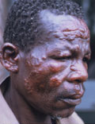
Diffuse-infiltrative leishmanioma

Slide 32
DIAGNOSIS
clinical manifestations;
demonstration of amastigotes in the blood (thick drop); in tissue or isolation of the organism in culture;
bone marrow aspiration is the safest diagnostic procedure;
lymphatic node aspiration or biopsy (when enlarged nodes are present);
ELISA (Enzyme linked immunoabsorbent assays)
Skin test (Montenegro test) becomes positive only after successful therapy.

Slide 33
Treatment.
Treatment depends on the location and extem of the lesion. Systemic treatment is required when there is risk that the sore may be due to L. brasiliensis, L. panamensis, or L. guyanensis, when the sore is too large or badly sited for local treatment, when there is lymphatic spread, and for mucosal leishmaniasis, diffuse cutaneous leishmaniasis, and recidivans leishmaniasis.
Pentamidine (Lomidin) 2-4 mg/kg body mass once or twice a week – 30 days
Antiboitics is necessary
Varios form of cryotherapy of local hyperthermic therapy

Slide 34
Local treatment
Surgery, curettage, CO2 laser, and cryotherapy are effective methods of removing small sores. Infiltration into the lesion with a pentavalent antimonial, weekly for 2 or 3 weeks or longer, may be successful.
The technique needs practice and the infiltration is transiently painful. An ointment containing 12% paromomycin and 15% methylbenzethonium chloride cures 70% lesions due to L. major in 20 days and may be suitable for lesions caused by other species, except L. brasiliensis, but is not always well tolerated.

Slide 35
Mucosal Leishmaniasis
Lesions in or around the nose or mouth are typical presentation of ML
ML presents as nasal stuffiness and bleeding followed by destruction of nasal cartillage, perforation of nasal septum, collapse of nasal bridge
The lips, cheeks, soft palate may also be affected

Slide 36
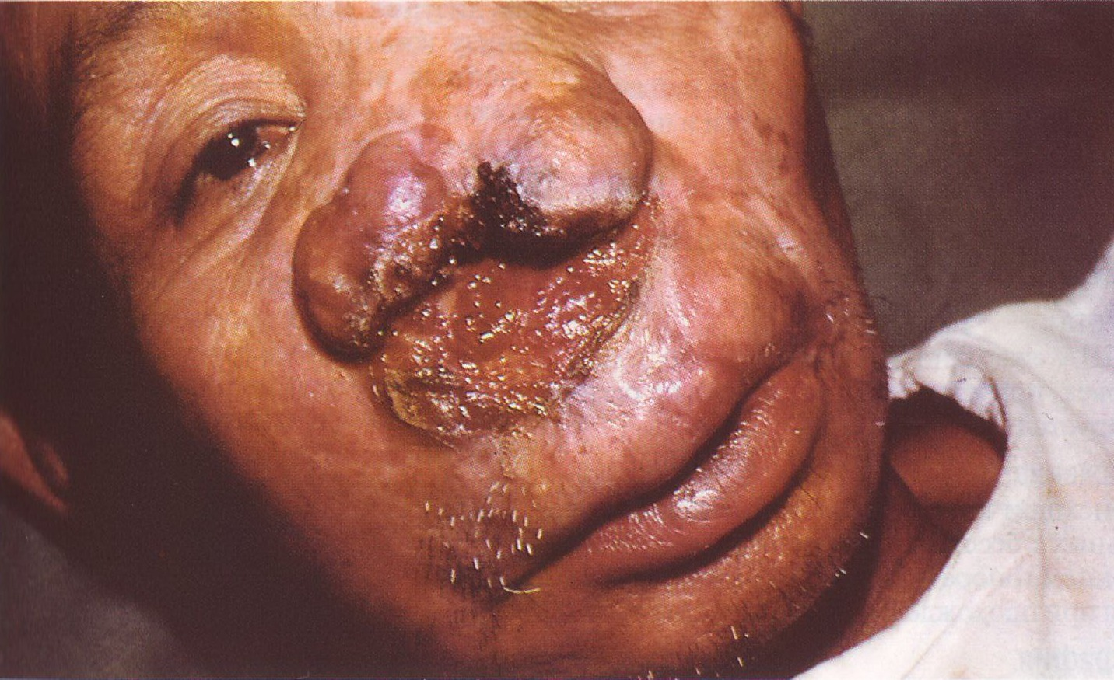
American cutaneous-mucous leishmaniasis

Slide 37
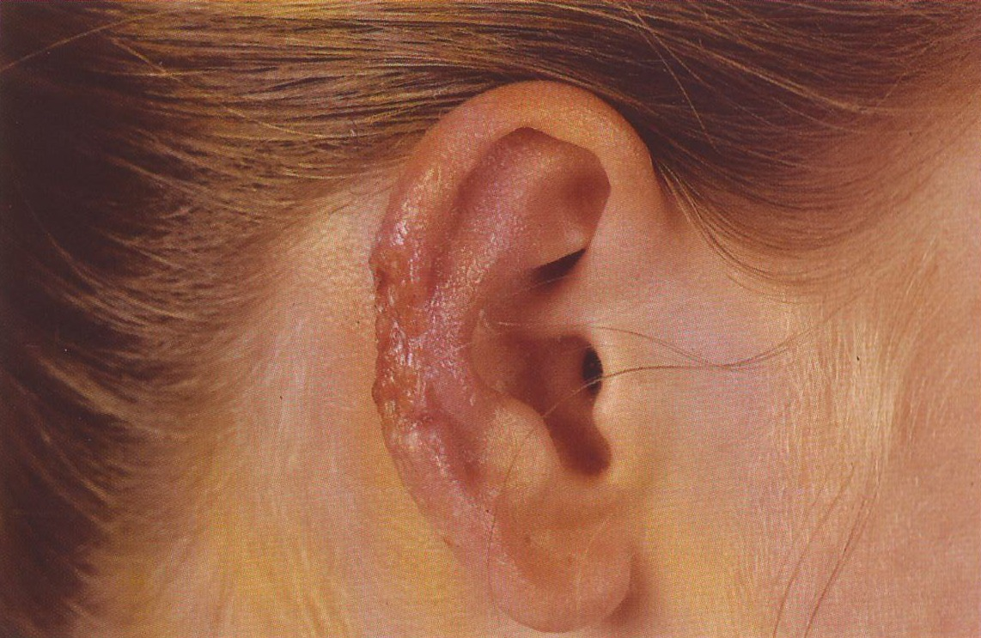

Slide 38
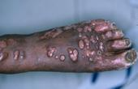
Amazonic leishmaniasis

Slide 39
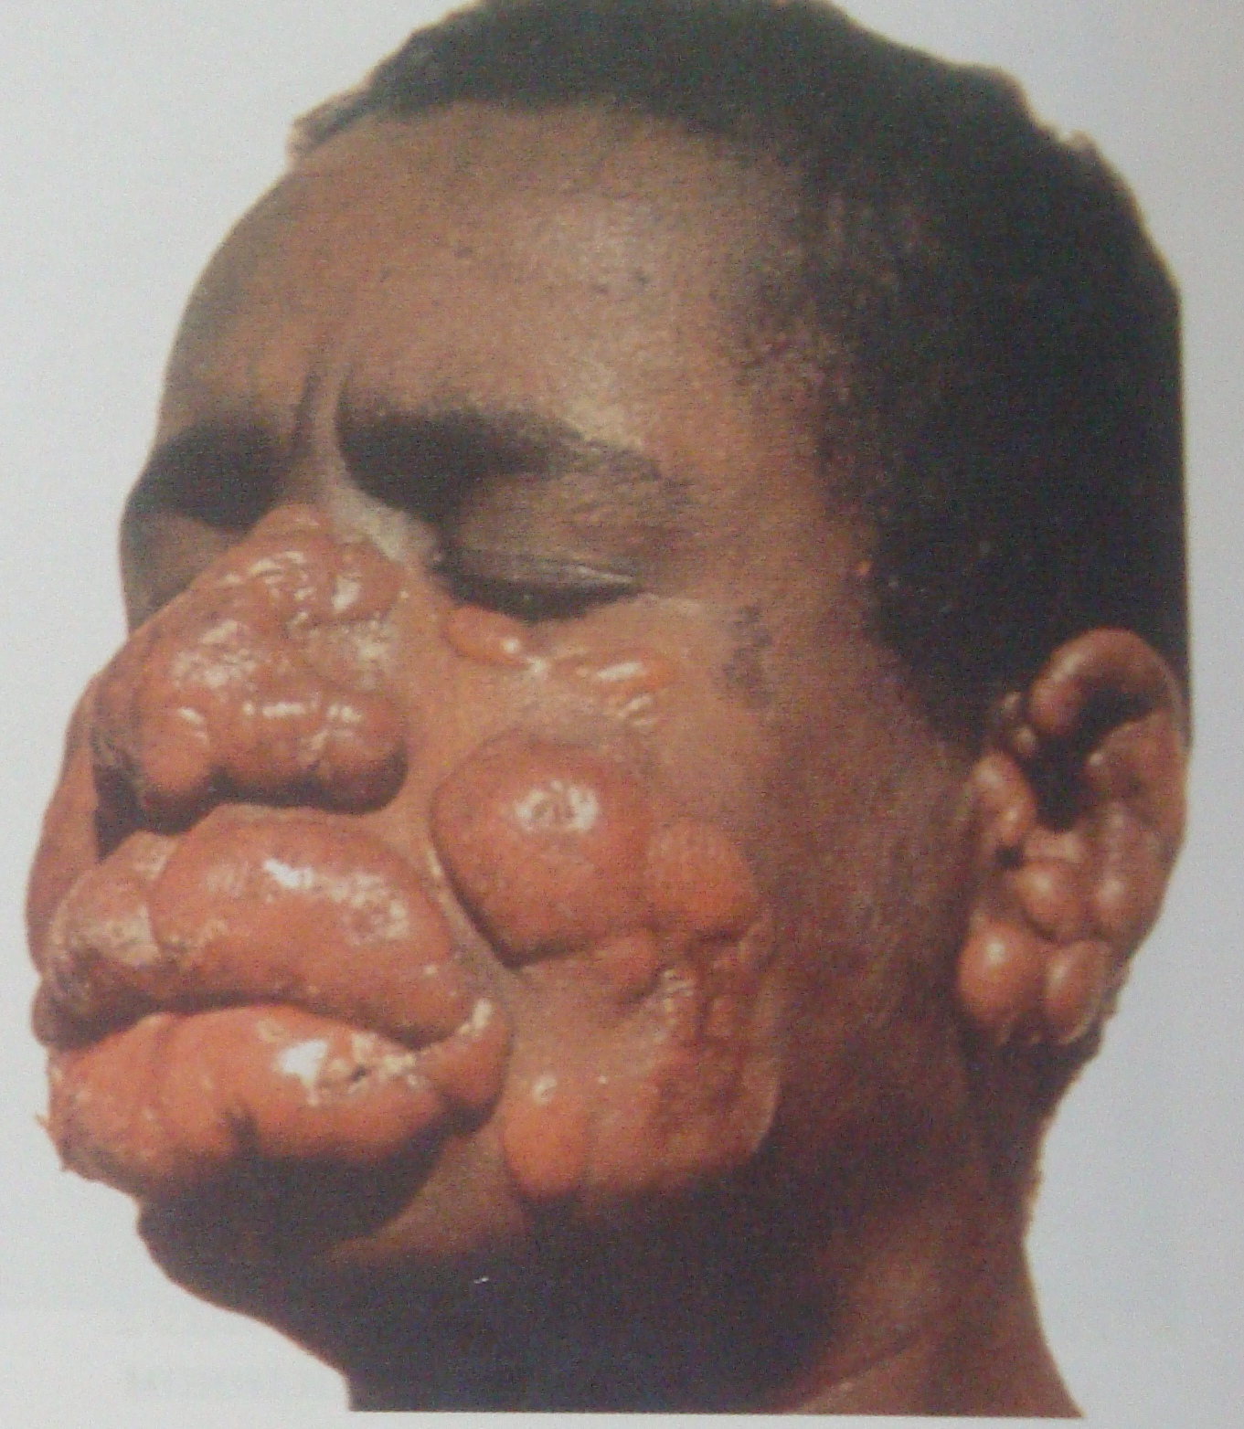
Diffuse lepra-like form of cutaneous leishmaniasis

