Slide 1
Arboviral Fevers

Slide 2
Arbovirus is a term used to refer to any viruses that is transmitted by arthropod vectors. The word arbovirus is an acronym (ARthropod-BOrne virus). Arboviruses can affect both animals, including humans, and plants.

Slide 3
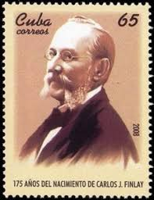

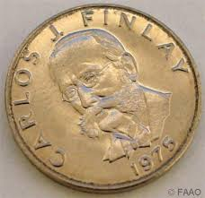
The connection between arthropods and disease was not postulated until 1881 when doctor Carlos Finlay proposed that yellow fever may be transmitted by mosquitoes instead of human contact, a reality that was verified by Major Walter Reed in 1901. The primary vector, Aedes aegypti, had spread globally from the 15th to the 19th centuries as a result of globalization and the slave trade.

Slide 4
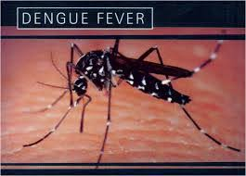

Slide 5
ALTERNATIVE NAMES
Hemorrhagic dengue
Dengue shock syndrome
Philippine hemorrhagic fever
Thai hemorrhagic fever
Singapore hemorrhagic fever

Slide 6
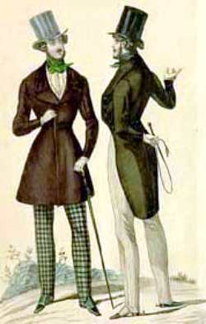
“A dandy is a man who dresses elegantly and fashionably. He exaggerates his manners, including the way he stands and moves, and the way he speaks. He promotes himself. This is called dandyism”.
This disease used to be called break-bone fever because it sometimes causes severe joint and muscle pain that feels like bones are breaking.

Slide 7

The earliest descriptions of an outbreak date from 1779.
Dengue has become a global problem since the Second World War
Philippine Hemorrhagic Fever was first reported in 1953. In 1958, hemorrhagic fever was reclassified as Dengue Hemorrhagic Fever

Slide 8
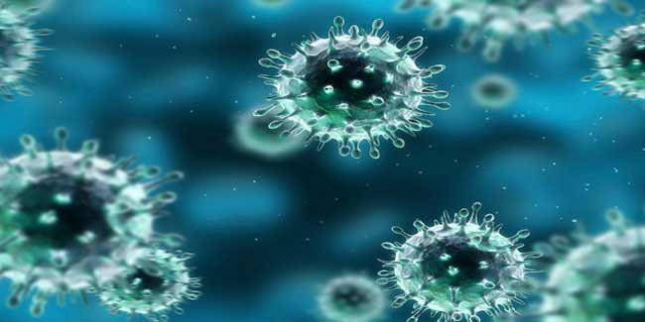
Etiology
Causative agent is RNA-containing virus of the family Flaviviridae, genus Flavivirus. Five serotypes of the virus have been found

Slide 9
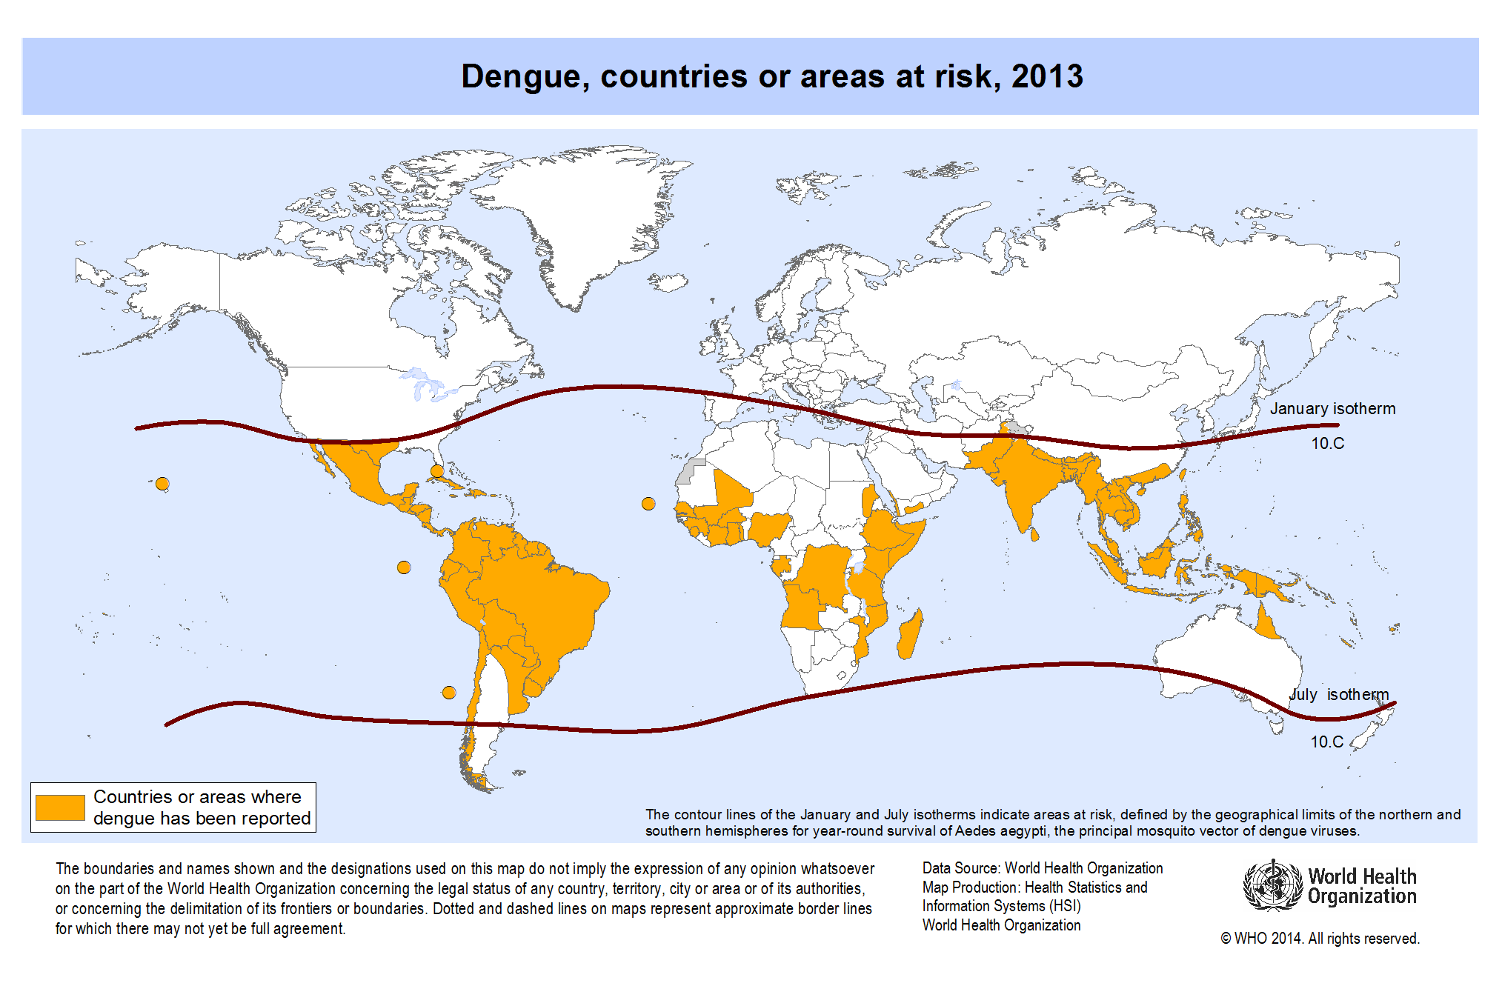

Slide 10
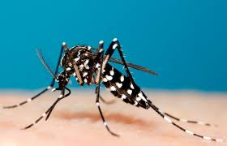
Epidemiology
Source of infection is human
Desease transmitted by mosquito bite: Aedes albopictus, Aedes aegipty
The insect is called a tiger mosquito for its striped appearance, which resembles that of the tiger.

Slide 11
Epidemiology
  All persons are susceptible. Bothe sexes are equally affected. Peak age affected 5-9 years.
  Occurrence is sporadic through out the year. Epidemic usually occur during the rainy seasons June – November. Peak months are September and October.
  Occurs wherever vector mosquito exists.

Slide 12
CLINICAL MANIFESTATIONS
Incubation period is uncertain, probably up to 1 week
An acute febrile infection of sudden onset with clinical manifestation of 3 stages:

Slide 13
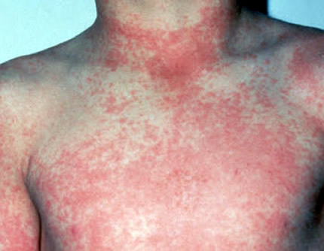
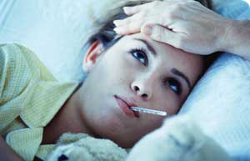
First 4 days – Febrile Stage
  The presence (the " dengue triad") of fever, rash, and headache (and other pains) is particulary characteristic of dengue fever.
  vomiting,
  conjunctivitis
  mild bleeding
  A characteristic rash appears along with or after the fever and spreads from the extremities to cover the entire body except the face
  The palms and soles may be bright red and swollen.

Slide 14
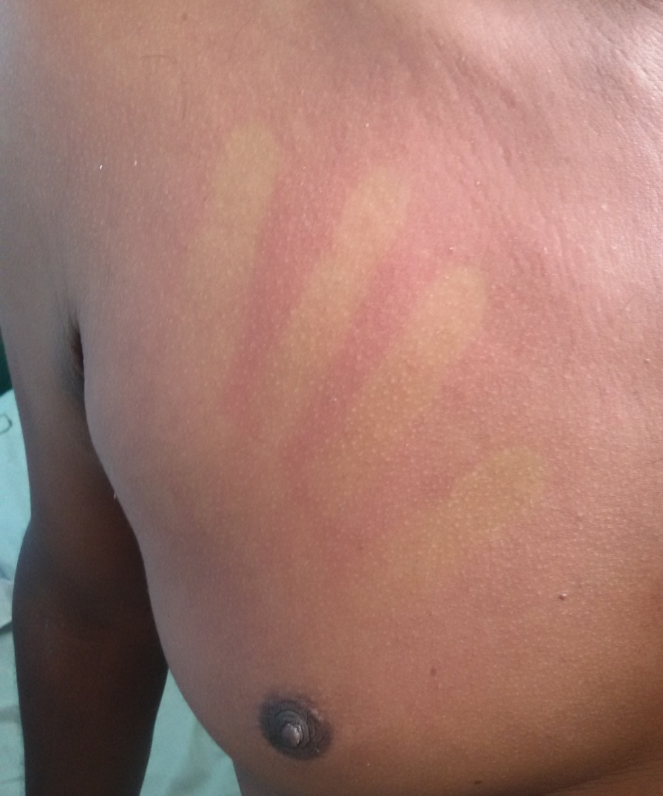
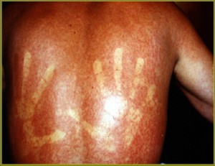
dengue rash disappears under pressure

Slide 15
4th-7th days – Toxic or Hemorrhagic Stage
lowering of temperature
severe abdominal pain
enlarging of lymphnodes, liver
vomiting and frequent bleeding from gastrointestinal tract in the form of hematemesis or melena
unstable BP
narrow pulse pressure
shock
7th-10th day – Convalescent or Recovery stage

Slide 16
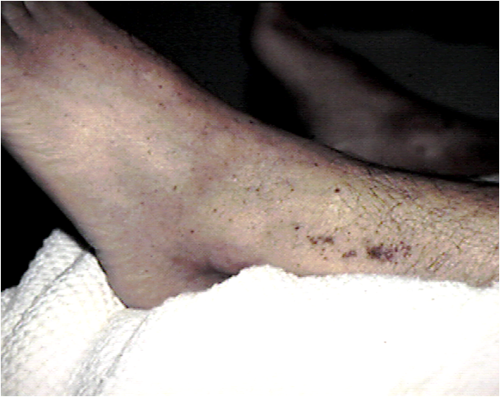
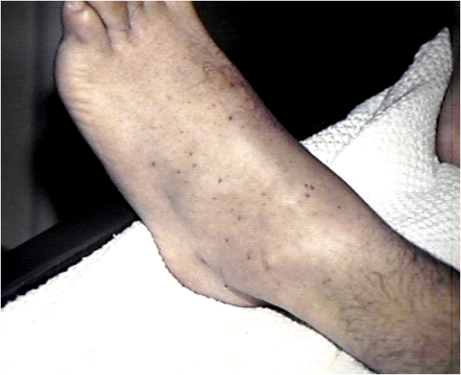
PETECHIAE

Slide 17

BRUISES

Slide 18
DIAGNOSTICS
Hematocrit
Platelet count
Electrolytes
Coagulation studies
Liver enzymes
Blood gases
Torniquet test (causes petechiae below the torniquet)
X-ray of the chest (may demonstrate pleural effusion)
Serologic studies (demonstrate antibodies to Dengue viruses)

Slide 19
There is no specific medicine to treat dengue infection
Supportive and symptomatic treatment should be provided
Analgetics and antipiretics . DON’T give ASPIRIN.
Rapid replacement of body fluids is the most important treatment for desintoxication.

Slide 20
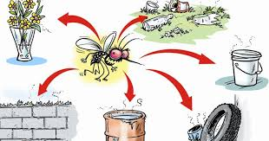
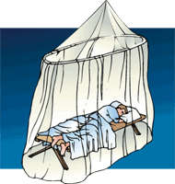
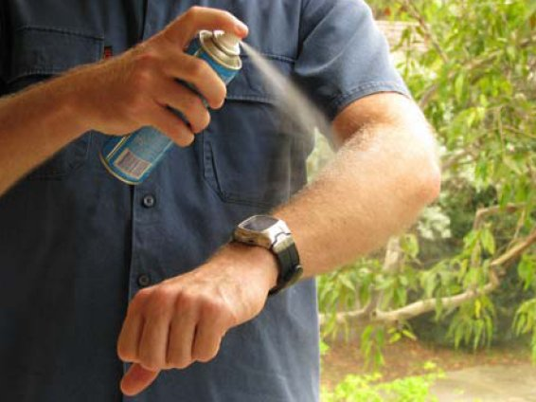
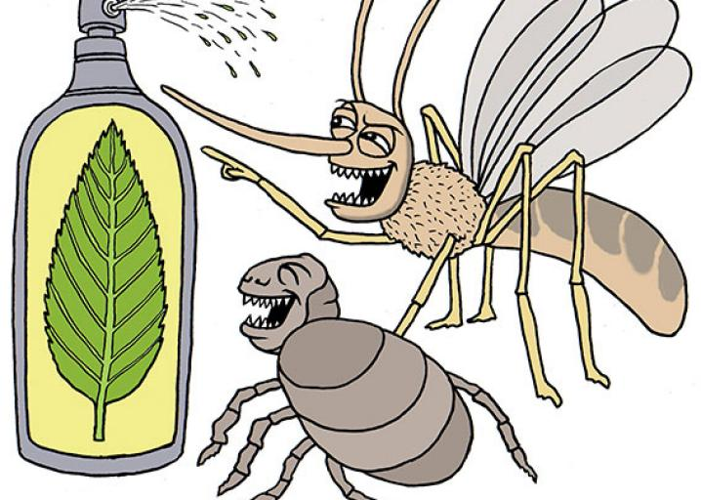

Slide 21
Chikungunya fever is a self-remitting febrile viral illness that has been associated with frequent outbreaks in tropical countries of Africa and Southeast Asia.
The illness has only recently become a concern in western countries and temperate zones around the world.

Slide 22
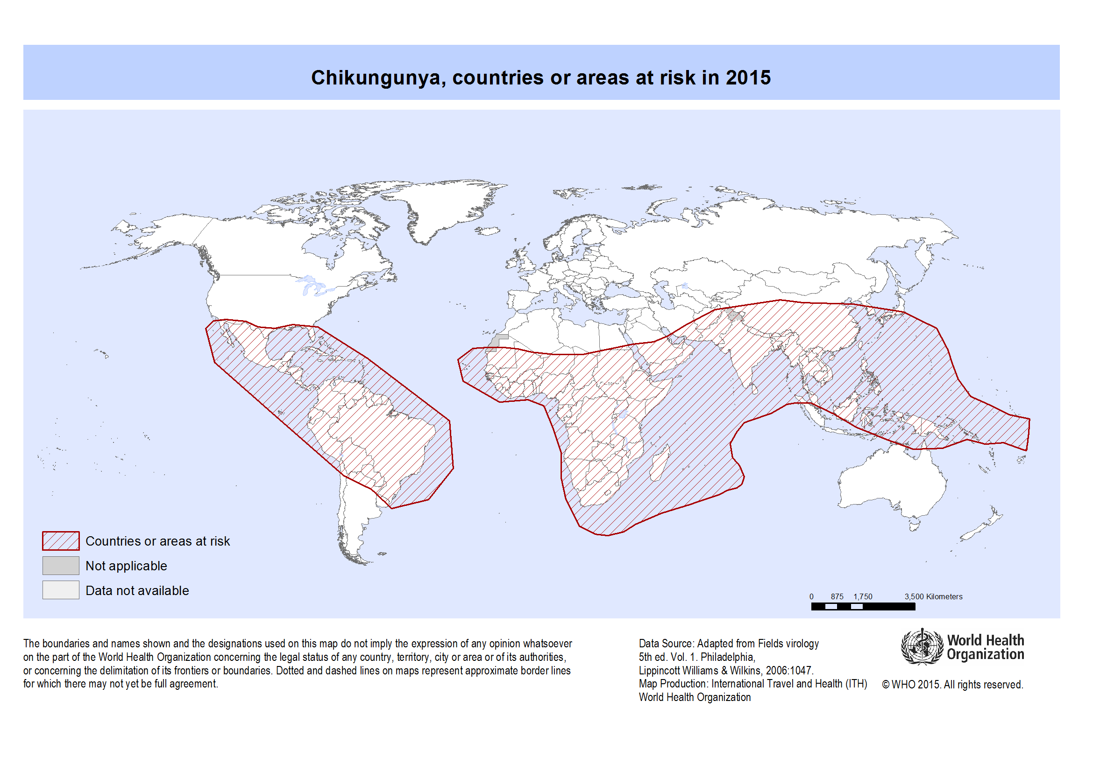

Slide 23
The name from the Makonde word is meaning "that which bends up" in reference to the stooped posture developed as a result of the arthritic symptoms of the disease. In Congo, it is referred to as “buka-buka,” which means “broken-broken.”
The disease was first described by Marion Robinson and W.H.R. Lumsden in 1955, following an outbreak on the Makonde Plateau, along the border between Tanganyika and Mozambique, in 1952.

Slide 24
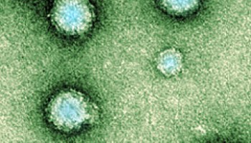
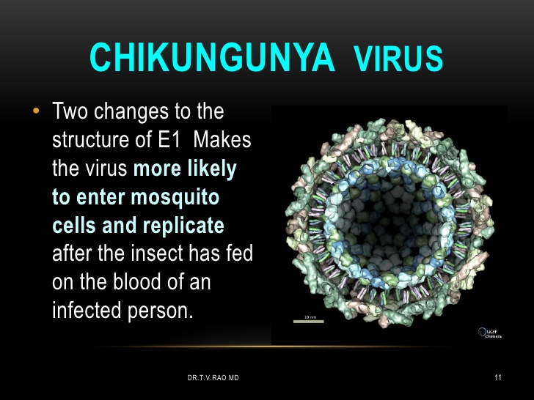
CHIKV belongs to the alphavirus genus of the Togaviridae family. It belongs to the Semliki Forest virus antigenic complex that also contains the O’Nyong Nyong, Mayaro, and Ross River viruses.

Slide 25
Main sources of infection are human and monkeys, but other primates, mammals and birds can also be affected.
Vector of transmission – mosquito A.aegipty, A.albopictus.

Slide 26
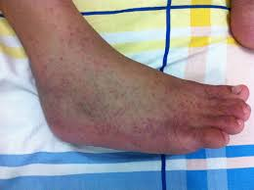
Symptoms
Chikungunya shares some clinical signs with dengue such as fever, severe joint pain, muscle pain, headache, nausea, fatigue as well as rash, and can be misdiagnosed in areas where dengue is common.

Slide 27
Chikungunya, like Zika and dengue, has also resulted in a number of neurologic diseases:
Guillain-Barré syndrome,
Meningoencephalitis
cranial nerve palsies.
The virus has also been associated with:
rheumatoid arthritis
spondyloarthritis
undifferentiated polyarthritis
Other serious complications of chikungunya that are rare:
myocarditis
ocular disease (uveitis, retinitis)
acute renal disease

Slide 28
DIAGNOSIS
The diagnostic tests include detection of antigens or antibodies in the blood, using
ELISA (or EIA - enzyme immunoassay)
polymerase chain reaction (PCR).

Slide 29
TREATMENT
There is no active treatment against chikv
Presently treatment is purely symptomatic - supportive care and rest and nutrition
Analgesics, antipyretics and fluid supplementation are important aspects in managing this infection.

Slide 30
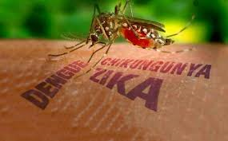

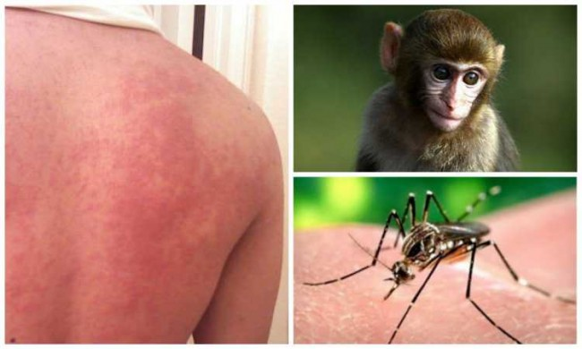
Zika disease
Zika virus (ZIKV) is a member of the virus family Flaviviridae. It is spread by daytime-active Aedes mosquitoes. Its name comes from the Ziika Forest of Uganda, where the virus was first isolated in 1947.Zika virus is related to the dengue, yellow fever, Japanese encephalitis, and West Nile viruses.

Slide 31
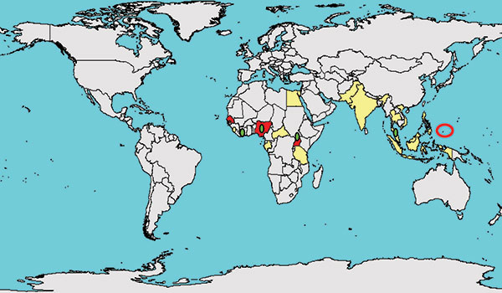
Since the 1950s, it has been known to occur within a narrow equatorial belt from Africa to Asia.

Slide 32
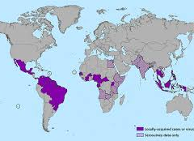
From 2007 to 2016, the virus spread eastward, across the Pacific Ocean to the Americas, leading to the 2015–16 Zika virus epidemic

Slide 33
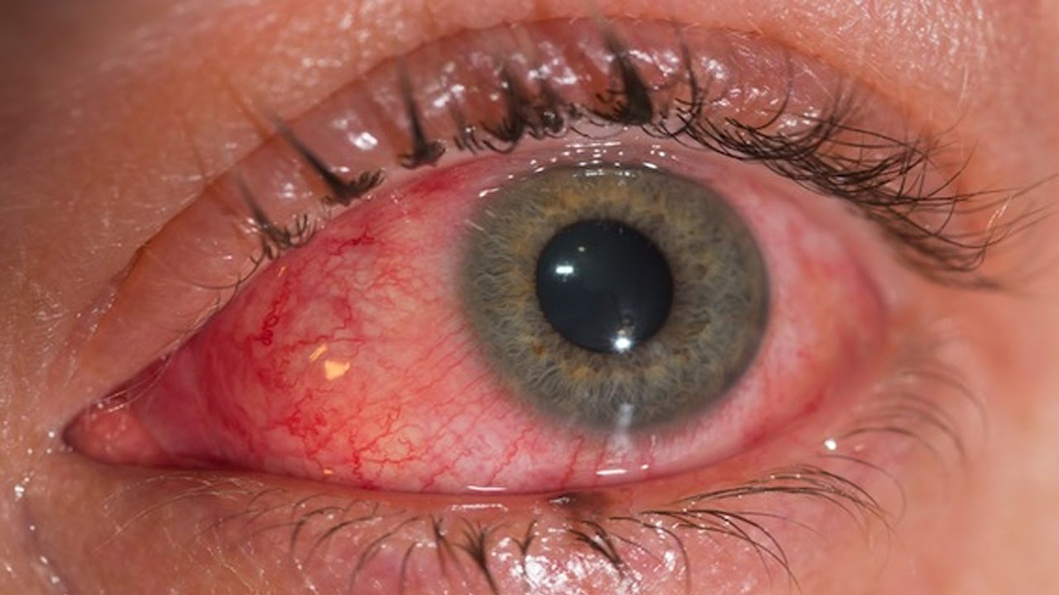
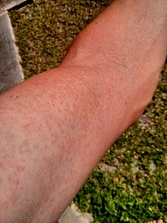
Zika-virus infection is characterized by influenza-like symptoms, including fever, headache, malaise. A maculo-papular rash, conjuctivitis, myalgia, arthralgia usually occure.

Slide 34
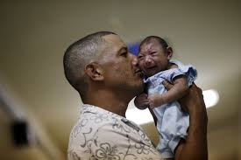
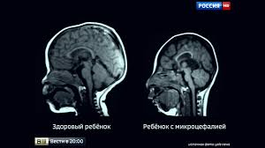
Zika can spread from a pregnant woman to her baby. This can result in microcephaly, severe brain malformations, and other birth defects.
Zika infections in adults may result rarely in Guillain–Barré syndrome.

Slide 35
YELLOW FEVER
Yellow fever is an acute transmissive viral disease. It is characterized by hepatorenal syndrome, DIC syndrome and multiple organ dysfunction syndrome in fatal stages.

Slide 36
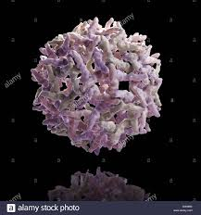
Etiology
Causative agent: Yellow Fever Virus- Single stranded RNA virus of the family FLAVIVIRIDAE

Slide 37
Epidemiology
Source of infection: man (in urban cycle) and monkeys (in jungle cycle)
Vector of transmission: mosquitoes of Aedes and Hemagogus Genus
Susceptibility is usually higher in children and older people

Slide 38
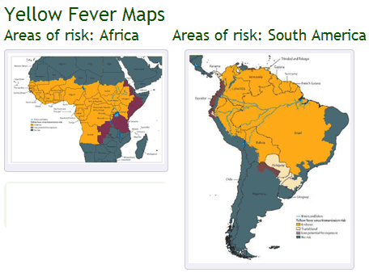

Slide 39
EPIDEMIOLOGY
Yellow fever is endemic in tropical and subtropical areas of South America and Africa.
Spread of the disease includes a Jungle cycle in which the main vectors are A africanus (Africa) and H janthinomys (South America). Monkeys are the main hosts in this setting. Humans acquire the disease through bites of mosquitoes when they walk in the jungle
An Urban cycle has been described which is mainly propagated by A aegypti from humans to humans
Worldwide there are about 600 million people living in endemic areas and the official estimations of the WHO amount to 200,000 cases of disease and 30,000 deaths a year; An estimated 90% of the infections occur on the African continent. In 2008, the largest number of cases was recorded in Togo.

Slide 40
CLINICAL MANIFESTATIONS
Incubation is usually 3-6days
Stages include
-early stage
-period of remission
-period of intoxication
Severity ranges from a self limiting infection to a life threatening hemorrhagic fever in about 15-25% of cases.

Slide 41
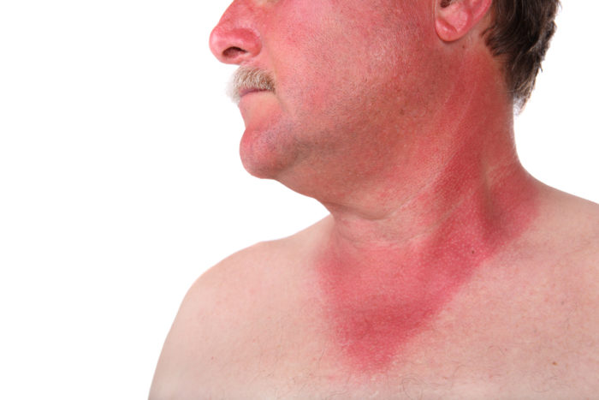
Early Stage:
Disease onset is acute and manifests as
headache
fever, flushing
muscle pain with prominent backache
headache
loss of appetite,
and nausea or vomiting.

Slide 42
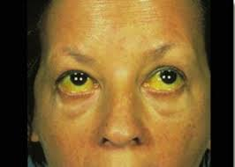
Early Stage:
Аt the end of this stage tachicardia is replaced by bradycardia,
epigastric tenderness, hepatomegaly develop
loss of appetite, vomiting, and jaundice are common and indicate poor prognosis.
lasts approximately 3 - 4 days
symptoms disappear briefly and then reappear (remission)

Slide 43
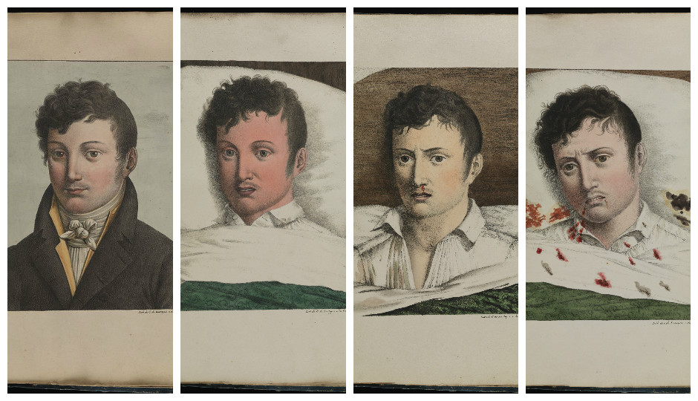
Period of Remission
In this period (After 3 - 4 days), fever and other symptoms disappear.
Most people will recover at this stage, but others enter the third, most dangerous stage (intoxication stage) within 24 hours.

Slide 44
Period of intoxication
jaundice worsens
abdominal pain and vomiting
decreased urination
petechiae, ecchymoses, epistaxis, and bleeding from gums and venipuncture sites can progress to melena, hematemesis, and metrorrhagia.
Bradycardia (50-40 per min) – Faget symptom

Slide 45
Period of intoxication
This stage is characterized by multiple organ dysfunction
Progressive liver involvement and humoral-mediated responses can lead to consumption coagulopathy.
Circulatory disturbances on background of DIC
Kidney insufficiency manifest as oligouria, protienuria
Respiratory disturbances manifest as hypoxia and ARDS
The terminal phase is marked by delirium, stupor, and coma due to cerebral edema and microscopic perivascular hemorrhage.
Hepatorenal disease carries a mortality rate of 20%-50%

Slide 46
COMPLICATIONS
infectious-toxic shoсk
kidney failure
myocarditis
pneumonia
secondary bacterial infections

Slide 47
DIAGNOSIS
On background of clinical and epidemiological data
Blood test: leukopenia, neutropenia, thrombocytopenia
Virologic: demonstration of virus in blood
Urine analysis: ncreased albumin level, increased urobilinogen level
Biochemical test:
-increased serum creatinine, metabolic acidosis, elevated bilirubin levels, elevated AST level
Serologic test: ELISA
PCR

Slide 48
TREATMENT
No etiotropic treatment exists for yellow fever at present time
Pathogenic treatment include:
desintoxicative therapy
coagulative therapy
intubation in ARDS
dialysis in kidney failure

Slide 49
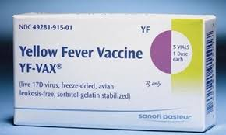
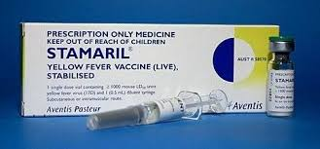
PROPHYLAXIS
Yellow fever vaccine- live attenuated vaccine.
Amendment to the period of validity of the international certificate of vaccination against yellow fever, which is now extended to the life of the person vaccinated

Slide 50
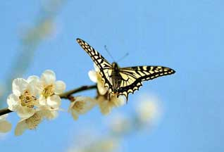
THAHKS FOR YOUR ATTENTION!

