Slide 1
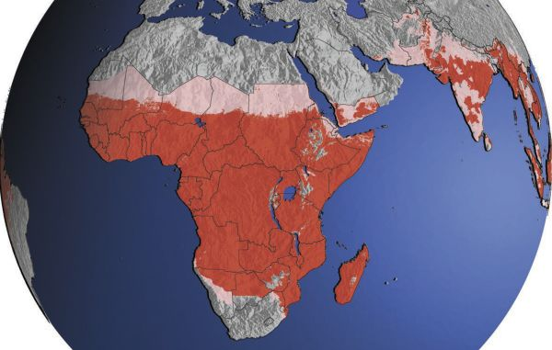
MALARIA

Slide 2
MALARIA
from Italian mala aria, “bad air,” once
thought to be the cause of the disease
Malaria is a group of transmissive endemic cyclic infectious diseases of Protozoal etiology. It is characterized by relapsing fever, hepatosplenomegaly and anemia.

Slide 3
The agents of malaria
Plasmodium vivax
(tertian malaria)
Plasmodium malariae
(quartian malaria)
Plasmodium falciparum
(tropical malaria)
Plasmodium ovale
(ovale malaria)

Slide 4
Another 7 species of plasmodia that circulate in primates can be transmitted to a human

Slide 5
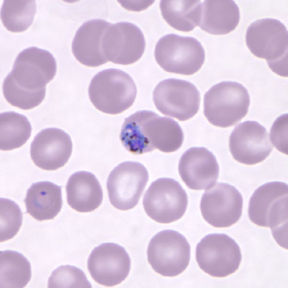
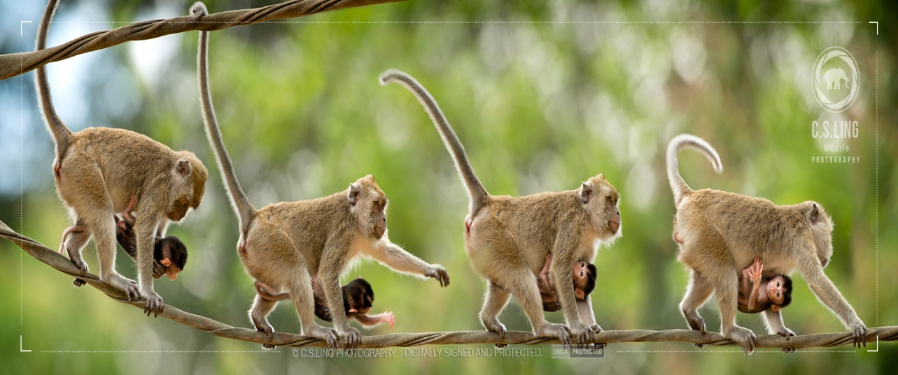
Plasmodium knolesii was first described in the long tail macaque. It also caused natural acquired malaria in monkeys of different species.
The first infection in humans was reported in 1965

Slide 6
In all types of malaria the periodic febrile response is caused by rupture of mature schizonts. In P vivax and P ovale malaria, a brood of schizonts matures every 48 hr, so the periodicity of fever is tertian (“tertian malaria”), whereas in P malariae disease, fever occurs every 72 hours (“quartan malaria”). The fever in falciparum malaria may occur every 48 hr, but is usually irregular, showing no distinct periodicity.

Slide 7
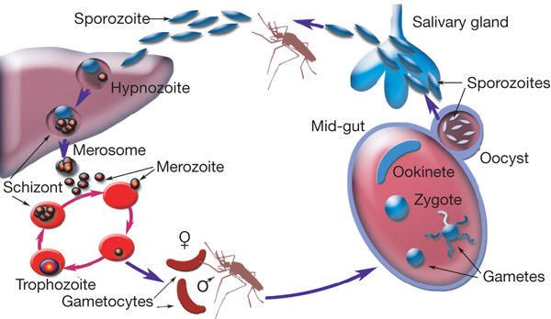

Slide 8
there are approximately 200 million to 500 million new cases each year in the world, and the disease is the direct cause of 1 million to 2.5 million deaths per year.

Slide 9
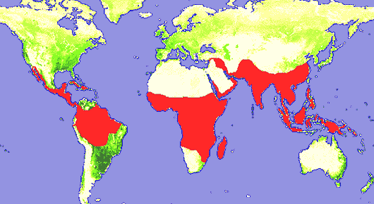

Slide 10
Tertian malaria and tropical malaria are world wide spread in countries of Asia, Oceania, Southern and Central America.
Pl.falciparum is the main agent in the countries of equatorial Africa.
An areal of Pl.ovale is equatorial Africa, in islands of Oceania and in Tailand

Slide 11
4 types of the foci
Hypoendemic
(lien index – 10%)
Mezoendemic (lien index – 11-50%)
Hyperendemic (lien index – 51-75%)
Holoendemic (lien index – more 75%)

Slide 12
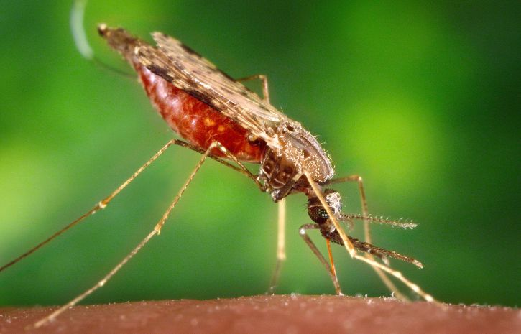
EPIDEMIOLOGY
The source of infection – sick man or gametocarrier
The routes of transmission
– transmissive (females of mosquitoes from genus Anopheles)
- parenteral
– vertical
The susceptibility of the organism is almost 100%

Slide 13
The reasons of the unsusceptibility of some persons to malaria
The lack of the isoantigens Duffy (Fyª, Fy^{b}) in inhabitants of the West Africa. These persons are not susceptible to Pl.vivax.
The genetic anomaly of the blood:
  The development of Pl.falciparum is supressed in the presence of fetal hemoglobin – hemoglobin S (HbS)
  Glucose-6-phosphatase dehydrogenase deficiency
Children till 3 years old:
  Passive immunity from hyperimmune mother
  Presence of fetal hemoglobin (HbF)
  The lack of paraaminobenzoic acid (milk diet)

Slide 14
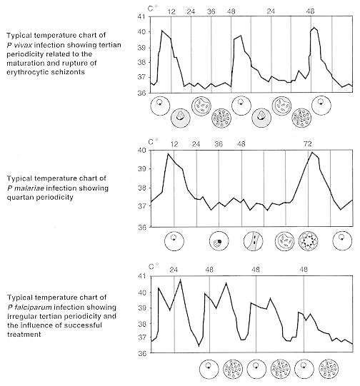

Slide 15
The malaria paroxysm comprises three successive stages. The first is a 15-to-60 minute cold stage characterized by shivering and a feeling of cold. Next comes the 2-to-6 hour hot stage, in which there is fever, sometimes reaching 41°C, flushed, dry skin, and often headache, nausea, and vomiting. Finally, there is the 2-to-4 hour sweating stage during which the fever drops rapidly and the patient sweats.

Slide 16
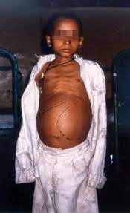
Physical findings in malaria
Splenomegaly (may not be apparent early in disease)
Hepatomegaly
jaundice,
anemia
hypotension and abdominal tenderness

Slide 17
FEATURES OF TROPICAL MALARIA
1. The biological features of Pl.falciparum is very high level of parasitemiae.
The result of repeated division is formation some decades (tens) of the thousands merozoides from 1 sporozoide
  In Pl.malariae – 7.500
  Pl.vivax – till 10.000
  Pl.ovale – more than 15.000
  Pl. falciparum – 40.000-50.000

Slide 18
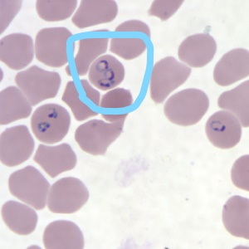
FEATURES OF TROPICAL MALARIA
In malaria 20-30% of the erythrocytes are affected.
The quantity of the parasites may be different in 1mkl of the blood:
    Pl.vivax – 10.000
    Pl.ovale – 9.000
    Pl.malariae – 6.000
    Pl. falciparum – 20.000 and
    more
The quantity of the parasites more than 100.000 in 1mkl is accompained by development of the complication

Slide 19
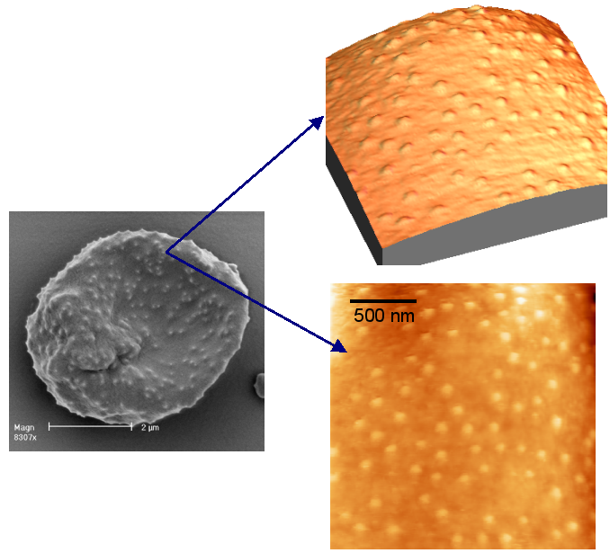
The erythrocitic schizogony of Pl.falciparum is realized in the capillaries of the internal organs.
Membrane protuberances appear on the erythrocyte’s surface
↓
“knobs” connect with receptors
↓
cytoadherence

Slide 20
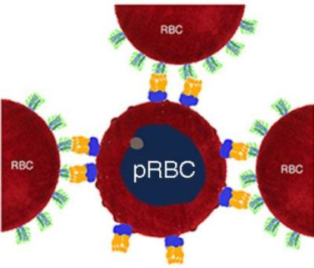
Malaria infected red blood cells (pRBC) with IgM (violet) and PfEMP1 (yellow) on their surface attract uninfected red blood cells (RBC) forming a rosette.
One strategy used by the pathogen to amplify its spreading probability is the formation of rosette-shaped clusters of uninfected erythrocytes surrounding a malaria-infected red blood cell.
One of the key players in the formation of the rosette is the protein PfEMP1, Plasmodium falciparum erythrocyte membrane protein-1.

Slide 21
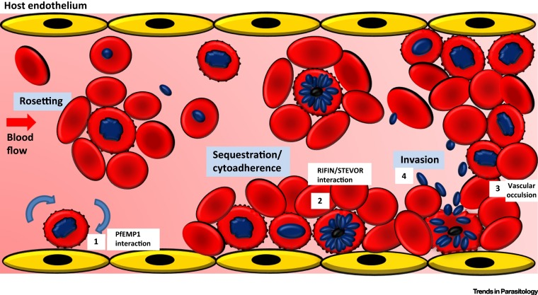

Slide 22
rosetting
↓
agglutination
↓
sequestration of RBCs with plasmodium in vital organs (brain)
↓
disorders of microcirculatory flow

Slide 23
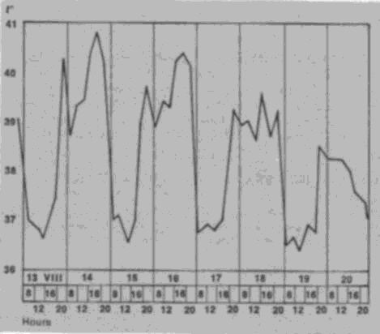
CLINICAL FEATURES OF TROPICAL MALARIA
The duration of the hot stage is 24-36 hours
The temperature curve without clean alteration between malarial paroxism and period of apyrexia

Slide 24
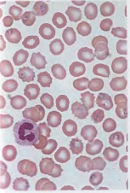
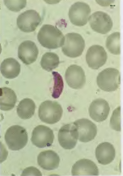
Pl. falciparum
Stage of ring Hametocytes

Slide 25
COMPLICATIONS
MALIGNANT FORMS OF MALARIA
Cerebral malaria
Acute renal insufficiency
Pulmonary edema
Malarial algid (infectious toxic shock with DIC-syndrome)
Hemoglobinurine fever

Slide 26
Cerebral malaria is the most severe neurological complication of infection with Plasmodium falciparum.
Mortality is high and some surviving patients sustain brain injury which manifest as long-term neuro-cognitive impairments.

Slide 27
The clinical hallmark of cerebral malaria is impaired consciousness, with coma the most severe manifestation.

Slide 28
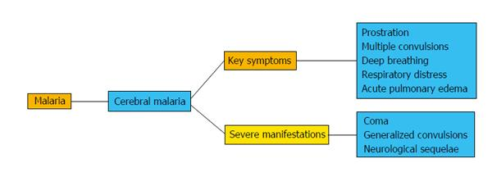

Slide 29
Brain swelling, intracranial hypertension, retinal changes (hemorrhages, peripheral and macular whitening, vessel discoloration and or papilledema) and brainstem signs (abnormalities in posture, pupil size and reaction, ocular movements or abnormal respiratory patterns) are commonly observed.

Slide 30
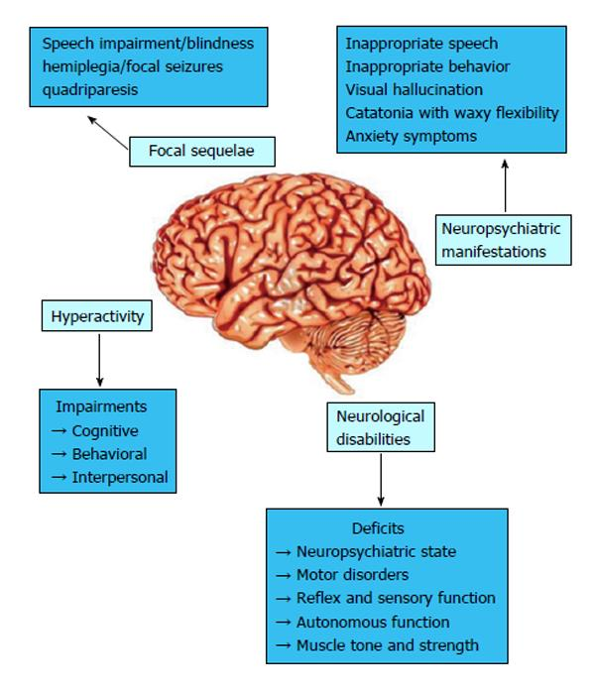

Slide 31
Haemoglobinuria
Haemoglobinuria reflects acute intravascular haemolysis, and can occur as a complication of severe malaria, potentially leading to acute kidney injury. While it can occur early in the course of infection as a direct consequence of a high parasite burden and rupture of parasitized and unparasitized cells, it may also occur as a complication of anti-malarial treatment.

Slide 32
In previous reports, haemoglobinuria occurring in patients with malaria has been referred to as blackwater fever. While definitions vary, the term was historically used to describe a clinical syndrome of haemoglobinuria, fever and jaundice that typically involved non- or partially immune European expatriates who had been residing in malaria-endemic areas and who had received, often intermittently, treatment with quinine.

Slide 33
More recent reports however, have described blackwater fever or haemoglobinuria in Southeast Asian adults and in African children, including in those treated with artesunate. The syndrome is most commonly associated with falciparum malaria, although has also been reported with Plasmodium vivax and with mixed species infections, and in severe knowlesi malaria

Slide 34
Black water fever
Fever
Rigor
Aching pains in the loin
Icterus
Bilious vomiting
Circulatory collaps
Haemoglobiuria
Acute renal failure

Slide 35
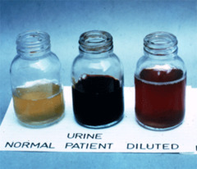
Urine appears dark red to brown black due to presens of free Hb

Slide 36
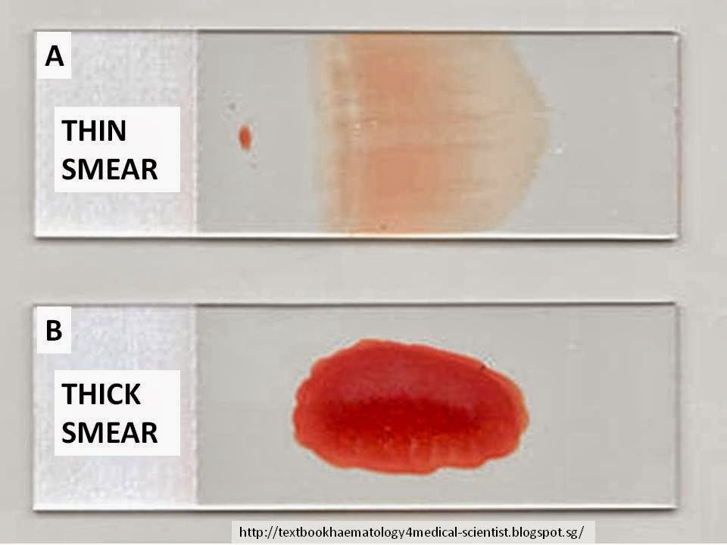
Repeat blood smears should be performed at least every 12-24h for 2 days if the first smears are negative and malaria strongly suspected

Slide 37
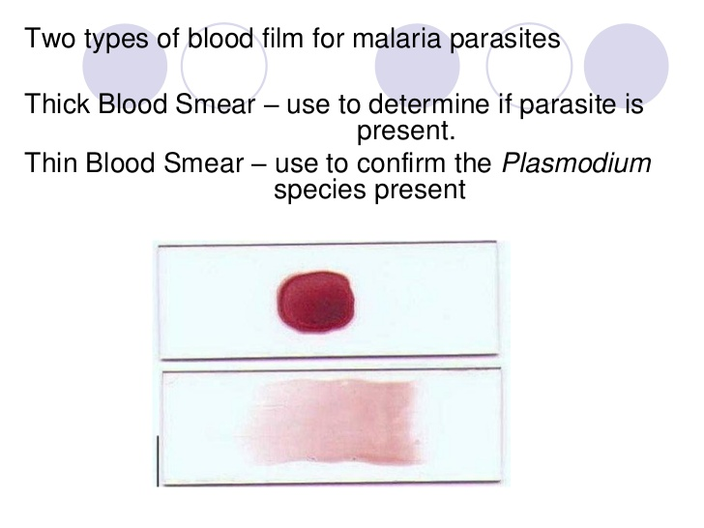

Slide 38
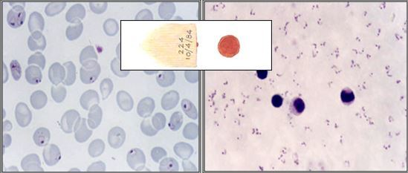
Plasmodium falciparum in thick-and-thin-smear

Slide 39
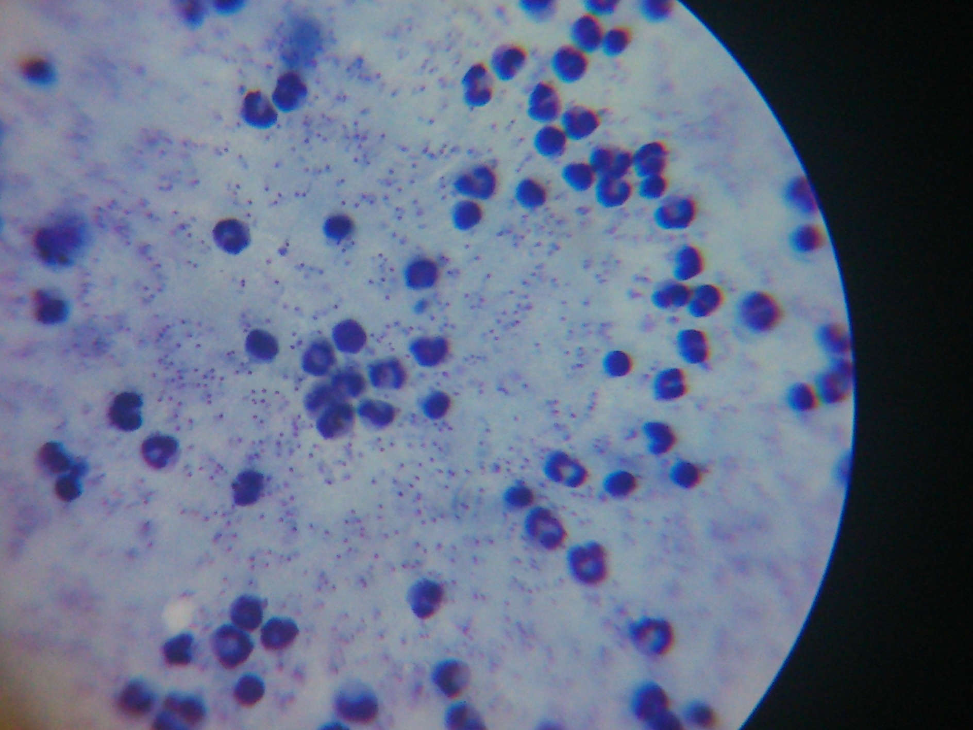

Slide 41
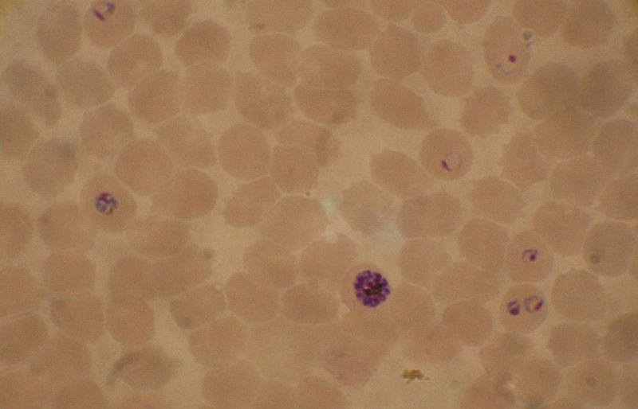
Plasmodium falciparum
(malaria tropica)

Slide 42
Treatment
The 4 major drug classes currently used to treat malaria:
quinoline-related compounds
antifolates
artemisinin derivatives
antimicrobials.

Slide 43
Quinine remains an important anti-malarial drug almost 400 years after its effectiveness was first documented.
Quinine, as a component of the bark of the cinchona (quina-quina) tree, was used to treat malaria from as early as the 1600s

Slide 44
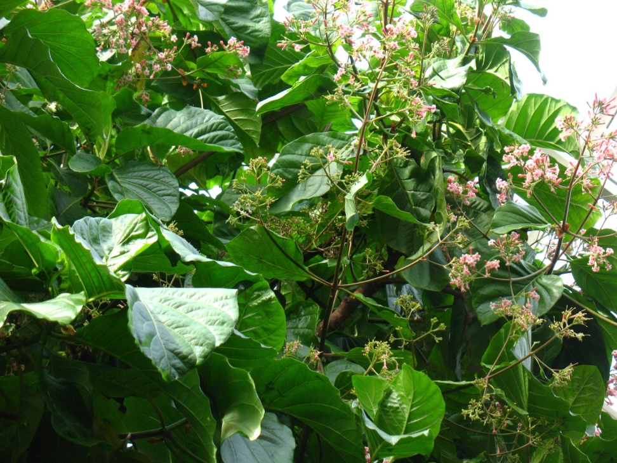
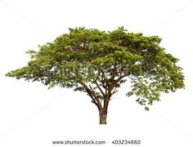
The native range of cinchona species are the lower to mid-elevations of the Andes in South America. Cinchona is the national tree of both Peru and Ecuador.

Slide 45
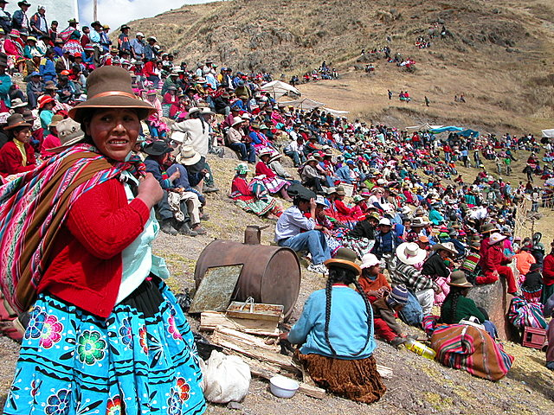
The Quechua peoples of Peru, Bolivia and Ecuador were the first to realise the medicinal properties of Cinchona. Though now famous as a cure for malaria, the Quechua used the tree’s bark as a muscle relaxant to treat shivering.

Slide 46
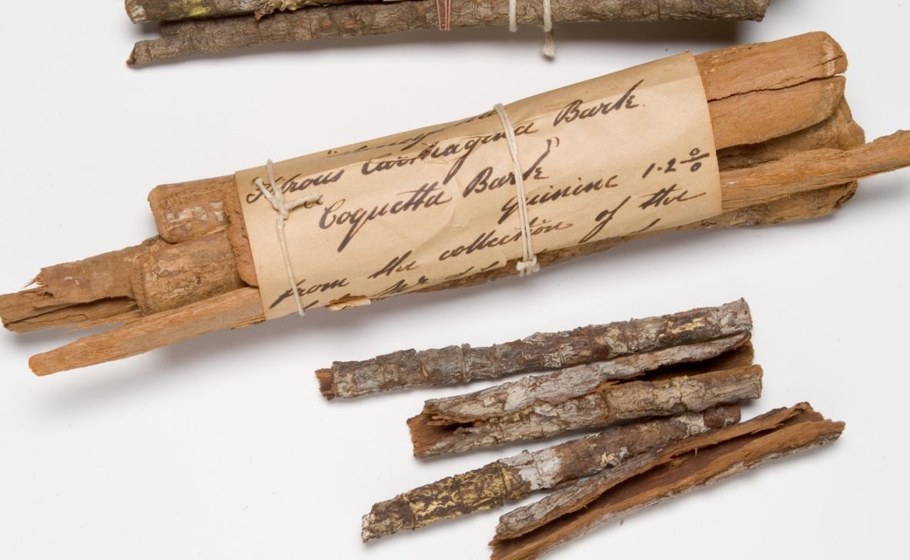
Since shivering can be one of the symptoms of the disease, the bark was coincidently used to treat malaria. The Quechua’s use of Cinchona was observed by Jesuit missionaries, who introduced the plant to Europe by the 1630s.

Slide 47
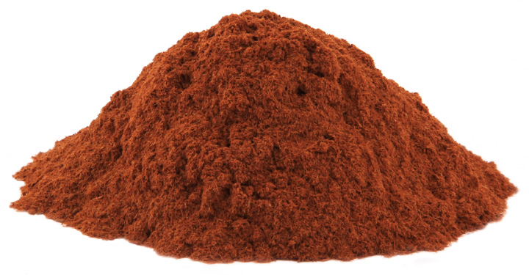
The bark of the Cinchona tee contains a number of medicinal compounds, including quinine and quinidine.
Quinidine is used in pharmaceuticals as an antiarrhythmic agent. Cinchona has been used in folk medicine to stimulate appetite, promote discharge of bile and treat mild influenza infections.

Slide 48
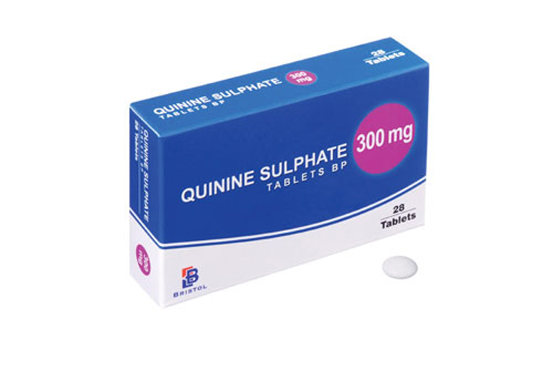
Quinine should be given orally to adults per 500 mg base (equivalent to quinine sulfate dihydrate 600 mg) every 8 hours for 7 or 10 days.

Slide 49
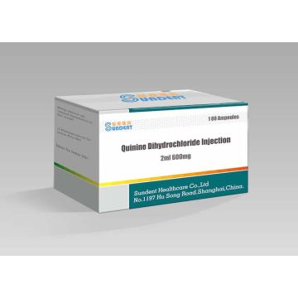
Quinine dihydrochloride should be given in dose:
– Child and adult:
• loading dose: 20 mg/kg administered over 4 hours, then keep the vein open with an infusion of 5% glucose over 4 hours
• maintenance dose: 8 hours after the start of the loading dose, 10 mg/kg every 8 hours (alternate quinine over 4 hours and 5% glucose over 4 hours)

Slide 50
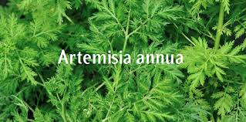
Artemisinin is derived from the plant Artemisia annua, better known as sweet wormwood. It is known for its ability to rapidly reduce the concentration of Plasmodium parasites in the bloodstream.

Slide 51
Artemisinin-based combination therapy (ACT) is recommended by the WHO to treat uncomplicated malaria.
Artesunate – 10 mg/kg x 1 t.p.d.
for 5 days or
2,4mg/kg stat IV followed by 2,4 mg/kg at 12 and 24h and then daily if necessary

Slide 52
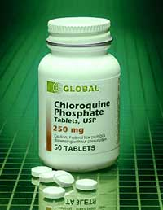
Chloroquine,
synthetic drug used in
the treatment of malaria.
Chloroquine, introduced
into medicine in the 1940s,
is a member of an
important series of
chemically related
antimalarial agents,
the quinoline derivatives.

Slide 53
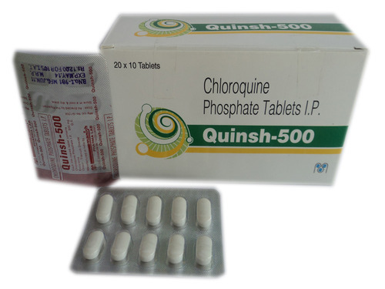
Chloroquine (10 mg of base/kg stat followed by 5 mg/kg at 12, 24 and 36 h
Or by 10mg/kg at 24h and 5 mg/kg at 48 h

Slide 54
Malaria can often be avoided using the ABCD approach to prevention, which stands for:
A - Awareness of risk – find out whether you're at risk of getting malaria.
B- Bite prevention – avoid mosquito bites by using insect repellent, covering your arms and legs, and using a mosquito net.
C- Compliance -check whether you need to take malaria prevention tablets – if you do, make sure you take the right antimalarial tablets at the right dose, and finish the course.
Diagnosis – seek immediate medical advice if you have malaria symptoms, including up to a year after you return from travelling.

Slide 55


