Slide 1
The features of tropical diseases. Traveller’s disease

Slide 2
The medical geography of the tropics
Tropical diseases encompass all diseases that occur solely, or principally, in the tropics. In practice, the term is often taken to refer to infectious diseases that thrive in hot, humid conditions, such as malaria, leishmaniasis, schistosomiasis, onchocerciasis, lymphatic filariasis, Chagas disease, African trypanosomiasis, and dengue.

Slide 3
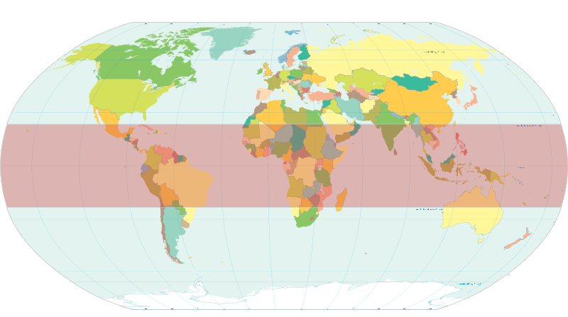

Slide 4

The tropical climate has a significant effect on the survival of protozoa and helminth eggs in the external environment, the spread of carriers and intermediate hosts of pathogens of parasitic diseases - blood-sucking insects, mollusks.

Slide 5
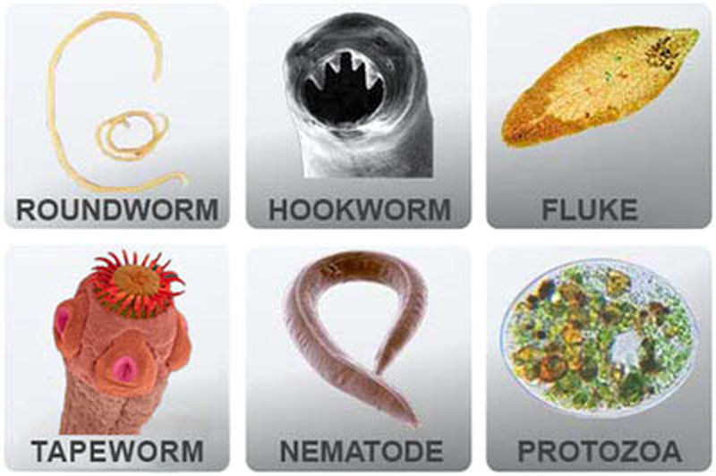
Features of tropical diseases
The peculiarity of the disease course in the tropics is due to the unfavorable background on which the diseases develop:
- disorders of water-electrolytic balance
- disorders of termoregulation
- protein-energy and vitamin deficiency
- chronic invasions
- the massiveness of infection
- the influence of environmental conditions
- high transmission intensity increases the likelihood of simultaneous infection by several types of pathogens.
Polyparasitism is a common phenomenon in the tropics.

Slide 6
“Tropical diseases moving into new parts of the globe”
Climate changes
Migration of population

Slide 7
Changes of climate
The winters are warming faster than summers.
Nighttime minimum temperatures are also rising faster than daytime
Each of this nuances bears upon the incidence of infection diseases in general and vector-born diseases specifically
The incidence of most infection diseases depends on climate, climate change determine disease epidemiology.
Climate change has become nearly synonymous with global warming.

Slide 8

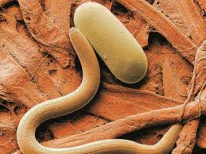
The warmer atmosphere holds more water vapor that increase the humidity of environment, warming tends to promote heavier precipitations events.
For example, the life cycle of some nematode parasites shortens as temperature and humidity rise. Higher nematode burden, higher rates of morbidity and mortality.

Slide 9
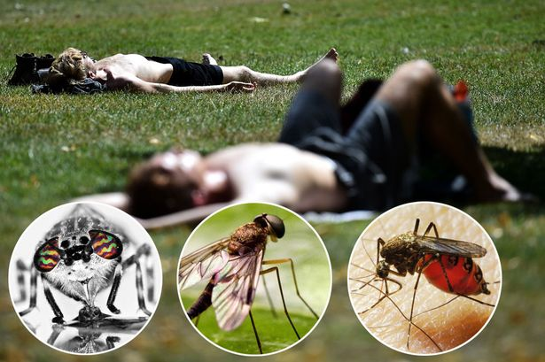
Because insects are cold-blooded, ambient temperature dictates their geographic distribution. With increase of temperature and humidity mosquitoes may spread to new areas.
For example, highland areas of East Africa and South America as perhaps most vulnerable to increased malaria incidence as a result of rising temperatures.
And highland populations may be more vulnerable to malaria epidemics because they lack immunity.

Slide 10



The recent outbreaks of Zika, yellow fever, dengue, chikungunya disease show a tendency to epidemic development of these severe, potentially life-threatening infections, and determine the need for systematic and rigid vector control of these diseases, increasing the global response potential to these threats.

Slide 11
Travellers’ diarrhea
Travellers’ diarrhoea is usually defined as the passage of three or more unformed stools over 24 hours, with one or more additional symptoms starting during or shortly after a period of foreign travel.

Slide 12
Additional symptoms include:
Nausea
Vomiting
Abdominal pain
Fever
Faecal urgency
Tenesmus.

Slide 13
Travellers’ diarrhea
The definition is also based on the functional impact on the person:
Mild (acute): diarrhoea that is tolerable, is not distressing, and does not interfere with planned activities
Moderate (acute): diarrhoea that is distressing or interferes with planned activities
Severe (acute): diarrhoea that is incapacitating or completely prevents planned activities; all dysentery (passage of grossly bloody stools) is considered severe
Persistent: diarrhoea lasting two weeks or longer.

Slide 14
Travellers’ diarrhea
Travellers' diarrhea (TD) accounts for more than 80 million cases each year.
It is not only the disease most commonly encountered by travellers to (sub)tropical destinations but also the most common health complaint at posttravel consultations.
Bacterial pathogens are known to predominate as etiologic agents.

Slide 15
Travellers’ diarrhea
Diarrhea, the leading cause of illness in travelers, is usually a short-lived, self-limited condition.
However, 40% of affected individuals need to alter their activities
Another 20% are confined to bad
Incidence rates per 2-week stay have been reported to be as low as 8% in industrialized countries and as high as 55% in parts of Africa, Central and South America, South-East Asia.

Slide 16
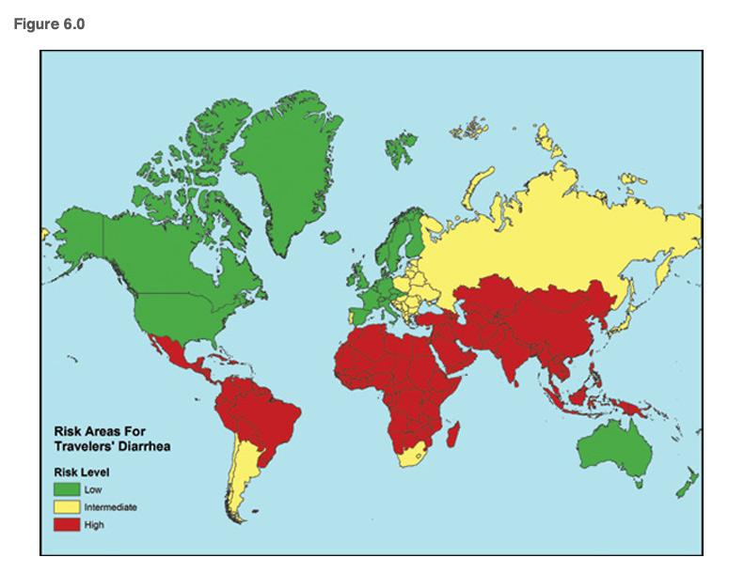
Countries with high risk of TD

Slide 17
Although most episodes resolve without treatment over several days, in about 10% the symptoms persist for more than one week, 5% more than two weeks, and in about 1% for more than one month.
Although rarely life threatening, travellers’ diarrhoea causes substantial disruption by interfering with travel itineraries, business opportunities, and tourist industry revenues.

Slide 18
Studies have also shown that an episode of travellers’ diarrhoea, particularly one with severe symptoms, can lead to irritable bowel syndrome (IBS), and may occur in 3% to 17% of patients.
Factors associated with the development of IBS include severity of travellers’ diarrhoea, the number of episodes, pre-travel diarrhoea, pre-travel adverse life events, and infection with heat labile toxin producing Enterotoxigenic Escherichia coli (ETEC).
Reactive arthritis, often associated with HLA-B27, and Guillain-Barré syndrome have also been associated with travellers’ diarrhoea.

Slide 19



Eating meals in restaurants and cafeterias or consuming food from street vendors, drinking unboiled water was associated with increased risk of infection

Slide 20
Strategies for prevention include:
Counselling high risk patients so they can make choices about their travel plans
Education about ingestion of safe food and drink
Therapeutic agents such as vaccination, chemoprophylaxis, and self treatment.

Slide 21
If travellers visit a specialised travel clinic they should receive advice about how to select food, the importance of fluid replacement if diarrhoea does occur, and when to seek medical care.
Travellers should also be advised about the importance of frequent hand washing, particularly before preparing food. Commercially available hand sanitisers are often a convenient substitute if soap and water are not readily available, with some evidence that they may also be associated with a reduction in the incidence of travellers' diarrhoea.

Slide 22

You should strongly encourage travellers to adhere to good hand hygiene measures.
Hand washing, however, decreases diarrhoea incidence in both high income and low income community settings; a Cochrane review found about a 30% reduction in diarrhoea episodes

Slide 23
Precoutions
Eating foods piping hot
Avoiding foods that are raw or poorly cooked
Drinking only boiled or commercially bottled beverages
Avoiding ice cubes made from unpurified water
“ Boil it, cook it, peel it, or forget it!”

Slide 24
Medical treatment
Medical treatment may not be easily accessible to travellers because of unfamiliarity with local healthcare systems, language barriers, remoteness, and time constraints. Carrying self treatment is therefore an attractive option.
Oral rehydration therapy
Loperamide
Bismuth subsalicylate
Antibiotics

Slide 25
When should your patient seek medical advice?
Signs of dehydration
Blood in the stools or black stools
Frequent vomiting so fluids cannot be replaced by mouth
Severe abdominal pain
High fever
No improvement after 24 hours, or persistent diarrhoea lasting longer than three to four days
Changes in mental status.

Slide 26
The time of onset is usually 3 days to 2 weeks after arriving in the country
The illness is generally lasting 1-5 days

Slide 27
Etiology
The most frequently identified pathogens causing traveller’s diarrhea are:
Enterotoxigenic Escherichia coli (ETEC)
Enteropathogenic Escherichia coli (EPEC)
Enteroaggregative Escherichia coli (EAEC)
Other common causative organisms include:
Campilobacter (predominant in Asia)
Shigella
Salmonella
Rota-, noroviruses
Parasitic infections are uncommon causative agents in short-term travellers

Slide 28
Echerichia coli
At least 5 pathotypes of intestinal pathogenic E.coli exist:
1. Shiga toxin-producing E.coli which includes
- enterohemorrhagic E.coli
- enteroaggregative E.coli
2. Enterotoxigenic E.coli
3. Enteropathogenic E.coli
4. Enteroinvasive E.coli
5. Enteroaggregative E.coli

Slide 29
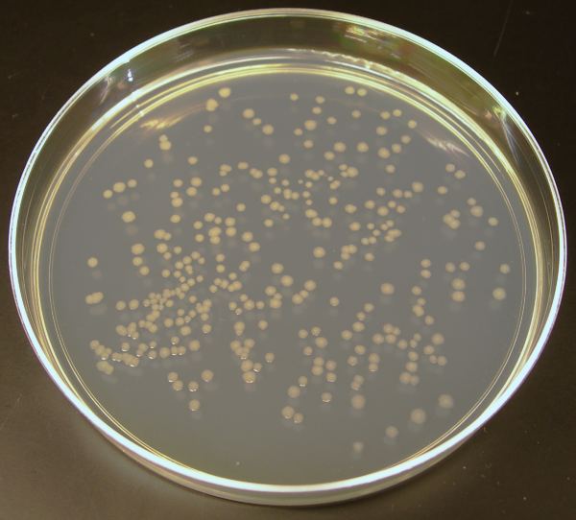
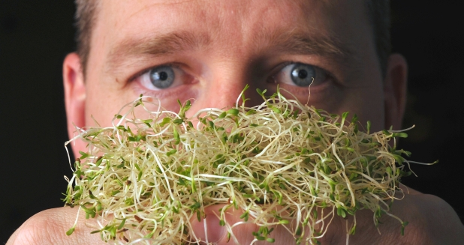
Enterohemorrhagic E.coli/ Shiga toxin-producing enteroaggregative E.coli
Can cause hemorrhagic colitis and hemolytic-uremic syndrome (HUS)
Several large outbreaks resulting from the consumption of fresh produce (lettuce, spinach, sprouts)

Slide 30

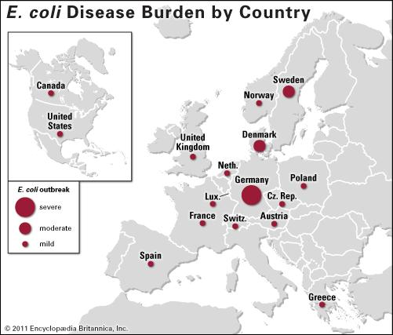
An outbreak in central Europe in 2011 due to STEAEC O104:H4
resulted in 4000 cases, 800 with HUS, 54 death
It is estimated that < 10²
colony-forming units (CFU) can cause disease

Slide 31
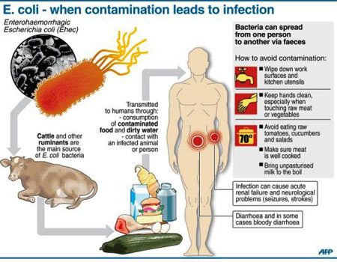

Slide 32
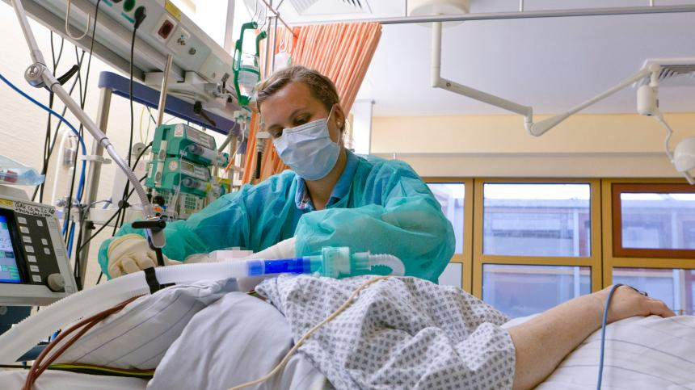
Clinical manifestation
Colonisation of intestine results in symptoms after an incubational period 3-4 days
Initial nonbloody diarrhea may develop in bloody diarrhea – hallmark syndrome – in 90% cases
Significant abdominal pain
Fever is not common
Complication – HUS – due to affection of small vessels of kidney and brain – trombotic microangiopathy :
- fever
- trombocytopenia
- renal failure
- encephalopathy

Slide 33
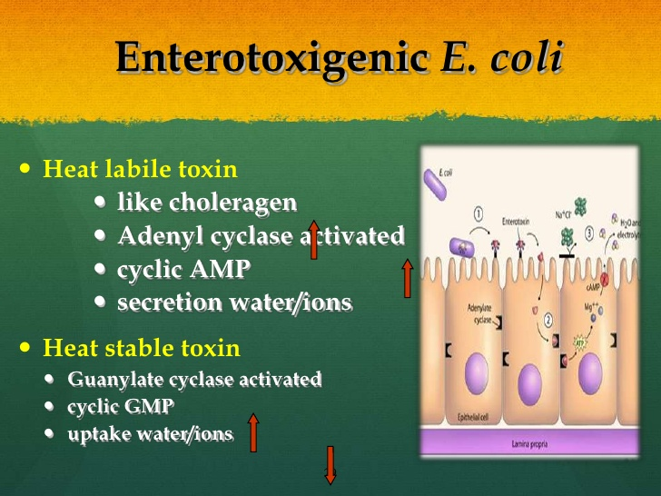
Enterotoxigenic E.coli (ETEC)
ETEC is the most common agent of TD(25-75% cases)
A large inoculum (10⁶-10¹⁰ CFU is needed to produce disease
Typically absent in ETEC-mediated disease are histopatological changes in the small bowel; mucus, blood, inflammatory cells in stool; fever.
The disease ranges from a mild illness to a life threatening cholera-like forms

Slide 34
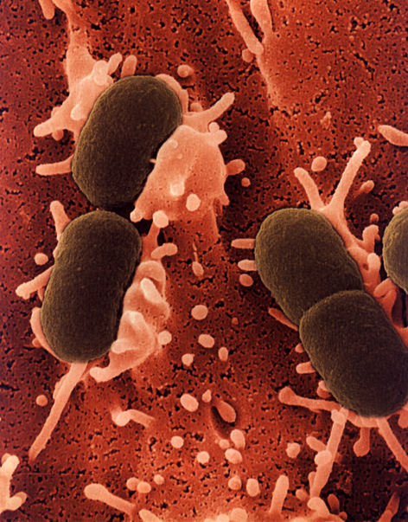
Enteropathogenic E.coli (EPEC)
EPEC O26/O11
Causes diseases in young children
Produce verocytotoxin, brush border of the intestine is lost
Frequent outbreaks in institutions
Occur in summer months
Brief incubation period (1-2 days)
Watery diarrhea with mucus but not blood

Slide 35
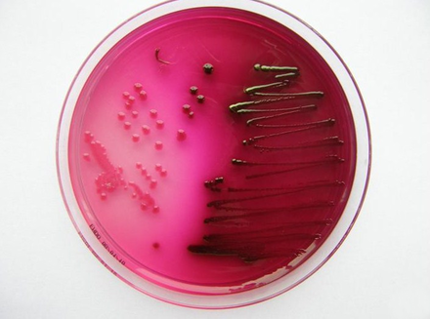
Enteroinvasive E.coli (EPEC)
EIEC shares many genetic and clinical features with Shigella
However, unlike Shigella, produce disease only with a large inoculum (10⁸-10¹⁰ CFU)
Development colitis characterised by fever, abdominal pain, tenesmus, scant stool containing mucus and blood.

Slide 36
Cholera
Cholera is an acute anthroponotic infectious disease with fecal-oral mechanism of transmission.
Cholera is characterized by dehydration due to loss of fluid with watery diarrhea and vomiting.
Cholera is related to the group of the diseases, which are submitted to “international medical-sanitary rules

Slide 37
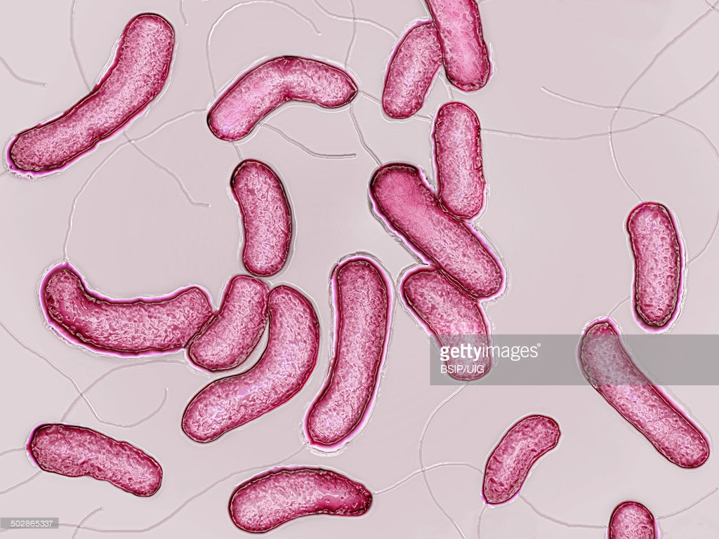
Vibrios are Gram-negative, highly motile curved rods with a single polar flagellum. They tolerate alkaline media that kill most intestinal commensals, but they are sensitive to acid. There are two biotypes, classical and El Tor, and three serotypes, Inaba, Ogawa and Hikoshima.

Slide 38
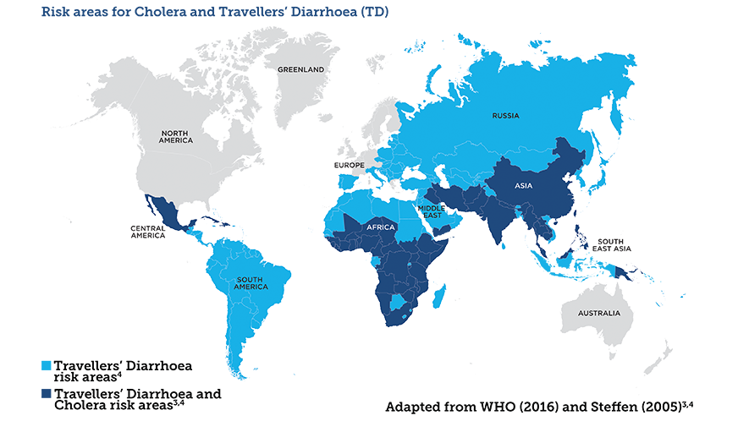

Slide 39
Cholera is transmitted by the fecal-oral route.
Vibrios are sensitive to acid, and most die in the stomach.
Surviving virulent organisms may adhere to and colonize the small bowel, where they secrete the potent cholera enterotoxin (CT, also called “cholerogen”).
This toxin binds to the plasma membrane of intestinal epithelial cells and releases an enzymatically active subunit that causes a rise in cyclic adenosine 5¹-monophosphate (cAMP) production.
The resulting high intracellular cAMP level causes massive secretion of electrolytes and water into the intestinal lumen.

Slide 40
Cholera may be present in typical and untypical forms.
In typical course: mild, moderately severe and severe form.
In accordance with the classification of WHO:
1. The I degree of dehydration
(losses of the fluid in a volume equal to 5% of the body mass).
2. The II degree of dehydration.
(losses of the fluid in a volume equal to 6-9% of the body mass).
3. The III degree of dehydration.
(losses of the fluid in a volume over 10% of the body mass)
Such dehydration is dangerous for life without resuscitation measures.

Slide 41
In accordance with classification
of V.I. Pokrovsky:
The I degree of dehydration
(loss of the fluid equal to 1-3% of the body mass).
The II degree of dehydration
(loss of the fluid equal 4-6% of the body mass).
The III degree of dehydration
(loss of the fluid equal 7-9% of the body mass).
The IV degree of dehydration
(loss of the fluid over 10% of the body mass).

Slide 42
CLINICAL MANIFESTATIONS.
The incubation period is from some hours to 5 days (an average 48 hours).
The onset of the disease is an acute
Mild course (dehydration of the first degree)
diarrhea (stool may be up to 10 times a day, not volume, without any pain)
thirst
rumbling in the stomach
dizziness (rarely), weakness
temperature is normal

Slide 43
Moderately severe course
vomiting; diarrhea (stool may be from 10 to 20 times a day; plentiful,
watery or “rice water like)
temperature is normal
considerable weakness
thirst
dizziness
turgor of the skin is decreased
cramps
tachycardia; arterial pressure is decreased to 90/60 mm Hg
olyguria

Slide 44
Severe course
diarrhea (stool without account, rice water-like)
temperature is subnormal (35,5)
weakness, adynamia
severe thirst
cramps of the muscles
skin is cold and wrinkled, cyanosis of the lips and extremities
symptoms of “black eyeglasses”
dryness of the tongue, lips, mucous membrane of the oral cavity
the voice is hoarse
pulse rate is 120-130 per minute, arterial pressure 60/40 mm Hg
respiration rate is till 30 per minute
anuria

Slide 45
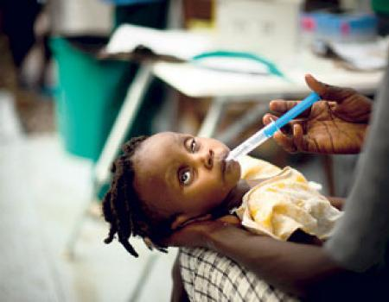
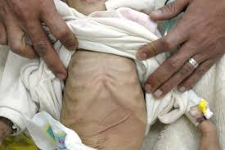
Very severe course (decompensate dehydration)
cold clammy skin; total cyanosis
temperature is subnormal
turgor of the skin is decreased, the skin fold is not smoothed out
eyes are deeply sunken in the orbit (“facies cholerica”, “washwoman’s hands”)
the voice is hoarse
generalized tonic cramps
pulse and arterial pressure are no determined
breath is frequent and superficial
anuria

Slide 46
Treatment
Dehydration has the leading meaning
in pathogenesis of cholera
↓
The principal direction of the therapy is rehydration -
restoration of water-electrolyte balance
The treatment consist of 2 stages:
1 stage – initial rehydration
2 stage – correction of continued losses
Therapeutic tactics is determined by of dehydration
I and II degree (part of the cases – without vomiting) →Peroral rehydration
III degree →Parenteral rehydration

Slide 47
Composition of the remedies for oral rehydration
(weight in grams to 1 liter of water)
Oralit (WHO solution) | 3,5 | NaHCO₃ – 2,5 | 1,5
Rehidrone | 3,5 | Citrate Na – 2,9 | 1,5

Slide 48
COMPOSITION OF POLYIONIC SOLUTIONS
FOR INTRAVENOUS INTRODUCTION IN CHOLERA
(IN 1 LITER OF THE WATER)
Solution | NaCl (g) | Alkaline (g) | KCl (g)
Threesalt (Phillips’s solution №1) | 5 | Sodii hydcarbonii (NaHCO₃) – 4 | 1
Desalt | 6 | Sodii acetate – 2
Quartasalt | 4,75 | Sodii acetate – 2,6 | 1,5
Chlosalt | 4,75 | Sodii acetate – 3,6 | 1,5
Acesalt | 5 | Sodii acetate – 2 | 1

Slide 49
AMEBIASIS
Amebiasis is anthropinotic protozoal disease, caused by Entamoeba hystolytica.
It is characterized by ulcerous damage of the large intestine, possibility of the formation of the abscesses in different organs and tendency to prolonged and chronic course

Slide 50
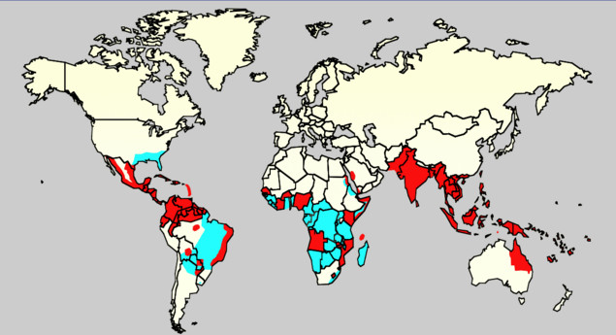

Slide 51
Amebiasis occurs worldwide, but it is more prevalent in tropical and developing countries. Approximately 40–50 million of world's population is estimated to be infected by Entamoeba histolytica (E. histolytica) annually with 40,000 deaths.
Among infected, 90% are asymptomatic and 1% may develop invasive amebiasis or involves other organs

Slide 52
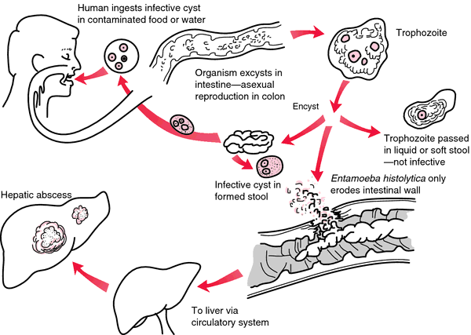
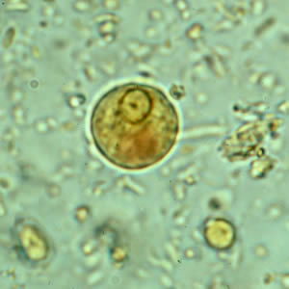
Life cycle
includes 2 stages:
Vegetative stage (unresistant)
Stage of the rest (cysts)

Slide 53
CLINICAL FORMS
E histolytica is capable of causing a spectrum of illness. Intestinal conditions resulting from E histolytica infection include the following:
Asymptomatic infection
Symptomatic noninvasive infection
Acute proctocolitis (dysentery)
Fulminant colitis with perforation
Toxic megacolon
Chronic nondysenteric colitis
Ameboma
Perianal ulceration

Slide 54
Patients with amebic colitis typically present with a several-week history of cramping abdominal pain, weight loss, and watery or bloody diarrhea.
The gradual onset and variable signs and symptoms make diagnosis difficult.

Slide 55
The differential diagnosis of a diarrheal illness with occult or grossly bloody stools should include
infection with:
shigella
salmonella
campylobacter
enteroinvasive and enterohemorrhagic
E coli.
Noninfectious causes include:
inflammatory bowel disease
ischemic colitis
diverticulitis
arteriovenous malformation.

Slide 56
Unusual manifestations of amebic colitis
acute necrotizing colitis
toxic megacolon
ameboma
perianal ulceration with potential formation of a fistula.

Slide 57
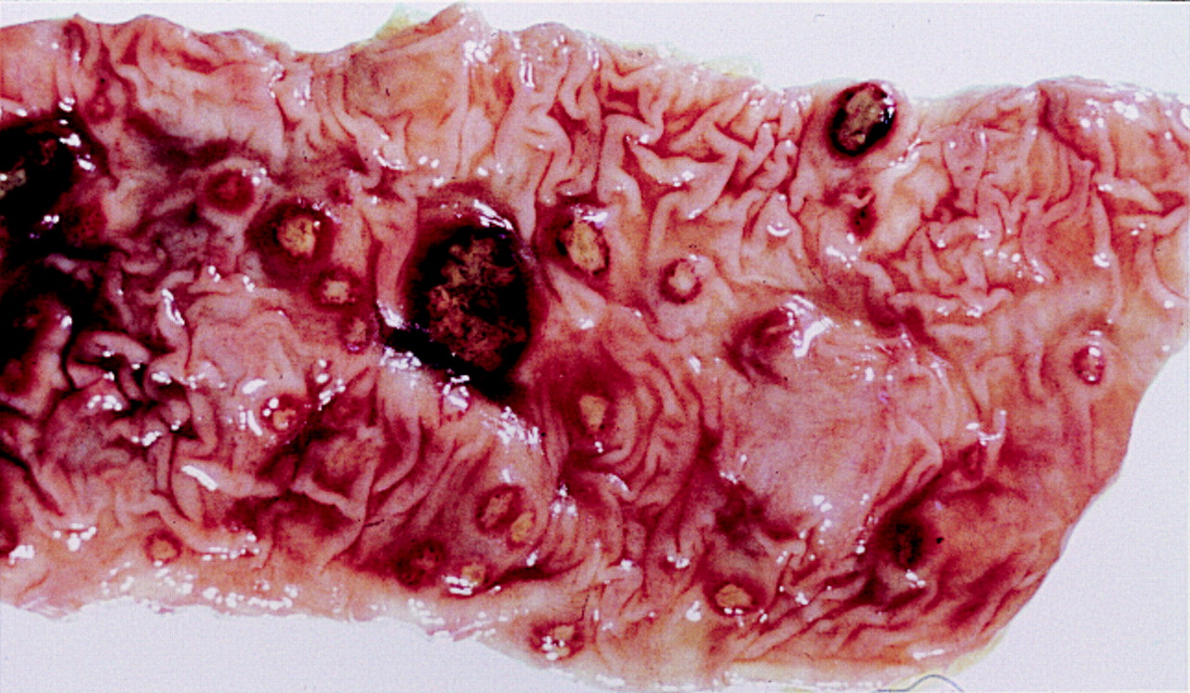

Slide 58
term “ameboma” originally described as amebic granuloma
Ameboma of the large bowel is a rare condition that occurs in 1% of all cases with invasive amebiasis characterized by mass of granulation tissue with peripheral fibrosis and a core of inflammation related to chronic amebic infection.

Slide 59
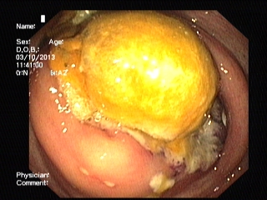
An ameboma usually presents as pain and lump in the right iliac fossa and/or symptoms of bowel obstruction.
It can mimic as appendicular abscess and Crohn's disease in younger individuals and colon cancer and diverticulitis in elderly

Slide 60
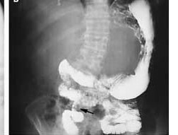
Picture shows luminal narrowing (arrow) on a barium-enema examination in a patient with ameboma.

Slide 61
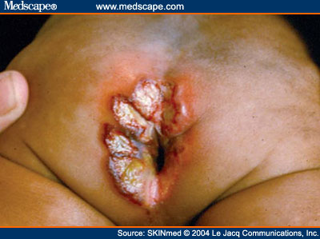

Slide 62
Extraintestinal conditions resulting from E histolytica infection
Liver abscess
Pleuropulmonary disease
Peritonitis
Pericarditis
Brain abscess
Genitourinary disease

Slide 63
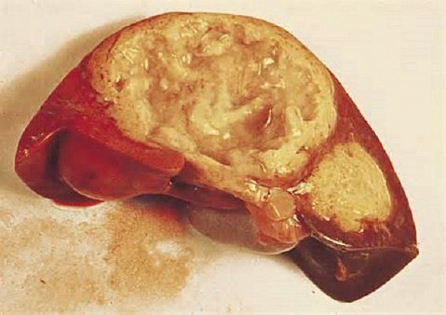

Slide 64
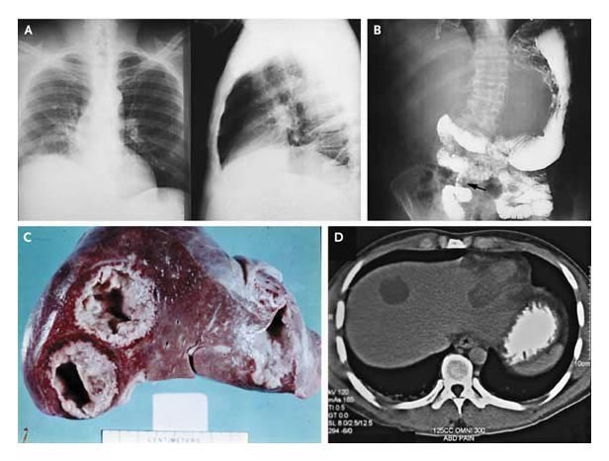

Slide 65
Panel A shows a posteroanterior (left-hand side) and lateral (right-hand side) chest radiograph in a patient with amebic liver abscess. The findings include elevated right hemidiaphragm and evidence of atelectasis. Panel B shows luminal narrowing (arrow) on a barium-enema examination in a patient with ameboma. Panel C shows two abscesses in the right lobe and one abscess in the left lobe in a patient with amebic liver abscess. In Panel D, abdominal computed tomography in a patient with amebic liver abscess shows one abscess in the right lobe and one abscess in the left lobe.

Slide 66
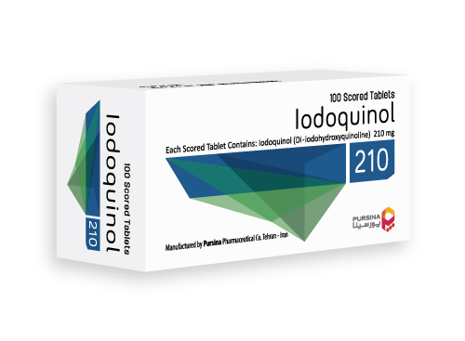
Treatment
Paromomycin
Iodoquinol (Yodoxin)
Diloxanide furoate
To treat invasive amebiasis:
metronidazole
tinidazole
Treatment of hepatic amebiasis has been successful in some patients with
chloroquine
dehydroemetine

Slide 67
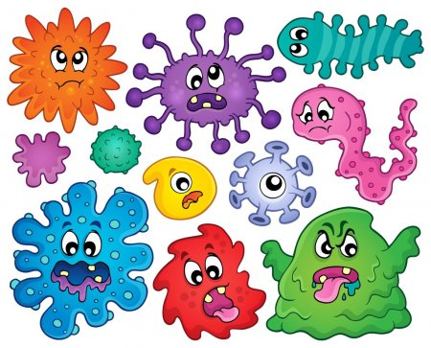
THANKS FOR YOUR ATTENTION!

