Slide 1
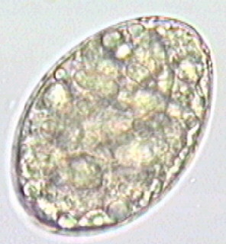
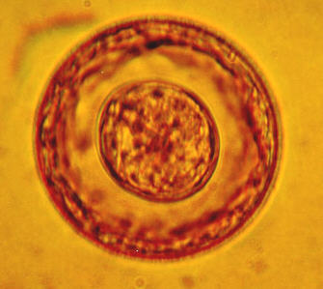
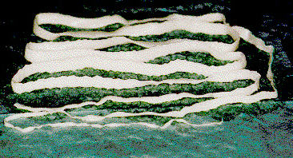
HELMINTHIASES. Classifications.

Slide 2
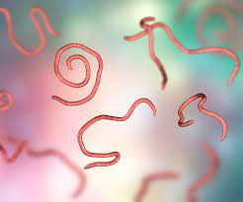
The parasitic infections have traveled throughout the centuries at the forefront of the scourges afflicting the human race, surpassing even cancer, tuberculosis and plague.
Not the least important of these are the helminth infections of the gastrointestinal tract, of which two, hookworm and schistosomiasis, are ranked with malaria as the most dangerous diseases of mankind.

Slide 3
It is estimated that there are 72,000,000 tapeworm, 148,000,000 fluke and more than 2,000,000,000 roundworm infections distributed throughout the world, a number exceeding the total of the world population. Well over half of these infections reside in the gastrointestinal tract.

Slide 4
The helminths are invertebrates characterized by elongated, flat or round bodies. , widespread all over the world including all climatic zones of our planet.
It is described more than 250 types of helminths in human.

Slide 5
The groups of helminths are separated according to their general external shape and the host organs they inhabit.

Slide 6
In medically oriented schemes the flatworms or platyhelminths (platy from the Greek root meaning “flat”) include flukes and tapeworms. Roundworms are nematodes (nemato from the Greek root meaning “thread”).

Slide 7
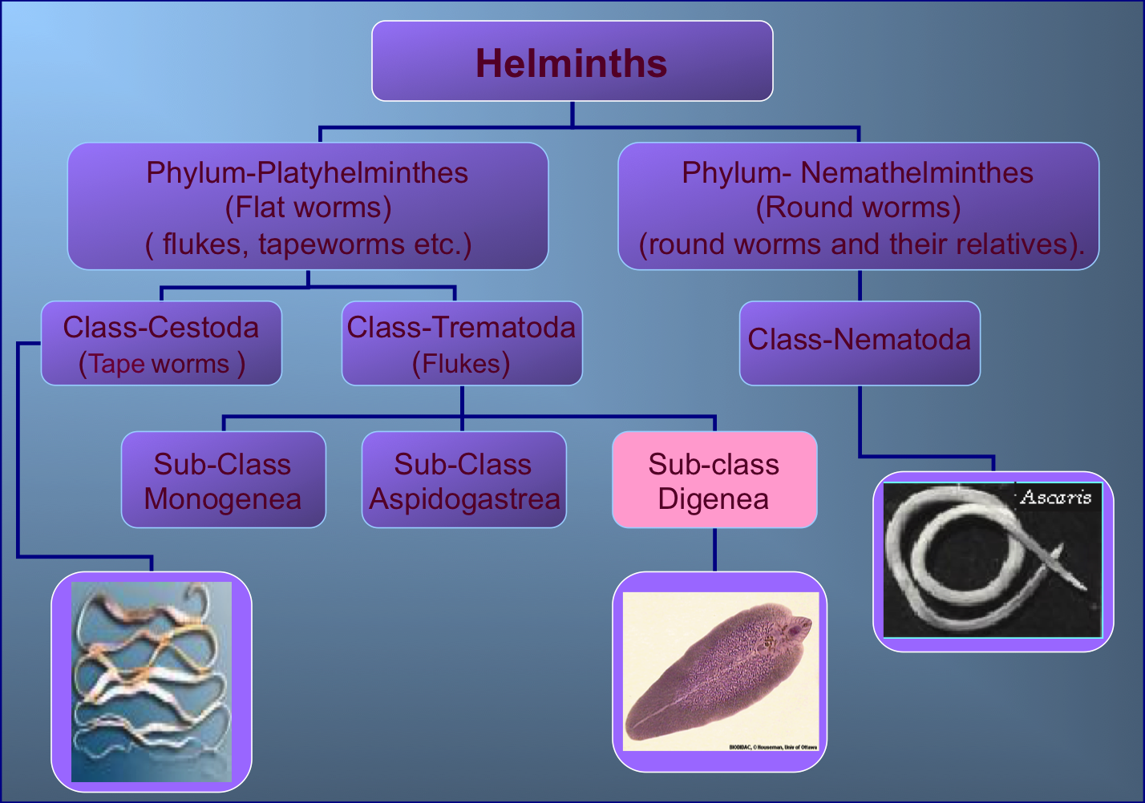

Slide 8

Class roundworms (Nematodas)
Ascariasis
Trichuriasis
Trichinosis
Enterobiasis (pinworm)
Filariases
Ancylostomiases (hookworms)
Strongyloidiasis
Dracunculiasis

Slide 9
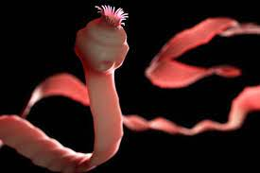
Class tapeworms
(Cestodas)
Taenia solium
(pork tapeworm)
Taenia saginata
(beef tapeworm)
Echinococcosis
(hydatid disease)
Alveococcosis
Hymenolepiasis
(dwarf tapeworm)
Diphyllobothriasis

Slide 10
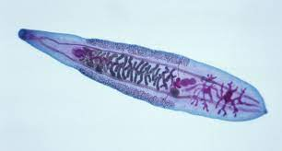
Class flukes
(Trematodas)
Fascioliasis
Fascipsidosis
Clonorchiasis
Paragonimiasis
Schistosomiases
Opisthorchiasis

Slide 11
Roundworms, or nematodes, are cylindrical in structure and usually bisexual; copulation between the male and female is important in fertilisation.
Most nematodes that are parasitic in humans lay eggs that, when voided, contain either a zygote or a completely formed larva.

Slide 12
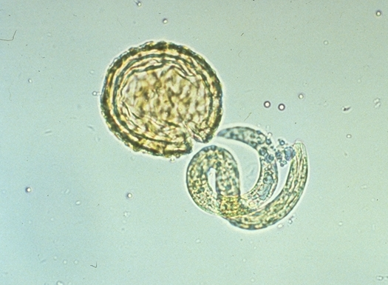
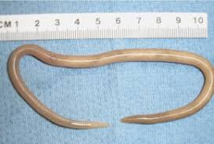
Some nematodes, such as the filariae and Trichinella spiralis, produce larvae that are deposited in host tissues.
The developmental process involves egg, larval and adult stages.

Slide 13
Classification is via infection mode: direct, modified direct, or skin penetration. Direct infection occurs when eggs are transmitted from anus to mouth without reaching soil (e.g. Enterobius vermicularis and Trichuris trichuria).
Modified direct infection occurs when eggs passed in faeces only become infectious following incubation time in soil (e.g. Ascaris lumbricoides).
Skin penetration is used by hookworms (Ancylostoma duodenale andNecator americanus).

Slide 14
Tapeworms, or cestodes, are flat, hermaphroditic, parasitic worms that colonise the human gastrointestinal tract. Some are primarily human pathogens, others are animal pathogens that also infect humans.
Adult tapeworms are elongated, segmented, flatworms that inhabit the intestinal lumen.
Larval forms, which are cystic or solid, inhabit extra-intestinal tissues and include Taenia saginata, Taenia solium, Diphyllobothrium latum, Hymenolepis nana andEchinococcus species.

Slide 15
Segments (proglottids) are hermaphroditic and vary in length from 2mm–10m, with three to several thousand segments per adult tapeworm.
Eggs are released when tapeworms shed gravid proglottids into the intestine, which are then shed in stools. All eggs are embryos that develop into different larval stages in both the immediate host (crustacean) and intermediate host (vertebrate). Larvae develop into adults in the definitive (human) host.

Slide 16
Flukes, or trematodes, are leaf-shaped, and vary in length from a few millimetres to 8cm. Excluding blood flukes, trematodes are hermaphroditic, having both male and female reproductive organs.
Both self-fertilisation and cross-fertilisation occur. Blood flukes (schistosomes) are the only bisexual flukes that infect humans. Within the definitive (human) host, male and female worms inhabit the lumen of blood vessels and are found in close physical association.

Slide 17
Flukes go through several larval stages before reaching adulthood. Eggs are passed in the faeces, urine, or sputum of humans and, on reaching an aquatic environment, the eggs hatch, releasing ciliated larvae, which either penetrate or are eaten by snail intermediate hosts.
A sporocyst develops from a miracidium within the tissues of the snail, producing cercariae that migrate to the external, usually aquatic, environment. Cercariae penetrate the definitive host and transform directly into adults.

Slide 18
Classification
geohelminths – eggs and larvae develop in environment
biohelminths – parasite in the organism of intermediate hosts.
Helminthiases are divided on anthroponoses and zoonoses.

Slide 19
Depending on ways of penetration of invasive stage
peroral
percutaneous
Depending on localization of larval and adults stages
blood and lymphatic vessels
lungs
biliary system
intestine
connective tissue.
The stages of invasive process:
acute, latent and chronic

Slide 20
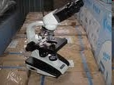
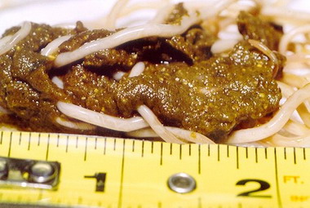
DIAGNOSTICS
Parasitological methods propose discovery of helminths, their larvae or eggs in tissues, excretions or secretions of the organism (macro- and microscopic methods).

Slide 21

Serological methods (reaction of complement fixation, latex-agglutination, indirect hemagglutination and other) are used in low intensity of helminths, which no discharge eggs and larvae into environment.
skin allergic test

Slide 22
