Slide 1
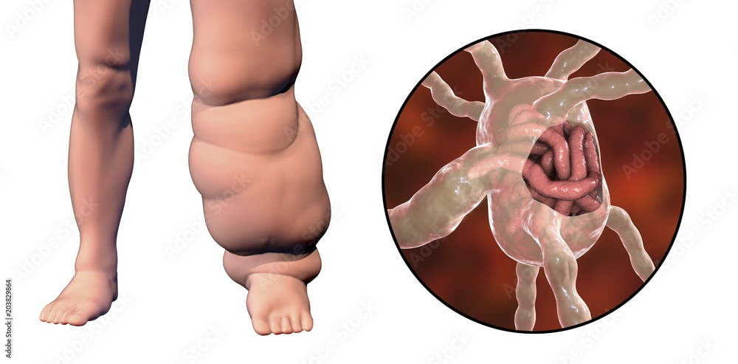
Nematodoses. Fslariases.

Slide 2
NEMATODOSES
Nematodoses are invasions, causes by representatives of round worms (Nematodas) with elongated, cylindrical, thread-like bodies. Length is from 1 mm till 1 meter and more.
They inhabit intestinal and extraintestinal sites.

Slide 3
Nematodes are the most numerically abundant animals on Earth
They’re not just a slim majority.
Four out of every five animals on Earth is a nematode.

Slide 4
Nathan Augustus Cobb, a famous nematologist said :
In short, if all the matter in the universe except the nematodes were swept away, our world would still be dimly recognizable, and if, as disembodied spirits, we could then investigate it, we should find its mountains, hills, vales, rivers, lakes, and oceans represented by a film of nematodes. The location of towns would be decipherable, since for every massing of human beings, there would be a corresponding massing of certain nematodes. Trees would still stand in ghostly rows representing our streets and highways. The location of the various plants and animals would still be decipherable, and, had we sufficient knowledge, in many cases even their species could be determined by an examination of their erstwhile nematode parasites.

Slide 5
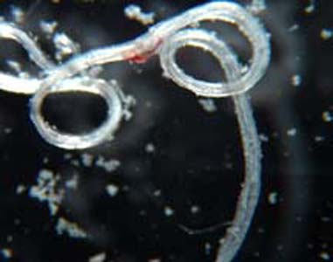
FILARIASES.
Filariases are group of tropical helminthiases, characterized by chronic course.
The agents of Filariases are round worms from family Filariidae with transmissive type of transmission.

Slide 6
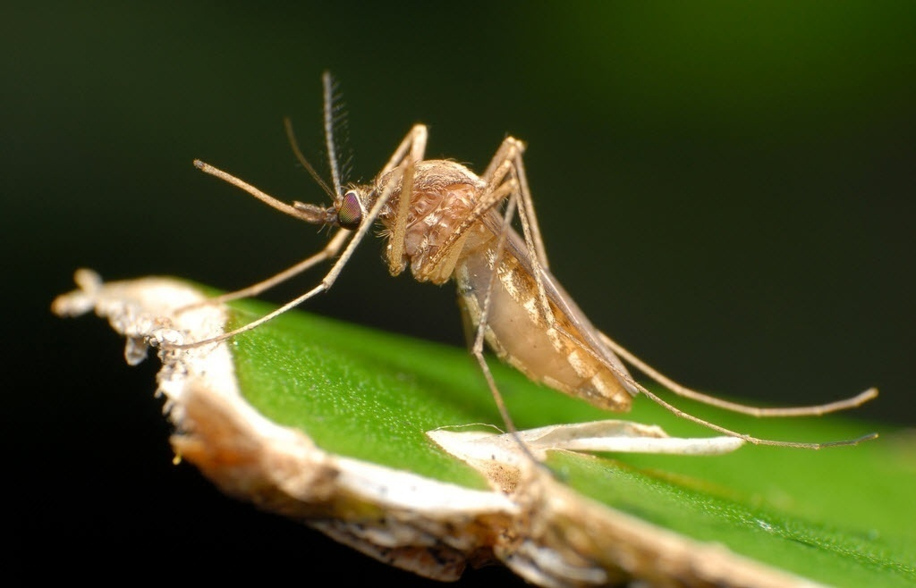
Final host is human.
Intermediate host are anthropodes (mosquitoes, biting flies, gagflies).
Adult filariae parasitize in closed systems and cavities of human’s body.
Larvae (microfilariae) circulate in the blood or parasitize in the tissues of host.

Slide 7
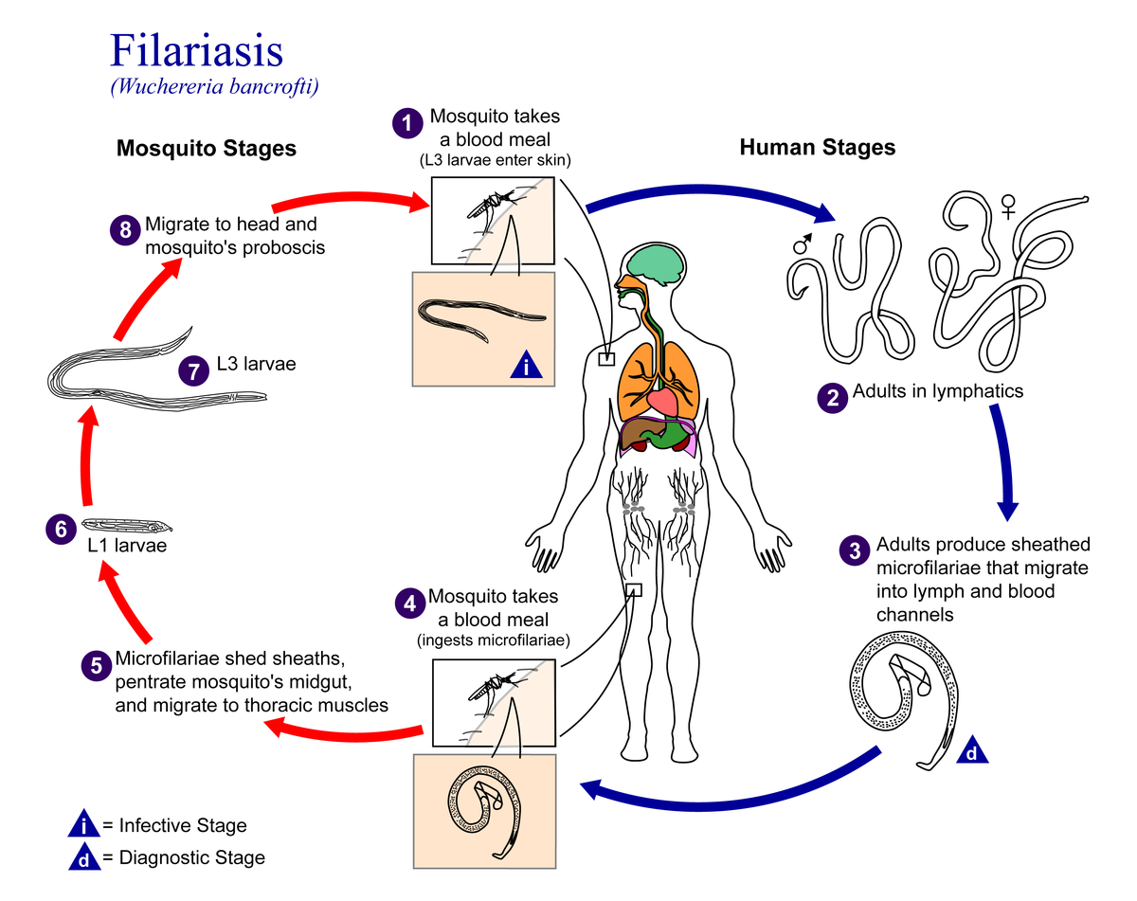

Slide 8
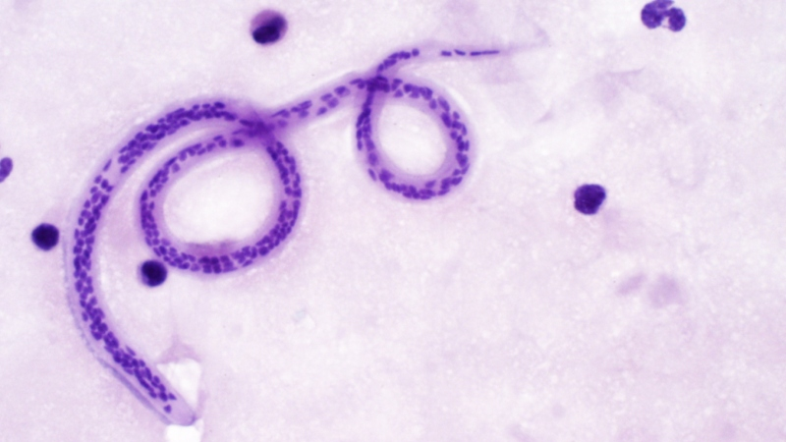
Lymphatic filariasis
Lymphatic filariasis caused by Wuchereria bancrofti,
Brugia malayi or B.timory.
Theу reside in lymphatic channels or lymph nodes.

Slide 9
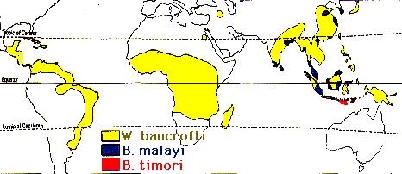
Lymphatic filariasis
Wuchereria bancrofti is most widely distributed parasite.
Brugian filariasis due to Brugia malayi occures primarily in eastern India, Indonesia, Malasia, Philippines.
The distribution of B.timory is limited to the islands of southeastern Indonesia

Slide 10
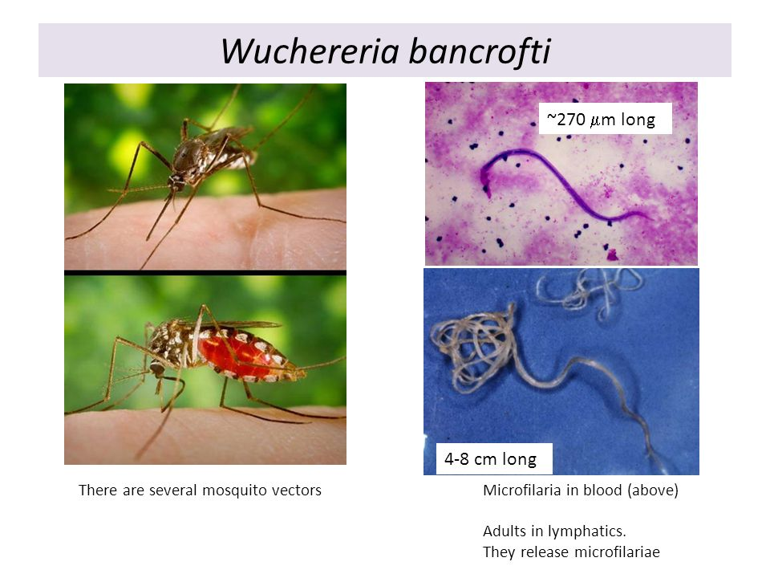
WUCHERERIOSIS.
Wuchereriosis is helminthiasis, characterized by chronic course and principal damage of lymphatic system (lymphatic filariasis).
Etiology. The agent is Wuchereriae bancrofti – 40-100 mm long cylindrical worm with quite delicate body making it difficult to remove from tissues.

Slide 11
Pathogenesis
There are 3 stages:
Acute - an organism's response to the parasitism of filarias in the vessels of the lymphatic system: cellular infiltration of walls with a predominance of eosinophils in granulomas.
Subacute - the reaction is enhanced, developing granulomatous lymphadenitis and lymphangitis.

Slide 12
Pathogenesis
Chronic - proliferation of the endothelium, thickening of the wall leads to a narrowing of the lumen of the lymphatic vessels. Adult filaria injure the wall, often closing their lumen. The rupture of vessels leads to the release of lymph in the tissue. As a result of lymphostasis, lymphatic edema and elephantiasis develop.

Slide 13
There are 4 clinical types of the disease:
1. asymptomatic, but with microfilmaremia
2. acute manifestations - with recurrence of fever, lymphadenitis, lymphangitis.
3. Chronic manifestations - with obstruction of the lymphatic vessels (elephantiasis, hydrocele).
4. Tropical pulmonary eosinophilia

Slide 14
Clinical manifestation
After infection the worms will mature within 6-18 month
The asymptomatic phase can occur many years
In the inflammatory (acute) phase the antigens from the helminths elicit inflammatory response. The worms in lymph channels cause lymphedema. Patient feel:
fever
chills
skin rash, urticaria, itching
painful lymph nodes
may occur orchitis and epididimitis

Slide 15
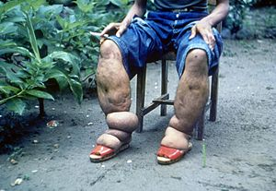
If lymphatic damage progresses, transient lymphedema can develop into lymphatic obstruction: limph varices, lymph scrotum, hydrocele and elephantiasis

Slide 16
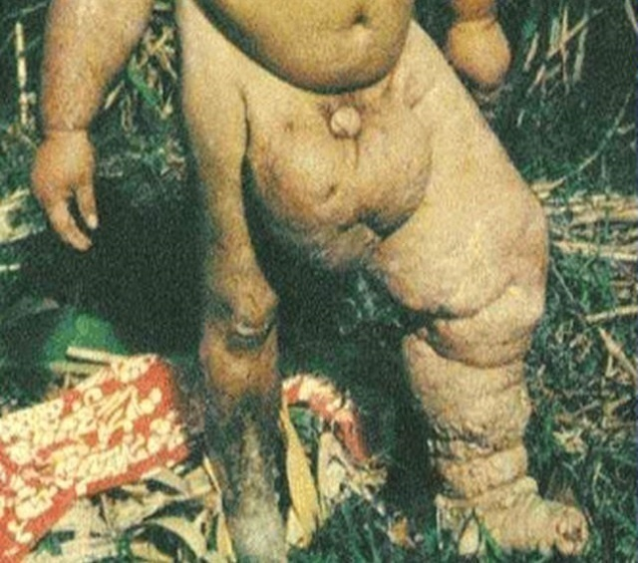
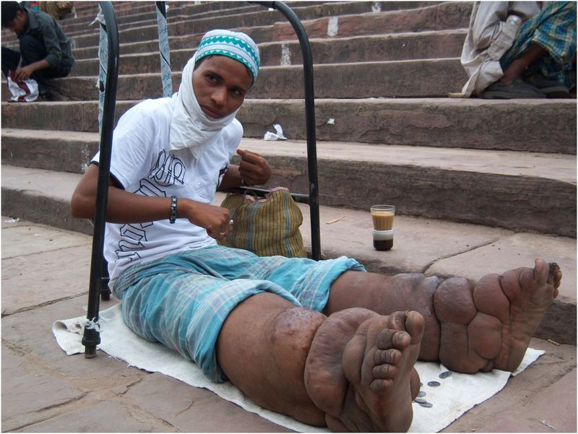

Slide 17
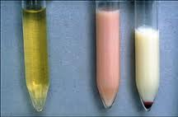
Furthermore, increased renal lymphatic pressure leads to rupture of the renal lymphatics and the development of chyluria

Slide 18
Tropical pulmonary eosinophilia
TPE is typically found in persons living with the diseases in Asia. Symptoms include cough, shortness of breath and wheezing (usually nocturnal), weight loss, low-grade fever. The eosinophilia is often accompanied by high levels of IgE and antifilarial antibodies.

Slide 19
BRUGIOSIS.
Brugiosis is chronic helminthiasis. It is concerned to group of lymphatic filariases.
Etiology. The agent is Brugia malayi.
Epidemiology.
Brugiosis is percutaneous transmissive biohelminthiasis.
The source of invasion and final host of periodical strain is human.
The vectors are mosquitoes of geneses Mansonia, Anopheles, Aedes. Periodical

Slide 20
A feature of Brugiosis is developing of granulomatous lymphangitis and lymphadenitis in both the upper and lower extremities, but the development of elephantiasis is observed only in the lower extremities, involvement of the genital lymphatics not typical.

Slide 21
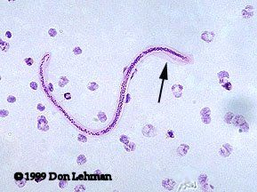
Diagnosis
Adult worms localized in lymphatic vessels or nodes are largely inaccessible.
Microfilaria can be found in the blood, hydrocele fluid.
Night blood sampling - collect blood specimen from 8 pm to 4 am

Slide 22
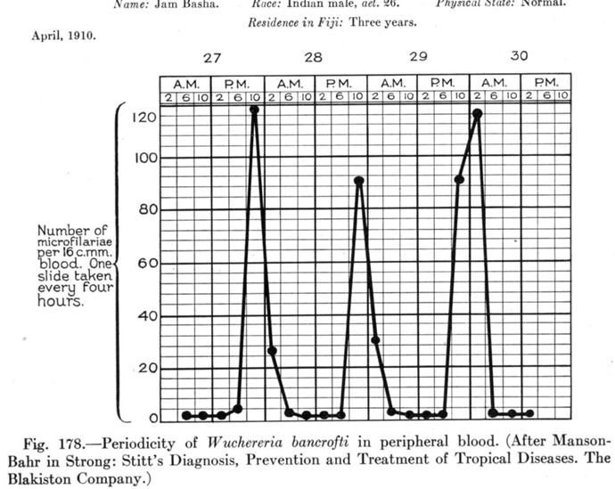
Periodicity of W.bancrofti in peripheral blood

Slide 23
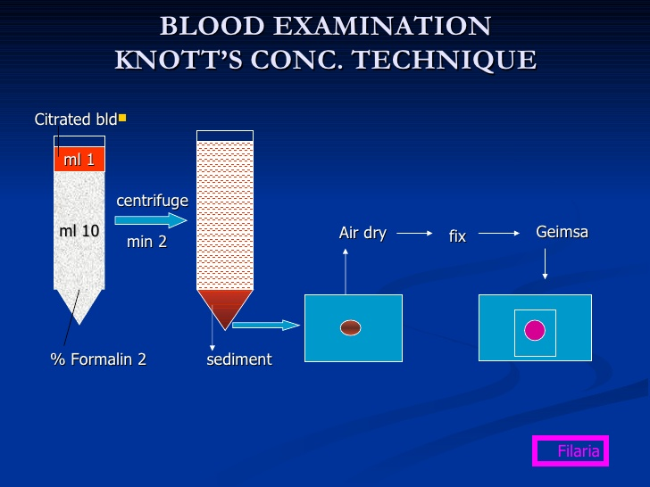
The modified Knott’s method is used for the concentration and identification of microfilariae

Slide 24
Diagnosis
ELISA
PCR – the sensetivity of this diagnostic method is greater than that of parasitologic one, because of many infected individuals do not have microfilariemia.

Slide 25
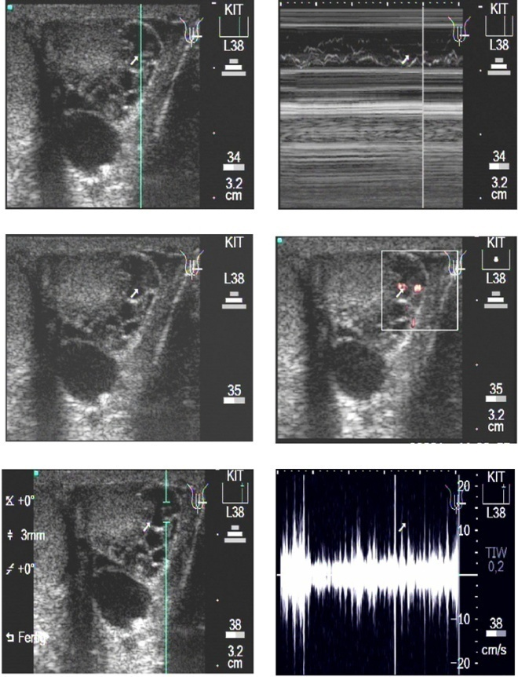
Ultrasonography is able to detect adult Wuchereria bancrofti worms
in scrotal lymphatic vessels of infected
men on account of the characteristic
pattern
of adult worm movements,
known as the
filarial dance sign.

Slide 26

Treatment
Diethylcarbamazine citrate (DEC) in an oral dose of 6 mg/kg daily for 12 days reduces the number of microfilaria in the peripheral blood.
Albendazol 400 mg twice daily – 21 days

Slide 27
Treatment
The addition of DEC to a 3 week course of doxicycline is efficacious in lymfatic filariasis.
Early treatment of asymptomatic persons who have microfilariemia is recommended to prevent further lymphatic damage
Acute inflammatory reactions should be treated with anti-inflammatory agents.
Antibiotic therapy of secondary bacterial infections is likely

Slide 28
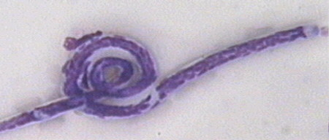
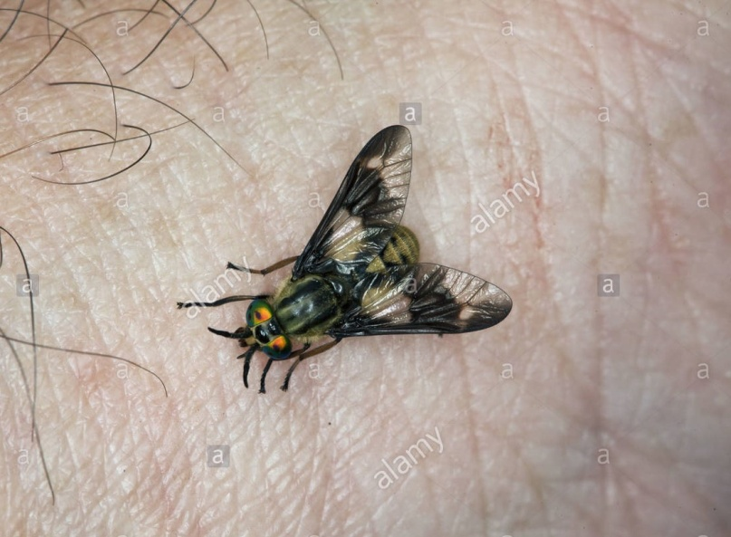
LOIASIS.
Loiasis is caused by Loa loa and is transmitted to humans by tabanid flies. It is characterized by transient subcutaneous swellings.
Epidemiology. The vectors are diurnally biting flies (Chrysops species) that live in the canopy of the rain forest.

Slide 29
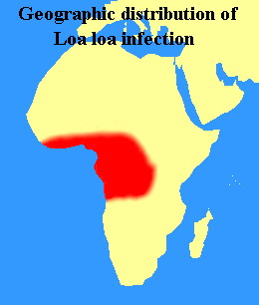
Loa loa is irregularly distributed in West and central Africa.

Slide 30
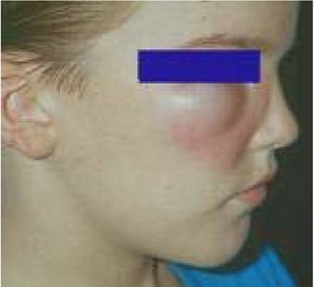
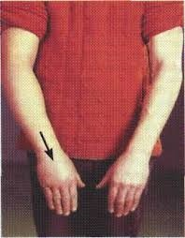
LOIASIS.
Clinical features.
Transient swellings of localized subcutaneous edema, called Calabar swellings, may develop.

Slide 31
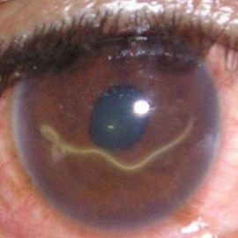
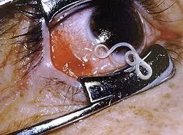
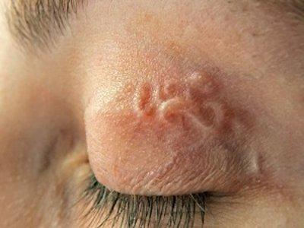
The most visual sign of an adult worm infections with Loa loa is when the worm crosses the sclera of the eye. The migration to the eye causes significant pain to the host and is usually associated with inflammation and less likely, blindness. Eye worms typically cause little eye damage.

Slide 32
Other tissues in which this worm can be found includes: the penis, testes, nipples, bridge of the nose, kidneys, and heart. The worms in these locations are not always possible to visualize.
Complications: renal disease, endomyocardialfibrosis, retinopathy, encephalopathy and arthritis.

Slide 33
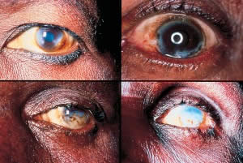
ONCHOCERCIASIS.
Onchocerciasis (river blindness) is caused by Onchocerca volvulus
transmitted to humans by blackflies
characterized by pruritic dermatitis, subcutaneous nodules, and keratitis.
It is the world’s second leading infectious cause of blindness.

Slide 34
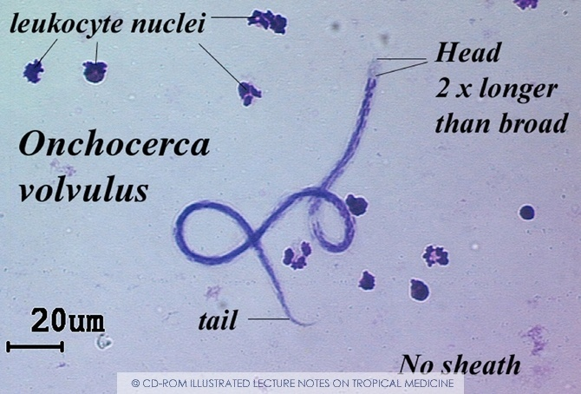
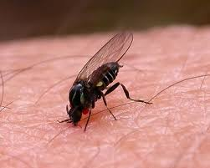
Epidemiology.
Onchocerca volvulus infects 30 million people in West, central, and East Africa and another 1 million people in scattered foci in Central and South America. Onchocerciasis is transmissive percutaneous biohelminthiasis, anthroponosis.

Slide 35
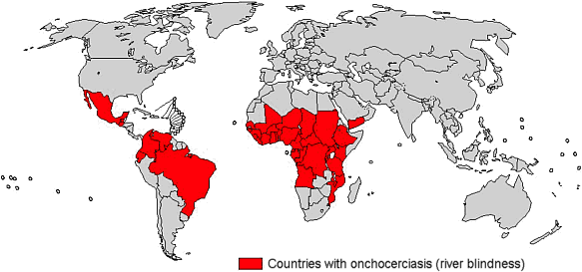

Slide 36
Clinical features
Onchocerciasis affects many systems and organs, but most important morbidity is due to cutaneous and ophthalmologic manifestations, with different clinical grades

Slide 37
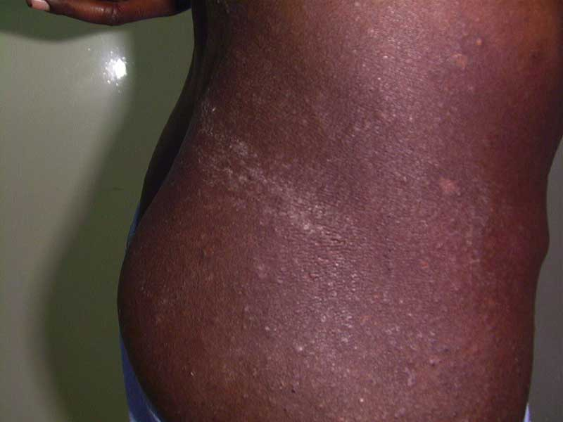
The skin manifestations of onchocerciasis are highly variable.
They include: acute papular onchodermatitis, which denotes an eczematous rash with multiple small widely scattered pruritic papules, that might progress to vesicles and pustules in severe cases.

Slide 38
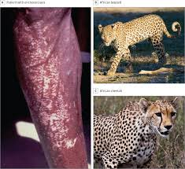
Skin lesions
Onchodermatitis often affects the face, trunk, buttocks, or extremities. After repeated years of exposure, these lesions may lead to disfigurative skin diseases sometimes named "leopard" skin

Slide 39
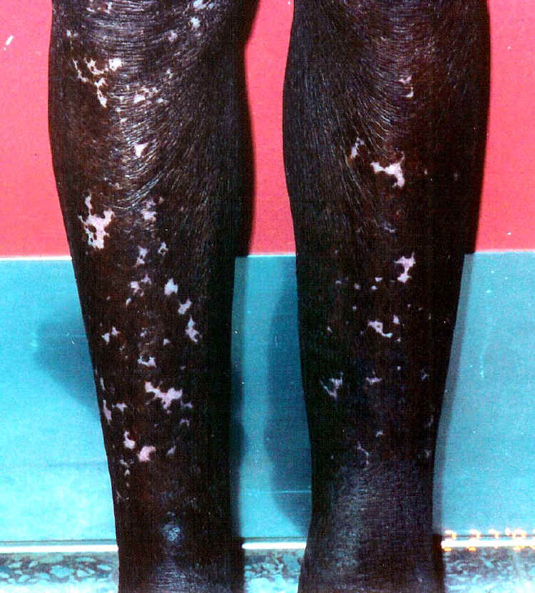
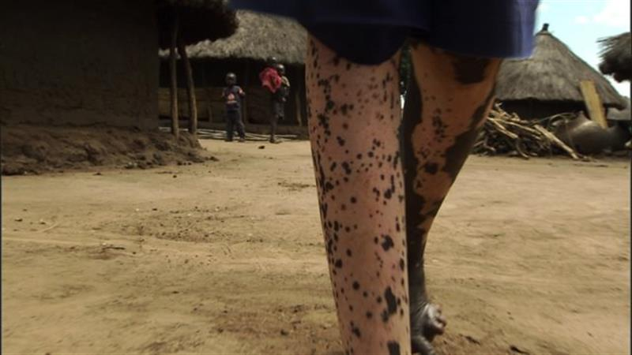
“Leopard” skin

Slide 40
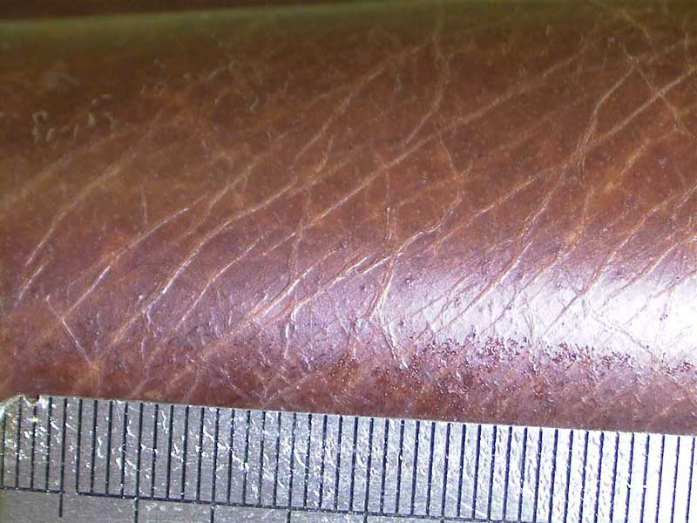
“Lizard” skin
Other classical clinical pictures include “lizard skin” with dry ichthyosis-like lesions with a mosaic pattern resembling the scales of a lizard skin.

Slide 41
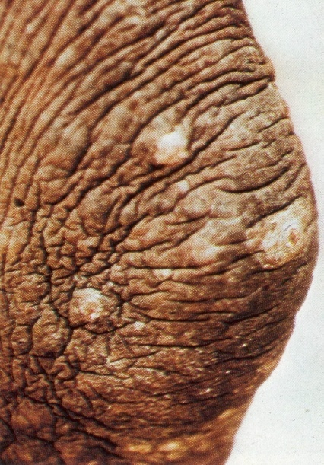
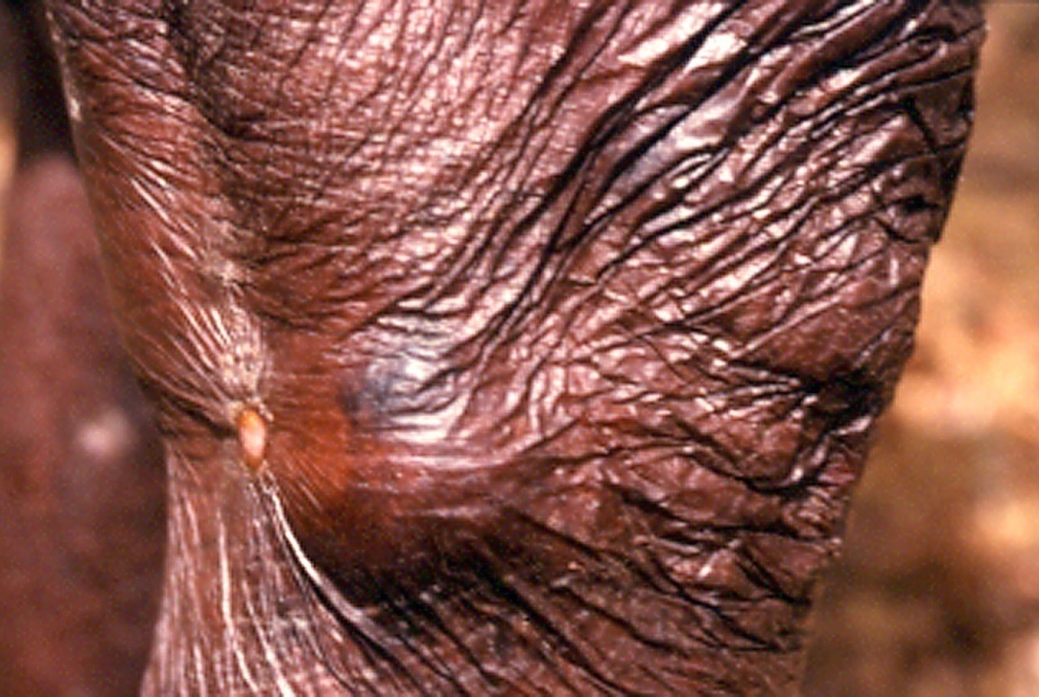
“Elephant skin”
wrinkled and dry skin with loss of elasticity and contours

Slide 42
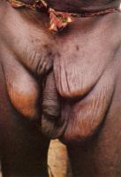
Hanging groin. Involvement of the inguinocrural glands can result in an appearance described as 'hanging groin'.

Slide 43
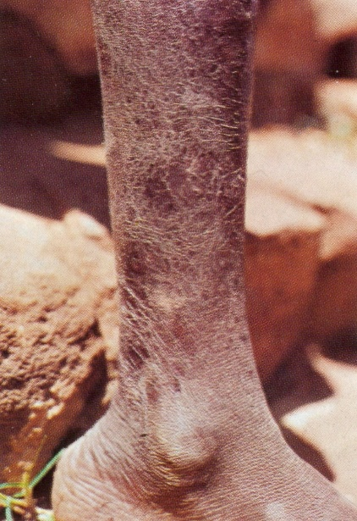
Tissue paper skin. In chronic infections atrophy of the skin may occur resulting in a 'tissue paper' appearance.

Slide 44
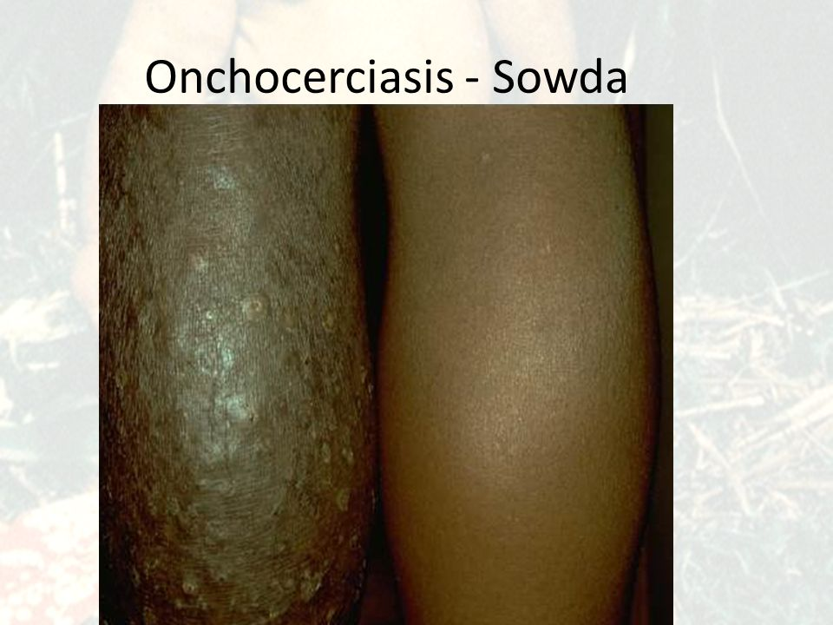
Sowda is a severe form of chronic lichenified dermatitis first described in Yemen, and associated with an active delayed swollen, darkened, pruritic, papular skin changes that were usually limited to one leg, more rarely to one arm, and large soft regional lymph nodes. Dermal changes were deeper and more diffuse than in African onchocerciasis

Slide 45
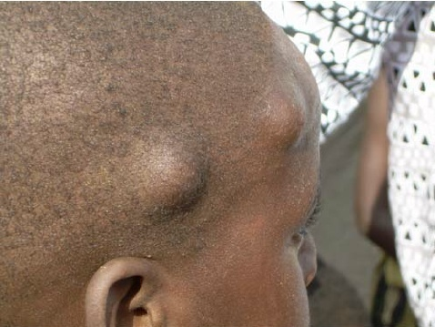
Onchocercomata
The adult filariae become encapsulated-in fibrous material which forms nodules in the subcutaneous tissues.
Nodules vary in size and characteristically are firm and not tender.
It has been estimated that for every palpable nodule, there are four deeper nonpalpapable ones.

Slide 46
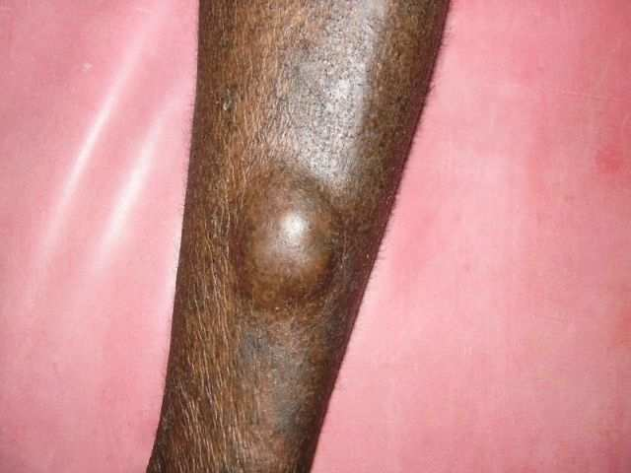
They are found predominantly in the lower part of the body in Africa, while in South and Central America they are more commonly found on the head and upper trunk.

Slide 47
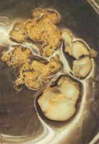
Macroscopic section of nodule. In this gross section of a nodule the adult worms are seen entwined.

Slide 48
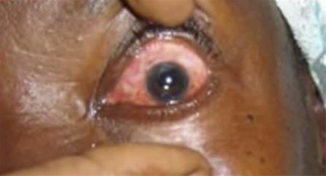
Ocular tissue
Visual impairment is most serious complication of onchocerciasis. Lesions may develop in all parts or the eye. The most common early sign – is conjunctivitis.

Slide 49
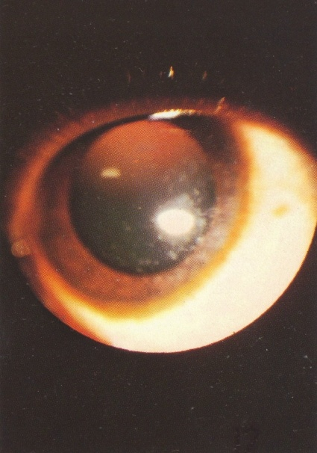
Punctate ceratitis – acute inflammatory reactions surrounding dying microfilariae and manifested as “snowflake” opacities

Slide 50
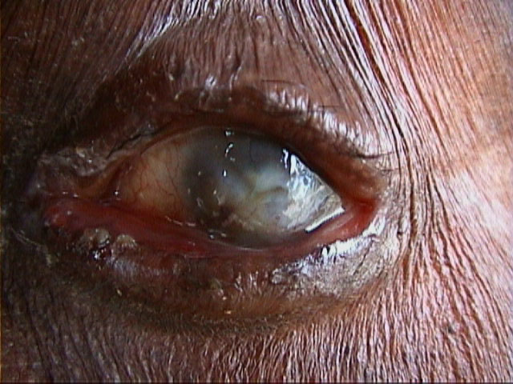
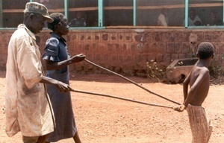
Ocular tissue
Sclerosing keratitis occurs in 1-5% infected persons and it is leading cause of onchcercal blindness in Africa

Slide 51
Treatment
Traditionally, patients with skin disease have been treated with diethylcarbamazine. This drug kills microfilariae but has little effect on the adult worm. Severe reactions such as rash, fever, generalized body pains, keratitis, and iritis may occur, so the dose must be built up gradually as follows: day 1 - 50 mg; day 2 - 50 mg three times; day 3 - 100 mg three times; and day 4 –21- 3 mg/kg three times a day.

Slide 52
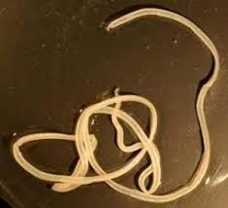
DRACUNCULIASIS.

Slide 53
Dracunculiasis (dracontiasis, guinea worm infection) develops after drinking water containing crustaceans infected with Dracunculus medinensis. It is characterized by a chronic cutaneous ulcer from which the worm protrudes.

Slide 54
Epidemiology.
At the beginning of the 20th century, Rishta disease was widespread in many countries in Africa and Asia.
According to reports, in the 1950s, there were about 50 million cases of the disease.

Slide 55
The incidence of dracunculiasis has declined dramatically because of global eradication effort.
In 2012 only 542 cases worldwide has been identified.
Only a few endemic areas remain in 4 African countries: South Sudan, Ethiopia, Chad and Mali.

Slide 56
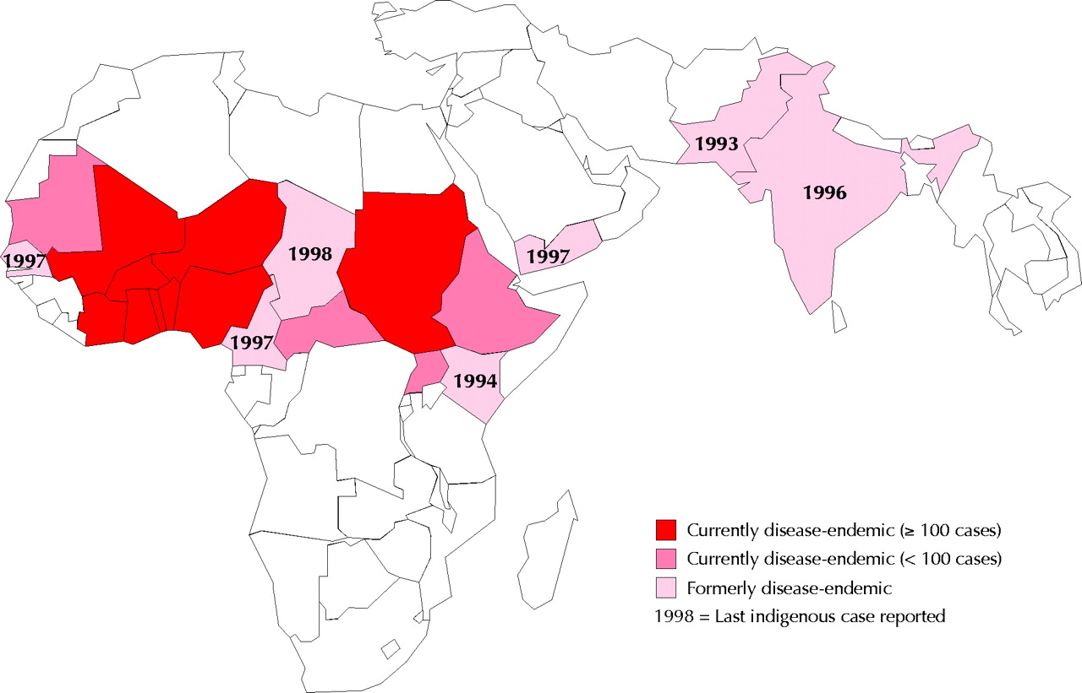

Slide 57
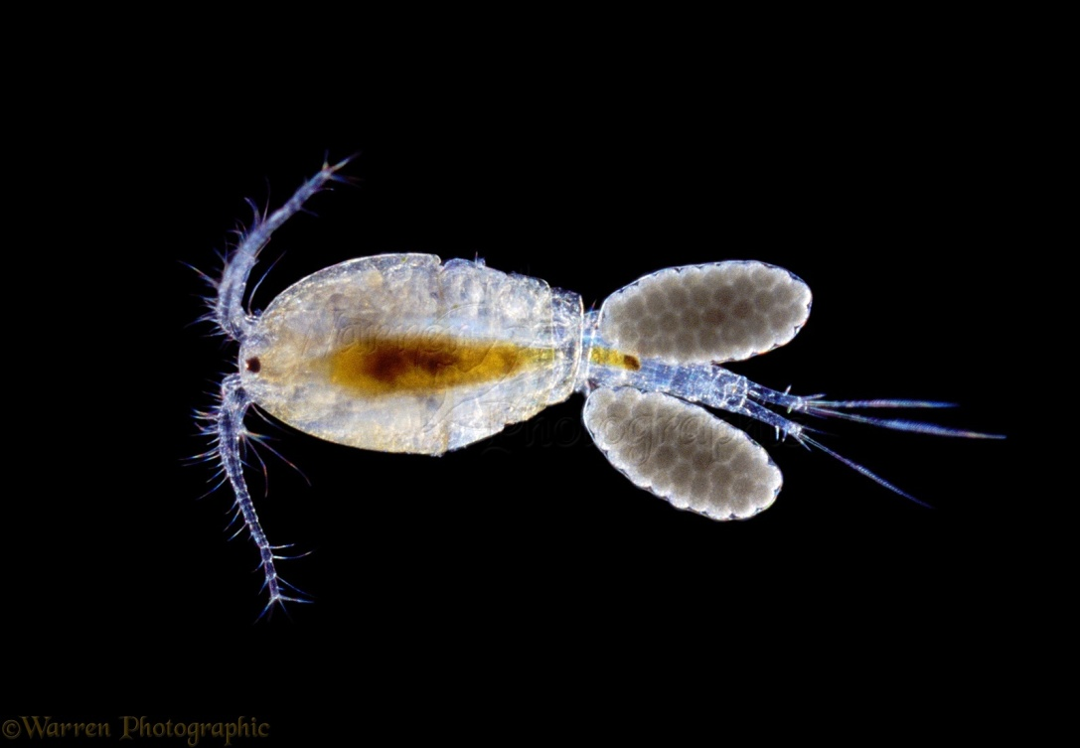
The final hosts are human, cattle, horses, dogs. Intermediate hosts are copepods of genus Cyclops,. Copepods live in fresh water.

Slide 58
Human acquire D.med. when they ingest water containing infective larvae.
Larva penetrate to stomach or intestinal wall, mate and mature.
A female warm migrates to subcutaneous tissues.

Slide 59
Adult female worms parasitize:
in subcutaneous fatty cellulose of lower extremities
rarely - in other parts of the body, including head, neck
cavities of joints
pericardium
membranes of spinal cord.

Slide 60
Clinical features
The emergence of the worm from the lower extremity causes a painful blister that becomes abscessed due to the host’s immune reaction.
At this time, some patients may have a generalized reaction with:
urticaria,
nausea, vomiting,
diarrhea,
dyspnea.

Slide 61
Over the next few days the lesion vesiculates, and then the blister ruptures and forms a painful ulcer within which part of the worm is often visible.

Slide 62
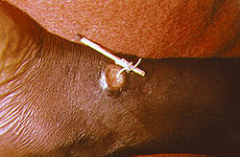
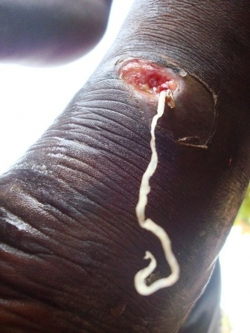
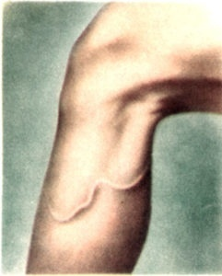

Slide 63

Treatment.
Worms that have emerged from skin may be successfully removed by wrapping the worm around a small stick. This process often lasts a few weeks to months. Ocassionaly it may take only a few days. There is no successful drug treatment, although some drugs may be used to treat symptoms.Worms may also be surgically removed before ulcer formation. Analgesics (aspirin and ibuprofen) are used to reduce swelling. Antibiotic ointment may be used to prevent bacterial infections

Slide 64

HOOKWORM. (ANCYLOSTOMIASES).
Human infection with two species of hookworm that have strong buccal hooks or plates for attaching to the host's intestinal mucosa

Slide 65
Epidemiology
Ancylostoma duodenale commonly known as the Old World hookworm, occurs in southern Europe, North Africa, India, China, Japan, and Southeast Asia.
It also has been reported in the New World among Paraguayan Indians, in isolated areas of the United States, and in the Caribbean.

Slide 66

This hookworm is well known in mines because of the combination of temperature and humidity that provide an ideal habitat for egg and larvae.
It is estimated more than 500 million people are infected with hookworms.

Slide 67

Transmission of
A. duodenale is
by contact of skin
with soil
contaminated
with larvae.

Slide 68


The way Ancylostoma duodenale enters the human body was understood in the 1880s, after an epidemic of ancylostomiasis
among miners working in the hot and humid Gotthard Tunnel (Switzerland).

Slide 69

Eggs are passed in the stool , and under favorable conditions (moisture, warmth, shade), larvae hatch in 1 to 2 days.
The released rhabditiform larvae grow in the feces and/or the soil , and after 5 to 10 days (and two molts) they become filariform (third-stage) larvae that are infective.
These infective larvae can survive 3 to 4 weeks in favorable environmental conditions.

Slide 70

On contact with the human host, the larvae penetrate the skin and are carried through the blood vessels to the heart and then to the lungs.

Slide 71

They penetrate into the pulmonary alveoli, ascend the bronchial tree to the pharynx, and are swallowed.

Slide 72

The larvae reach the small intestine, where they reside and mature into adults. Adult worms live in the lumen of the small intestine, where they attach to the intestinal wall with resultant blood loss by the host.
Most adult worms are eliminated in 1 to 2 years, but the longevity may reach several years.

Slide 73


Slide 74

There are 3 clinical phases: invasive, migratory, and intestinal.
infective larvae may provoke intense pruritic maculopapular dermatitis (“ground itch”) at the site of skin penetration as well as serpiginous tracks of subcutaneous migration, local edema, burning and itching of the skin that persists for 10-12 days.

Slide 75
The migration phase is the period during which larvae escape from capillary beds in the lung, enter the alveoli, and progress up the bronchi to the throat.
This migration can produce severe hemorrhaging when large numbers of worms are involved;
otherwise, a dry cough and sore throat may be the only symptoms.

Slide 76

The most serious stage of hookworm infection arises when the parasites become established in the host’s intestine.
Upon reaching the small intestine, young worms use their buccal capsule and “teeth” to burrow through the mucosa where they begin feeding upon blood

Slide 77
Salivary secretions of the worms contain anticoagulants to facilitate blood-feeding.
In the place of fixation of the parasite, erosion and ulcers are formed, which can bleed for a long time, leading to the development of iron deficiency anemia.
In addition, being hematophagous by the way of feeding, each individual of the necator consumes 0.03-0.05 ml of blood per day, ancylostoma - 0.16-0.34 ml, which also contributes to chronic blood loss.

Slide 78
The intestinal phase of hookworm infection occurs with symptoms of duodenitis - anorexia, taste perversion (craving to eat soil (geophagy), nausea, vomiting, epigastric pain, diarrhea or constipation.

Slide 79
Positive diagnosis requires identification of eggs in the feces. For light infections, concentration-type diagnostic techniques, such as zinc sulfate flotation or several modifications of the formalin-ether method, are employed.

Slide 80

Hookworms attached to the duodenal mucosa seen at endoscopy.

Slide 81
Treatment
Mebendazole (Vermox) is the current drug of choice. It is administered as 100mg twice a day for 3 days regardless of the patient’s body weight.
This regimen results in a 95% cure rate and a 99,9% reduction of egg counts.
Anemia should be corrected by iron therapy.

Slide 82

STRONGYLOIDIASIS.
Infection with the nematode Strongyloides stercoralis is potentially lethal because of its capacity to cause an overwhelming autoinfection, particularly in the immunosuppressed host.

Slide 83
Strongyloides stercoralis worms can survive and reproduce as parasitic forms in humans or as free-living forms in soil.
The symptoms of strongyloidiasis correspond to the 3 stages of infection:
invasion of the skin
migration of larvae
penetration of the intestinal mucous by adults

Slide 84
The skin and pulmonary symptoms:
pruritic papular erythematous rash
a Loffler-like syndrome with eosinophilia.
Intestinal phase: abdominal pain, diarrhea, nausea, vomiting and weight loss.
Eosinophilia is a prominent feature of this infection till 80-90%.

Slide 85
Treatment
Thiabendazole (Mintezol) is the only known effective agent. It is given in a dose of 25 mg/kg twice a day for 2 days.

Slide 86

ASCARIASIS.
Ascariasis, or roundworm, infection is the most common helminthic infection of humans with an estimated worldwide prevalence of 1 billion. The causative organism is Ascaris lumbricoides.
Epidemiology. Ascariasis is anthroponosis, peroral geohelminthiasis.

Slide 87
Clinical syndromes.
The pulmonary manifestations of ascariasis occur during the stage of larval migration through the lungs and resemble Loffler syndrome.
Eosinophilia are the main features of this syndrome.
A small number of worms in the intestine does not usually cause digestive symptoms.

Slide 88

Serious complication of Ascariasis infection is encountered when a mass of worms obstructs the lumen of the small bowel (acute intestinal obstruction).

Slide 89

Another obstructive syndrome is encountered when Ascaris worms invade the biliary duct, mostly the common duct.

Slide 90
Treatment
The drug of choice for treatment of intestinal infections with A.lumbricoides is mebendazole (Vermox). It is given as 100mg twice daily for 3 days. In cases in which intestinal or biliary obstruction is suspected, piperazine citrate (Antepar) is recommended.

