Slide 1
Sexual health, sexual adaptation. Treatment of sexual disorders. Infertility

Slide 2

SEX
Sex refers to the biological characteristics that define humans as female or male. While these sets of biological characteristics are not mutually exclusive, as there are individuals who possess both, they tend to differentiate humans as males and females. In general use in many languages, the term sex is often used to mean “sexual activity”, but for technical purposes in the context of sexuality and sexual health discussions, the above definition is preferred.
This Photo by Unknown author is licensed under CC BY-NC.

Slide 3

Sexual Health
According to the current working definition, sexual health is:
“…a state of physical, emotional, mental and social well-being in relation to sexuality; it is not merely the absence of disease, dysfunction or infirmity. Sexual health requires a positive and respectful approach to sexuality and sexual relationships, as well as the possibility of having pleasurable and safe sexual experiences, free of coercion, discrimination and violence. For sexual health to be attained and maintained, the sexual rights of all persons must be respected, protected and fulfilled.” (WHO, 2006a)

Slide 4
Sexuality
Sexual health cannot be defined, understood or made operational without a broad consideration of sexuality, which underlies important behaviours and outcomes related to sexual health. The working definition of sexuality is:
“…a central aspect of being human throughout life encompasses sex, gender identities and roles, sexual orientation, eroticism, pleasure, intimacy and reproduction. Sexuality is experienced and expressed in thoughts, fantasies, desires, beliefs, attitudes, values, behaviours, practices, roles and relationships. While sexuality can include all of these dimensions, not all of them are always experienced or expressed. Sexuality is influenced by the interaction of biological, psychological, social, economic, political, cultural, legal, historical, religious and spiritual factors.” (WHO, 2006a)

Slide 5

Nonmedical Treatment For Female Sexual Dysfunction
To treat sexual dysfunction, your doctor might recommend that you start with these strategies:
Talk and listen. Open communication with your partner makes a world of difference in your sexual satisfaction. Even if you're not used to talking about your likes and dislikes, learning to do so and providing feedback in a nonthreatening way sets the stage for greater intimacy.
Practice healthy lifestyle habits. Limit alcohol — drinking too much can blunt your sexual responsiveness. Be physically active — regular physical activity can increase your stamina and elevate your mood, enhancing romantic feelings. Learn ways to decrease stress so you can focus on and enjoy sexual experiences.
Seek counseling. Talk with a counselor or therapist who specializes in sexual and relationship problems. Therapy often includes education about how to optimize your body's sexual response, ways to enhance intimacy with your partner, and recommendations for reading materials or couples exercises.
Use a lubricant. A vaginal lubricant may be helpful during intercourse if you have vaginal dryness or pain during sex.
Try a device. Arousal may be enhanced with stimulation of the clitoris. Use a vibrator to provide clitoral stimulation.
This Photo by Unknown author is licensed under CC BY-SA-NC.

Slide 6
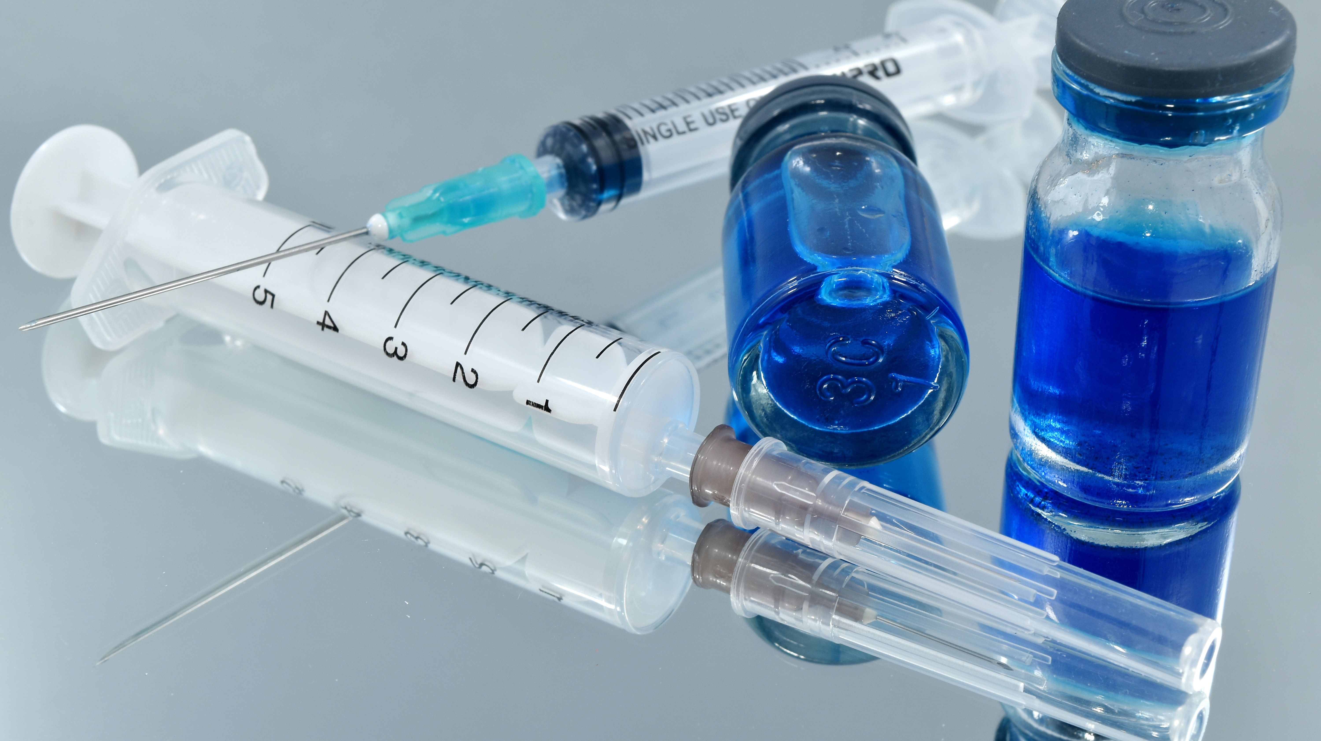
Medical Treatment For Female Sexual Dysfunction
Effective treatment for sexual dysfunction often requires addressing an underlying medical condition or hormonal change. Your doctor may suggest changing a medication you're taking or prescribing a new one.
Possible treatments for female sexual dysfunction might include:
Estrogen therapy. Localized estrogen therapy comes in the form of a vaginal ring, cream or tablet. This therapy benefits sexual function by improving vaginal tone and elasticity, increasing vaginal blood flow and enhancing lubrication.
The risks of hormone therapy may vary depending on your age, your risk of other health issues such as heart and blood vessel disease and cancer, the dose and type of hormone and whether estrogen is given alone or with a progestin.
Talk with your doctor about benefits and risks. In some cases, hormonal therapy might require close monitoring by your doctor.
Ospemifene (Osphena). This medication is a selective estrogen receptor modulator. It helps reduce pain during sex for women with vulvovaginal atrophy.
Androgen therapy. Androgens include testosterone. Testosterone plays a role in healthy sexual function in women as well as men, although women have much lower levels of testosterone.
Androgen therapy for sexual dysfunction is controversial. Some studies show a benefit for women who have low testosterone levels and develop sexual dysfunction; other studies show little or no benefit.

Slide 7
Flibanserin (Addyi). Originally developed as an antidepressant, flibanserin is approved by the Food and Drug Administration (FDA) as a treatment for low sexual desire in premenopausal women.
A daily pill, Addyi may boost sex drive in women who experience low sexual desire and find it distressing. Potentially serious side effects include low blood pressure, sleepiness, nausea, fatigue, dizziness and fainting, particularly if the drug is mixed with alcohol. Experts recommend that you stop taking the drug if you don't notice an improvement in your sex drive after eight weeks.
Bremelanotide (Vyleesi). Bremelanotide is another FDA-approved treatment for low sexual desire in premenopausal women. This medication is an injection you give yourself just under the skin in the belly or thigh before anticipated sexual activity.
Some women experience nausea, which is more common after the first injection but tends to improve with the second injection. Other side effects include vomiting, flushing, headache and a skin reaction at the site of the injection.

Slide 8

What is sexual dysfunction and how common is it?
Sexual dysfunction is a problem in a person’s sexual desire, arousal, or orgasm. Sexual dysfunction is common. It affects as many as 30% of men and 40% of women. For couples dealing with infertility, it is even more common. Often, people ignore or downplay the sexual problems of infertile couples. Many think that the issues will go away on their own or will not have long-term consequences.
Some sexual problems may go away when the pressures of infertility treatment end. But sexual difficulties often linger or get worse after treatment ends or a couple becomes parents. Even couples who never have major sexual problems often find they have times when they have less sexual desire and satisfaction because of emotional distress or the physical strains of infertility or a specific treatment.
This Photo by Unknown author is licensed under CC BY-SA-NC.

Slide 9
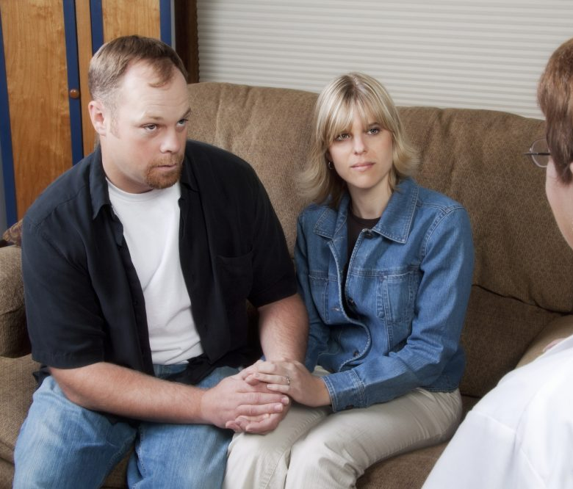
Why is it more common in couples with fertility problems?
Infertility treatments often bring stress, psychological demands, and physically intrusive procedures. These can affect a person’s sexual self-image, desire, and performance. For many couples, making love is a way to connect emotionally. When their sex lives are associated with failure, frustration, anger, and resentment, they can lose this way of showing their emotions. The pressure to perform, and to have (or abstain from) sex due to infertility treatment plans can push couples even further apart. Fertility treatments can make sex less spontaneous and less enjoyable. As sex becomes focused on baby making, couples often stop lovemaking for sexual pleasure.
These issues can get worse as fertility treatments go on. It doesn’t matter if a couple already had problems with sexual dysfunction or if the problems started with infertility treatments. Sexual dysfunction can take a large toll on emotional well-being. It can also increase the disappointment of not having children and the distress of medical treatment.
This Photo by Unknown author is licensed under CC BY-ND.

Slide 10

What Happens With Sexual Dysfunction Physically?
Sexual problems that interfere with intercourse and prevent conception can have a deep impact on couples. Problems in any of the phases of sexual response (desire, arousal, orgasm, resolution) as well as pain disorders may contribute to infertility. This may show up in several ways: not wanting to engage in sex (diminished libido), not being able to have or keep an erection (erectile dysfunction), problems with releasing semen (premature ejaculation and retarded ejaculation), and vaginal muscle tightness that prevents intercourse (vaginismus).
This Photo by Unknown author is licensed under CC BY-ND.

Slide 11

What happens with sexual dysfunction emotionally?
For many couples, sexual performance is affected by the pressure to have planned sex, pressure to perform on demand, extensive and painful tests, and anxiety. Other issues can include turning over control of such a personal aspect of life to a health-care provider. As infertility continues, feelings of sexual inadequacy and depression can occur due to the emotional link between sexuality and fertility. Many couples in infertility treatment say they avoid sexual intimacy during non-fertile times. Men and women can lose pleasure from sexual activity that isn’t for baby making and may avoid sex or not care about having sex. This can lead to a loss of affection overall, and couples may feel tension or disconnected.
This Photo by Unknown author is licensed under CC BY-NC-ND.

Slide 12

Is there any way to treat this?
Depending on how they are affected by these problems, some couples will need to seek medical help. Others will benefit from counseling or psychological support. Overall, a combination approach is a helpful strategy. Sex therapy and medications are often the best treatment approaches for physical and emotional issues. The most important factor in treatment is the couple’s willingness to reach out and ask for help.
Summary
Sexual dysfunction can affect anyone at any time but is especially common in couples struggling with infertility. It is important for couples undergoing treatment for infertility to be aware that some type of sexual dysfunction is common. Being willing to accept support when it is needed can help couples keep the intimacy of their relationship during this challenging time.
This Photo by Unknown author is licensed under CC BY-ND.

Slide 13
Strategies to help:
• Focus on your relationship as a couple (not just parents-to-be).
• Talk about sex.
• Face your sexual challenges as partners.
• Do it anyway! Sex encourages intimacy.
• Avoid ritualized, mechanistic, procreative approaches to sex.
• Make time for lovemaking not baby making.
• Plan sexual activities that are playful, enjoyable, or interesting, especially during non-fertile times.
• Find alone time for the two of you.
• Play together…whatever that means to you.
• Devote time to activities and interests that you enjoy together.
• Don’t let infertility be all you do or talk about.
• Know that your fertility does not define you.
• Know that sexual challenges during this time are normal.
• Seek help and know you are not alone

