Slide 1
Sexual disorders.
Classification of sexual disorders

Slide 2
SEXUAL DYSFUNCTION
Sexual dysfunction can be any problems that prevent a person or couple from experiencing satisfaction from sexual activity. Some 43% of women and 31% of men report some degree of sexual dysfunction.

Slide 3
What is sexual dysfunction?
Sexual dysfunction is a problem that can happen during any phase of the sexual response cycle. It prevents you from experiencing satisfaction from sexual activity.

Slide 4
What are the types of sexual dysfunction?
Sexual dysfunction generally is classified into
four categories:
Desire disorders: lack of sexual desire or interest
in sex.
Arousal disorders: inability to become physically aroused or excited during sexual activity.
Orgasm disorders: delay or absence of orgasm (climax).
Pain disorders: pain during intercourse.

Slide 5
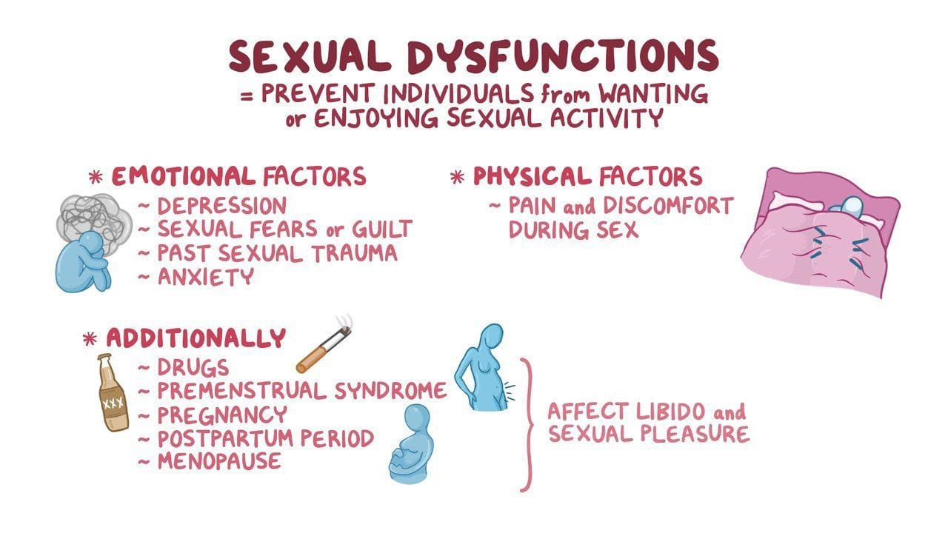
Who is affected by sexual dysfunction?
Sexual dysfunction can affect any age, although it is more common in those over 40 because it’s often related to a decline in health associated with aging.

Slide 6
CAUSES
Physical causes: Many physical and/or medical conditions can cause problems with sexual function. These conditions include diabetes, heart and vascular (blood vessel) disease, neurological disorders, hormonal imbalances, chronic diseases such as kidney or liver failure, and alcoholism and drug abuse. In addition, the side effects of some medications, including some antidepressant drugs, can affect sexual function.

Slide 7
DIAGNOSIS OF SEXUAL DYSFUNCTION
In most cases, you recognize something’s interfering with your enjoyment (or a partner’s enjoyment) of a sexual relationship. Your provider usually begins with a complete history of symptoms and a physical. They may order diagnostic tests to rule out medical problems that may be contributing to the dysfunction. Typically lab testing plays a very limited role in the diagnosis of sexual dysfunction.
An evaluation of attitudes about sex, as well as other possible contributing factors —fear, anxiety, past sexual trauma/abuse, relationship concerns, medications, alcohol or drug abuse, etc. — helps a clinician understand the underlying cause of the problem and recommend the right treatment.

Slide 8
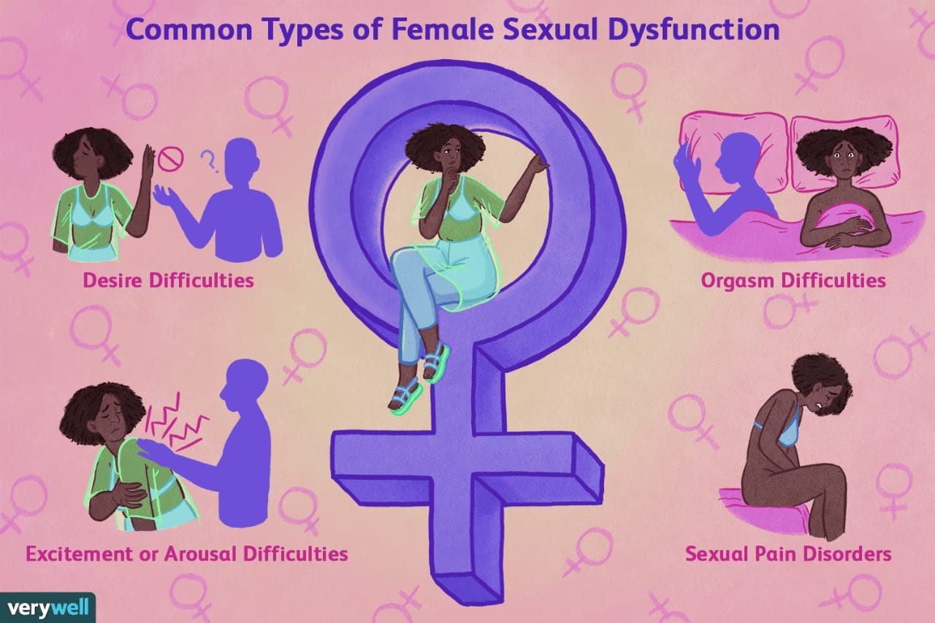
TREATMENT
Most types of sexual dysfunction can be addressed by treating the physical or psychological problems. Other treatment strategies include:
Medication: When a medication is the cause of the dysfunction, a change in the medication may help. Men and women with hormone deficiencies may benefit from hormone shots, pills or creams. For men, drugs, including sildenafil (Viagra®), tadalafil (Cialis®), vardenafil (Levitra®, Staxyn®) and avanafil (Stendra®) may help improve sexual function by increasing blood flow to the penis. For women, hormonal options such as estrogen and testosterone can be used (although these medications are not approved for this purpose). In premenopausal women, there are two medications that are approved by the FDA to treat low desire, including flibanserin (Addyi®) and bremelanotide (Vyleesi®).

Slide 9
Mechanical aids: Aids such as vacuum devices and penile implants may help men with erectile dysfunction (the inability to achieve or maintain an erection). A vacuum device (EROS-CTD™) is also approved for use in women, but can be expensive. Dilators may help women who experience narrowing of the vagina. Devices like vibrators can be helpful to help improve sexual enjoyment and climax.
Sex therapy: Sex therapists can people experiencing sexual problems that can’t be addressed by their primary clinician. Therapists are often good marital counselors, as well. For the couple who wants to begin enjoying their sexual relationship, it’s well worth the time and effort to work with a trained professional.

Slide 10
Behavioral treatments: These involve various techniques, including insights into harmful behaviors in the relationship, or techniques such as self-stimulation for treatment of problems with arousal and/or orgasm.
Psychotherapy: Therapy with a trained counselor can help you address sexual trauma from the past, feelings of anxiety, fear, guilt and poor body image. All of these factors may affect sexual function
Education and communication: Education about sex and sexual behaviors and responses may help you overcome anxieties about sexual function. Open dialogue with your partner about your needs and concerns also helps overcome many barriers to a healthy sex life.

Slide 11
Erectile dysfunction Treatment
Anti-hypertensive medications (used to treat high blood pressure)
Diuretics, including spironolactone (Aldactone) and the thiazides (Diuril, Naturetin, and others)
Centrally acting agents, including methyldopa (Aldomet) and reserpine (Serpasil, Raudixin)
a-Adrenergic blockers, including prazosin (Minipress) and terazosin (Hytrin)
b-adrenergic (beta) blockers, including propranolol (Inderal) and metoprolol (Lopressor)

Slide 12
The End

