Slide 1
Medical Psychology

Slide 2
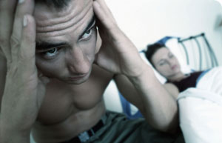

Medical Psychology

Slide 3
What Is Medical Psychology Problem?
How Common Are Sexual Problems?
Evaluating a Sexual Problem: A Three-Dimensional Model
Duration: Primary or Secondary
Context: Global or Situational
Frequency: Partial or Total
Notes:
Encourage students to examine
Table 7.1: Categories of Sexual Problems on page 230,
Table 7.2: Prevalence of Sexual Problems in the U.S. on page 231, and
Table 7.3: Applying the Three-Dimensional Model to Some Specific Sexual Problems

Slide 4
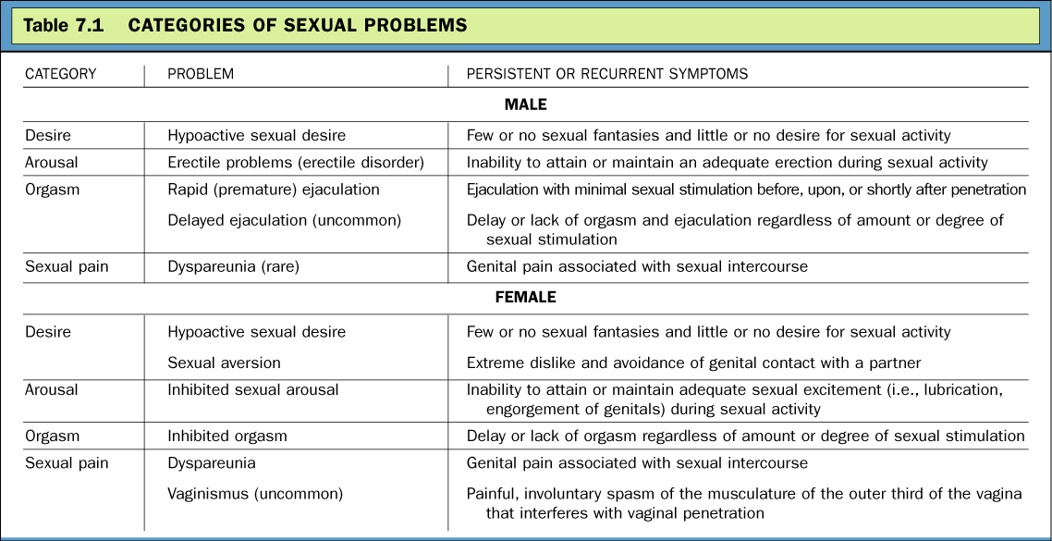
What Is a Sexual Problem? (cont.)
Notes:
Encourage students to examine
Table 7.1: Categories of Sexual Problems on page 230,

Slide 5
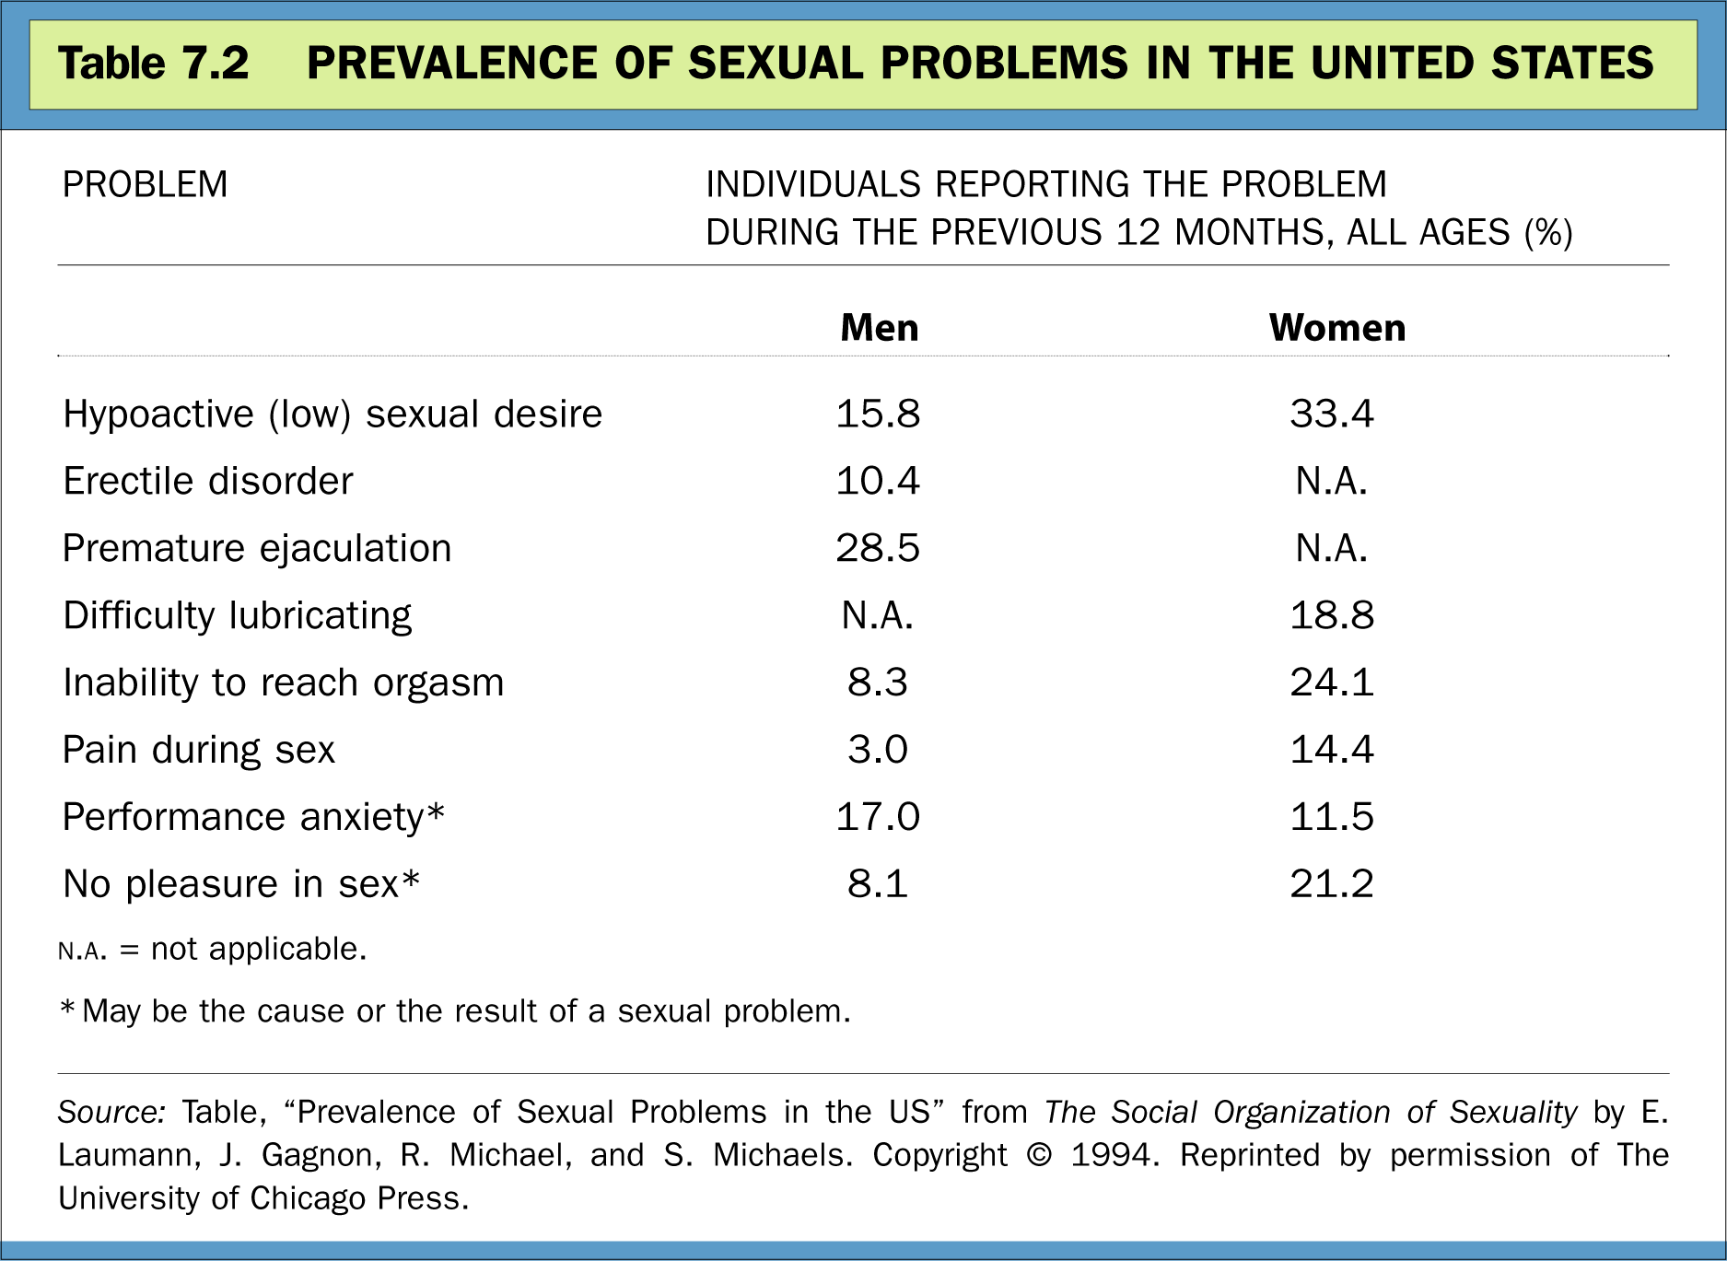
What Is a Sexual Problem? (cont.)
Notes:
Encourage students to examine
Table 7.2: Prevalence of Sexual Problems in the U.S. on page 231, and

Slide 6
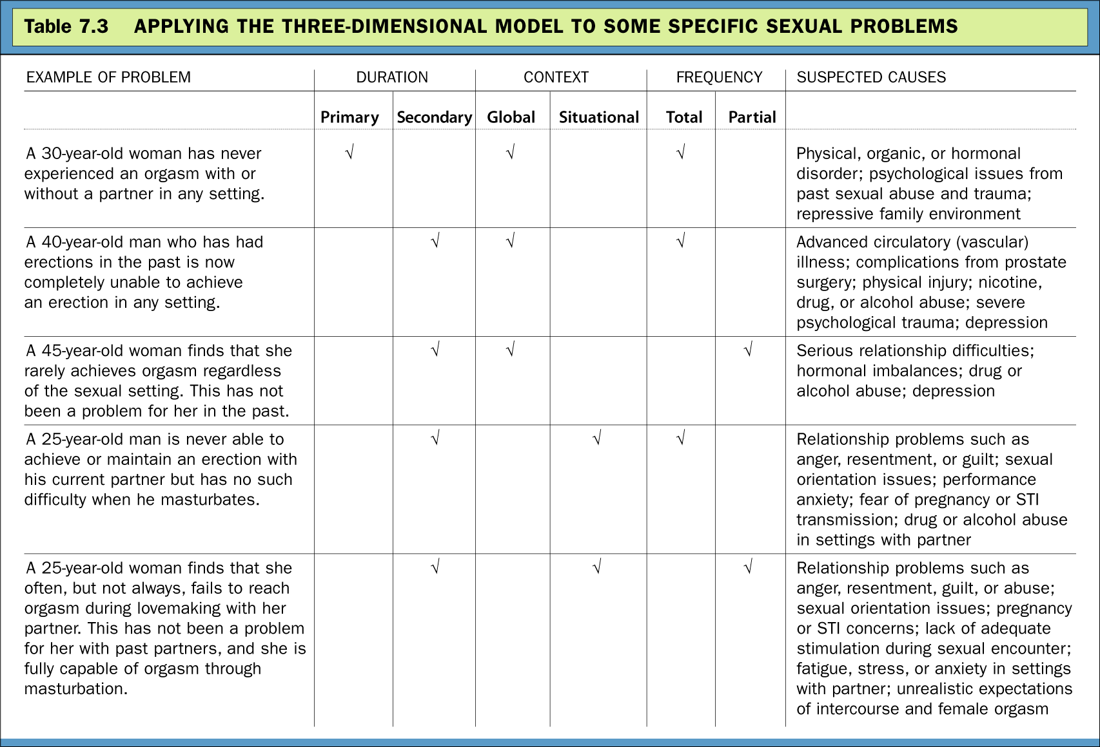
What Is a Sexual Problem? (cont.)
Notes:
Encourage students to examine
Table 7.3: Applying the Three-Dimensional Model to Some Specific Sexual Problems

Slide 7
Sources of Sexual Problems:
Neurological
Hormonal
Vascular
Use and Abuse of Alcohol and other Recreational Drugs
SSRIs (Selective Serotonin Reuptake Inhibitors)
Psychological
Notes:
Encourage students to examine Table 7.4: Effects of Drug Abuse on Sexual Functioning on page 235.

Slide 8
Sources of Sexual Problems: Psychological Causes
Frequency
Types
Fear Of . . .
Anxiety About . . .
Guilt Over . . .
Stress Due to . . .
Other Psychological Causes
Notes:
Encourage students to examine Table 7.5: Common Psychological Causes of Sexual Problems on page 236.

Slide 9
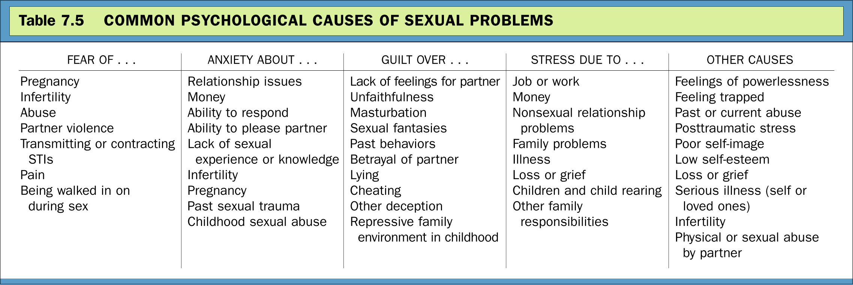
Sources of Sexual Problems: Psychological Causes (cont.)
Notes:
Encourage students to examine Table 7.5: Common Psychological Causes of Sexual Problems on page 236.

Slide 10
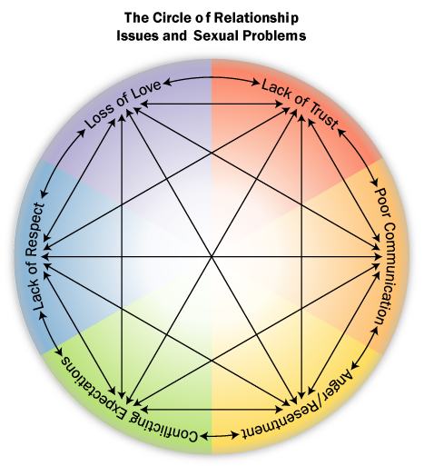
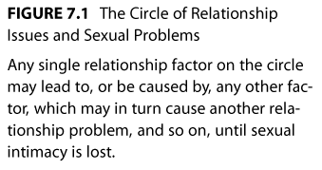
Sources of Sexual Problems: Relationship Issues
Loss of Trust
Poor Communication
Anger and Resentment
Conflicting Sexual Expectations
Lack of Respect
Loss of Love
Interactions Among the Above 6 Factors

Slide 11
Male Sexual Dysfunction

Slide 12
Disorders of Desire
Psychological causes
A general increase in anxiety, depression, or anger may reduce sexual desire in both men and women
Fears, attitudes, and memories may contribute to disorder of sexual desire
Certain psychological disorders, including depression and obsessive-compulsive disorder, may lead to sexual desire disorders

Slide 13
Disorders of Desire
psychological causes
Attitudes, fears, and psychological disorders that contribute to sexual desire disorders occur within a social context
Many sufferers of desire disorders are feeling situational pressures
Examples: divorce, death, job stress, infertility, and/or relationship difficulties
Cultural standards can set the stage for development of these disorders
The trauma of sexual molestation or assault is especially likely to produce disorder of sexual desire

Slide 14
Disorders of Excitement
Psychological causes
Any of the psychological causes of hypoactive sexual desire can also interfere with arousal and lead to erectile dysfunction
For example, as many as 90% of men with severe depression experience some degree of ED
One well-supported cognitive explanation for ED emphasizes performance anxiety and the spectator role
Once a man begins to have erectile difficulties, he becomes fearful and worries during sexual encounters; instead of being a participant, he becomes a spectator and judge
This can create a vicious cycle of disorder of sexual desire where the original cause of the erectile failure becomes less important than the fear of failure

Slide 15
Disorders of Orgasm – Early Ejaculation
Characterized by persistent reaching of orgasm and ejaculation with little sexual stimulation
  As many as 30% of men experience rapid ejaculation at some time
Psychological, particularly behavioral, explanations of this disorder have received more research support than other explanations
  The dysfunction seems to be typical of young, sexually inexperienced men
  It may also be related to anxiety, hurried masturbation experiences, or poor recognition of arousal
Notes:
There is a growing belief among many clinical theorists that biological factors may also play a key role in many cases of this disorder
One theory states that some men are born with a genetic predisposition
A second theory argues that the brains of men with rapid ejaculation contain certain serotonin receptors that are overactive and others that are underactive
A third explanation holds that men with this dysfunction experience greater sensitivity or nerve conduction in the area of their penis

Slide 16
Disorders of Orgasm – Delayed Ejaculation
Characterized by a repeated inability to reach orgasm or by a very delayed orgasm after normal sexual excitement
A leading psychological cause appears to be performance anxiety and the spectator role, the cognitive factors involved in ED
Notes:
Another psychological factor may be past masturbation habits
This disorder also may develop out of hypoactive sexual desire disorder

Slide 17
Female Sexual Dysfunction

Slide 18
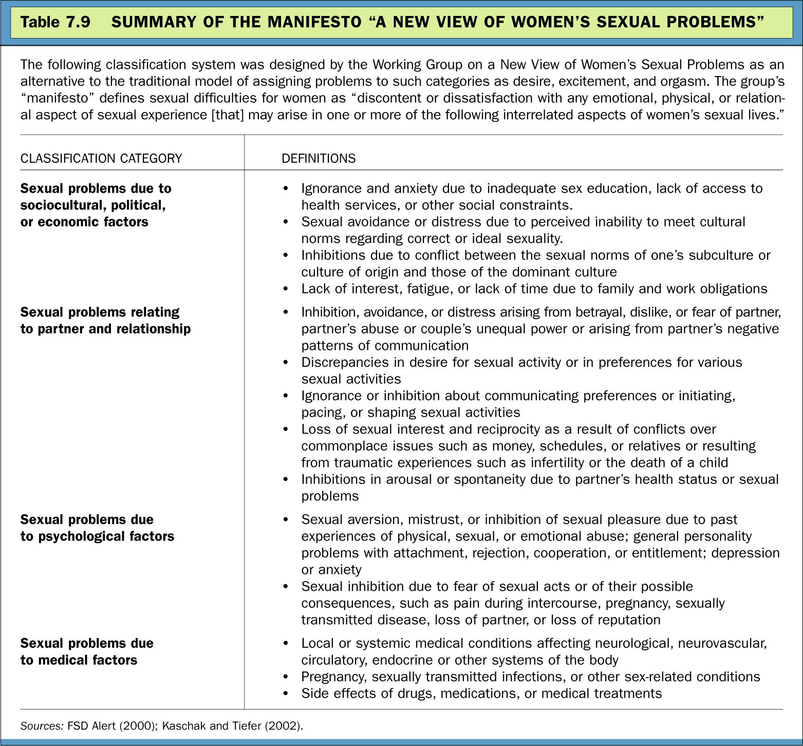
A “New View” of Female Sexual Problems (cont.)
Notes:
Encourage students to examine Table 7.9: Summary of the Manifesto “A New View of Women’s Sexual Problems” on page 267.

Slide 19
Disorders of Desire
Psychological causes
A general increase in anxiety, depression, or anger may reduce sexual desire in both men and women
Fears, attitudes, and memories may contribute to disorder of sexual desire
Certain psychological disorders, including depression and obsessive-compulsive disorder, may lead to sexual desire disorders

Slide 20
Disorders of Desire
psychological causes
Attitudes, fears, and psychological disorders that contribute to sexual desire disorders occur within a social context
Many sufferers of desire disorders are feeling situational pressures
Examples: divorce, death, job stress, infertility, and/or relationship difficulties
Cultural standards can set the stage for development of these disorders
The trauma of sexual molestation or assault is especially likely to produce disorder of sexual desire

Slide 21
Disorders of Orgasm- Female Orgasmic Disorder
Psychological causes
The psychological causes of hypoactive sexual desire and sexual aversion, including depression, may also lead to female arousal and orgasmic disorders
Memories of childhood trauma and relationship distress may also be related

Slide 22
Disorders of Orgasm- Female Orgasmic Disorder
Sociocultural causes
For years, the leading sociocultural theory of female disorder of sexual desire was that it resulted from sexually restrictive cultural messages
This theory has been challenged because:
Sexually restrictive histories are equally common in women with and without disorders
Cultural messages about female sexuality have been changing while the rate of female disorder of sexual desire stays constant
Researchers suggest that unusually stressful events, traumas, or relationships may produce the fears, memories, and attitudes that characterize these dysfunctions
Research has also linked orgasmic behavior to certain qualities in a woman's intimate relationships (such as emotional intimacy)

Slide 23
Disorders of Sexual Pain
Vaginismus
  Characterized by involuntary contractions of the muscles of the outer third of the vagina
  This problem has received relatively little research, but estimates are that it occurs in fewer than 1% of all women
  Most clinicians agree with the cognitive-behavioral theory that vaginismus is a learned fear response
  Some women experience painful intercourse because of infection or disease
  Many women with vaginismus also have other sexual disorders

Slide 24
Disorders of Sexual Pain
Dyspareunia
  Characterized by severe pain in the genitals during sexual activity
    As many as 14% of women and about 3% of men suffer from this problem
  Dyspareunia in women usually has a physical cause, most commonly from injury sustained in childbirth
  Although psychological factors or relationship problems may contribute to dyspareunia, psychosocial factors alone are rarely responsible

Slide 25
Thank you

