Slide 1
ACUTE HEART FAILURE. PULMONARY OEDEMA.
Odesa National Medical University
Department of Internal Medicine #2
2023-2024

Slide 2
AHF refers to rapid or gradual onset of symptoms and/or signs of HF, severe enough for the patient to seek urgent medical attention, leading to an unplanned hospital admission or an emergency department visit.
AHF may be the first manifestation of HF (new onset) or, more frequently, be due to an acute decompensation of chronic HF. Compared to patients with acutely decompensated CHF, those with new onset HF may have a higher in-hospital mortality but have lower post-discharge mortality and rehospitalization rates.

Slide 3

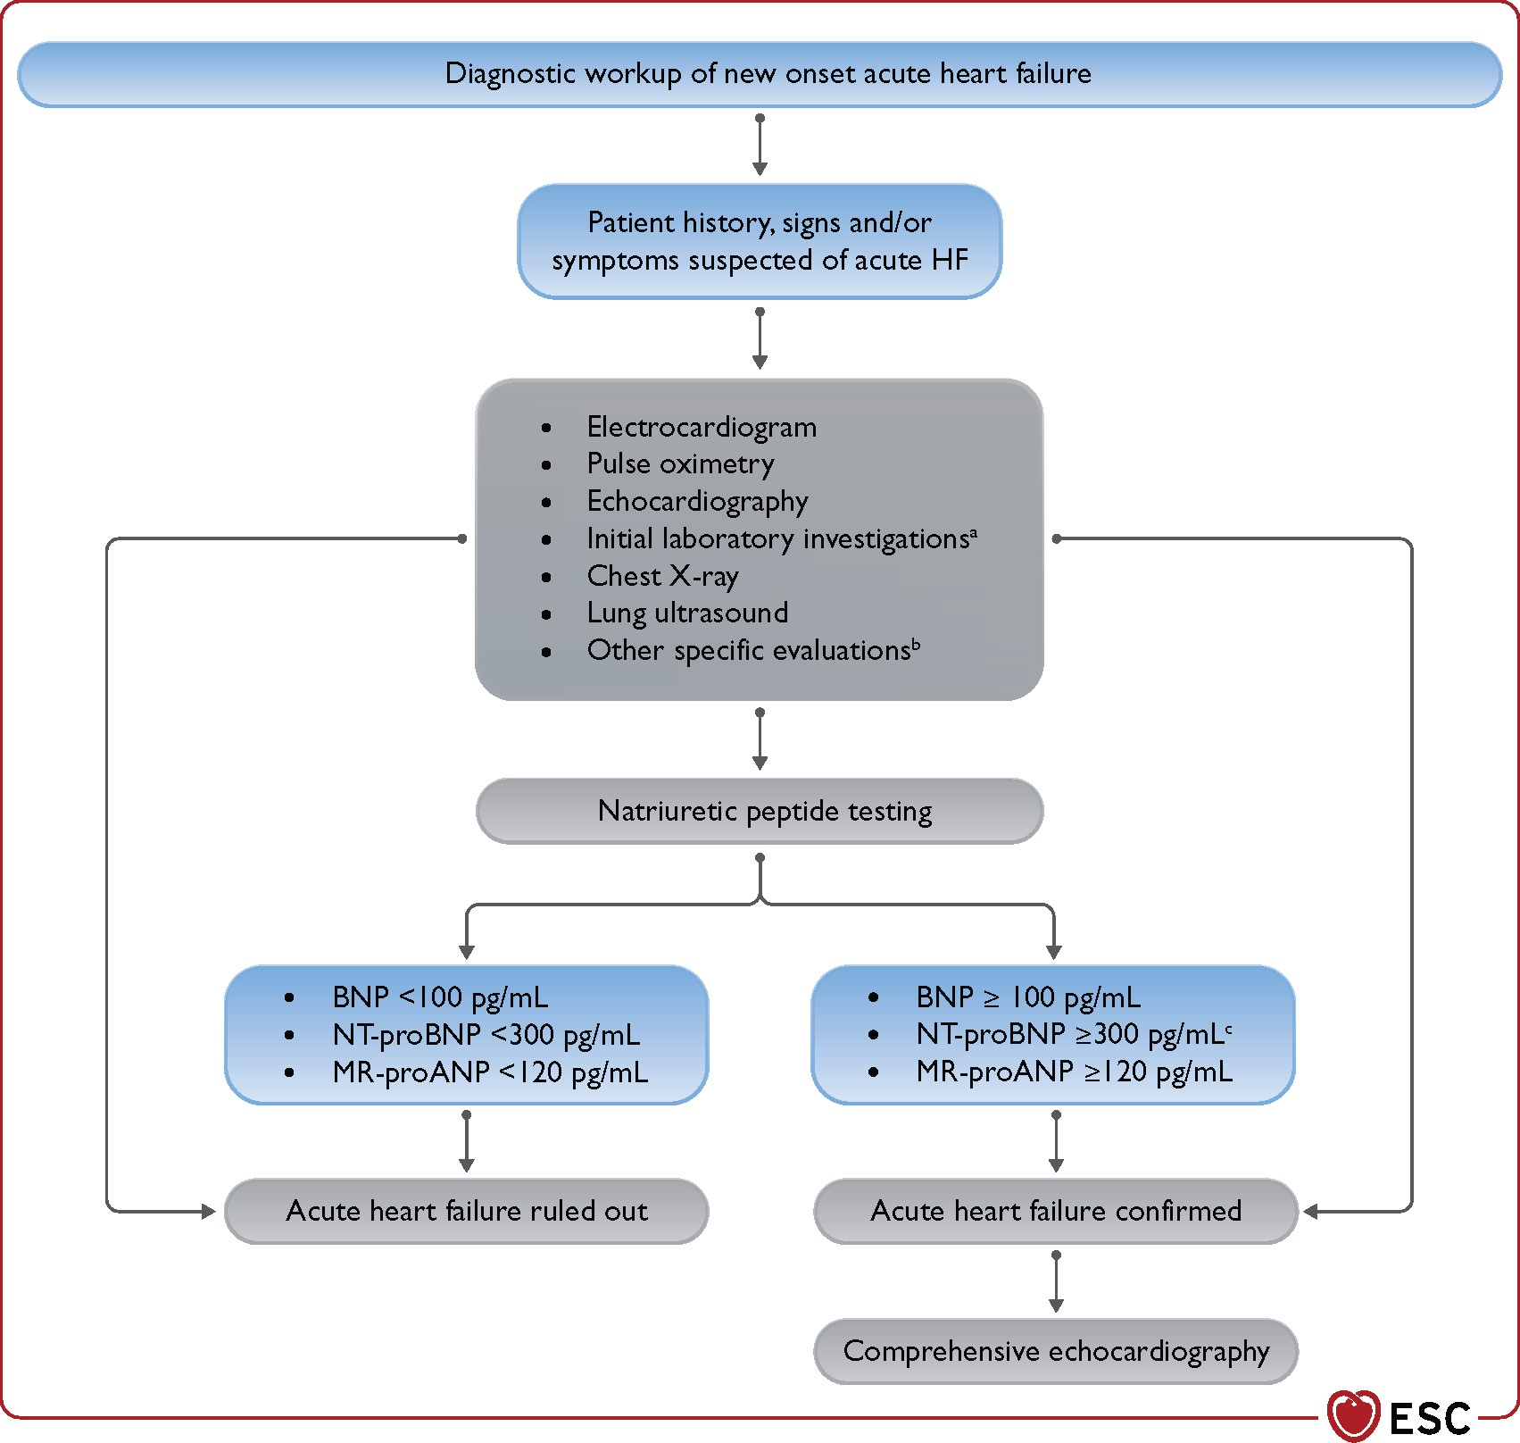
Diagnostic workup of new onset acute heart failure.
BNP = B-type natriuretic peptide; MR-proANP = mid-regional pro-atrial natriuretic peptide; NT-proBNP = N-terminal pro-B-type natriuretic peptide
ªInitial laboratory exams include troponin, serum creatinine, electrolytes, blood urea nitrogen or urea, TSH, liver function tests as well as D-dimer and procalcitonin when pulmonary embolism or infection are suspected, arterial blood gas analysis in case of respiratory distress, and lactate in case of hypoperfusion. ^{b}Specific evaluation includes coronary angiography, in case of suspected ACS, and CT in case of suspected pulmonary embolism. ^{c}Rule-in values for the diagnosis of acute HF: >450 pg/mL if aged <55 years, >900 pg/mL if aged between 55 and 75 years and >1800 pg/mL if aged >75 years

Slide 4
Diagnostic tests in patients with AHF
Exam | Time of measurement | Possible findings | Diagnostic value for AHF | Indication
ECG | Admission, during hospitalization, pre-discharge | Arrhythmias, myocardial ischaemia | Exclusion of ACS or arrhythmias | Recommended
Chest-X ray | Admission, during hospitalization | Congestion, lung infection | Confirmatory | May be considered
LUS (lung ultrasound) | Admission, during hospitalization pre-discharge | Congestion | Confirmatory | May be considered
Echocardiography | Admission, during hospitalization, pre-discharge | Congestion, cardiac dysfunction, mechanical causes | Major | Recommended
Natriuretic peptides (BNP, NT-proBNP, MR-proANP) | Admission, pre-discharge | Congestion | High negative predictive value | Recommended
Serum troponin | Admission | Myocardial injury | Exclusion of ACS | Recommended
Serum creatinine | Admission, during hospitalization, pre-discharge | Renal dysfunction | None | Recommended for prognostic assessment
Serum electrolytes (sodium, potassium, chloride) | Admission, during hospitalization, pre-discharge | Electrolyte disorders | None | Recommended for prognostic assessment and treatment
Iron status (transferrin, ferritin) | Pre-discharge | Iron depletion | None | Recommended for prognostic assessment and treatment
TSH | Admission | Hypo- hyperthyroidism | None | Recommended when hypo-hyperthyroidism is suspected
D-dimer | Admission | Pulmonary embolism | Useful to exclude pulmonary embolism | Recommended when pulmonary embolism is suspected
Procalcitonin | Admission | Pneumonia | Useful for diagnosis of pneumonia | May be done when pneumonia is suspected
Lactate | Admission, during hospitalization | Lactic acidosis | Useful to assess perfusion status | Recommended when peripheral hypoperfusion is suspected
Pulse oximetry and arterial blood gas analysis | Admission, during hospitalization | Respiratory failure | Useful to assess respiratory function | Recommended when respiratory failure is suspected

Slide 5
Clinical presentations of AHF
 | Acute decompensated HF | Acute pulmonary oedema | Isolated right ventricular failure | Cardiogenic shock
Main mechanisms | LV dysfunction Sodium and water renal retention | Increased afterload and/or predominant LV diastolic dysfunction Valvular heart disease | RV dysfunction and/or pre-capillary pulmonary hypertension | Severe cardiac dysfunction
Main cause of symptoms | Fluid accumulation, increased intraventricular pressure | Fluid redistribution to the lungs and acute respiratory failure | Increased central venous pressure and often systemic hypoperfusion | Systemic hypoperfusion
Onset | Gradual (days) | Rapid (hours) | Gradual or rapid | Gradual or rapid
Main haemodynamic abnormalities | Increased LVEDP and PCWPª Low or normal cardiac output Normal to low SBP | Increased LVEDP and PCWPª Normal cardiac output Normal to high SBP | Increased RVEDP Low cardiac output Low SBP | Increased LVEDP and PCWPª Low cardiac output Low SBP
Main clinical presentations | Wet and warm OR Dry and cold | Wet and warm^{b} | Dry and cold OR Wet and cold | Wet and cold
Main treatment | Diuretics Inotropic agents/vasopressors (if peripheral hypoperfusion/hypotension) Short-term MCS or RRT if needed | Diuretics Vasodilators^{b} | Diuretics for peripheral congestion Inotropic agents/vasopressors (if peripheral hypoperfusion/hypotension) Short-term MCS or RRT if needed | Inotropic agents/vasopressors Short-term MCS RRT
LV = left ventricular; LVEDP = left ventricular end-diastolic pressure; MCS = mechanical circulatory support; PCWP = pulmonary capillary wedge pressure; RV = right ventricular; RVEDP = right ventricular end-diastolic pressure; RRT = renal replacement therapy; SBP = systolic blood pressure.
A May be normal with low cardiac output.
B Wet and cold profile with need of inotropes and/or vasopressors may rarely occur.

Slide 6
Acutely decompensated heart failure (ADHF)
is the most common form of AHF, accounting for 50–70% of presentations.
It usually occurs in patients with history of HF and previous cardiac dysfunction across the spectrum of LVEF and may include RV dysfunction.
Distinct from the acute pulmonary oedema phenotype, it has a more gradual onset, and the main alteration is progressive fluid retention responsible for systemic congestion. Sometimes, congestion is associated with hypoperfusion.
The objectives of treatment are identification of precipitants, decongestion, and in rare instances, correction of hypoperfusion.

Slide 7
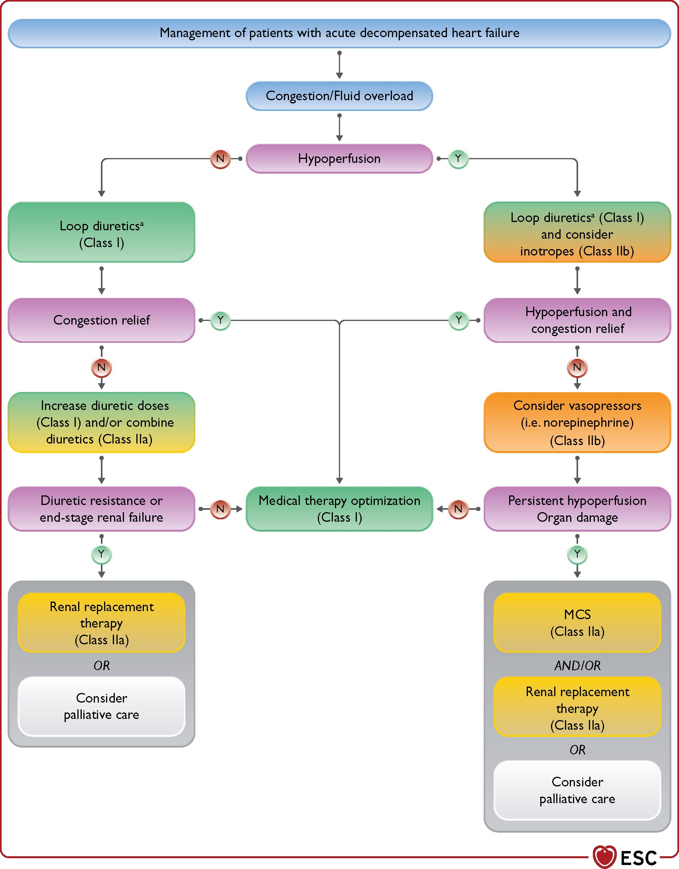
Management of acute decompensated heart failure.
ª Adequate diuretic doses to relieve congestion and close monitoring of diuresis is recommended regardless of perfusion status.
Notes:
Unless provided in the caption above, the following copyright applies to the content of this slide: This article has been co-published with permission in the European Heart Journal and European Journal of Heart Failure. © the European Society of Cardiology 2021. All rights reserved. The articles are identical except for minor stylistic and spelling differences in keeping with each journal’s style. Either citation can be used when citing this article. For permissions, please email journals.permissions@oup.com.This article is published and distributed under the terms of the Oxford University Press, Standard Journals Publication Model (https://academic.oup.com/journals/pages/open_access/funder_policies/chorus/standard_publication_model)

Slide 8
Acute pulmonary oedema is related to lung congestion.
Clinical criteria for acute pulmonary oedema diagnosis include:
dyspnoea with orthopnoea, respiratory failure (hypoxaemia-hypercapnia), tachypnoea, >25 breaths/min, and increased work of breathing.
Three therapies should be commenced, if indicated.
oxygen, given as continuous positive airway pressure, non-invasive positive-pressure-ventilation and/or high-flow nasal cannula, should be started.
i.v. diuretics should be administered
i.v. vasodilators may be given if systolic BP (SBP) is high, to reduce LV afterload.
In a few cases of advanced HF, acute pulmonary oedema may be associated with low cardiac output and, in this case, inotropes, vasopressors, and/or MCS are indicated to restore organ perfusion.

Slide 9
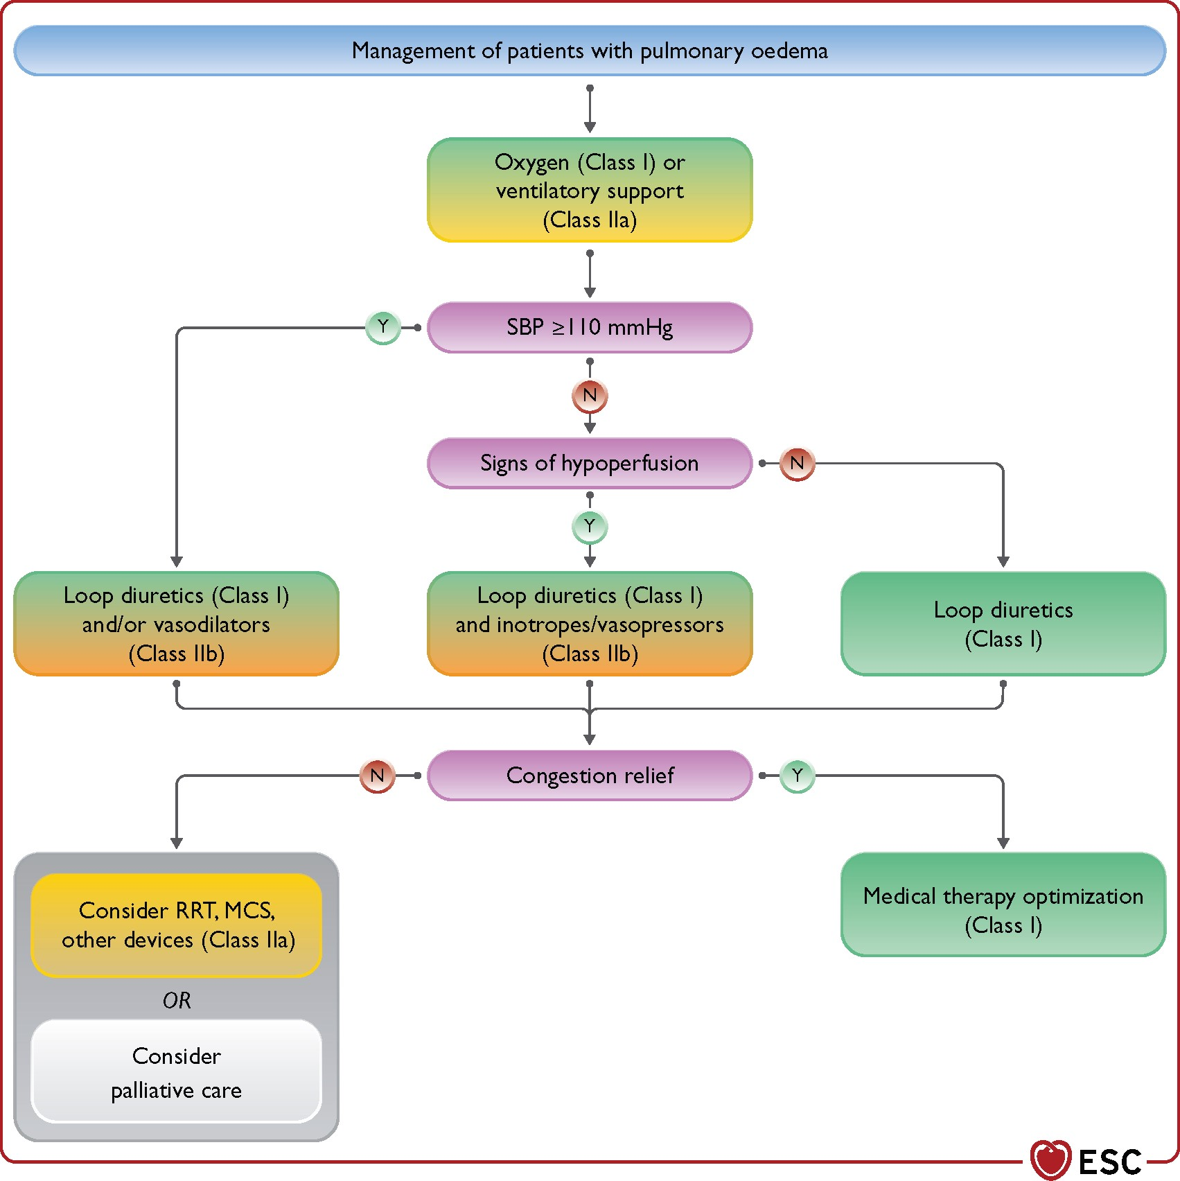

Slide 10
Cardiogenic shock is a syndrome due to primary cardiac dysfunction resulting in an inadequate cardiac output, comprising a life-threatening state of tissue hypoperfusion, which can result in multi-organ failure and death.
Cardiac insult causing severe impairment of cardiac performance may be acute, as a result of the acute loss of myocardial tissue (acute MI, myocarditis) or may be progressive as seen in patients with chronic decompensated HF who may experience a decline in disease stability as a result of the natural progression of advanced HF and/or specific precipitants.
Diagnosis of cardiogenic shock mandates the presence of clinical signs of hypoperfusion, such as cold sweated extremities, oliguria, mental confusion, dizziness, narrow pulse pressure. In addition, biochemical manifestations of hypoperfusion, elevated serum creatinine, metabolic acidosis and elevated serum lactate are present and reflect tissue hypoxia and alterations of cellular metabolism leading to organ dysfunction.
Of note, hypoperfusion is not always accompanied by hypotension, as BP may be preserved by compensatory vasoconstriction (with/without pressor agents), albeit at the cost of impaired tissue perfusion and oxygenation.
Management of cardiogenic shock should start as early as possible. Early identification and treatment of the underlying cause, concomitant with haemodynamic stabilization and management of organ dysfunction, are key components of its management

Slide 11
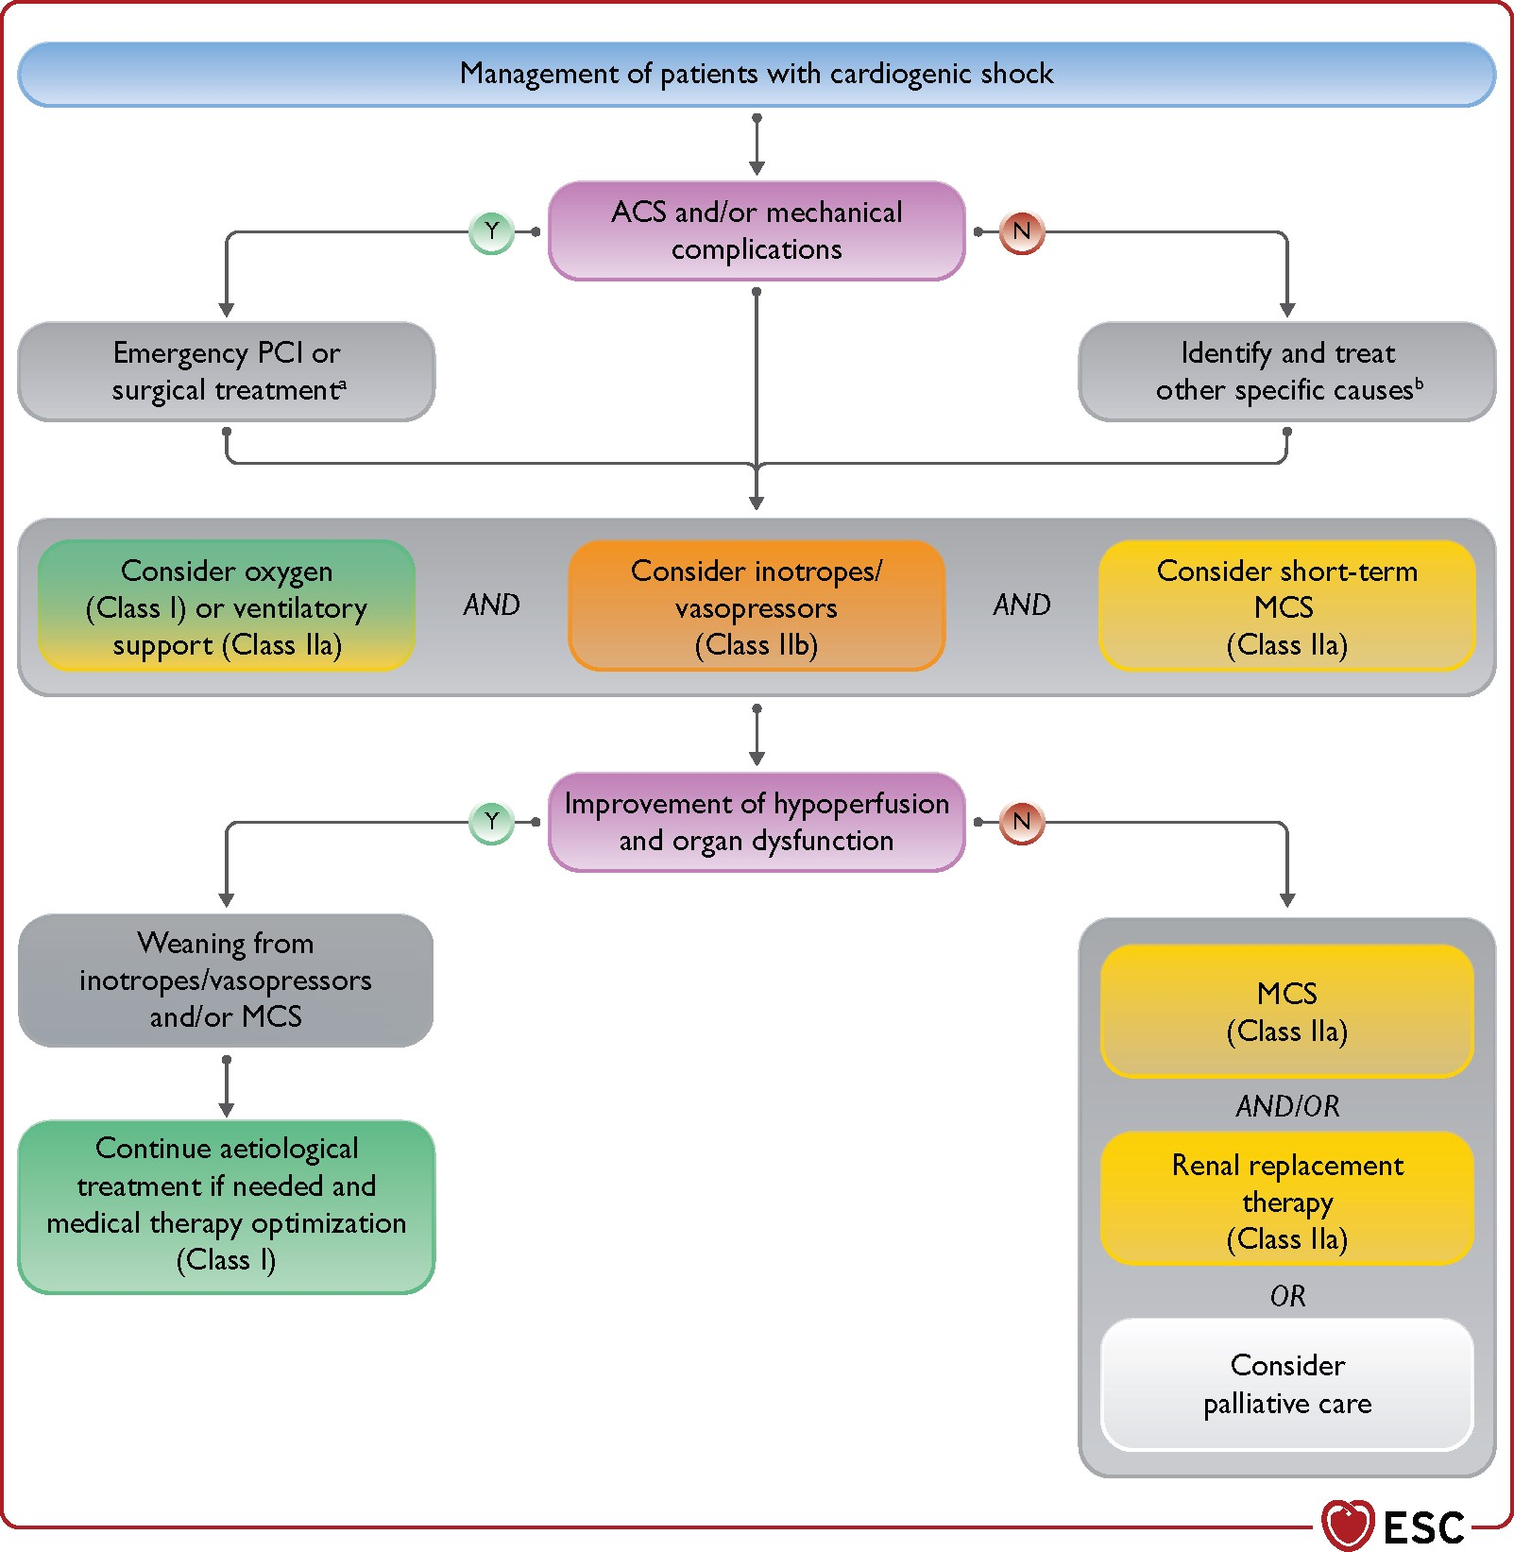

Slide 12
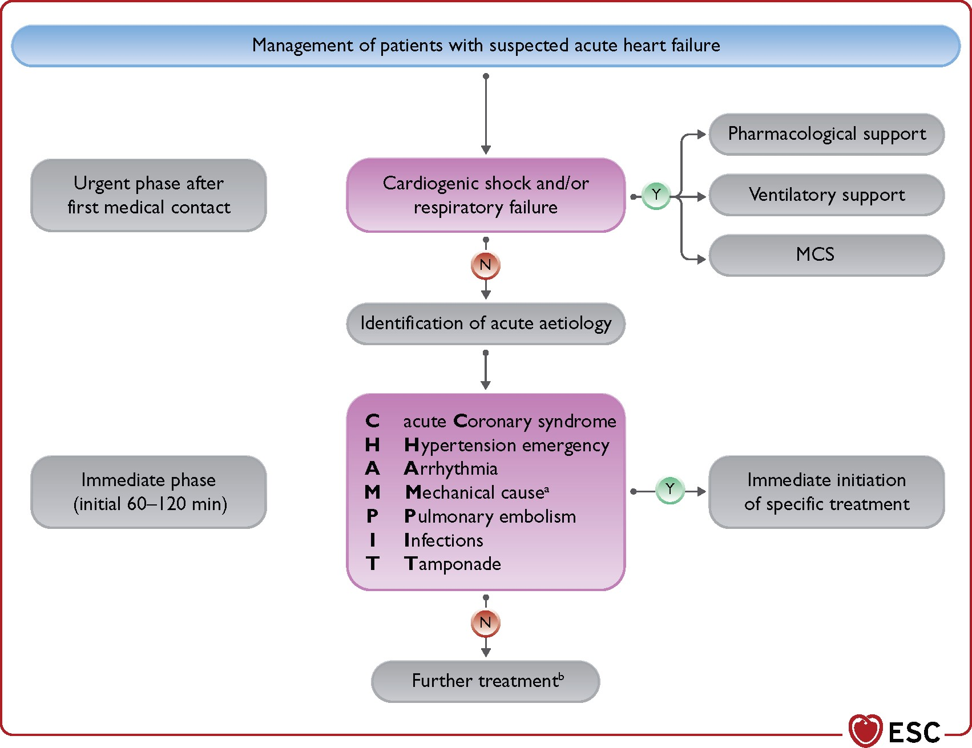
ªAcute mechanical cause: myocardial rupture complicating acute coronary syndrome (free wall rupture, ventricular septal defect, acute mitral regurgitation), chest trauma or cardiac intervention, acute native or prosthetic valve incompetence secondary to endocarditis, aortic dissection or thrombosis.

Slide 13
Oxygen therapy and/or ventilatory support
In AHF, oxygen should not be used routinely in non-hypoxaemic patients, as it causes vasoconstriction and a reduction in cardiac output. Oxygen therapy is recommended in patients with AHF and SpO₂ <90% or PaO₂ <60 mmHg to correct hypoxaemia.
Non-invasive positive pressure ventilation, either continuous positive airway pressure and pressure support, improves respiratory failure, increases oxygenation and pH, and decreases the partial pressure of carbon dioxide (pCO₂) and work of breathing. Although a large randomized trial had neutral results, meta-analyses suggest it may improve dyspnoea and reduce the need for intubation and mortality, compared with traditional oxygen therapy.
Non-invasive positive pressure ventilation should be started as soon as possible in patients with respiratory distress (respiratory rate >25 breaths/min, SpO₂ <90%) to improve gas exchange and reduce the rate of endotracheal intubation. The fraction of inspired oxygen (FiO₂) should be increased up to 100%, if necessary, according to oxygen saturation level.
!Blood pressure should be monitored regularly during non-invasive positive pressure ventilation. The increase in intrathoracic pressure with non-invasive positive pressure ventilation decreases venous return and right and left ventricular preload. It may also decrease cardiac output and BP and should therefore be used with caution in patients with reduced preload reserve and hypotension. The increase in pulmonary vascular resistance and RV afterload may also be detrimental in RV dysfunction.
Intubation is recommended for progressive respiratory failure in spite of oxygen administration or non-invasive ventilation

Slide 14
Diuretics
Intravenous diuretics are the cornerstone of AHF treatment. They increase renal excretion of salt and water and are indicated for the treatment of fluid overload and congestion in the vast majority of AHF patients.
Diuretic treatment should be started with an initial i.v. dose of furosemide, or equivalent dose of bumetanide or torasemide, corresponding to 1–2 times the daily oral dose taken by the patient before admission. If the patient was not on oral diuretics, a starting dose of 20–40 mg of furosemide, or a bolus of 10–20 mg i.v. torasemide, can be used. Furosemide can be given as 2–3 daily boluses or as a continuous infusion. Daily single bolus administrations are discouraged because of the possibility of post-dosing sodium retention. With continuous infusion, a loading dose may be used to achieve steady state earlier. Diuretic response should be evaluated shortly after start of diuretic therapy and may be assessed by performing a spot urine sodium content measurement after 2 or 6 h and/or by measuring the hourly urine output. A satisfactory diuretic response can be defined as a urine sodium content >50–70 mEq/L at 2 h and/or by a urine output >100–150 mL/h during the first 6 h. If there is an insufficient diuretic response, the loop diuretic i.v. dose can be doubled, with a further assessment of diuretic response. If the diuretic response remains inadequate, e.g. <100 mL hourly diuresis despite doubling loop diuretic dose, concomitant administration of other diuretics acting at different sites, namely thiazides or metolazone or acetazolamide, may be considered. However, this combination requires careful monitoring of serum electrolytes and renal function. This strategy, based on early and frequent assessment of diuretic response, allows starting treatment with relatively low doses of loop diuretics, with frequent dose adjustments that may be less likely to cause dehydration and increase in serum creatinine. The loop diuretic dose should be progressively decreased when a significant negative fluid balance has been obtained.
Transition to oral treatment should be commenced when the patient’s clinical condition is stable. It is recommended that, after achievement of congestion relief, oral loop diuretics are continued at the lowest dose possible to avoid congestion.

Slide 15
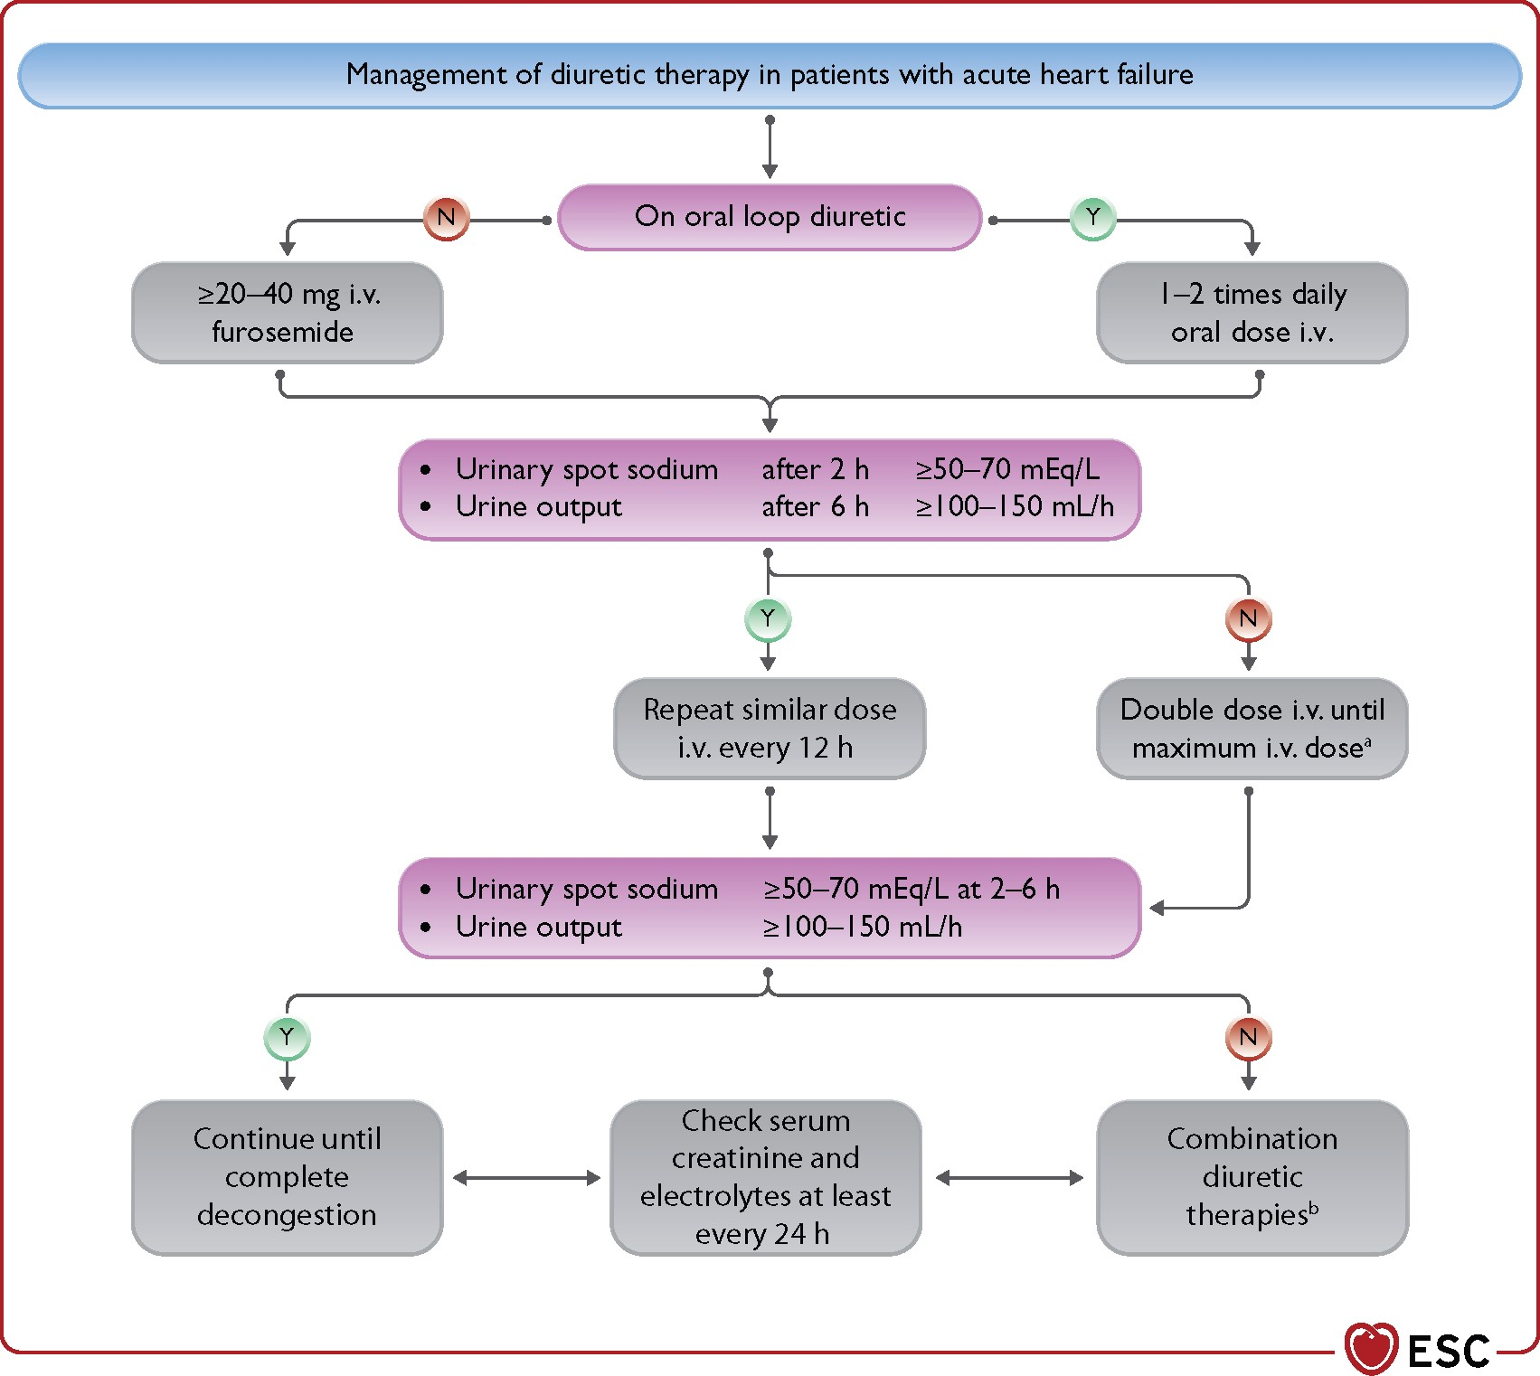
ªThe maximal daily dose for i.v. loop diuretics is generally considered furosemide 400–600 mg though up to 1000 mg may be considered in patients with severely impaired kidney function.
^{b}Combination therapy is the addition to the loop diuretic of a diuretic with a different site of action, e.g. thiazides or metolazone or acetazolamide.

Slide 16
Vasodilators
Intravenous vasodilators, namely nitrates or nitroprusside dilate venous and arterial vessels leading to a reduction in venous return to the heart, less congestion, lower afterload, increased stroke volume and consequent relief of symptoms.
Nitrates act mainly on peripheral veins whereas nitroprusside is more a balanced arterial and venous dilator.
Because of their mechanisms of action, i.v. vasodilators may be more effective than diuretics in those patients whose acute pulmonary oedema is caused by increased afterload and fluid redistribution to the lungs in the absence or with minimal fluid accumulation. However, two recent randomized trials comparing usual care with early intensive and sustained vasodilation failed to show a beneficial effect of i.v. vasodilators vs. high-dose diuretics. No recommendation favouring a regimen based on vasodilator treatment vs. usual care can thus be given, to date.
Intravenous vasodilators may be considered to relieve AHF symptoms when SBP is >110 mmHg. They may be started at low doses and uptitrated to achieve clinical improvement and BP control.
Nitrates are generally administered with an initial bolus followed by continuous infusion. However, they may also be given as repeated boluses. Nitroglycerine can be given as 1–2 mg boluses in severely hypertensive patients with acute pulmonary oedema. Care should be taken to avoid hypotension due to an excessive decrease in preload and afterload. For this reason, they should be used with extreme caution in patients with LVH and/or severe aortic stenosis. However, favorable effects were described in patients with LV systolic dysfunction and aortic stenosis when vasodilators were given with careful monitoring of haemodynamic parameters.

Slide 17
Inotropes
should be reserved for patients with LV systolic dysfunction, low cardiac output and low SBP (e.g. <90 mmHg) resulting in poor vital organ perfusion. However, they must be used with caution starting at low doses and uptitrating them with close monitoring.
Inotropes, especially those with adrenergic mechanisms, can cause sinus tachycardia, increase ventricular rate in patients with AF, may induce myocardial ischaemia and arrhythmias, and increase mortality.
Levosimendan or type-3-phosphodiesterase inhibitors may be preferred over dobutamine for patients on beta-blockers as they act through independent mechanisms. Excessive peripheral vasodilation and hypotension can be major limitations of type-3-phosphodiestaerase inhibitors or levosimendan, especially when administered at high doses and/or when commenced with a bolus dose.
Vasopressors
Among drugs with a prominent peripheral arterial vasoconstrictor action, norepinephrine may be preferred in patients with severe hypotension. The aim is to increase perfusion to the vital organs. However, this is at the expense of an increase in LV afterload. Therefore, a combination of norepinephrine and inotropic agents may be considered, especially in patients with advanced HF and cardiogenic shock.
Some studies, though with limitations, support the use of norepinephrine as first choice, compared with dopamine or epinephrine. Dopamine was compared with norepinephrine as a first-line vasopressor therapy in patients with shock and was associated with more arrhythmic events and with a greater mortality in patients with cardiogenic shock but not in those with hypovolaemic or septic shock. As there were no data regarding revascularization, this limits the generalizability of the results. In another prospective randomized trial epinephrine was compared with norepinephrine in patients with cardiogenic shock due to acute MI. The trial was stopped prematurely due to a higher incidence of refractory shock with epinephrine. Epinephrine was also associated with higher heart rate and lactic acidosis.

Slide 18
Digoxin
Digoxin should be considered in patients with AF with a rapid ventricular rate (>110 b.p.m.) despite beta-blockers. It can be given in boluses of 0.25–0.5 mg i.v., if not used previously. However, in patients with comorbidities (i.e. CKD) or other factors affecting digoxin metabolism (including other drugs) and/or the elderly, the maintenance dose may be difficult to estimate theoretically and measurements of serum digoxin concentrations should be performed.
Thromboembolism prophylaxis
Thromboembolism prophylaxis with heparin (e.g. low-molecular-weight heparin) or another anticoagulant is recommended, unless contraindicated or unnecessary (because of existing treatment with oral anticoagulants)

Slide 19
Short-term mechanical circulatory support
In patients presenting with cardiogenic shock, short-term MCS may be necessary to augment cardiac output and support end-organ perfusion. The initial improvements in cardiac output, BP and arterial lactate may be counterbalanced by significant complications.
The Intra-aortic Balloon Pump in Cardiogenic Shock II (IABP-SHOCK-II) trial showed no difference in 30-day, as well as in long-term, mortality between intra-aortic balloon pump (IABP) and optima medical treatment in patients with cardiogenic shock following acute MI who underwent early revascularization. According to these results, IABP is not routinely recommended in cardiogenic shock post-MI. However, it may still be considered in cardiogenic shock, especially if not due to ACS, and refractory to drug therapy.
A meta-analysis including only observational studies showed favourable outcomes in patients with cardiogenic shock or cardiac arrest treated with veno-arterial (VA)-ECMO compared to controls. VA-ECMO may also be considered in fulminant myocarditis and other conditions causing severe cardiogenic shock. Depending on the severity of myocardial dysfunction and/or concomitant mitral or aortic regurgitation, VA-ECMO may increase LV afterload with an increase in LV end-diastolic pressure and pulmonary congestion. In these cases, LV unloading is mandatory and can be achieved by means of transeptal/ventricular apex vent or adding an unloading device such as the Impella device.

Slide 20
Case
67 year old man
PMH: Diabetes, hypertension, stage 3 CKD, hypercholesterolemia
Previous medications: Sitagliptin 50 mg/d, basal-bolus insulin regimen, enalapril 10 mg bid, amlodipine 5 mg/d, aspirin 100 mg/d, atorvastatin 20 mg/d
He complains of progressive dyspnea on exertion and orthopnea over the last 4 months. He has noticed lower extremity edema and increased abdominal girth in the last 2 months
He was seen by a family doctor 4 weeks ago, who prescribed some “waterpills”, which he has been taking regularly.
Over the last 2 weeks he has been experiencing frequent episodes of PND
He currently complains of shortness of breath at rest. He has gained 11 Kg, since the beginning of his present illness.
Denies chest pain

Slide 21
Physical exam
HR: 104 bpm, BP: 134/87 mmHg, RR: 26 bpm, 0₂Sat: 84%, T: 36.2ºC, W: 97 Kg
Awake, aware and oriented. On distress.
JVP 10 cm, hepatojugular reflux
Bilateral rales (2/3s from bases)
Loud S3, grade 2/6 holosystolic murmur at the apex
Ascites
3+ LE edema, warm extremities

Slide 22
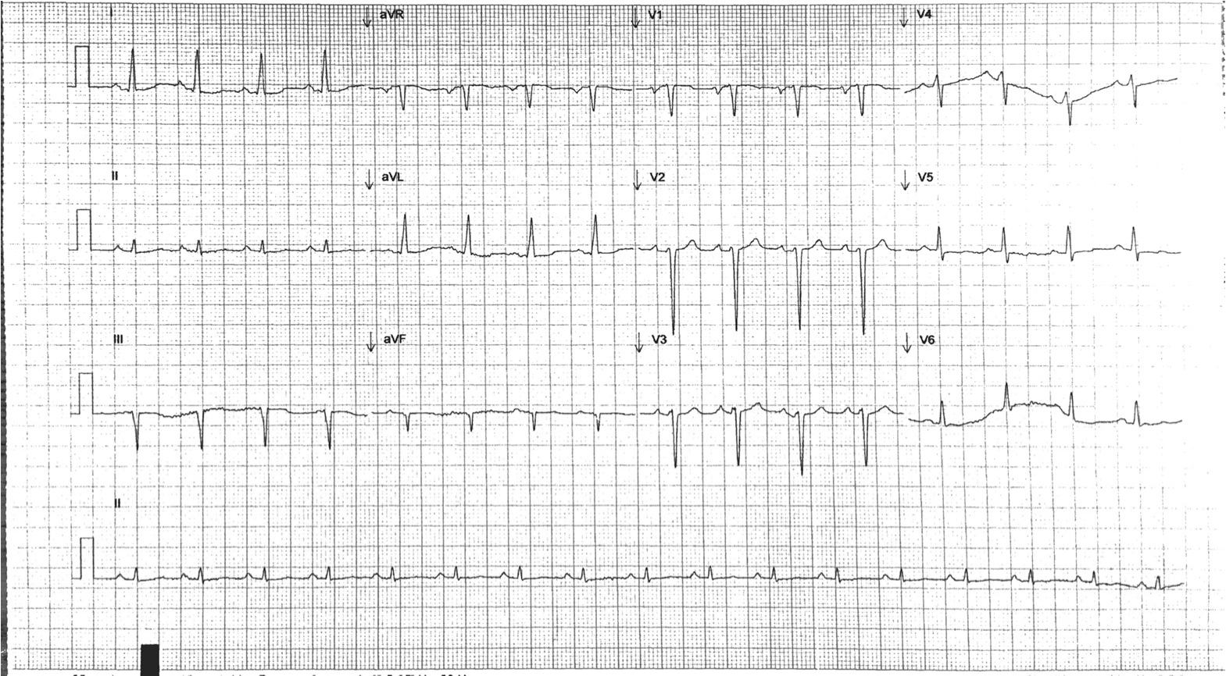
ECG

Slide 23
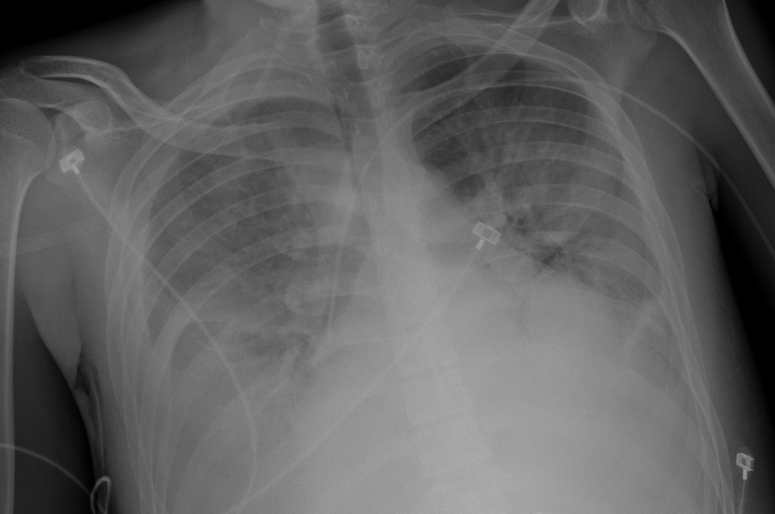
Chest X-ray

Slide 24
Lab tests
ABGs: pH 7.41, HCO3 16 mmHg, PCO2 24 mmHg, PaO2 49 mmHg, lactate 1.2 mmol/L
Blood count: Hb 11.2 g/dl, Hct 34%, Pl 161, WBC 9
Cr 2.1 mg/dl (prev. 1.6), BUN 63 mg/dL, glucose 190 mg/dl, Na 127 mmol/L,
K 4.9 mmol/L, Cl 101 mmol/L
Cardiac biomarkers: TnI 0.04 ng/ml (no 6 h𝗈), NT-Pro BNP 24,124 pg/ml

Slide 25
Initial treatment
Admitted to CCU
IV and central line (initial CVP 18 mmHg) , cardiac monitoring
NIPPV (CPAP 7 cm H₂O)
Lasix: 40 mg IV bolus
NTG 20 mcg/min
DVT prophylaxis

Slide 26
2-hour reassessment
HR: 91 bpm, BP: 121/82 mmHg, RR: 18 bpm, 0₂Sat: 91%,CVP 18
mmHG
Urine output: 190 ml (0.9 ml/kg/hr)
Still congested
NTG up-titrated as tolerated (40 mcg/min)
80 mg IV Lasix bolus→ additional boluses as needed

Slide 27
Day 2
ASSESSMENT
INTERVENTIONS
Switched to Lasix drip (up- titrated to 20 mg/hr)
Intermittent NIPPV→ nasal prongs
NTG
HR: 87 bpm, BP: 100/61 mmHg, RR: 17 bpm, 0₂Sat: 93%, CVP 16
mmHg
Rales 1/2 lung fields
Lasix daily dose 240 mg (day 1)
Total weight 𝗈 | Daily Urine output | Total Fluid balance | Creatinine | Hct | Sodium | Potassium
-1 kg (0.17/40 mg furosemide) | 1783 mL (0.77 ml/kg/hr) | - 1.4 L | 2.7 mg/dL ↑ | 34% → | 129 mmol/L ↑ | 4.1 mmol/L ↓

Slide 28
Day 3
ASSESSMENT
INTERVENTIONS
HR: 91 bpm, BP: 97/59 mmHg, RR: 16 bpm, 0₂Sat: 94%, CVP 14
mmHg
Lasix daily dose 360 mg (day 2)
Rales 1/3 lung fields
IV Lasix→ tapered to 5 mg/hr
NTG→ tapered→ hydralazine+ isosorbide dinitrate
K+ and Mg+ replaced
Total weight 𝗈 | Daily Urine output | Total Fluid balance | Creatinine | Hct | Sodium | Potassium
-4 kg (0.26/40 mg furosemide) | 3,234 mL (1.44ml/kg/hr) | - 4.3 L | 3.1 mg/dL ↑ | 36% ↑ | 132 mmol/L ↑ | 3.3 mmol/L. ↓

Slide 29
Day 4
ASSESSMENT
INTERVENTIONS
HR: 88 bpm, BP: 110/83 mmHg, RR: 16 bpm, 0₂Sat: 94%, CVP 14
mmHg
Lasix daily dose 200 mg (day 3)
Rales 1/3 lung fields
Lasix drip→ switched back to 80 mg IV BID and as needed boluses.
K+ and Mg+ replaced
Total weight 𝗈 | Daily Urine output | Total Fluid balance | Creatinine | Hct | Sodium | Potassium
-7kg (0.35/40 mg furosemide) | 2,871 mL (1.32 ml/kg/hr) | - 6.8 L | 3.4 mg/dL ↑ | 38% ↑ | 134 mmol/L ↑ | 3.9 mmol/L ↑

Slide 30
Day 5
ASSESSMENT
INTERVENTIONS
HR: 93 bpm, BP: 120/79 mmHg, RR: 15 bpm, 0₂Sat: 95%, CVP 12
mmHg
Lasix daily dose 160 mg (day 4)
Rales 1/3 lung fields
IV Lasix→ switched to oral Lasix
Total weight 𝗈 | Daily Urine output | Total Fluid balance | Creatinine | Hct | Sodium | Potasium
-8.5kg (0.35/40 mg furosemide) | 1,954 mL (0.9 ml/kg/hr) | - 7.9 L | 2.9 mg/dL ↓ | 39% ↑ | 134 mmol/L → | 4.1 mmol/L ↑

Slide 31
Day 6
Started on carvedilol 3.125 mg BID
K+ and Mg+ replaced
HR: 94 bpm, BP: 124/81 mmHg, RR: 14 bpm, 0₂Sat: 96%, CVP 11
mmHg
Lasix daily dose 160 mg (oral)
Rales < 1/3 lung fields
Total weight 𝗈 | Daily Urine output | Total Fluid balance | Creatinine | Hct | Sodium | Potassium
-9.9kg | 1,733 mL (0.8 | - 8.7 L | 2.2 mg/dl ↓ | 39% → | 136 mmol/L ↑ | 3.7 mmol/L↓
(0.38 kg/ 40 | ml/kg/hr)
mg
furosemide)

Slide 32
Day 9
Cr 1.8 mg/dl
Coronary angiography→ non-obstructive coronary artery disease

Slide 33
Day 12
HR: 69 bpm, BP: 102/59 mmHg, RR: 14 bpm, 0₂Sat: 96 %
Clear lung fields, JVP 4 cm
Cr stable (1.7 mg/dL), NT-ProBNP 2,361 pg/ml
Discharged on:
  Carvedilol 3.125 mg/d
  Enalapril 2.5 mg/d
  Spironolactone 25 mg/d
  Lasix 60 mg BID

Slide 34
Pending Assesments/Interventions:
LVEF and ICD assessment
BB and ACEI up-titration
  Consider replacing ACEI with ARNI

