Slide 1
Algorithms of EC in cardiogenic shock.
Cardiac arrest.
Odesa National Medical University
Department of Internal Medicine #2
2023-2024

Slide 2
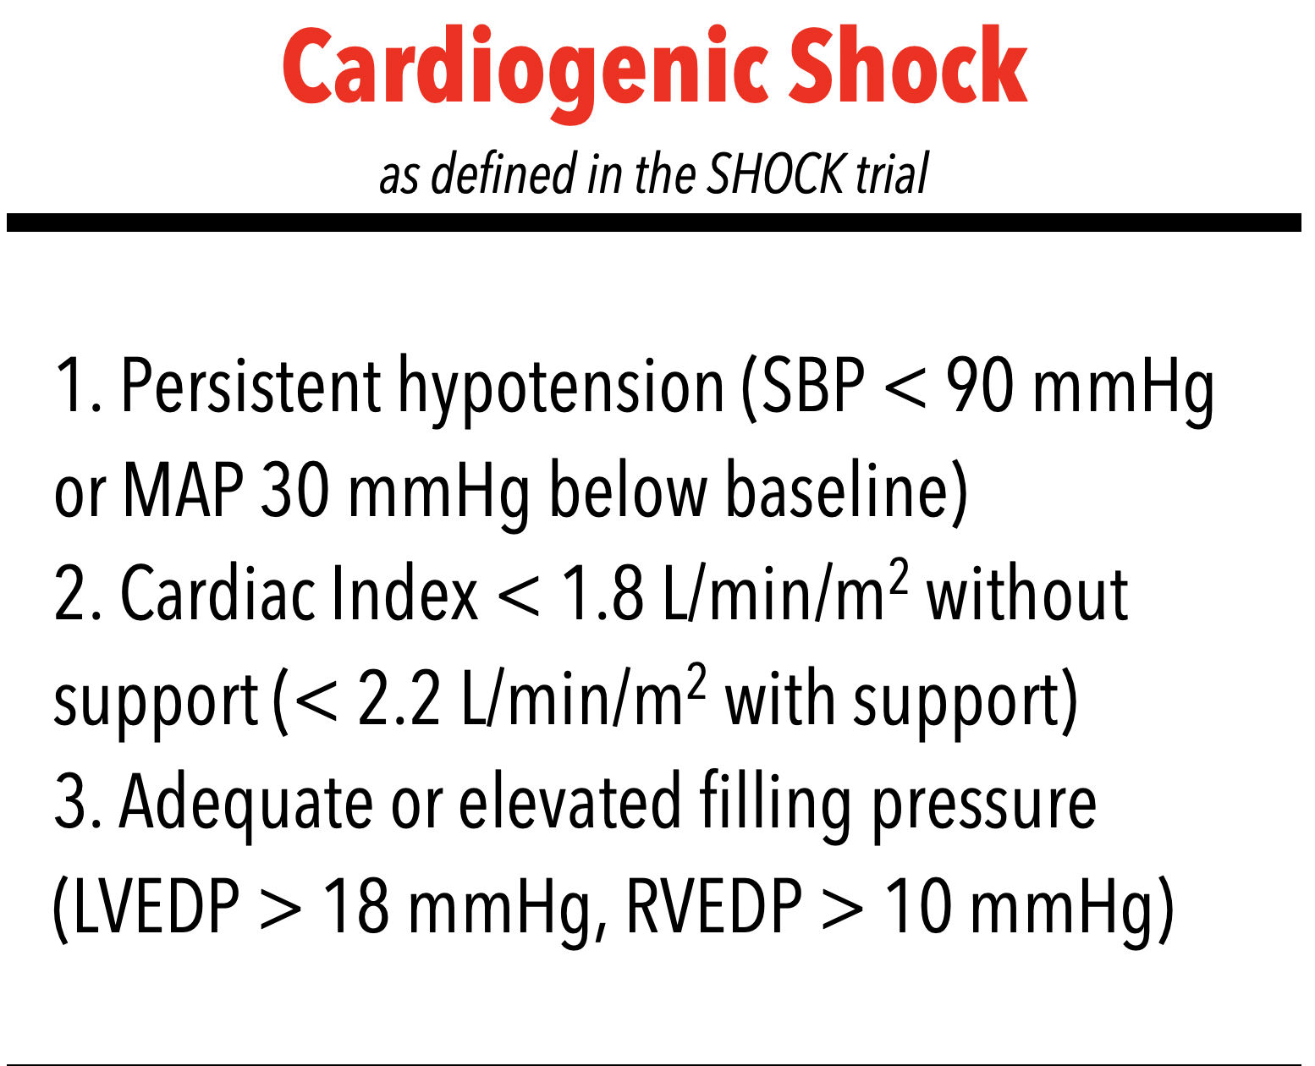

Slide 3
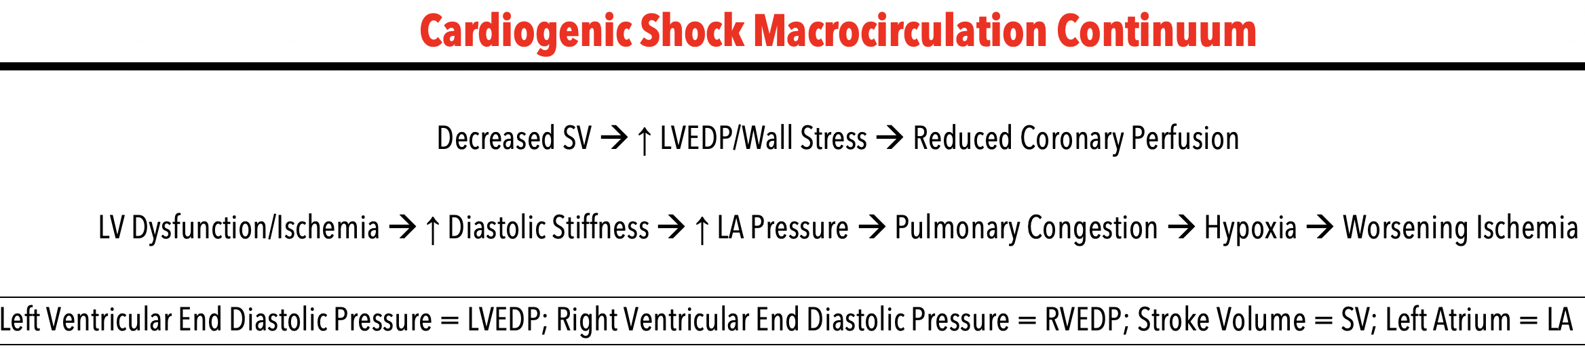

Slide 4
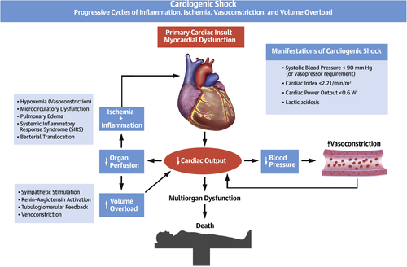

Behnam N. Tehrani et al. J Am Coll Cardiol HF 2020; 8:879-891.
2020 American College of Cardiology Foundation

Slide 5
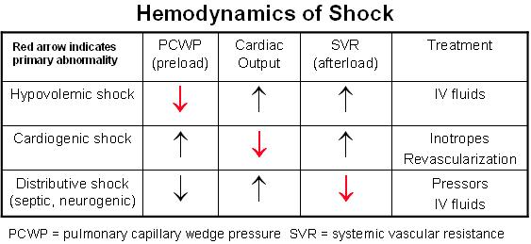

Slide 6
“Heart failure” and “cardiogenic shock” do not refer to just one entity. Further classification is according to:
Portion of the cardiac cycle (systole/diastole)
Side of the heart (right/left)

Slide 7
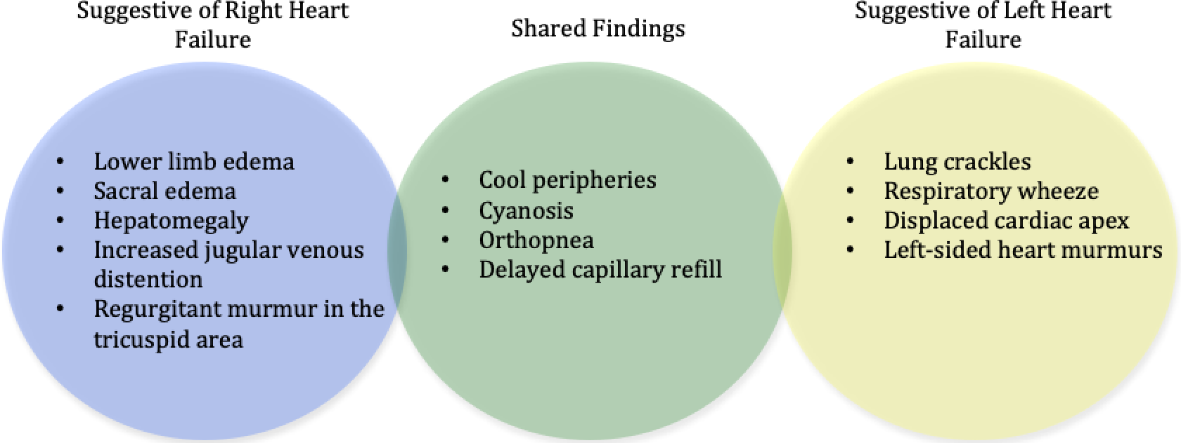

Copyright © 2019 The Authors. Published on behalf of the American Heart Association, Inc., by Wiley Blackwell
Cyrus Vahdatpour. Journal of the American Heart Association. Cardiogenic Shock, Volume: 8, Issue: 8, DOI: (10.1161/JAHA.119.011991)

Slide 8
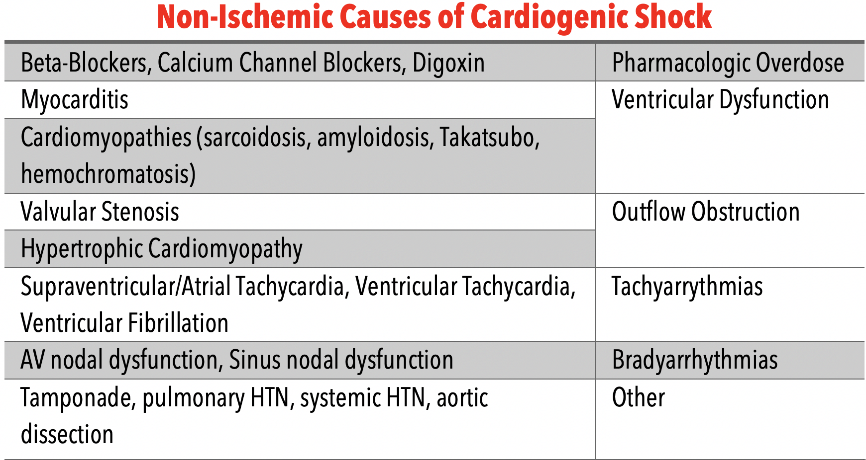

Slide 9
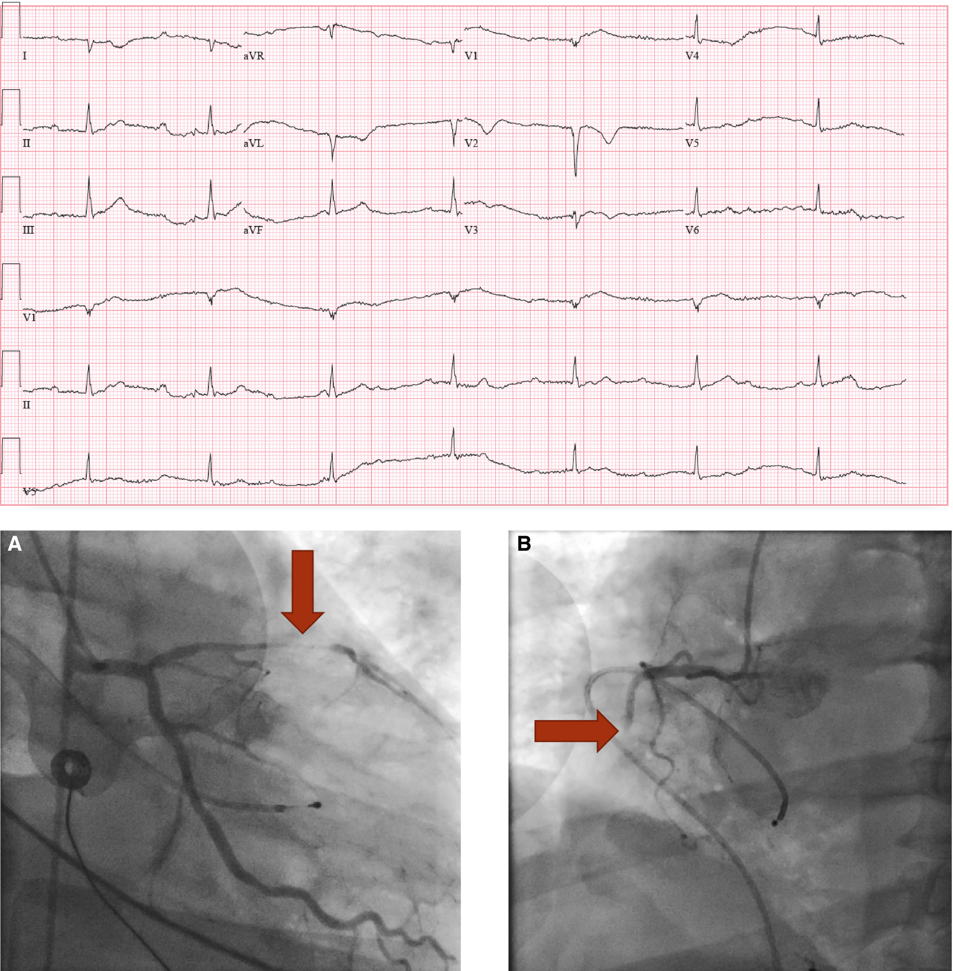
ECG and coronary angiogram of a 53‐year‐old male who presented following sudden onset of nausea, and syncope. The patient was profoundly hypotensive on arrival and an ECG revealed complete atrioventricular dissociation with junctional bradycardia. Coronary angiography demonstrated (A) a high‐grade proximal LAD stenosis with Thrombolysis in Myocardial Infarction 2 flow and (B) a total thrombotic proximal right coronary artery (RCA) occlusion. An Impella 2.5 was inserted for left ventricular support and PCI to the LAD was performed with a drug eluting stent. He recovered, the Impella was discontinued, and he was discharged. LAD indicates left anterior descending; PCI, percutaneous intervention.
Cyrus Vahdatpour. Journal of the American Heart Association. Cardiogenic Shock, Volume: 8, Issue: 8, DOI: (10.1161/JAHA.119.011991)

Slide 10
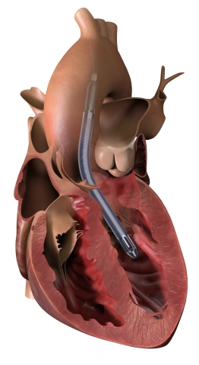
The Impella 5.5 with SmartAssist pulls blood from the left ventricle through an inlet area near the tip of the pump and expels blood from the catheter into the ascending aorta.

Slide 11
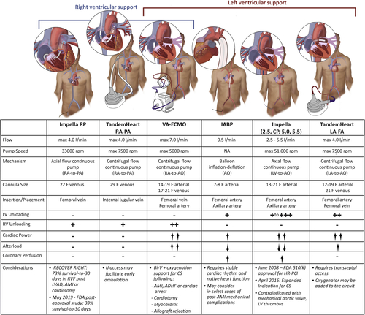
Current Mechanical Circulatory Support Devices Used for the Treatment of Cardiogenic Shock
The hemodynamic profiles of the various circulatory support devices available for treatment of cardiogenic shock. ADHF = acute decompensated heart failure; AMI = acute myocardial infarction; AO = aorta; Bi-V = biventricular; CS = cardiogenic shock; FA = femoral artery; FDA = Food and Drug Administration; HR-PCI = high risk percutaneous coronary intervention; IABP = intra-aortic balloon pump; IJ = internal jugular; LA = left atrium; LV = left ventricular; LVAD = left ventricular assist device; PA = pulmonary artery; RA = right atrium; RPM = revolutions per minute; RV = right ventricular; RVF = right ventricular failure; VA-ECMO = venoarterial extracorporeal membrane oxygenation.
Behnam N. Tehrani et al. J Am Coll Cardiol HF 2020; 8:879-891.
2020 American College of Cardiology Foundation

Slide 12
Patient A .
Was admitted to cardiology department 20 min ago with complaints on heaviness behind the breastbone, palpitation, general weakness, “fog before the eyes”.
Got sick 2 hours ago, after significant physical overload (carrying appr. 15 kg in both hands for a distance of more than 1 km during heatwave). Noticed intensive chest pain with irradiation to left arm. At this time, the patient had already reached home, took Corvalol and Spasmalgon.
Taking into account absence of relief, the patient called cardiology ambulance 1 hour later. STEMI was diagnosed. Promedolol anaesthesia was performed, and the patient was given 325 mg of aspirin orally. The patient was hospitalised.
During the transport and in the hospital, the above complaints were added to the sternum pain.

Slide 13
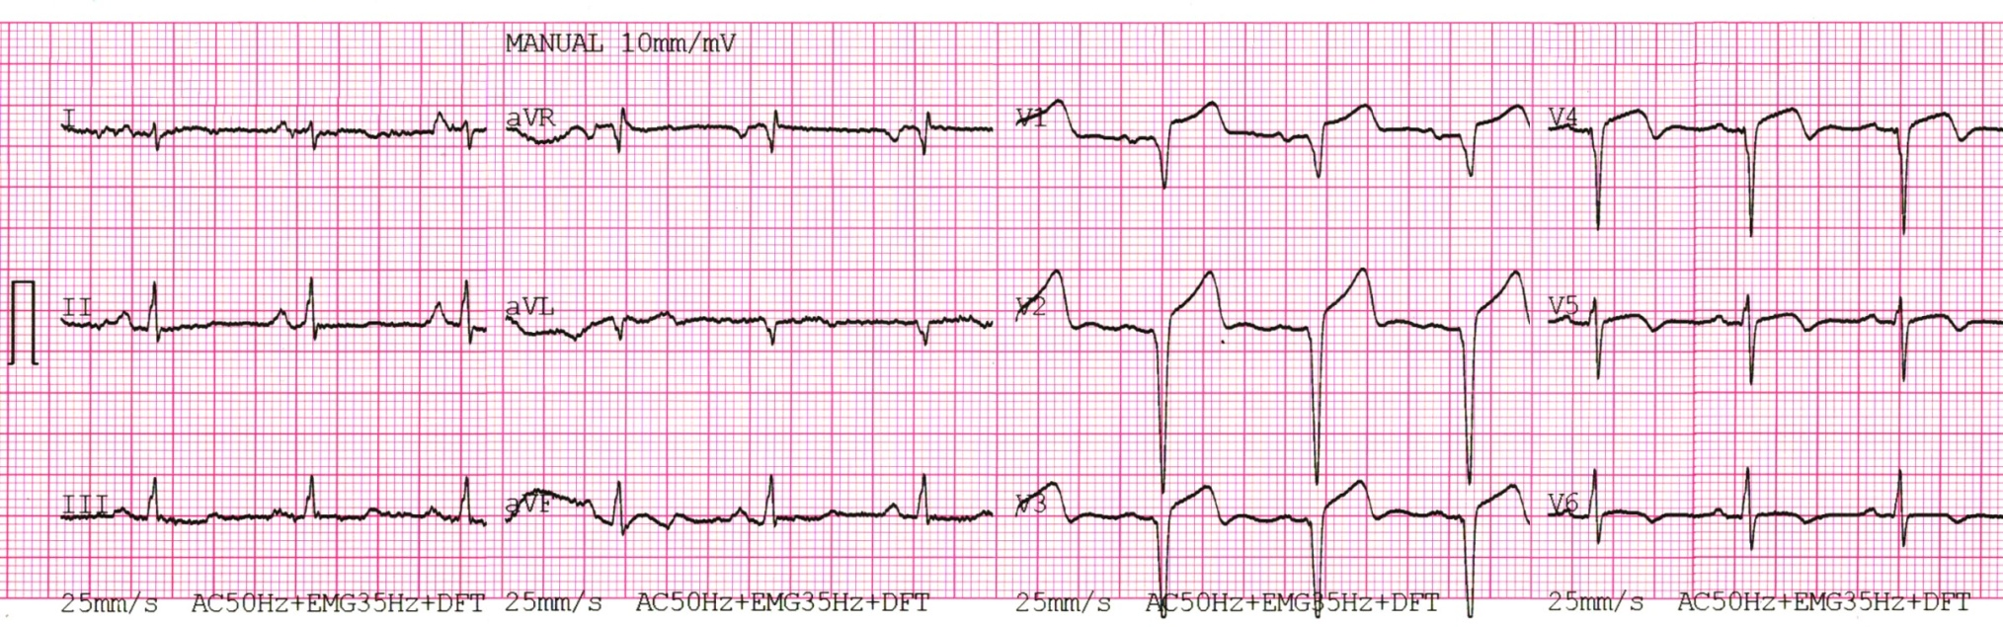
Пацієнт А.

Slide 14
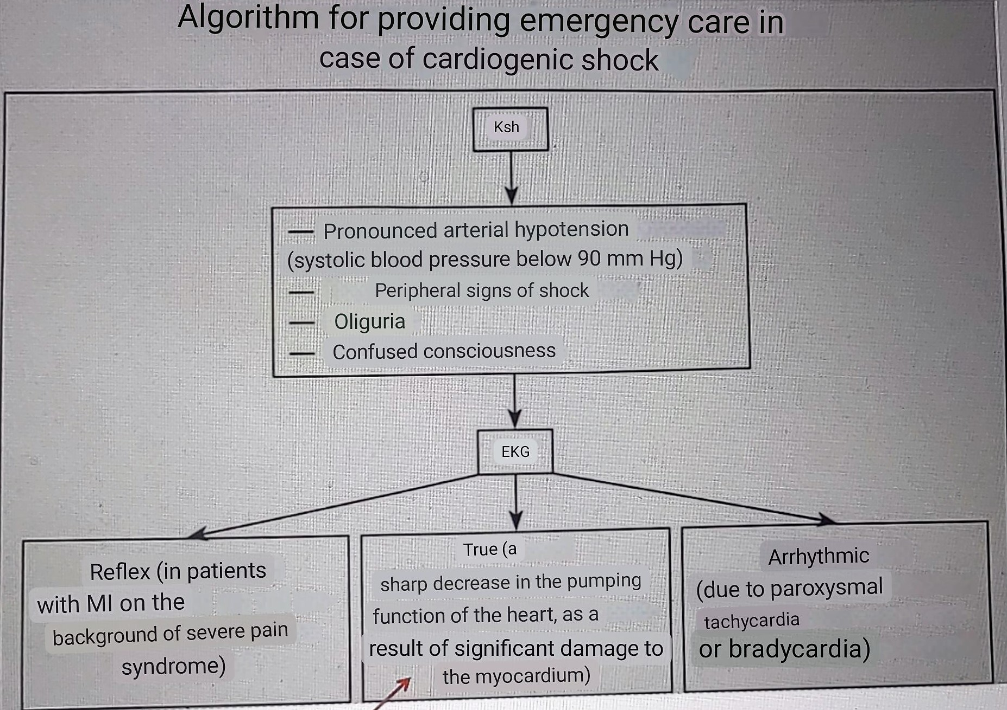
А.
General condition of the patient is serious
The patient is somewhat inhibited, in a stupor, but consciousness is preserved
Acrocyanosis, skin is moist, cold
The pulse on the radial arteries is threadlike, rhythmic, heart rate - 124 per 1 minute, blood pressure - 82/50 mm Hg.
A small number of scattered dry rales + weakening of breathing in the basal lungs, respiratory rate - 24 per 1 min.
According to the patient, the last urination was 5 hours ago, during bladder catheterisation the amount of urine obtained was 50 ml

Slide 15
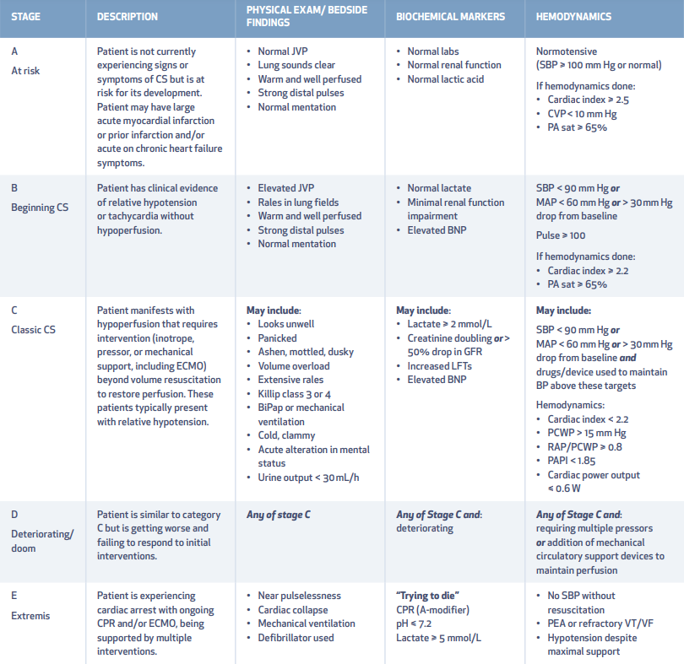
The Society for Cardiovascular Angiography and Interventions classification scheme.CS: cardiogenic shock; JVP: jugular venous pressure; SBP: systolic blood pressure; CVP: central venous pressure; PA sat: pulmonary artery saturation; BNP: brain natriuretic peptide; MAP: mean arterial pressure; PCWP: pulmonary capillary wedge pressure; RAP: right atrial pressure; PAPI: pulmonary artery pulsatility index; GFR: glomerular filtration rate; LFT: liver function test; CPR: cardiopulmonary resuscitation; ECMO: extracorporeal membrane oxygenation; BiPaP: bilevel positive airway pressure

Slide 16
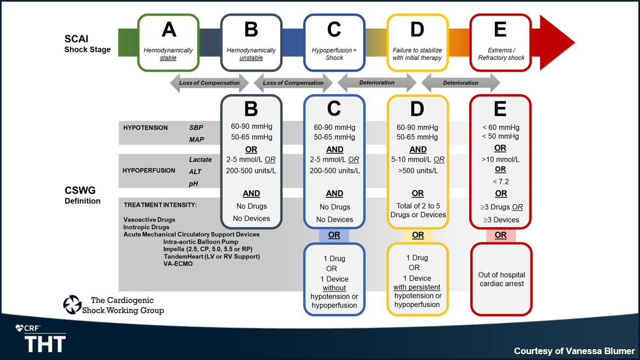
Photo Credit: Sinha SS. SCAI stage across hospitalization and in-hospital mortality among cardiogenic shock patients. Presented at: THT 2022.

Slide 17
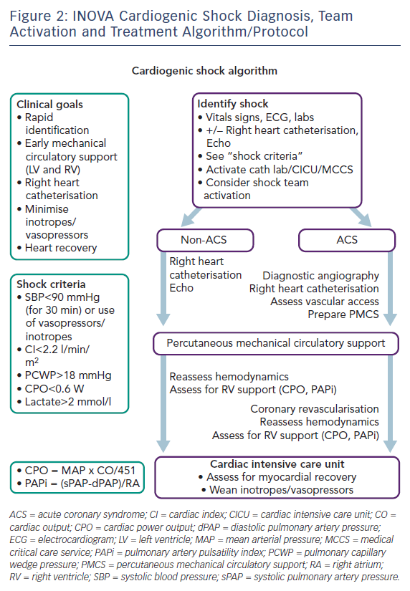

Slide 18

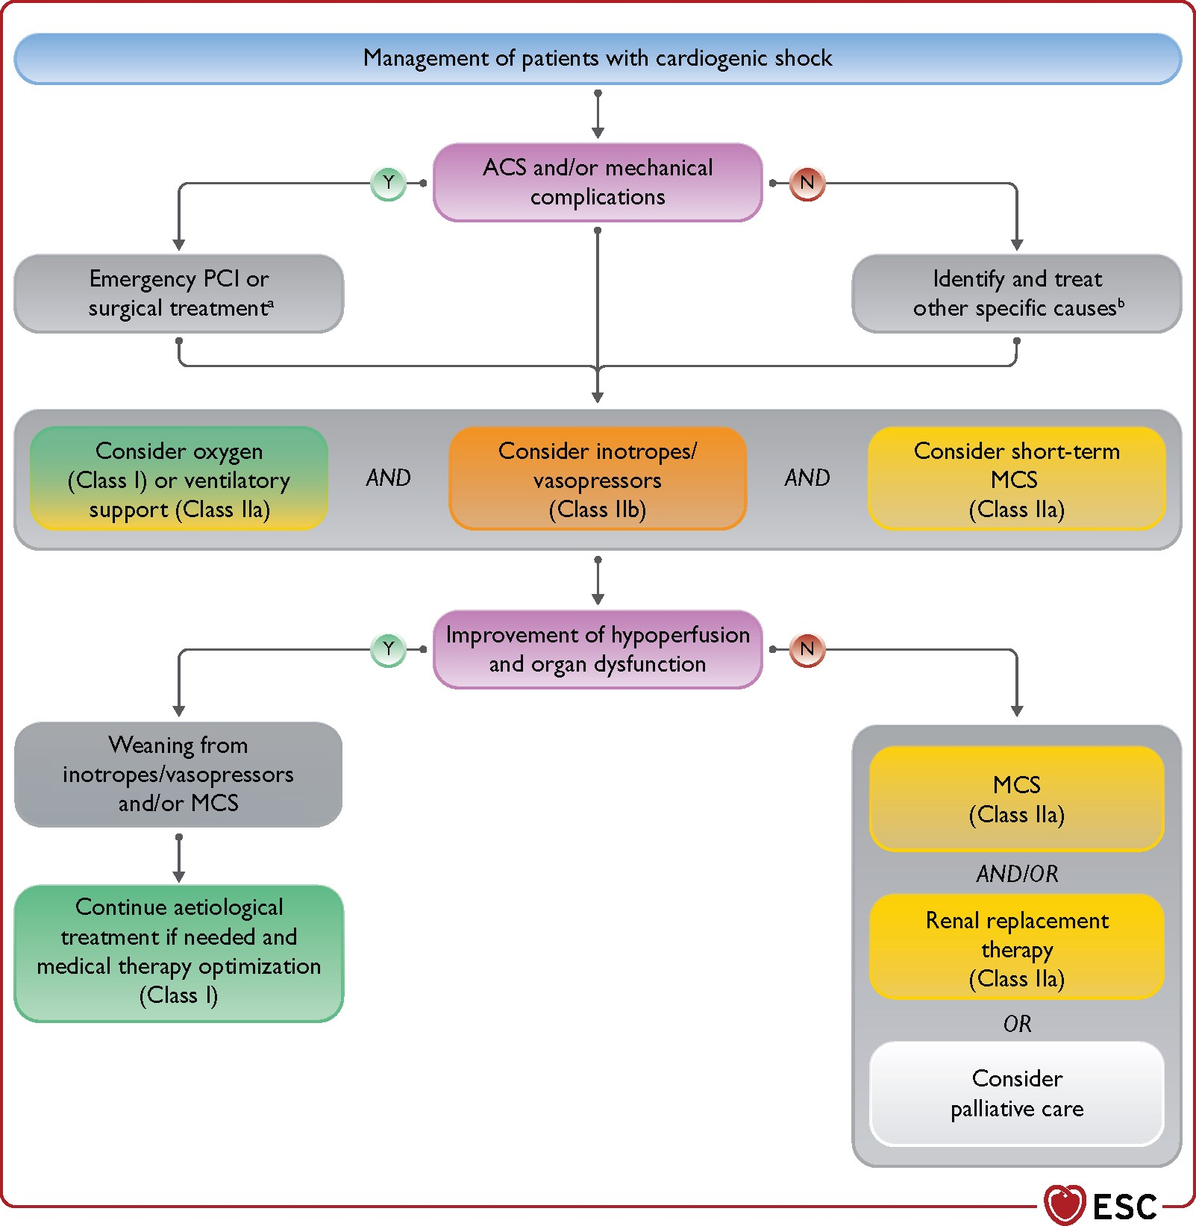

Management of cardiogenic shock. ACS = acute coronary syndrome; BTT = bridge to transplantation; MCS = mechanical circulatory support; PCI = percutaneous coronary intervention. ªPCI in ACS, pericardiocentesis in tamponade, mitral valve surgery in papillary muscle rupture. In case of interventricular septum rupture, MCS as BTT should be considered. ^{b}Other causes include acute valve regurgitation, pulmonary embolism, infection, acute myocarditis, arrhythmia
Notes:
Figure 10 Management of cardiogenic shock. ACS = acute coronary syndrome; BTT = bridge to transplantation; MCS = mechanical circulatory support; PCI = percutaneous coronary intervention. aPCI in ACS, pericardiocentesis in tamponade, mitral valve surgery in papillary muscle rupture. In case of interventricular septum rupture, MCS as BTT should be considered. bOther causes include acute valve regurgitation, pulmonary embolism, infection, acute myocarditis, arrhythmia (see Figure 12).
Unless provided in the caption above, the following copyright applies to the content of this slide: This article has been co-published with permission in the European Heart Journal and European Journal of Heart Failure. © the European Society of Cardiology 2021. All rights reserved. The articles are identical except for minor stylistic and spelling differences in keeping with each journal’s style. Either citation can be used when citing this article. For permissions, please email journals.permissions@oup.com.This article is published and distributed under the terms of the Oxford University Press, Standard Journals Publication Model (https://academic.oup.com/journals/pages/open_access/funder_policies/chorus/standard_publication_model)

Slide 19
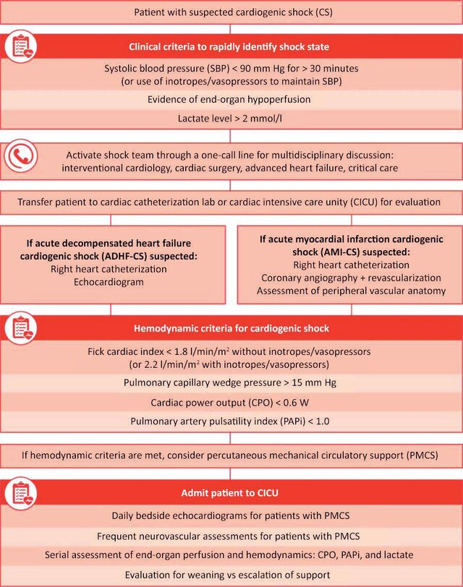

Slide 20
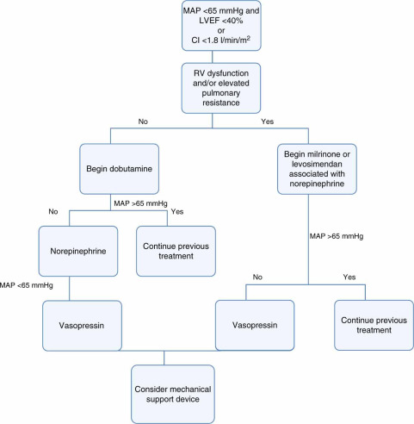
Proposed therapeutic scheme for patients in cardiogenic shock unresponsive to fluid therapy. CI: cardiac index; LVEF: left ventricular ejection fraction; MAP: mean arterial pressure; RV: right ventricular

Slide 21
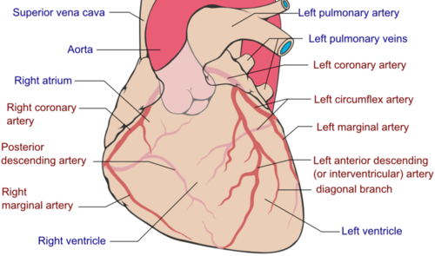

Slide 22
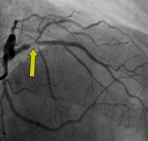
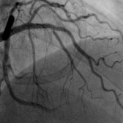
Пацієнт А.
For 1 hour the patient was infused with dobutamine, after stabilisation of haemodynamics at the level of : BP - 102/74 mmHg and heart rate - 102 per 1 min, the patient underwent coronary angiography (subtotal stenosis of the proximal third of the LAD with subsequent stenting)

Slide 23
Patient B.
As you walk to the public transport stop, you see a small crowd of people and hear shouts of "help, he's dying!!!"
As you make your way through the crowd, you see a neatly dressed elderly man lying face up on the pavement, with no signs of life.
His face is pale, not twisted.
You cannot detect a pulse on the carotid arteries.
The pupils' reaction to light is lively.
Asking others what happened, you get the following answer: “He was walking, swayed and collapsed about two minutes ago".

Slide 24
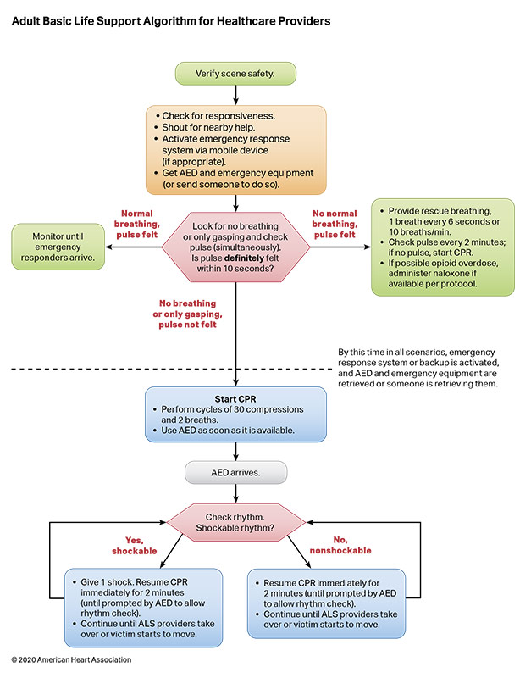
AED indicates automated external defibrillator; ALS, advanced life support; BLS, basic life support; and CPR, cardiopulmonary resuscitation.

Slide 25
Airway is clear
CPR 30:2 performed within 1 minute
Spontaneous breathing has not been restored AED (automated external defibrillator) is not available
Continue CPR 30:2 until the ambulance arrives or until the person opens their eyes, takes a breath, starts moving

Slide 26
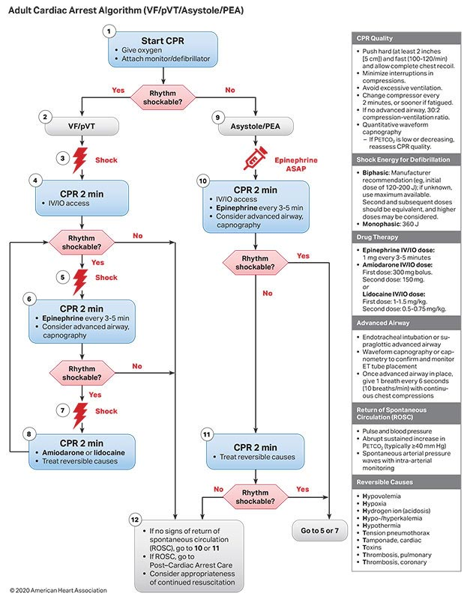

Slide 27
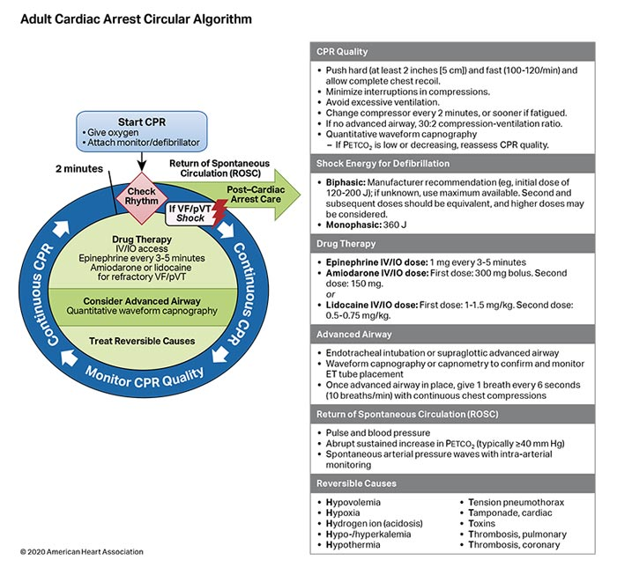

Slide 28
As you walk down the corridor of the therapeutic department, you hear the sound of a body falling in ward 5.
Running into the ward, you see patient V. lying face down in an unnatural position.
When you ask "What happened?" You do not hear an answer.
The patient's face is pale, not contorted.
You cannot detect a pulse on the carotid arteries.
Pupil reaction to light is vivid

Slide 29
Patient V.
The patient's rhythm did not recover after the first defibrillator discharge
The 2nd and then the 3rd defibrillator shocks were performed with a 360 J discharge (the first shock was 200 J)The patient took a deep breath and opened his eyes
The ECG monitor shows sinus tachycardia with frequent ventricular extrasystoles

Slide 30
