Slide 1
Emergency conditions in cardiovascular diseases. Treatment algorithm for a patient with suspected acute pericarditis and/or cardiac tamponade.
Odesa National Medical University
Department of Internal Medicine 2
2023-2024

Slide 2
34-year-old patient complains of medium intensity aching character pain in the area of the heart ,pain intensity changes with the patient`s body position.
The patient fell ill 5 days ago, when the symptoms of a cold and sore throat appeared, fever up to 37,6 °С. The patient was treated with paracetamol, decatilene, naphthyzinum.
On the 4th day of illness the patient developed pain in the heart area.
Physical examination results: body temperature – 37,0 °С, the patient has pain during palpation of the precordial region, pericardial friction rub during cardiac auscultation BP – 110/80 mm Hg, heart rate – 92 in 1 minute.

Slide 3
Diagnostic criteria for acute pericarditis
2 signs or more
+ pain in the area of the heard, which varies with body position
+ pericardial friction rub
- typical ECG changes (elevation ST segment and/or depression PR segment
- EchoCG (new exudative pericarditis)
| |
Signs are determined signs are not determined or it is
difficult to unambiguously interpret them
| | | |
Myopericarditis Acute pericarditis Magnetic resonance Consider an
Increased Troponin I imaging of the heart alternative
Decreased LV function (thickening of the diagnosis
pericardium)
|
Acute pericarditis

Slide 4
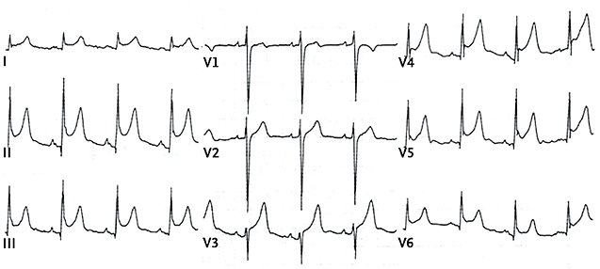
Patient M, ECG

Slide 5
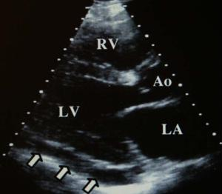
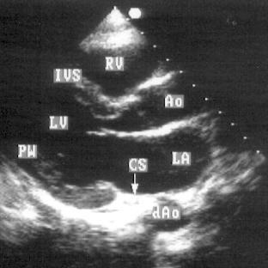
Patient M, EchoCG
ФВ – 63%
N

Slide 6
Patient M
Тroponin І – 28,2 ng/ml
(N - 34.2)

Slide 7
Diagnostic criteria for acute pericarditis
2 signs or more
+ pain in the area of the heard, which varies with body position
+ pericardial friction rub
+ typical ECG changes (elevation ST segment and/or depression PR segment
+ EchoCG (new exudative pericarditis)
| |
Signs are determined signs are not determined or it is
difficult to unambiguously interpret them
| | | |
Myopericarditis Acute pericarditis Magnetic resonance Consider an
Increased Troponin I imaging of the heart alternative
Decreased LV function (thickening of the diagnosis
pericardium)
|
Acute pericarditis

Slide 8
Management of the patient with acute pericarditis
Acute pericarditis
Other causes of pericarditis The most common form
-post-traumatic syndrome is viral pericarditis
(condition after heart injury) |
-condition after cardiac surgery no high risk signs
interventions |
- Dressler`s syndrome (MI) outpatient treatment
- neoplasms nonsteroid antiinflamatory drugs
- metabolic desorders (ibuprofen 600 mg 2 times a day 2 weeks)
( uremia, renal failure, myxedema) |
- bacterial, fungal infections persistent or recurrent chest pain
- tuberculosis + colchicine 2.0 mg 2 times a day for
- systemic connective tissue diseases 24 hours, then 0.5-1.0 mg 2 times a day
-idiopathic 6 mounths
corticosteroids are not prescribed

Slide 9
Management of the patient with acute pericarditis
Acute pericarditis with high risk signs
- fever >38 °С
- subacute onset of the disease
- anticoagulant therapy
- injury
- weakening of the immune system
- hypotension
- swelling of the jugular veins
- massive effusion
|
hospitalization → stable condition
| |
tamponade ibuprofen + colchicine
| examination to determine etiological factors
pericardial puncture
(pericardiocentesis)

Slide 10
Patient M
Diagnosis: Acute pericarditis
Treatment:
ibuprofen 600 mg 2 times a day 2 weeks)

Slide 11
Patient M
Diagnosis: Acute pericarditis
Treatment:
ibuprofen 600 mg 2 times a day 2 weeks
The patient`s condition did not improve within 24 hours after the diagnosis was established and treatment started, and 2 days later the patient`s condition worsened. The patient began to complain of weakness, dyspnea, edema of the legs and feet and these symptoms began to intensify.
Physical examination results:
- the patient sits with the torso tilted forward, as this position reduced dyspnea
- dull heart sounds during auscultation
- swelling of the neck veins
- paradoxical pulse
- BP 80/60 mm Hg , heart rate – 120 in 1 minute.

Slide 12
Management of the patient with cardiac tamponade
Physical examination results ECG results
- swelling of the neck veins - sinus tachycardia
- shock - microvoltage of waves
- paradoxical pulse of the QRS complex
- dullness heart sounds - electrical alternation
(alternation of relatively
high-amplitude ventricular
complexes with ventricular
complexes of lower amplitude)

Slide 13
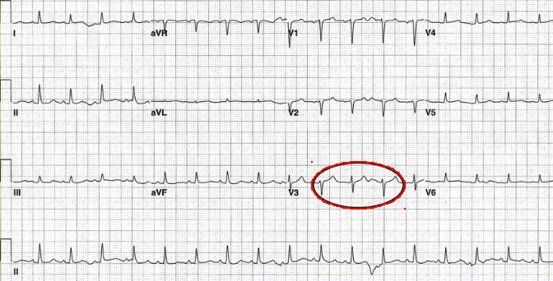
Patient M, ECG 2

Slide 14
Management of the patient with cardiac tamponade
EchoCG
+ moderate or massive perscardial effusion
+ diastolic collapse of the right atrium and right ventricle
- ventricular interdependence
- increased blood flow through the tricuspid valve and pulmonary valve (>50%)
- decrease blood flow through the mitral and aortic valves (>25%) during inspiration ( predictive value > 90%)

Slide 15
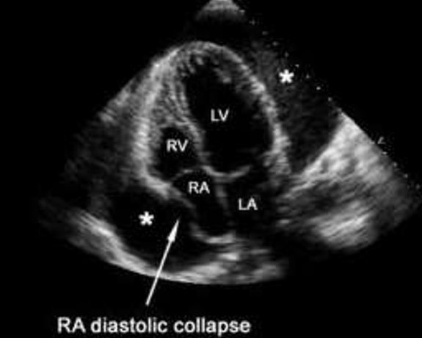
Patient M, EchoCG2

Slide 16
Management of the patient with cardiac tamponade
Examinations that are not performed routinely
Cardiac catheterization
Early signs
- increased pressure in the right atrium
- loss of the downward wave on the pressure curve in the internal
jugular vein
Late signs
- decrease in pressure in the aorta
- paradoxical pulse
- intracardiac balancing of diastolic pressure

Slide 17
Patient M
Physical examination results ECG results
- swelling of the neck veins - sinus tachycardia
- shock - microvoltage of waves
- paradoxical pulse of the QRS complex
- dullness heart sounds - electrical alternation
EchoCG
- moderate or massive perscardial effusion
- diastolic collapse of the right atrium and right ventricle
|
Cardiac tamponade
|
- percutaneous pericardiocentesis and drainage
- consider surgical drainage

Slide 18
Pericardial puncture
Larey-Morphan`s metod of pericardial puncture –
the trocar is inserted between the cartilage of the 7th
rib and the xiphoid process on the left or downward

Slide 19
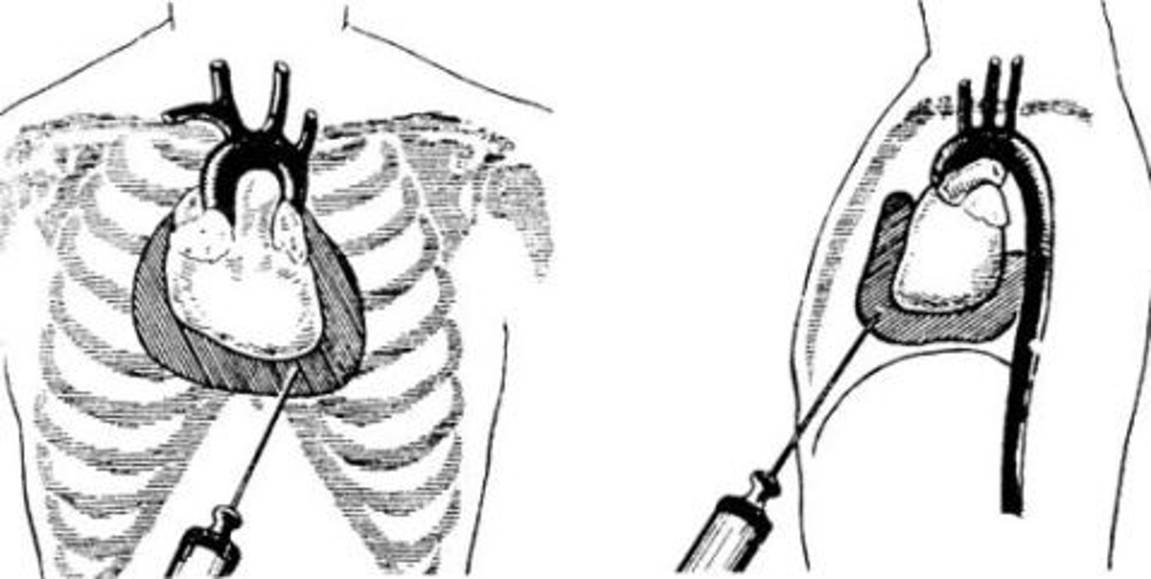
Pericardial puncture

