Slide 1
Odesa national medical university
Department of Internal Medicine №2
Algorithm for the treatment of a patient with pulmonary embolism
2023-2024 academic year

Slide 2
🞂​ Patient K., femail, 74 years old, consulted a doctor about general weakness, shortness of breath while walking and with minimal physical exertion, dizziness, inability to be in a horizontal position due to shortness of breath.
🞂​ A severe worsening of the condition in the form of suffocation, general weakness noted the deterioration of the condition while traveling in public transport

Slide 3
Anamnesis vitae
🞂​ Long-term arterial hypertension, regularly takes enalapril 5 mg 2 times a day. Blood pressure within 140-150/90-100 mm Hg. Periodically takes diuretics, the last time on 21.09.21 furosemide. In 2008, she was diagnosed with bronchial asthma/, regularly takes inhaled salbutamol and beclomethasone. In April 2021, she suffered from a coronavirus infection and pneumonia. At the same time, type 2 diabetes was diagnosed. She regularly takes diaglizid 30 mg in the morning, metformin 500 mg in the evening. Long-term rheumatoid arthritis. From the words takes metipred 4 mg/day for rheumatoid arthritis. Periodical pains in the joints. Long-term osteochondrosis of the spine, causing severe pain in the lumbar region. She also has a history of chronic rhinitis, constantly uses Naphthysine drops. In 2016, hernioplasty for umbilical hernia.

Slide 4
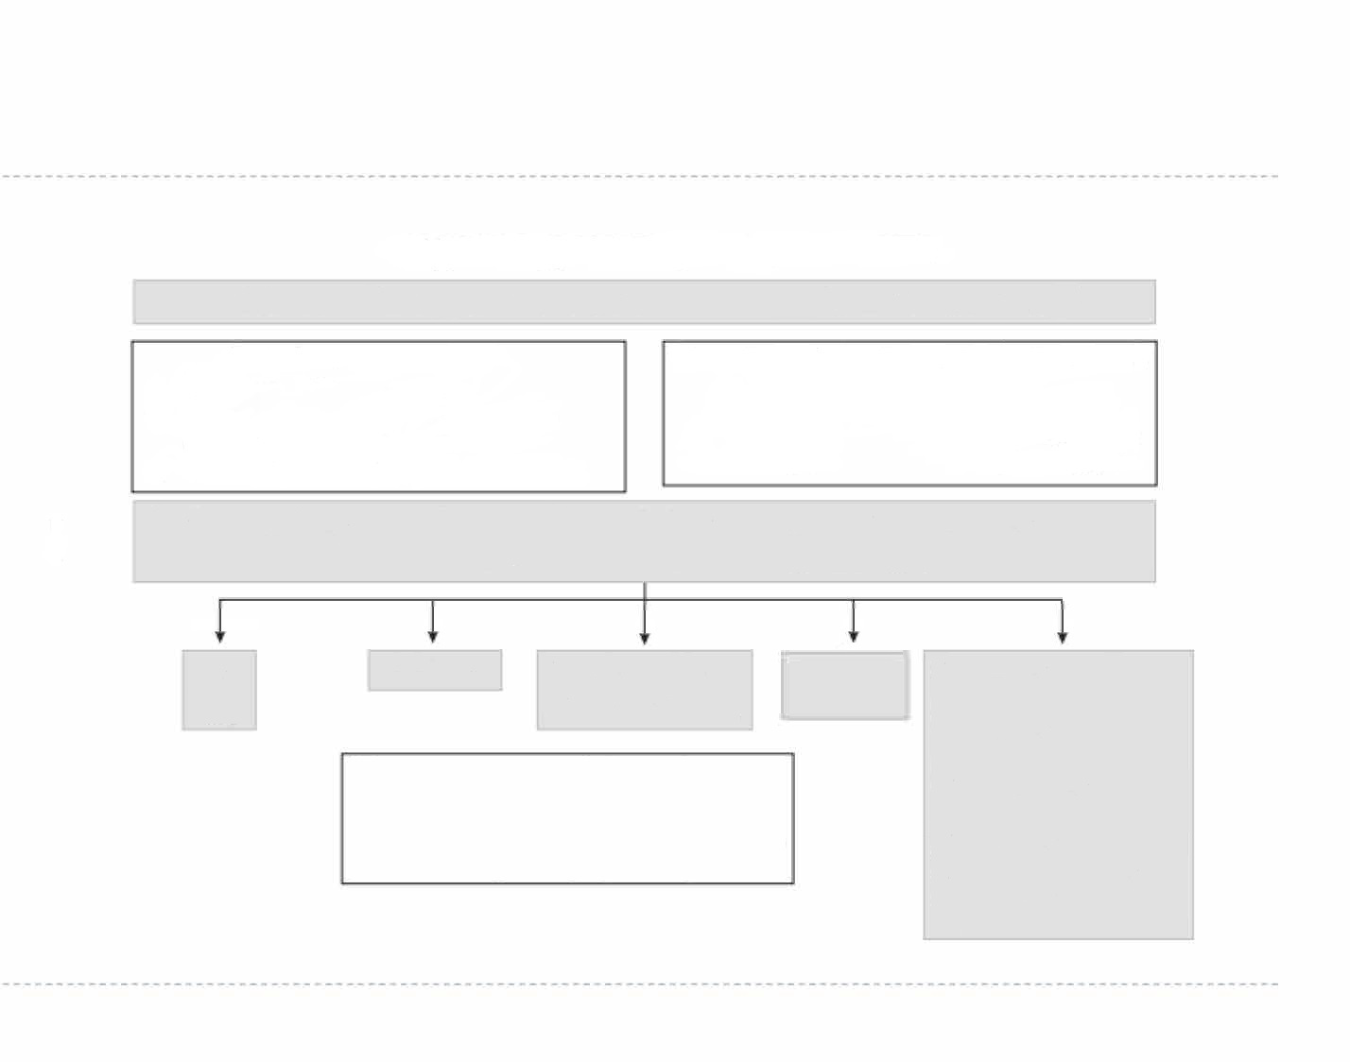
SHORTNESS OF BREATH: DIFFERENTIAL DIAGNOSIS
50% have > 2 diseases that can lead to acute respiratory failure
Main indicators and measures
BP, heart rate, respiratory rate, SpO₂ and temperature
Start oxygen therapy until reaching target values SpO₂ 94-98 %
Establish IV infusion and monitoring of the patient
Criteria of transporting of the patient to to intensive care unit
(in case of non-effective treatment during 30 min)
RR> 35/min
SpO₂< 85%
sysBP< 90 mm .Hg heart rate > 120 b/m
Research:
ECG - Chest X-Ray
BNP - Arterial blood gas analysis
Complete blood count - Troponin (Tn)
D-dimer in case of suspicion of pulmonary embolism
ADHF
ACS
Pneumonia
Exacerbation of COPD or any other chronic lung disease
Pulmonary embolism
Other reasons:
Bronchial asthma
Sepsis
Tumor
Pneumothorax
Pleural effusion, ascites
Anxiety disorder
Anemia
Bronchitis
Metabolic acidosis
Neurological disease
Determined if > 1 criteria present:
-
-
-
-
RR> 25/min
PaO2 < 755 mm.Hg
SpO2< 92% while breathing atmospheric air PaCO2> 455 mm.Hg with arterial pH < 7,3
BNP
-brain natriuretic peptide
►

Slide 5
🞂​ On examination: height 168 cm, weight 80 kg, BMI 28.3
🞂​ Skin - acrocyanosis, body temperature - 35.7 °C
🞂​ Respiratory rate 21 in 1 minute. Sp02-88%
🞂​ Blood pressure 150/90 mm Hg.Art
🞂​ The heart sounds are rhythmic, muffled, the accent of the II tone is over the pulmonary artery. Heart rate - 87 in 1 minute. Pulse - 87 in 1 min.
🞂​ Breathing is rough on both sides

Slide 6
Laboratory indicators
Date | CPK (U/L) | CPK-MB (U/L) | Troponin I
22.09.21 | 142 | 20 | Negative
Complete blood count L (10⁹/l) 6,5
Er (10¹²/l) 4,32
Hb (g/l) 126
Ht (%) 35,2
Thrombocytes (10⁹/l) 184
ESR (mm/h) 2
Eosinophils (%) 2 Band neutrophils (%) 5
Segmented neutrophils (%) 59 Lymphocytes (%) 31
Mоnocytes (%) 3
D-Dimer 3,5 mkg/mL (N 0 -
0,55)

Slide 7
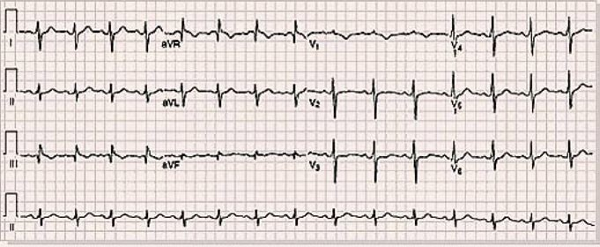
ЕCG

Slide 8
ЕCG
🞂​ ЕCG (22.09.2021): sinus rhythm, regular, heart rate - 68 beats/min., axis deviated to the left. SI-QIII syndrome. Negative T in III and V2. Incomplete blockade of the right leg of the bundle of His.There are no data for acute coronary pathology.

Slide 9
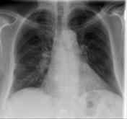

Slide 10
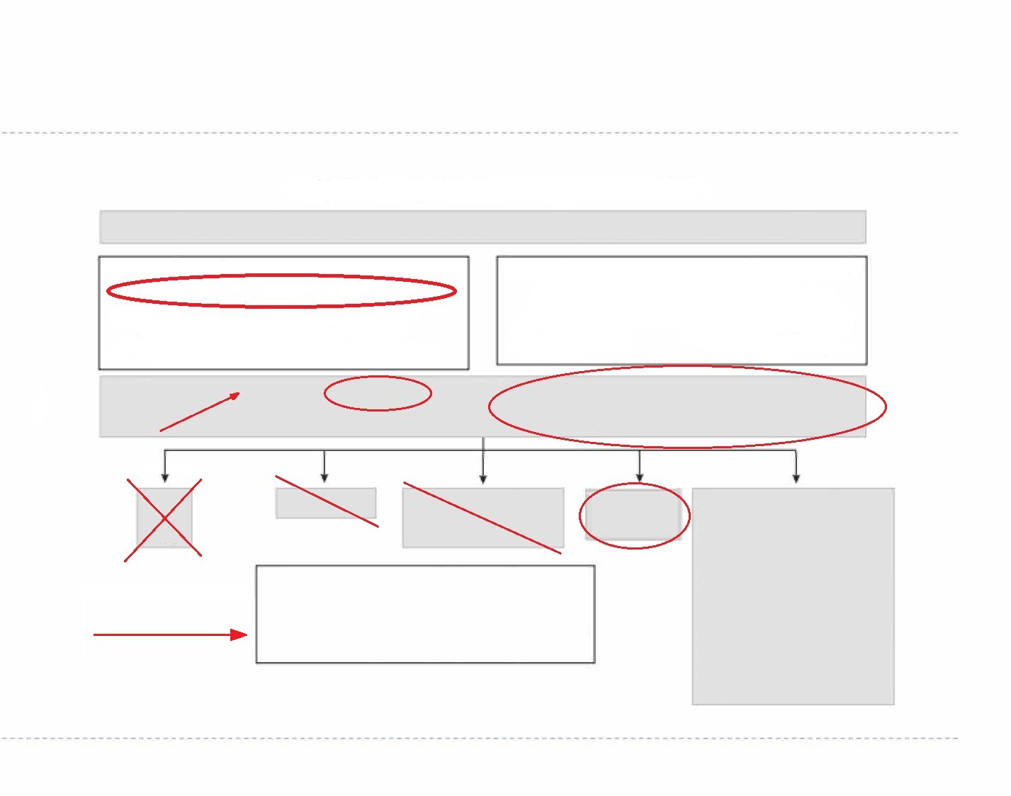
SHORTNESS OF BREATH: DIFFERENTIAL DIAGNOSIS
50% have > 2 diseases that can lead to acute respiratory failure
Main indicators and measures
BP, heart rate, respiratory rate, SpO₂ and temperature
Start oxygen therapy until reaching target values SpO₂ 94-98 %
Establish IV infusion and monitoring of the patient
Criteria of transporting of the patient to to intensive care unit
(in case of non-effective treatment during 30 min)
RR> 35/min
SpO₂ < 85%
sysBP < 90 mm.Hg heart rate > 120 b/m
Research:
ECG - Chest X-Ray
BNP - Arterial blood gas analysis
Complete blood count - Troponin (Tn)
D-dimer in case of suspicion of pulmonary embolism
ADHF
ACS
Pneumonia
Other reasons:
Bronchial asthma;
Sepsis;
Tumor;
Pneumothorax;
Pleural effusion, ascites;
Anxiety disorder;
Anemia;
Bronchitis;
Metabolic acidosis;
Neurological disease
Exacerbation of COPD or any other chronic lung disease
Pulmonary embolism
Determined if > 1 criteria present:
-
-
-
-
RR> 25/min
PaO2 < 755 mm.Hg
SpO2< 92% while breathing atmospheric air PaCO2> 455 mm.Hg with arterial pH < 7,3
BNP
-brain natriuretic peptide
►

Slide 11
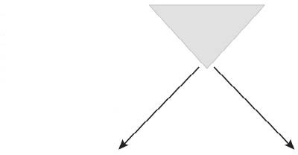
ACUTE PULMONARY EMBOLISM: DIAGNOSTIC
Pulmonary embolism manifests, but is not limited of such simptoms of cardiovascular system:
Pulmonary embolism manifests, but is not limited of such simptoms of respiratory system:
SHORTNESS OF BREATH
Suspicion of acute PE
- chest pain
- pleural effusion
- tachypnea
- hemoptysis
- hypoxemia
- atelectasis
- chest pain (angina)
- syncopal state
- tachycardia
- changes on ECG
- ↑BNP and proBNP
- ↑ Tn
YES
NO
Shock? or
sysBP <90 mm/Hg or
decreasing of sysBP on more than 40 mm.Hg?
BP 150/90 mm.Hg
Algorithm for managing UNSTABLE patients
Algorithm for managing STABLE patients
BNP - brain natriuretic peptide

Slide 12
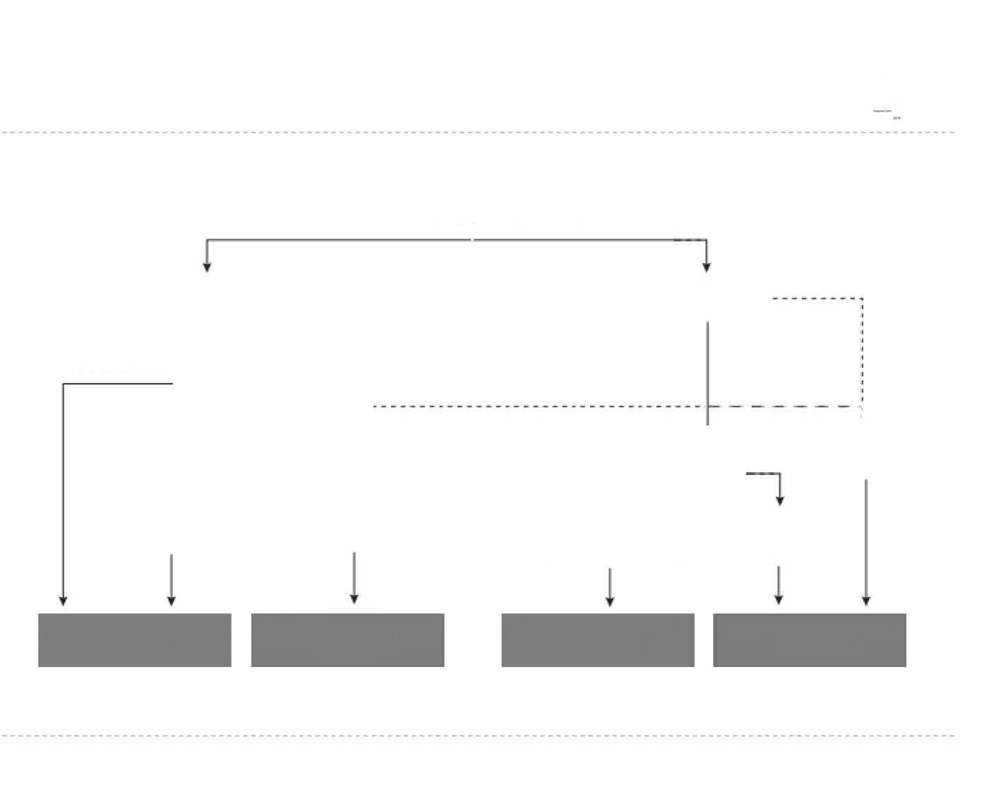
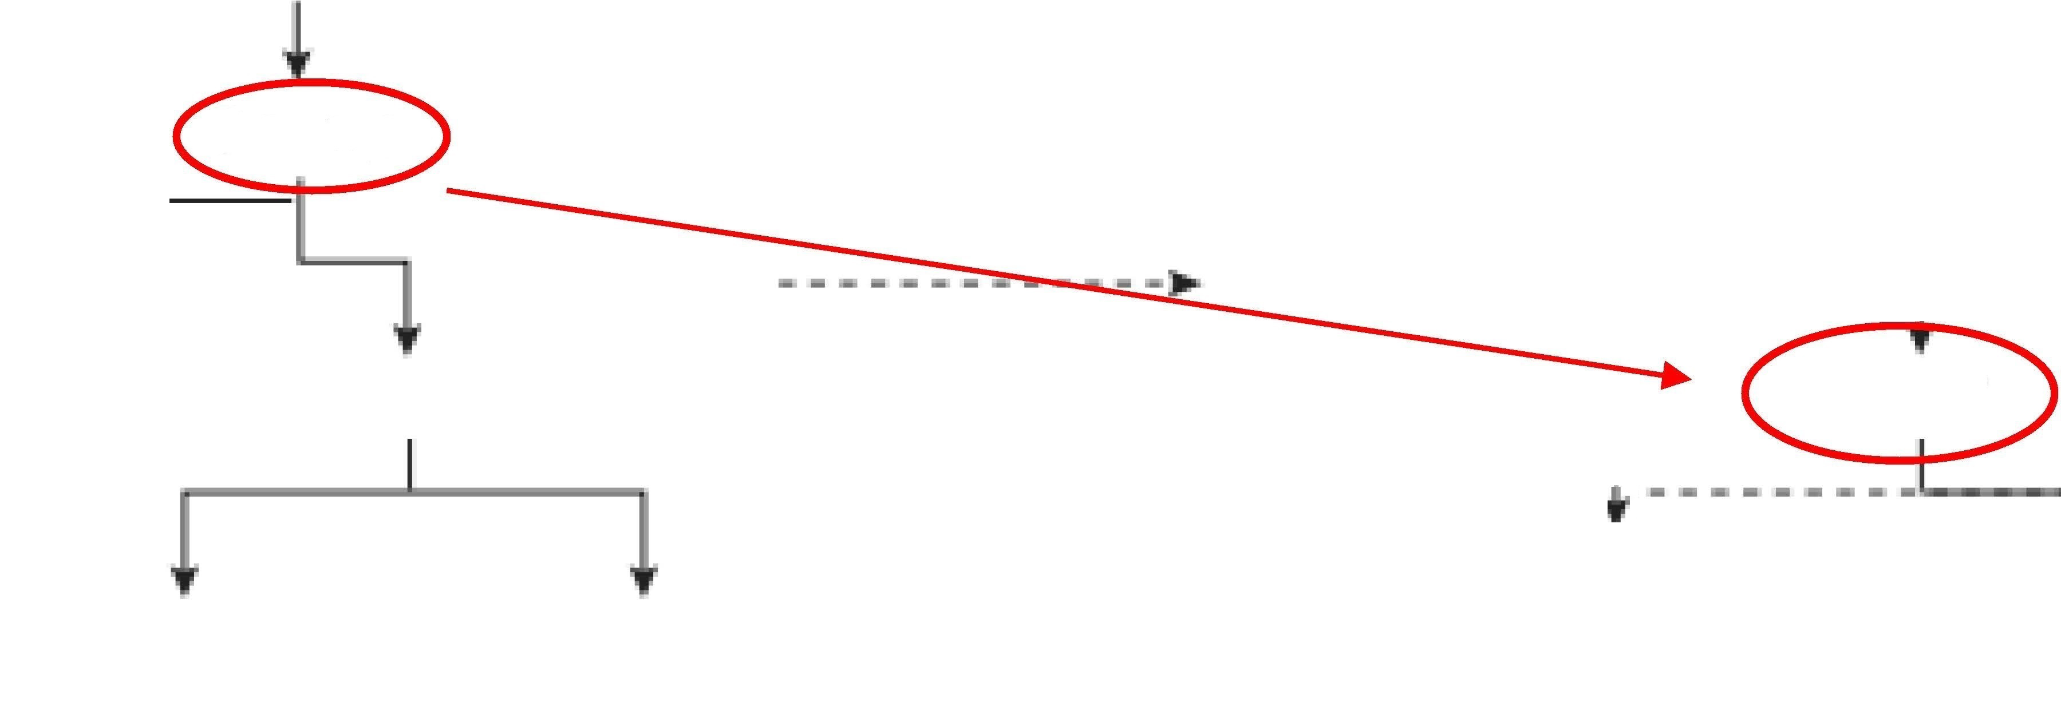
MANAGEMENT ALGORYTHM FOR INITIALY STABLE PATIENS WITH SUSPECTED PULMONARY EMBOLISM
Estimate the clinical (pretest) probability
Low or intermediate "PE probability"
High
"PE probability"
Negative
D-dimer
Positive
CUV
"1
Results of CUV positive
Spiral CT
Spiral CT
Negative result prove throught CUV, scan V/Q or angiography
Spiral CT scan negative
Spiral CT scan
positive
Result of spiral CT positive
Anticoagulant therapy is recommended
Anticoagulant therapy is necessary
Anticoagulant therapy is recommended
Anticoagulant therapy is necessary
Spiral CT - multidetector CT
CT with more then 4 elements
CUV - Compression ultrasonography of veins
►

Slide 13
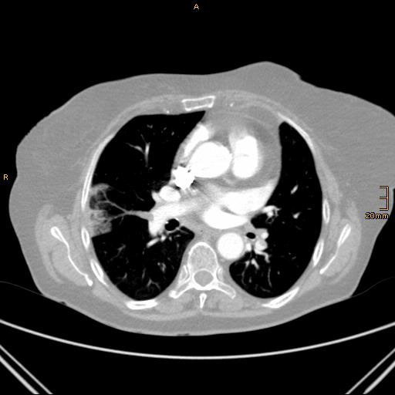

Slide 14
CT of lungs/chest cavity
🞂​ CT with contrastmaterial (22.09.21): CT image of bilateral pulmonary embolism of segmental and subsegmental arteries. CT signs of infarction-pneumonia of the right lung. Large residual changes after the transferred inflammatory process in the parenchyma of both lungs, pneumofibrosis.

Slide 15
🞂​ Echocardiogram (10.09.2021 before hospitalization.): minimal enlargement of the left atrium, thickening of the aorta walls. Moderate fibrosis of the aortic valve. An increase in the pressure gradient on the aortic valve up to 11 mm Hg. Art. Insufficiency of the aortic valve 0-1 st. Minimal fibrosis of the mitral valve. Regurgitation on mitral valve 1 st., tricuspid valve 1 st. Concentric hypertrophy of the left ventricle. LV diastolic dysfunction type 1. There are no zones of hypokinesis. The contractile capacity of the LV is preserved. FV 61%.

Slide 16
Diagnosis:
🞂​ Pulmonary embolism of very high-risk segmental and subsegmental arteries (134 PESI points). Infarct-pneumonia of the right lung Respiratory failure 2 (SaO2 88%)

Slide 17
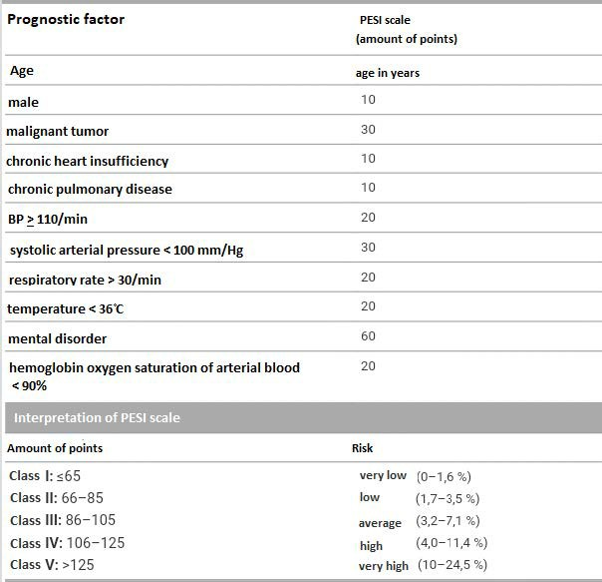
PESI SCALE
74 years
134 points

Slide 18
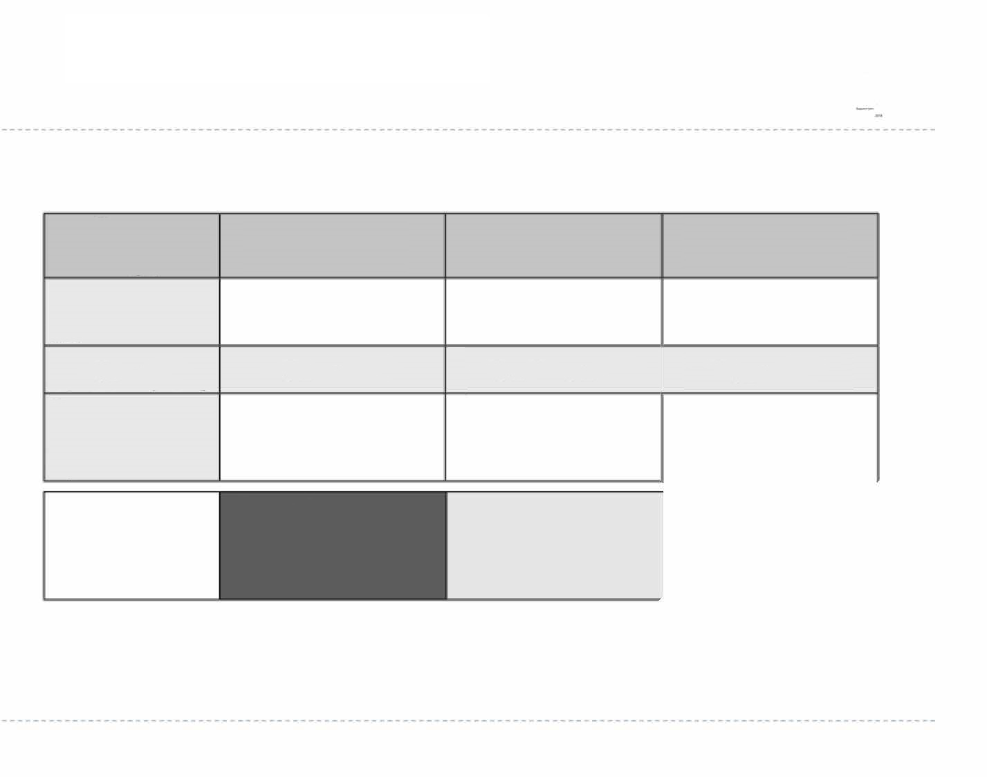




Management of initialy stable patients with confirmed low-risk pulmonary embolism
Markers of myocardial damage*
Positive*
Positive**
Negative
Markers of RV overload
Clinical scale of risk assessment
Preffered initial anticoagulant therapy
Positive*
or Positive**
Negative
Positive*
or Positive**
Negative
IV UFH/LMWH
LMWH/Fondaparinux/ NOAC
LMWH/Fondaparinux/ NOAC
Monitoring in the conditions of the cardiac intensive care unit
Life-saving
thrombolysis***
STRATEGY
Hospitalization monitoring
Early discharge from the hospital
* - if all three positive. ** - if one out of three is positive. *** - early thrombolysis can prevent hemodynamic decompensation, but it's use must be carefully considered due to the risk of severe hemorrhagic complications and stroke
►

Slide 19

PULMONARY EMBOLISM: PHARMACOTHERAPY
Main drugs for primary treatment of patients with verified pulmonary embolism
Unstable state
Alteplase (rtPA) (IV)
100 mg/2 h
or 0,6 mg/kg/15 min minimum (max. 50mg)
Urokinase (IV)
3 million IU per 2 hours
Streptokinase (IV)
1,5 million IU per 2 hours
UFH (IV)
80 IU/ kg bolus + 18 IU/kg/h
Enoxaparin (subcutaneously)
1,0 mg/kg 2 times per day or 1,5 mg/kg 1 time per day
Stable state
Tinzaparin (subcutaneously)
175 U/kg
80 kg = 80 mg
(0,8 ml) 2 times per day
Fondaparinux (subcutaneously)
7,5 mg (weight 50-100 kg)
5 mg (weight < 50 kg)
10 mg (weight >100 kg)
Rivaroxaban (per os)
15 mg 2 times per day (during 3 weeks after 20 mg 1 time per day)
Approval of these drugs for treatment of pulmonary embolism is expected
Other NOACs

Slide 20
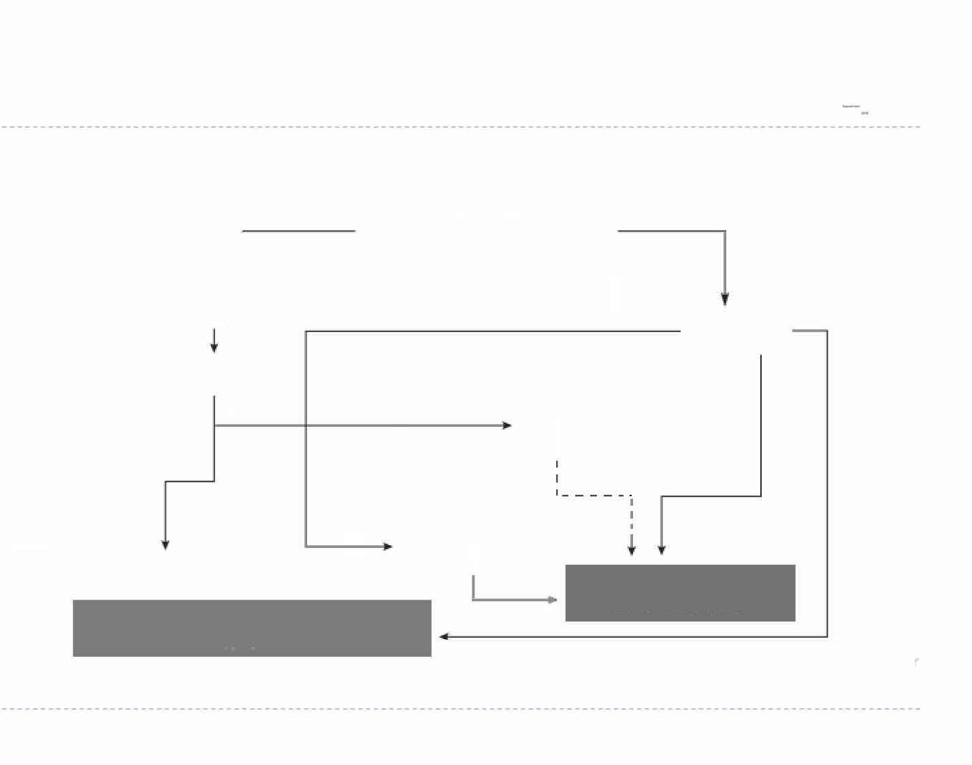


Algorythm of management of unstable patients with suspected pulmonary embolism
There is an opportunity to perform CT-angiography and patient is stabilized
NO
YES
TEE (in patient's bed)
CT-
angiography*
Pressure overload of RV
YES
Patient condition is stabilized
CUV TEE
Blood clots in the right heart, pulmonary arteries or venous blood clots
NO
YES
Positive result
Unable to perform following diagnostic prosedure
Look for another reasons
Thrombolysis or embolectomy
Thrombolysis/ embolectomy is inappropriate
Negative results
* Also consider conducting an angiopulmonography in the patien's unstable condition in the conditions of the hemodynamic laboratory
►

Slide 21
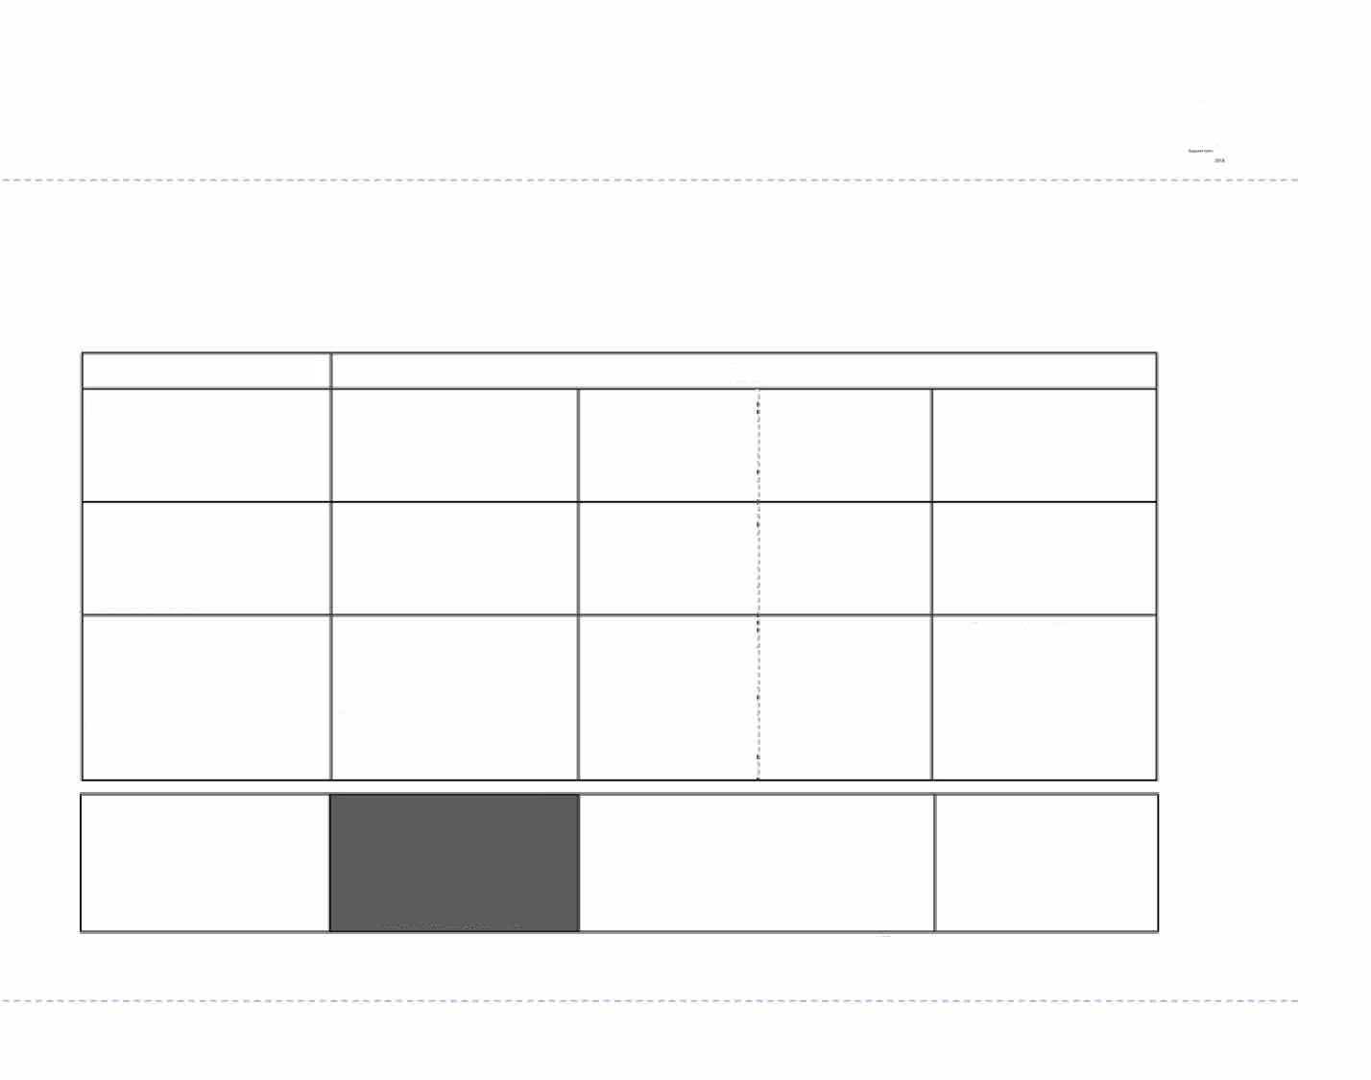
Algorythm of management of unstable patients with confirmed high-risk pulmonary embolism
Shock or hypotension
YES
Recent intracranial hemorrhage
NO
YES
Recent surgery or heavy bleeding
NO
YES
Floating thrombus in the right side of the heart
No or small and limited by right side of the heart
NO
Yes, especially if large or protruding though an open foramen ovale
NO
Thrombolysis, surgical or percutaneous catheter embolectomy
Surgical or percutaneous catheter embolectomy (availability/ experience of the performer)
Surgical embolectomy
STRATEGY
Intravenous UFH, BP stabilization, correction of hypoxemya
►

