Slide 1
Cardiac Rhythm and Conduct Abnormalities
Lecturer:
Kholopov Leonid Semenovich
MD, PhD, Associate professor

Slide 2
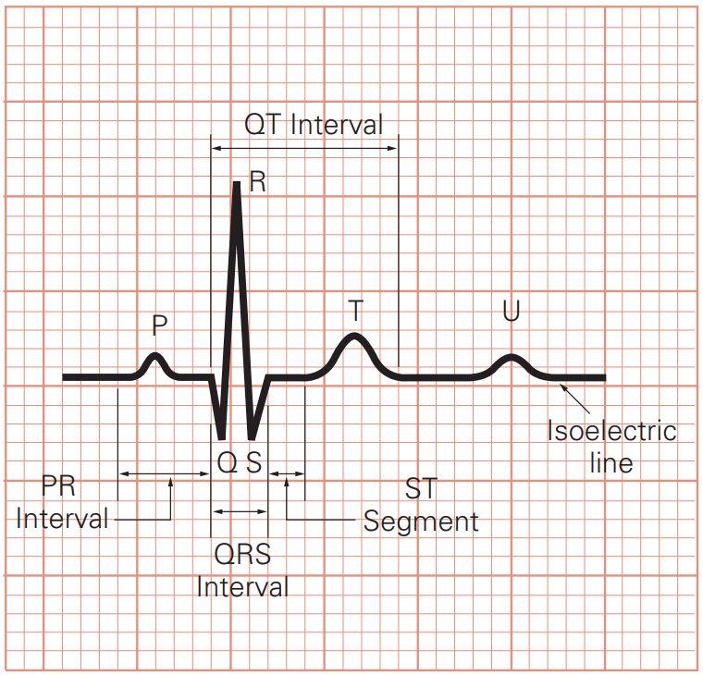
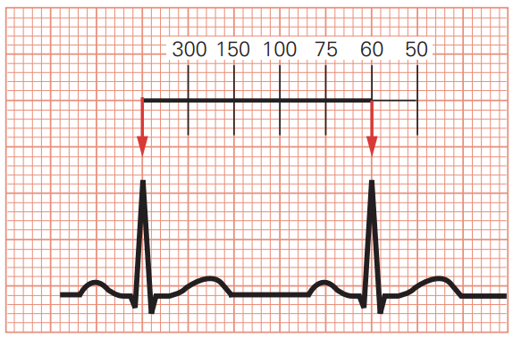
ANALYZING AN ECG RHYTHM
Rate
The bpm is commonly the ventricular rate.
If atrial and ventricular rates differ, as in a third-degree block, measure both rates.
Normal: 60–100 bpm
Slow (bradycardia): <60 bpm
Fast (tachycardia): >100 bpm

Slide 3
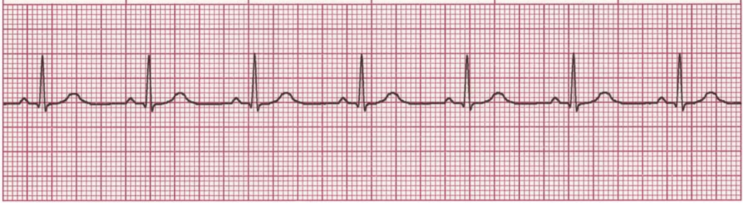
ANALYZING AN ECG RHYTHM
Regularity
Measure R-R intervals and P-P intervals.
Regular: Consistent intervals
Regularly irregular: Repeating pattern
Irregular: No pattern

Slide 4
ANALYZING AN ECG RHYTHM
P waves
If present: Same in size, shape, position?
Does each QRS have a P wave?
Normal: Upright (positive) and uniform
Inverted: Negative
Notched: P’
None: Rhythm is junctional or ventricular

Slide 5
ANALYZING AN ECG RHYTHM
PR interval
Constant: Intervals are the same.
Variable: Intervals differ.
Normal: 0.12–0.20 sec and constant

Slide 6
ANALYZING AN ECG RHYTHM
QRS interval
Normal: 0.06–0.10 sec
Wide: >0.10 sec
None: Absent

Slide 7
ANALYZING AN ECG RHYTHM
QT interval
Beginning of QRS to end of T wave
Varies with HR.
Normal: Less than half the R-R interval

Slide 8
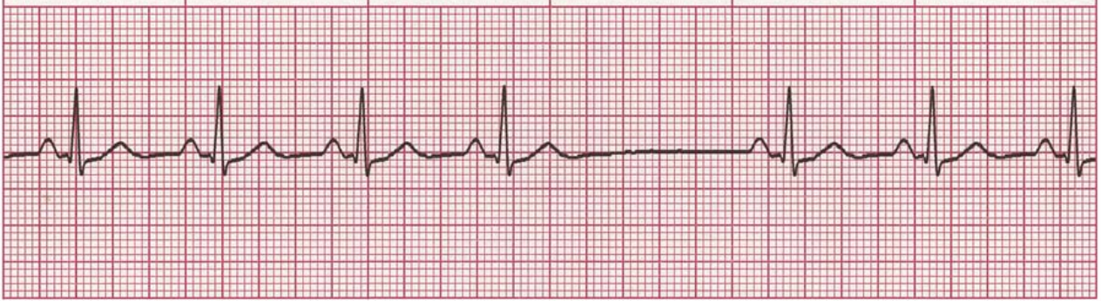
ANALYZING AN ECG RHYTHM
Dropped beats
Occur in AV blocks.
Occur in sinus arrest.

Slide 9
ANALYZING AN ECG RHYTHM
Pause
Compensatory: Complete pause following a premature atrial, junctional, or ventricular contraction (PAC, PJC, or PVC)
Noncompensatory: Incomplete pause following a PAC, PJC, or PVC

Slide 10
ANALYZING AN ECG RHYTHM
QRS Complex grouping
Bigeminy: Repeating pattern of normal complex followed by a premature complex
Trigeminy: Repeating pattern of 2 normal complexes followed by a premature complex
Quadrigeminy: Repeating pattern of three normal complexes followed by a premature complex
Couplets: 2 consecutive premature complexes
Triplets: 3 consecutive premature complexes

Slide 11
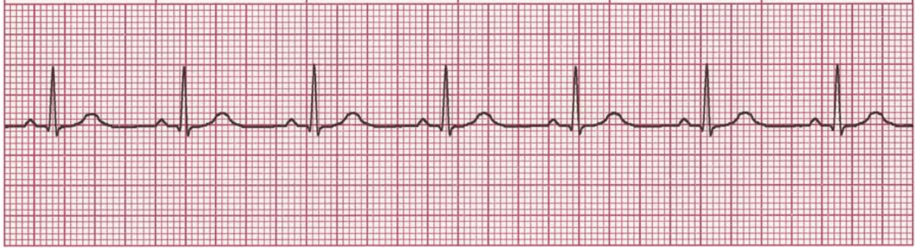
NORMAL SINUS RHYTHM
Rate: Normal (60–100 bpm)
Rhythm: Regular
P Waves: Normal (upright and uniform)
PR Interval: Normal (0.12–0.20 sec)
QRS: Normal (0.06–0.10 sec)
A normal ECG does not exclude heart disease.
This rhythm is generated by the sinus node and its rate is within normal limits (60–100 bpm).

Slide 12
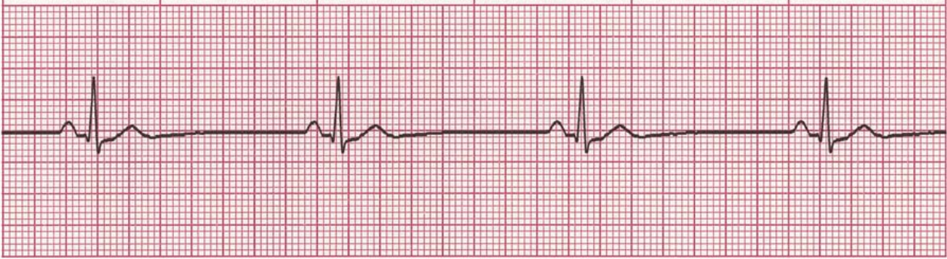
SINUS BRADYCARDIA
Sinoatrial Node
Arrhythmias
Rate: Slow (<60 bpm)
Rhythm: Regular
P Waves: Normal (upright and uniform)
PR Interval: Normal (0.12–0.20 sec)
QRS: Normal (0.06–0.10 sec)
The SA node discharges more slowly than in NSR.
Sinus bradycardia is normal in athletes and during sleep. In acute MI, it may be protective and beneficial or the slow rate may compromise cardiac output.
Certain medications, such as beta blockers, may also cause sinus bradycardia.

Slide 13
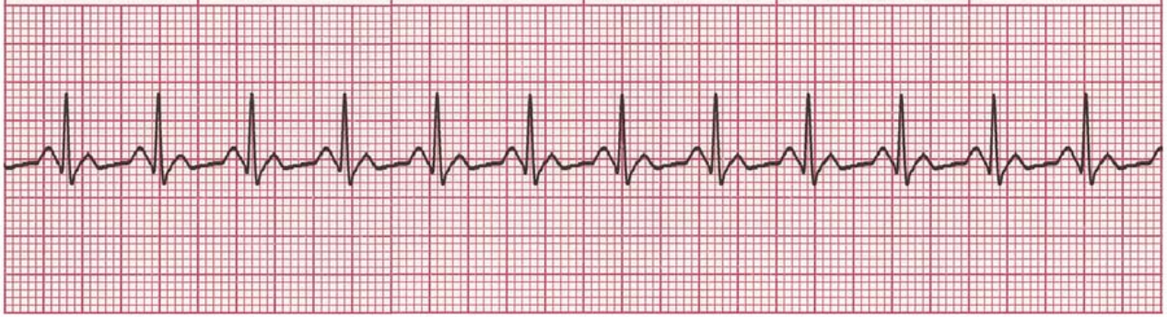
SINUS TACHYCARDIA
Sinoatrial Node
Arrhythmias
Rate: Fast (>100 bpm)
Rhythm: Regular
P Waves: Normal (upright and uniform)
PR Interval: Normal (0.12–0.20 sec)
QRS: Normal (0.06–0.10 sec)
The SA node discharges more frequently than in NSR.
Sinus tachycardia may be caused by exercise, anxiety, fever, hypoxemia, hypovolemia, or cardiac failure.

Slide 14
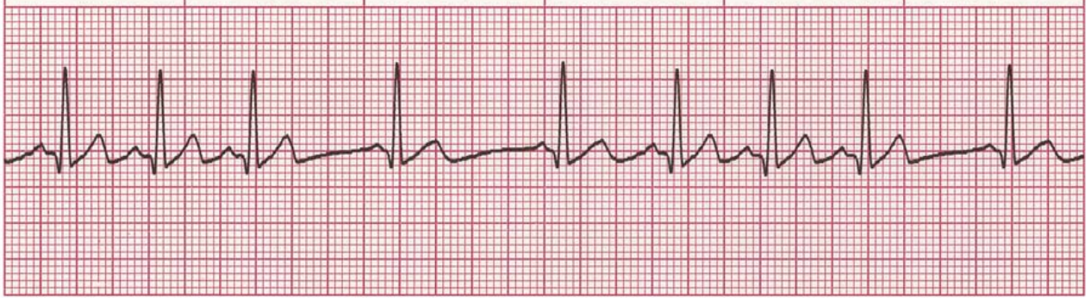
SINUS ARRHYTHMIA
Sinoatrial Node
Arrhythmias
Rate: Usually normal (60–100 bpm); frequently increases with inspiration and decreases with expiration; may be <60 bpm
Rhythm: Irregular; varies with respiration; increases with inspiration; difference between shortest R-R and longest R-R intervals is >0.12 sec
P Waves: Normal (upright and uniform)
PR Interval: Normal (0.12–0.20 sec)
QRS: Normal (0.06–0.10 sec)
The SA node discharges irregularly.
The R-R interval is irregular
The pacing rate of the SA node varies with respiration, especially in children and elderly people.

Slide 15
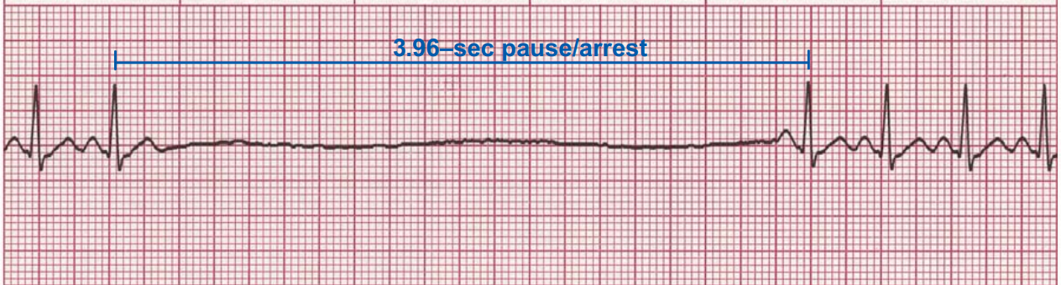
SINUS PAUSE (SINUS ARREST)
Sinoatrial Node
Arrhythmias
Rate: Normal to slow; determined by duration and frequency of sinus pause (arrest)
Rhythm: Irregular whenever a pause (arrest) occurs
P Waves: Normal (upright and uniform) except in areas of pause (arrest)
PR Interval: Normal (0.12–0.20 sec)
QRS: Normal (0.06–0.10 sec)
The SA node fails to discharge and then resumes.
Electrical activity resumes either when the SA node resets itself or when a lower latent pacemaker begins to discharge.
The pause (arrest) time interval is not a multiple of the normal P-P interval
Cardiac output may decrease, causing syncope or dizziness.

Slide 16
SINUS PAUSE (SINUS ARREST)
Atrial Arrhythmias
Rate: Normal to slow; determined by duration and frequency of sinus pause (arrest)
Rhythm: Irregular whenever a pause (arrest) occurs
P Waves: Normal (upright and uniform) except in areas of pause (arrest)
PR Interval: Normal (0.12–0.20 sec)
QRS: Normal (0.06–0.10 sec)
The SA node fails to discharge and then resumes.
Electrical activity resumes either when the SA node resets itself or when a lower latent pacemaker begins to discharge.
The pause (arrest) time interval is not a multiple of the normal P-P interval
Cardiac output may decrease, causing syncope or dizziness.

Slide 17
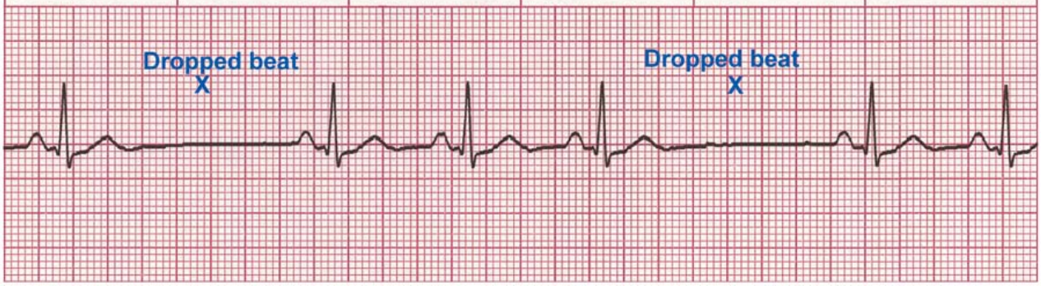
SINOATRIAL (SA) BLOCK
Atrial Arrhythmias
Rate: Normal to slow; determined by duration and frequency of SA block
Rhythm: Irregular whenever an SA block occurs
P Waves: Normal (upright and uniform) except in areas of dropped beats
PR Interval: Normal (0.12–0.20 sec)
QRS: Normal (0.06–0.10 sec)
The block occurs in some multiple of the P-P interval.
After the dropped beat, cycles continue on time.
Cardiac output may decrease, causing syncope or dizziness.

Slide 18
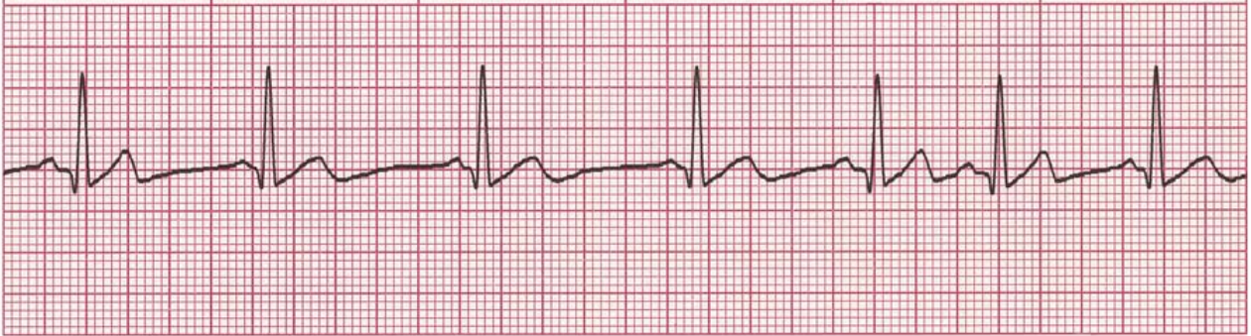
WANDERING ATRIAL PACEMAKER (WAP)
Atrial Arrhythmias
Rate: Normal (60–100 bpm)
Rhythm: Irregular
P Waves: At least three different forms, determined by focus in atria
PR Interval: Variable; determined by focus
QRS: Normal (0.06–0.10 sec)
The pacemaker site transfers from the SA node to other latent pacemaker sites in the atria and the AV junction and then moves back to the SA node.
Wandering atrial pacemaker may occur in normal hearts as a result of fluctuations in vagal tone. It may also be seen in patients with heart disease or COPD.

Slide 19
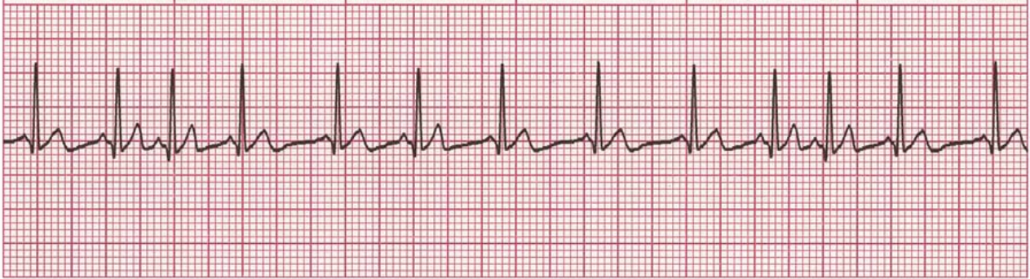
MULTIFOCAL ATRIAL TACHYCARDIA (MAT)
Atrial Arrhythmias
Rate: Fast (>100 bpm)
Rhythm: Irregular
P Waves: At least three different forms, determined by focus in atria
PR Interval: Variable; determined by focus
QRS: Normal (0.06–0.10 sec)
This form of WAP is associated with a ventricular response of >100 bpm.
MAT may be confused with atrial fibrillation (A-fib); however, MAT has a visible P wave
MAT is commonly seen in patients with chronic obstructive pulmonary disease but may also occur in acute MI

Slide 20
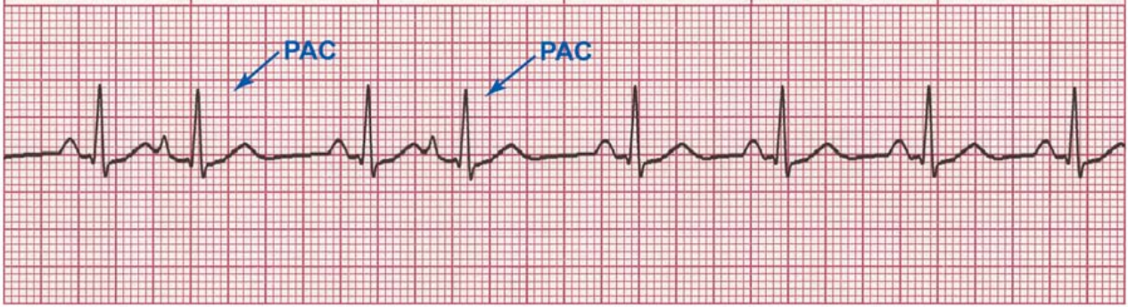
PREMATURE ATRIAL CONTRACTION (PAC)
Atrial Arrhythmias
Rate: Depends on rate of underlying rhythm
Rhythm: Irregular whenever a PAC occurs
P Waves: Present; in the PAC, may have a different shape
PR Interval: Varies in the PAC, otherwise normal (0.12–0.20 sec)
QRS: Normal (0.06–0.10 sec)
A single contraction occurs earlier than the next expected sinus contraction.
After the PAC, sinus rhythm usually resumes
In patients with heart disease, frequent PACs may precede PSVT, A-fib, or A-flutter

Slide 21
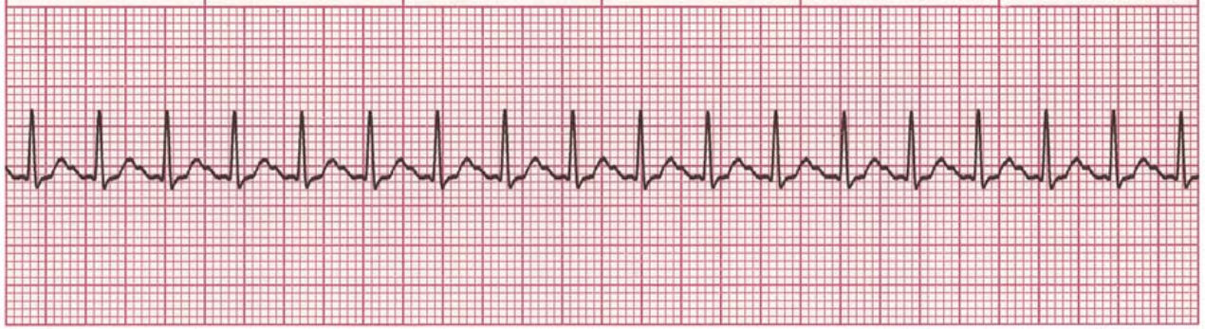
ATRIAL TACHYCARDIA
Atrial Arrhythmias
Rate: 150–250 bpm
Rhythm: Regular
P Waves: Normal (upright and uniform) but differ in shape from sinus P waves
PR Interval: May be short (<0.12 sec) in rapid rates
QRS: Normal (0.06–0.10 sec), but can be aberrant at times
A rapid atrial rate overrides the SA node and becomes the dominant pacemaker.
Some ST wave and T wave abnormalities may be present.

Slide 22
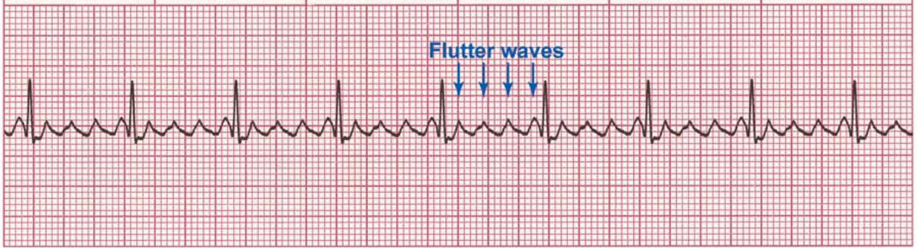
ATRIAL FLUTTER
Atrial Arrhythmias
Rate: Atrial: 250–350 bpm; ventricular: variable.
Rhythm: Atrial: regular; ventricular: variable
P Waves: Flutter waves have a saw-toothed appearance; some may not be visible, being buried in the QRS
PR Interval: Variable
QRS: Usually normal (0.06–0.10 sec), but may appear widened if flutter waves are buried in the QRS
The AV node conducts impulses to the ventricles at a 2:1, 3:1, 4:1, or greater ratio (rarely 1:1).
The degree of AV block may be consistent or variable
The presence of A-flutter may be the first indication of cardiac disease.
Signs and symptoms depend on the ventricular response rate.

Slide 23
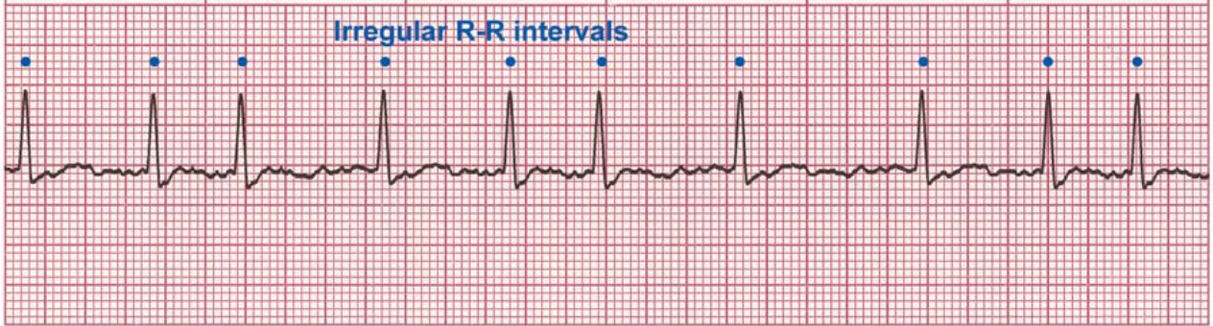
ATRIAL FIBRILLATION
Atrial Arrhythmias
Rate: Atrial: ≥350 bpm; ventricular: variable
Rhythm: Irregular
P Waves: No true P waves; chaotic atrial activity
PR Interval: None
QRS: Normal (0.06–0.10 sec)
Rapid, erratic electrical discharge comes from multiple atrial ectopic foci.
No organized atrial depolarization are detectable
Atrial fibrillation is often a chronic arrhythmia associated with underlying heart disease
Signs and symptoms depend on the ventricular response rate.

Slide 24
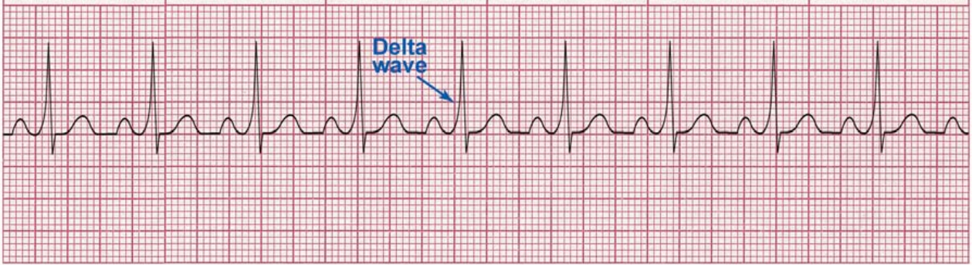
WOLFF-PARKINSON-WHITE (WPW) SYNDROME
Atrial Arrhythmias
Rate: Depends on rate of underlying rhythm
Rhythm: Regular unless associated with A-fib
P Waves: Normal (upright and uniform) unless A fib is present
PR Interval: Short (<0.12 sec)
QRS: Wide (>0.10 sec); delta wave present
In WPW an accessory conduction pathway is present between the atria and the ventricles. Electrical impulses may be rapidly conducted to the ventricles.
These rapid impulses create a slurring of the initial portion of the QRS; the slurred effect is called a delta wave
WPW is associated with narrow-complex tachycardias, including A-flutter and A-fib.

Slide 25
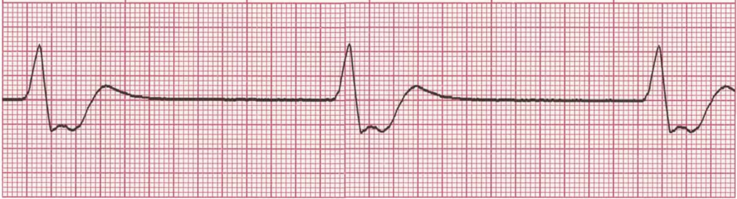
IDIOVENTRICULAR RHYTHM
Ventricular Arrhythmias
Rate: 20–40 bpm
Rhythm: Regular
P Waves: None
PR Interval: None
QRS: Wide (>0.10 sec), bizarre appearance
Diminished cardiac output is expected because of the slow heart rate.
An idioventricular rhythm may be called an agonal rhythm when the heart rate drops below 20 bpm.
An agonal rhythm is generally a terminal event and is usually the last rhythm before asystole.

Slide 26
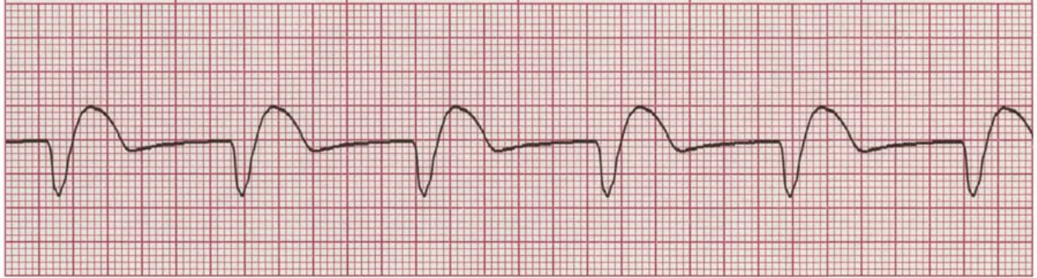
ACCELERATED IDIOVENTRICULAR RHYTHM
Ventricular Arrhythmias
Rate: 41–100 bpm
Rhythm: Regular
P Waves: None
PR Interval: None
QRS: Wide (>0.10 sec), bizarre appearance
Idioventricular rhythms appear when supraventricular pacing sites are suppressed or absent.

Slide 27
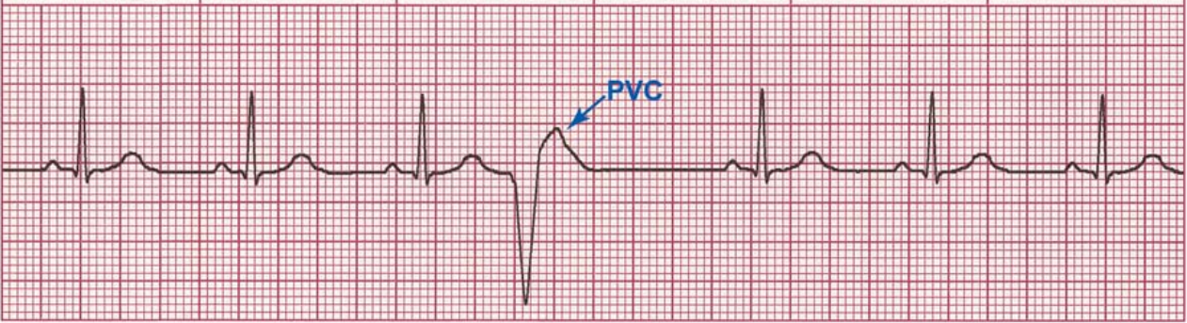
PREMATURE VENTRICULAR CONTRACTION (PVC)
Ventricular Arrhythmias
Rate: Depends on rate of underlying rhythm
Rhythm: Irregular whenever a PVC occurs
P Waves: None associated with the PVC
PR Interval: None associated with the PVC
QRS: Wide (>0.10 sec), bizarre appearance
PVCs result from an irritable ventricular focus.
PVCs may be uniform (same form) or multiform (different forms).
Usually a PVC is followed by a full compensatory pause because the sinus node timing is not interrupted.
Normally the sinus rate produces the next sinus impulse on time.
In contrast, a PVC may be followed by a noncompensatory pause if the PVC enters the sinus node and resets its timing; this enables the following sinus P wave to appear earlier than expected
Patients may sense the occurrence of PVCs as skipped beats.
Because the ventricles are only partially filled, the PVC frequently does not generate a pulse.

Slide 28
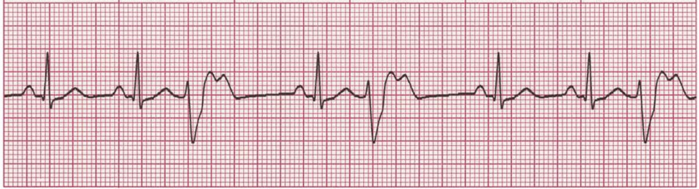
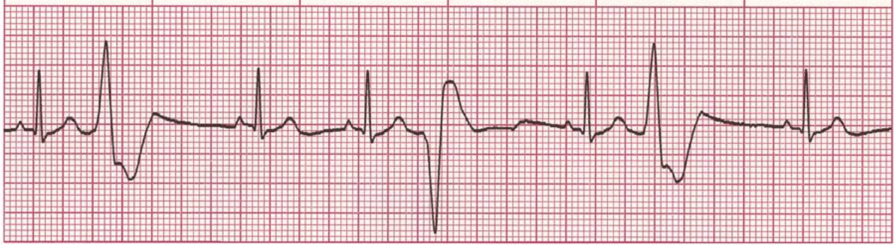
PREMATURE VENTRICULAR CONTRACTION (PVC)
Ventricular Arrhythmias
Uniform
Multiform

Slide 29
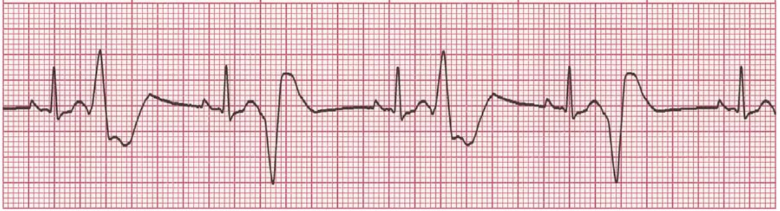
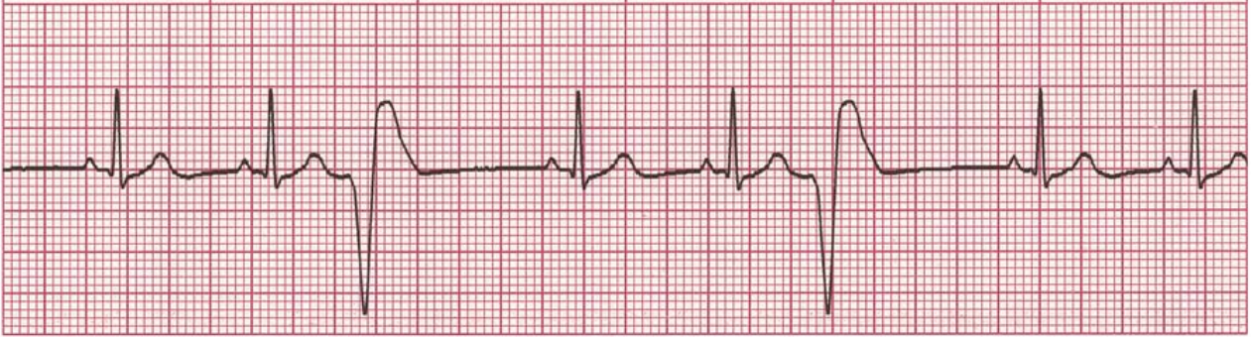
PREMATURE VENTRICULAR CONTRACTION (PVC)
Ventricular Arrhythmias
Ventricular bigeminy, the PVC occurs with every other beat
Ventricular trigeminy - the PVC occurs with every third beat

Slide 30
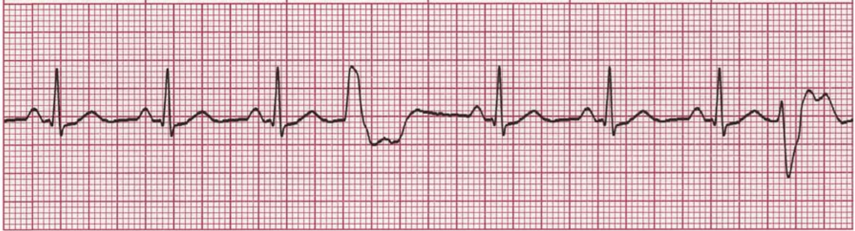
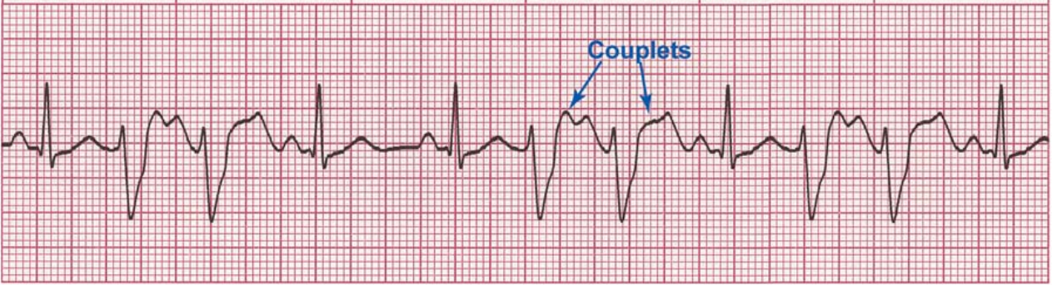
PREMATURE VENTRICULAR CONTRACTION (PVC)
Ventricular Arrhythmias
Ventricular quadrigeminy, the PVC occurs with every fourth beat
In a rhythm with PVC couplets, the PVCs occur in pairs

Slide 31
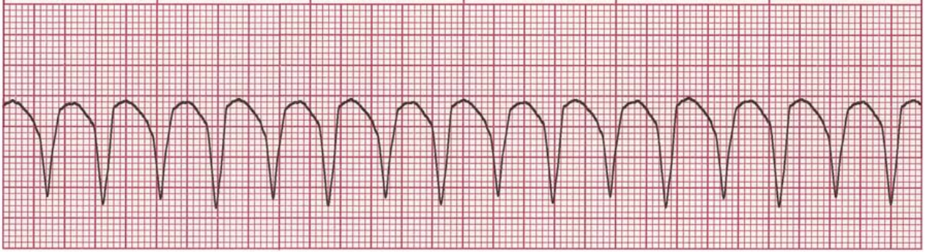
VENTRICULAR TACHYCARDIA (VT): MONOMORPHIC
Ventricular Arrhythmias
Rate: 100–250 bpm
Rhythm: Regular
P Waves: : None or not associated with the QRS
PR Interval: None
QRS: Wide (>0.10 sec), bizarre appearance
In monomorphic VT, QRS complexes have the same shape and amplitude
It is important to confirm the presence or absence of pulses because monomorphic VT may be perfusing or nonperfusing.
Monomorphic VT will probably deteriorate into VF or unstable VT if sustained and not treated.

Slide 32
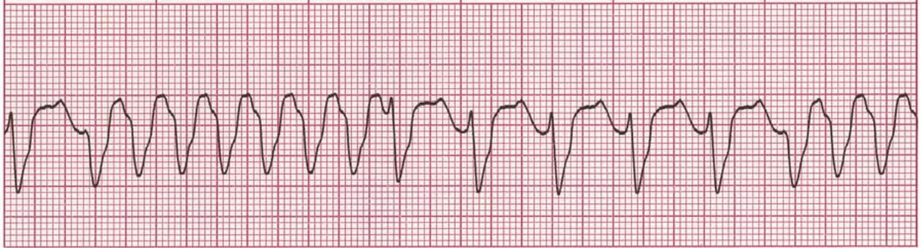
VENTRICULAR TACHYCARDIA (VT): POLYMORPHIC
Ventricular Arrhythmias
Rate: 100–250 bpm
Rhythm: Regular or irregular
P Waves: : None or not associated with the QRS
PR Interval: None
QRS: Wide (>0.10 sec), bizarre appearance
In polymorphic VT, QRS complexes vary in shape and amplitude.
The QT interval is normal or long
It is important to confirm the presence or absence of pulses because polymorphic VT may be perfusing or nonperfusing.
Consider electrolyte abnormalities as a possible cause

Slide 33
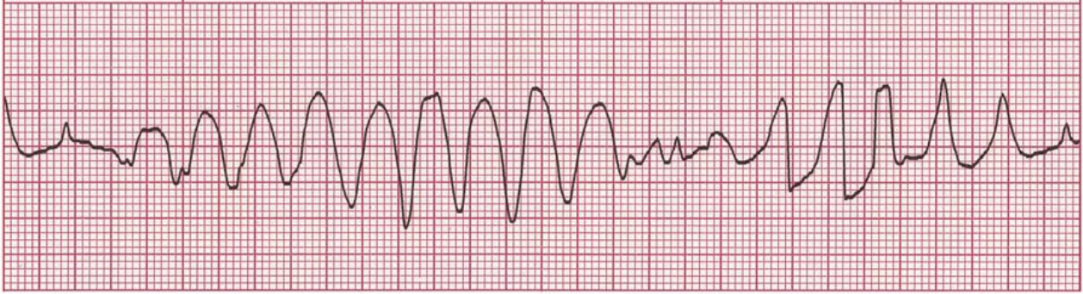
VENTRICULAR TACHYCARDIA (VT): TORSADE DE POINTES
Ventricular Arrhythmias
Rate: 200–250 bpm
Rhythm: Irregular
P Waves: : None
PR Interval: None
QRS: Wide (>0.10 sec), bizarre appearance
The QRS reverses polarity and the strip shows a spindle effect.
This rhythm is an unusual variant of polymorphic VT with long QT intervals.
In French the term means ′′twisting of points.′′
Torsade de pointes may deteriorate to VF or asystole.
Frequent causes are drugs that prolong QT interval, and electrolyte abnormalities such as hypomagnesemia

Slide 34
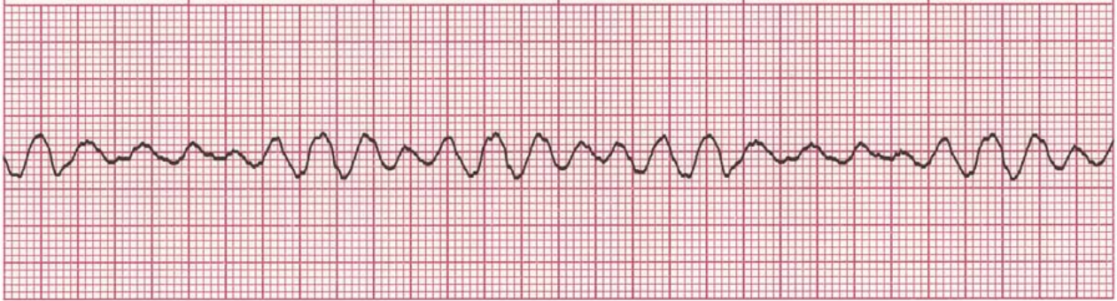
VENTRICULAR FIBRILLATION (VF)
Ventricular Arrhythmias
Rate: Indeterminate
Rhythm: Chaotic
P Waves: : None
PR Interval: None
QRS: None
Chaotic electrical activity occurs with no ventricular depolarization or contraction.
The amplitude and frequency of the fibrillatory activity can be used to define the type of fibrillation as coarse, medium, or fine.
There is no pulse or cardiac output.
Rapid intervention is critical.
The longer the delay, the less the chance of conversion.

Slide 35
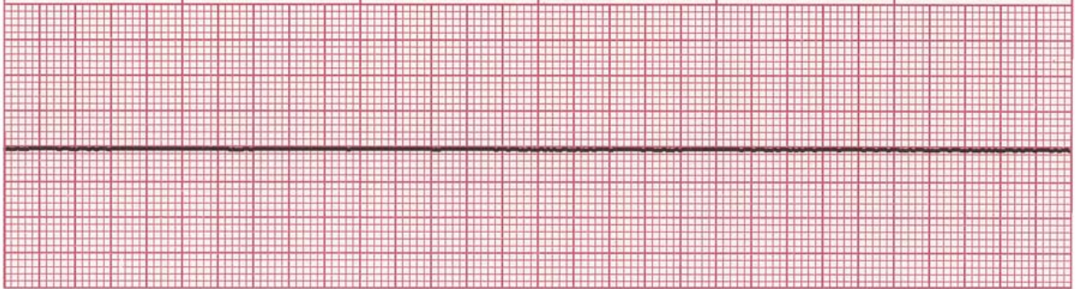
ASYSTOLE
Ventricular Arrhythmias
Rate: None
Rhythm: None
P Waves: : None
PR Interval: None
QRS: None
Electrical activity in the ventricles is completely absent.
Rule out other causes such as loose leads, no power, or signal gain too low.
Seek to identify the underlying cause: trauma, tension pneumothorax, thrombosis (pulmonary or coronary), cardiac tamponade, toxins, hypo- or hyperkalemia, hypovolemia, hypoxia, hypoglycemia, hypothermia, and acidosis.

Slide 36
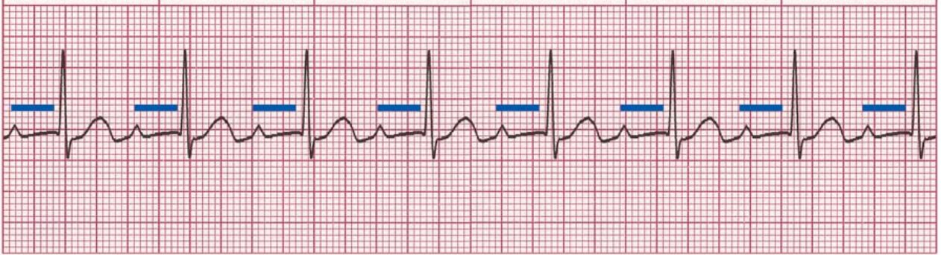
FIRST-DEGREE AV BLOCK
Atrioventricular and Bundle Branch Blocks
Rate: Depends on rate of underlying rhythm
Rhythm: Regular
P Waves: Normal (upright and uniform)
PR Interval: Prolonged (>0.20 sec)
QRS: Normal (0.06–0.10 sec)
Usually a first-degree AV block is benign, but if associated with an acute MI it may lead to further AV defects.
Often AV block is caused by medications that prolong AV conduction; these include digoxin, calcium channel blockers, and beta blockers

Slide 37
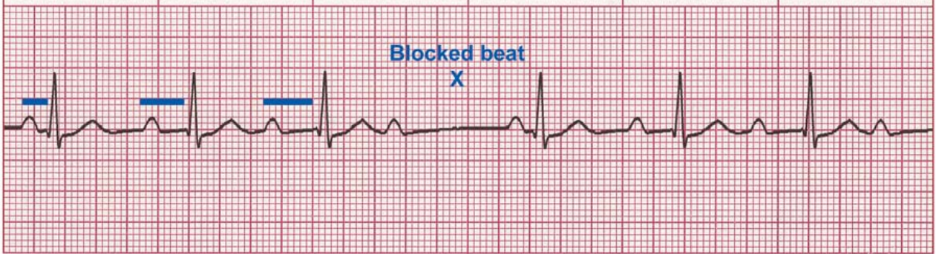
SECOND-DEGREE AV BLOCK: TYPE I
(MOBITZ I OR WENCKEBACH)
Atrioventricular and Bundle Branch Blocks
Rate: Depends on rate of underlying rhythm
Rhythm: Atrial: regular; ventricular: irregular
P Waves: Normal (upright and uniform), more P waves than QRS
PR Interval: Progressively longer until one P wave is blocked and a QRS is dropped
QRS: Normal (0.06–0.10 sec)
PR intervals become progressively longer until one P wave is totally blocked and produces no QRS complex.
After a pause, during which the AV node recovers, this cycle is repeated.
This rhythm may be caused by medication such as beta blockers, digoxin, and calcium channel blockers. Ischemia involving the right coronary artery is another cause.

Slide 38
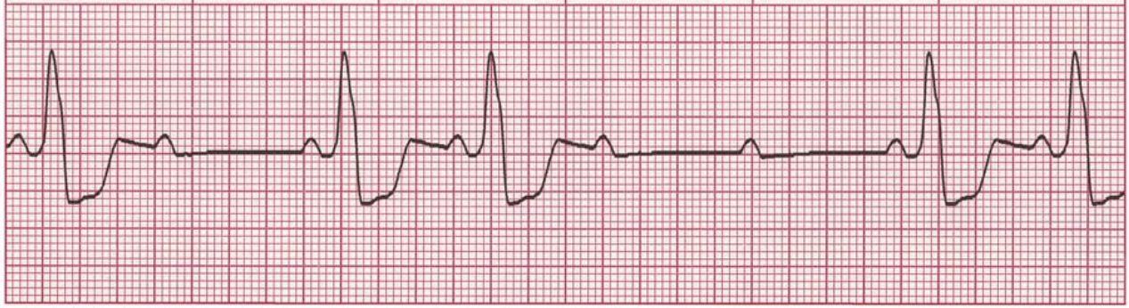
SECOND-DEGREE AV BLOCK: TYPE II (MOBITZ II)
Atrioventricular and Bundle Branch Blocks
Rate: Atrial: usually 60–100 bpm; ventricular: slower than atrial rate
Rhythm: Atrial regular and ventricular may be regular or irregular
P Waves: Normal (upright and uniform), more P waves than QRS
PR Interval: Normal or prolonged but constant
QRS: May be normal, but usually wide (>0.10 sec) if the bundle branches are involved
Conduction ratio (P waves to QRS complexes) is commonly 2:1, 3:1, 4:1, or variable.
QRS complexes are usually wide because this block usually involves both bundle branches
Resulting bradycardia can compromise cardiac output and lead to complete AV block. This rhythm often occurs with cardiac ischemia or an MI.

Slide 39
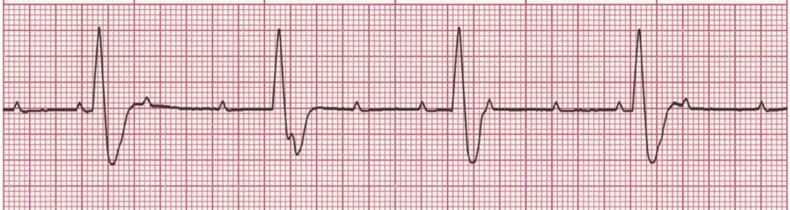
THIRD-DEGREE AV BLOCK
Atrioventricular and Bundle Branch Blocks
Rate: Atrial: 60–100 bpm; ventricular: 40–60 bpm if escape focus is junctional, <40 bpm if escape focus is ventricular
Rhythm: Usually regular, but atria and ventricles act independently
P Waves: Normal (upright and uniform), may be superimposed on QRS complexes or T waves
PR Interval: Varies greatly
QRS: Normal if ventricles are activated by junctional escape focus; wide if escape focus is ventricular
Conduction between the atria and the ventricles is totally absent because of complete electrical block at or below the AV node. This is known as AV dissociation.
“Complete heart block” is another name for this rhythm
Third-degree AV block may be associated with ischemia involving the left coronary arteries.

Slide 40
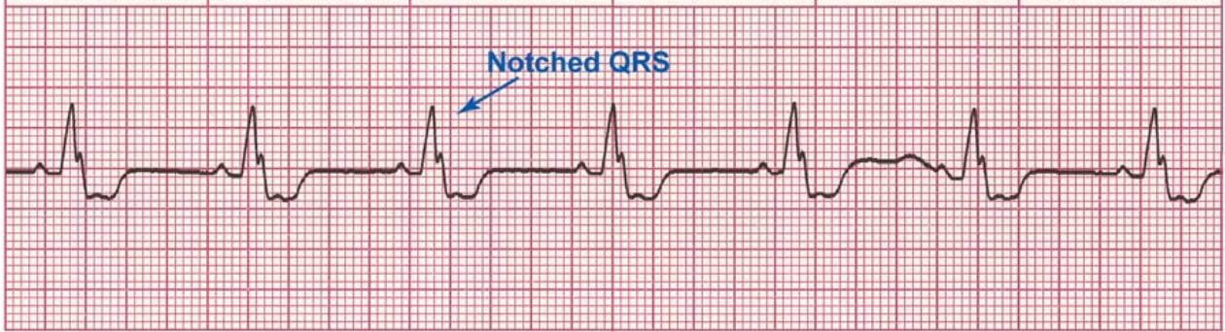
BUNDLE BRANCH BLOCK (BBB)
Atrioventricular and Bundle Branch Blocks
Rate: Depends on rate of underlying rhythm
Rhythm: Regula
P Waves: Normal (upright and uniform)
PR Interval: Normal (0.12–0.20 sec)
QRS: Wide (>0.10 sec) with or without a notched appearance
Either the left or the right ventricle may depolarize late, creating a “wide” or “notched” QRS complex.
Bundle branch block commonly occurs in coronary artery disease

Slide 41
Case history
AV-block
A 78-year-old man with a history of hypertension presents to his primary care physician with 1 episode of dizziness while watching television.
On physical examination, his heart rate is measured at about 40 bpm.
A 12-lead ECG is obtained showing sinus rhythm at about 75 bpm and complete heart block with a wide escape rhythm at about 40 bpm.

Slide 42
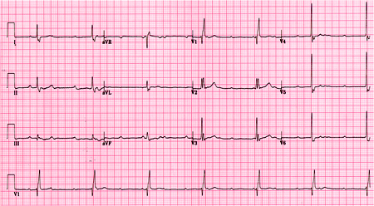
Case history
AV-block

Slide 43
Case history
AV-block
On further questioning, the patient admits to increasing fatigue and dyspnoea on exertion for the past few weeks.
Notably, the patient has bifascicular block at baseline (right bundle-branch block and left anterior fascicular block).

Slide 44
Case history
AV-block
The degree of AV block and the severity of symptoms are not necessarily directly related.
For example, patients with complete (third-degree) AV block may be minimally symptomatic or completely asymptomatic.
Ultimately, these patients may be diagnosed incidentally on undergoing an evaluation for other reasons. On the other hand, patients with type I second-degree AV block may be very symptomatic, presenting with syncope or pre-syncope due to very slow ventricular rates.
AV block may also occur in the setting of other acute illnesses such as an acute coronary syndrome, severe electrolyte or pH disturbances, or severe hypoxaemia.
AV block of any degree may also occur in post-cardiac surgery patients and in patients with Lyme disease.

Slide 45
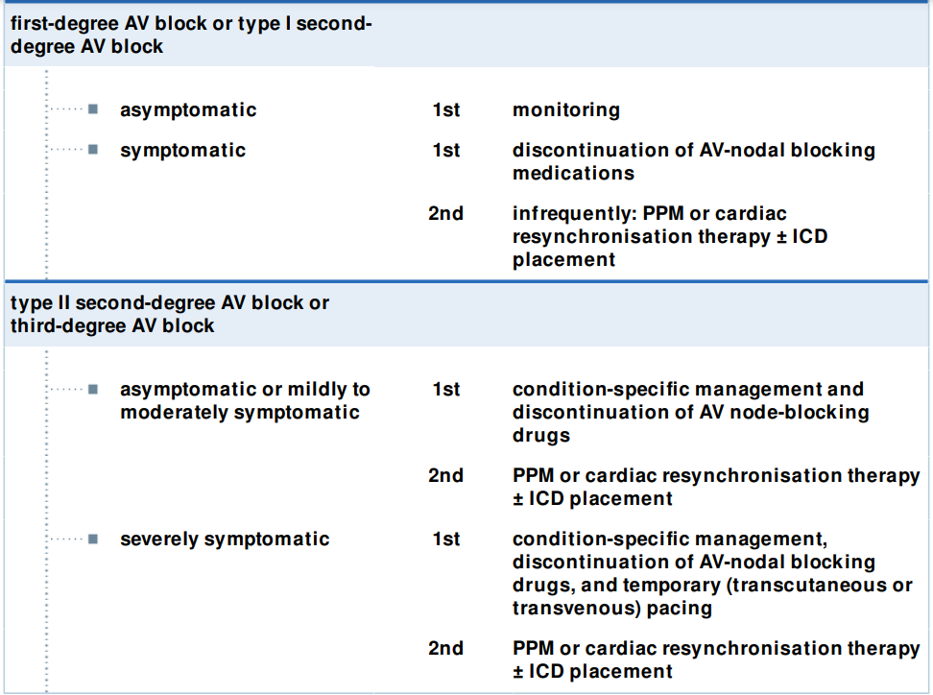
Treatment algorithm
AV-block
Patients are at low risk for progression to higher-degree AV block.
ECGs may be rechecked if symptoms develop, but do not need to be re-checked on a routine basis.

Slide 46
Treatment algorithm
AV-block
Pts with first-degree AV block and a PR>300 msec may experience symptoms related to the haemodynamic consequence of such prolonged AV delay.
An increased pulmonary capillary wedge pressure and attendant symptoms of dyspnoea result, as well as decreased ventricular filling leading to decreased stroke volume and cardiac output.
Some patients with type I second-degree AV block can experience symptoms, ranging from those related to first-degree AV block to more generalised symptoms of fatigue, pre-syncope, or syncope.
The most common AV-nodal blocking medications include β-blockers, nondihydropyridine CCB, and digitalis.

Slide 47
Treatment algorithm
AV-block
If symptoms are severe enough, permanent pacemaker (PPM) implantation should be considered.
Usually a dualchamber (1 right atrial and 1 right ventricular lead) pacemaker is placed.
Biventricular pacemaker (placement of a third wire, in a branch of the coronary sinus, to enable left ventricular pacing), with or without an implantable cardioverter-defibrillator (ICD) placement, may be considered when the left ventricular ejection fraction is ≤35%.
An ICD is not indicated for patients with NYHA Class IV heart failure symptoms

Slide 48
Treatment algorithm
AV-block
Mild to moderate symptoms include fatigue or dyspnoea, especially exertional, mild symptoms of CHF (pedal oedema, orthopnoea), or mild, episodic lightheadedness.
While discontinuing these medicines may improve AV conduction, they are not likely to completely reverse clinically significant AV block.
Condition-specific management includes
  treating acute coronary syndrome (i.e., antiplatelet medications, urgent revascularisation) and
  medication toxicity (e.g., glucagon for beta blocker toxicity, calcium for calcium-channel toxicity, or digoxin antibody for digitalis toxicity).
  When present, electrolyte or pH disturbances and hypoxaemia should be treated appropriately.
Risks and balances of discontinuing possible causative medications (e.g., beta-blockers) should be weighed in each instance.

Slide 49
Treatment algorithm
AV-block
In the absence of a reversible cause, these patients should undergo permanent pacemaker (PPM) implantation.
Usually a dual-chamber pacemaker is placed.
Biventricular pacemaker, with or without an implantable cardioverter-defibrillator (ICD), when LVEF is ≤35%.
In patients with highdegree or complete heart block and LVEF of 36% to 50%, cardiac resynchronisation therapy (CRT) may reduce total mortality and hospitalisations, and improve symptoms and QOL.

Slide 50
Treatment algorithm
AV-block
Severe symptoms include syncope or persistent, severe lightheadedness indicating profound decreases in the ventricular rate.
When the ventricular rate is significantly low (<40-45 bpm) or the BP is low (mean arterial pressure <65 mmHg), temporary (transcutaneous or transvenous) pacing should be considered.
Transvenous pacing is much more reliable than transcutaneous pacing and should be performed by a cardiologist when the heart block leads to haemodynamic instability.
Condition-specific management includes treating ACS, medication toxicity, electrolyte or pH disturbances, hypoxaemia.

Slide 51
Treatment algorithm
AV-block
Severe symptoms include syncope or persistent, severe lightheadedness indicating profound decreases in the ventricular rate.
PPM
ICD
CRT

Slide 52
Case history
Sustained ventricular tachycardias
A 65-year-old man has a history of prior anterior wall myocardial infarction that occurred 2 years ago, complicated by severe left ventricular systolic dysfunction.
While walking to the shops, he suddenly became aware of palpitations, diaphoresis, dizziness, and a sense of overwhelming malaise.
One minute later, he turned grey, lost consciousness, and collapsed onto the floor.
An ECG revealed sustained monomorphic ventricular tachycardia at 150 bpm.

Slide 53
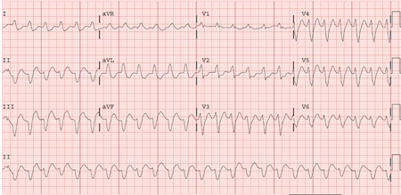
Case history
Sustained ventricular tachycardias

Slide 54
Case history
Sustained ventricular tachycardias
Cardiopulmonary resuscitation was initiated and the patient was cardioverted to sinus rhythm with a 200-J biphasic shock delivered from an external defibrillator.
The patient regained consciousness.
There was no antecedent chest discomfort and cardiac enzymes were negative after the event.
Serum electrolytes were also normal.
He received an implantable cardioverter/defibrillator the next day.

Slide 55
Case history
Sustained ventricular tachycardias
Ventricular arrhythmias may present with a diverse spectrum of symptoms, including palpitations, chest pain, and/or syncope, or may be asymptomatic.
The type of symptom associated with the arrhythmia depends on its duration, its rate, and whether or not it is associated with abnormal perfusion to the heart or brain.
Short-lived arrhythmias frequently are asymptomatic or manifest as brief palpitations, whereas longer and more rapid arrhythmias are frequently associated with presyncope or syncope.
Sudden cardiac death is the most severe manifestation of ventricular arrhythmias; victims of sudden cardiac arrest rarely survive without cardiopulmonary resuscitation and prompt electrical defibrillation.

Slide 56
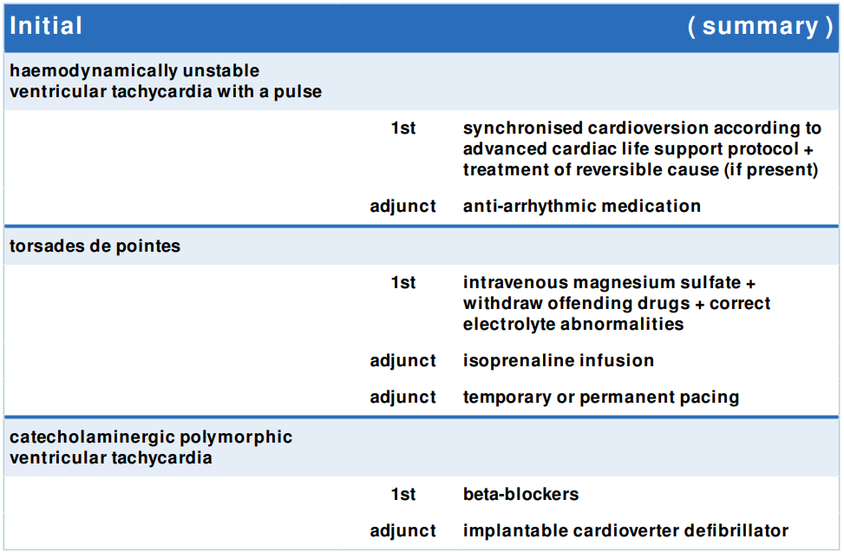
Treatment algorithm
VT
Cardioversion is essential for the acute treatment of haemodynamically unstable ventricular tachycardia (VT) (symptomatic or severely hypotensive VT).
Synchronised cardioversion should be considered before attempting anti-arrhythmic drug therapy in patients who have syncope, presyncope, frequent palpitations, or hypotension (particularly those with symptoms of diminished cerebral perfusion), even if they have apparently stable haemodynamics.
Cardioversion may be repeated as needed until rhythm is controlled.
In patients with an identifiable reversible cause of VT (e.g., ischaemia, myocardial infarction, toxicity, drug overdose) management will also involve treatment of the reversible cause.

Slide 57
Treatment algorithm
VT
Treatment recommended for SOME patients in selected patient group
Primary options » amiodarone: 300 mg intravenous push
Secondary options » lidocaine: 1 to 1.5 mg/kg intravenously as a single dose
Medical therapy provides an important adjunctive therapy to emergency cardiovascular care, based on the advanced cardiac life support protocol.
Amiodarone and/or lidocaine are considered useful anti-arrhythmic drugs in these circumstances.

Slide 58
Treatment algorithm
VT
magnesium sulfate: 1-2 g intravenously as a single dose
Torsades de pointes, a specific type of polymorphic ventricular tachycardia (VT) characterised by a twisting appearance around the baseline, occurs in the setting of QT prolongation due to either the congenital or the acquired forms of the long QT syndrome.
Torsades de pointes should be treated as any other form of VT according to the advanced cardiac life support protocol, with special recognition of the fact that hypokalaemia and hypomagnesaemia are frequently associated with torsades.
Electrolyte deficiencies should be replenished aggressively.
Offending drugs should be withdrawn.
Intravenous magnesium sulfate should be administered.
Additionally, overdrive pacing and isoprenaline infusion may be useful in this arrhythmia as they reduce the QT interval.

Slide 59
Treatment algorithm
VT
Treatment recommended for SOME patients in selected patient group
isoprenaline: 2 micrograms/minute intravenous infusion initially, dose titrated according to response, maximum 10 micrograms/minute
Indicated in patients who present with recurrent torsades de pointes after initial acute therapy.
It may be useful in this arrhythmia as it reduces the QT interval.
It is important to be certain that the patient does not have acute ischaemia before administering isoprenaline

Slide 60
Treatment algorithm
VT
Treatment recommended for SOME patients in selected patient group
Indicated in recurrent torsades de pointes after acute therapy.

Slide 61
Treatment algorithm
VT
Nadolol
Medical therapy for catecholaminergic polymorphic ventricular tachycardia includes the use of beta-blockers for both acute and chronic treatment.
High dose of beta-blockers is usually required.
Other treatment strategies have been proposed, including a stepwise addition of alternative treatment options, such as calcium-channel blockers and flecainide, to beta-blockers in patients who do not respond sufficiently or who cannot tolerate beta-blockers.
Left cardiac sympathetic denervation appears to be effective, but has only been tested on small cohorts, and is not universally available.

Slide 62
Treatment algorithm
VT
Implantable cardioverter defibrillator (ICD) insertion is needed in patients with recurrent syncope despite beta-blockers, or those who are survivors of cardiac arrest, especially in the setting of coronary artery disease.
ICDs should not be implanted without concomitant betablocker therapy, as ICD shocks will increase catecholamine surge, potentially leading to a vicious cycle of ventricular arrhythmias and ICD shocks.
ICD therapy provides a continuous monitor for the cardiac rhythm and the capability of terminating ventricular tachycardia by overdrive pacing and/or cardioversion defibrillation.
ICD implant requires surgery and is associated with a small risk of procedural mortality.
ICD shocks can be painful and if frequent may impair the patient's quality of life.

Slide 63
Case history atrial fibrillation
A 65-year-old man with a history of hypertension, diabetes mellitus, and hyperlipidaemia presents to the accident and emergency department with the first episode of rapid palpitations, shortness of breath, and discomfort in his chest.
His symptoms came on suddenly 4 hours ago.
Physical examination shows an irregularly irregular radial pulse rate at 90 to 110 bpm, a BP of 110/70 mmHg, and respiratory rate of 20 breaths per minute.
Heart sounds are irregular, but no S3 or S4 gallop or murmurs are audible.
There are no other abnormalities on examination.

Slide 64
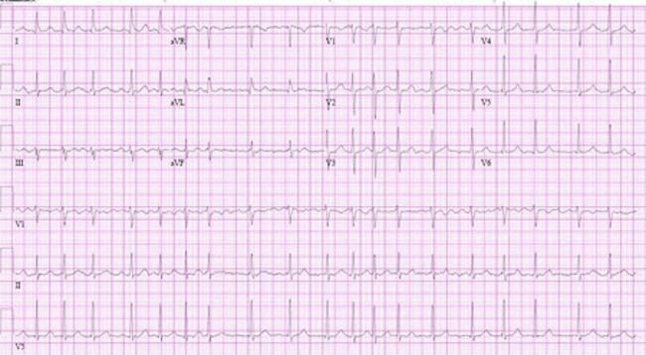
Case history atrial fibrillation

Slide 65
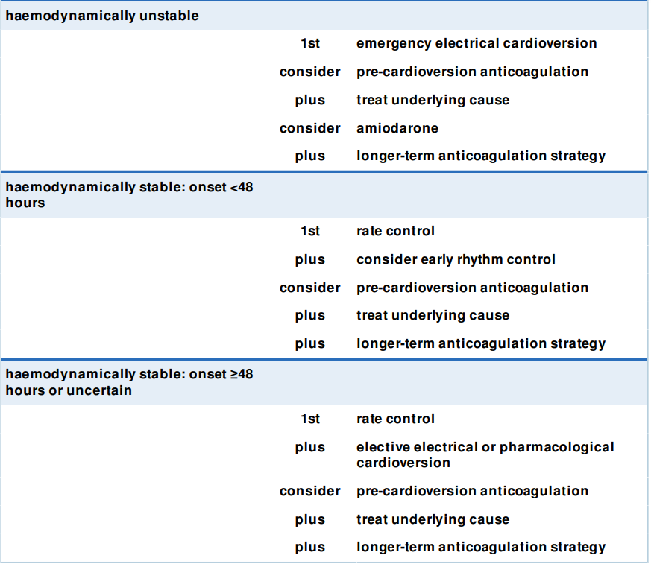
Treatment algorithm
AF
Electrical cardioversion quickly and effectively converts AF to sinus rhythm.
Electrical cardioversion restores sinus rhythm quicker and more effectively than pharmacological cardioversion and is associated with shorter hospital stays.
Do not use pharmacological cardioversion in haemodynamically compromised patients.
Urgently admit to an acute medical unit.
Call for anaesthetic support to sedate the patient before DC cardioversion.
This will usually be with a short-acting general anaesthetic.
Record and store an ECG rhythm strip during and immediately after shock delivery.
Continuously monitor the patient’s BP and oximetry during the procedure.

Slide 66
Treatment algorithm
AF
Check the patient’s oral anticoagulation status as soon as possible.
In patients not already on therapeutic anticoagulation, immediately start anticoagulation precardioversion.
Use a low molecular weight heparin (LMWH), such as enoxaparin, or unfractionated heparin.
This is important to prevent potential thromboembolic complications and should be given in a timely manner even in haemodynamically unstable patients.
After cardioversion, transition patients who are started on a LMWH or unfractionated heparin to a DOAC, such as rivaroxaban, apixaban, edoxaban, or dabigatran, or warfarin when appropriate.

Slide 67
Treatment algorithm
AF
Identify and manage risk factors and concomitant conditions.
Correct, where possible, treatable causes of AF or refer, as appropriate.
In practice, refer to a cardiologist, any patient:
  Who is young and has suspected underlying structural heart disease
  With a pre-excitation syndrome such as Wolff-Parkinson-White syndrome.
  With valvular heart disease associated with AF
  With suspected heart failure.
Signs of stroke or heart failure may be subtle in some instances.
Bear in mind that rhythm control is often unsuccessful in critically ill patients and those with severely impaired ventricular systolic function, because AF is often precipitated/ exacerbated by increased sympathetic tone, inotropes, and vasopressors.
In these patients, work to identify and correct precipitating factors and secondary causes and optimise background treatment.

Slide 68
Treatment algorithm
AF
amiodarone: 5 mg/kg intravenously over 20-120 minutes initially, repeat infusion according to response, maximum 1200 mg/ day
The European Society of Cardiology recommends 300 mg intravenously over 30-60 minutes initially, followed by 900-1200 mg intravenously over 24 hours.
Consider intravenous amiodarone for acute control of heart rate in these patients.
Do not use rate control drugs in people with AF with a pre-excitation syndrome such as Wolff-Parkinson-White syndrome.
These drugs accelerate conduction down the accessory pathway to the ventricle putting the patient at risk of life-threatening arrhythmias, such as ventricular fibrillation and sudden death.
AF is the second most common arrhythmia in WPWs, occurring in approximately 1/3 pts.
Atrial activity predominantly conducts down the accessory pathway, causing ventricular pre-excitation.

Slide 69
Treatment algorithm
AF
Apixaban: 2.5 to 5 mg orally twice daily OR Edoxaban: 30-60 mg orally once daily OR Rivaroxaban: 15-20 mg orally once daily OR Dabigatran: 110-150 mg orally twice daily OR
Use a direct oral anticoagulant (DOAC) in preference to a vitamin K antagonist.
Warfarin: 5-10 mg orally once daily initially, adjust dose according to target INR
Use the CHA₂DS₂-VASc score to calculate stroke risk in all patients presenting with AF
When indicated by the CHA₂DS₂-VASc score, start oral anticoagulation as soon as possible.
Use the HAS-BLED score to assess the risk of a major bleed; Identify modifiable risk factors for bleeding, such as uncontrolled hypertension, harmful alcohol consumption, labile INR if the patient is on warfarin, concurrent use of medication and reversible causes of anaemia
Do not use bleeding risk scores to exclude anticoagulant treatment; a high score should not rule out anticoagulation.
Bleeding risk is dynamic and requires regular re-assessment; it should not be based on a single one-off assessment.
For most people the benefit of anticoagulation outweighs the bleeding risk
For people with an increased risk of bleeding the benefit of anticoagulation may not always outweigh the bleeding risk, and careful monitoring of bleeding risk is important.

Slide 70
Treatment algorithm
AF
Bisoprolol: 1.25 mg orally OD initially, increase gradually, maximum 20 mg/day OR
Metoprolol: 2.5 to 5 mg i.v. or 50 mg orally BID or TID, maximum 300 mg/day OR
Esmolol: 500 μg/kg/min i.v. as a loading dose, maintenance dose 50-200 μg/kg/min OR
Carvedilol: 3.125 mg orally TID initially, maximum 50 mg/day OR
Verapamil: 5-10 mg i.v.; 40-120 mg orally TID initially, maximum 480 mg OR
Diltiazem: 60 mg orally TID initially, maximum 360 mg OR
Digoxin: 0.75-1.5 mg/day orally for rapid digitalisation, then 0.125-0.25 mg/day
Use rate control to slow the patient’s heart rate in the presence of tachycardia.
Use atrioventricular nodal blocking drugs – either a standard beta-blocker, or a rate-limiting non-dihydropyridine calciumchannel blocker – as initial monotherapy.
Base the choice of drug on the person's symptoms, heart rate, comorbidities, and preferences when considering drug treatment.
If monotherapy does not control symptoms, consider combination therapy
Do not use rate control drugs in people with AF with a pre-excitation syndrome such as Wolff-Parkinson-White syndrome.

Slide 71
Treatment algorithm
AF
Flecainide: 200-300 mg orally as a single dose OR
Amiodarone: 5-7 mg/kg i.v. over 1-2 hours, followed by 50 mg/hour i.v., max 1200 mg/day
Start anticoagulation precardioversion as soon as possible
In patients with AF duration 24 to 48 hours who are undergoing cardioversion, initiate oral anticoagulation for at least 4 weeks after cardioversion.
This is an optional step for those with AF onset definitely less than 24 hours.
Consider either pharmacological or electrical cardioversion depending on clinical circumstances, patient preferences, and resources, to reduce symptoms.
Electrical cardioversion restores sinus rhythm quicker and more effectively than pharmacological cardioversion and is associated with shorter hospital stays.
Pharmacological cardioversion, however, does not require fasting or sedation.
A choice of flecainide or amiodarone to people with no evidence of structural or ischaemic heart disease OR
Amiodarone to people with evidence of structural heart disease

Slide 72
Treatment algorithm
AF
Apixaban: 2.5 to 5 mg orally twice daily OR
Edoxaban: 30-60 mg orally once daily OR
Rivaroxaban: 15-20 mg orally once daily OR Dabigatran: 110-150 mg orally twice daily OR
Use a direct oral anticoagulant (DOAC) in preference to a vitamin K antagonist.
Warfarin: 5-10 mg orally once daily initially, adjust dose according to target INR

Slide 73
Treatment algorithm
AF

Slide 74
Treatment algorithm
AF
Apixaban: 2.5 to 5 mg orally twice daily OR
Edoxaban: 30-60 mg orally once daily OR
Rivaroxaban: 15-20 mg orally once daily OR Dabigatran: 110-150 mg orally twice daily OR
Use a direct oral anticoagulant (DOAC) in preference to a vitamin K antagonist.
Warfarin: 5-10 mg orally once daily initially, adjust dose according to target INR

Slide 75
Treatment algorithm
AF
Bisoprolol: 1.25 mg orally OD initially, increase gradually, maximum 20 mg/day OR
Metoprolol: 2.5 to 5 mg i.v. or 50 mg orally BID or TID, maximum 300 mg/day OR
Esmolol: 500 μg/kg/min i.v. as a loading dose, maintenance dose 50-200 μg/kg/min OR
Carvedilol: 3.125 mg orally TID initially, maximum 50 mg/day OR
Verapamil: 5-10 mg i.v.; 40-120 mg orally TID initially, maximum 480 mg OR
Diltiazem: 60 mg orally TID initially, maximum 360 mg OR
Digoxin: 0.75-1.5 mg/day orally for rapid digitalisation, then 0.125-0.25 mg/day

Slide 76
Treatment algorithm
AF
If the onset of AF is 48 hours or more, or is uncertain:
Make a plan for therapeutic anticoagulation for a minimum of 3 weeks followed by elective electrical or pharmacological cardioversion
Continue therapeutic anticoagulation for 4 weeks after cardioversion (in patients without a need for long-term anticoagulation).
If the patient is already on therapeutic anticoagulation, proceed with cardioversion.

Slide 77
Treatment algorithm
AF

Slide 78
Treatment algorithm
AF

Slide 79
Treatment algorithm
AF

Slide 80
Case history atrial flutter
A 77-year-old man presents with complaints of palpitations and new shortness of breath, especially with exertion.
He has a history of rheumatic fever in childhood.
He has been told he has a murmur but does not recall having had an echocardiogram.
He is otherwise healthy.

Slide 81
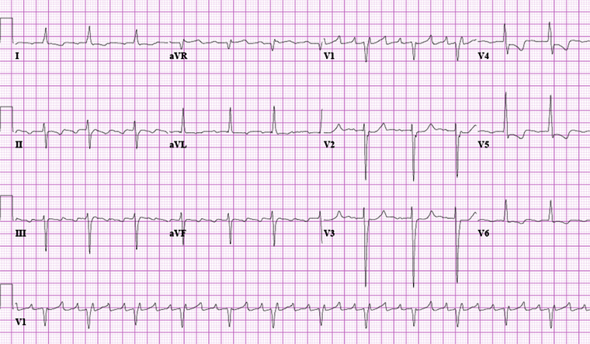
Case history atrial flutter

Slide 82
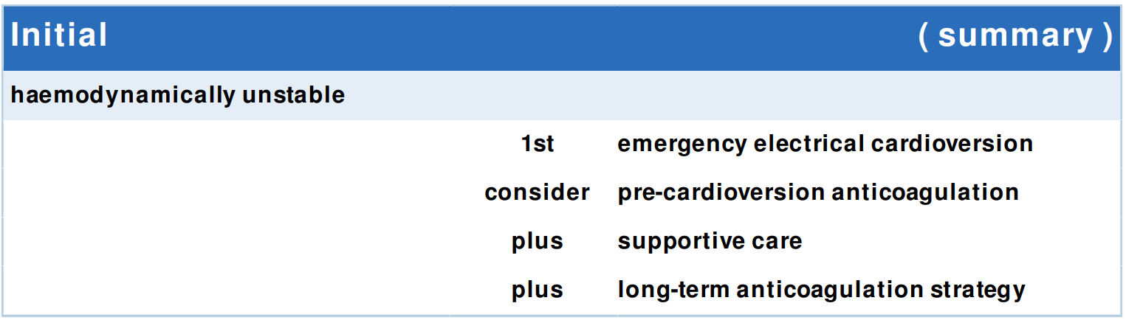
Treatment algorithm
AFl
Urgently identify any patient with features of haemodynamic instability, which include:
  Shock
  Syncope
  Myocardial ischaemia
  Acute, severe heart failure (characterised by acute pulmonary oedema or raised jugular venous pressure)
Organise immediate synchronised direct current (DC) cardioversion.
Call for anaesthetic support to ensure any conscious patient has sedation or general anaesthesia.
Give up to three shocks.
For the initial shock, use 70 to 120 J of energy.
Give subsequent shocks using stepwise increases in energy.

Slide 83
Treatment algorithm
AFl
If the patient has new-onset atrial flutter and is receiving no, or subtherapeutic, anticoagulation, start initial parenteral anticoagulation and continue this until you have made a full assessment.
Unfractionated heparin or a low molecular weight heparin (LMWH) such as enoxaparin are options.
Transition patients who are started on unfractionated heparin or an LMWH to a direct oral anticoagulant (e.g., rivaroxaban, apixaban, edoxaban, or dabigatran), or warfarin, when appropriate, and after assessment of stroke and bleeding risk.

Slide 84
Treatment algorithm
AFl
While assessing the patient, start resuscitation measures.
Monitor controlled oxygen therapy.
An upper SpO2 limit of 96% is reasonable when administering supplemental oxygen to most patients with acute illness who are not at risk of hypercapnia.
A lower target SpO2 of 88% to 92% is appropriate if the patient is at risk of hypercapnic respiratory failure.
Monitor the ECG and blood pressure.
Obtain intravenous access.
Identify and treat any reversible causes (e.g., electrolyte abnormalities).

Slide 85
Treatment algorithm
AFl
Treatment recommended for ALL patients in selected patient group
Apixaban: 2.5 to 5 mg orally twice daily OR
Edoxaban: 30 – 60 mg orally once daily OR
Rivaroxaban: 15-20 mg orally once daily OR
Dabigatran: 110-150 mg orally twice daily OR
Warfarin: 5-10 mg orally once daily initially, adjust dose according to target INR

