Slide 1
Demand

Slide 2
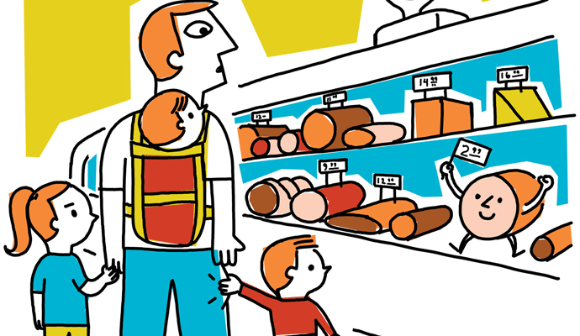
What Is Demand?
Demand in economics is the consumer's desire and ability to purchase a good or service. It's the underlying force that drives economic growth and expansion. Without demand, no business would ever bother producing anything.

Slide 3
The meaning of demand is the various amounts of a product that will be purchased in particular. Prices during a particular period of time in the market, consumer demand for a produced represent is desires for it, which is sufficiently backed by ability and willingness to pay for produce. Demand and desire are not the same, only an effective desire is a demand and effective desire is a desire which is fully backed by ability and willingness to pay show as to make the desire the reality.
Demand | Desire
It is an effective desire to get a commodity-backed by ability and willingness to pay. | It is just a wish to have a commodity without sufficient income to pay it.
Demand is bounded by price quantity, place and time. | Desire is unbounded one can desire anything they like.
Demand effective economic activities like production, exchange, consumption, etc. | Desire like production, exchange, consumption, etc.
Example: when a person with sufficient money buys an air ticket it is demand. | Example: a beggar may desire to travel by air.

Slide 4
Law of Demand
The law of demand governs the relationship between the quantity demanded and the price. This economic principle describes something you already intuitively know. If the price increases, people buy less. The reverse is also true. If the price drops, people buy more.
But the price is not the only determining factor. The law of demand is only true if all other determinants don't change.

