Slide 1
Supply

Slide 2
What Is Supply?
Supply in economics is defined as the total amount of a given product or service a supplier offers to consumers at a given period and a given price level. It is usually determined by market movement. For instance, a higher demand may push a supplier to increase supply.

Slide 3
Supply in Economics
Ideally, supply and demand would be equal. Assuming all factors are constant, under the law of supply, the demand for more units of a product gives the supplier a positive indication to increase their supplies. In turn, this could lead to higher prices.
Actual patterns may vary across products and services. Several factors affect the supply and demand pattern, including changes in manufacturing costs, consumer preferences, government subsidies, and extreme weather.
Talking about supply in economics requires you to have an understanding of the concept of demand as well. Demand represents the desire or willingness of consumers to buy a certain product or service.
These two components affect each other. They are equally important for the economy as they play a huge role in determining prices, amount consumed and the quantity to produce.

Slide 4
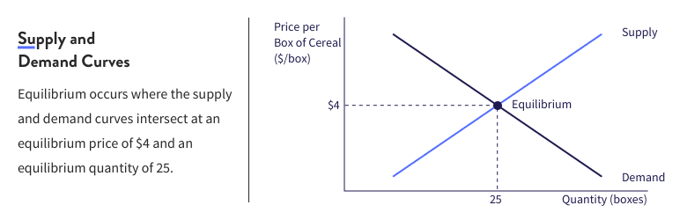
Visualizing Supply
The supply and demand pattern can be characterized by curves.
Basically, you have to examine the maximum number consumers would potentially buy at various price levels. This will get you the demand curve. The vertical axis represents the price and the horizontal axis is based on quantity. The demand curve is typically downward-sloping.
The supply curve reflects the number of products supplied at various price levels. Suppliers can decide whether to increase or decrease supply based on how much they expect to charge for the product. The supply curve is often upward-sloping.
At one point, the two curves intersect. That is when the supply and demand are equal, which means prices are at equilibrium. There is no supply excess or shortage. Therefore, there is no need to increase or decrease product prices.

Slide 5
Short-run costs
There are many things behind the scenes that business owners have to contend with, one of the most critical being the cost of running the business. Being able to accurately calculate business expenses is important for the financial health of a company. Understanding the short-run production cost is an important step in figuring out the fixed and variable costs associated with a firm as well as being able to interpret the graph showing the short-run production cost curve.

Slide 6
Short-run production costs are the total of fixed and variable costs incurred by the production of a good or service where factors such as land and heavy machinery cannot change in the short term.
Fixed production costs are costs that remain constant regardless of production input or output and cannot change in the short term.
Variable production costs are costs that can vary depending on the level of input and output.

Slide 7
In the short-run period, an organisation cannot change the fixed factors of production, such as capital, factory buildings, plant and equipment, etc. However, the variable costs, such as raw material, employee wages, etc., change with the level of output.
Example: If a firm intends to increase its output in the short run, it would need to hire more workers and purchase more raw materials. The firm cannot expand its plant size or increase the plant capacity in the short run.
Similarly, when demand falls, the firm would reduce the work hours or output, but cannot downsize its plant. Therefore, in the short run only variable factors are changed, while the fixed factors remain unchanged. Let us discuss the cost-output relations in the short run

Slide 8
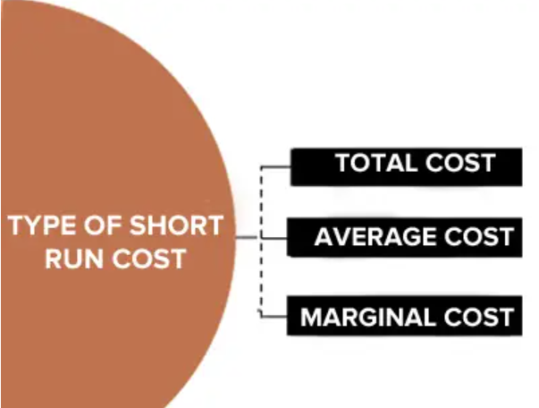
There are basically three types of short run costs

Slide 9
Short Run Total Cost
The total cost refers to the actual cost that is incurred by an organisation to produce a given level of output. The Short-Run Total Cost (SRTC) of an organisation consists of two main elements:
Total Fixed Cost (TFC): These costs do not change with the change in output. TFC remains constant even when the output is zero. TFC is represented by a straight line horizontal to the x-axis (output).
Total Variable Cost (TVC): These costs are directly proportional to the output of a firm. This implies that when the output increases, TVC also increases and when the output decreases, TVC decreases as well

Slide 10
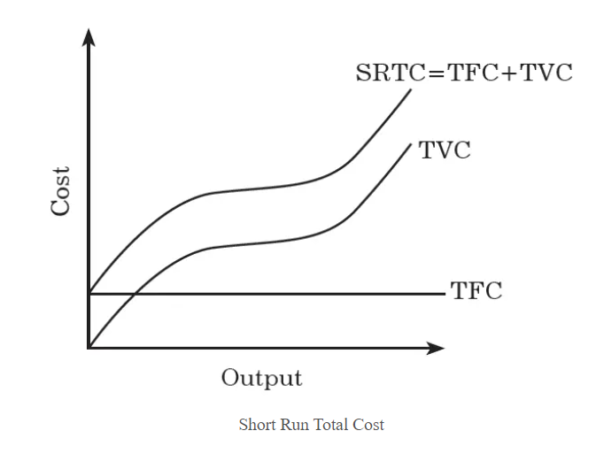
Figure depicts the short run cost curve of a firm
SRTC is obtained by adding the total fixed cost and the total variable cost.
SRTC = TFC + TVC
As the TFC remains constant, the changes in SRTC are entirely due to variations in TVC.

Slide 11
Short Run Average Cost
The average cost is calculated by dividing total cost by the number of units a firm has produced. The short-run average cost (SRAC) of a firm refers to per unit cost of output at different levels of production. To calculate SRAC, short-run total cost is divided by the output
SRAC = SRTC/Q = TFC + TVC/Q
Where, TFC/Q =Average Fixed Cost (AFC) and
TVC/Q =Average Variable Cost (AVC)
Therefore, SRAC = AFC + AVC
SRAC of a firm is U-shaped. It declines in the beginning, reaches to a minimum and starts to rise.

Slide 12
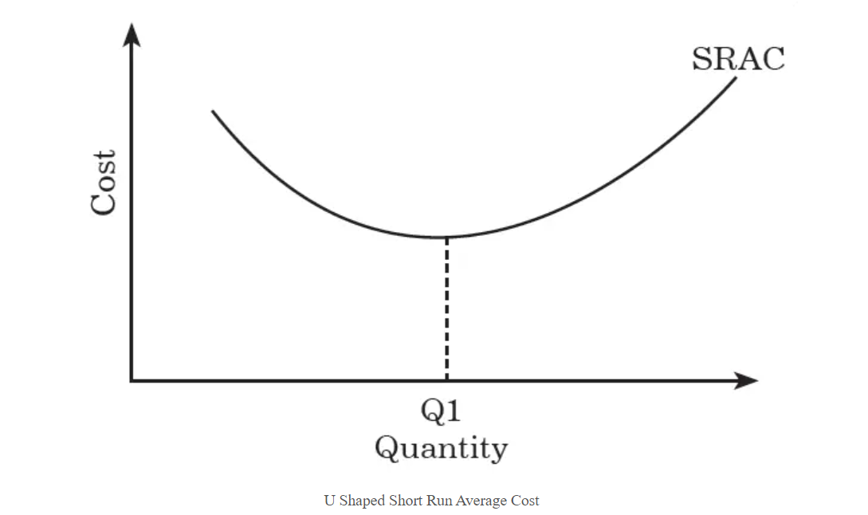
Figure depicts the short run average cost curve of a firm
The SRAC curve represents the average cost in the short run for producing a given quantity of output. The downward-slope of the SRAC curve indicates that as the output increases, average costs decrease. However, the SRAC curve begins to slope upwards, indicating that at output levels above Q1, average costs start to increase

Slide 13
Short Run Marginal Cost
Marginal cost (MC) can be defined as the change in the total cost of a firm divided by the change in the total output. Short-run marginal cost refers to the change in short-run total cost due to a change in the firm’s output.
SRMC = ∅SRTC / ∅Q
In the marginal cost concept, Δ Q = 1. Therefore, SRMC = TVC
SRMC = ∅SRTC / ∅Q
In the marginal cost concept, Δ Q = 1. Therefore, SRMC = TVC
Short-run marginal cost on a graph is the slope of the short-run total cost and depicts the rate of change in total cost as output changes. The marginal cost of a firm is used to determine whether additional units need to be produced or not. If a firm could sell the additional unit at a price greater than the cost incurred to produce the additional unit (marginal cost), the firm may decide to produce the additional unit.

Slide 14
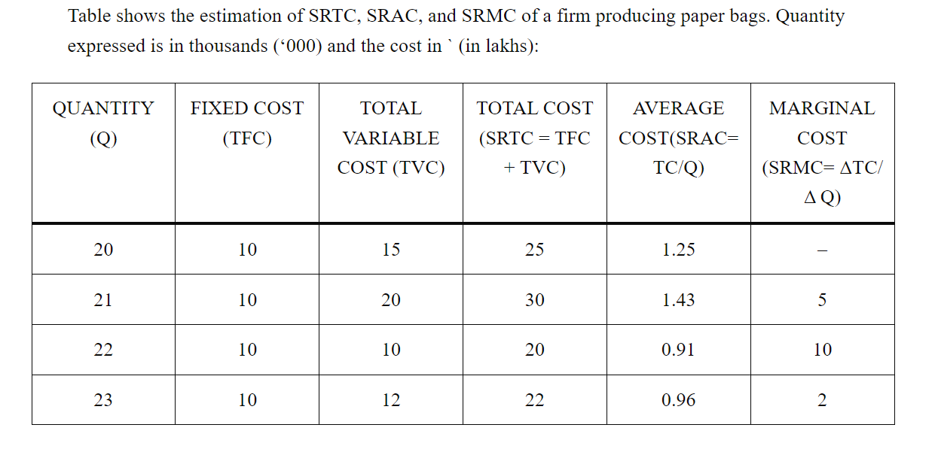

Slide 15
Formula and Calculating Price Elasticity of Supply
To find an item's PES, you need to know the percent change in quantity supplied and the percent change in its price.
PES=%CS÷%CP
where:
PES=Price elasticity of supply
CS=Change in supply
CP=Change in price​

Slide 16
So, imagine you have a farm that can produce and deliver 500 bushels of corn per quarter. The price for one bushel in the first quarter was $157.56. In the second quarter, one bushel was $159.25, and your farm produced and delivered 505 bushels.
First, determine the percent change in price:
$159.25 - $157.56 = 1.69
1.69 ÷ $157.56 = 0.0107
0.0107 x 100 = 1.07%
Then, the percent change in supply:
505 - 500 = 5
5 ÷ 500 = 0.01
0.01 x 100 = 1.0%
Use the formula to calculate price elasticity:
1.0% ÷ 1.07% = 0.000107
A result of 0.0001 shows that your farm's corn price elasticity of supply is very low or inelastic. But if your farm produced 525 bushels in the second quarter, the elasticity would change:

