Slide 1
Competitive Markets

Slide 2
What Is Market?
Market is a place where buyer and seller meet, goods and services are offered for the sale and transfer of ownership occurs. A market may be also defined as the demand made by a certain group of potential buyers for a good or service. The former one is a narrow concept and later one, a broader concept.

Slide 3
What Is Market?
Economists describe a market as a collection of buyers and sellers who transact over a particular product or product class (the housing market, the clothing market, the grain market etc.). For business purpose we define a market as people or organizations with wants (needs) to satisfy, money to spend, and the willingness to spend it.

Slide 4
What Is Market?
Broadly, market represents the structure and nature of buyers and sellers for a commodity/service and the process by which the price of the commodity or service is established. In this sense, we are referring to the structure of competition and the process of price determination for a commodity or service. The determination of price for a commodity or service depends upon the structure of the market for that commodity or service (i.e., competitive structure of the market).

Slide 5
Different Market Structures
Market structure describes the competitive environment in the market for any good or service. A market consists of all firms and individuals who are willing and able to buy or sell a particular product. This includes firms and individuals currently engaged in buying and selling a particular product, as well as potential entrants.
The determination of price is affected by the competitive structure of the market. This is because the firm operates in a market and not in isolation. In marking decisions concerning economic variables it is affected, as are all institutions in society by its environment.

Slide 6
Market Structures
Markets
Imperfect competition
Monopoly
Oligopoly
Perfect competition
Monopolic competition

Slide 7
Perfect Competition
Perfect competition refers to a market structure where competition among the sellers and buyers prevails in its most perfect form. In a perfectly competitive market, a single market price prevails for the commodity, which is determined by the forces of total demand and total supply in the market.

Slide 8
Characteristics of Perfect Competition
1. A large number of buyers and sellers: The number of buyers and sellers is large and the share of each one of them in the market is so small that none has any influence on the market price.
5. Indifference: No buyer has a preference to buy from a particular seller and no seller to sell to a particular buyer.
2. Homogeneous product: The product of each seller is totally undifferentiated from those of the others.
6. Non-existence of transport costs: Perfectly competitive market also assumes the non-existence of transport costs.
3. Free entry and exit: Any buyer and seller is free to enter or leave the market of the commodity.
7. Perfect mobility of factors of production: Factors of production must be in a position to move freely into or out of industry and from one firm to the other
4. Perfect knowledge: All buyers and sellers have perfect knowledge about the market for the commodity.

Slide 9
Equilibrium of a firm and industry under perfect competition
Equilibrium is a position where the firm has no incentive either to expand or contrast its output. The firm is said to be in equilibrium when it earn maximum profit. There are two conditions for attaining equilibrium by a firm.

Slide 10
Equilibrium of a firm and industry under perfect competition
Marginal cost is an additional cost incurred by a firm for producing and additional unit of output. Marginal revenue is the additional revenue accrued to a firm when it sells one additional unit of output. A firm increases its output so long as its marginal cost becomes equal to marginal revenue. When marginal cost is more than marginal revenue, the firm reduces output as its costs exceed the revenue. It is only at the point where marginal cost is equal to marginal revenue, and then the firm attains equilibrium.
Secondly, the marginal cost curve must cut the marginal revenue curve from below. If marginal cost curve cuts the marginal revenue curve from above, the firm is having the scope to increase its output as the marginal cost curve slopes downwards. It is only with the upward sloping marginal cost curve, there the firm attains equilibrium. The reason is that the marginal cost curve when rising cuts the marginal revenue curve from below.

Slide 11
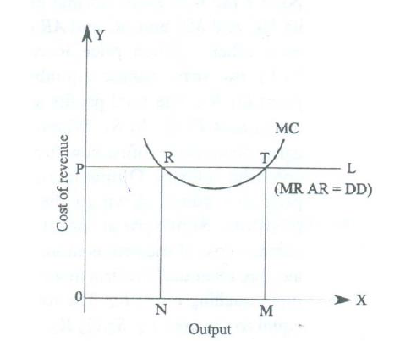

Slide 12
In the given fig. PL and MC represent the Price line and Marginal cost curve. PL also represents Marginal revenue, Average revenue and demand. As Marginal revenue, Average revenue and demand are the same in perfect competition, all are equal to the price line. Marginal cost curve is U- shaped curve cutting MR curve at R and T. At point R marginal cost becomes equal to marginal revenue. But MC curve cuts the MR curve fro above. So this is not the equilibrium position. The downward sloping marginal cost curve indicates that the firm can reduce its cost of production by increasing output. As the firm expands its output, it will reach equilibrium at point T. At this point, on price line PL; the two conditions of equilibrium are satisfied. Here the marginal cost and marginal revenue of the firm remain equal. The firm is producing maximum output and is in equilibrium at this stage. If the firm continues its output beyond this stage, its marginal cost exceeds marginal revenue resulting in losses. As the firm has no idea of expanding or contracting its size of out, the firm is said to be in equilibrium at point T.

Slide 13
Shifts in Demand and Supply
We often hear news about how prices of gold change every single moment. They never seem to be static and are always fluctuating. Thus a graphical representation of market equilibrium for gold would always keep changing. This can happen due to many factors that come under the umbrella of either shift or increase in demand, supply or both.

Slide 14
The Shift in Demand and Supply
Definitely, if there is any change in supply, demand or both the market equilibrium would change. Let’s recollect the factors that induce changes in demand and supply:
Shift in Supply
Prices of factors of production
Prices of other goods
State of technology
Taxation policy
An expectation of change in price in future
Goals of the firm
Number of firms
Shift in Demand
Price of complementary goods
Price of substitute goods
Income
Tastes and preferences
An expectation of change in the price in future
Population

Slide 15
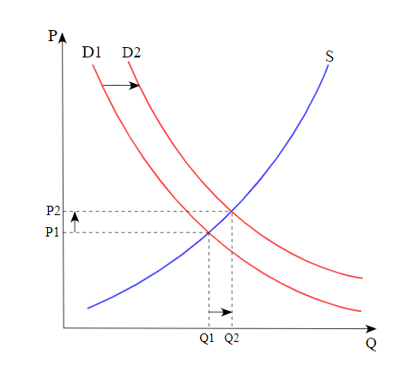
When only Demand Changes
A change in demand can be recorded as either an increase or a decrease. Note that in this case there is a shift in the demand curve.
Increase in Demand
When there is an increase in demand, with no change in supply, the demand curve tends to shift rightwards. As the demand increases, a condition of excess demand occurs at the old equilibrium price. This leads to an increase in competition among the buyers, which in turn pushes up the price.
Of course, as price increases, it serves as an incentive for suppliers to increase supply and also leads to a fall in demand. It is important to realize that these processes continue to operate until a new equilibrium is established. Effectively, there is an increase in both the equilibrium price and quantity.

Slide 16
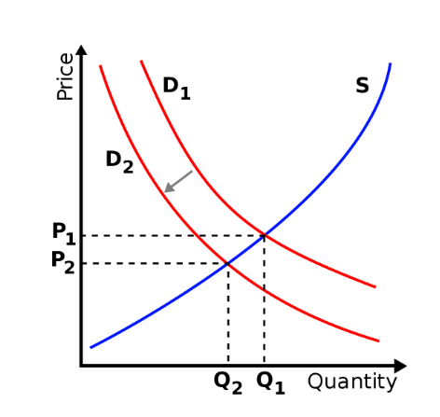
Decrease in Demand
Under conditions of a decrease in demand, with no change in supply, the demand curve shifts towards left. When demand decreases, a condition of excess supply is built at the old equilibrium level. This leads to an increase in competition among the sellers to sell their produce, which obviously decreases the price.
Now as for price decreases, more consumers start demanding the good or service. Observably, this decrease in price leads to a fall in supply and a rise in demand. This counter mechanism continues until the conditions of excess supply are wiped out at the old equilibrium level and a new equilibrium is established. Effectively, there is a decrease in both the equilibrium price and quantity.

Slide 17
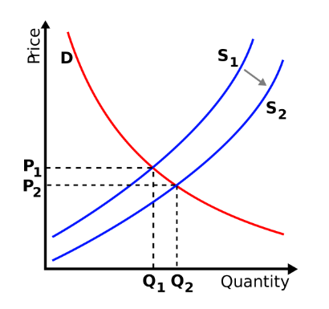
When only Supply Changes
A change in supply can be noted as either an increase or a decrease. Note that in this case there is a shift in the supply curve.
Increase in Supply
When supply increases, accompanied by no change in demand, the supply curve shift towards the right. When supply increases, a condition of excess supply arises at the old equilibrium level. This induces competition among the sellers to sell their supply, which in turn decreases the price.
This decrease in price, in turn, leads to a fall in supply and a rise in demand. These processes operate until a new equilibrium level is attained. Lastly, such conditions are marked by a decrease in price and an increase in quantity.

Slide 18
Decrease in Supply
When the supply decreases, accompanied by no change in demand, there is a leftward shift of the supply curve. As supply decreases, a condition of excess demand is created at the old equilibrium level. Effectively there is increased competition among the buyers, which obviously leads to a rise in the price.
An increase in price is accompanied by a decrease in demand and an increase in supply. This continues until a new equilibrium level is attained. Further, there is a rise in equilibrium price but a fall in equilibrium quantity.

Slide 19
Demand Decreases but Supply Increases
This condition translates to the fact that the demand curve shifts leftwards whereas the supply curve shifts rightwards. As they move in opposite directions, the final market conditions are deduced by pointing out the magnitude of their shifts. Here, three cases further arise which are as follows:
The decrease in demand = increase in supply
In this case, although the two curves move in opposite directions, the magnitudes of their shifts is effectively the same. As a result, the equilibrium quantity remains the same but the equilibrium price falls.
The decrease in demand > increase in supply
When the decrease in demand is greater than the increase in supply, the relative shift of demand curve is proportionately more than the supply curve. Effectively, both the equilibrium quantity and price fall.
The decrease in demand < increase in supply
Here, the leftward shift of the demand curve is less than the rightward shift of the supply curve. It is important to realize, that the equilibrium quantity rises whereas the equilibrium price falls.

Slide 20
Demand Increases but Supply Decreases
Similar to the aforementioned condition, here also the demand and supply curve moves in the opposite directions. However, the demand curve shift towards the right(indicating an increase in demand) and the supply curve shift towards left(indicating a decrease in supply). Further, this is studied with the help of the following three cases:
Increase in demand = decrease in supply
When the increase in demand is equal to the decrease in supply, the shifts in both supply and demand curves are proportionately equal. Effectively, the equilibrium quantity remains the same however the equilibrium price rises.
Increase in demand > decrease in supply
In this case, the right shift of the demand curve is proportionately more than the leftward shift of the supply curve. Hence, both equilibrium quantity and price rise.
Increase in demand < decrease in supply
If the increase in demand is less than the decrease in supply, the shift of the demand curve tends to be less than that of the supply curve. Effectively, equilibrium quantity falls whereas the equilibrium price rises.

