Slide 1

ODESSA NATIONAL MEDICAL UNIVERSITY
Faculty of pharmacy
Department of Organization and Economics of Pharmacy
with post-diploma specialization
Basic laws and regulations. Organizational issues of labor protection.
The lecture was prepared by
senior teacher Oksana STEPANOVA

Slide 2

Pharmacy workers may be exposed to a variety of workplace hazards in the course of performing their functions. The type and
degree of exposure is dependent upon the type of pharmacy and its location (e.g., in communities and retail establishments, in
hospitals, etc.). A key component of a health and safety program is to identify and assess hazards and determine appropriate
controls. A systematic approach to hazard assessment includes the following steps:
1. List all work-related tasks and activities.
2. Identify potential biological, chemical, physical and psychological hazards associated with each task.
3. Assess the risk of the hazard by considering the severity of consequences of exposure, the probability that the exposure will
occur and the frequency the task is done.
4. Identify the controls that will eliminate or reduce the risk. The hierarchy of controls should be followed. This means that
engineering controls are the most effective, followed by administrative controls (such as training and rules), followed by personal
protective equipment (PPE).
5. Implement the controls for each hazard.
6. Communicate the hazard assessments and required controls to all workers who perform the tasks.
7. Evaluate the controls periodically to ensure they are effective

Slide 3

Occupational Safety and Health
Occupational safety and health is concerned with preserving and protecting human and facility resources in the workplace.
Occupational safety and health involves helping people by preventing them from being injured or becoming ill due to hazards in their workplaces.
Practitioners in the field try to prevent needless deaths and injuries to workers.
Demonstrating concern for workers by ensuring he was trained in hazard recognition and correctly performing his job are jobs of the safety professional.

Slide 4
Occupational safety and health is also a field wherein professionals attempt to prevent catastrophic losses.
When they conduct preinspections, safety professionals may prevent explosions or fires thatcould destroy entire buildings.
Occupational safety and health is also the management function in an organization concerned with improving its quality and efficiency.
Safety professionals consider the way products are moved from place to place and are concerned with reducing lifting injury exposures, while minimizing product movement. They attempt to eliminate property and facility damage, waste, and costs that lessen an organization’s ability to operate profitably

Slide 5
Importance of Occupational Safety and Health
Economically, morally, and legally, occupational safety and health has become an important issue. Companies are attempting to remain profitable in an ever more competitive global economy.
For these companies, addressing safety, health, and environmental issues may mean more than good business practice. For many companies, strong safety, health, and environmental programs may actually mean survival.

Slide 6

According to the Bureau of Labor Statistics there are approximately five injury and illness cases per year for every one hundred workers, or approximately four million total per year.
The costs associated with these losses number in the billions of dollars. The staggering numbers of people involved in these accidents are a real concern.

Slide 7
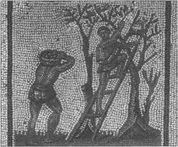
Early Historical Examination of Occupational Safety and Health
Ancient Greek and Roman
Physicians Concern for occupational safety and health is not a recent issue. Many of today’s health and safety concerns were first observed over 2,000 years ago.
An early account is associated with the Code of Hammurabi that dates back to approximately 2100 BC. It was primarily concerned with personal injury and losses and it prescribed a schedule of punishments and payments for wrongdoers in an attempt to recompense victims of the listed violations.

Slide 8

Early Historical Examination of Occupational Safety and Health
Greek and Roman physicians, practicing between 400 BC and 300 AD, expressed concern for the health of individuals exposed to the metals commonly used during this period.
These included Hippocrates, the Father of Medicine, and Pliny the Elder, a Roman physician and scientist, both discussed in Galen, a Roman physician who lived during the second century, wrote about occupational diseases and the dangers of acid mists to copper miners.
He was also concerned with the mining, tanning, and chemical occupations, noting several diseases contracted by individuals working in those professions.

Slide 9


Terms and Concepts in the Safety Profession
Safety professionals are concerned with people and company resources.
They have the knowledge and skills that are often acquired through formal education and/or experience in the safety field.
Many safety professionals are certified after successfully completing the requirements for the designations ‘‘Certified Safety Professional’’ (CSP), ‘‘Certified Industrial Hygienist’’ (CIH) etc.

Slide 10


Safety professionals are concerned with the elimination or control of hazards that may result in injury, illness, and property damage. They will often use techniques referred to as loss prevention and loss control to accomplish that goal.
Loss prevention describes a program designed to identify and correct potential accident problems before they result in financial loss or injury.
Loss control, on the other hand, is a program designed to minimize incident-based financial losses.
An example of the difference between loss prevention and loss control can be seen in the various activities associated with a fire protection and prevention program.

Slide 11

Loss prevention and loss control techniques are important to the safety professional who attempts to recognize, evaluate, and control hazards in the workplace.
This is part of the process referred to as ‘‘safety management.’’
Safety management encompasses the responsibilities of planning, organizing, leading, and controlling activities necessary to achieve an organization’s loss prevention and loss control goals.
Continuing the fire example, the safety professional might wish to establish a safety management program to address this danger. Safety professionals would determine the problems that exist
at their facility.

Slide 12

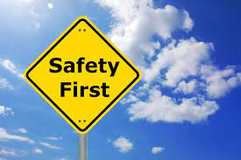
One of the most important terms used in the safety and health profession is ‘‘safety.’’
For the layperson, safety means not getting injured. ‘‘Safety,’’ to the professional, implies reference to the likelihood or risk that a loss event will occur.
It can be defined as ‘‘operating within an acceptable or low probability of risk associated with conditions or activities having the potential to cause harm to people, equipment, facilities or the enterprise.’’

Slide 13

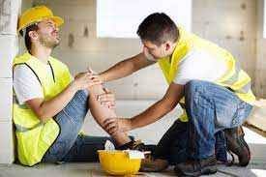

There are several different types of occupational health and safety losses safety professionals attempt to eliminate or control.
Typical worker-related health and safety losses include injuries, illnesses, and fatalities.
Workplace losses can include damaged equipment, damaged raw materials or finished products, damaged or destroyed facilities, downtime, service/production interruption, or loss of reputation.

Slide 14
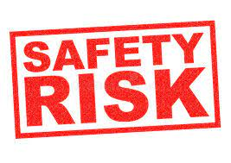
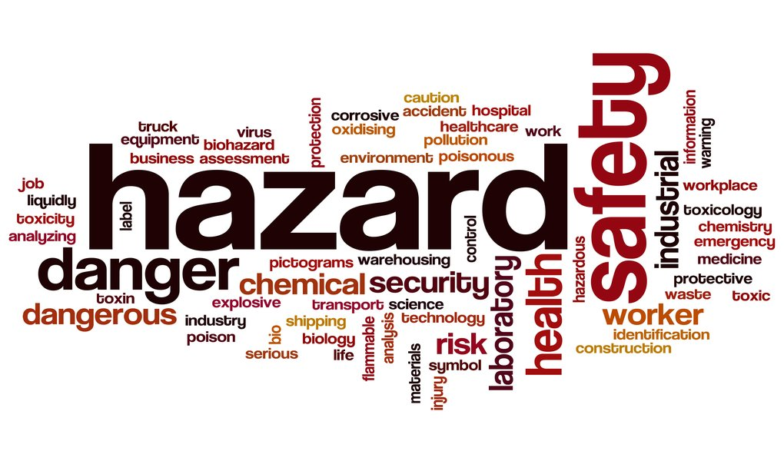
Risk can be defined as the measure of the probability and severity of a loss event taking place.
A hazard is a workplace condition or worker action that can result in injury, illness, or other organizational loss.
As revealed in these definitions, determining occupational risk requires an examination of both the probability of an event occurring and the potential severity of the end result.

Slide 15
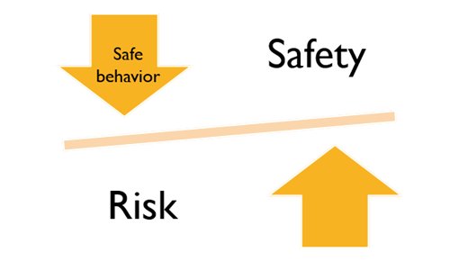
The evaluation of risks in the workplace starts with the identification of the types of hazards existing at the facility.
The organization eliminates or reduces the risks associated with those hazards to the lowest achievable and reasonable level.
Nothing is risk free.
Safety professionals identify the tasks and activities having the greatest inherent risk.

Slide 16



Accidents are unplanned events, often resulting in injuries or damage, that often interrupt routine operations.
They are nearly always preceded by unsafe acts of employees, hazardous conditions in the workplace, or both. When appropriate action is taken, most accidents can be eliminated.

Slide 17
Roles and responsibilities of safety professionals identified the following activities :
Accident Investigation: determining the facts and causes related to an accident based on witness interviews and site inspections.
Work with Emergency Response Teams: organizing, training, and coordinating skilled employees to react to emergencies such as fires, accidents, or other disasters.
Environmental Protection: recognizing, evaluating, and controlling hazards that can lead to undesirable releases of harmful substances into air, water, or the soil.
Ergonomic Analysis and Modification: designing or modifying the workplace based on an understanding of human physiological/psychological characteristics, abilities, and limitations.
Fire Protection: eliminating or minimizing fire hazards by inspection, layout of facilities, and design of fire suppression systems.

Slide 18
Roles and responsibilities of safety professionals identified the following activities :
Hazard Recognition: identifying conditions or actions that may cause injury, illness, or property damage.
Hazardous Materials Management: ensuring dangerous chemicals and other products are stored and used in such a manner as to prevent accidents, fires, and the exposure of people to these substances.
Health Hazard Control: recognizing, evaluating, and controlling hazards that can create undesirable health effects, including noise, chemical exposures, radiation, or biological hazards.

Slide 19
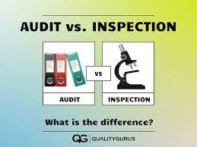


Inspection/Audit: evaluating/assessing safety and health risks associated with equipment, materials, processes, or activities.
Recordkeeping: maintaining safety and health information to meet government requirements, as well as provide data for problem solving and decision making.
Regulatory Compliance: ensuring all mandatory safety and health standards are satisfied.
Training: providing employees with the knowledge and skills necessary to recognize hazards and perform their jobs safely and effectively.

Slide 20
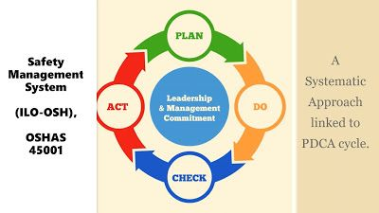
Functions of the Professional Safety Position
Anticipate, identify, and evaluate hazardous conditions and practices.
Develop hazard control designs, methods, procedures, and programs.
Implement, administer, and advise others on hazard controls and hazard control programs
Measure, audit, and evaluate the effectiveness of hazard controls and hazard control programs.

Slide 21
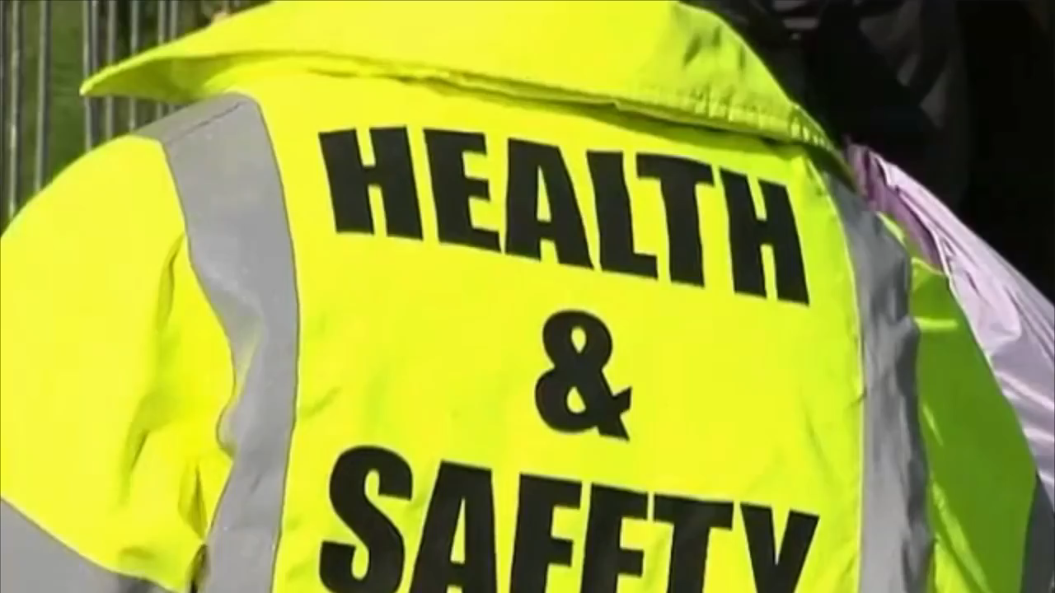

Slide 22

Legislative History
The history of occupational safety and health has been dominated by legislation. Governments have observed problems and have attempted to solve those problems through the enactment of laws. In this country, the regulations culminated with the passage of the Occupational Safety and Health Act in 1970
Occupational Safety and Health Act
Although more than 90 million Americans were working then, until
1970 no uniform and comprehensive provisions existed for their protection against workplace safety and health hazards.
In 1970, Congress considered annual figures such as these:
• Job-related accidents accounted for more than 14,000 worker deaths
• Nearly 2.2 million workers were disabled
• Ten times as many person-days were lost from job-related disabilities
• Estimated new cases of occupational diseases totaled 300,000

Slide 23

The Occupational Safety and Health Administration (OSHA),
the federal agency responsible for workplace safety and health, attempts to address the safety and health concerns faced by Americans.
OSHA may not only levy fines, but may also seek criminal prosecution of business owners and managers who willfully neglect the safety and health of their employees.

Slide 24

SHA Standards
OSHA standards fall into four categories:
General Industry
Maritime
Construction
Agriculture
Horizontal and Vertical Standards
Standards are referred to as being either horizontal or vertical in their application.
Most standards are horizontal or general in that they apply to any employer. Standards relating to fire protection or first aid are examples of horizontal standards
Some standards are relevant only to a particular industry, and are called vertical or particular standards. Examples are standards that apply to the longshoring or construction industry.

Slide 25

Employer Responsibilities and Rights
Aside from providing a workplace free from recognized hazards likely to cause death or serious physical harm, the employer has other responsibilities. An employer must:
Examine workplace conditions to make sure they comply with applicable standards
Minimize or reduce hazards
Use color codes, posters, labels, or signs when needed to warn employees of potential hazards
Provide training required by OSHA standards
Keep OSHA-required records
Provide access to employee medical records and exposure records to employees or their authorized representatives

Slide 26

Employers have the right to seek advice and off-site consultation as needed by writing, calling, or visiting the nearest OSHA office/
When an inspection visit occurs, the employer must:
Be advised by the compliance officer of the reason for the inspection
Accompany the compliance officer on the inspection
Be assured of the confidentiality of any trade secrets observed by an OSHA compliance officer during an inspection

Slide 27


Inspections
To enforce its standards, OSHA is authorized under the Act to conduct workplace inspections.
Every establishment covered by the Act is subject to inspection by OSHA compliance safety and health officers.
Inspections occur as a result of the following priorities established by OSHA:
Imminent danger situations are inspected first.
Where there is reasonable certainty that an employee is exposed to a hazard likely to cause death or immediate serious physical harm, OSHA will try to respond as soon as possible.mminent danger situations are inspected first. Where there is
reasonable certainty that an employee is exposed to a hazard likely to cause death or immediate serious physical harm, OSHA will try to respond as soon as possible.

Slide 28

Inspections
Catastrophes and fatal accidents are investigated after imminent danger situations. If three or more employees are hospitalized or if anemployee is killed, OSHA must be notified within eight hours.
Employee complaints, alleging violation of standards or unsafe oruhealthy working conditions, are investigated after catastrophes and fatal accidents. The employee has the right to remain anonymous to his employer.
Programmed high-hazard inspections are given the next priority.
These are aimed at specific high-hazard industries, occupations, or health substances. Selection is based on factors such as death, injury, and illness incidence rates and employee exposure to hazardous substances.
Follow-up inspections are given last priority. These are used to determine if previously cited violations have been corrected
https://www.youtube.com/watch?v=HA6bixDzeLY

Slide 29
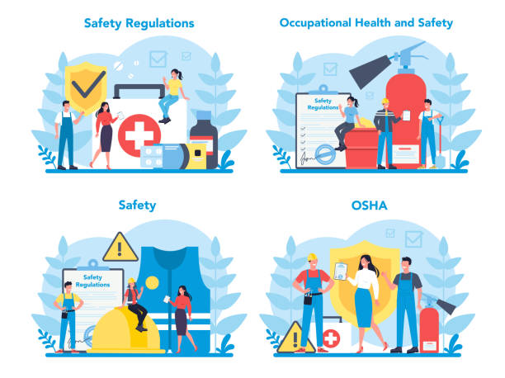
Regulatory Agencies Occupational Safety and Health
Occupational Safety and Health Administration (OSHA)
Drug Enforcement Agency (DEA)
Food and Drug Administration (FDA)
Joint Commission on Accreditation of Healthcare Organizations (JCAHO)
Pharmacy Boards
Conclusion
The Occupational Safety and Health Act was the culmination of centuries of governmental response to occupational safety and health problems.

Slide 30


