Slide 1
ODESSA NATIONAL MEDICAL UNIVERSITY
Faculty of pharmacy
Department of Organization and Economics of Pharmacy with post-diploma specialization
Health and Safety
in the Pharmaceutical
Industry
The lecture was prepared by
senior teacher Oksana STEPANOVA

Slide 2


Health and safety are an integral component of workforce sustainability and improved productivity in the pharmaceutical industry. The pharmacists are constantly being exposed to chemical and biological hazards which pose a serious threat to their health
Furthermore, lack of adequate safety standards and non-compliance may impact workforce productivity and have significant repercussions on business sustenance in the long run. Therefore, it is important to have optimal health and safety practices while ensuring that all employees adhere to such regulations.

Slide 3
Maintaining improved health and safety standards in the pharmaceutical industry involves several steps:
Practice Primary Laboratory
Safety
Risk Evaluation
Ensure Injury Free Work
Environment
Health & Safety Standards in Handling Chemicals

Slide 4
Risk Evaluation
Effective risk evaluation is the cornerstone of assessing the potential hazards at workplace and ensuring safety of the employees. In the pharmaceutical industry, it is legally obligatory to conduct thorough health and safety risk estimation. It involves reviewing the workplace to identify the dangers and their sources. Typically, the following steps are involved in health and safety risk assessment:
Walk around the facility to discover potential risks and evaluate the accident record sheets
Once the dangers are identified, check which employees are most vulnerable to such threats
Determine how the workplace hazards can be managed and control; set a definitive action plan – the objective must be to either minimize or remove the hazard to ensure improved health and safety of the employees
Record the risks and action taken to demonstrate the issue has been identified and given attention
Review the risk evaluation report annually to ensure effective implementation of health and safety measures in the workplace

Slide 5
Practice Primary Laboratory Safety
In the pharmaceutical industry, maintaining basic safety in the laboratory is mandatory. The Occupational Safety and Health Administration (OSHA) have comprehensive guidelines regarding how to practice lab safety. Ensure all your employees are aware of the primary health and safety practices and take preventive measures when working in a hazard-prone environment.
Based on OSHA guidelines, the following key steps can be taken to maintain health and safety at the laboratory:
•Practice frequent cleaning, particularly when the employees are exposed to chemical hazards or particles
•Wash hands regularly and properly to inhibit the spread of bacteria, viruses or hazardous chemicals
•Never eat, drink or smoke inside the laboratory
•Make wearing suitable Personal Protective Equipment mandatory inside the laboratory – coveralls, eye gear, protective helmet, shoe covers, etc.

Slide 6

•Label the containers appropriately
•Regularly check that all equipment is working properly and safe to use
•Wear head cap to prevent contamination through hair
•Keep the corridors clean and sanitized
•Perform risk evaluations every day

Slide 7
Ensure Injury Free Work Environment
For any pharmaceutical company, employees are the biggest asset. To ensure their improved health and safety, it is important to implement and regulate an “injury free” environment. Set guidelines, take action and regulate implementation of safety measures that eliminate injuries and incidents.
Some of the key steps here are:
Visibly demonstrate and inspire through your commitment to inculcate an injury and incident free culture.
Educate employees that they are accountable for their own safety and also for the safety of those around them.
Implement effective management that helps identify, control and eliminate all types of hazards up to an acceptable limit.
Take appropriate action to prevent the reoccurrence of incidents and injuries through effective investigation and anticipatory strategy development
Implement and regulate corporate safety standards across all your pharmaceutical buildings, offices and laboratories
Conduct injury-free survey wherever appropriate to discover opportunities for improvements

Slide 8
Health & Safety Standards in Handling Chemicals
Transporting and handling hazardous chemicals can be dangerous. If done inappropriately by untrained staff, it can cause chemical releases, explosions and fire. To minimize the risk and ensure more safety, it should be done “so far as is reasonably practicable.” Using the Classification of Chemicals can be an effective way of handling hazardous chemicals and mitigating the associated risks.
The Classification of Chemicals helps identify how the chemicals can have detrimental effects. It also states how the chemicals should be labelled correctly and handled in a legally-compliant manner to avoid disasters or health risks. High temperature, high pressure or oxidation often causes chemicals to explode or release. By lowering the oxidation work scale and understanding the right flammable limits, pharmaceutical companies can help reduce the risks.

Slide 9
Installing emergency showers is also an effective way of handling chemicals when they come directly into contact with the user. It can help wash away the chemical from the PPE and the skin to prevent health hazards. Consider installing eye wash stations inside the facility to minimize the risk of major damages.

Slide 10


Top Safety Risks in the Pharmaceutical Industry
Carbon Monoxide Exposure
UV
Radiation
Hazardous Chemicals
Biological Hazards
Ergonomic
Hazards
Flammable
and
Combustible
Materials
.
Psychological Hazards
Physical Hazards

Slide 11
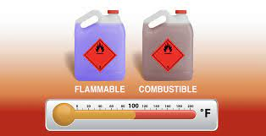
Flammable and
Combustible
Materials
Hazardous Chemicals
Working with, handling, transporting, and storing chemicals is a primary component of the pharmaceutical manufacturer's workday. Many chemicals used in both primary and secondary processing can be extremely hazardous to human health if accidentally ingested or inhaled.
Combustible and flammable materials present within pharmaceutical manufacturing facilities can cause uncontrolled fires, leading to extensive and often costly property damage. Accidents involving flammable materials can also lead to serious and potentially fatal worker injury (e.g., burns, smoke inhalation).

Slide 12

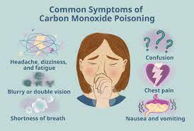
Biological Hazards
Carbon Monoxide Exposure
The pharmaceutical industry continues to make rapid advances in the prevention and treatment of infectious pathogens, including bacteria, viruses, and fungi. To drive this innovation, pharmaceutical workers, scientists, and researchers must routinely handle these hazardous organisms, along with any chemicals and materials needed for the development of vaccines and other types of medicines.
Carbon monoxide can develop as a byproduct of certain chemical reactions. This odorless and colorless gas is toxic to humans and can cause dizziness, weakness, vomiting, and even death when inhaled. Protecting workers from carbon monoxide and other toxic fumes should include the use of (and regular inspection of) carbon monoxide detectors and appropriate signage wherever this gas is stored or potentially created.
To reduce the risk of accidental exposure to biological hazards, tightly controlled primary and secondary containment methods should be utilized. These methods include even the simplest strategies, such as routine handwashing, up to and including advanced ventilation systems.

Slide 13


UV Radiation
We typically think of ultraviolet (UV) radiation in the context of sunlight. However, the pharmaceutical manufacturing industry may use UV radiation for operations such as vitamin D production.
Excessive exposure to UV radiation has been associated with an increased risk of cataracts, skin cancer, and burns on the eyes and skin. When applicable, pharmaceutical workers should be offered apparel and accessories that can protect their eyes and skin from UV light.

Slide 14

Personal Protective Equipment (PPE) in the Pharmaceutical Industry
It is important to consider that the health and safety hazards typical of the pharmaceutical manufacturing industry can affect individuals other than direct staff. Due to issues such as cross-contamination and accidental environmental exposure, workers within the pharmaceutical manufacturing industry can unintentionally expose their families, fellow community members, and domesticated and wild animals to toxic or otherwise harmful materials.

Slide 15
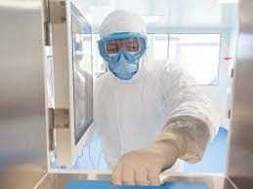
Recommended pharmaceutical PPE varies considerably, but generally includes:
4. Eye protection, including face masks and goggles
1. Protective apparel,
including gowns and coveralls
5. Respiratory
protection, which includes
N95 respirators and powered
air-purifying
respirators (PAPR)
2. Gloves
3. Shoe covers
Employers should always ensure their workforce has access to high quality and durable pharmaceutical PPE that provides adequate protection without impairing worker mobility, gross motor function, vision, productivity, and general comfort. It is also the employer's responsibility to ensure that all personnel are thoroughly trained on how to properly don, doff, store, and if necessary, dispose of PPE to further mitigate the risk of hazardous conditions or exposure

Slide 16

Personal Protective Equipment (PPE) in the Pharmaceutical Industry
To reduce this risk of accidental exposure both inside and outside the workplace, it is imperative for company leaders within this industry to make safety their leading priority. Company leaders should establish protocols that help standardize and streamline safety procedures. When relevant, safety protocols should also comply with local and national regulatory boards, including the Occupational Health and Safety Administration (OSHA).

Slide 17

Potential Hazards and Recommended Controls
Biological Hazards and Controls
Biological agents are widely found in the natural environment and as a result found in many work sectors. They include bacteria, viruses, fungi (including yeasts and molds) and internal human parasites (endoparasites). The majority of these agents are harmless however some may have potential to cause ill health.

Slide 18
Biological Hazards and Controls
The Effects of Biological Agents
As they are usually invisible, it is often difficult to appreciate the risks they present. As a worker you may be harmed by:
being infected by a biological agent
being exposed to toxins produced by the biological agent, or
having an allergic reaction to the biological agent or substances it produces, for example, enzymes.
Biological agents have the ability to replicate rapidly, require minimal resources to survive and can infect at very small doses.

Slide 19
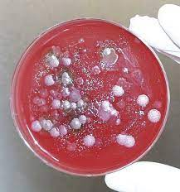
Types of Exposure
In the workplace, exposure to biological agents can be:
•intentional, whereby the employee works directly with them, for example, in a laboratory or research facility, or
•unintentional, whereby the employee is exposed to the biological agent due to the work they do, for example, a healthcare worker who is exposed to a blood borne virus

Slide 20
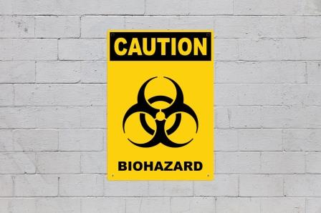
Classification of Biological Agents
Biological Agents are classified in the Code of Practice to the Safety, Health and Welfare at Work (Biological Agents) Regulations 2013 and 2020, into four risk groups
– groups 1, 2, 3 and 4.
A "group 1
biological agent", means one that is unlikely to cause human disease to employees.
B "group 2
biological agent", means one that can cause human disease and might be a hazard to employees, although it is unlikely to spread to the community and in respect of which, there is usually effective prophylaxis or treatment available.
C "group 3
biological agent" means one that can cause severe human disease and presents a serious hazard to employees and which may present a risk of spreading to the community, although there is usually effective prophylaxis or treatment available.
D "group 4
biological agent" means one that causes severe human disease and is a serious hazard to employees and which may present a high risk of spreading to the community and in respect of which there is usually no effective prophylaxis or treatment available.

Slide 21
What hygiene and individual protection measures should be taken when
working with biological agents?
In the case of any activity in relation to which there is a risk to the safety or health of employees caused by working with a biological agent, the employer must take appropriate measures to ensure that:
Employees do not eat or drink in any location within a place of work where there is a risk of contamination by a biological agent
•Employees are provided with suitable washing and toilet facilities, which may include eye washes and skin antiseptics (or both)
Employees are provided with suitable personal protective equipment (PPE)
• Any necessary PPE is:
i. properly stored in a designated place
ii. checked and cleaned if possible, before, and in any case after each use
iii. repaired, where defective, or replaced, before further use
Procedures are specified for taking, handling and processing samples of human or animal origin
• Working clothes and PPE, which may be contaminated by a biological agent, are removed on leaving the working areas and, before taking measures for cleaning/decontaminating/destroying, kept separately from other clothing
• The working clothes and PPE are decontaminated and cleaned or, if necessary, destroyed.

Slide 22
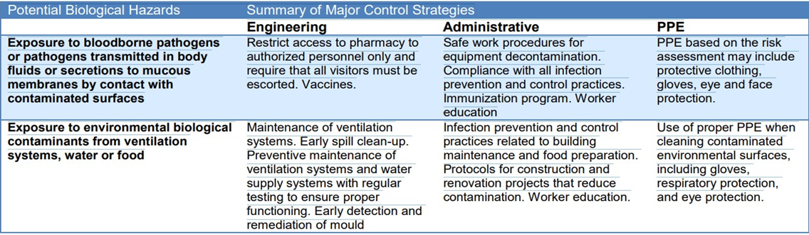
Biological Hazards

Slide 23

Exposure to biological hazards may occur for any pharmacy staff in contact with patients or the public or through contaminants found in the ventilation system, water or food. Controls include controlled access to pharmacy spaces and the encouragement of pharmacy staff to be immunized against infectious diseases to which they may be exposed. Ventilation systems and water supplies should be monitored regularly for microbial growth.
Engineering Control
sIn the hierarchy of controls, the highest level of control is directed at the source. From an occupational health perspective, the highest level of control may be immunization of workers who may come in direct contact with infected patients. Good engineering controls such as vaccines, proper ventilation, needleless systems, safety engineered sharps, biological safety cabinets, and effective biological waste containment also contribute to minimizing the transmission of infectious agents. Engineering controls, once designed and implemented, are not under the control of the worker, but are directed at the source of the hazard.

Slide 24
Biological Hazards
Administrative Controls
The next level of controls includes administrative controls. Because it is not always possible to eliminate or control the hazard at the source, administrative controls are frequently used for biological hazards in healthcare. Administrative controls focus on ensuring that the appropriate prevention steps are taken, that all proper work procedures are documented, that pharmacy staff are trained to use the proper procedures, and that their use is enforced. Administrative controls include policies and procedures that establish expectations of performance, codes of practice, staff placement, required orientation and training, work schedules, and occupational health programs in which baseline immune status is recorded and immunizations are provided.
Administrative controls related to the prevention of exposure to biological hazards include the development of infection prevention and control guidelines, including equipment decontamination and safe work procedures for building maintenance and protocols for construction and renovation projects.
Surfaces must be decontaminated after any spill of potentially infectious materials and at the end of the working day. Specific written protocols must be developed and followed for each decontamination process. Pharmacy staff must be trained in all decontamination procedures specific to their activities and should know the factors influencing the effectiveness of the treatment procedure.

Slide 25

Personal Protective Equipment (PPE)
Gloves, gowns and other protective clothing reduce exposure through the dermal (skin) contact route and help contain the microorganisms to the work environment. Eye and face protection reduce exposure through mucous membrane contact. Masks worn by patients reduce exposure through droplet containment at the source, and respirators worn by health care workers reduce exposure to the respiratory system.
Personal protective equipment such as gloves, respiratory protection and eye protection should be used based on the risk assessment.
PPE is often used in conjunction with other controls (engineering and
administrative) to provide additional protection to workers. The primary
types of PPE are designed to protect the worker from infectious disease by breaking the chain of infection at the “portal of entry or exit” of the microorganisms. This means that all PPE is designed to reduce
exposure via specific routes of transmission.

Slide 26

Chemical Hazards and Controls
Necessary for working with all harmful substances and
educating workers in the practices is vital.
Safe work procedures should be designed to:
Limit the worker’s exposure time
Reduce contact with the substance through any route of exposure to the worker
Ensure safe disposal of substances and disposable equipment that comes into contact with harmful substances
Ensure safe handling and decontamination of reusable equipment
Require the use of all designated controls
Worker education is critical for safely handling harmful substances

Slide 27
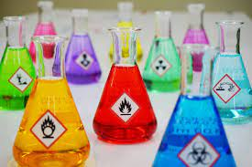

The use of chemicals is widespread in healthcare and includes chemicals such as:
•
cleaning agents
disinfecting and sterilising agents
laboratory chemicals
medical gases
anaesthetic agents
cytotoxic drugs and pharmaceutical substances.

Slide 28
Effects of Chemicals
Routes of Exposure
Any chemical that has the potential to
cause harm is called a hazardous or dangerous chemical. Such chemicals may:
Healthcare workers (and in certain cases, the unborn child) may suffer health effects when dangerous chemicals enter the body. The main routes of exposure are:
cause health effects, for example be a respiratory sensitizer or skin irritant or sensitizer;
be a physical hazard, for example a flammable, explosive or oxidising chemical;
affect the environment, if they are used, stored or disposed of incorrectly.
inhalation: breathing in the chemical;
absorption: through skin contact or a splash in the eye;
ingestion: via contaminated food or hands; and
inoculation: when a sharp object such as a needle punctures the skin.

Slide 29


Chemical safety: Key duties of employers and employees
There are key duties for employers and employees under
the relevant health and safety
Employers are required to:
Determine which hazardous substances are present in the workplace.
Assess the risks to employees and others from the presence of these hazardous substances.
Prevent or control exposure to the hazardous substances to as low a level as is reasonably practicable.
Have arrangements in place to deal with accidents, incidents and emergencies.
Provide information, training and consultation to employees.
Make available health surveillance to employees

Slide 30


Chemical safety
Employees also have duties.
They must:
Co-operate with their employer e.g. follow procedures.
Make full and proper use of control measures e.g.
using extract ventilation where provided, and report any defects.
Report any defects in plant/ equipment immediately to the employer as appropriate.
Report any accident or incident which may have resulted in the release of a dangerous chemical/substance into the workplace

Slide 31
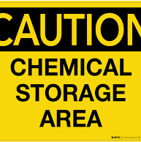
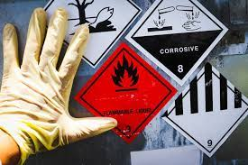


A chemical risk assessment follows the same steps as a risk assessment for any
other hazards in your
workplace.
There are three basic steps:
Identify the hazard:
This involves identifying the chemicals you have in
your workplace and the hazards associated with them.
Assess the risk:
This involves assessing the risk from chemicals or processes in your workplace.
Control the exposure:
This involves considering the various recognized
control measures to eliminate or reduce the risk

Slide 32
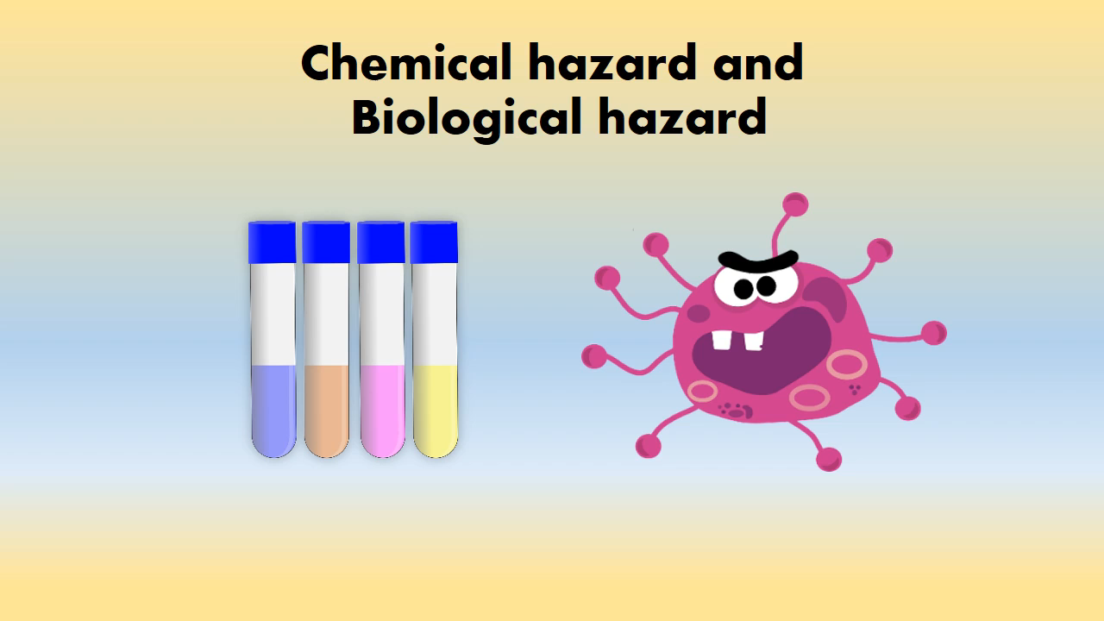
https://www.youtube.com/watch?v=0cbg_eYKjsc&t=112s

Slide 33

Chemical Storage
An often-neglected engineering control is the proper storage of chemicals. Chemicals must be stored properly to reduce risks of fire and explosion, chemical reactions, and worker exposure. Chemical storage must consider local fire regulations that specify the types and quantities of specific chemicals that may be stored. Organizations should reduce the risks related to chemical storage by ensuring that only quantities of chemicals and sizes of containers that are necessary for the tasks are purchased and stored. The temptation to save money by purchasing large quantities should be discouraged, as these quantities have more stringent storage requirements and are often more difficult (and expensive) to dispose of than to purchase.

Slide 34
Some major reasons why chemicals are stored improperly include:
• An initial decision (when the area is designed) to purchase small quantities of chemicals that is later reversed for economic reasons, leading to the purchase of larger quantities that exceed the storage capabilities of the area
• Lack of space to accommodate storage facilities
• “Shared” storage facilities, with no one designated as responsible for ensuring proper storage
• Confusion as to how to store chemicals that have more than one hazard
• Lack of training/knowledge of chemical composition and reactivities
• Bad habits related to convenience
• Lack of a well thought out chemical storage plan

Slide 35
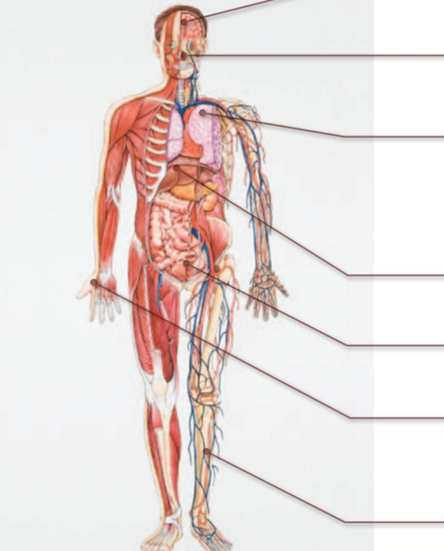
How can chemicals be hazardous to health?
Chemicals can cause many different types of harm, ranging from mild skin irritation to cancer.
The effects of hazardous chemicals may be seen:
Immediately after contact (e.g. chemical burn) or many years after the exposure (e.g. lung cancer following exposure to asbesto)
Following a single short exposure (e.g. infrequent use of a chemical) or longer-term exposures (e.g. daily use of a chemical in the workplace).
Therefore, it is important to minimise exposure to chemicals at all times.
In order for a chemical to be hazardous to a person’s health, it must either be in contact with or enter the body.

Slide 36


Effects on brain and nervous system For example, exposure to pesticides, mercury, lead, solvents, carbon monoxide gas
Eye, nose and throat irritation (dryness, soreness or pain) For example, exposure to acid mists and vapours, welding fumes or diesel exhaust
Effects on the lung Lung damage For example asbestos (lung cancer), welding fume (chronic obstructive pulmonary disease). Irritant induced asthma For example acids (“burn effect” on airways). Allergic asthma For example flour dust, isocyanate (in 2-pack paints), wood dust
Liver damage For example, exposure to vinyl chloride.
Bladder damage For example, exposure to some azo dyes (bladder cancer)
Effects on skin Allergic contact dermatitis For example nickel, latex, chromate (found in some cements). Irritant contact dermatitis For example solvents, detergents, oils, lubricants.
Effects on blood and bone marrow For example, exposure to benzene in petrol fumes (anaemia and leukaemia).

Slide 37

Thanks.
Your attention is appreciated!

