Slide 1

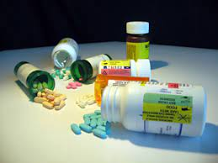
ODESSA NATIONAL MEDICAL UNIVERSITY
Faculty of pharmacy
Department of Organization and Economics of Pharmacy
with post-diploma specialization
Occupational safety when working with Hazardous drags
The lecture was prepared by
senior teacher Oksana STEPANOVA

Slide 2
Hazardous drags are specific drugs with the potential to harm workers who are exposed to them. Continual or frequent exposures to low levels of hazardous drugs, or a single exposure to a larger amount, can put workers at risk of negative health effects

Slide 3
According to National Institute for Occupational Health and Safety (NIOSH) definition, a drug is hazardous if there is evidence of one or more of the following characteristics in humans or animals:
• Carcinogenicity: the ability to cause cancer
• Teratogenicity or other developmental toxicity: the ability to affect the development of an embryo or fetus
• Reproductive toxicity: the ability to affect reproductive function in adults
• Organ toxicity at low doses: the ability to seriously affect organs or organ systems
• Genotoxicity: the ability to damage genetic material within cell

Slide 4
NIOSH determines whether drugs meet these criteria by reviewing existing scientific evidence for each drug and then lists qualified drugs in a periodical. For drugs not on the NIOSH list, employers can determine whether a drug is considered hazardous by using the following sources of information:
• Evidence-based research that indicates the drug meets the
criteria for a hazardous drug
• Drug information sheets provided by the manufacturer, such as
safety data sheets
• Product monographs in Health Canada’s Drug Product Database
• Health warnings from government or professional groups

Slide 5
Who is at risk of exposure?
A wide range of people can be at risk of exposure to hazardous drugs in their workplace, including: • Pharmacy workers •
Laboratory workers •
Nurses • Health care assistants
• Cleaners, housekeeping and laundry staff
• Physicians •
Veterinary and animal attendant workers
• Community health workers •
Workers involved in drug shipping/receiving/transport services
• Workers involved in hazardous waste services

Slide 6
Hazardous drugs can cause serious acute and chronic health effects such as skin rashes, fertility problems, genetic damage, birth defects, organ toxicity, and possibly leukemia and other cancers.
Potentially harmful exposure can occur when you handle or work around hazardous drugs. These drugs include antineoplastic cytotoxic medications, anesthetics, anti-viral drugs, hormones, and others.
https://www.youtube.com/watch?v=qL1E7VElswc
https://www.youtube.com/watch?v=MgwnCh364is

Slide 7
Routes of occupational exposure
Workers can be exposed to hazardous drugs in a number of ways.
The potential route of exposure depends on the form of the drug being handled and the tasks being conducted.
Surface contamination is one of the main sources of occupational exposure to hazardous drugs. Due to their chemical stability, residue from hazardous drugs can persist in the workplace and be spread far from their point of origin. Trace residue from hazardous drugs can deposit on surfaces, such as vials and IV bags containing hazardous drugs, work tables, and hazardous drug transport carts. Residue can also collect on items that are not directly used for handling hazardous drugs, such as pens, door handles, and elevator buttons. Since surfaces throughout the workplace may be contaminated, there is a potential risk of exposure to others present in the workplace, including visiting staff or patient family members.

Slide 8
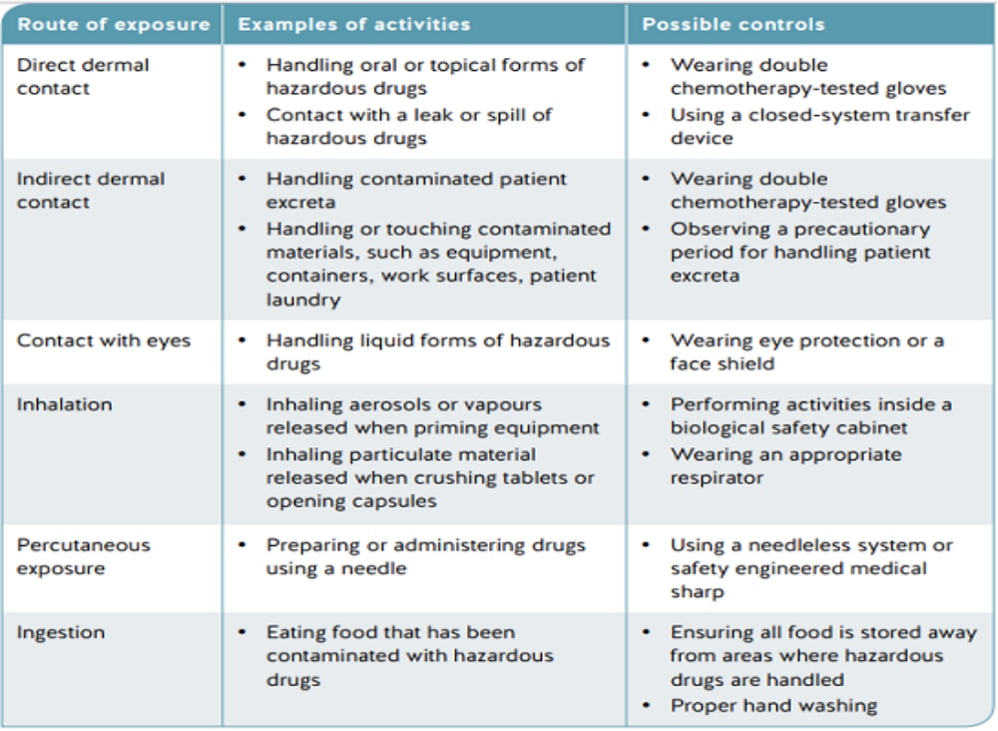

Slide 9
Creating an exposure control plan
An exposure control plan (ECP) describes how workers will be protected from hazardous drugs in the workplace. An ECP includes information on the nature of the hazard and the risk associated with exposure, as well as controls that the employer will use to protect workers.

Slide 10
The ECP includes the following components:
• Statement of purpose and responsibilities
• Risk identification and assessment
• Risk controls
• Written safe work procedures
• Education and training
• Written records
• Hygiene facilities and decontamination procedures (when
required)
• Health monitoring (when required)
The ECP should be reviewed at least annually and updated as
necessary by the employer, in consultation with the joint occupational health and safety committee or the worker health and safety representative.

Slide 11
A risk assessment
A risk assessment provides a foundation for eliminating or minimizing worker exposure to hazardous drugs in your workplace. It involves examining the level to which workers are being exposed to hazardous drugs and what can be done to reduce that exposure as much as practicable.

Slide 12
A risk assessment involves performing the following three steps:
• Identify hazardous drugs that are present in the workplace.
• Assess the risks of exposure to hazardous drugs.
• Develop and implement controls to eliminate or reduce exposure.

Slide 13
A risk assessment should be performed by an individual or team who, through a combination of education, training, and experience, are knowledgeable about the work, the hazards involved, and the means to control the hazards.
Throughout this process, it‘s essential that front-line workers and representatives from the joint occupational health and safety committee of your workplace are consulted. Workers and their representatives provide knowledge on how work is being done and insight into potential solutions. The most effective solutions to controlling exposure will take the needs and knowledge of the worker into account

Slide 14
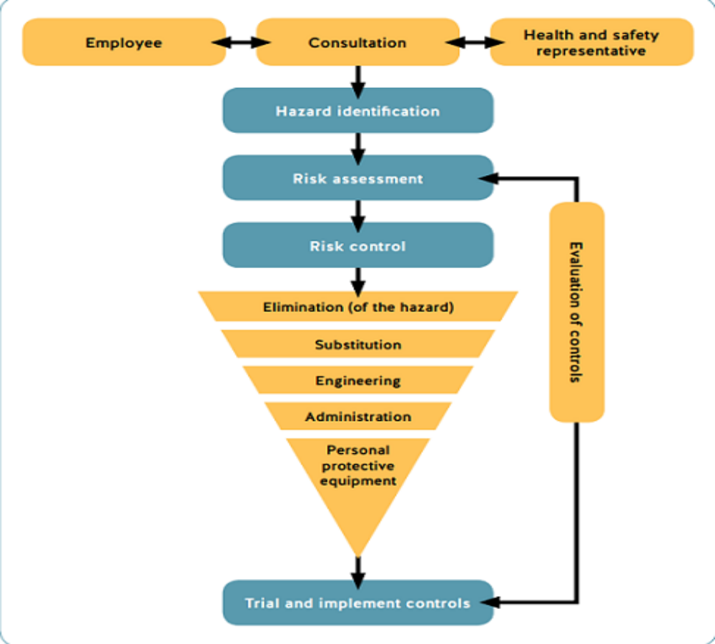
The following diagram shows the steps to performing a risk assessment.

Slide 15
Identifying hazards is the first step toward controlling exposure to hazardous drugs in your workplace. This involves creating an inventory of all drugs in the workplace and then determining whether hazardous drugs are present among them.
Create a list of hazardous drugs in your workplace
Once you’ve listed all the drugs that are present in your workplace, compare them with known hazardous drugs. Visit the following websites to view the most recent hazardous drug lists:
• BC Cancer Agency
• NIOSH Hazardous Drugs

Slide 16
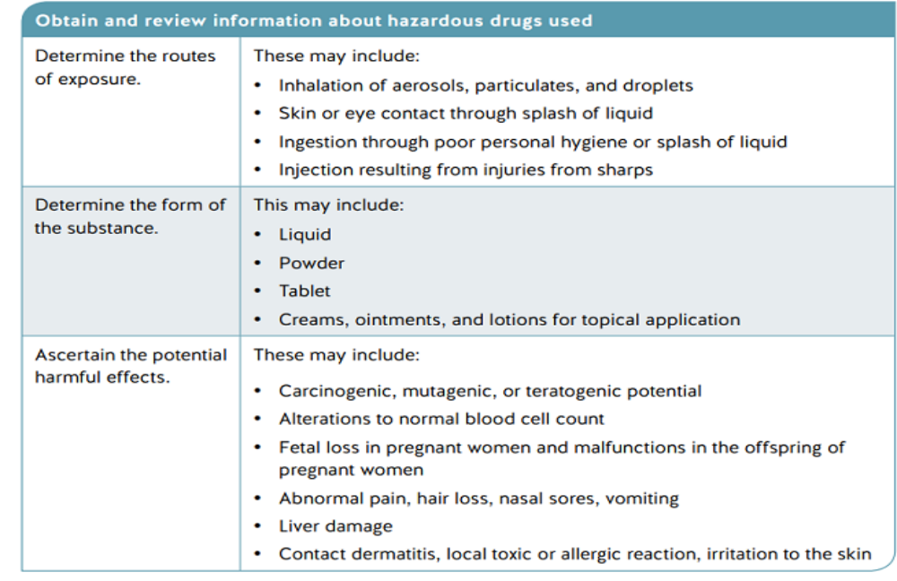
Potential routes of exposure, the form of the substance, and the potential health effects

Slide 17
Assessing risk
Once the presence of hazardous drugs has been identified, the next step is to determine the level of risk. This involves determining how
he drugs are used in the workplace and identifying which tasks place workers at risk of exposure.

Slide 18
Evaluation involves analyzing the work environment, tasks and activities performed, and any previous incidents where workers may have been exposed to hazardous drugs. This information can be gathered by performing a walk-through survey of the workplace, consulting with workers who are performing the tasks being evaluated, and reviewing employer health and safety records.

Slide 19
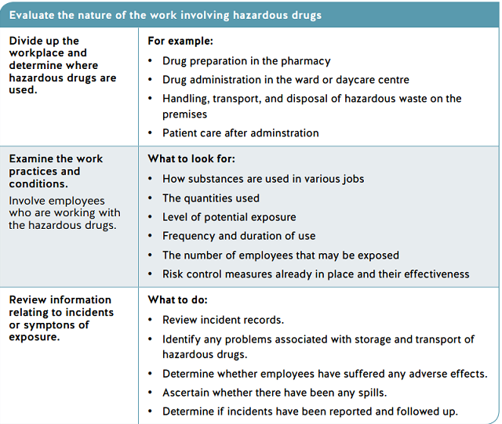

Slide 20
Tools for assessing risk
You can use one or all of the following assessment tools to help you determine the level of risk posed by hazardous drugs in your workplace:
• Categorizing hazardous drugs
• Environmental monitoring
• Health monitoring

Slide 21
Categorizing hazardous drugs
For workplaces that use a wide variety or a large number of hazardous drugs, it may be helpful to categorize them in terms of the degree of risk of exposure. This may make it easier for the employer to communicate to workers situations where they are at high risk of exposure. This would be based on information about the drug itself, such as the form of the drug, potential routes of exposure, and potential health effects, as well as information on the how the drug is used in the workplace, as determined in the risk assessment.
https://www.youtube.com/watch?v=MBk6EBU-6kw
https://www.youtube.com/watch?v=TK0aqckcVEw
Hazardous Drug Compounding

Slide 22
Categorizing hazardous drugs is a tool that may be used for assessing risk, or you may find that other means are more useful or practicable in your workplace.

Slide 23
Health monitoring
Health monitoring is intended to prevent the development of
occupational disease in workers by detecting biomarkers in blood or urine samples that indicate early signs of disease. For hazardous drugs, this can be difficult in practice because the health outcomes due to exposure are not yet fully understood.

Slide 24
There are also methods to detect hazardous drugs (or their
metabolites) in blood or urine. These tests should always be
interpreted with caution, as detecting signs of exposure does not necessarily mean that disease will develop.
Health monitoring is typically used in a research setting. If health monitoring is used in the workplace, it can help inform a risk assessment by tracking whether worker exposure to hazardous drugs changes over a period of time. However, health monitoring is not a required component of an exposure control plan since these
methods are not all easily available or validated

Slide 25
Thank you for your attention

