Slide 1

ODESA NATIONAL MEDICAL UNIVERSITY
Department of Dermatology and Venereology
Lecture № 1
Theme: Propaedeutic of Dermatovenereology.
Principles of Treatment of the Patients with Skin.
Skin Diseases due to Animal Parasites.
Pyodermas.
Mycosis of the Skin and Mucous Membranes.

Slide 2

Dermatology (Greek Derma - skin + logos - study) is a part of clinical medicine that studies the function and structure of the skin, its appendages in health and disease, and develops methods for the diagnosis, treatment and prevention of skin diseases.

Slide 3
Dermatology is distinguished into general and specific
The object of study of specific dermatology are individual dermatoses; causes of their development, course, clinical symptoms, differential diagnosis, methods of treatment and prevention.
General dermatology studies the anatomy, histology, physiology, biochemistry of healthy and diseased skin, general issues of the etiology and pathogenesis of skin diseases, develops methods for their diagnosis, principles of therapy and prevention.

Slide 4
In the history of the development of dermatology, the following periods are conditionally distinguished:
Ι - Empirical period (from prehistoric times until the middle of the XVI century)
ΙΙ - Morphological period (from the middle of the XVI to the middle of the XIX century)
ΙΙΙ - Etiopathogenetic period (from the middle of the 19th century to the present)

Slide 5
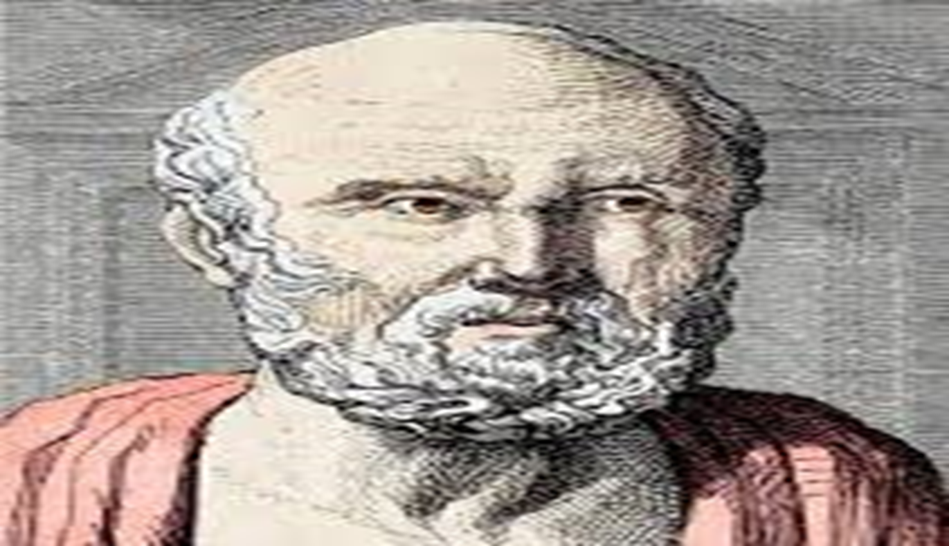
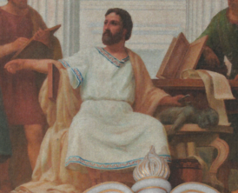
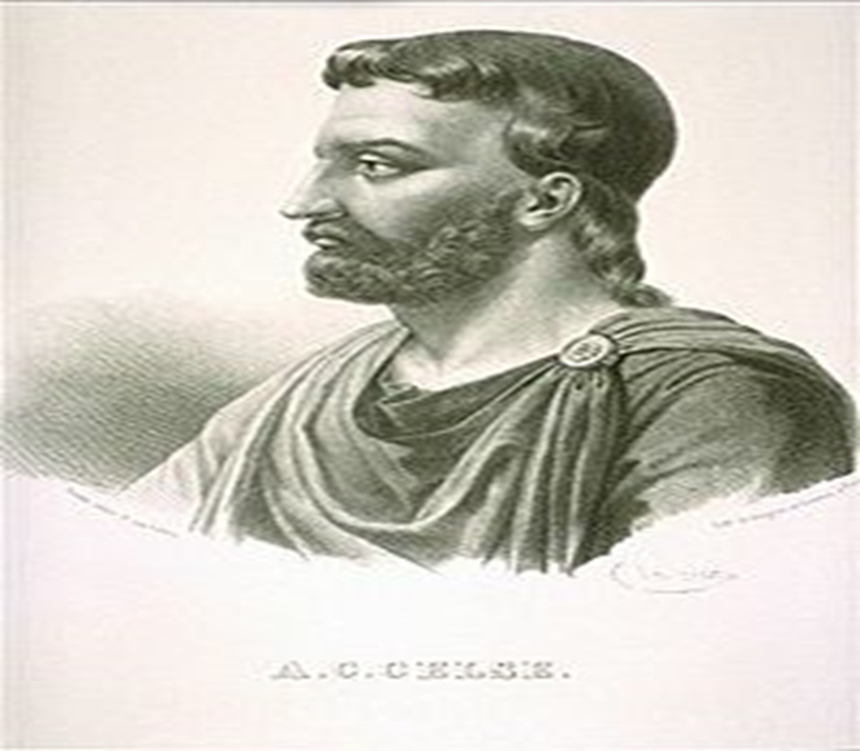
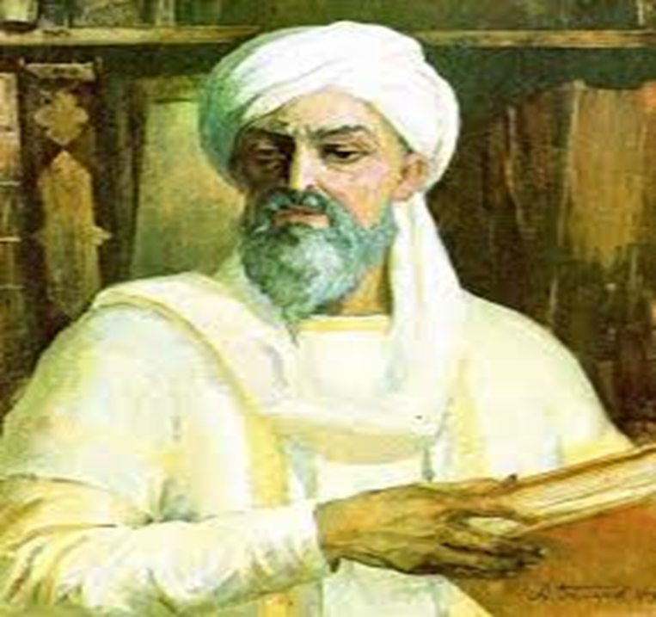
The main representatives of the empirical period:
Hippocrates
Claudius Galen
Dr. Cornelius Celsus
Avicenna

Slide 6
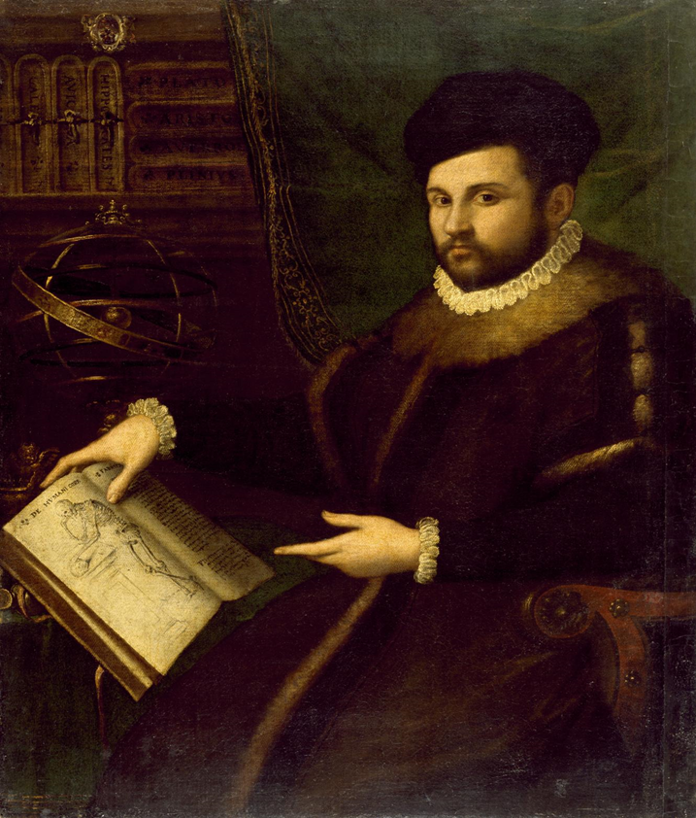
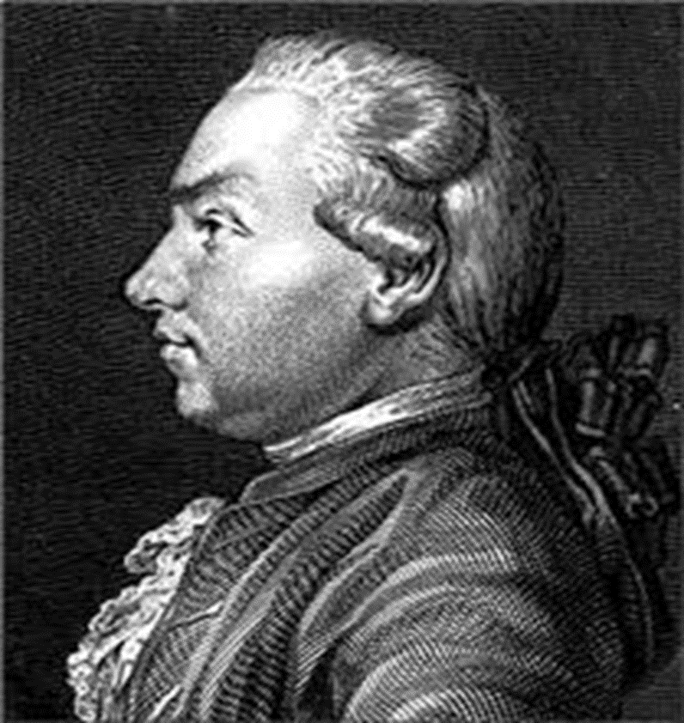
ΙΙ - Morphological period (from the middle of the XVI to the middle of the XIX century)
During this period, an in-depth study of the structure of the skin began, attempts to classify the morphological elements of the rash.
In 1571, the Italian Girolamo Mercuriale published a special reference book on skin diseases "De morbus cutaneus".
In 1776, the Viennese professor Josef Plenk thoroughly and reasonably had classified skin diseases, taking into account the peculiarities of the manifestations of the rash.

Slide 7
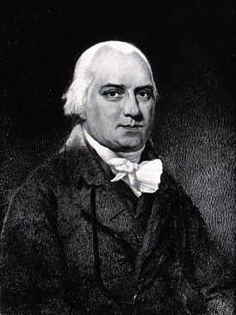
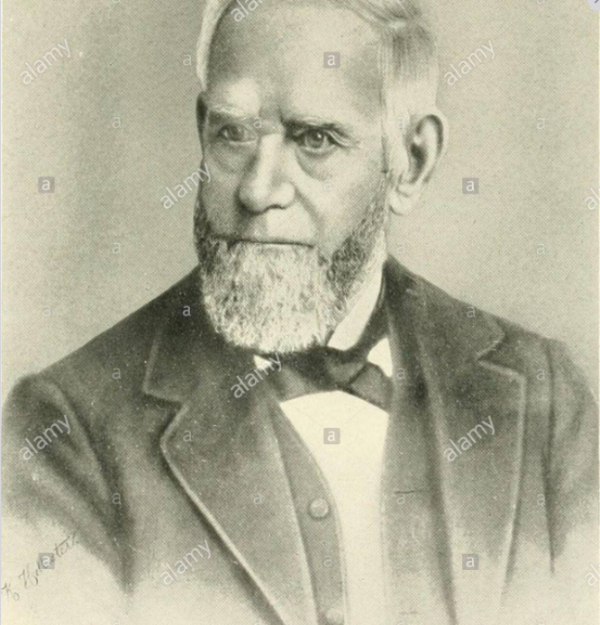
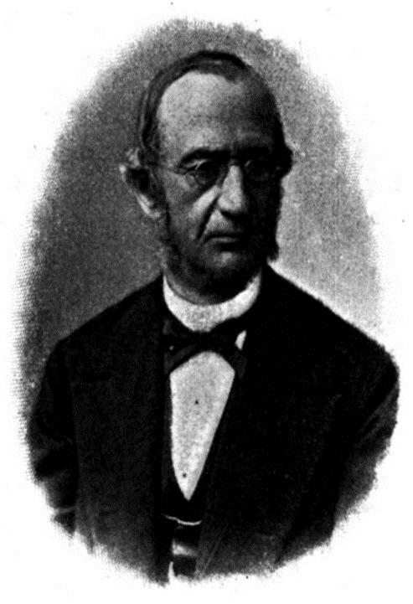
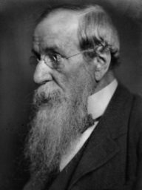
In the 18-19th centuries, the first dermatological schools appeared in Europe and North America.
Representatives of the English School of Dermatology
Robert Willan
W. Wilson
Thomas Bateman
Jonathan Hutchinson

Slide 8
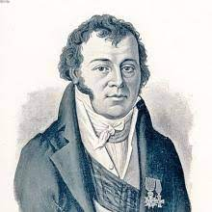
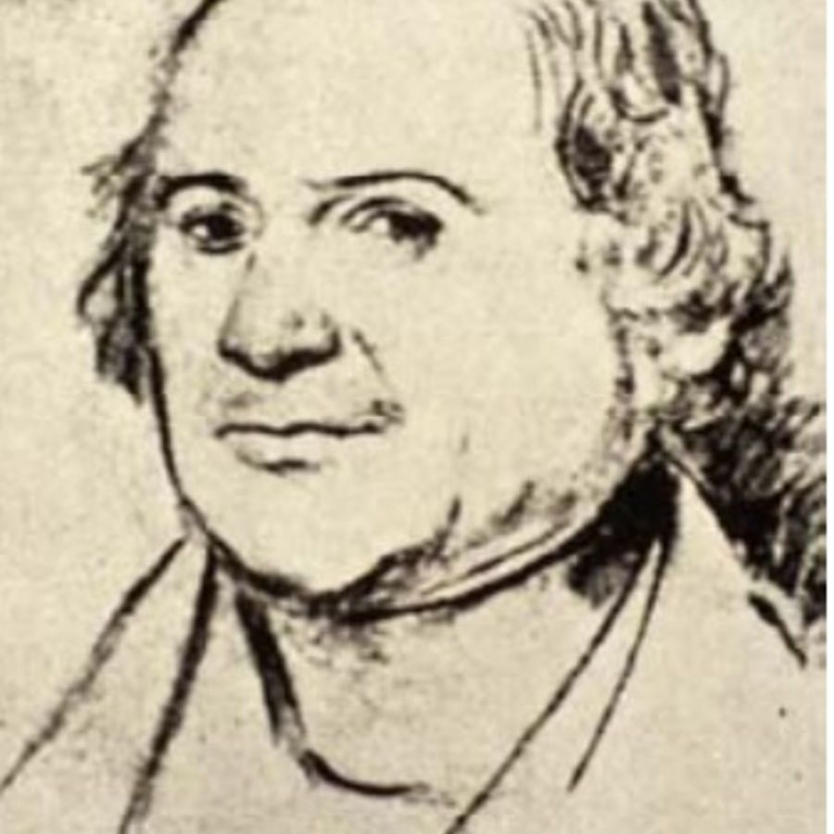
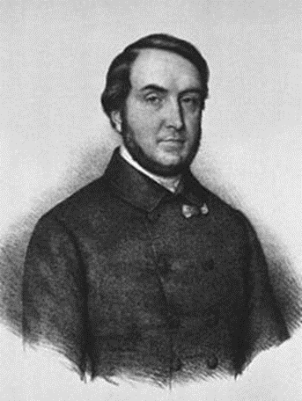
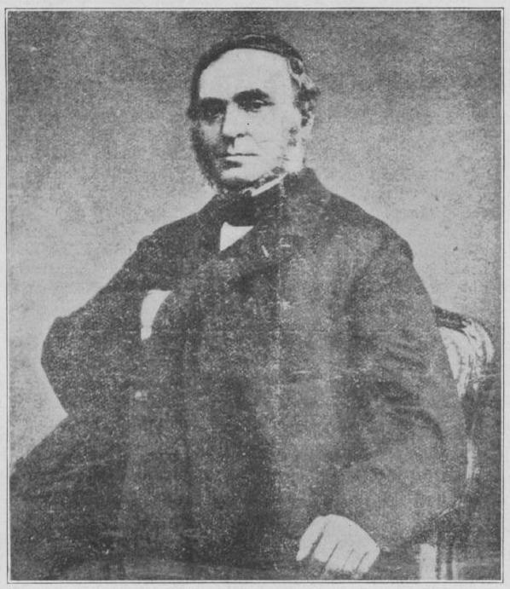
Representatives of the French dermatological school:
Jean-Louis Alibert
Laurent Théodore Biett
Pierre Cazenave
Ernest Bazin

Slide 9
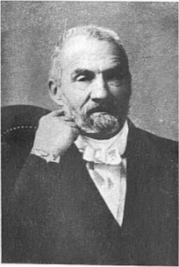
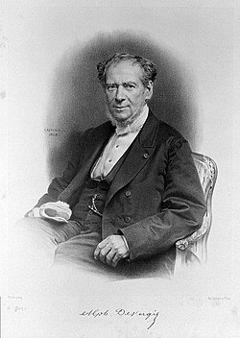
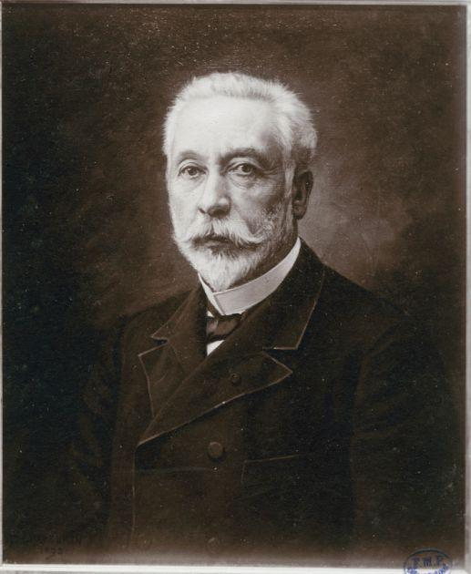
Representatives of the French dermatological school:
Camille Melchior Gibert
Guillaume Alphonse Devergie
François Hallopeau

Slide 10
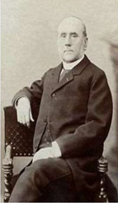
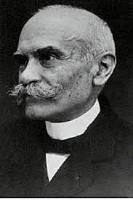
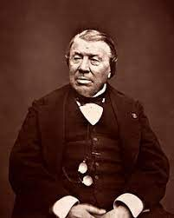
Representatives of the French dermatological school:
Ernest Besnier
Louis Anne Brocq
Philippe Ricord

Slide 11
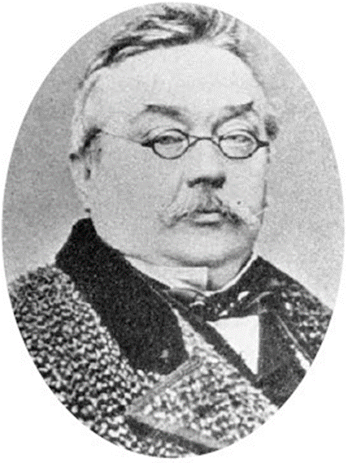
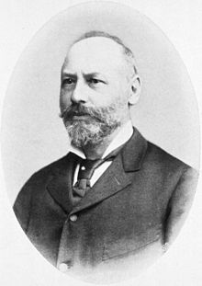
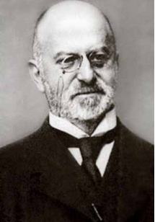
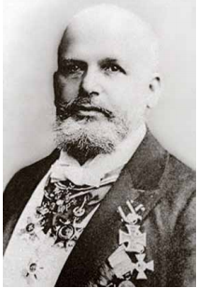
Representatives of the German School of Dermatology:
Ferdinand Ritter von Hebra
Moritz Kaposi
Edmund Lesser
Oscar Lassar

Slide 12
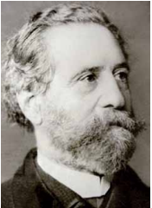
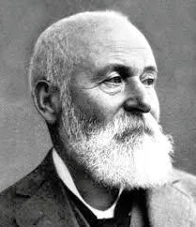
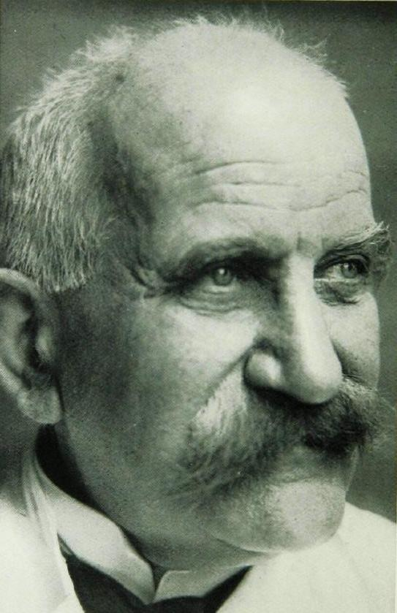
Representatives of the German School of Dermatology:
Georg Richard Lewin
Paul Gerson Unna
Joseph Jadassohn

Slide 13
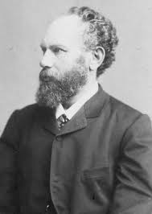
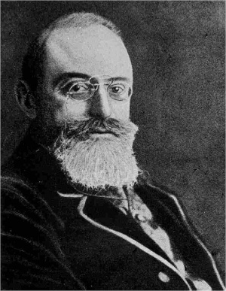
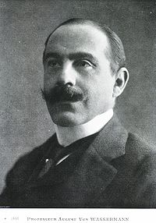
Representatives of the German School of Dermatology:
Heinrich Auspitz
Albert Ludwig Sigesmund Neisser
August Paul von Wassermann

Slide 14
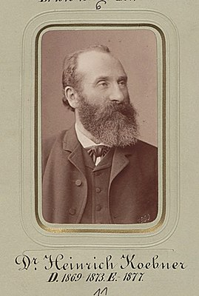
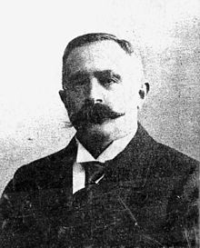
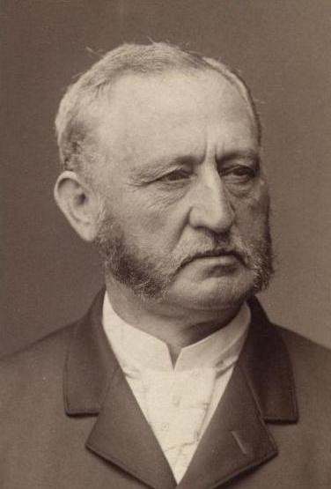
Representatives of the German School of Dermatology:
Heinrich Koebner
Abraham Buschke
Isidor Neumann

Slide 15
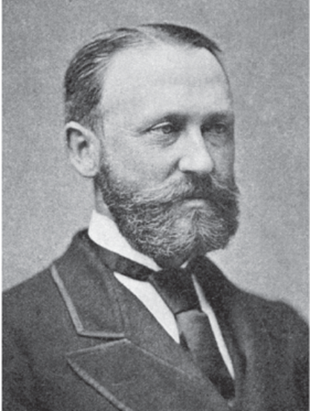
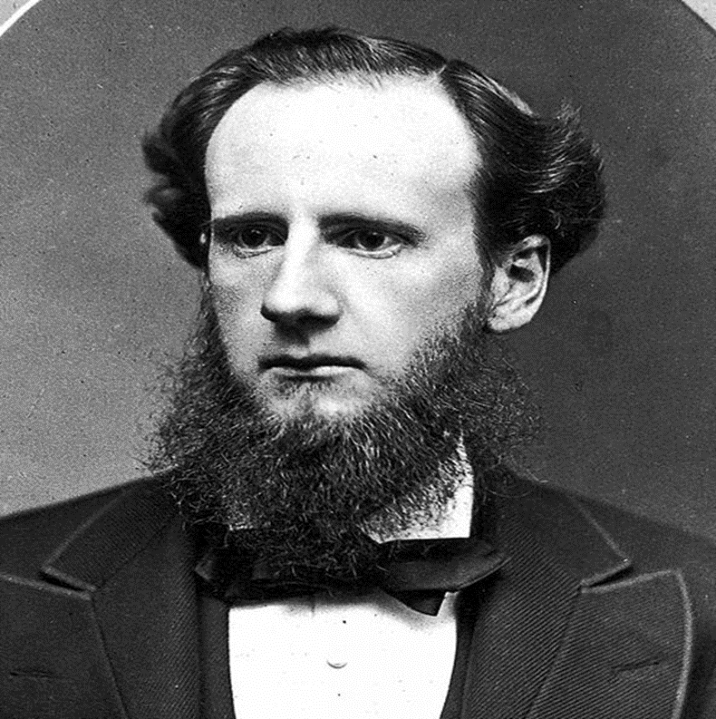
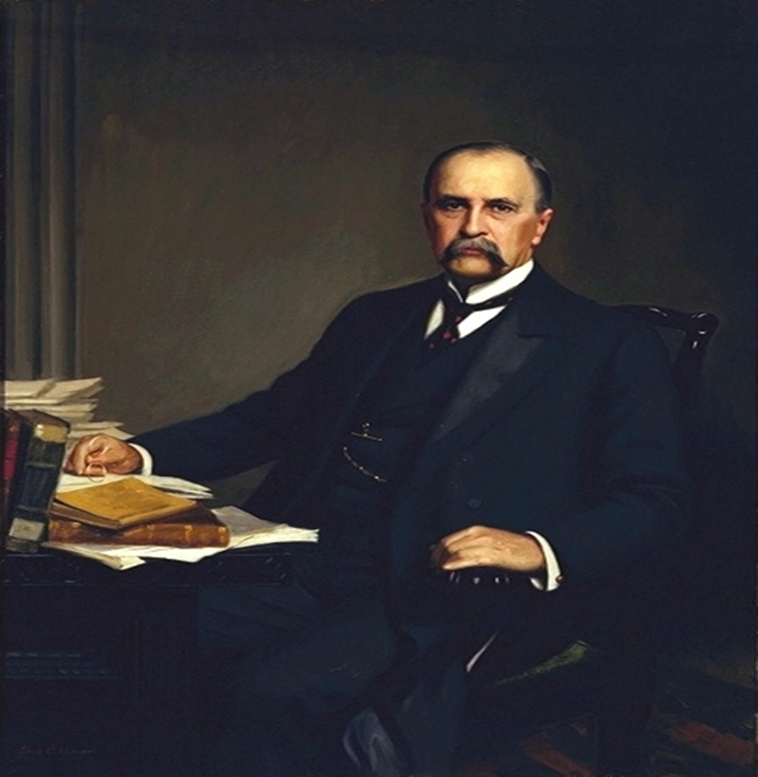
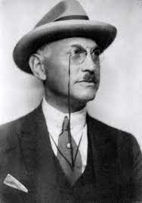
Representatives of the American School of Dermatology:
James Clarke White
Lois Duhring
William Osler
Jay Frank Schamberg

Slide 16
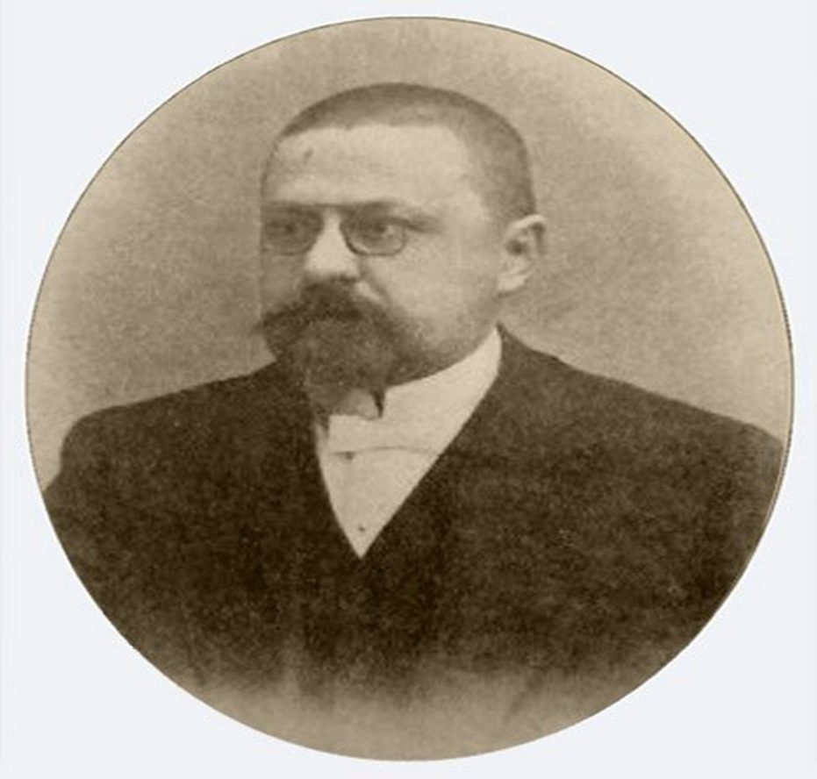
Odessa Dermatological School
The history of the formation of the dermatovenerological service of the Odessa region can be counted from the beginning of the last century. Even then, Odessa was a large seaport. The polyclinic for the treatment of skin and venereal diseases was opened in 1917 and it was the first independent skin and venereal medical institution in the country.
The clinic was headed by Egor Glavche. He opened a pathological and serological laboratory on his own money. In 1922, the polyclinic was reorganized into the State Dermatovenerological Institute, which was named after E.S. Glavche.
Egor Glavche

Slide 17
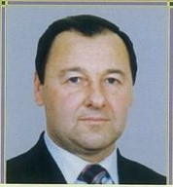
Representatives of the Odessa dermatological school:
From September 2003 to the present, the head of the Department of Dermatology and Venereology of the National Medical University is Professor Mikhail Nikolaevich Lebedyuk
He studies the clinical and epidemiological features of chronic dermatoses and sexually transmitted infections, conducts epidemiological surveillance of HIV infection among patients with sexually transmitted diseases.
He is the author of more than 200 scientific works, of which 3 textbooks "Skin and Venereal Diseases", "Dermatovenereology", "Voluntary counseling and testing for HIV.“ Registered 17 patents and copyright certificates.

Slide 18

Treatment of patients with one or another dermatosis can be conditionally divided:
Etiological treatment (to eliminate the cause of the disease).
Pathogenetic treatment (to correct certain aspects of the pathological process).
Symptomatic treatment (to eliminate individual symptoms of the disease if its etiopathogenesis is unclear).

Slide 19
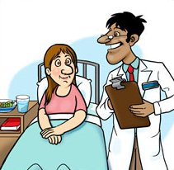
Complex treatment of a patient with dermatosis includes
External therapy
General therapy

Slide 20
General therapy
Sedatives, psychotropic drugs
Antifungal antibiotics
Hyposensitizing agents
Antiviral agents
Antihistamines
Immunotropic drugs
Anti-inflammatories
Chemotherapeutic agents
Antibiotics
Metabolic therapy
Detoxification methods

Slide 21
External treatment
When prescribing external therapy, many factors must be taken into account:
the nature of dermatosis (acute, subacute, chronic),
stage of the process (progressive, stationary, regressive),
depth and localization of pathomorphological changes,
pharmacological properties of the prescribed medication,
a dosage form for using an external agent.

Slide 22
There are the following drugs for external treatment, which can act various depending on the concentration, dosage form and the chosen method of application.
Antiseptic (antimicrobial) drugs
Indifferent drugs
Antiviral drugs
Anti-inflammatory drugs
Antiparasitic drugs
Fungicidal and fungistatic drugs
Keratoplastic (reducing) drugs
Antipruritic drugs
Keratolytic, cauterizing drugs
Photoprotective drugs
Cytostatic drugs

Slide 23
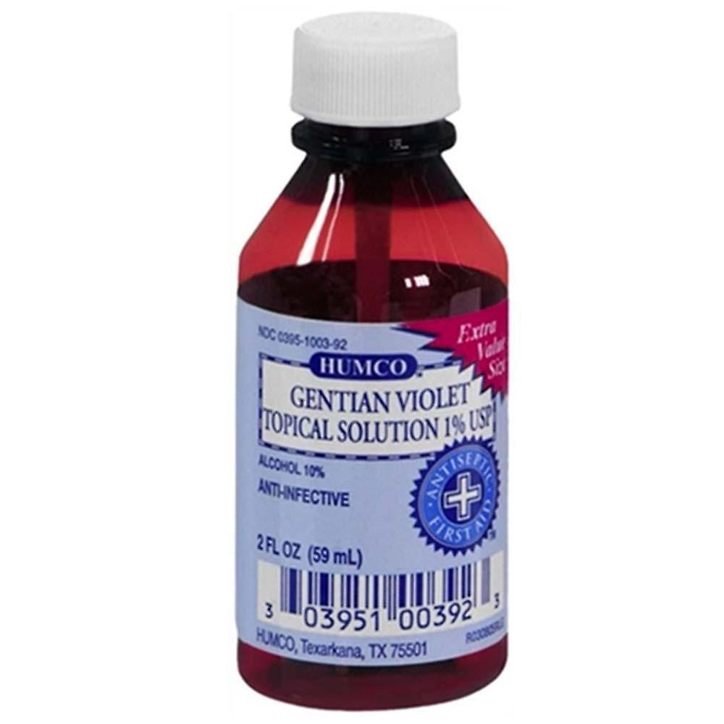
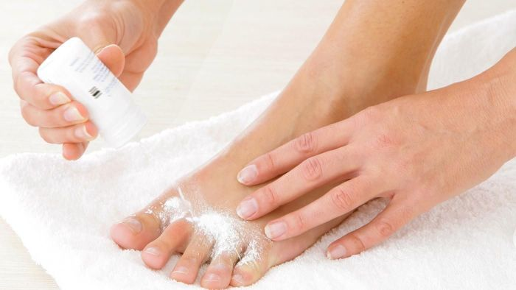
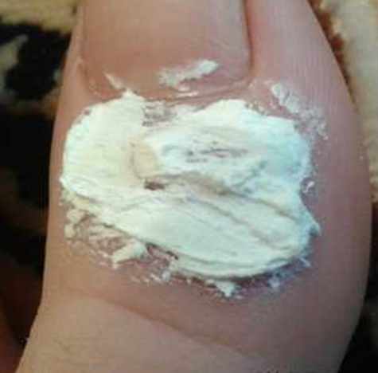
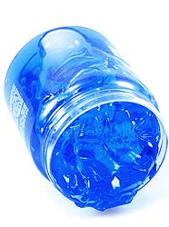
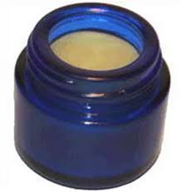
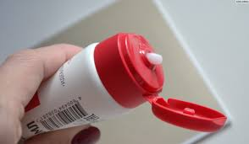
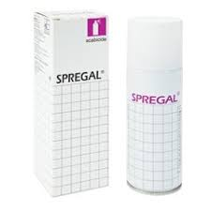
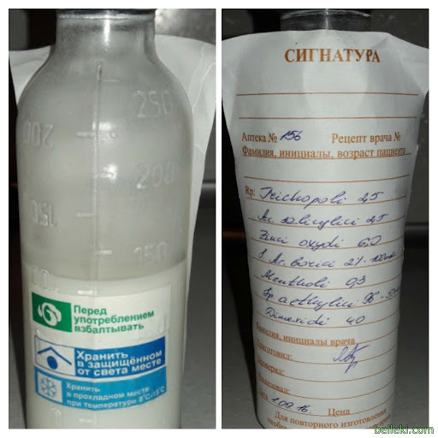
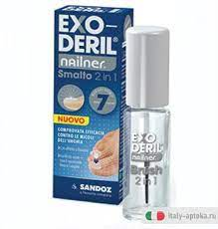
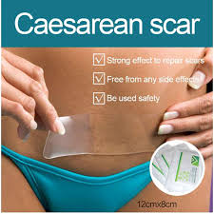
DERMATOLOGICAL DOSAGE FORMS
for external treatment
Powders
Pastes
Dermatological gels
Ointment
Solutions (aqueous, alcoholic)
Creams
Aerosols
Shake lotions (talkers)
Varnish
Plasters

Slide 24



SPECIAL RESEARCH METHODS OF DERMATOLOGICAL PATIENT
1. Medical history
2. Inspection of the skin (ad oculus).
Examine the entire skin, oral mucosa, you must assess their color, moisture влажность, dermographism, the presence of scars, pigmentation.

Slide 25


3. Inspection through a magnifying glass.
You must determine the nature of the scales, the presence of elevation, depressions.
4. Palpation.
Palpation determines:
skin elasticity and tone;
skin temperature increase or decrease can be determined;
location of the element (epidermis, dermis, subcutaneous base), its size, shape, consistency, connectivity with surrounding tissues, painfulness;
in case of edema, determine its intensity, presence of fluctuation (abscess, hydradenitis), absence of painfulness (primary syphiloma).

Slide 26


5. Scraping (scratching)
The scraping carry out with a glass slide, a non-sharp scalpel. The scraping method allows you to detect peeling of the skin, to determine its nature (small-lamellar, large-lamellar), the density of attachment of scales to the skin surface.
6. Diascopy (vitropression)
This is pressure on the affected area of the skin with a glass slide or a special device - a diascope (transparent plastic plate). The nature of the element (vascular, pigmented) is determined when using this method. When pressed, the vascular spot becomes pale or disappears, and the hemorrhagic spot (or pigmented spot) does not disappear.

Slide 27


7. Dermographism is a method of a special dermatological study that allows you to determine the state of the autonomic nervous system, in particular the reflex reaction of the vascular wall as a response to skin irritation (the tone of the sympathetic part of the nervous system prevails in white dermographism, and in red - parasympathetic).
The flat end of a ballpoint pen or the edge of a spatula or a special device (dermograph) is used to draw strips on the skin. After 10-20 seconds, a line appears at the site of irritation.
8. Dermatoscopy is a non-invasive, visual diagnostic method, in which the doctor can conduct research and assessment of various, primarily pigmented formations.

Slide 28




9. Ultrasound examination. It is used to assess the depth of the location of melanoma, focal scleroderma process. The radiography, computed tomography and magnetic resonance imaging are used in addition to ultrasound.

Slide 29

10. . Fluorescent diagnostics using a Wood lamp allows to assess the nature of the affected hair and skin scales in microsporia, pityriasis versicolor, lupus erythematosus.
11. Research:
on LE-cells (with lupus erythematosus);
on acantholytic cells of smears-prints with erosion in acantholytic pemphigus;
on treponema Pallidum, on streptobacillus Petersen-Ducreaus out of discharge of eroded, ulcerative and weeping elements in syphilis, soft chancre;
to identify the scabies mite (with scabies) or Demodex folliculorum (with demodicosis);
by microscopy and sowing the affected scales and hair, nails on fungi;
by sowing material from foci of infection on the flora and determination of the sensitivity of microorganisms to antibiotics;
12. Histological examination of biopsy skin material is used to clarify the clinical diagnosis.
13. Conducting allergy skin tests.
14. Immunodiagnostics is used to determine the immune status in severe chronic dermatoses.

Slide 30


Skin diseases due to animal parasites
Skin diseases caused by animal parasites are called dermatozoonoses. The group of animal parasites includes lice, fleas, bed-bugs, mosquitoes, and some species of mites (the scab mite, the mites of horses and rats, pigeon and chicken mites, and the louse mites).
Scabies and pediculosis are most important in the practice of dermatologists.

Slide 31

Scabies
The incubation period is 7-10 days to one month and more.
Infestation occurs from direct contact with a skin individual, particularly when the bed-clothes, underwear or bed are shares. Among children the disease may be transmitted through toys handled by a sick child. Scabies is not primarily a sexually transmitted disease but sexual transmission occurs.

Slide 32




Clinical picture
Itching is the first and essential symptom of scabies. Most of all it occurs in the evening and night. Typical elements are paired and scattered pin-point papulo-vesicules, burrows and excoriations.

Slide 33



The forms of scabies
Nodular scabies: nodules occur in 7-10% of patients with scabies. The lymphocytic infiltrate remains for several months after all mites have been eliminated; because the cause is "antigen persistence".
In Norwegian scabies, the skin in the lesions is dry and covered with thick, dark green crusts and resembles a armor. A foul odor is emitted from the patient.
Scabies incognita.
It is observed in patients with thorough personal hygiene (scabies cleaner) or those who use topical corticosteroids.

Slide 34
Treatment of scabies
The patient should take a hot shower, and then one of the following medicines should be rubbed onto the skin and even on the intact surfaces:
33 % sulphur ointment,
20 % benzyl benzoate solution for adults, or 10 per cent benzyl benzoate solution for children,
“Spregal” spray,
Permethrin cream,
5 % emulsion of potassium soap,
lindane,
crotamiton,
vermectin (Stromectol)
Demyanovich’s method for treating scabies employs a 60 per cent sodium thiosulphate solution (solution N 1) and a 6 per cent solution of concentrated hydrochloric acid or 18 per cent solution of diluted hydrochloric acid (solution N 2).

Slide 35


Pediculosis
This is infestation with lice
Spread of infection occurs through direct contact with a sick person, through his clothes, bed-clothes, and through sexual contact.

Slide 36



Three species of lice may parasitize on the human skin
The head louse lives on the scalp, mainly on the temporal-occipital area, but is also found on eyebrows and eyelashes.
Typical sites of the localization of pubic louse are the pubis, axillae, areas of genitals, anus, and the chest.
The body (clothes) louse localizes on the shoulders, the upper part of the back, in the axillae, on the abdomen, loin, and in the inguinal folds.

Slide 37




Treatment of pediculosis
Mechanical method
Chemical method
Haircut
Shaving
Pedilin - made on the basis of the chemical malathion;
Itax shampoo - made on the basis of phenothrin;
Medifox Gel/Higia (shampoo) - made on the basis of permethrin.
Combing

Slide 38


Pyoderma (from ancient Greek πύον - pus and δέρμα - skin) is a purulent lesion of the skin that occurs as a result of the introduction of pyogenic cocci into it.

Slide 39
acute
chronic
primary
secondary
superficial
deep
by the nature of the flow:
by the depth of the lesion:
Classification of pyoderma
by the chronology of occurrence:
by prevalence:
by etiology:
localized
common
Staphylococcal
Streptococcal
Mixed strepto-staphyloderma
Hair follicles, sebaceous and sweat glands are affected.
Smooth skin and folds with a tendency to peripheral growth of lesions are affected. The appendages of the skin are not affected.

Slide 40
Superficial staphylococcal pyodermas are:
Folliculitis
Sycosis
Vesiculopustulosis
Osteofolliculitis (Bockhart’s impetigo)
Pemphigus epidemicus neonatorum
Ritter’s Disease (Dermatitis Exfoliativa Neonatorum)
Staphylococcal scalded skin syndrome (SSSS)
Staphylococcal toxic shock syndrome (TSS)

Slide 41


Osteofolliculitis (impetigo Bockhart) is inflammation of the orifice of the hair follicle.
Folliculitis is purulent inflammation of the hair follicle.

Slide 42


Sycosis vulgaris (staphylococcal sycosis, nonparasitic sycosis) is chronic diffuse folliculitis.

Slide 43



Vesiculopustulosis (periporitis, osteoporitis) is purulent inflammation of the orifices of the eccrine sweat glands. The disease is common in newborns
Epidemic pemphigus of newborns (pyococcal pemphigoid, pyococcal pemphigus) is highly contagious pustular skin disease of newborns, characterized by a fast clinical course, onset and disseminanion of the phlyctenas (flabby blisters) on the skin. The phlyctenas have the size from a pea to a hazelnut with a cloudy content on non-inflamed skin.

Slide 44




Ritter`s dermatitis exfoliativa (epidermolysis of newborns, acute) is severe version of epidemic pemphigus newborns.
Staphylococcal Scalded Skin Syndrome is similar to exfoliative dermatitis, there is in children older than a month of life and up to 5 years.

Slide 45


Staphylococcal toxic shock syndrome (TSS) is characterized by a sudden rise in temperature body, arterial hypotension, redness of the skin and mucous membranes and multiple organ failure.

Slide 46
Deep staphyloderma
Furuncle
Furunculosis
Carbuncle
Hydradenitis
Pseudofurunculosis
Abscess

Slide 47




Furuncle is purulent-necrotic inflammation of the hair follicle, the sebaceous gland and the surrounding subcutaneous fat.
Furunculosis is a chronic recurrent process in which furuncules appear in the patient successively for a long time. New elements often appear, when the old ones did not regress.

Slide 48


Carbuncle is the conglomerate of furuncles, united by a common infiltrate.
The ulcer fills with granulation and heals with a scar.

Slide 49



Hydradenitis is purulent inflammation of the apocrine glands.
Abscess is a limited cavity filled with pus, which is located in the dermis, subcutaneous tissue, muscles.

Slide 50



Pseudofurunculosis (multiple miliary abscesses of newborn) is inflammation of the eccrine sweat glands in children.

Slide 51
Superficial streptoderma
Streptococcal impetigo
Erysipelas
Streptococcal toxic shock syndrome (STSSS)
A types of impetigo
Impetigo bullous
Angulus infectious (impetigo fissurica (Perleche)
Pytyriasis simplex
Paronychia
Papulo-erosive streptoderma
Intertriginous streptoderma
Acute diffuse streptoderma

Slide 52


Streptococcal impetigo is highly contagious skin infection, more common in children and young women, characterized by the formation of phlyctena.

Slide 53







The clinical types of streptococcal impetigo are
Bullous impetigo
Angulus infectious (perleche, impetigo fissurica)
Pytyriasis simplex (dry streptoderma
Paronychia (superficial panaritium)
Intertriginous streptoderma
Acute streptoderma
Papular syphiloid impetigo (papulo-erosive streptoderma)

Slide 54




Erysipelas is an acute bacterial infection of the dermis and subcutaneous tissue, characterized by the formation of a sharply limited inflammatory focus, as well as fever and symptoms of general intoxication.
Streptococcal toxic shock syndrome (STSS) develops as a complication in patients with extensive traumatic skin lesions and disorder peripheral circulation.
It is characterized by acute development of shock and multisystem organ deficiency. Lethality reaches 30%

Slide 55



Deep streptoderma
Cellulite is acute infectious inflammation of the subcutaneous fat.
Ecthyma vulgaris (streptoderma ulcerative) is deep streptococcal skin lesions with ulceration in a limited area (non-follicular deep pustule).

Slide 56


Superficial strepto-staphyloderma
Strepto-staphylococcal vulgar impetigo
is a contagious skin disease caused by streptococci and staphylococci.

Slide 57
Chronic deep ulcerative vegetative pyoderma
Chancriform pyoderma
Gangrene of the penis and scrotum
Acne keloidea (folliculitis sclerosans of the occiput )
Hallopo`s vegetative pyoderma
Deep strepto-staphyloderma
Gangrenous pyoderma
Hoffmann's folliculitis abscendens et suffodiens capitis
Scarring folliculitis (folliculitis decalvans)
Vegetative pyostomatitis

Slide 58
Treatment of pyoderma
To treat any kind of pyoderma it is necessary to follow three main principles:
Elimination of predisposing factors:
Local circulatory disturbances;
Endocrine disorders;
Hypo and avitaminosis;
Immunodeficiency states;
Focal infection;
Hyperhidrosis, poor skin hygiene;
Mechanical irritation.
III. Prevention of dissemination:
Treatment of skin with 2 per cent salicylic spirit;
Prohibition of washing and massage;
Prohibition of opining and stripping of any elements of eruption on the skin by a patient.
II. Focus control:
Antimicrobials (it is desirable to take into consideration microorganisms sensitivity);
Specific immunobiological medications (staphylococcal anatoxin, staphylococcal antifagin);
Local therapy -disinfectants, antibacterial and anti-inflammatory medications.

Slide 59



Mycoses

Slide 60

Classification of Mycoses
Keratomycoses
Pseudomycoses
Dermatomycoses
Candidiasis
Deep mycoses

Slide 61

Keratomycoses affect only the stratum corneum of the epidermis, have the low contagious and do not cause severe inflammation.
Pityriasis versicolor
Nodular trichophytosis (piedra) is a disease that occurs mainly in the countries of Central and South America.

Slide 62

Pityriasis versicolor (keratomycosis)
The causative agent of the disease is a yeast-like fungus which capable are existing in three forms transforming into each other: Pityrosporum ovale; Pityrosporum obriculare; Malassezia furfur. Fungus located in the stratum corneum of the epidermis and follicular orifices.
Clinical picture:
Eruption element is a yellowish-brownish-pink non-inflammatory spot starting from the hair follicle orifices and gradually increasing in size. Sometimes the spots take on the color of "coffee with milk, accompanied by a floury peeling.

Slide 63


Nodular trichophytosis (piedra) is a disease of the hair cuticle with the formation of white (piedra alba) or black (piedra nigra) nodules on it (piedra from the Spanish – “ stone”).
Piedra alba (european)
Piedra nigra (true)
The causative agent
Trichosporon Beigelii (family of yeast-like fungi)
Trichosporon hortai (family of mycelial fungi)

Slide 64


Pseudo mycoses occupy an intermediate position between fungi and bacteria.
Erythrasma is
superficial pseudo mycoses.
Actinomycosis is
deep pseudo mycoses.

Slide 65


Erythrasma is a chronic superficial skin lesion. The causative agent is Corinebacteria fluorescens erythrasmae.
Clinical Picture.
The yellowish-brown, brick-red, red-brown spots localized mainly in the folds of groin, axilla and under the breasts.
The diagnostic methods:
• microscopic (bacteriological) examination.
• luminescent study (when exposed to a Wood’s lamp, a coral-red or brick-red fluorescence is observed because the causative agent of erythrasma secretes water-soluble porphyrins during its life activity.

Slide 66




Actinomycosis of the skin is a chronic infectious non-contagious disease that affects humans and animals, caused by actinomycetes, more often Actinomyces israeli.
Forms
Nodular
Tubercular
Ulcerative
Atheromatous

Slide 67
Dermatomycosis - a group of fungal diseases that affect not only the skin, but also its appendages (hair and nails).
Epidermophytosis inguinal.
The causative agent is Epidermophyton floccosum.
Microsporia (microsporosis).
The causative agents are Microsporum ferrugineum, Microsporum Audonii
M. canis, M. folineum, M. gypseum.
Epidermophytosis of the Feet.
The causative agents of the disease are Thrichophyton rubrum (approximately 90 per cent), and Thrichophyton mentagrophytes or Thrichophyton Interdigital (about 10 per cent).
Trichophytosis.
The causative agents are Trichophyton tonsurans, Trichophyton mentagrophytes.
Rubromycosis.
The causative agent is T. rubrum
Favus.
The causative agent is Trichophyton Schonleinii.

Slide 68
Epidermophytosis is a contagious fungal disease of the surface layers of smooth skin and nail plates caused by fungi of the genus epidermophyton. Hair is not affected.
Epidermophytosis of large folds, or inguinale.
Epidermophytosis of the feet
Mycosis of the feet
Rubrophytosis of smooth skin
Generalized rubromycosis
Rubromycosis of the nail plates
Rubromycosis of the feet and hands
Rubrophytia (Latin ruber red + Greek phyton plant; synonym: rubromycosis, Trichophyton rubrum infectio) is a fungal disease in which the skin, nails and downy hair are affected.

Slide 69


Epidermophytosis of the large skin folds, or Epidermophytosis inguinalis.
Epidemiology. Infection occurs in bathhouses, when using public baths, washcloths, in sports halls.
Clinical picture.
The main morphological elements are inflammatory rounded pink spots.
They coalesce and form polycyclic foci with a well-defined edematous peripheral border. The desquamation is observed in the center of the lesion, when the pathological process resolves. Severe itching is a subjective symptom.

Slide 70



Mycosis of the feet.
The disease is common in all countries of the world. Athletes are so often affected by mycosis of the feet that this disease is called "athlete's foot".

Slide 71





Clinical varieties of the epidermophytosis of the feet
Squamous form
Squamous-hyperkeratotic form
Intertriginous form
Dyshidrotic form
Epidermophytosis of nails.
More often, the nail plates of the I, V toes are affected, in the thickness of which yellowish spots appear. The free edge of the affected nail plates becomes loose, crumbling. The nail plates of the hands are not involved in the pathological process.

Slide 72






Clinical varieties of rubrophytosis of the feet (hands and nails may be affected at the same time)
Squamous-hyperkeratotic form
Intertriginous form
Dyshidrotic form
Types of lesions of the nail plates with rubrophytosis
of the feet and hands:
Rubromycosis of the hands
Normotrophic
Hypertrophic
Atrophic

Slide 73


Rubcomycosis of the smooth skin.
Smooth skin lesions develop as a result of the spread of infection with the bloodstream, through the lymphatic tracts from foci located on the feet, or through transfers by hand or washing.

Slide 74




Generalized rubromycosis of smooth skin
Clinical varieties of generalized rubromycosis can be divided into erythematous-squamous (superficial), follicular-papular (deep), exudative forms and erythrodermic type lesions.
Erythematous-squamous form
Follicular-papular (deep) form
Exudative form
Rubromycotic erythroderma

Slide 75
Trichophytoses
Superficial trichophytosis of smooth skin
Superficial trichophytosis of the scalp
Infiltrative-suppurative trichophytosis
Chronic trichophytosis, including nail trichophytosis
Tinea imbricata (tokelo)
Favus

Slide 76
Trichophytosis (anthropophilic)
The causative agent is Trichophyton tonsurans. Infection occurs from a sick person, household items.
Clinical forms:
Superficial
smooth skin
scalp
nail plates
Chronic
Trichophytosis (zooanthropophilic)
The causative agent is Trichophyton mentagrophytes. Infection occurs due to contact with sick animals, infected objects.
Clinical forms:
Superficial trichophytosis
Infiltrative-suppurative trichophytosis
Scalp
Face

Slide 77


Trichophytosis (anthropophilic) of the smooth skin
Superficial.
The rounded, erythematous squamous lesions with distinct, raised edges appear on exposed skin areas (face, neck). The downy hair is involved in the process.
Chronic.
The cyanotic bluish foci do not have distinct boundaries and transition to normal skin.

Slide 78


Trichophytosis (anthropophilic) of the scalp (capitis).
Superficial
Hair breaks off 2-3 mm from the skin surface, looks like commas, hooks, question marks, and is called stubs. Healthy hair is left in the foci of lesions.
Chronic
The hair breaks off at the level of the smooth skin and resembles comedones (black dots). This disease is often called black dot trichophytosis. A sick person represents a great epidemiological hazard.

Slide 79


Trichophytosis (anthropophilic) of the nail
Superficial
The nail plate thickens, becomes loose and crumbly, and acquires a dirty grayish color. The hyperkeratosis develops under nail.
Chronic
The nail becomes dirty-grayish and uneven, crumbling and breaking easily. The free edge of the nail separates from the nail bed.

Slide 80


Trichophytia zooanthropophilic
In infiltrative-purulent trichophytosis of smooth skin, hyperemia and infiltration are characteristic lesions.
Superficial zooanthropophilic trichophytosis. Clinical picture does not differ from superficial anthropophilic trichophytosis.

Slide 81




Trichophytosis zooanthropophilic
Infiltrated suppurative trichophytosis of the scalp.
Another name for the disease is «follicular abscess». The release of pus from each follicle individually resembles honey extracted from a honeycomb. From this, the third common name of the disease is Celci kerion (Celsus'honeycomb).
Infiltrative-suppurative trichophytosis of the beard and moustache areas (parasitic sycosis).
It is accompanied by intoxication, subfebrile body temperature, lymphangitis, lymphadenitis, allergic rashes (trichophytosis), which can be vesicular, lichenoid, urticarial, nodular, erythematous-squamous.

Slide 82

Tinea imbricate (tropical mycosis, scaly lichen, tokelo) is contagious mycosis, endemic to the tropics, caused by the fungus Trichophyton concentricum.
The causative agent of the tokelo is an anthropophilic dermatophyte that does not affect hair and nails.
The process is localized mainly on the trunk, extensor surfaces of the limbs, buttocks, and less often on other parts of the body.
Patients look as if covered with scales with a complex pattern ("people-fish").The rash is accompanied by itching, often leading to lichenification. Also, depigmentation of lesions is noted.

Slide 83
Microsporia "ringworm" (from Greek μικρός - small and σπόρος - seed, sowing), is a contagious disease (mycosis) of animals caused by fungi of the Microsporum genus, characterized by lesions of the skin and its appendages. Microsporium also affects humans.
Anthropophilic
Geophilic
Zooanthropophilic
Infection occurs
due to contact with sick kittens, less often adult cats, dogs, infected objects, with a sick person.
due to contact with the patient or household items.
They live in soil and very rarely cause disease in humans and animals
The causative agents
Microsporum ferrugineum
Microsporum Audonii
M. gypseum
M. canis
M. folineum

Slide 84



Forms of microsporia
( skin, downy hair, less often nails are affected)
Infiltrative-suppurative form.
There are single, large, infiltrative, hyperemic lesions. All hair is broken off at a distance of 6-8 mm from the skin.
Superficial microsporia of smooth skin.
The downy hairs are affected. The lesions are edematous, hyperemic, annular.
Superficial microsporia of the scalp.
There are the erythematous- desquamation lesions with irregular edges, in which the hair (not all) is broken off at a distance of 5-8 mm above the level the skin and is covered|ˈkʌvəd| by a gray fungal spores.

Slide 85
Favus
The disease is caused by the anthropophilic fungus Trichophyton Schonleinii, which is found inside the hair in the form of pinprick-like spores located in a straight line.
The incubation period varies from 2-3 weeks to 6-12 months.
Infection occurs through direct contact with sick people or through infected objects. Long-term contact is usually necessary to get infected with favus.
The pathogen affects
smooth skin,
scalp,
Nails,
internal organs.

Slide 86





Forms of the favus
Typical (scutular)
Atypical (squamous)
Impetiginous
It accompanied by spotty eruptions resembling seborrheic eczema.
It differs in the formation of pustules, which similar to vulgar impetigo.
The main element is the scutula (favose scute), which is a pure culture of the fungus in the epidermis.
The hair has the appearance of old wigs[wɪɡ]. There is a specific "barn" or "mouse" smell coming from the patient.

Slide 87
Treatment of the mycoses
When treating fungal diseases, medicines are used in different forms: ointments, creams, sprays, solutions, nail lacquers and tablets.
Treatment is prescribed according to the location of the lesion, the stage of the disease and the severity of the process. The best results are seen with a combination of topical preparations (creams, ointments, sprays, lotions) and oral preparations. Superficial mycosis of the skin can be treated with external agents, while internal preparations are prescribed for lesions of the skin appendages and the scalp.
Oral (systemic) antifungal therapy
Topical antifungal therapy
is used for extensive infections or infections that are resistant to topical therapy.
is the method of choice for most patients.

Slide 88
Antifungal drugs classification
CLASS
DRUGS
Nystatin (cream, ointment and oral suspension)
Amphotericin B*(indicated for the treatment of systemic mycoses)
Polienes
Azoles
Imidazoles
Bifonazole (cream and spray)
Ketoconazole (cream, shampoo, 200 mg Tablets)
Clotrimazole (cream and spray)
Econazole (cream and lotion)
Isoconazole (cream, lotion, powder, spray)
Miconazole (lotion and powder)
Oxiconazole (cream and solution)
Sertaconazole (cream, solution and powder)
Tioconazole (cream, lotion, powder, spray and nail lacquer)

Slide 89
Antifungal drugs classification
CLASS
DRUGS
Azoles
Fluconazole (150 mg tablets)
Itraconazole (100 mg tablets)
Triazoles
Lanoconazole: use in dermatophytoses and candidiasis
Eberconazole: indicated in dermatophytoses and triazole resistant mycoses (Candida kruzei and C. glabrata).
Voriconazole: fluconazole derivative.* (indicated for the treatment of systemic mycoses)
Terconazole
Posaconazole* (indicated for the treatment of systemic mycoses)
Ravuconazole* (indicated for the treatment of systemic mycoses)

Slide 90
Antifungal drugs classification
CLASS
DRUGS
Naftifine
Terbinafine (cream, spray, 125 or 250 mg tablets)
Butenafine
Allylamines
Equinocandines
Caspofungin* (indicated for the treatment of systemic mycoses)
Micafungin* (indicated for the treatment of systemic mycoses)
Ciclopirox olamine (cream, solution, nail lacquer)
Rilopirox: ciclopirox olamine derivative. Indications: candidiasis, pityriasis versicolor and seborrheic dermatitis
Hydroxypyridone
Amorolfine (cream and nail lacquer)
Morpholine Derivatives

Slide 91




Antifungal drugs classification
CLASS
DRUGS
Griseofulvin (500 mg tablets)
Other

Slide 92
kdvrem@gmail.com

