Slide 1

ODESSA NATIONAL MEDICAL UNIVERSITY
Department of Dermatology and Venereology
Larysa Kovtun, M.D.,PhD
Practical lesson on the topics:
History of the Dermatovenereology.
Principles of examination and treatment of patients with skin diseases.
Skin diseases due to animal parasites

Slide 2

Dermatology (Greek Derma - skin + logos - study) is a part of clinical medicine that studies the function and structure of the skin, its appendages in health and disease, and develops methods for the diagnosis, treatment and prevention of skin diseases.

Slide 3
Dermatology is distinguished into general and specific
The object of study of specific dermatology are individual dermatoses; causes of their development, course, clinical symptoms, differential diagnosis, methods of treatment and prevention.
General dermatology studies the anatomy, histology, physiology, biochemistry of healthy and diseased skin, general issues of the etiology and pathogenesis of skin diseases, develops methods for their diagnosis, principles of therapy and prevention.

Slide 4
In the history of the development of dermatology, the following periods are conditionally distinguished:
Ι - Empirical period (from prehistoric times until the middle of the XVI century)
ΙΙ - Morphological period (from the middle of the XVI to the middle of the XIX century)
ΙΙΙ - Etiopathogenetic period (from the middle of the 19th century to the present)

Slide 5
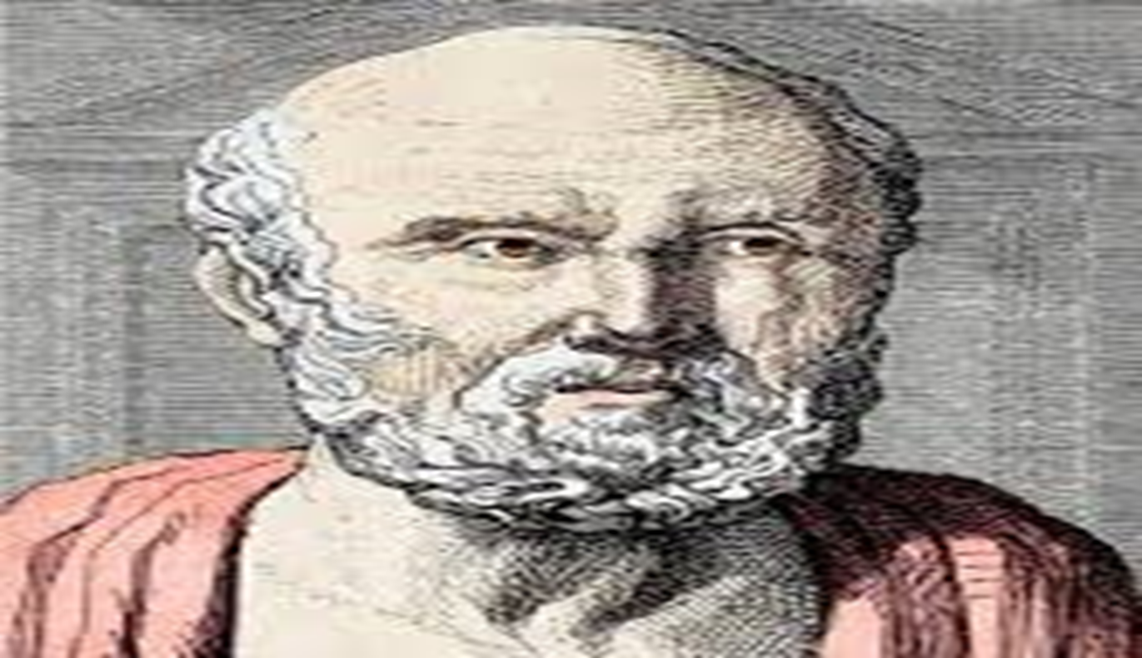
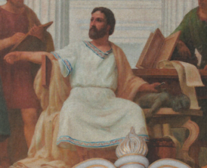
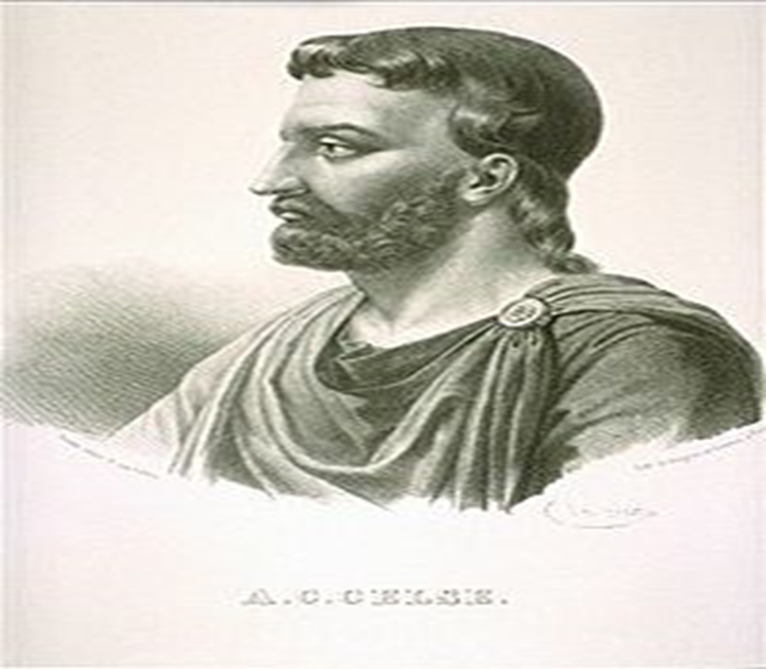
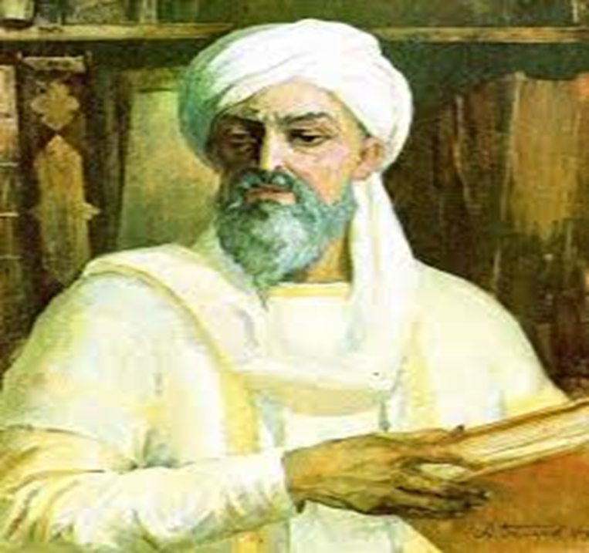
The main representatives of the empirical period:
Hippocrates
Claudius Galen
Dr. Cornelius Celsus
Avicenna

Slide 6
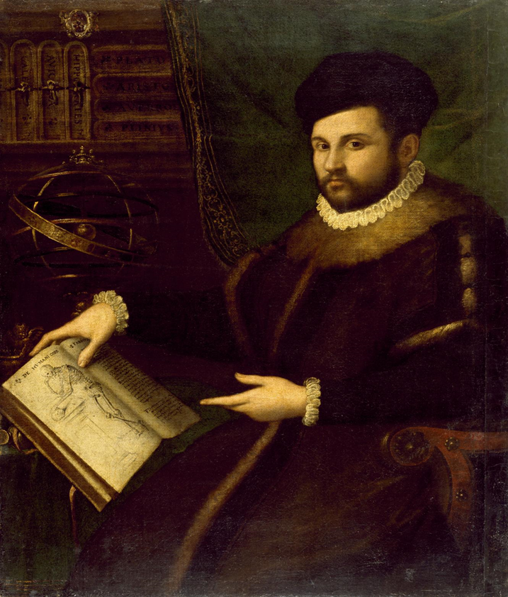
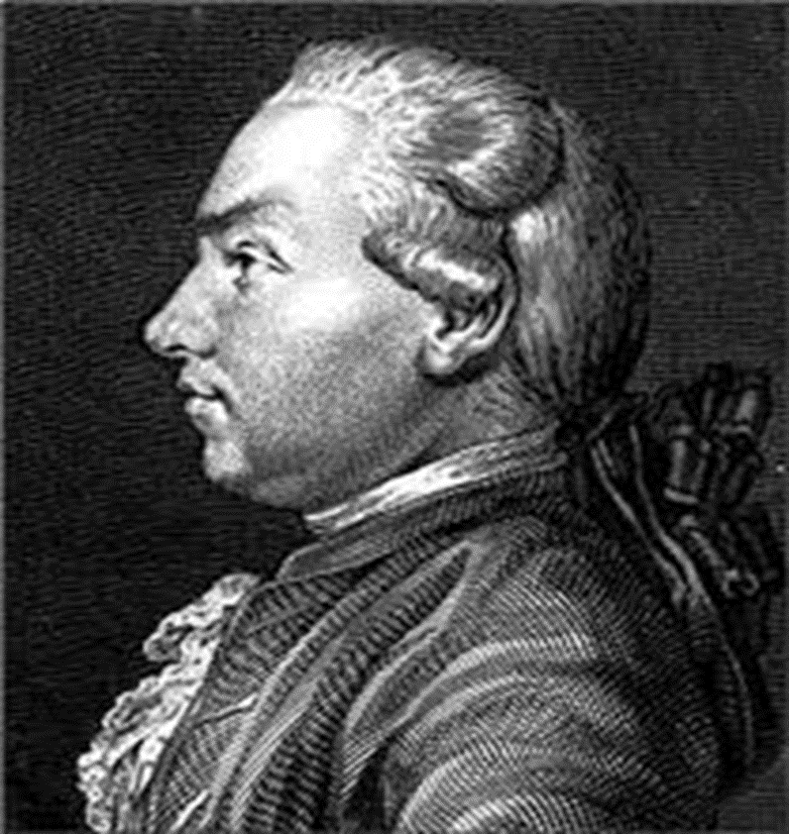
ΙΙ - Morphological period (from the middle of the XVI to the middle of the XIX century)
During this period, an in-depth study of the structure of the skin began, attempts to classify the morphological elements of the rash.
In 1571, the Italian Girolamo Mercuriale published a special reference book on skin diseases "De morbus cutaneus".
In 1776, the Viennese professor Josef Plenk thoroughly and reasonably had classified skin diseases, taking into account the peculiarities of the manifestations of the rash.

Slide 7
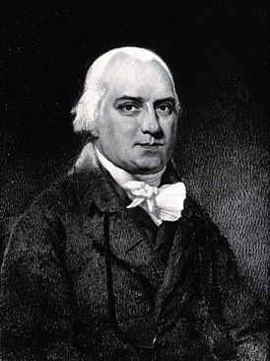
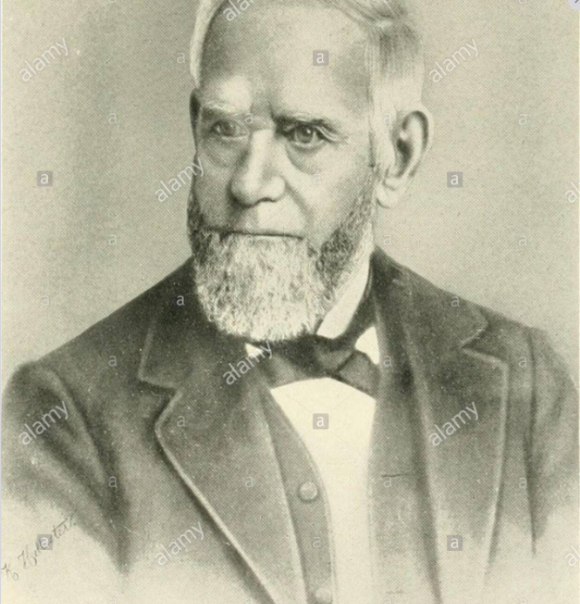
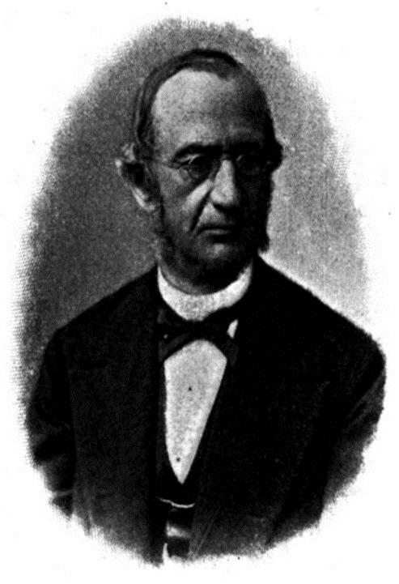
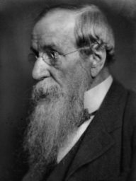
In the 18-19th centuries, the first dermatological schools appeared in Europe and North America.
Representatives of the English School of Dermatology
Robert Willan
W. Wilson
Thomas Bateman
Jonathan Hutchinson

Slide 8
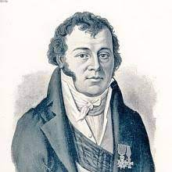
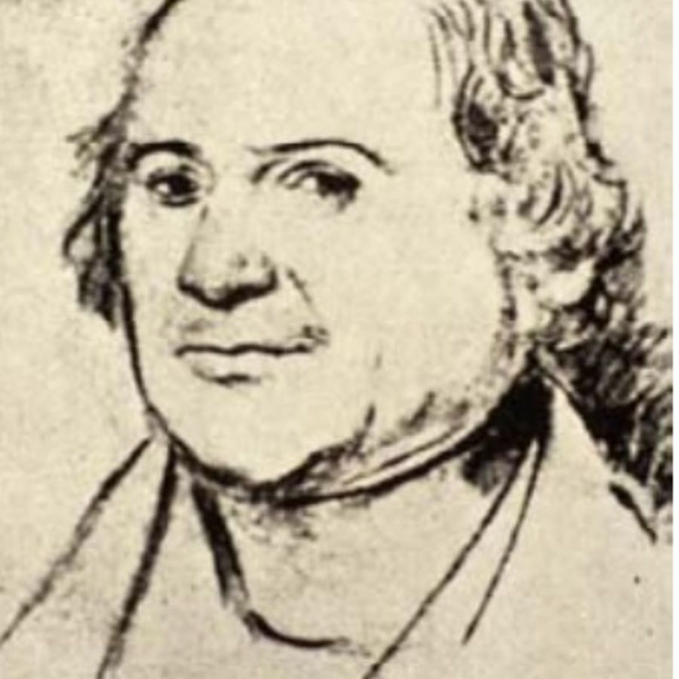
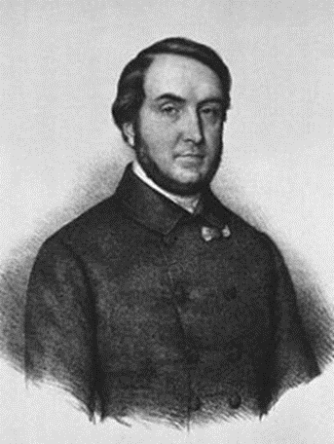
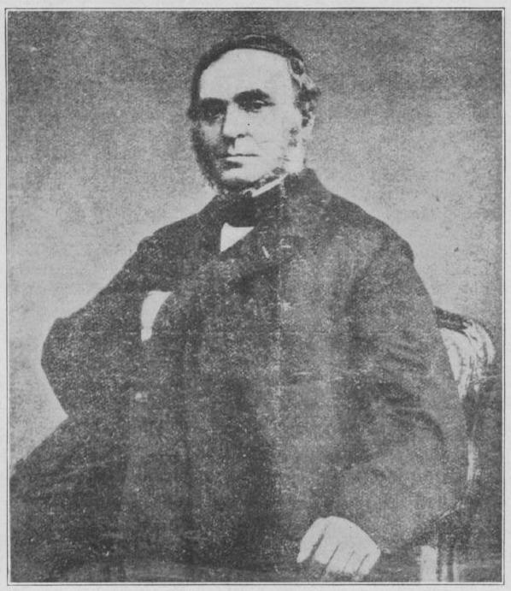
Representatives of the French dermatological school:
Jean-Louis Alibert
Laurent Théodore Biett
Pierre Cazenave
Ernest Bazin

Slide 9
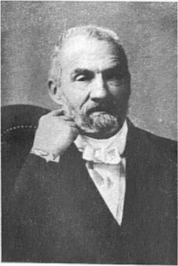
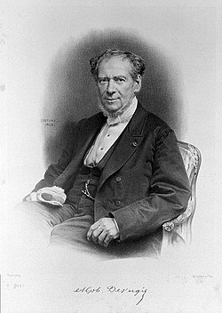
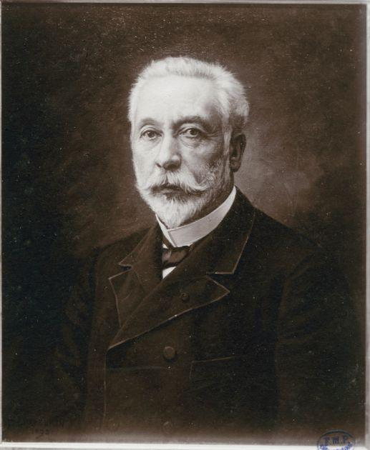
Representatives of the French dermatological school:
Camille Melchior Gibert
Guillaume Alphonse Devergie
François Hallopeau

Slide 10
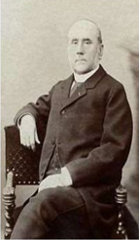
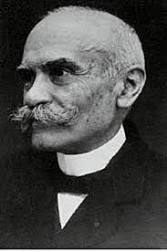
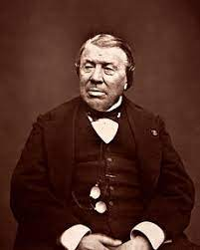
Representatives of the French dermatological school:
Ernest Besnier
Louis Anne Brocq
Philippe Ricord

Slide 11
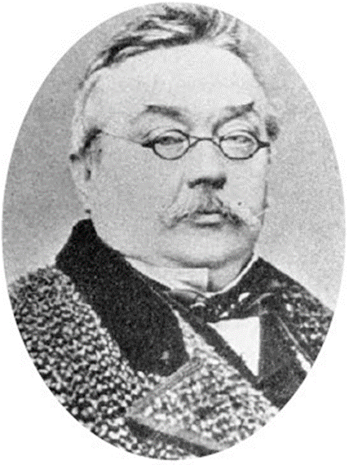
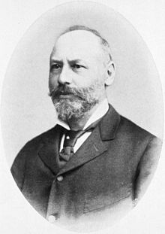
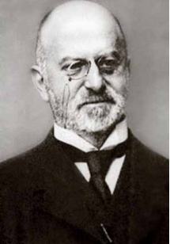
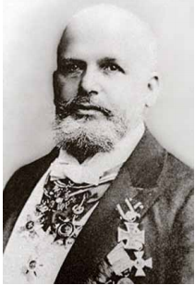
Representatives of the German School of Dermatology:
Ferdinand Ritter von Hebra
Moritz Kaposi
Edmund Lesser
Oscar Lassar

Slide 12
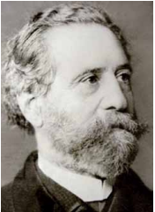
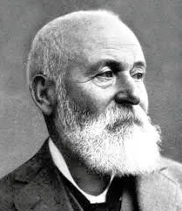
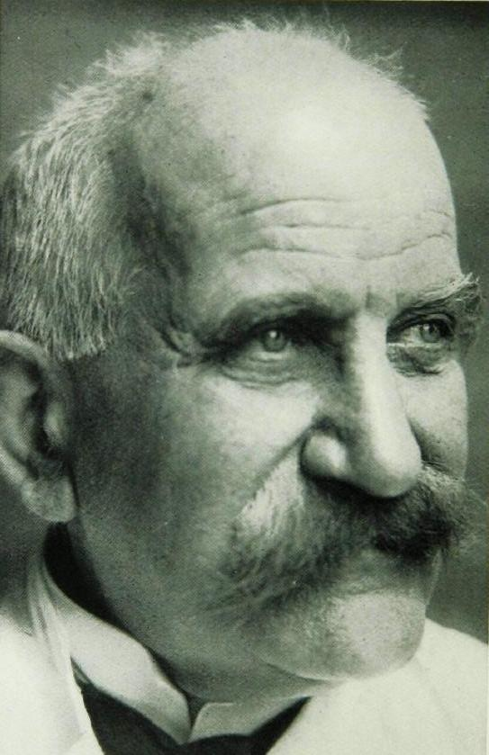
Representatives of the German School of Dermatology:
Georg Richard Lewin
Paul Gerson Unna
Joseph Jadassohn

Slide 13
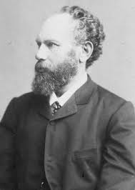
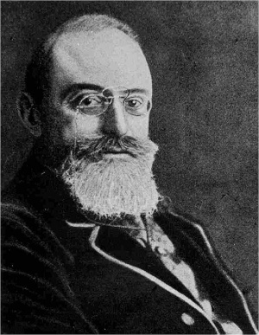
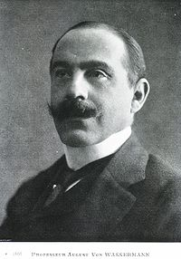
Representatives of the German School of Dermatology:
Heinrich Auspitz
Albert Ludwig Sigesmund Neisser
August Paul von Wassermann

Slide 14
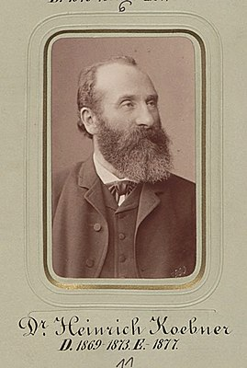
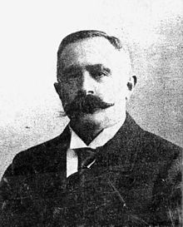
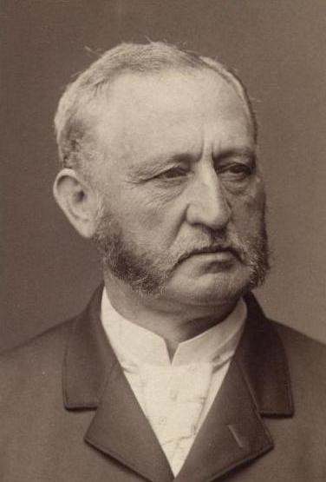
Representatives of the German School of Dermatology:
Heinrich Koebner
Abraham Buschke
Isidor Neumann

Slide 15
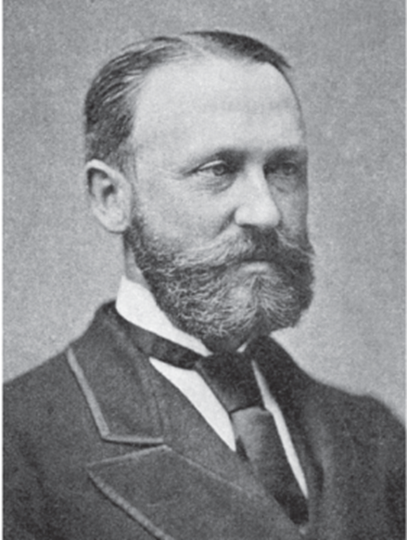
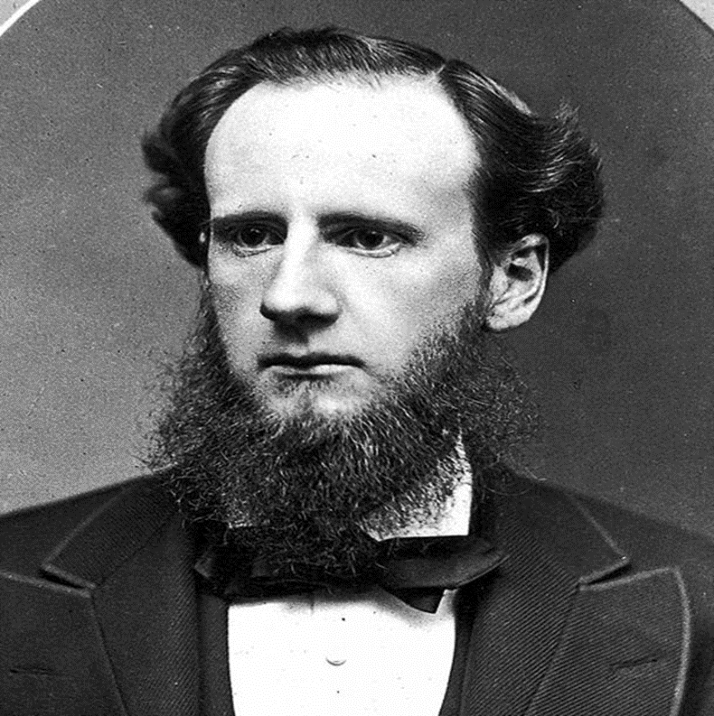
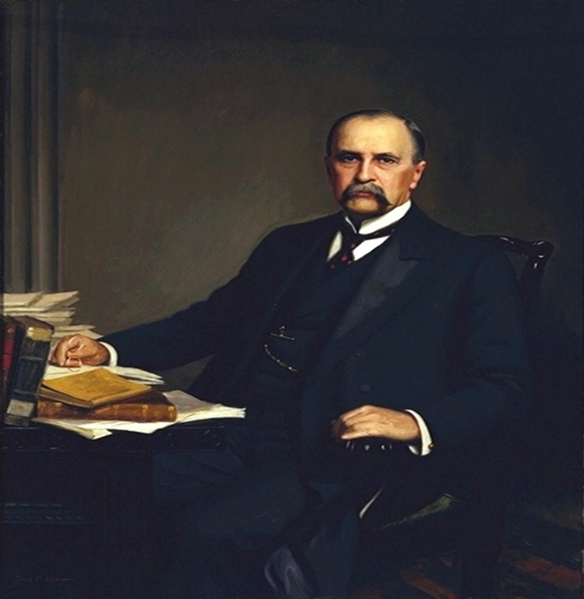
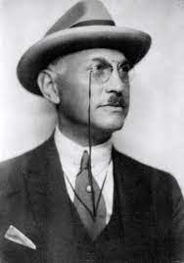
Representatives of the American School of Dermatology:
James Clarke White
Lois Duhring
William Osler
Jay Frank Schamberg

Slide 16
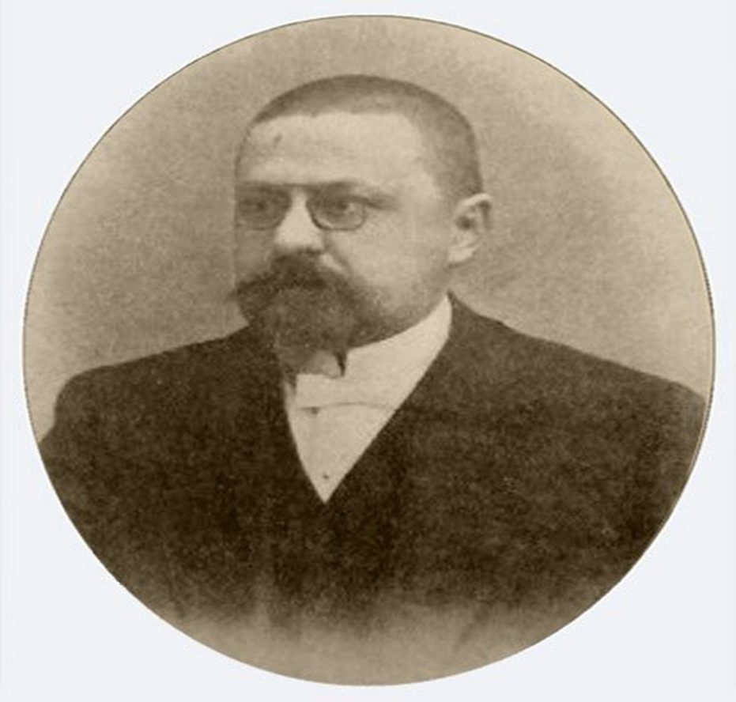
Odessa Dermatological School
The history of the formation of the dermatovenerological service of the Odessa region can be counted from the beginning of the last century. Even then, Odessa was a large seaport. The polyclinic for the treatment of skin and venereal diseases was opened in 1917 and it was the first independent skin and venereal medical institution in the country.
The clinic was headed by Egor Glavche. He opened a pathological and serological laboratory on his own money. In 1922, the polyclinic was reorganized into the State Dermatovenerological Institute, which was named after E.S. Glavche.
Egor Glavche

Slide 17
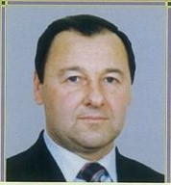
Representatives of the Odessa dermatological school:
From September 2003 to the present, the head of the Department of Dermatology and Venereology of the National Medical University is Professor Mikhail Nikolaevich Lebedyuk
He studies the clinical and epidemiological features of chronic dermatoses and sexually transmitted infections, conducts epidemiological surveillance of HIV infection among patients with sexually transmitted diseases.
He is the author of more than 200 scientific works, of which 3 textbooks "Skin and Venereal Diseases", "Dermatovenereology", "Voluntary counseling and testing for HIV.“ Registered 17 patents and copyright certificates.

Slide 18

Treatment of patients with one or another dermatosis can be conditionally divided:
Etiological treatment (to eliminate the cause of the disease).
Pathogenetic treatment (to correct certain aspects of the pathological process).
Symptomatic treatment (to eliminate individual symptoms of the disease if its etiopathogenesis is unclear).

Slide 19
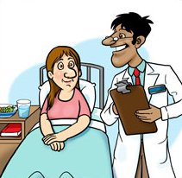
Complex treatment of a patient with dermatosis includes
External therapy
General therapy

Slide 20
General therapy
Sedatives, psychotropic drugs
Antifungal antibiotics
Hyposensitizing agents
Antiviral agents
Antihistamines
Immunotropic drugs
Anti-inflammatories
Chemotherapeutic agents
Antibiotics
Metabolic therapy
Detoxification methods

Slide 21
External treatment
When prescribing external therapy, many factors must be taken into account:
the nature of dermatosis (acute, subacute, chronic),
stage of the process (progressive, stationary, regressive),
depth and localization of pathomorphological changes,
pharmacological properties of the prescribed medication,
a dosage form for using an external agent.

Slide 22
There are the following drugs for external treatment, which can act various depending on the concentration, dosage form and the chosen method of application.
Antiseptic (antimicrobial) drugs
Indifferent drugs
Antiviral drugs
Anti-inflammatory drugs
Antiparasitic drugs
Fungicidal and fungistatic drugs
Keratoplastic (reducing) drugs
Antipruritic drugs
Keratolytic, cauterizing drugs
Photoprotective drugs
Cytostatic drugs

Slide 23
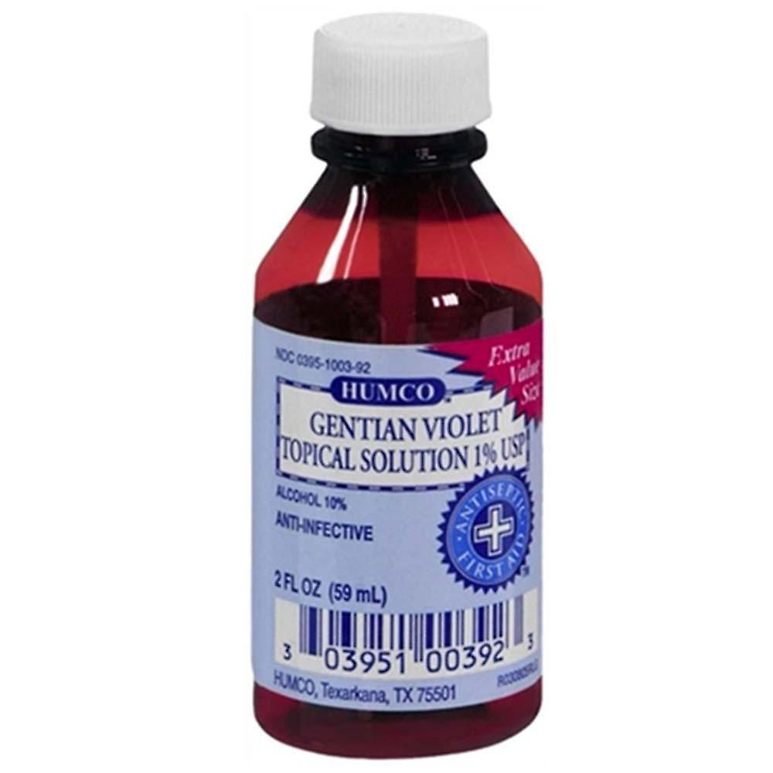
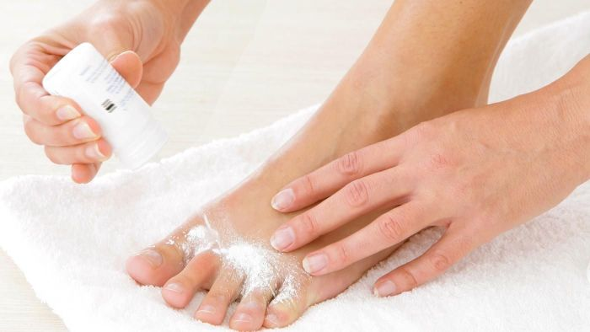
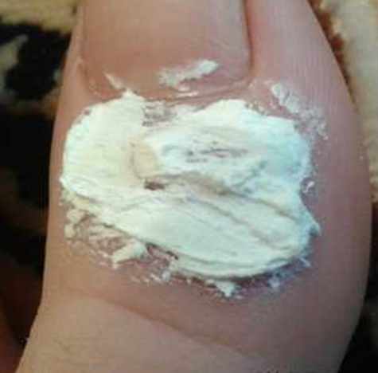
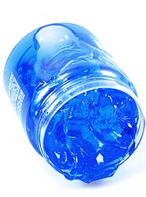
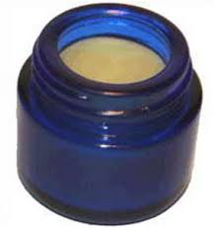
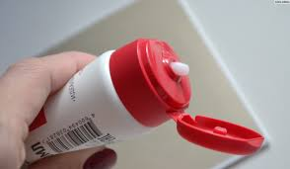

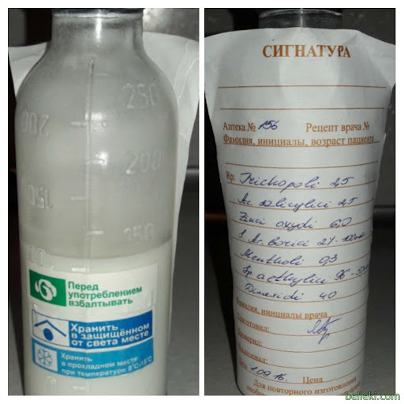
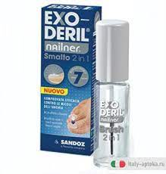
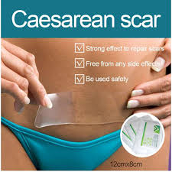
DERMATOLOGICAL DOSAGE FORMS
for external treatment
Powders
Pastes
Dermatological gels
Ointment
Solutions (aqueous, alcoholic)
Creams
Aerosols
Shake lotions (talkers)
Varnish
Plasters

Slide 24
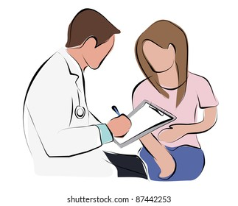


SPECIAL RESEARCH METHODS OF DERMATOLOGICAL PATIENT
1. Medical history
2. Inspection of the skin (ad oculus).
Examine the entire skin, oral mucosa, you must assess their color, moisture влажность, dermographism, the presence of scars, pigmentation.

Slide 25


3. Inspection through a magnifying glass.
You must determine the nature of the scales, the presence of elevation, depressions.
4. Palpation.
Palpation determines:
skin elasticity and tone;
skin temperature increase or decrease can be determined;
location of the element (epidermis, dermis, subcutaneous base), its size, shape, consistency, connectivity with surrounding tissues, painfulness;
in case of edema, determine its intensity, presence of fluctuation (abscess, hydradenitis), absence of painfulness (primary syphiloma).

Slide 26


5. Scraping (scratching)
The scraping carry out with a glass slide, a non-sharp scalpel. The scraping method allows you to detect peeling of the skin, to determine its nature (small-lamellar, large-lamellar), the density of attachment of scales to the skin surface.
6. Diascopy (vitropression)
This is pressure on the affected area of the skin with a glass slide or a special device - a diascope (transparent plastic plate). The nature of the element (vascular, pigmented) is determined when using this method. When pressed, the vascular spot becomes pale or disappears, and the hemorrhagic spot (or pigmented spot) does not disappear.

Slide 27


7. Dermographism is a method of a special dermatological study that allows you to determine the state of the autonomic nervous system, in particular the reflex reaction of the vascular wall as a response to skin irritation (the tone of the sympathetic part of the nervous system prevails in white dermographism, and in red - parasympathetic).
The flat end of a ballpoint pen or the edge of a spatula or a special device (dermograph) is used to draw strips on the skin. After 10-20 seconds, a line appears at the site of irritation.
8. Dermatoscopy is a non-invasive, visual diagnostic method, in which the doctor can conduct research and assessment of various, primarily pigmented formations.

Slide 28




9. Ultrasound examination. It is used to assess the depth of the location of melanoma, focal scleroderma process. The radiography, computed tomography and magnetic resonance imaging are used in addition to ultrasound.

Slide 29

10. . Fluorescent diagnostics using a Wood lamp allows to assess the nature of the affected hair and skin scales in microsporia, pityriasis versicolor, lupus erythematosus.
11. Research:
on LE-cells (with lupus erythematosus);
on acantholytic cells of smears-prints with erosion in acantholytic pemphigus;
on treponema Pallidum, on streptobacillus Petersen-Ducreaus out of discharge of eroded, ulcerative and weeping elements in syphilis, soft chancre;
to identify the scabies mite (with scabies) or Demodex folliculorum (with demodicosis);
by microscopy and sowing the affected scales and hair, nails on fungi;
by sowing material from foci of infection on the flora and determination of the sensitivity of microorganisms to antibiotics;
12. Histological examination of biopsy skin material is used to clarify the clinical diagnosis.
13. Conducting allergy skin tests.
14. Immunodiagnostics is used to determine the immune status in severe chronic dermatoses.

Slide 30


Skin diseases due to animal parasites
Skin diseases caused by animal parasites are called dermatozoonoses. The group of animal parasites includes lice, fleas, bed-bugs, mosquitoes, and some species of mites (the scab mite, the mites of horses and rats, pigeon and chicken mites, and the louse mites).
Scabies and pediculosis are most important in the practice of dermatologists.

Slide 31

Scabies
The incubation period is 7-10 days to one month and more.
Infestation occurs from direct contact with a skin individual, particularly when the bed-clothes, underwear or bed are shares. Among children the disease may be transmitted through toys handled by a sick child. Scabies is not primarily a sexually transmitted disease but sexual transmission occurs.

Slide 32




Clinical picture
Itching is the first and essential symptom of scabies. Most of all it occurs in the evening and night. Typical elements are paired and scattered pin-point papulo-vesicules, burrows and excoriations.

Slide 33



The forms of scabies
Nodular scabies: nodules occur in 7-10% of patients with scabies. The lymphocytic infiltrate remains for several months after all mites have been eliminated; because the cause is "antigen persistence".
In Norwegian scabies, the skin in the lesions is dry and covered with thick, dark green crusts and resembles a armor. A foul odor is emitted from the patient.
Scabies incognita.
It is observed in patients with thorough personal hygiene (scabies cleaner) or those who use topical corticosteroids.

Slide 34
Treatment of scabies
The patient should take a hot shower, and then one of the following medicines should be rubbed onto the skin and even on the intact surfaces:
33 % sulphur ointment,
20 % benzyl benzoate solution for adults, or 10 per cent benzyl benzoate solution for children,
“Spregal” spray,
Permethrin cream,
5 % emulsion of potassium soap,
lindane,
crotamiton,
vermectin (Stromectol)
Demyanovich’s method for treating scabies employs a 60 per cent sodium thiosulphate solution (solution N 1) and a 6 per cent solution of concentrated hydrochloric acid or 18 per cent solution of diluted hydrochloric acid (solution N 2).

Slide 35


Pediculosis
This is infestation with lice
Spread of infection occurs through direct contact with a sick person, through his clothes, bed-clothes, and through sexual contact.

Slide 36



Three species of lice may parasitize on the human skin
The head louse lives on the scalp, mainly on the temporal-occipital area, but is also found on eyebrows and eyelashes.
Typical sites of the localization of pubic louse are the pubis, axillae, areas of genitals, anus, and the chest.
The body (clothes) louse localizes on the shoulders, the upper part of the back, in the axillae, on the abdomen, loin, and in the inguinal folds.

Slide 37




Treatment of pediculosis
Mechanical method
Chemical method
Haircut
Shaving
Pedilin - made on the basis of the chemical malathion;
Itax shampoo - made on the basis of phenothrin;
Medifox Gel/Higia (shampoo) - made on the basis of permethrin.
Combing

Slide 38
kdvrem@onmedu.edu.ua

