Slide 1
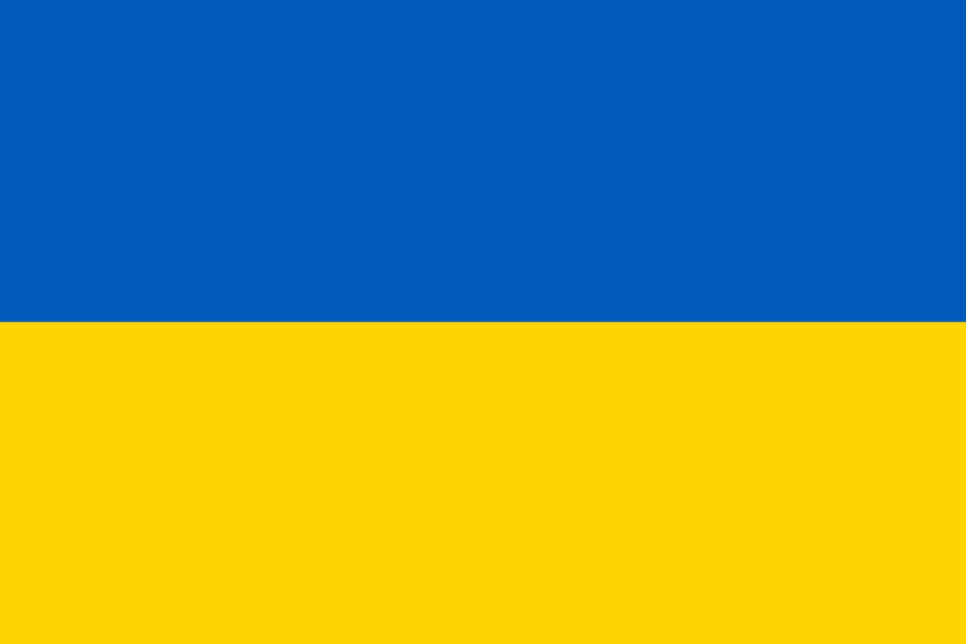
ODESSA NATIONAL MEDICAL UNIVERSITY
Department of Dermatology and Venereology
Larysa Kovtun, M.D.,PhD
Practical lesson on the topic: Mycosis.

Slide 2
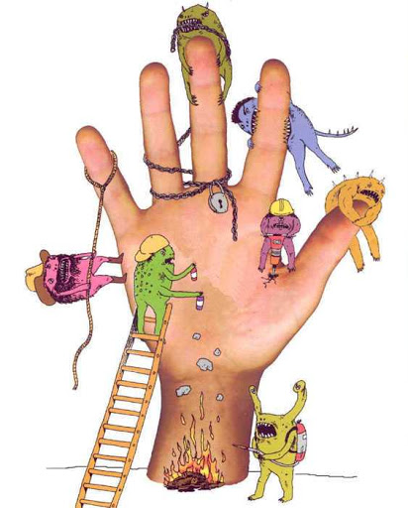
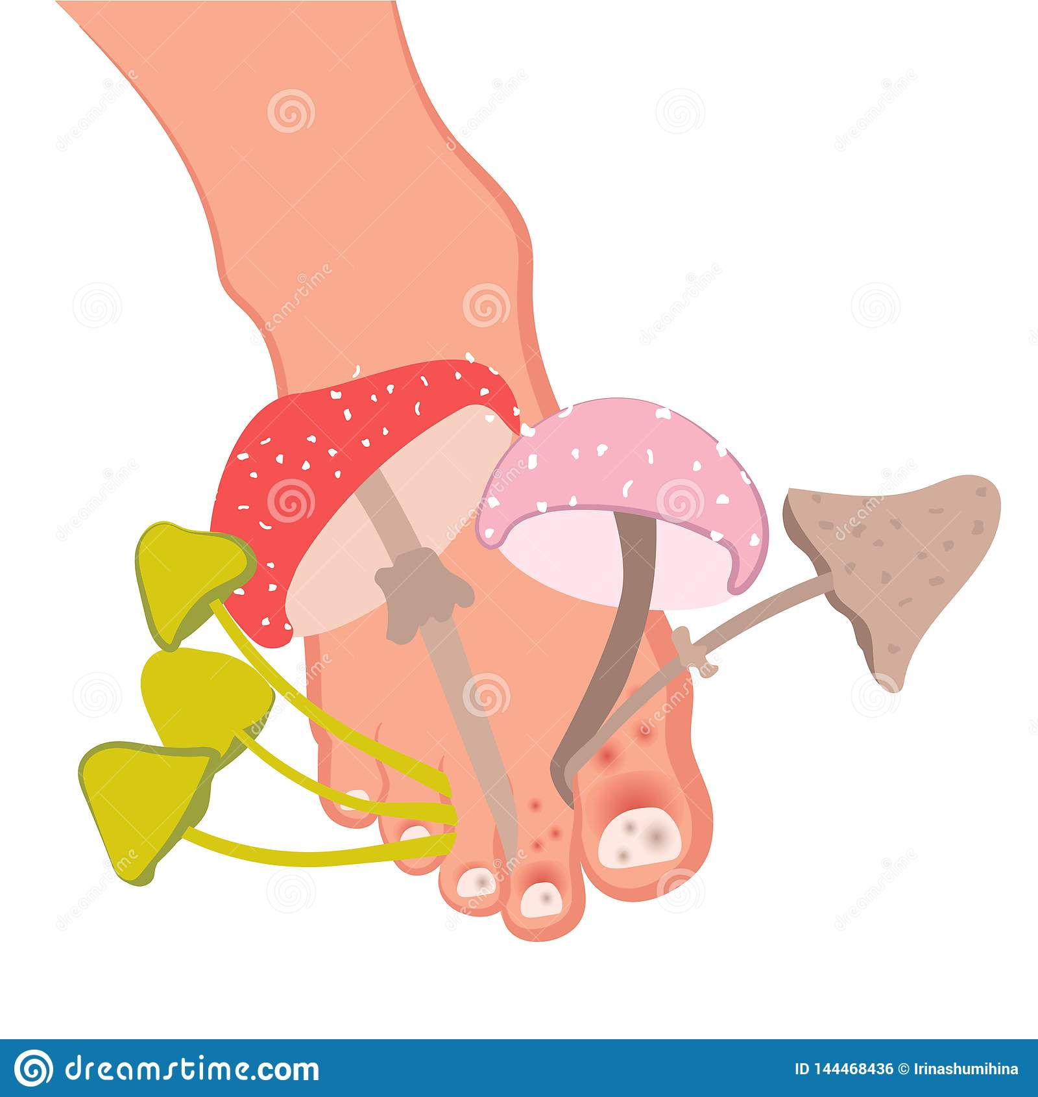
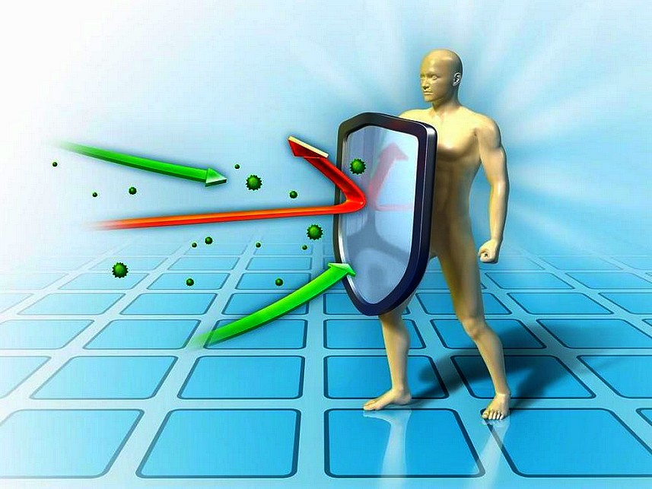
Mycoses

Slide 3
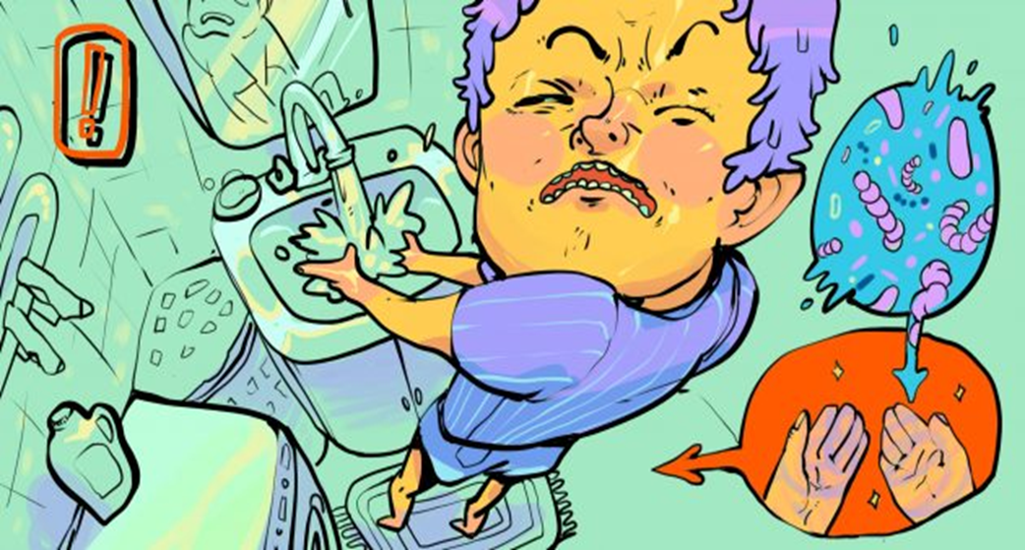
Classification of Mycoses
Keratomycoses
Pseudomycoses
Dermatomycoses
Candidiasis
Deep mycoses

Slide 4

Keratomycoses affect only the stratum corneum of the epidermis, have the low contagious and do not cause severe inflammation.
Pityriasis versicolor
Nodular trichophytosis (piedra) is a disease that occurs mainly in the countries of Central and South America.

Slide 5
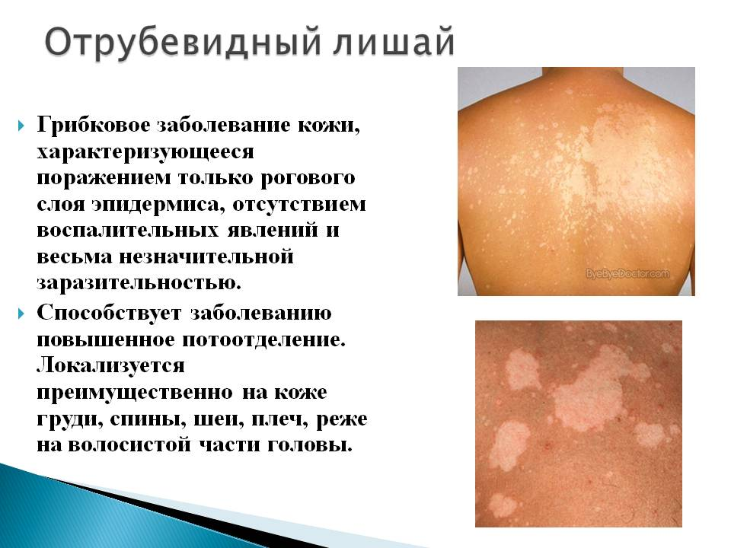
Pityriasis versicolor (keratomycosis)
The causative agent of the disease is a yeast-like fungus which capable are existing in three forms transforming into each other: Pityrosporum ovale; Pityrosporum obriculare; Malassezia furfur. Fungus located in the stratum corneum of the epidermis and follicular orifices.
Clinical picture:
Eruption element is a yellowish-brownish-pink non-inflammatory spot starting from the hair follicle orifices and gradually increasing in size. Sometimes the spots take on the color of "coffee with milk, accompanied by a floury peeling.

Slide 6
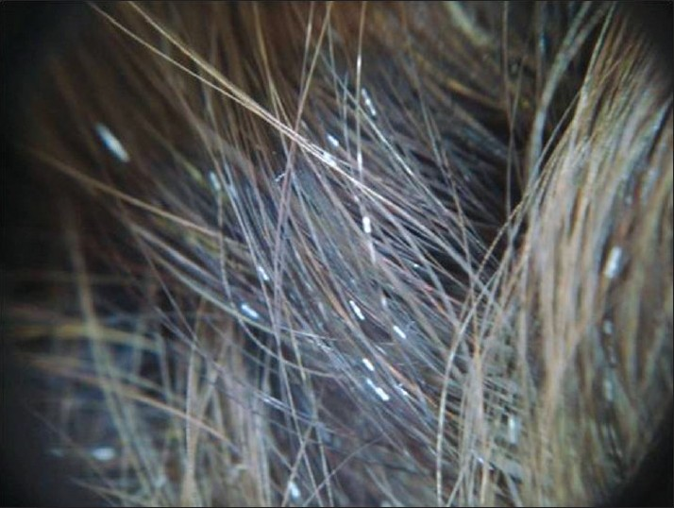
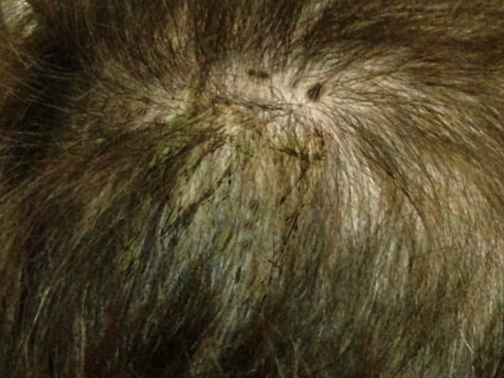
Nodular trichophytosis (piedra) is a disease of the hair cuticle with the formation of white (piedra alba) or black (piedra nigra) nodules on it (piedra from the Spanish – “ stone”).
Piedra alba (european)
Piedra nigra (true)
The causative agent
Trichosporon Beigelii (family of yeast-like fungi)
Trichosporon hortai (family of mycelial fungi)

Slide 7
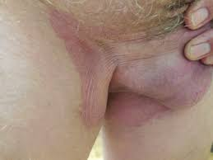
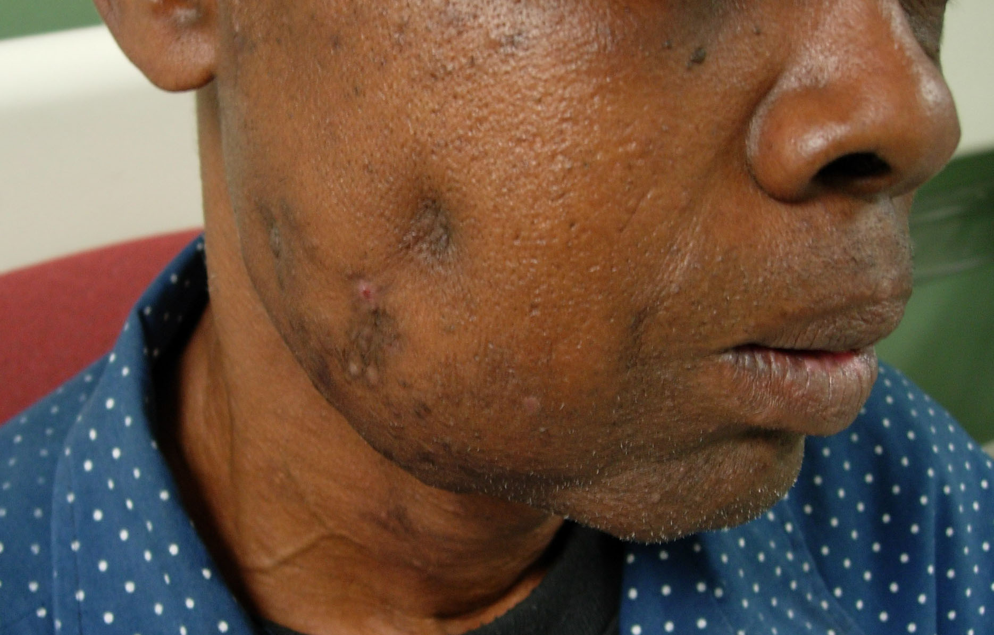
Pseudo mycoses occupy an intermediate position between fungi and bacteria.
Erythrasma is
superficial pseudo mycoses.
Actinomycosis is
deep pseudo mycoses.

Slide 8
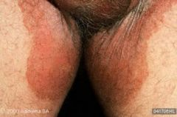
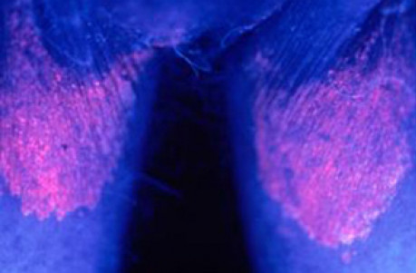
Erythrasma is a chronic superficial skin lesion. The causative agent is Corinebacteria fluorescens erythrasmae.
Clinical Picture.
The yellowish-brown, brick-red, red-brown spots localized mainly in the folds of groin, axilla and under the breasts.
The diagnostic methods:
• microscopic (bacteriological) examination.
• luminescent study (when exposed to a Wood’s lamp, a coral-red or brick-red fluorescence is observed because the causative agent of erythrasma secretes water-soluble porphyrins during its life activity.

Slide 9
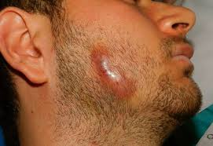
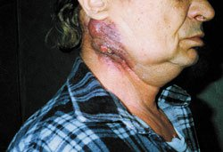
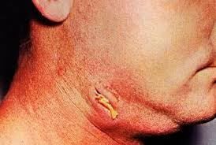
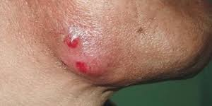
Actinomycosis of the skin is a chronic infectious non-contagious disease that affects humans and animals, caused by actinomycetes, more often Actinomyces israeli.
Forms
Nodular
Tubercular
Ulcerative
Atheromatous

Slide 10
Dermatomycosis - a group of fungal diseases that affect not only the skin, but also its appendages (hair and nails).
Epidermophytosis inguinal.
The causative agent is Epidermophyton floccosum.
Microsporia (microsporosis).
The causative agents are Microsporum ferrugineum, Microsporum Audonii
M. canis, M. folineum, M. gypseum.
Epidermophytosis of the Feet.
The causative agents of the disease are Thrichophyton rubrum (approximately 90 per cent), and Thrichophyton mentagrophytes or Thrichophyton Interdigital (about 10 per cent).
Trichophytosis.
The causative agents are Trichophyton tonsurans, Trichophyton mentagrophytes.
Rubromycosis.
The causative agent is T. rubrum
Favus.
The causative agent is Trichophyton Schonleinii.

Slide 11
Epidermophytosis is a contagious fungal disease of the surface layers of smooth skin and nail plates caused by fungi of the genus epidermophyton. Hair is not affected.
Epidermophytosis of large folds, or inguinale.
Epidermophytosis of the feet
Mycosis of the feet
Rubrophytosis of smooth skin
Generalized rubromycosis
Rubromycosis of the nail plates
Rubromycosis of the feet and hands
Rubrophytia (Latin ruber red + Greek phyton plant; synonym: rubromycosis, Trichophyton rubrum infectio) is a fungal disease in which the skin, nails and downy hair are affected.

Slide 12
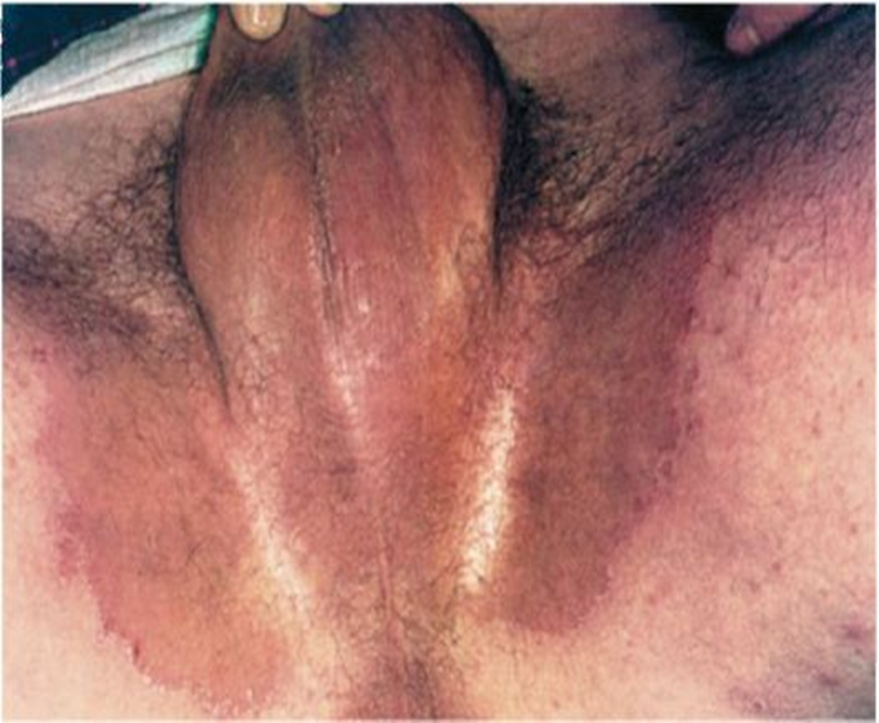
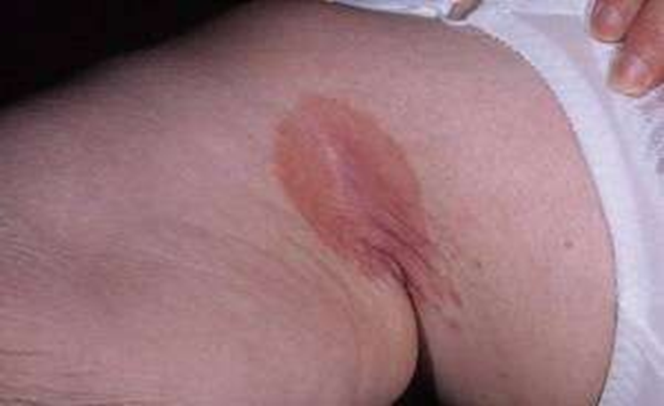
Epidermophytosis of the large skin folds, or Epidermophytosis inguinalis.
Epidemiology. Infection occurs in bathhouses, when using public baths, washcloths, in sports halls.
Clinical picture.
The main morphological elements are inflammatory rounded pink spots.
They coalesce and form polycyclic foci with a well-defined edematous peripheral border. The desquamation is observed in the center of the lesion, when the pathological process resolves. Severe itching is a subjective symptom.

Slide 13
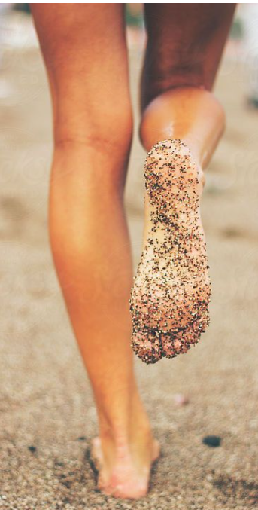
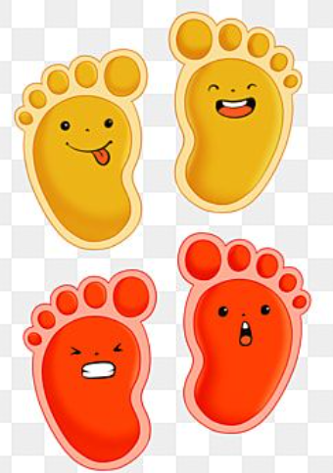
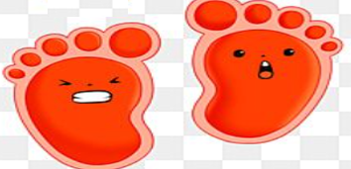
Mycosis of the feet.
The disease is common in all countries of the world. Athletes are so often affected by mycosis of the feet that this disease is called "athlete's foot".

Slide 14
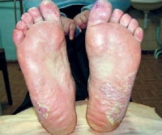
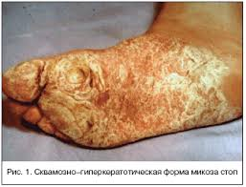
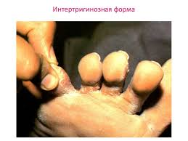
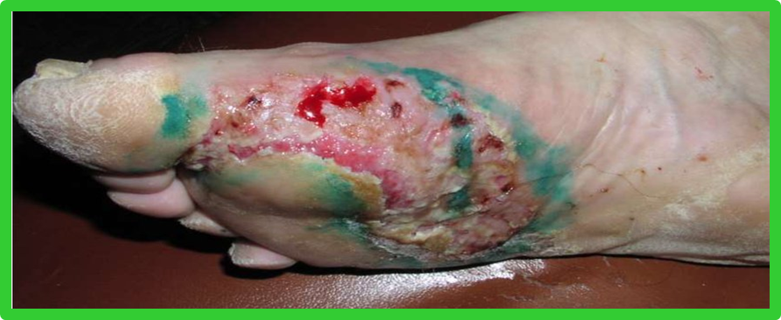
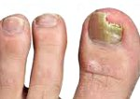
Clinical varieties of the epidermophytosis of the feet
Squamous form
Squamous-hyperkeratotic form
Intertriginous form
Dyshidrotic form
Epidermophytosis of nails.
More often, the nail plates of the I, V toes are affected, in the thickness of which yellowish spots appear. The free edge of the affected nail plates becomes loose, crumbling. The nail plates of the hands are not involved in the pathological process.

Slide 15
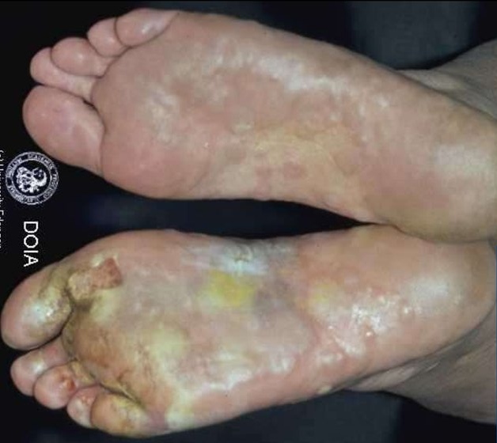
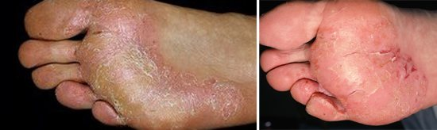
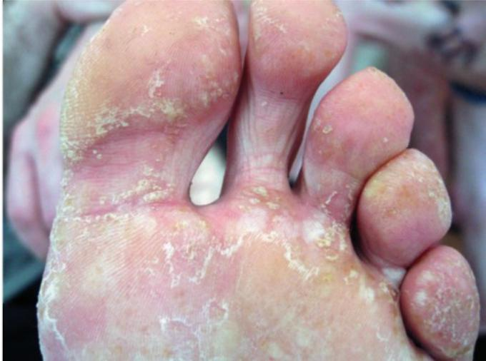
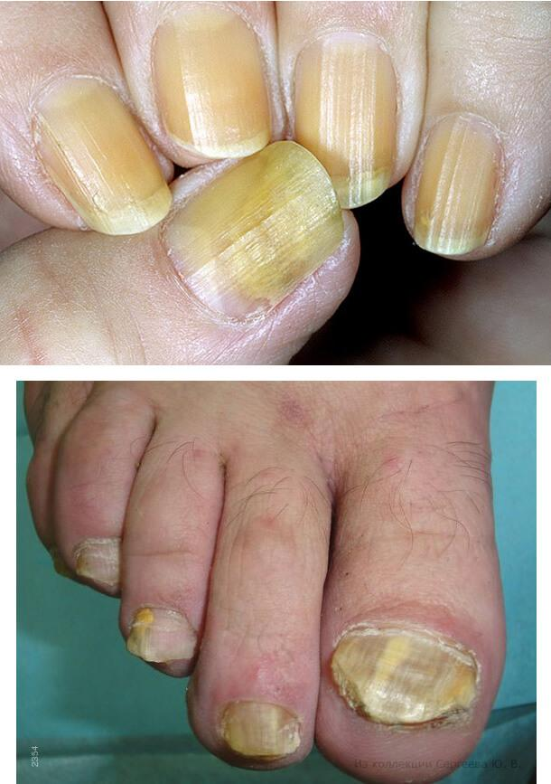
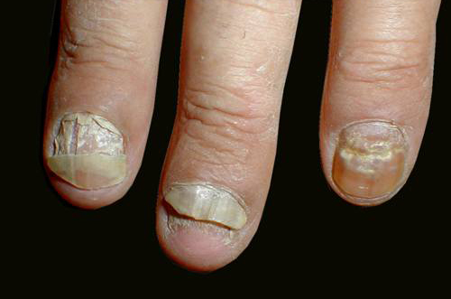
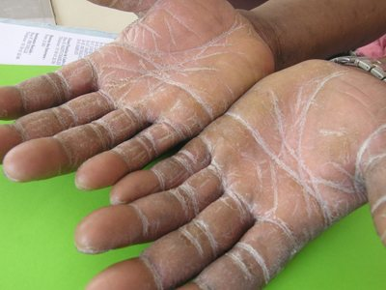
Clinical varieties of rubrophytosis of the feet (hands and nails may be affected at the same time)
Squamous-hyperkeratotic form
Intertriginous form
Dyshidrotic form
Types of lesions of the nail plates with rubrophytosis
of the feet and hands:
Rubromycosis of the hands
Normotrophic
Hypertrophic
Atrophic

Slide 16
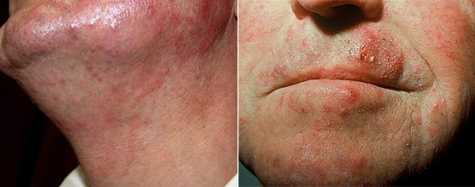
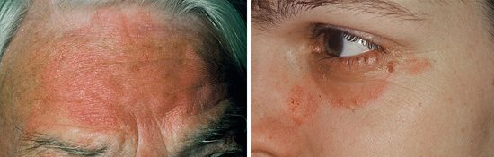
Rubcomycosis of the smooth skin.
Smooth skin lesions develop as a result of the spread of infection with the bloodstream, through the lymphatic tracts from foci located on the feet, or through transfers by hand or washing.

Slide 17
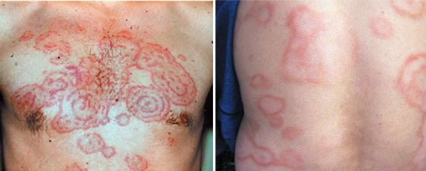
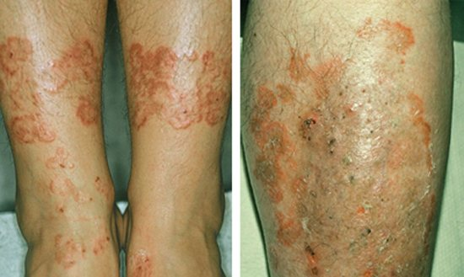
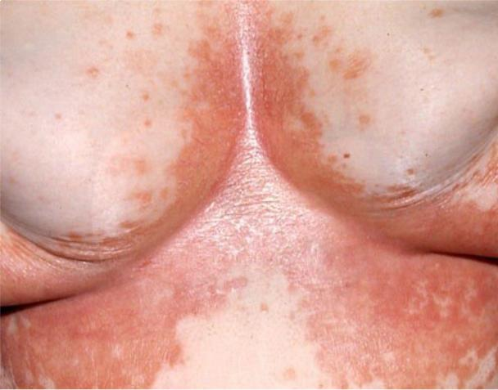
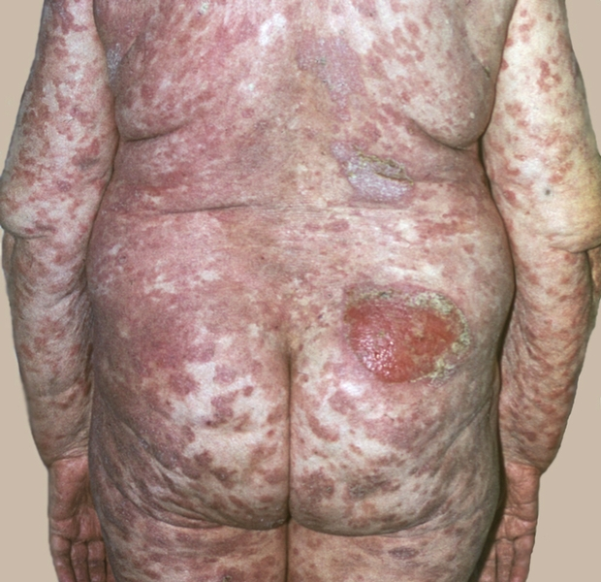
Generalized rubromycosis of smooth skin
Clinical varieties of generalized rubromycosis can be divided into erythematous-squamous (superficial), follicular-papular (deep), exudative forms and erythrodermic type lesions.
Erythematous-squamous form
Follicular-papular (deep) form
Exudative form
Rubromycotic erythroderma

Slide 18
Trichophytoses
Superficial trichophytosis of smooth skin
Superficial trichophytosis of the scalp
Infiltrative-suppurative trichophytosis
Chronic trichophytosis, including nail trichophytosis
Tinea imbricata (tokelo)
Favus

Slide 19
Trichophytosis (anthropophilic)
The causative agent is Trichophyton tonsurans. Infection occurs from a sick person, household items.
Clinical forms:
Superficial
smooth skin
scalp
nail plates
Chronic
Trichophytosis (zooanthropophilic)
The causative agent is Trichophyton mentagrophytes. Infection occurs due to contact with sick animals, infected objects.
Clinical forms:
Superficial trichophytosis
Infiltrative-suppurative trichophytosis
Scalp
Face

Slide 20
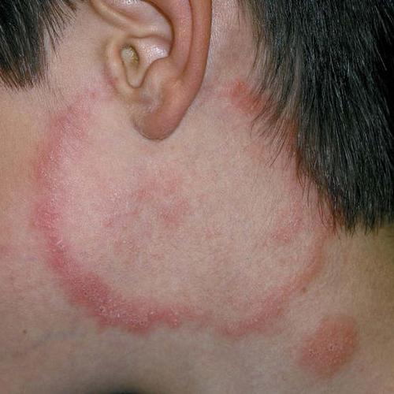
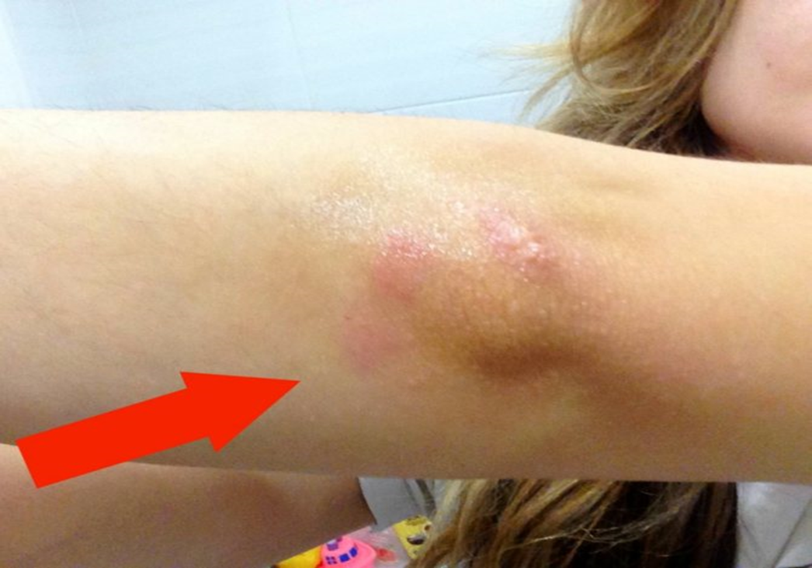
Trichophytosis (anthropophilic) of the smooth skin
Superficial.
The rounded, erythematous squamous lesions with distinct, raised edges appear on exposed skin areas (face, neck). The downy hair is involved in the process.
Chronic.
The cyanotic bluish foci do not have distinct boundaries and transition to normal skin.

Slide 21
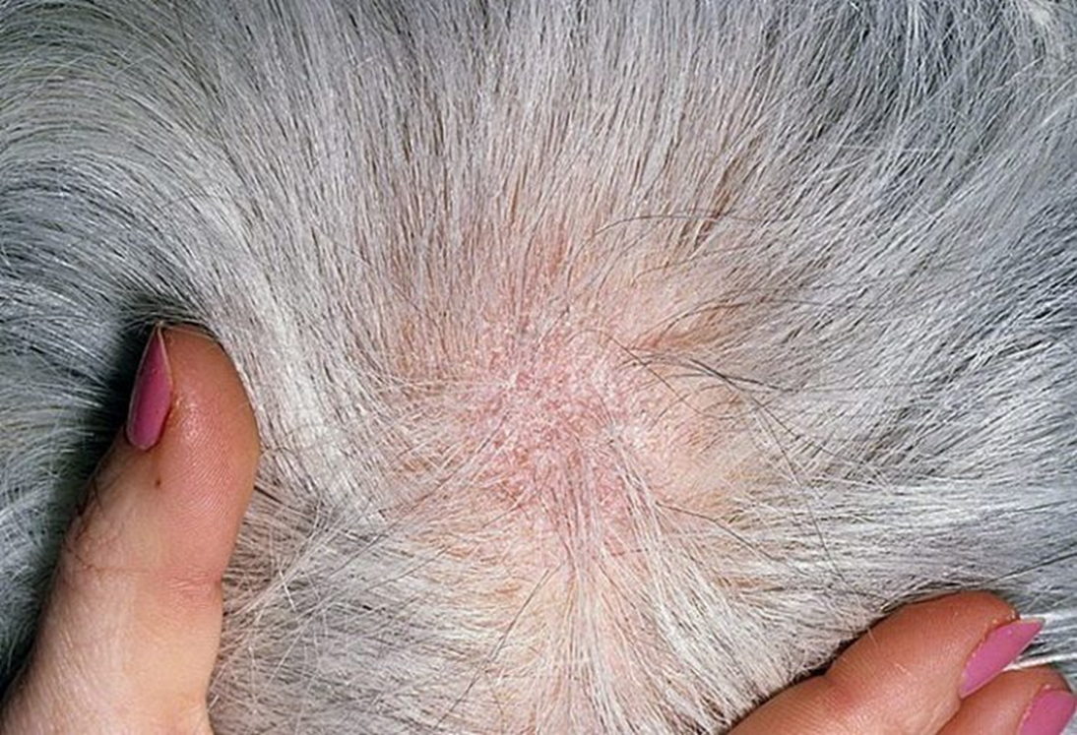
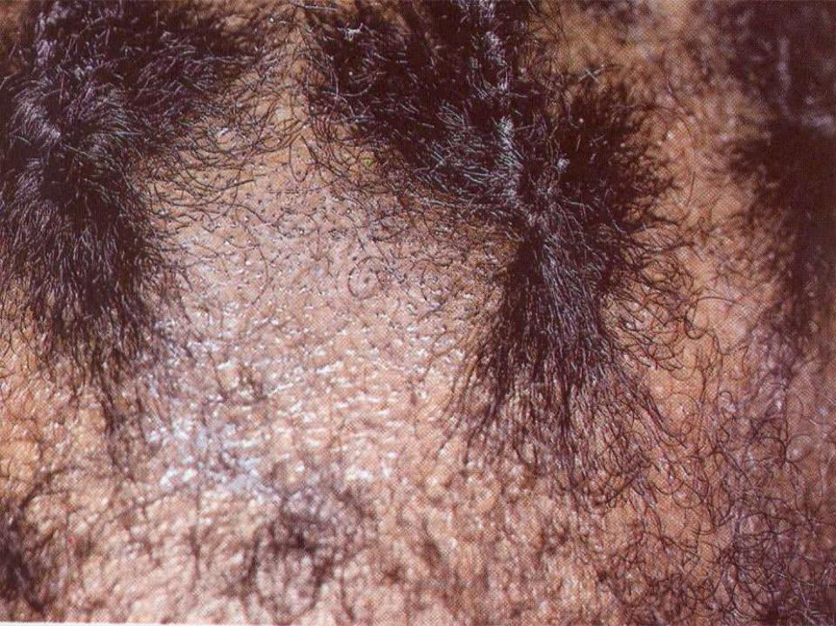
Trichophytosis (anthropophilic) of the scalp (capitis).
Superficial
Hair breaks off 2-3 mm from the skin surface, looks like commas, hooks, question marks, and is called stubs. Healthy hair is left in the foci of lesions.
Chronic
The hair breaks off at the level of the smooth skin and resembles comedones (black dots). This disease is often called black dot trichophytosis. A sick person represents a great epidemiological hazard.

Slide 22
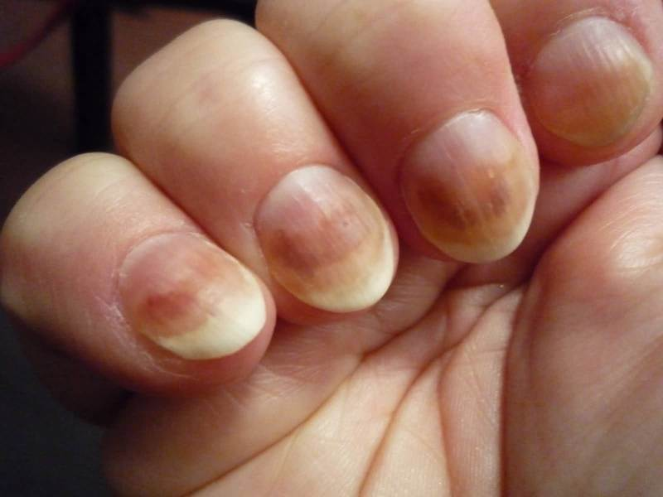
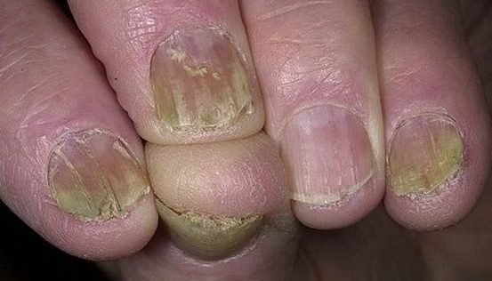
Trichophytosis (anthropophilic) of the nail
Superficial
The nail plate thickens, becomes loose and crumbly, and acquires a dirty grayish color. The hyperkeratosis develops under nail.
Chronic
The nail becomes dirty-grayish and uneven, crumbling and breaking easily. The free edge of the nail separates from the nail bed.

Slide 23
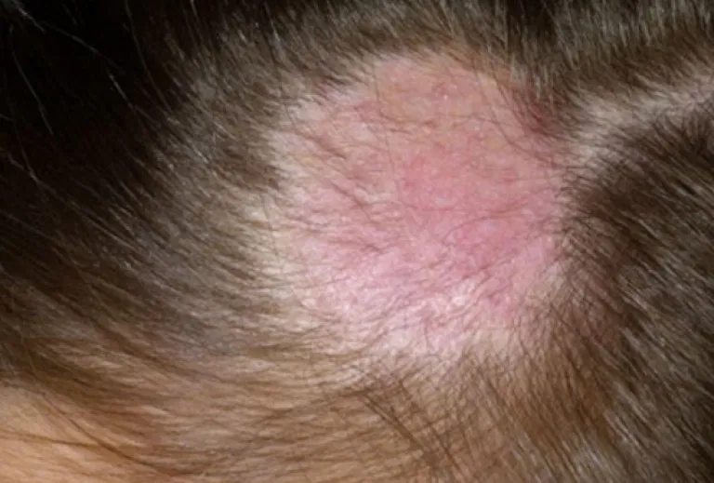
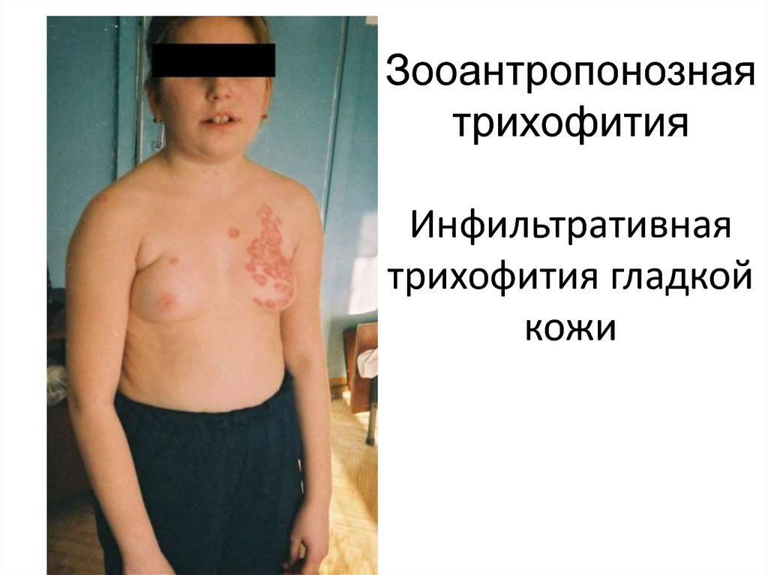
Trichophytia zooanthropophilic
In infiltrative-purulent trichophytosis of smooth skin, hyperemia and infiltration are characteristic lesions.
Superficial zooanthropophilic trichophytosis. Clinical picture does not differ from superficial anthropophilic trichophytosis.

Slide 24
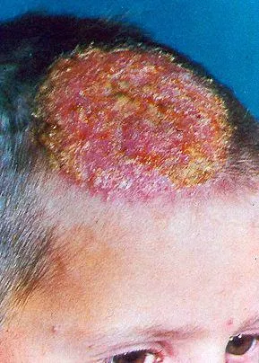
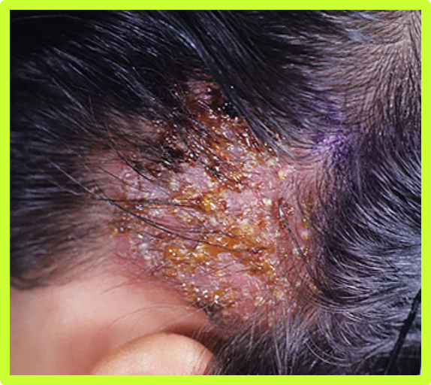
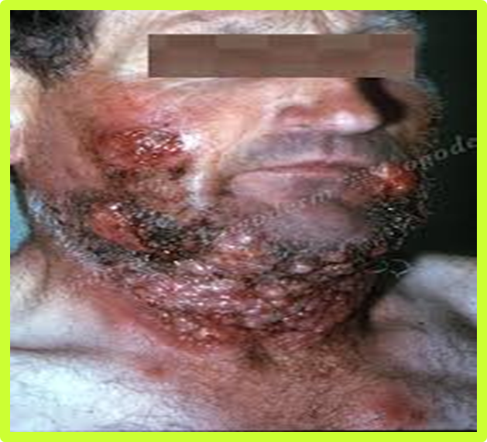
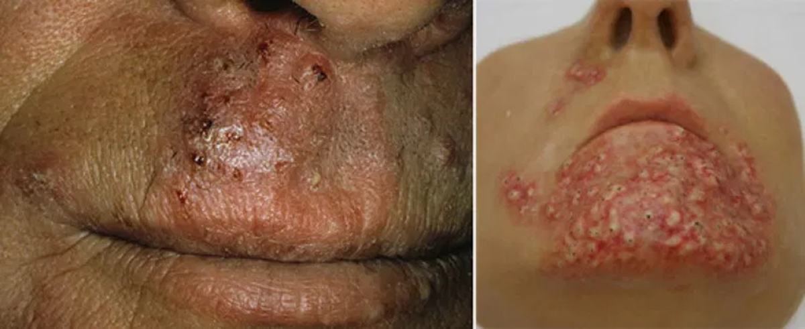
Trichophytosis zooanthropophilic
Infiltrated suppurative trichophytosis of the scalp.
Another name for the disease is «follicular abscess». The release of pus from each follicle individually resembles honey extracted from a honeycomb. From this, the third common name of the disease is Celci kerion (Celsus'honeycomb).
Infiltrative-suppurative trichophytosis of the beard and moustache areas (parasitic sycosis).
It is accompanied by intoxication, subfebrile body temperature, lymphangitis, lymphadenitis, allergic rashes (trichophytosis), which can be vesicular, lichenoid, urticarial, nodular, erythematous-squamous.

Slide 25

Tinea imbricate (tropical mycosis, scaly lichen, tokelo) is contagious mycosis, endemic to the tropics, caused by the fungus Trichophyton concentricum.
The causative agent of the tokelo is an anthropophilic dermatophyte that does not affect hair and nails.
The process is localized mainly on the trunk, extensor surfaces of the limbs, buttocks, and less often on other parts of the body.
Patients look as if covered with scales with a complex pattern ("people-fish").The rash is accompanied by itching, often leading to lichenification. Also, depigmentation of lesions is noted.

Slide 26
Microsporia "ringworm" (from Greek μικρός - small and σπόρος - seed, sowing), is a contagious disease (mycosis) of animals caused by fungi of the Microsporum genus, characterized by lesions of the skin and its appendages. Microsporium also affects humans.
Anthropophilic
Geophilic
Zooanthropophilic
Infection occurs
due to contact with sick kittens, less often adult cats, dogs, infected objects, with a sick person.
due to contact with the patient or household items.
They live in soil and very rarely cause disease in humans and animals
The causative agents
Microsporum ferrugineum
Microsporum Audonii
M. gypseum
M. canis
M. folineum

Slide 27



Forms of microsporia
( skin, downy hair, less often nails are affected)
Infiltrative-suppurative form.
There are single, large, infiltrative, hyperemic lesions. All hair is broken off at a distance of 6-8 mm from the skin.
Superficial microsporia of smooth skin.
The downy hairs are affected. The lesions are edematous, hyperemic, annular.
Superficial microsporia of the scalp.
There are the erythematous- desquamation lesions with irregular edges, in which the hair (not all) is broken off at a distance of 5-8 mm above the level the skin and is covered|ˈkʌvəd| by a gray fungal spores.

Slide 28
Favus
The disease is caused by the anthropophilic fungus Trichophyton Schonleinii, which is found inside the hair in the form of pinprick-like spores located in a straight line.
The incubation period varies from 2-3 weeks to 6-12 months.
Infection occurs through direct contact with sick people or through infected objects. Long-term contact is usually necessary to get infected with favus.
The pathogen affects
smooth skin,
scalp,
Nails,
internal organs.

Slide 29





Forms of the favus
Typical (scutular)
Atypical (squamous)
Impetiginous
It accompanied by spotty eruptions resembling seborrheic eczema.
It differs in the formation of pustules, which similar to vulgar impetigo.
The main element is the scutula (favose scute), which is a pure culture of the fungus in the epidermis.
The hair has the appearance of old wigs[wɪɡ]. There is a specific "barn" or "mouse" smell coming from the patient.

Slide 30
Treatment of the mycoses
When treating fungal diseases, medicines are used in different forms: ointments, creams, sprays, solutions, nail lacquers and tablets.
Treatment is prescribed according to the location of the lesion, the stage of the disease and the severity of the process. The best results are seen with a combination of topical preparations (creams, ointments, sprays, lotions) and oral preparations. Superficial mycosis of the skin can be treated with external agents, while internal preparations are prescribed for lesions of the skin appendages and the scalp.
Oral (systemic) antifungal therapy
Topical antifungal therapy
is used for extensive infections or infections that are resistant to topical therapy.
is the method of choice for most patients.

Slide 31
Antifungal drugs classification
CLASS
DRUGS
Nystatin (cream, ointment and oral suspension)
Amphotericin B*(indicated for the treatment of systemic mycoses)
Polienes
Azoles
Imidazoles
Bifonazole (cream and spray)
Ketoconazole (cream, shampoo, 200 mg Tablets)
Clotrimazole (cream and spray)
Econazole (cream and lotion)
Isoconazole (cream, lotion, powder, spray)
Miconazole (lotion and powder)
Oxiconazole (cream and solution)
Sertaconazole (cream, solution and powder)
Tioconazole (cream, lotion, powder, spray and nail lacquer)

Slide 32
Antifungal drugs classification
CLASS
DRUGS
Azoles
Fluconazole (150 mg tablets)
Itraconazole (100 mg tablets)
Triazoles
Lanoconazole: use in dermatophytoses and candidiasis
Eberconazole: indicated in dermatophytoses and triazole resistant mycoses (Candida kruzei and C. glabrata).
Voriconazole: fluconazole derivative.* (indicated for the treatment of systemic mycoses)
Terconazole
Posaconazole* (indicated for the treatment of systemic mycoses)
Ravuconazole* (indicated for the treatment of systemic mycoses)

Slide 33
Antifungal drugs classification
CLASS
DRUGS
Naftifine
Terbinafine (cream, spray, 125 or 250 mg tablets)
Butenafine
Allylamines
Equinocandines
Caspofungin* (indicated for the treatment of systemic mycoses)
Micafungin* (indicated for the treatment of systemic mycoses)
Ciclopirox olamine (cream, solution, nail lacquer)
Rilopirox: ciclopirox olamine derivative. Indications: candidiasis, pityriasis versicolor and seborrheic dermatitis
Hydroxypyridone
Amorolfine (cream and nail lacquer)
Morpholine Derivatives

Slide 34




Antifungal drugs classification
CLASS
DRUGS
Griseofulvin (500 mg tablets)
Other

Slide 35
kdvrem@onmedu.edu.ua

